Slide 1

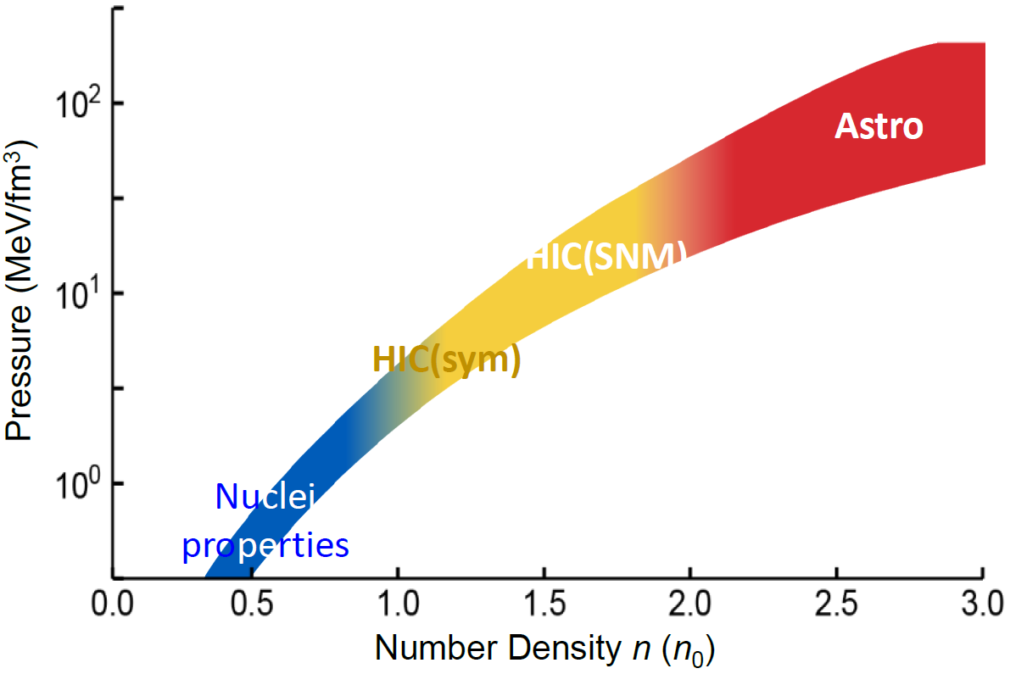

Betty Tsang (Tsang @FRIB.MSU.EDU)
Determination of the equation of State from Nuclear Experiments and Neutron Star observables
PNM EOS
INT 89W, August 26-September 6, 2024

Slide 2
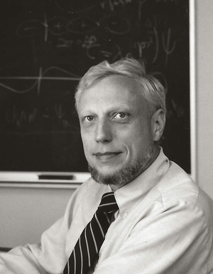
Betty Tsang (Tsang@FRIB.MSU.EDU)
Determination of the equation of State from Nuclear Experiments and Neutron Star observables
PNM EOS
1933-2024
1981 Glen Seaborg Award

Slide 3
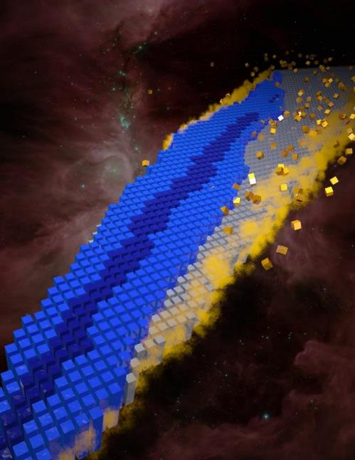
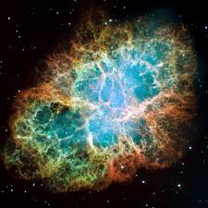
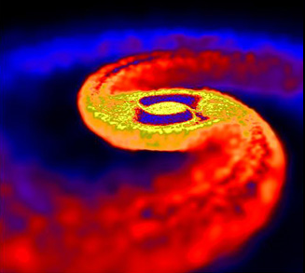
From Nucleus to Neutron Stars
Equation of State of nuclear matter
E/A (ρ,δ) = E/A (ρ,0) + δ²⋅S(ρ)
δ = (ρ_{n}- ρ_{p})/ (ρ_{n}+ ρ_{p}) = (N-Z)/A
Symmetry Energy of asymmetric matter
^{Crab Nebula}
    To probe fundamental questions on the nature of nuclear matter especially the isospin asymmetric matter.
    To recreate and study astrophysical environments

Slide 4
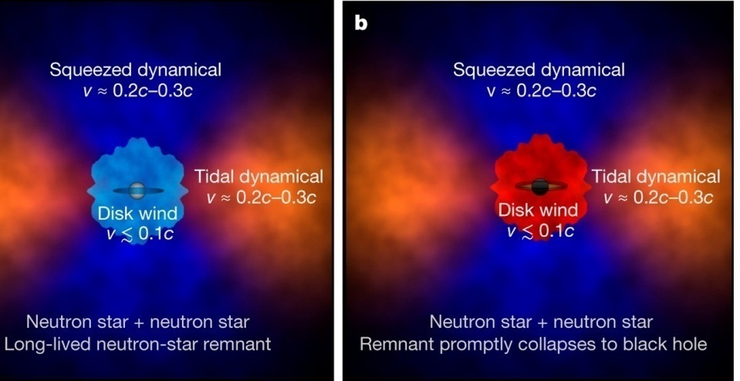
Equation of State and Dynamics of the Merger
D Kasen et al. Nature 551, 80–84 (2017) doi:10.1038/nature24453
Tidal deformation of the Neutron Star yield information on properties of neutron star e.g. how big, how massive and how much can the matter be compressed?
Fate of a Neutron Star Merger: n-star, black hole or transient? Nucleosynthesis?

Slide 5
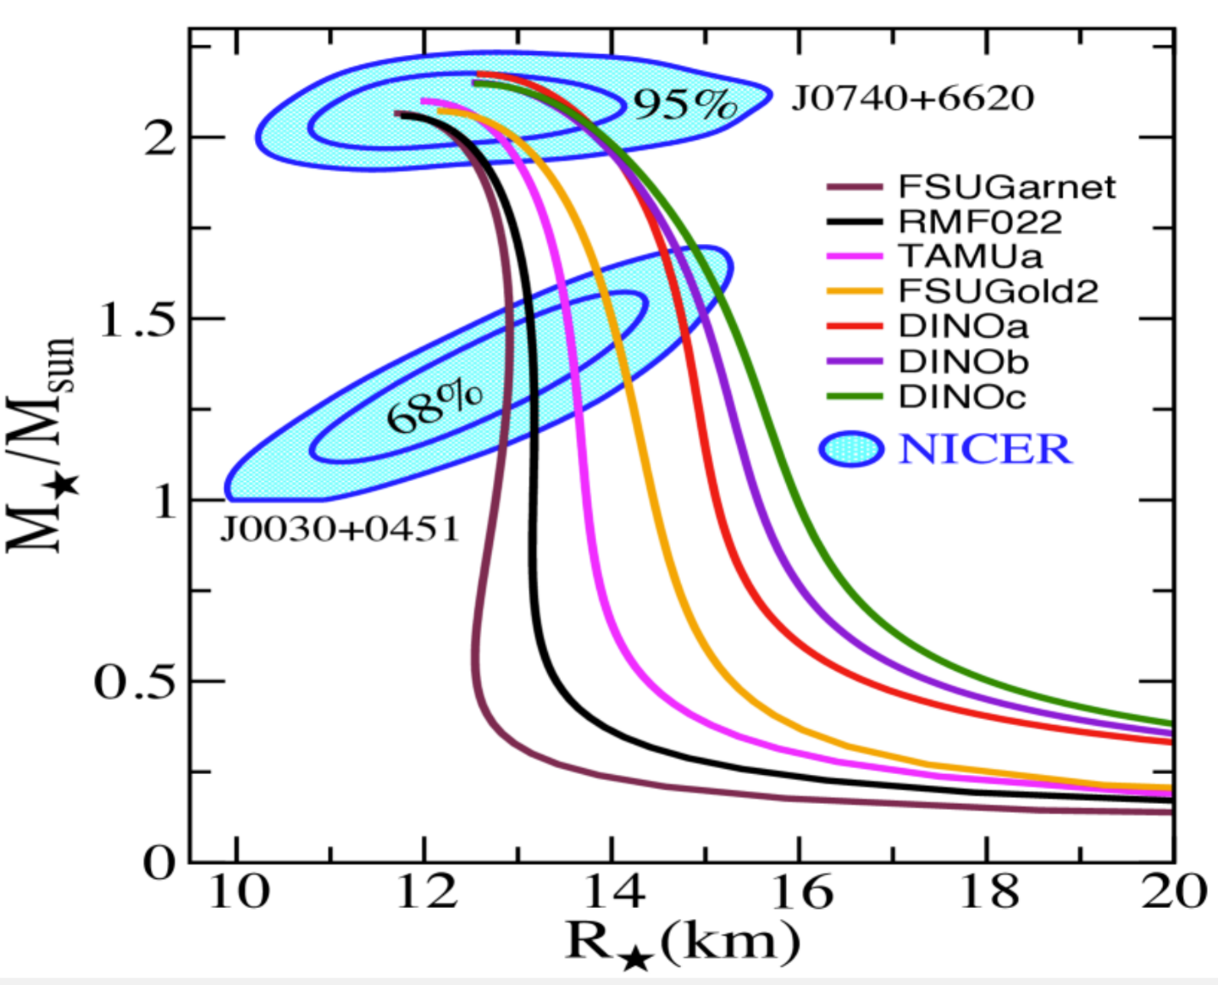
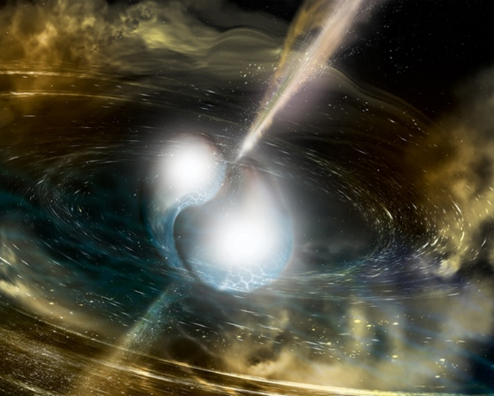
Abbott et al., Rev. Lett. 119, 161101 (2017)
EOS from NS merger

Slide 6
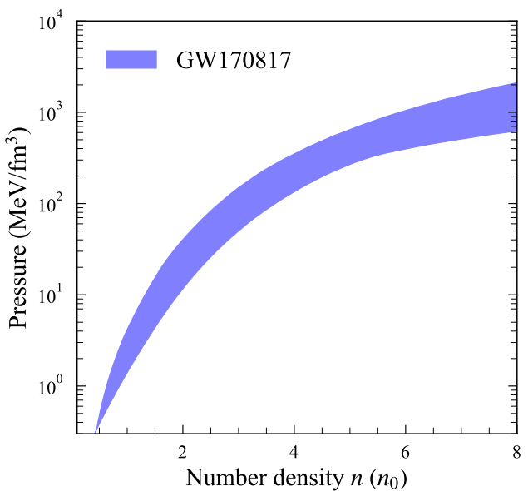
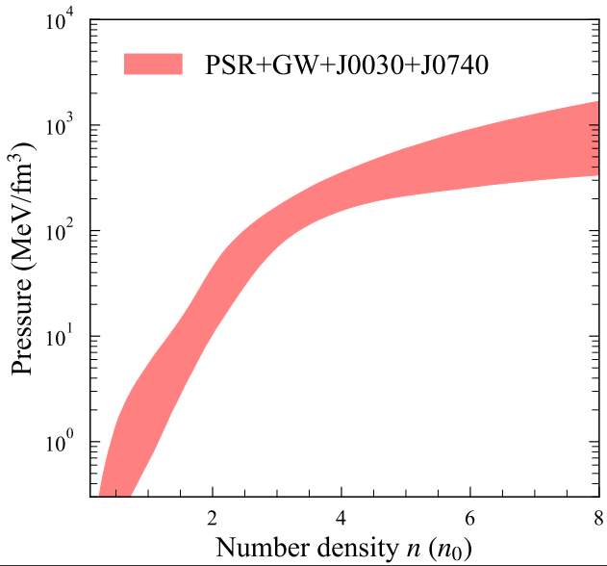

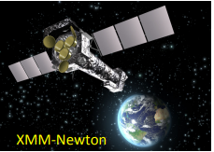
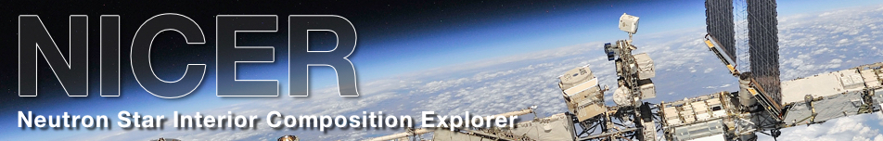
Legred et al., Phys. Rev. D 104, 063003 (2021)
EOS from MR measurements
EOS from NS merger

Slide 7
EOS from MR measurements
EOS from NS merger
Without Nuclear Physics input (i.e. Skyrme interactions), uncertainties from constraints with Astrophysics observation alone is large at low density.
Can one extend the EOS >>4 rho_0?

Slide 8

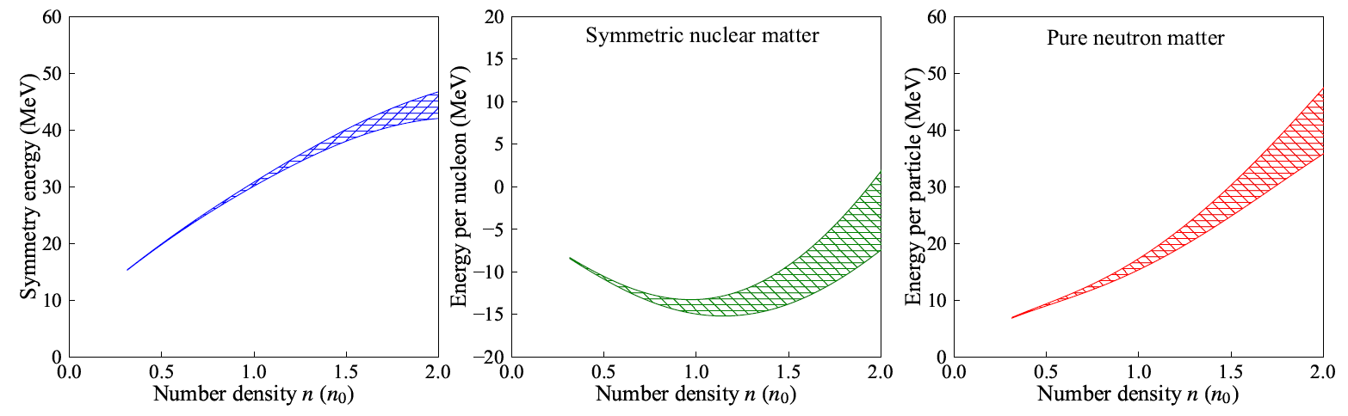
The Nucear Equation of State
ε(ρ,δ=1)=ε(ρ,δ=0)+S(ρ)δ² ; δ = (ρ_{n}- ρ_{p})/ (ρ_{n}+ ρ_{p}) = (N-Z)/A
PNM
SNM
sym
Christian Drischler
Chiral Effective Field Theory
PRL 125, 202702 (2020)
PRC 102, 054315 (2020)
PRL 122, 042501 (2019)
Symmetry Energy=
Energy difference between pure neutron matter and symmetric nuclear matter

Slide 9
Symmetry Energy=
Energy difference between pure neutron matter and symmetric nuclear matter
n₀ ~ 0.16/fm³
E₀ ~ -16 MeV
LDM
a_{sym}~30 MeV
Liquid Drop Model
ε(ρ,δ=1)=ε(ρ,δ=0)+S(ρ)δ²

Slide 10
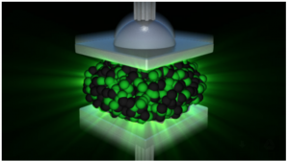
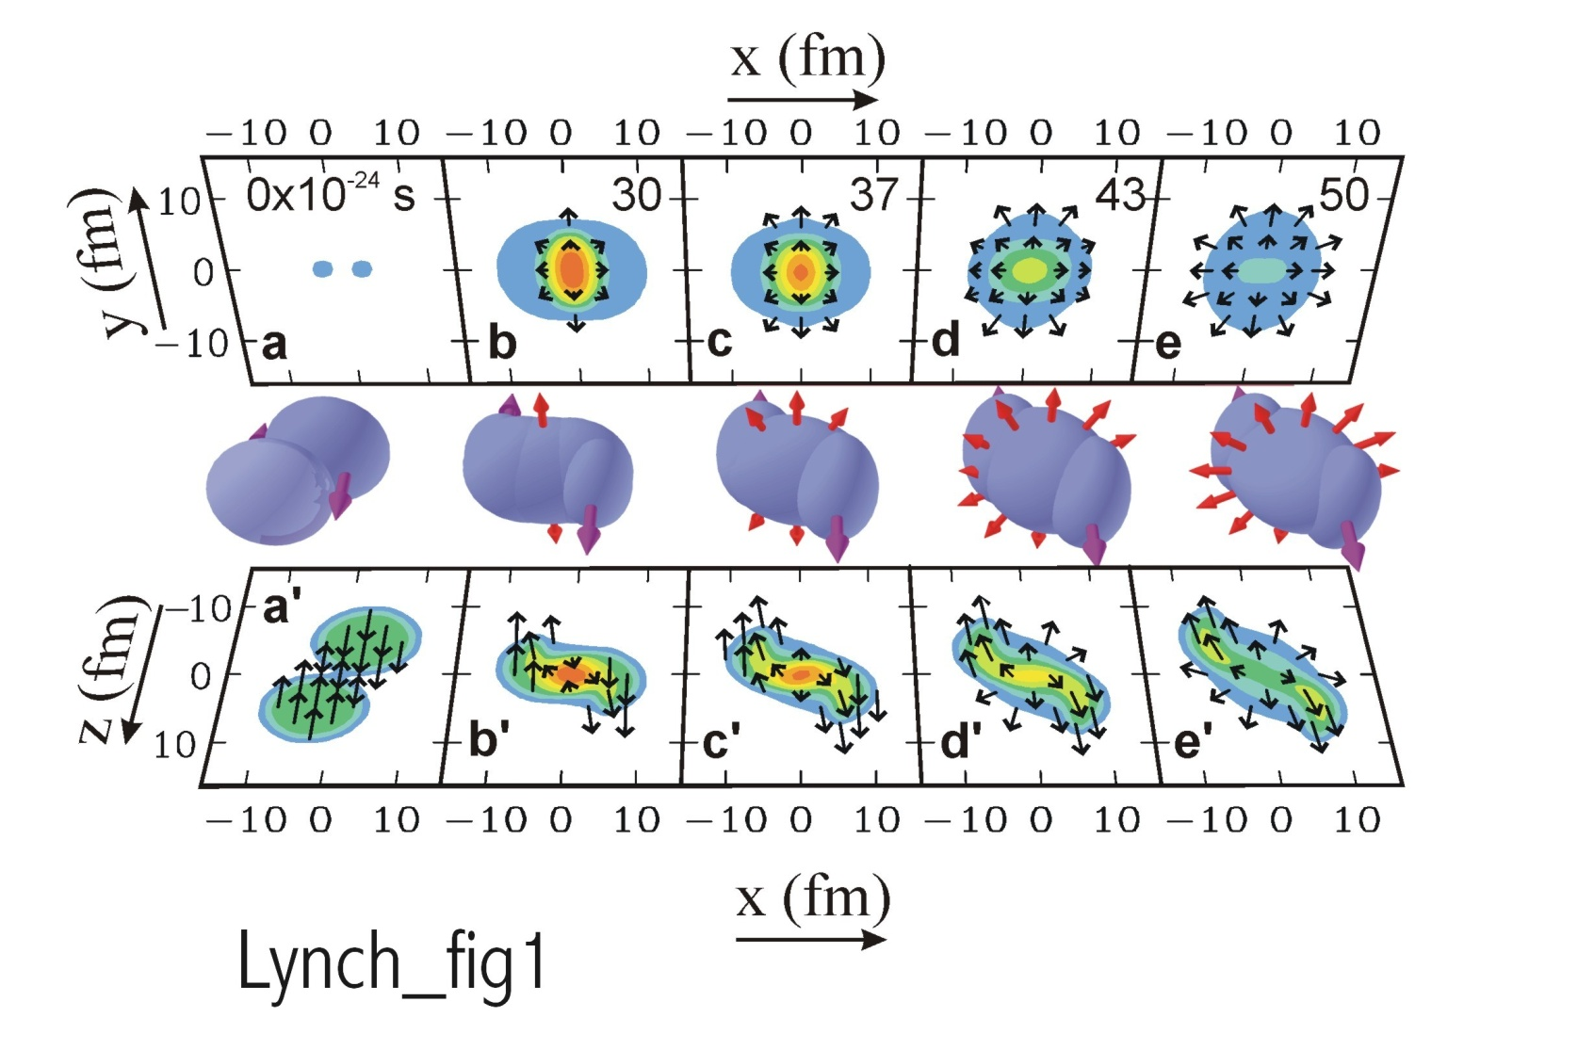
How to squeeze nuclear matter
Au+Au collisions E/A = 1 GeV
pressure contours
Observable:
Particle emission patterns ➔
Transverse & Squeeze-out flow
density contours
Transport models:
Density
Pressure
Science 298, 1592 (2002)

Slide 11
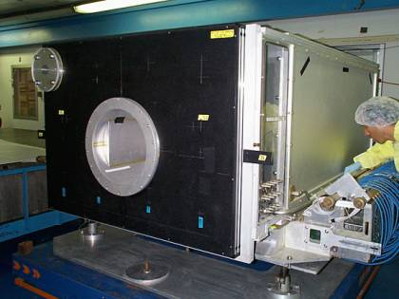
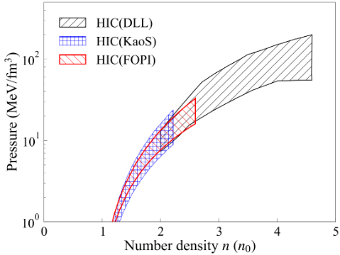
Determination of symmetric matter EOS from heavy-ion collisions
Danielewicz et al., Science 298,1592 (2002)
Two observables from the high pressure formed in the overlap region:
Nucleons are “squeezed out” above and below the reaction plane.
Nucleons from residues are deflected sideways in the reaction plane
Pressure (MeV/fm³)
EOS/LBL
Transport Models
Confirmed by Kaons (2009) and GSI Fourpi results (2016)

Slide 12
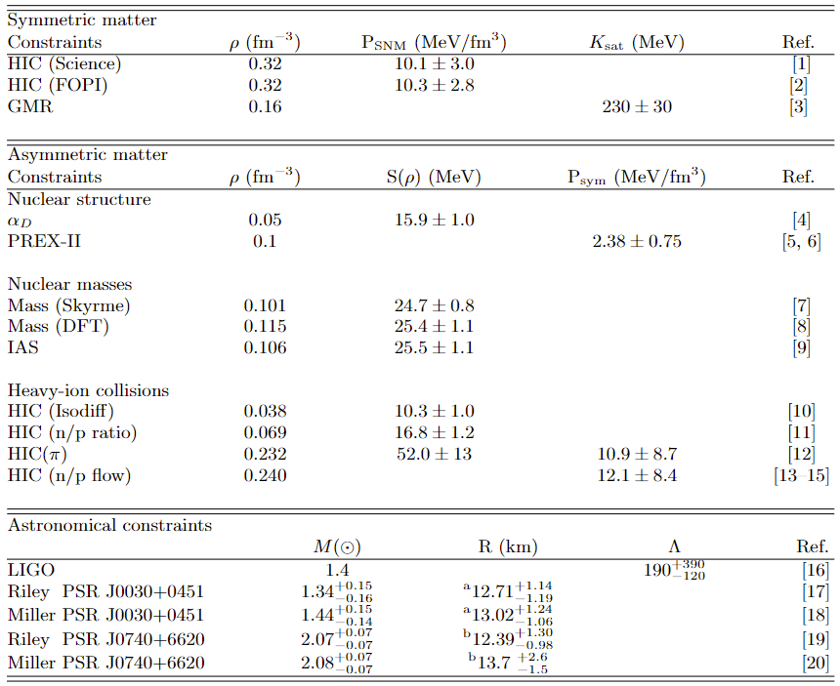
Nuclear structure, reactions, & Astro (15)

Slide 13
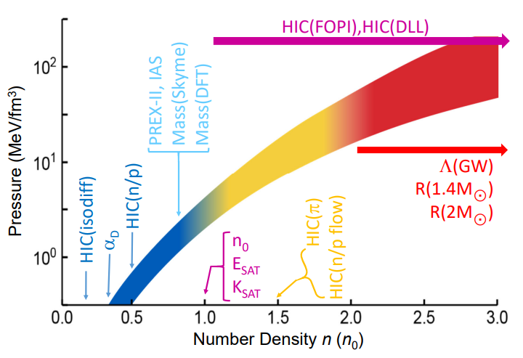


Constraints from nuclear experiments and astrophysics observations
^{Nuclei Properties}
²⁰⁸Pb neutron skin (PREX-II):
PRL 126, 172502 (2021);PRL 126, 172503 (2021)
Isobaric Analog States (IAS):
NPA 958, 147 (2017)
Mass (Skyrme):
PRL 111, 232502 (2013); PRC 89, 011307(R) (2014)
Mass (DFT):
PRC 82, 024313 (2010); PRC 85, 024304 (2012)
Heavy-ion collisions: Symmetric nuclear matter
Science 298, 1592 (2002)
NPA 945, 112 (2016)
Astronomy observations
Tidal deformability:
PRL 119, 161101 (2017); PRL 121, 161101 (2018)
PSR J0030+0451:
Riley et al APL 887, L21 (2019)
Miller et al APL 887, L24 (2019)
PSR J0740+6620:
Riley et al APL 918, L27 (2021
Miller et al APL 918, L28 (2021)
Heavy-ion collisions : Asymmetric nuclear matter
HIC Isospin diffusion:
PRL 102, 122701 (2009)
Dipole polarizability:
PRC 92, 031301(R) (2015)
HIC n/p spectral ratio:
PLB 799, 135045 (2019)
Heavy-ion collisions : Asymmetric nuclear matter
HIC pion spectral ratios:
PRL 126, 162701 (2021)
HIC n/p flow:
PRC 94, 034608 (2016); EPJ A 54, 40 (2018)
GMR: n=n₀; K_{sat}=230$±$30 MeV
PRL 82, 691 (1999); PRC 85, 035201 (2012)
Lynch and Tsang, Phys. Lett. B 830,137098 (2022)
Rohit Kumar

Slide 14



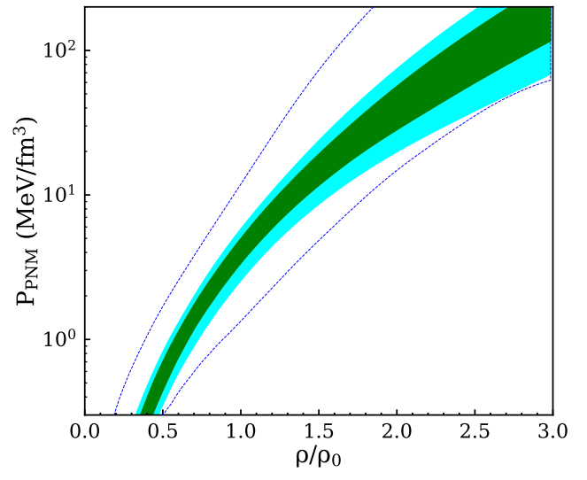
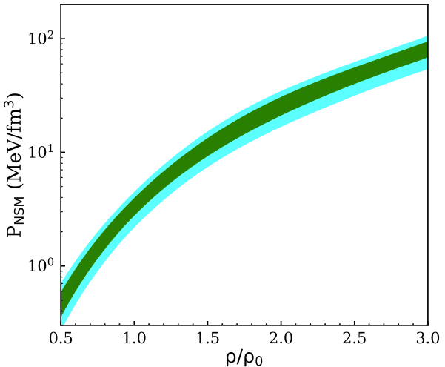
Inputs
constraints
CY Tsang, Nature Astronomy 8, 328-336 (2024)
constraints
EOS
E(ρ,δ) = E_{is}(ρ) + δ²⋅ E_{iv}(ρ)
Tommy Tsang
Bill Lynch
Rohit Kumar
Chuck Horowitz
PRIORS
NS model
NS model=TOV equation that must support maximum mass ~2.07 solar mass
Bayesian analysis
Outputs
EOS parameters
PNM
NS matter
Posteriors
with uncertainties

Slide 15
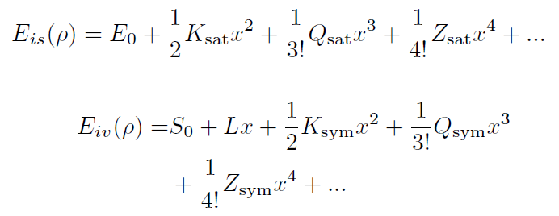

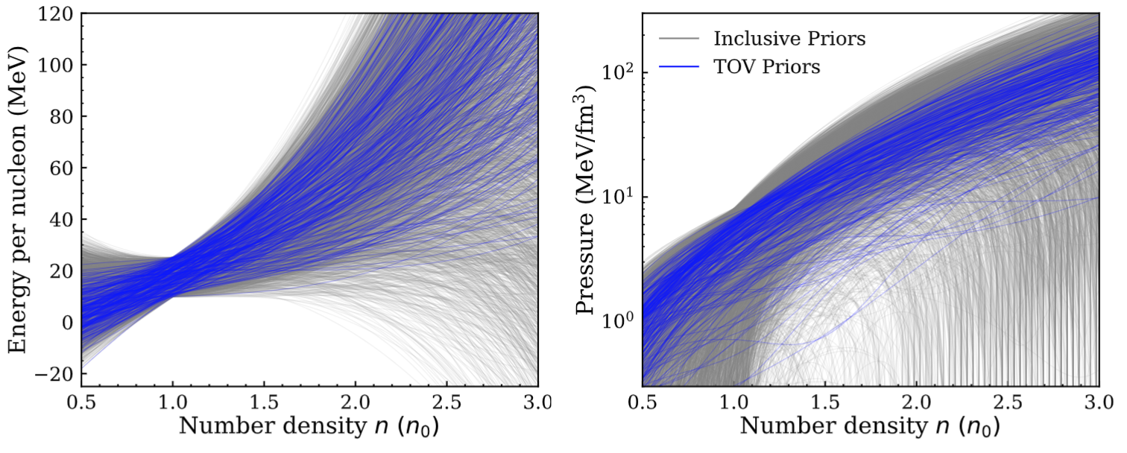
EOS parameters from metamodeling
E(ρ,δ) = E_{is}(ρ) + δ²⋅ E_{iv}(ρ); δ = (ρ_{n}- ρ_{p})/ (ρ_{n}+ ρ_{p}) = (N-Z)/A
Margueron, PRC 97 025805 (2018)

Slide 16
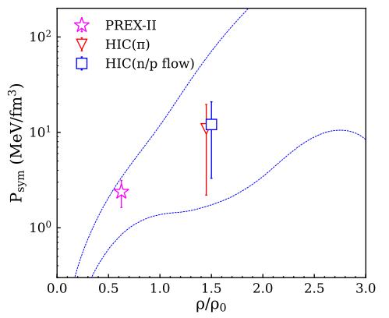
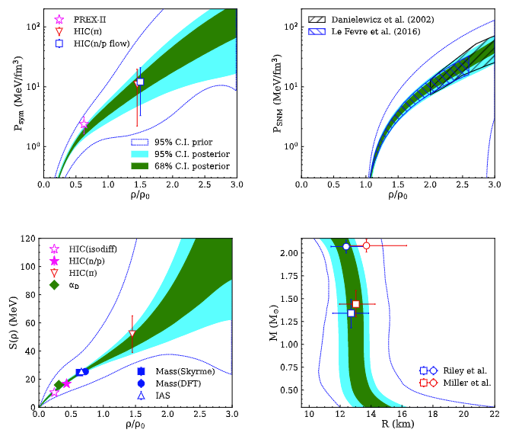
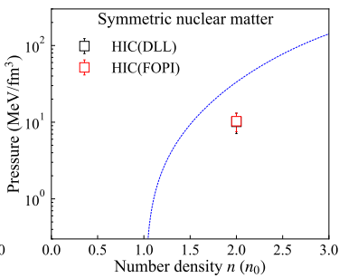
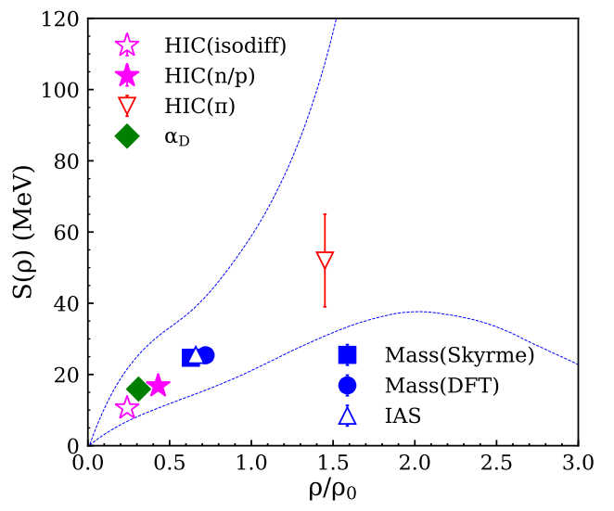
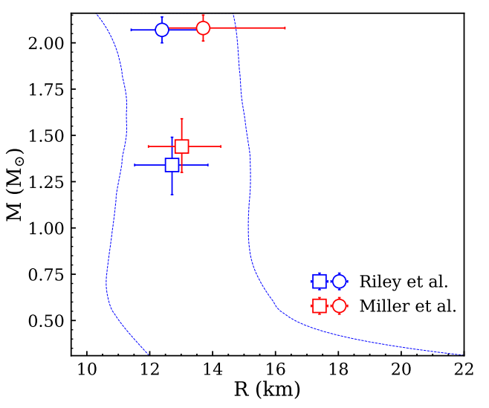
CY Tsang, Nature Astronomy 8, 328-336 (2024)
Data and Priors

Slide 17
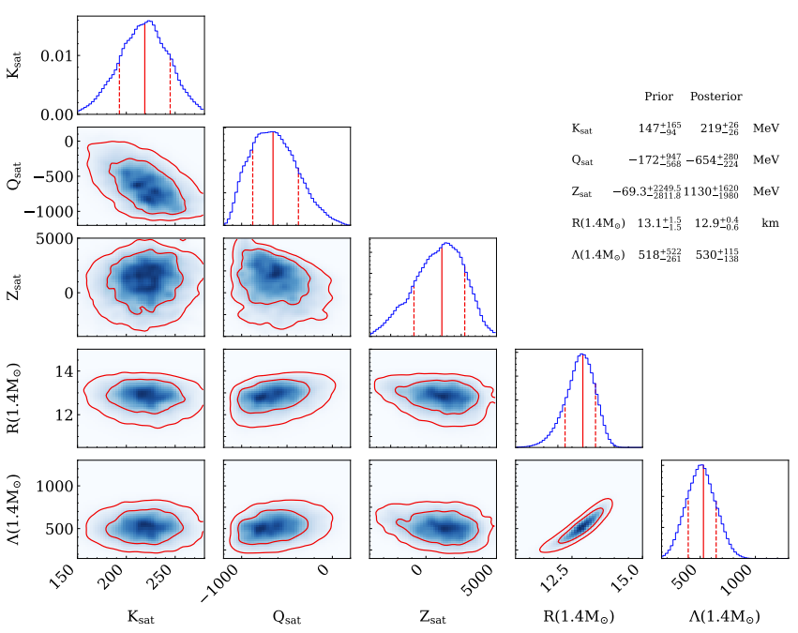
E(ρ,δ) = E_{is}(ρ,0) + δ²⋅ E_{iv}(ρ); δ = (ρ_{n}- ρ_{p})/ (ρ_{n}+ ρ_{p}) ∝(N-Z)/A

Slide 18
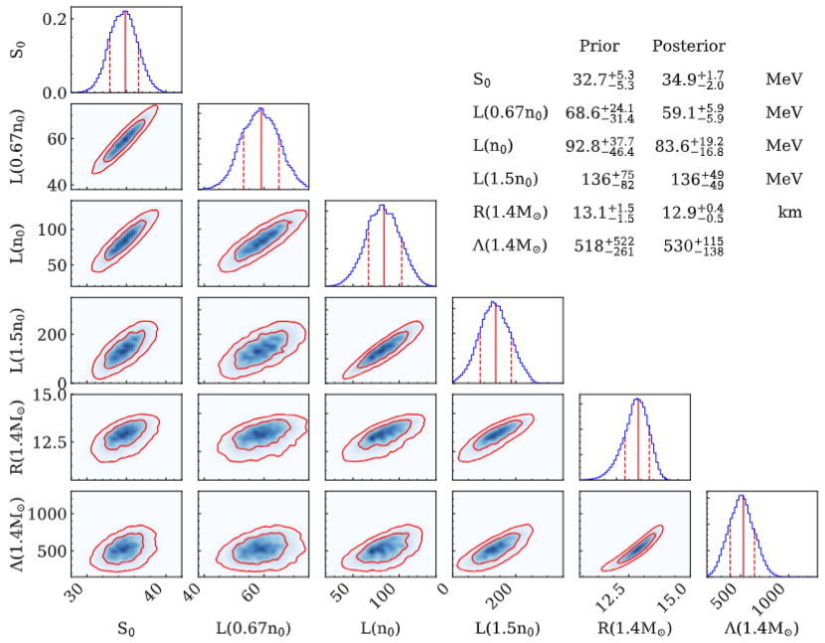
E(ρ,δ) = E_{is}(ρ,0) + δ²⋅ E_{iv}(ρ); δ = (ρ_{n}- ρ_{p})/ (ρ_{n}+ ρ_{p}) = (N-Z)/A

Slide 19
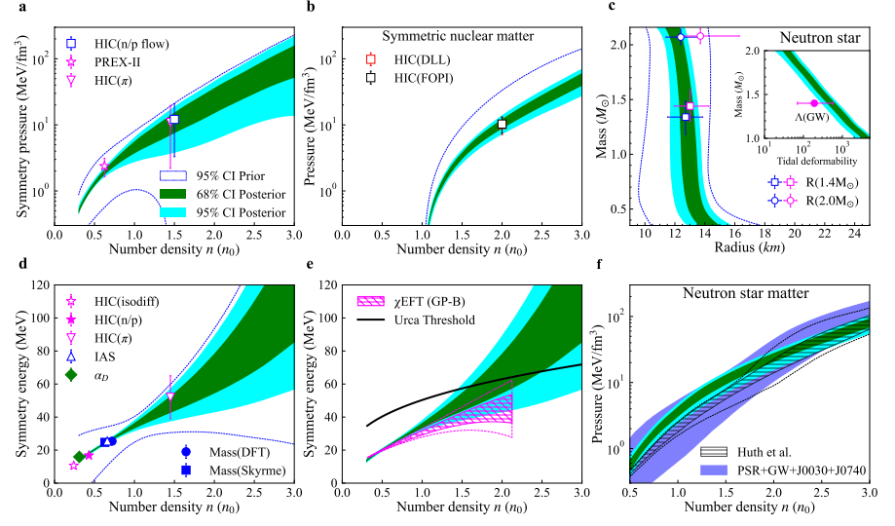
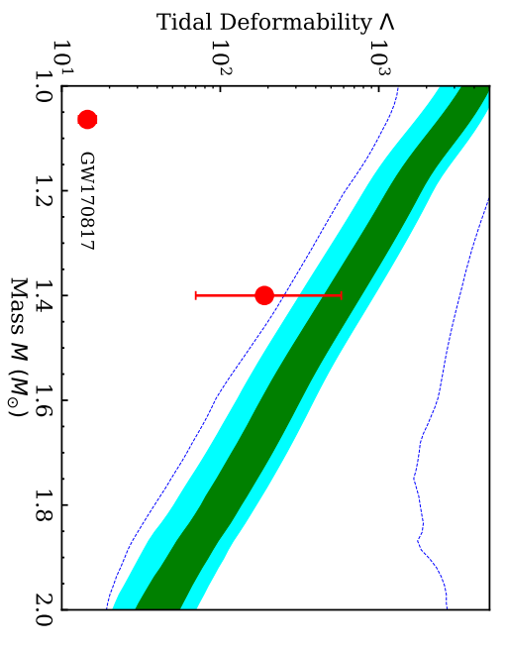
Results of Bayesian analysis
68% & 95% posterior distributions and agreements with data
P_sym > P_SNM
Symmetry term has large uncertainties at high densities
CY Tsang, Nature Astronomy 8, 328-336 (2024)

Slide 20
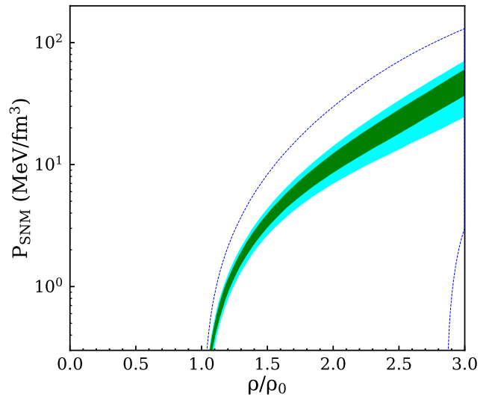
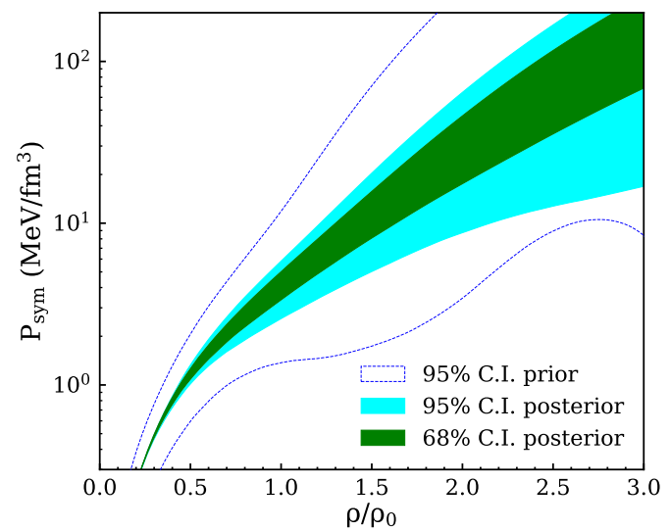
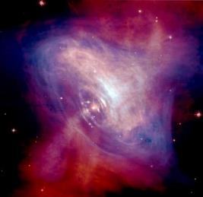
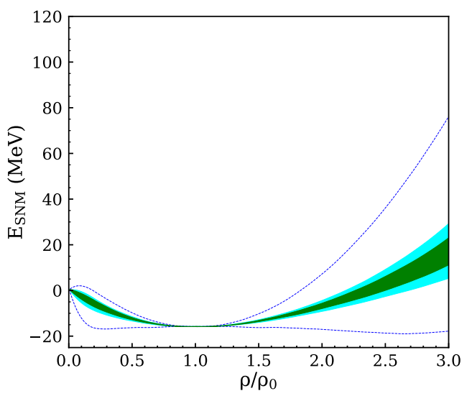
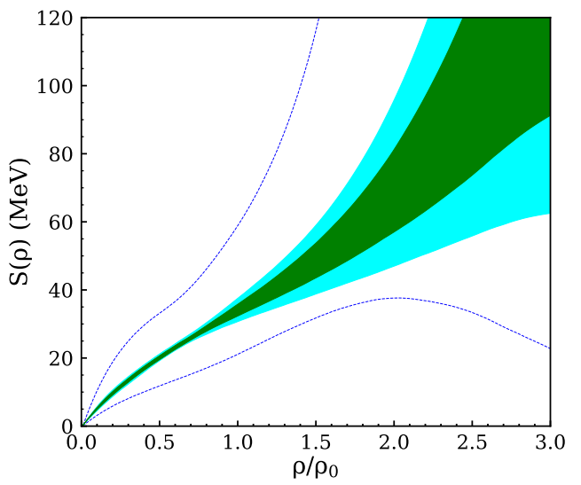
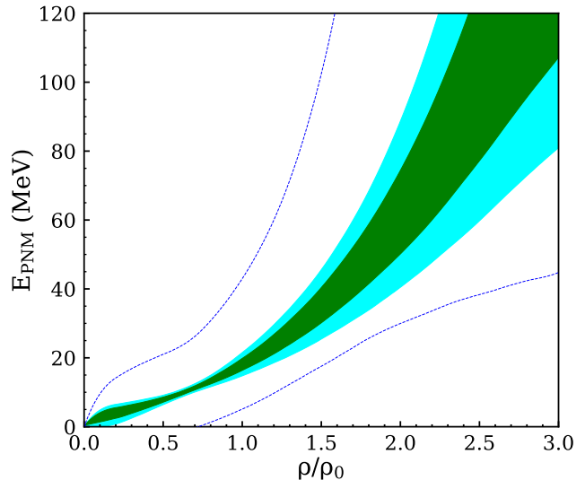
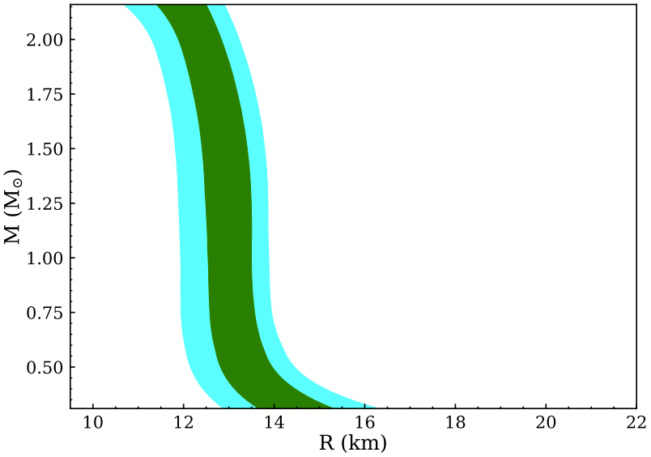
Equation of State of nuclear matter
E(ρ,δ) = E_{SNM}(ρ,0) + δ²⋅S(ρ); δ = (ρ_{n}- ρ_{p})/ (ρ_{n}+ ρ_{p}) = (N-Z)/A
Symmetric
Nuclear
Matter
Symmetry
Term
Pure
Neutron
Matter
Neutron Star Matter
Pressure (MeV/fm³)
Eo=-16 MeV;ρ₀=0.16
Ko=220±27 MeV
Qo=-669±305-218
So=-34±1.7 MeV
L=79±16 MeV
Energy (MeV)
Ksym=0±115-86 MeV
Density (ρ₀)
CY Tsang, Nature Astronomy 8, 328-336 (2024)

Slide 21
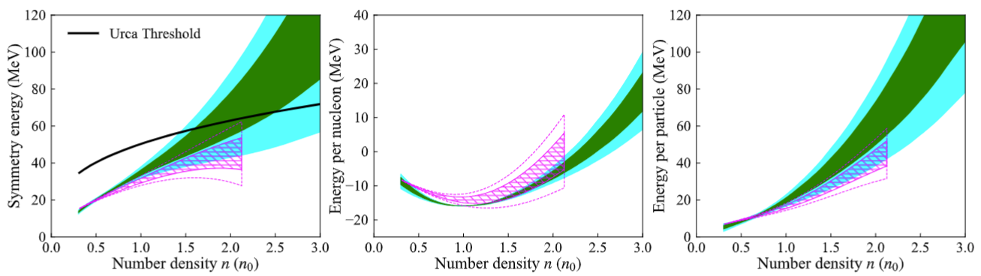
Challenges & Opportunities: Benchmarks for nuclear Theories
Energy/A (MeV)
CY Tsang, Nature Astronomy 8, 328-336 (2024)

Slide 22
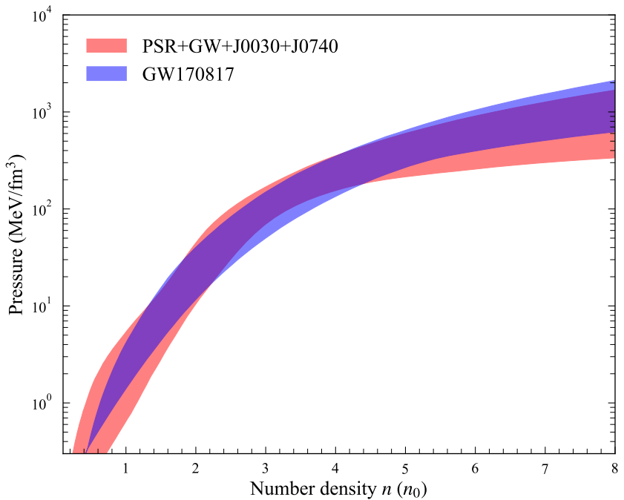
Comparisons with other neutron star EoS
Legred et al., Phys. Rev. D 104, 063003 (2021)
Non-parametric equation of states as priors.
Astrophysical observations are used as constraints
Huth, Pang et al., Nature 606, 279 (2022)
Prior distribution from the Chiral Effective Field theory (upto 1.5n₀); constant speed of sound model >1.5n₀.
Include HIC(FOURPI) & astrophysical observations as constraints

Slide 23
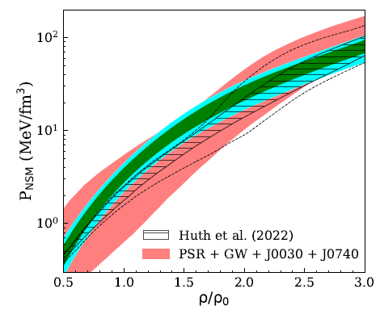
Comparisons with other neutron star EoS
Legred et al., Phys. Rev. D 104, 063003 (2021)
Non-parametric equation of states as priors.
Astrophysical observations are used as constraints
Huth, Pang et al., Nature 606, 279 (2022)
Prior distribution from the Chiral Effective Field theory (upto 1.5n₀); constant speed of sound model >1.5n₀.
Include HIC(FOURPI) & astrophysical observations as constraints

Slide 24
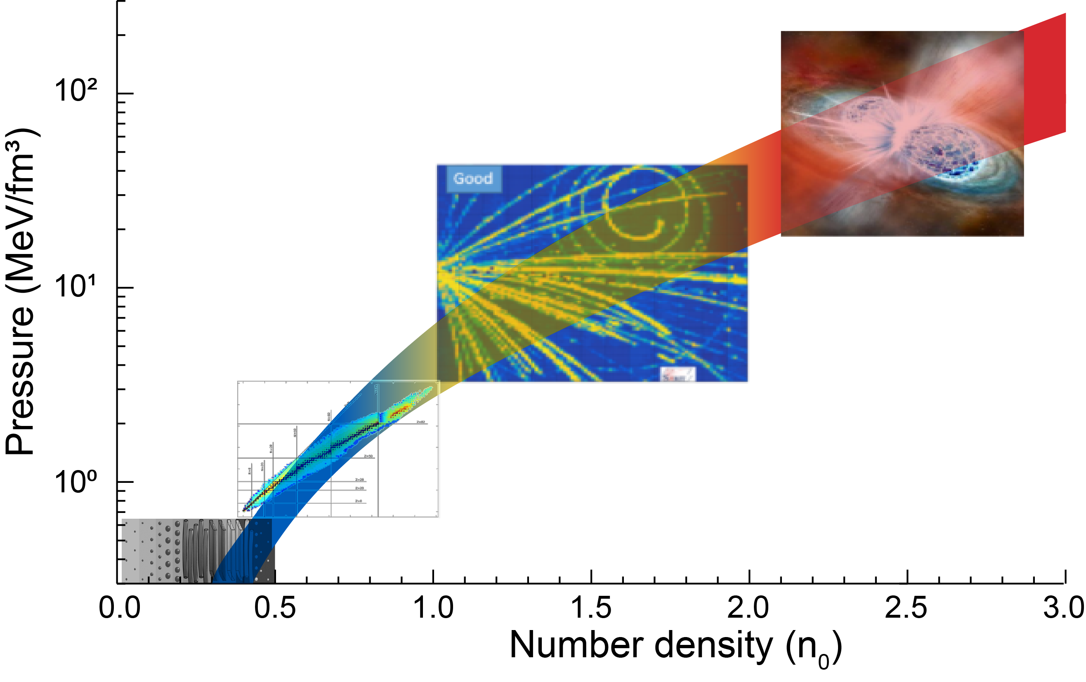
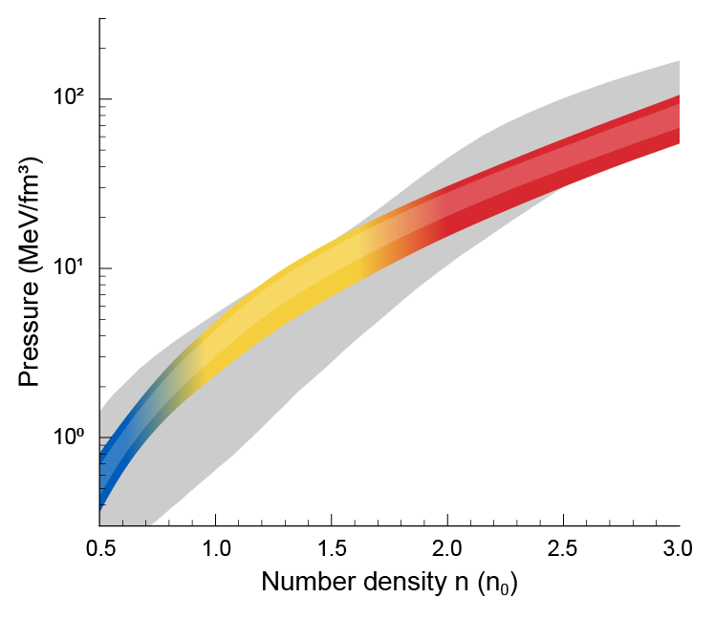


Conclusion 1:
CY Tsang, Nature Astronomy 8, 328-336 (2024); Huth, Pang et al., Nature 606, 279 (2022)
Heavy ion collisions
Pure Neutron Matter
Neutron Star Matter
Astronomy
observations
combining experimental and astrophysics information
Nuclear experiments
Using astrophysics
observation only
Crust
Nuclei properties
Incorporating nuclear physics information significantly reduces the uncertainties of the derived equation of state.

Slide 25


Conclusion: Comprehensive cold EOS is in sight
Importance of including nuclear physics data (calculations) to obtain a comprehensive nuclear EOS to describe nuclei and NS.
Moving Forward
New NS measurements from LVK (O4 & O5) and NICER
New measurements of symmetric matter constraints from Hades, BES (In progress)
Improvement of symmetry energy constraints around 1.5 to 3 rho_0 (FRIB, FRIB400, RIKEN,SIS).
Improvements/breakthroughs in transport model simulations.
NEW facility (FRIB400?, FAIR), NEW experiments and NEW theories to explore the golden era of neutron star physics with HIC.

Slide 26
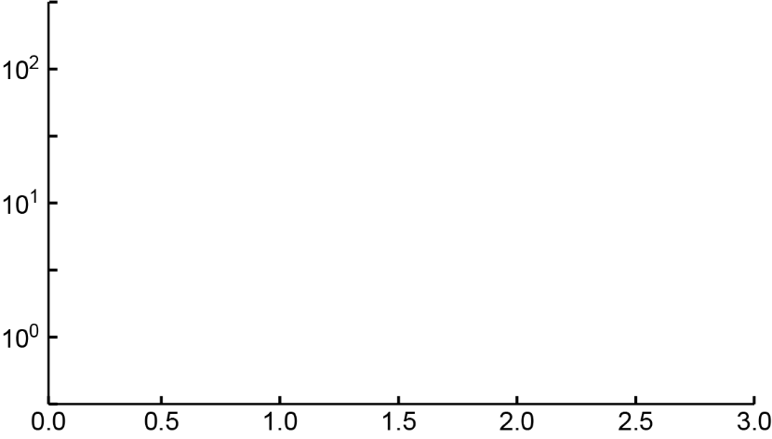

ε(ρ,δ=1)=ε(ρ,δ=0)+S(ρ)
Sensitivity Studies
PREX-II, IAS
Mass(Skyme)
Mass(DFT)
HIC(π)
HIC(n/p flow)
Λ(GW)
R(1.4M⊙)
R(2M⊙)
Rohit Kumar
Pressure (MeV/fm³)
α_{D}
HIC(n/p)
HIC(FOPI),HIC(DLL)
HIC(isodiff)
n₀
E_{SAT}
K_{SAT}
Number Density n (n₀)

Slide 27
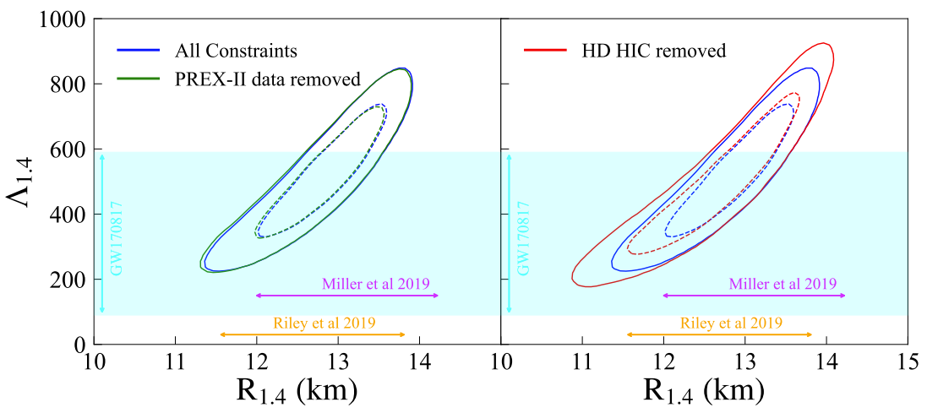
Moving Forward: Sensitivity Studies
Rohit Kumar
Without PREX constraints,
there is little to no effect.
Without high density HIC constraints, uncertainties are much larger

Slide 28
Sensitivity Studies
Rohit Kumar
Without PREX constraints,
There is little to no effect.
Without high density HIC constraints, uncertainties are much larger.

Slide 29
Upcoming experiments to improve Symmetry Energy constraints
AsysEOS2 – Scheduled to run at GSI in March 2025
Observables: n/H differential flows.
New experiment @ 320 MeV.
¹²⁴Xe + ¹¹²Sn (finished in June, analysis in progress)
¹³⁶Xe + ¹²⁴Sn (Scheduled to run in October, 2024)
Obervables: π⁻/π⁺; and n/p yield ratios, v1, v2 and n/p differential flows.

Slide 30
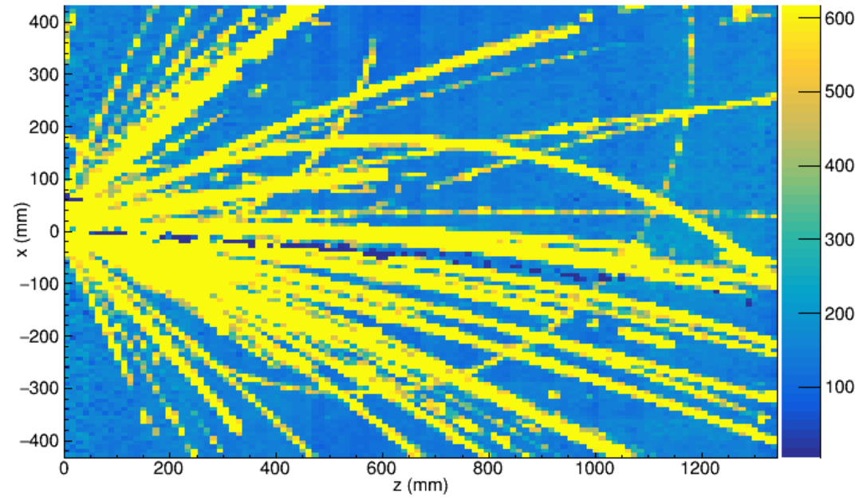
Upcoming experiments to improve Symmetry Energy constraints
¹²⁴Xe + ¹¹²Sn @ 320 MeV
June 27-July 1, 2024
¹²⁴Xe + ¹¹²Sn
Tracks of
negative pions

Slide 31
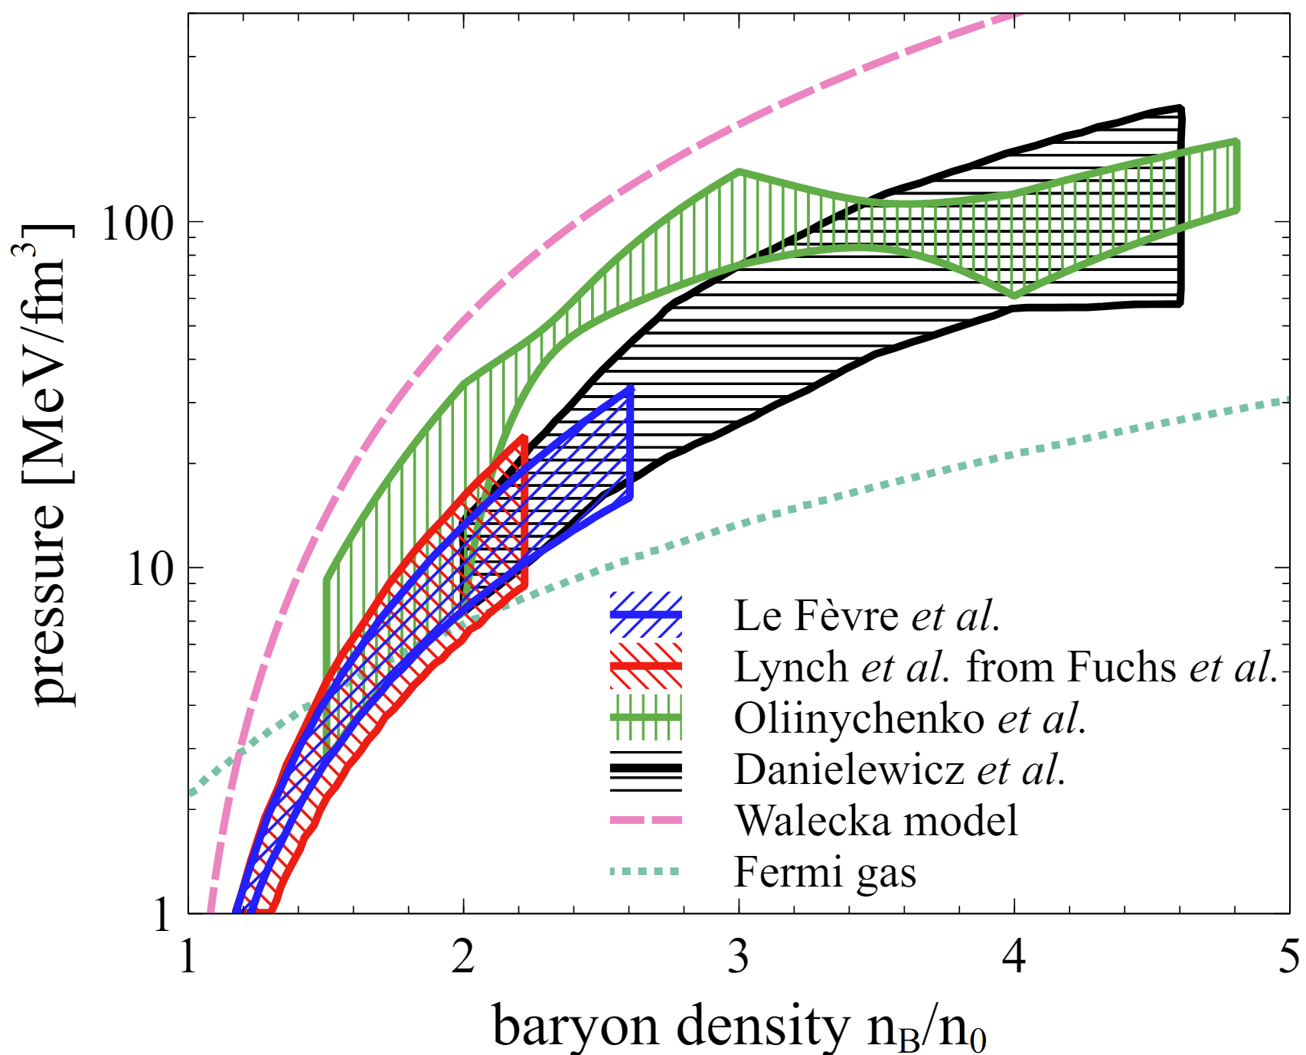
Upcoming analysis to improve symmetric matter constraints
¹²⁴Xe + ¹¹²Sn
Improved EOS for symmetric matter using BES & HADES data (in progress)
Improvements/breakthroughs in transport model simulations!
Transport Model Evaluation Project.

Slide 32
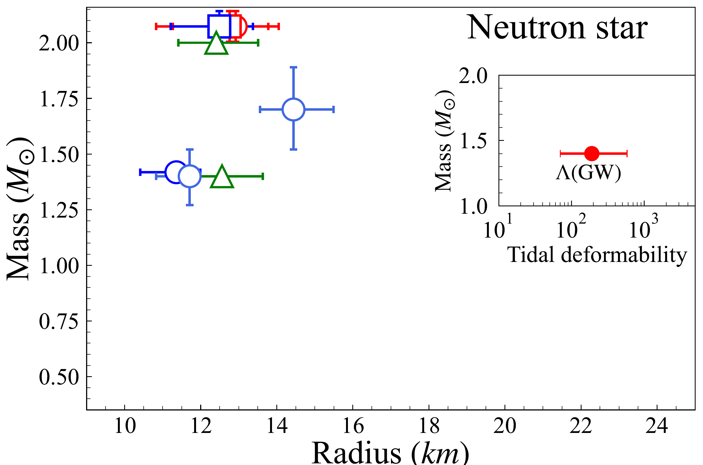
Upcoming Astrophysics Measurements/Analysis
New GW O4 & O5 Results???
New NICER analysis
and measurements

Slide 33
Upcoming Astrophysics (NICER and GW (O4 & O5)) measurements
New Bayesian Analysis?

Slide 34
Conclusion: Comprehensive cold EOS is in sight
Importance of including nuclear physics data (calculations) to obtain a comprehensive nuclear EOS to describe nuclei and NS.
Moving Forward
New NS measurements from LVK (O4 & O5) and NICER
New measurements of symmetric matter constraints from Hades, BES (In progress)
Improvement of symmetry energy constraints around 1.5 to 3 rho_0 (FRIB, FRIB400, RIKEN,SIS).
Improvements/breakthroughs in transport model simulations.
NEW facility (FRIB400?, FAIR), NEW experiments and NEW theories to explore the golden era of neutron star physics with HIC.

Slide 36
Panel Discussion Talking Points:
New NS measurements from LVK (O4 & O5) and NICER
How to evaluate the data vs. model dependence?

Slide 37
Talking Points:
2. Next Frontier is the Neutron Star Crust – Will Newton, Jerome Marguron
Reserved for future panel discussions
3. Low Density (0.5ρ₀ – ρ₀) constraints improvements –
NS and Nuclides properties
a. PREX/CREX – not so relevant to EOS but may be important in general nuclear theory (Betty’s bias) – other radii measurements (discussed yesterday)
b. dipole polarizability sensitive to density ρ~0.5ρ₀ (PRC 92, 031301(R) (2015)) Need confirmation!
c. Inclusion of other observables from scattering?
HIC experiments at low energy – Kyle Brown

Slide 38
Talking Points:
4. Intermediate Density (1.5 ρ₀ -3ρ₀) – Heavy Ion Collisions
a. Symmetric matter – urgently need updates of DLL constraints
b. New (existing) data from BES and Hades
c. Valid transport model
Sorenson et al., PPNP134 (2024) 104080

Slide 39
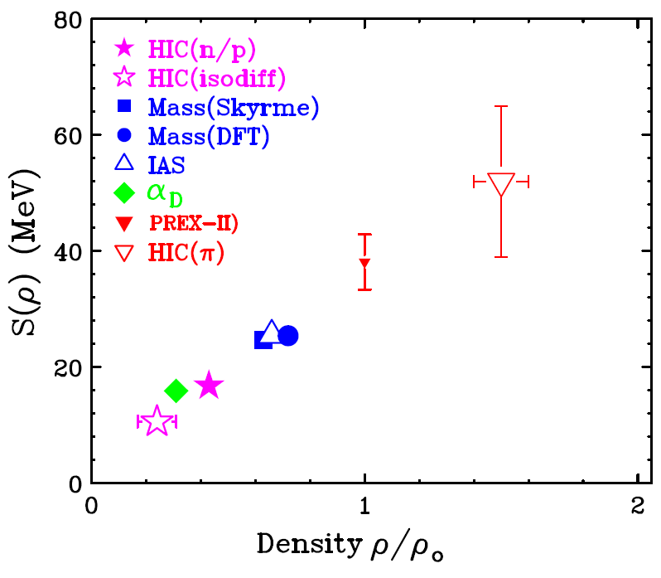

5. Improvement of symmetry energy constraints around 1.5 to 3ρ₀
a. ASYEOSII collaboration n/H yield ratios measurements -- symmetry energy → scheduled in March 2025
b. SpiRIT II (SpiRIT I is 108Sn+112Sn & 132Sn+124Sn at 270 MeV)
a. 124Xe+112Sn at 370 MeV (finished in June)
b. 136Xe+124Sn at 370 MeV (scheduled in October, 2024)
c. Should have results in ~18 month
6. Is L vs S0 a good representation of the EOS?
L
Lynch and Tsang, PLB 830,137098 (2022)
S₀

Slide 40
6. Weakest Links: transport model simulations
7. Transport Model Evaluation Projects (TMEP);
Meeting of Transport theorists from Asia, Europe and US to understand differences in different transport models
Under controlled conditions (e.g. collisions in a box), most “good” models agree to within 10%. However in open systems such as realistic collisions of nuclei, the discrepancies persist.
8. How to prioritize and recruit people-power to attack the model problems -- Agnieszka

Slide 41



Nusym2018 Busan, Korea
Transport Models Evaluation Project
Maria Colonna
Dan Cozma
Pawel Danielewicz
Natsumi Ikeno
CheMing Ko
Bill Lynch
Akira Ono
Jun So
Betty Tsang
Hermann Wolter
Jun Xu
YingXun Zhang
Zhen Zhang
Weekly Zoom meeting (Wed @8 AM)
Pre-Nusym2019 Zuhai, China

