Slide 1



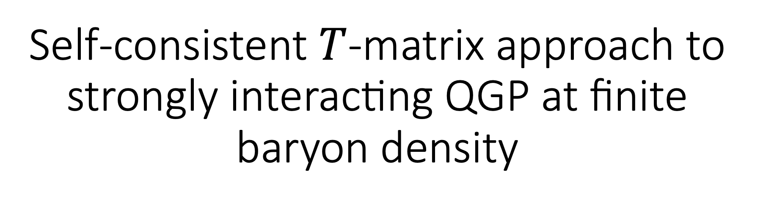
Self-consistent $T$-matrix approach to strongly interacting QGP at finite baryon density
K. Maslov
University of Houston & Cyclotron Institute, Texas A&M University
In collaboration with R. Rapp, C. Ratti, V. Dexheimer, J. Grefa, R. Kumar

Slide 2
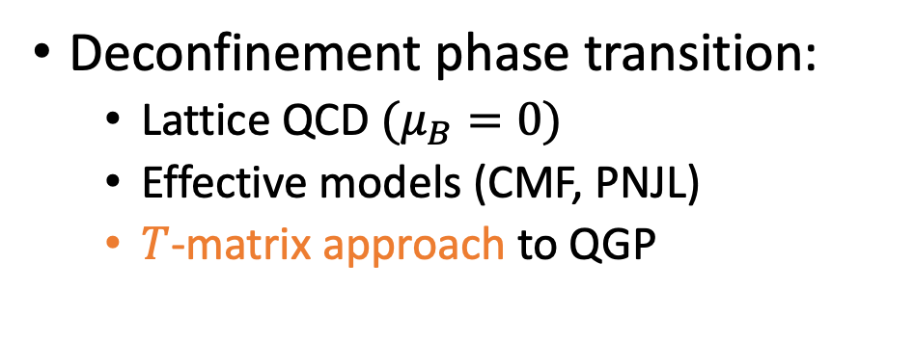
Nuclear Physics from Multi-Messenger Mergers
“High-T” EoS working group:
  New level of understanding of the equation of state and spectral properties of strongly interacting matter...
  with electric charge, strangeness, baryonic density, and temperature suitable for astrophysical applications
Deconfinement phase transition:
  Lattice QCD $(μ_{B}=0)$
  Effective models (CMF, PNJL)
  $T$-matrix approach to QGP

Slide 3
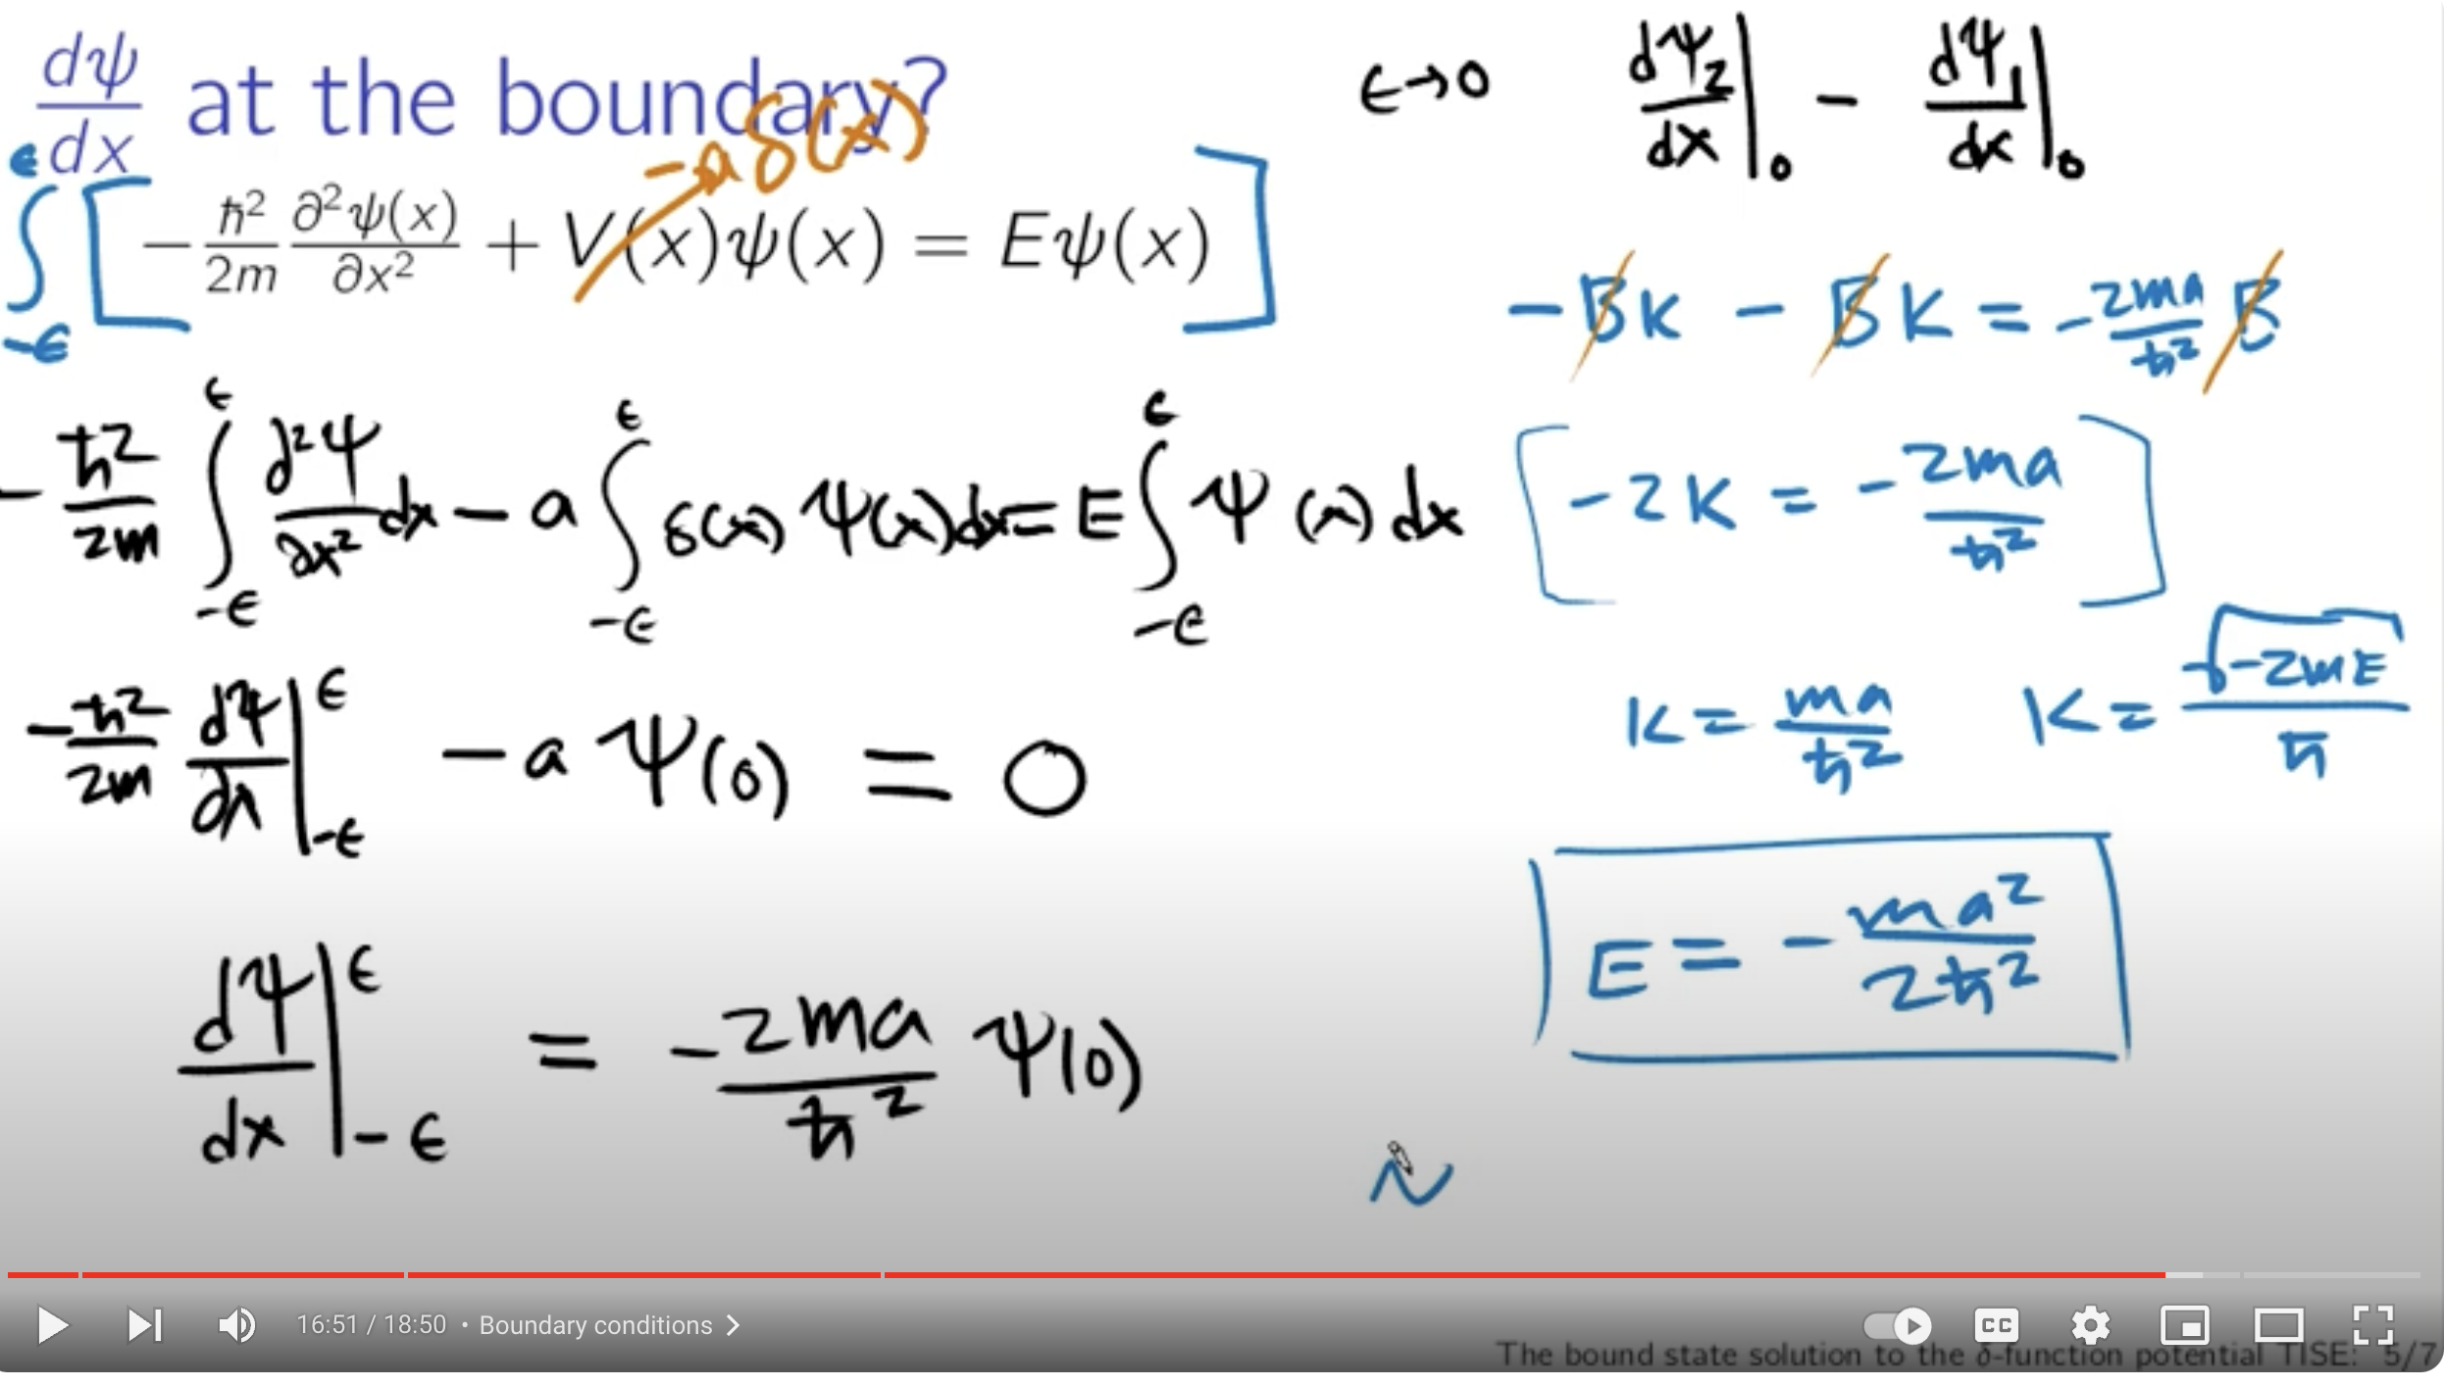

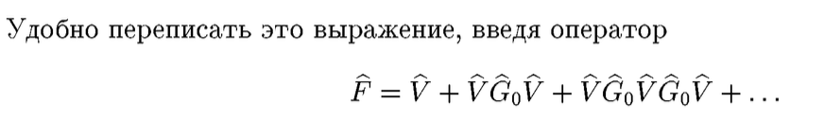
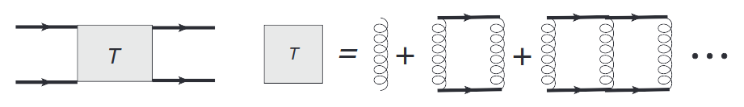
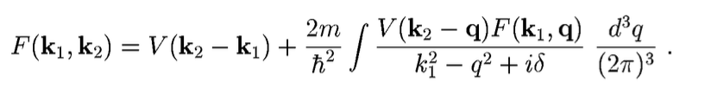
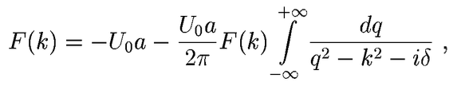
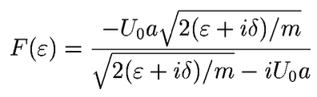
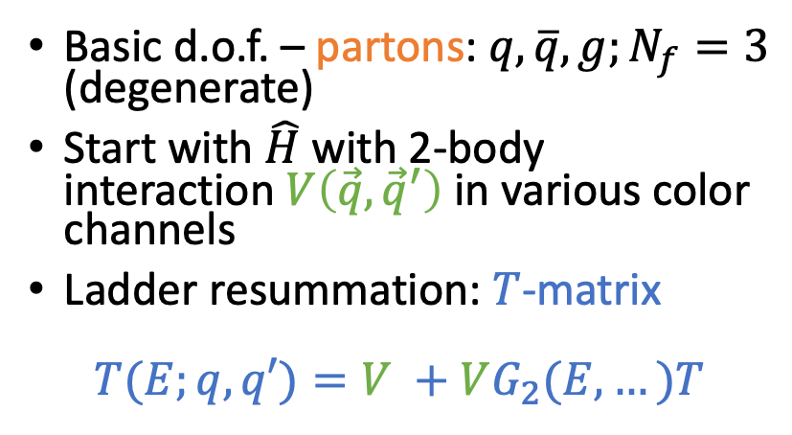




T-matrix approach to strongly interacting QGP
Basic d.o.f. – partons: $q, \overline{q}, g;N_{f}=3$ (degenerate)
Start with $\hat{H}$ with 2-body interaction$V\left(\vec{q}, {\vec{q}}^{′}\right)$ in various color channels
Ladder resummation: $T$-matrix
$$T(E;q,q′)=V +VG_{2}(E,…)T$$
Example: 1D bound state in $V\left(x\right)=−U_{0}aδ(x)$
a)
b) www.mit.edu/~levitov/book/ ; muellergroup.lassp.cornell.edu/scatter.pdf
$$=\hat{V}{\hat{G}}_{0}\hat{F}$$
Poles of $T$-matrix $↔$bound states
$$V\left(\vec{k}\right)=−U_{0}a:$$
has a pole at

Slide 4
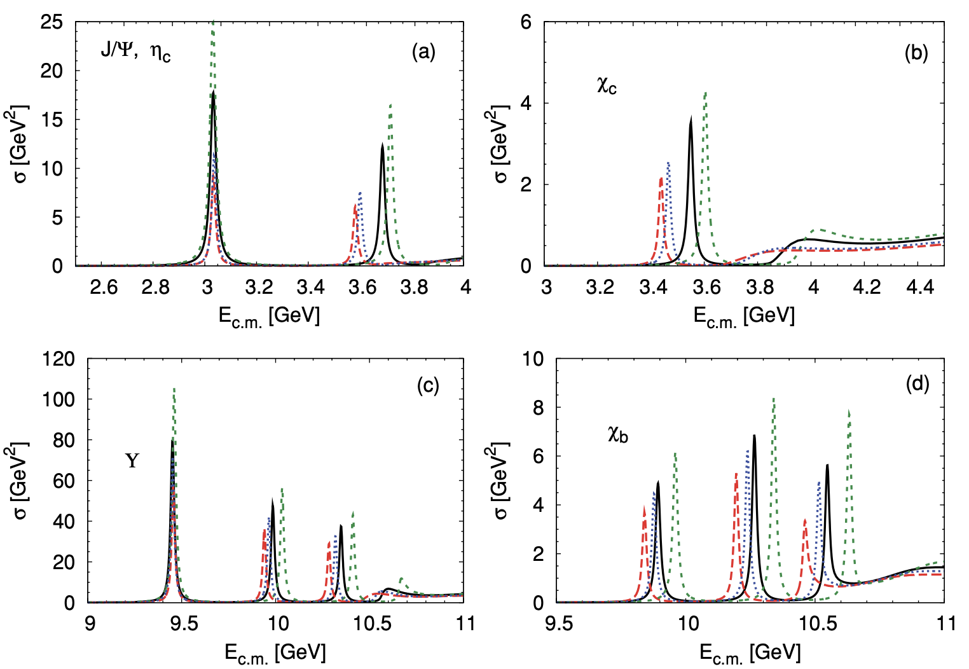
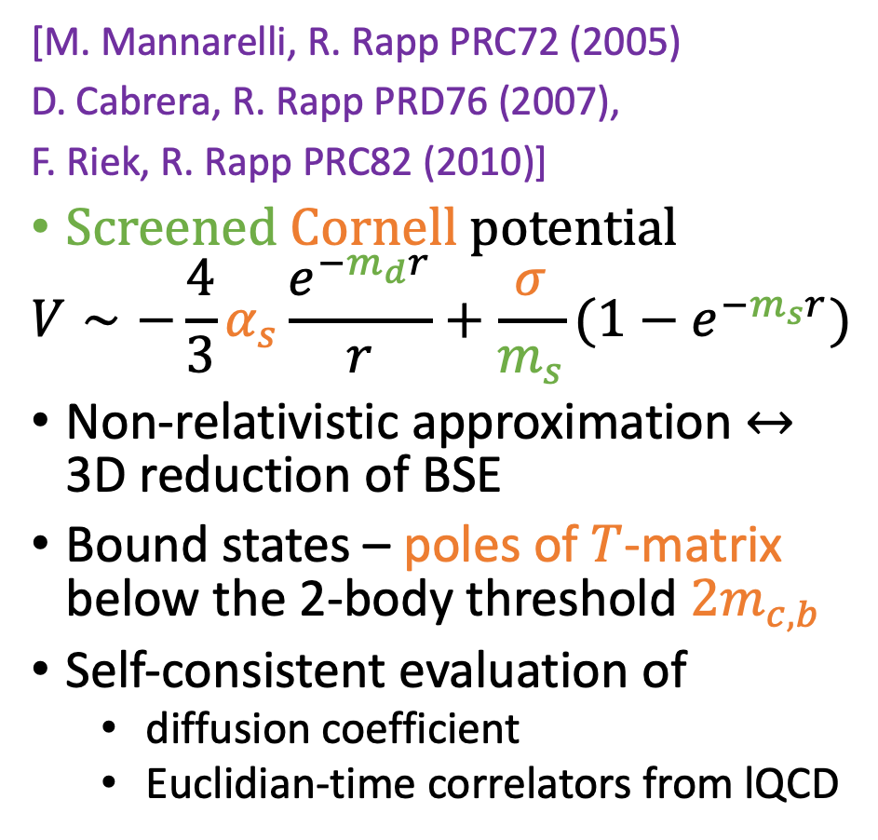


Example: heavy quarkonia $\overline{b}b, \overline{c}c$
$$σ(E_{c.m.})∼Im T(E_{c.m.})$$
[M. Mannarelli, R. Rapp PRC72 (2005)
D. Cabrera, R. Rapp PRD76 (2007),
F. Riek, R. Rapp PRC82 (2010)]
Screened Cornell potential
$$V∼−\frac{4}{3}α_{s}\frac{e^{−m_{d}r}}{r}+\frac{σ}{m_{s}}(1−e^{−m_{s}r})$$
Non-relativistic approximation $↔$ 3D reduction of BSE
Bound states – poles of $T$-matrix below the 2-body threshold $2m_{c,b}$
Self-consistent evaluation of
  diffusion coefficient
  Euclidian-time correlators from lQCD
F. Riek, R. Rapp PRC82 (2010)

Slide 5
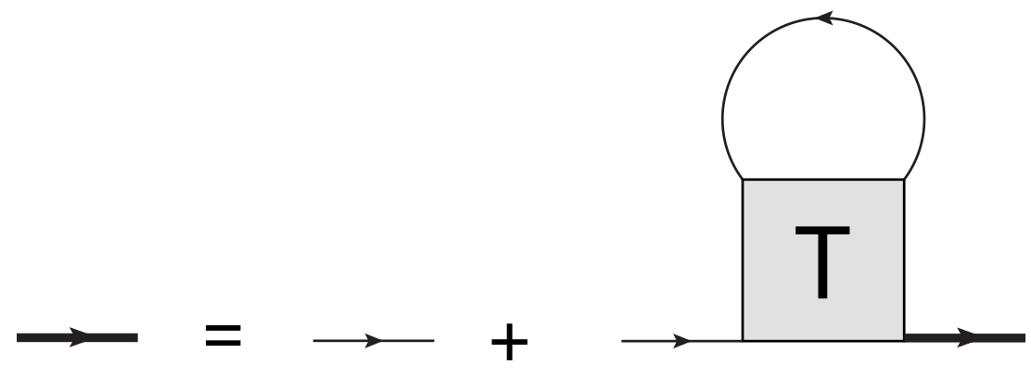

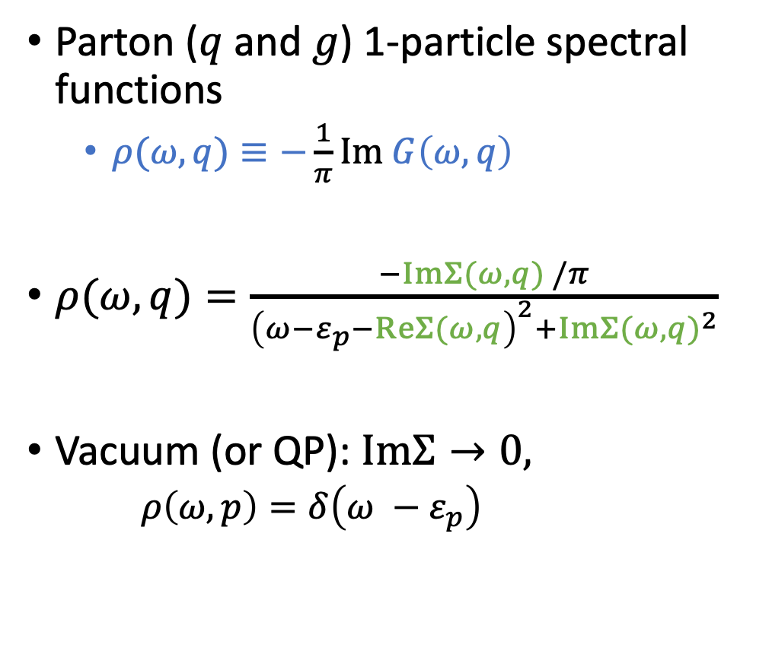



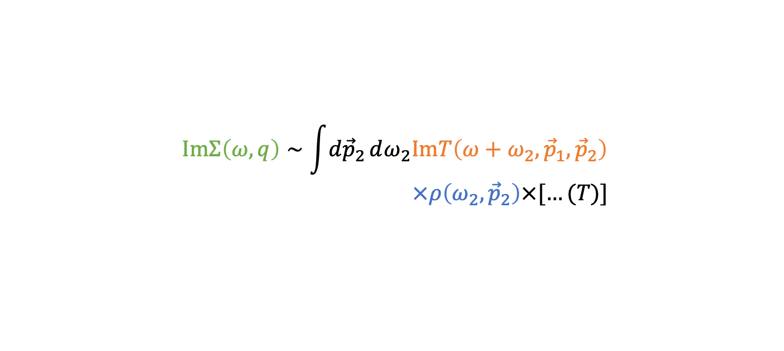
In-medium: self-consistency
Interactions induce self-energies
Parton ($q$ and $g$) 1-particle spectral functions
  $ρ(ω, q)≡−\frac{1}{π}Im G\left(ω, q\right)$
$ρ(ω, q)=\frac{−ImΣ(ω,q) /π}{{\left(ω−ε_{p}−ReΣ(ω, q\right)}^{2}+Im{Σ(ω,q)}^{2}}$
Vacuum (or QP): $ImΣ→0,$
  $ρ\left(ω,p\right)=δ\left(ω −ε_{p}\right)$
$$G=G_{0}+G_{0}ΣG$$
$$ImΣ\left(ω,q\right)∼\int{d{\vec{p}}_{2}}dω_{2}ImT\left(ω+ω_{2},{\vec{p}}_{1},{\vec{p}}_{2}\right)$$
$×ρ\left(ω_{2},{\vec{p}}_{2}\right)×[…(T)]$
Self-consistent scheme
$$Σ(ω, q)$$
$$T(E, q_{c.m.})$$
$$G(ω, q)$$
$$G_{2}(E,q)$$

Slide 6
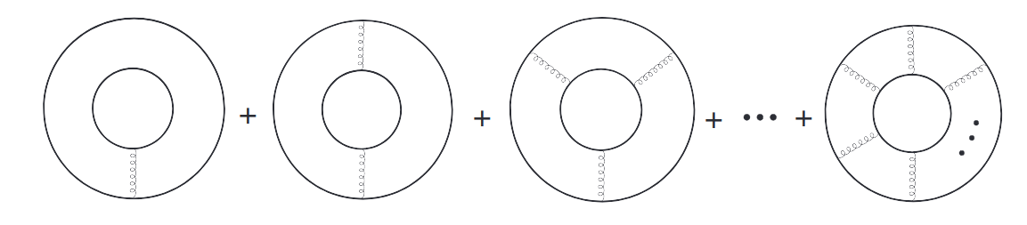
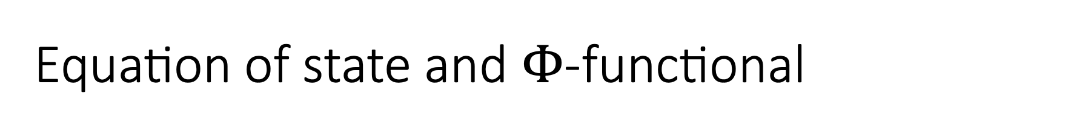
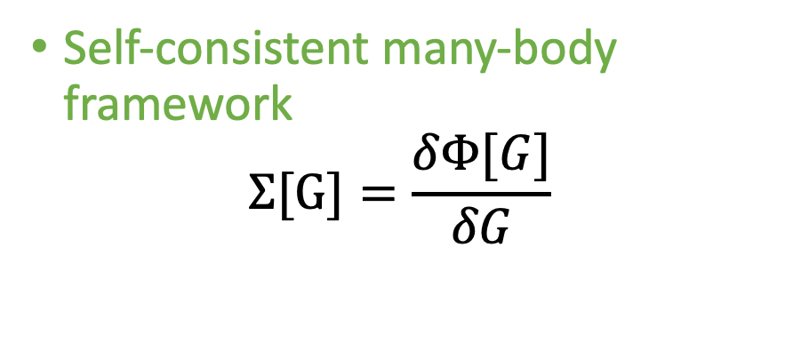
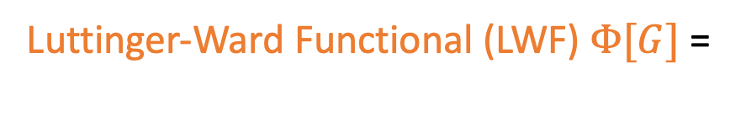

Equation of state and $Φ$-functional
S. Liu, R. Rapp PRC97 (2018)
$$Ω\left(\left\{μ\right\},T\right)=∓T\sum_{n}{\underbrace{Tr\left\{ln\left(−G^{−1}\right)+ΣG\right\}}±\underbrace{Φ[G]}}$$
1-body
2-body
Luttinger-Ward Functional (LWF) $Φ[G]$ =
Self-consistent many-body framework
$$Σ[G]=\frac{δΦ[G]}{δG}$$
Conserving 2PI approximation to description of many-body system
[G. Baym PR 127 (1962)]

Slide 7
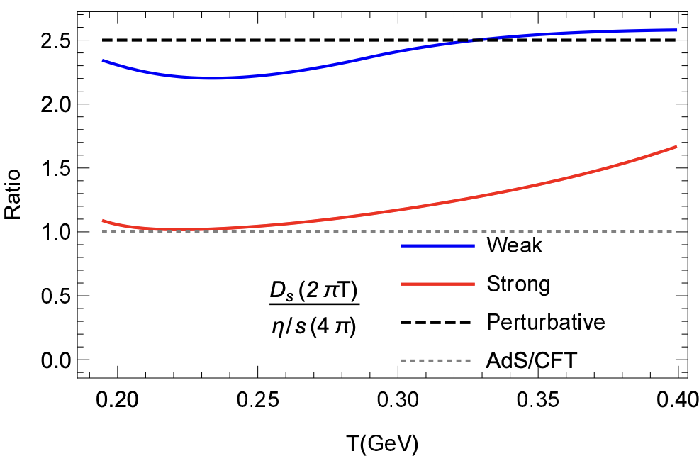
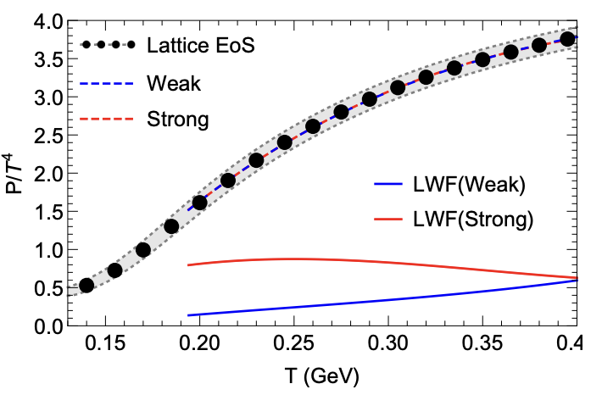
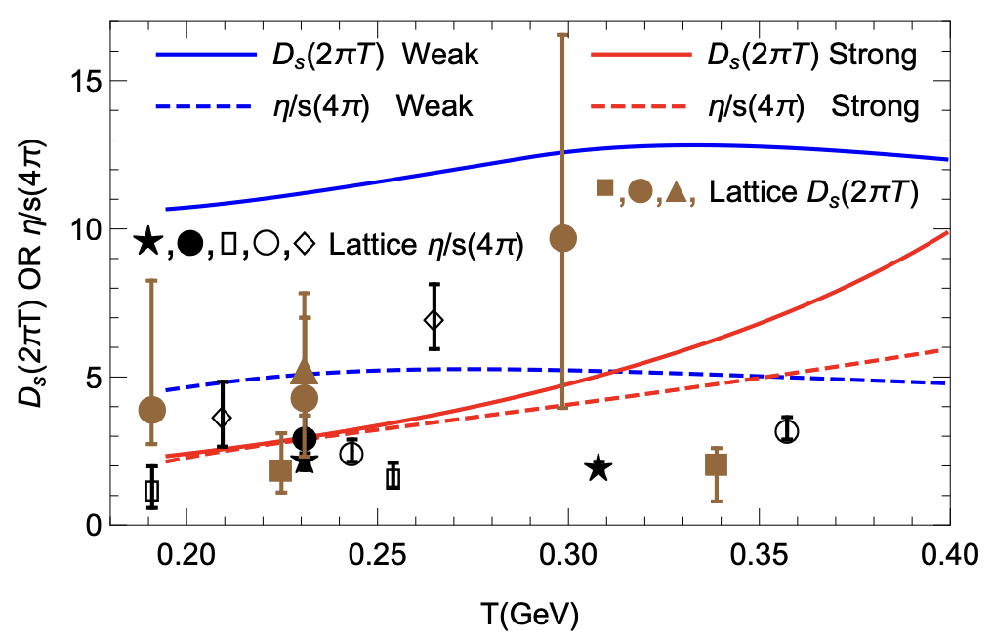

Light sector: weakly/strongly coupled scenarios
Parton masses and interaction screening fit lQCD data:
  $P(T,μ_{B}=0)$
  Heavy-quark free energy and correlators
Same EoS, significant difference in transport properties
S. Liu, R. Rapp EPJA 56 (2020)
S. Liu, R. Rapp PRC97 (2018)

Slide 8
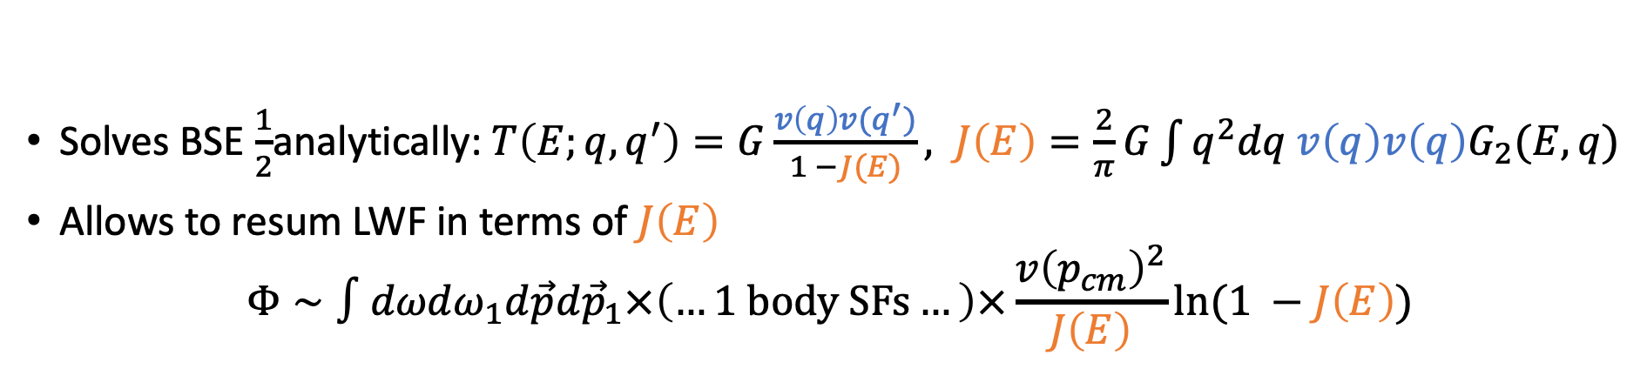
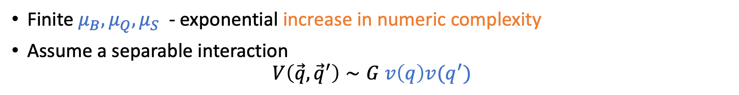

Separable interactions
Technical simplification
Finite $μ_{B},μ_{Q},μ_{S}$ - exponential increase in numeric complexity
Assume a separable interaction
$$V\left(\vec{q},{\vec{q}}^{′}\right)∼G v\left(q\right)v(q^{′})$$
$×$ rel. corrections
Benefits
Solves BSE $\frac{1}{2}$analytically:$T\left(E;q,q^{′}\right)=G\frac{v\left(q\right)v(q^{′})}{1 −J(E)}, J\left(E\right)=\frac{2}{π}G\int{q^{2}dq v\left(q\right)v\left(q\right)G_{2}(E, q)}$
Allows to resum LWF in terms of $J\left(E\right)$
$$Φ∼∫dωdω_{1}d\vec{p}d{\vec{p}}_{1}×\left(…1 body SFs…\right)×\frac{v{\left(p_{cm}\right)}^{2}}{J\left(E\right)}ln⁡(1 −J\left(E\right))$$
Can we mimic the strongly coupled QGP with a simplified interaction?

Slide 9
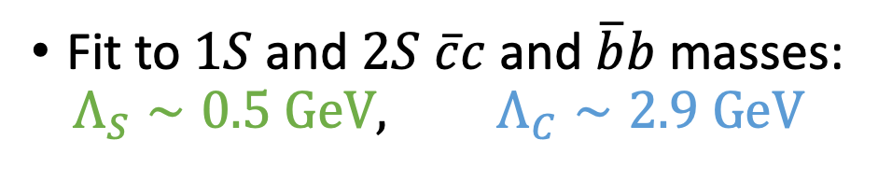

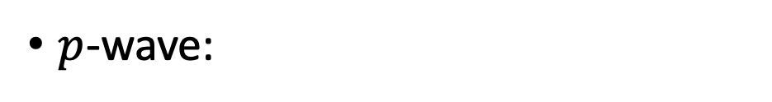

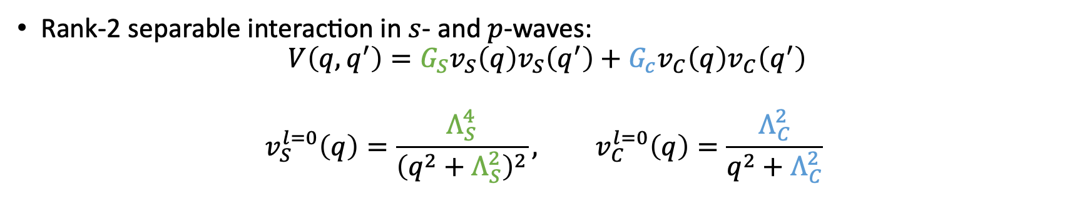
Interaction parameters: vacuum $\overline{Q}Q$ binding
Rank-2 separable interaction in $s$- and $p$-waves:
$$V\left(q,q^{′}\right)=G_{S}v_{S}\left(q\right)v_{S}\left(q^{′}\right)+G_{c}v_{C}\left(q\right)v_{C}\left(q^{′}\right)$$
$$v_{S}^{l=0}\left(q\right)=\frac{Λ_{S}^{4}}{{\left(q^{2}+Λ_{S}^{2}\right)}^{2}}, v_{C}^{l=0}\left(q\right)=\frac{Λ_{C}^{2}}{q^{2}+Λ_{C}^{2}}$$
($×$ rel. corrections)
Fit to $1S$ and $2S$ $\overline{c}c$ and $\overline{b}b$ masses:
$$Λ_{S}∼0.5 GeV, Λ_{C}∼2.9 GeV$$
$p$-wave:

Slide 10
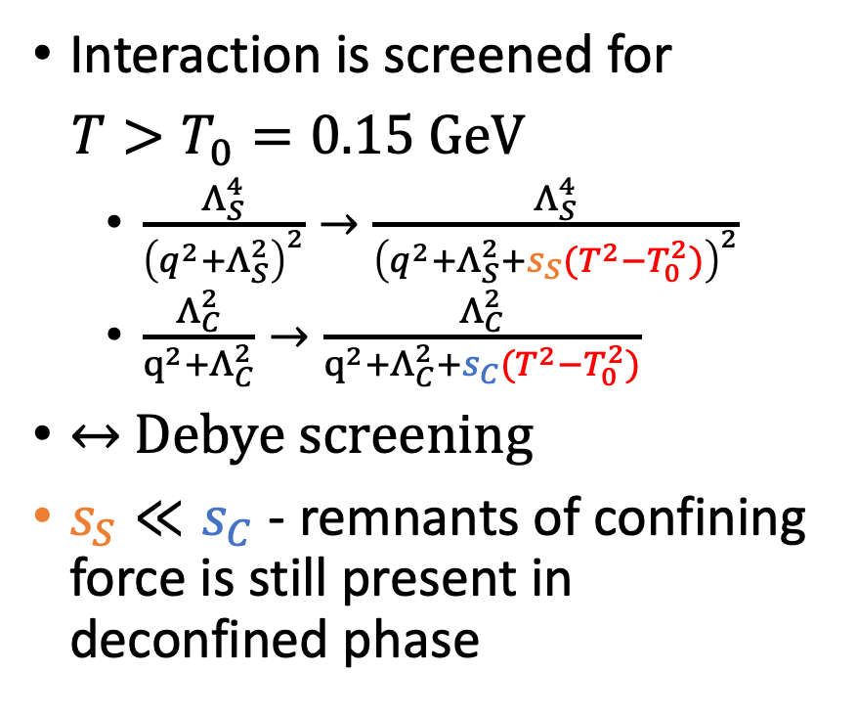
In-medium screening
Interaction is screened for
$T>T_{0}=0.15 GeV$
  $\frac{Λ_{S}^{4}}{{\left(q^{2}+Λ_{S}^{2}\right)}^{2}}→\frac{Λ_{S}^{4}}{{\left(q^{2}+Λ_{S}^{2}+s_{S}(T^{2}−T_{0}^{2})\right)}^{2}}$
  $\frac{Λ_{C}^{2}}{{q^{2}+Λ}_{C}^{2}}→\frac{Λ_{C}^{2}}{{q^{2}+Λ}_{C}^{2}+s_{C}(T^{2}−T_{0}^{2})}$
$↔$Debye screening
$s_{S}≪s_{C}$ - remnants of confining force is still present in deconfined phase
Resonance masses:

Slide 11

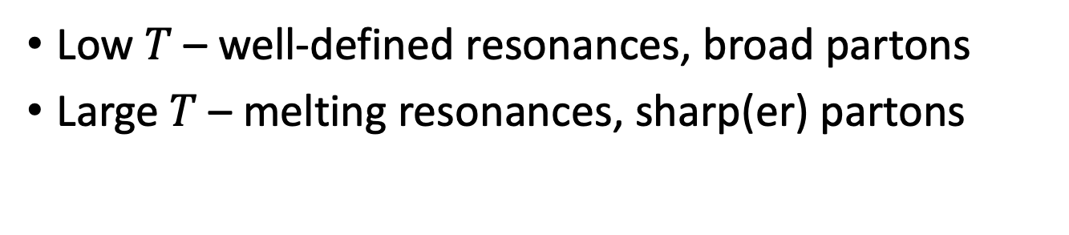

Transition of d.o.f.
Low $T$ – well-defined resonances, broad partons
Large $T$ – melting resonances, sharp(er) partons
$$m_{q}(T=190 MeV)$$

Slide 12
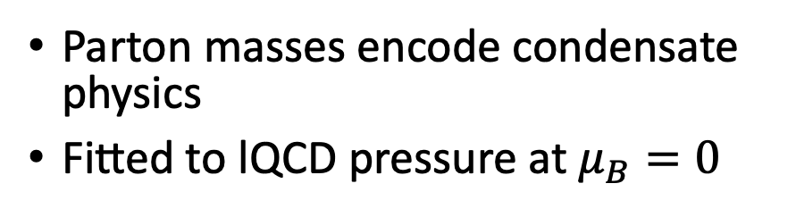
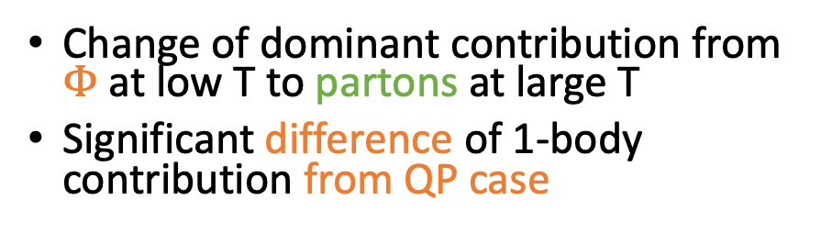
EoS and LWF
Parton masses encode condensate physics
Fitted to lQCD pressure at $μ_{B}=0$
Change of dominant contribution from $Φ$ at low T to partons at large T
Significant difference of 1-body contribution from QP case

Slide 13
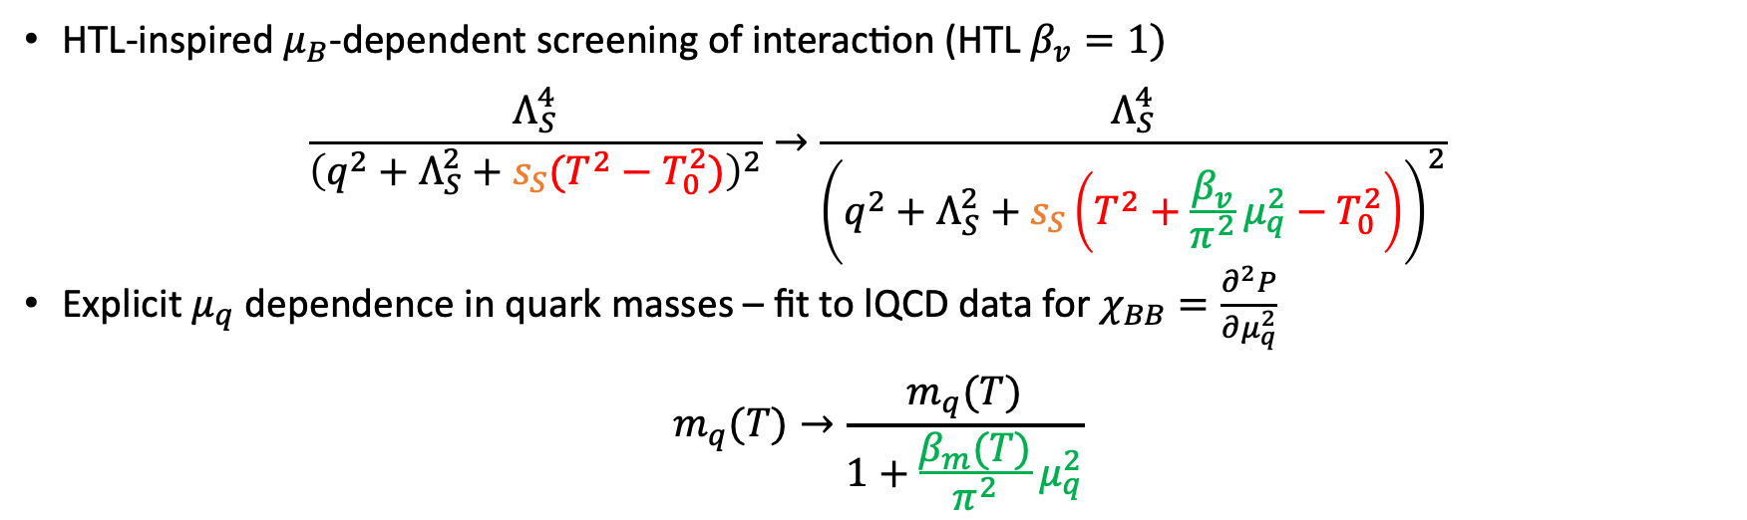

Extension to finite $μ_{B}$
Formalism
$G_{q}\left(E,q\right)→G_{q}\left(E−μ_{q}\right), G_{\overline{q}}\left(E, q\right)→G_{\overline{q}}(E+μ_{q})$, break $G_{2}$ and $T$-matrix channel degeneracy
Screening
HTL-inspired $μ_{B}$-dependent screening of interaction (HTL $β_{v}=1)$
$$\frac{Λ_{S}^{4}}{{\left(q^{2}+Λ_{S}^{2}+s_{S}(T^{2}−T_{0}^{2})\right)}^{2}}→\frac{Λ_{S}^{4}}{{\left(q^{2}+Λ_{S}^{2}+s_{S}\left(T^{2}+\frac{β_{v}}{π^{2}}μ_{q}^{2}−T_{0}^{2}\right)\right)}^{2}}$$
Explicit $μ_{q}$ dependence in quark masses – fit to lQCD data for $χ_{BB}=\frac{∂^{2}P}{∂μ_{q}^{2}}$
$$m_{q}(T)→\frac{m_{q}(T)}{1+\frac{β_{m}(T)}{π^{2}}μ_{q}^{2}}$$

Slide 14
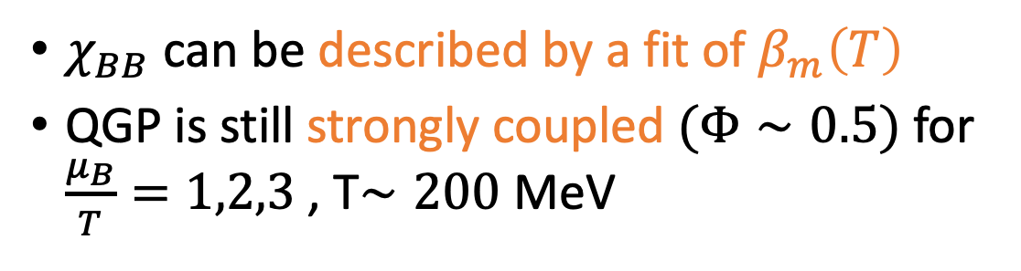
Susceptibility and pressure
$χ_{BB}$ can be described by a fit of $β_{m}\left(T\right)$
QGP is still strongly coupled $(Φ∼0.5)$for $\frac{μ_{B}}{T}=1,2,3$ , T$∼200$ MeV
Symbols - J. Noronha-Hostler, P. Parotto, C. Ratti, J.M. Stafford PRC 100 (2019)

Slide 15
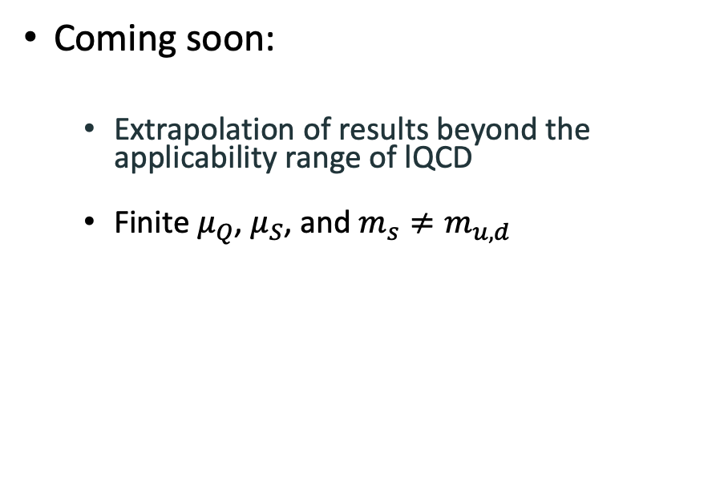
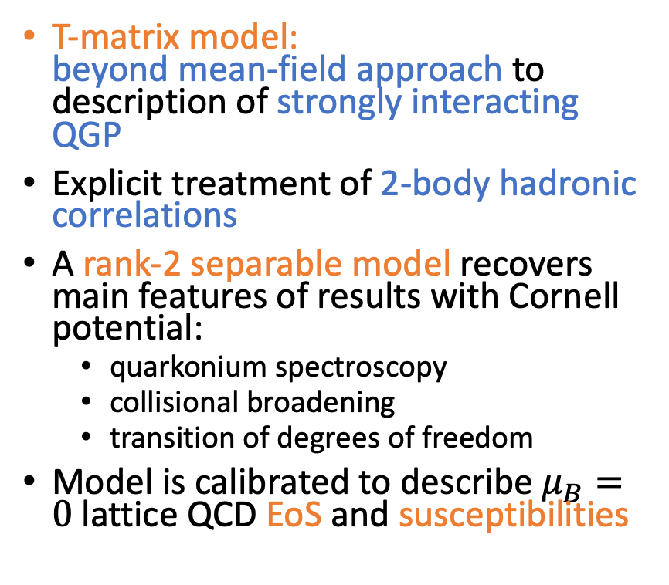
Summary
T-matrix model:
beyond mean-field approach to description of strongly interacting QGP
Explicit treatment of 2-body hadronic correlations
A rank-2 separable model recovers main features of results with Cornell potential:
  quarkonium spectroscopy
  collisional broadening
  transition of degrees of freedom
Model is calibrated to describe $μ_{B}=0$ lattice QCD EoS and susceptibilities
Coming soon:
  Extrapolation of results beyond the applicability range of lQCD
  Finite $μ_{Q}$, $μ_{S}$, and $m_{s}≠m_{u,d}$

