Slide 1
Thermal Effects in Binary Neutron Star Mergers
Jacob Fields
J. Fields, A. Prakash, M. Breschi, D. Radice, S. Bernuzzi, A. d. S. Schneider, ApJL 952, L36 (2023),
arXiv:2302.11359 [astro-ph.HE].

Slide 2
Outline
Context for Thermal Effects
Simulations and Results
Future Directions and Related Work

Slide 3
I. Context for Thermal Effects

Slide 4
Status of the nuclear equation of state
Some major sources of constraints:
Heavy-ion collisions
X-ray and radio observations of pulsars
GW observations of BNS inspirals and EM counterparts
Few constraints for hot matter at NS densities!
Capano et al., Nat. Astr. 4, 625-632 (2020).

Slide 5
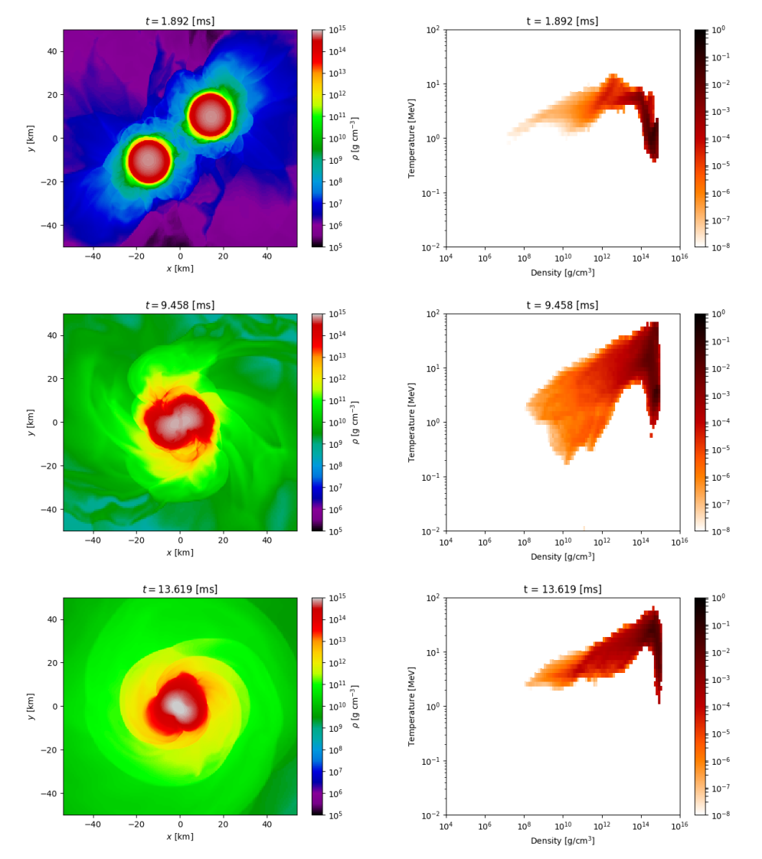
BNS Thermodynamics
$T_{F}∼50 MeV$
Early inspiral: $T≪T_{F}⇒T≈0$ is a valid approximation
Late inspiral: tidal forces heat up outer layers of star
Merger and postmerger: $T∼T_{F}$, thermal effects cannot be neglected!
A. Perego et al., Eur. Phys. J. A 55 , 124 (2019).
Notes:
If anyone asks, 50 MeV is a very rough OoM estimate based on an ideal non-relativistic Fermi gas: T_F = hbar^2/(2m)(3pi^2*n)^(2/3)

Slide 6
Question: Can we use BNS mergers to probe the finite-temperature EOS?

Slide 7
Separable EOS
Assume your EOS has the form
$$e_{B}\left(n,Y_{e},T\right)=e_{C}\left(n,Y_{e}\right)+e_{th}\left(n,Y_{e},T\right),$$
$$e_{th}\left(n,Y_{e},0\right)=0.$$
Assume that $e_{th}(n,Y_{e},T)$ is characterized by some set of parameters which do not affect $e_{C}(n,Y_{e})$.
Systematically alter parameters to get different behavior for $T>0$.

Slide 8
Option A: classic hybrid EOS
Cold component: zero-temperature table or piecewise-polytropic EOS
Hot component: ideal gas with effective thermal adiabatic index $Γ_{th}$
$$e_{B}\left(n,Y_{e},T\right)=e_{C}\left(n,Y_{e}\right)+\frac{T}{Γ_{th}−1}.$$

Slide 9
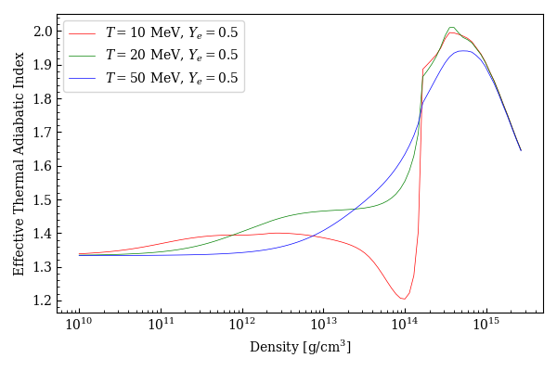
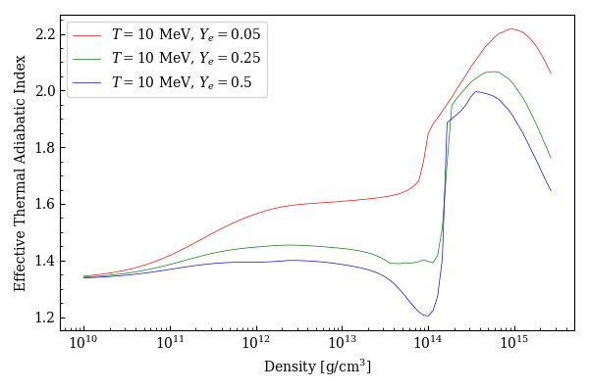
Problems with Hybrid EOS
Fixed $Γ_{th}$ is a lousy approximation
Composition dependence ($Y_{e}$) is overly simplified
No dependence at all for piecewise polytropes
Neutrino emissions, ejecta, etc. suspect at best

Slide 10
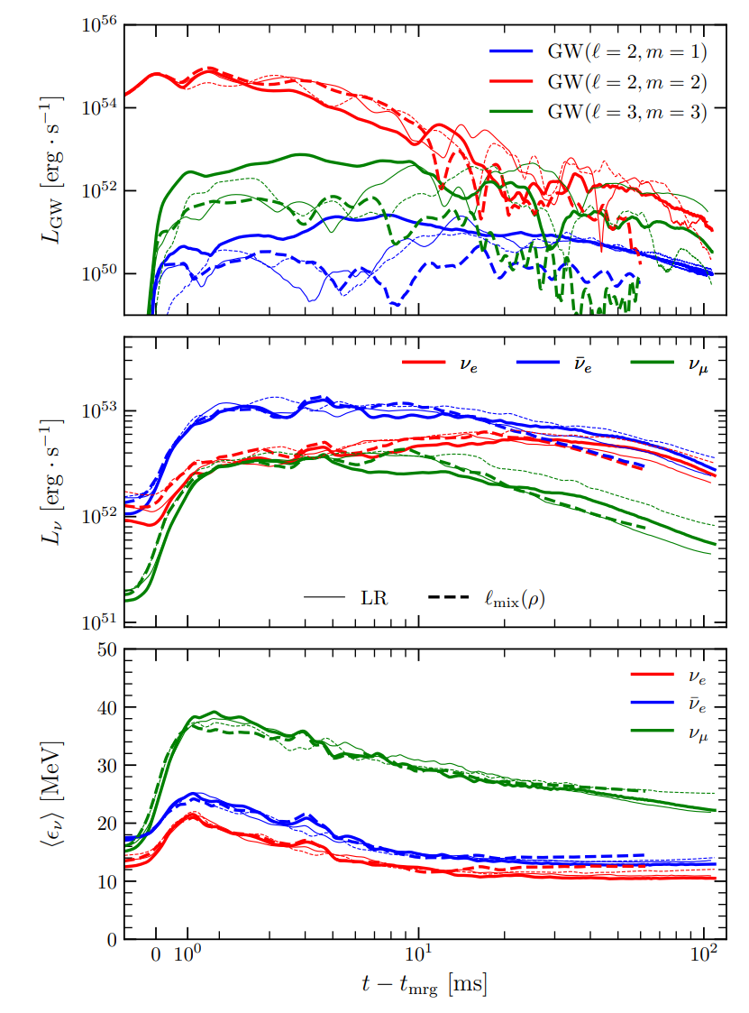
Neutrinos in BNS mergers
Neutrino cooling
Dominates over GW after $10−15 ms$ or so
Nucleosynthesis
Important for EM counterparts, origins of heavy elements, etc…
Emission rate highly sensitive to temperature
D. Radice and S. Bernuzzi, arXiv:2306.13709 [astro-ph.HE] (2023).
Notes:
Blackbody number density \propto T^3, energy \propto T^4

Slide 11
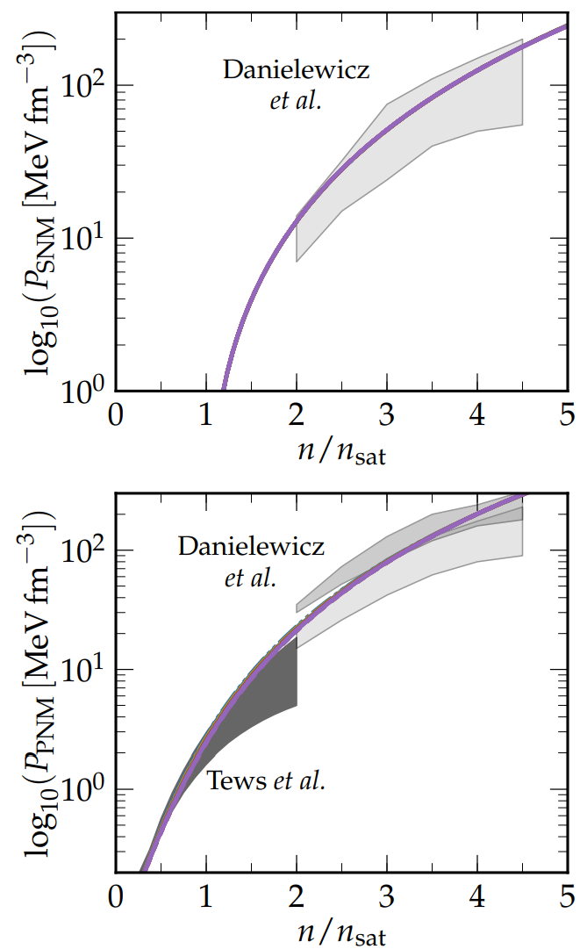
Option B: parameterized EOS
EOS w/ Skyrme-interaction of form
$$e_{B}\left(n,Y_{e},T\right)=e_{kin}\left(n,Y_{e},T\right)+e_{pot}\left(n,Y_{e}\right)$$
$e_{kin}(n,Y_{e},T)$ depends on effective nucleon masses $m_{n}^{∗}$ and $m_{p}^{∗}$
$c_{V}={\left(\frac{π}{3}\right)}^{\frac{2}{3}}\frac{T}{n}(n_{p}^{\frac{1}{3}}m_{p}^{∗}+n_{n}^{\frac{1}{3}}m_{n}^{∗})$
Can be parameterized by defining
$$m^{∗}≡m_{n}^{∗}\left(n=n_{sat},Y_{e}=1/2\right)$$
$m^{∗}$ effectively controls the specific heat capacity ➔ only affects thermal behavior
Schneider et al, PRC 100, 055802 (2019).

Slide 12
II. Simulations and Results

Slide 13
Simulations
Equal mass binaries with $m^{∗}/m_{n}∈\{0.55,0.75,0.95\}$
THC_M1
No magnetic fields
M1 neutrino transport
GRLES subgrid model

Slide 14
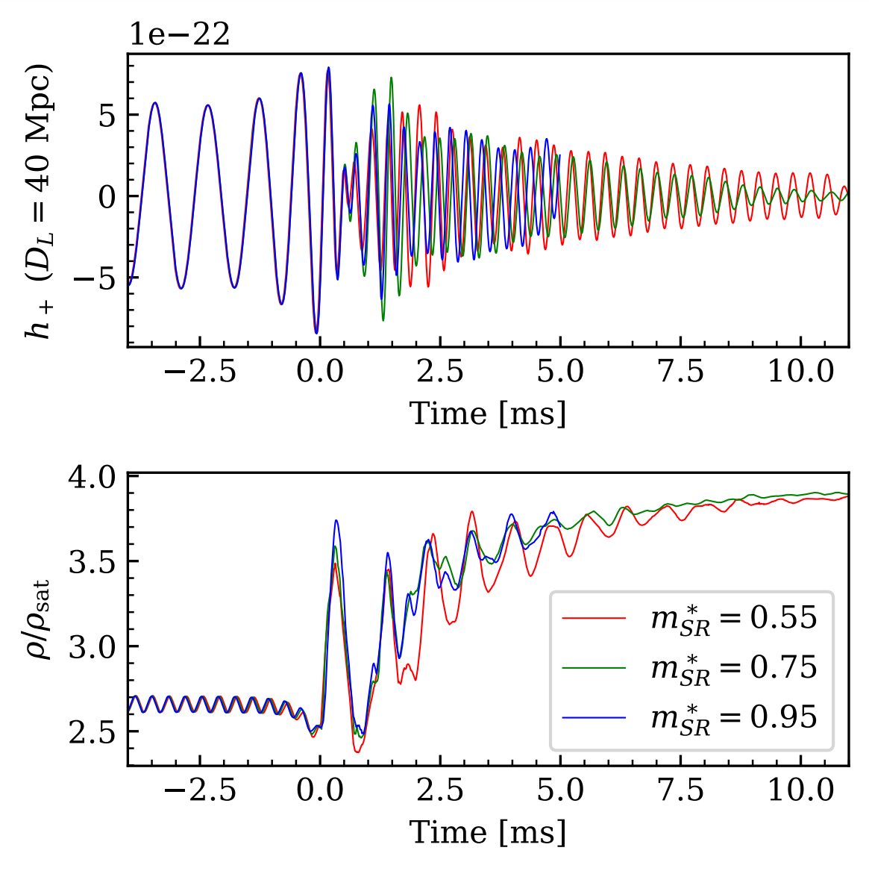
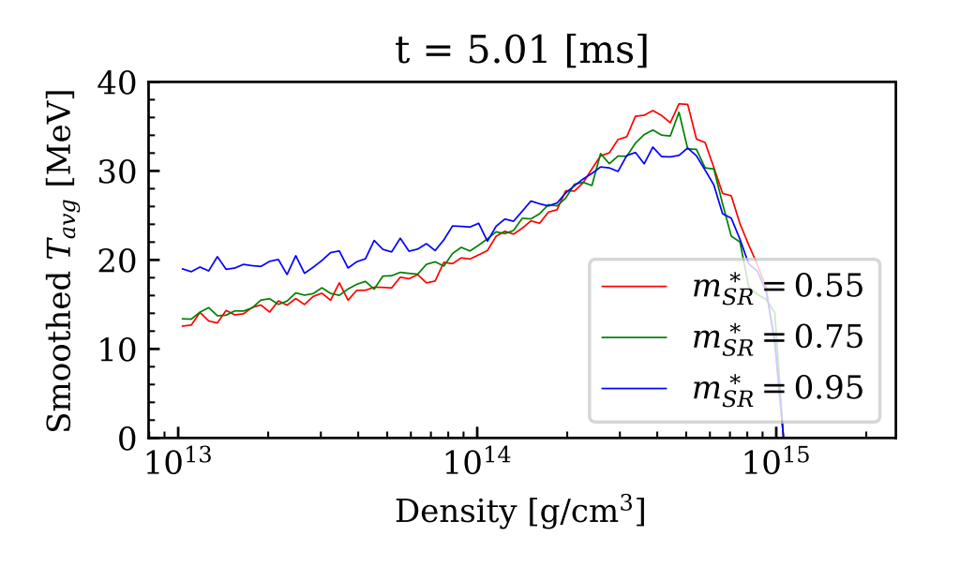
Results

Slide 15
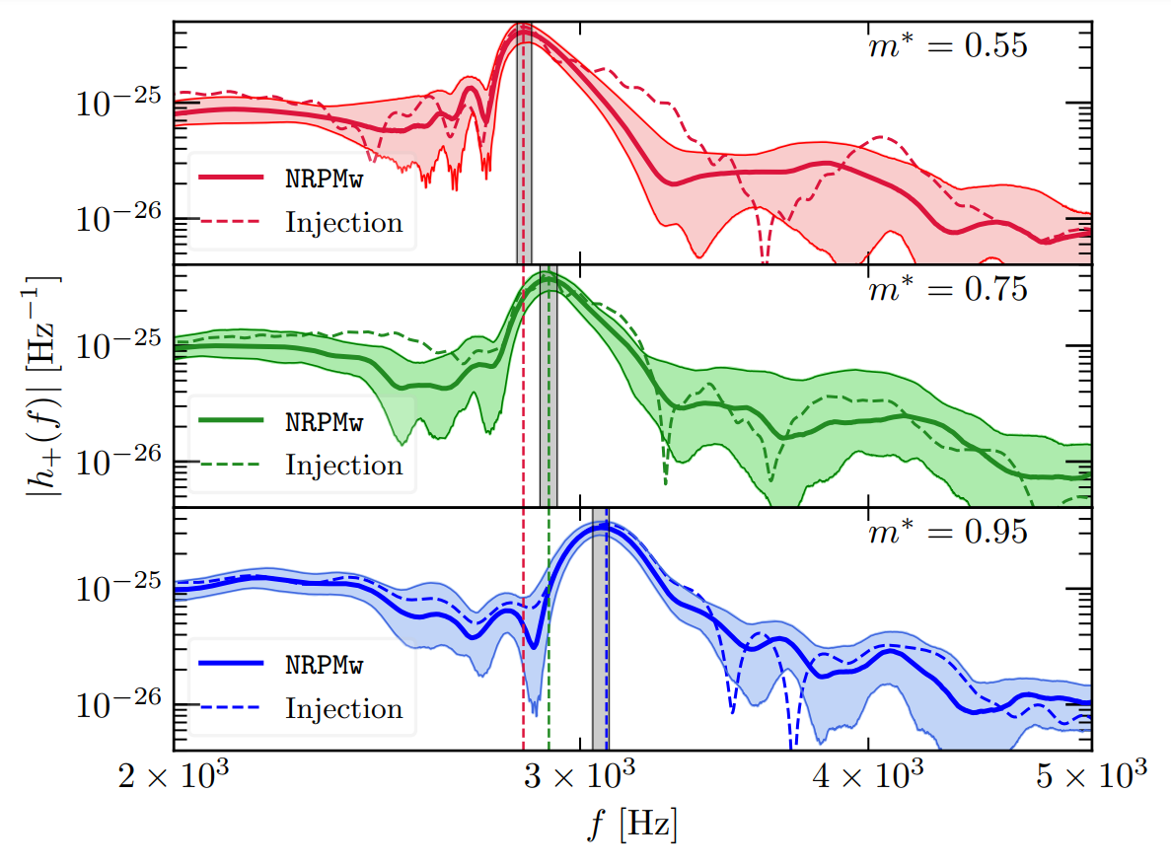
Observational signatures
Peak frequency ($f_{2}$) positively correlated with $m^{∗}$
Differences discernible at SNR 15 or less in next-gen detectors
Suggests $f_{2}$ contains valuable information about finite-T EOS

Slide 16
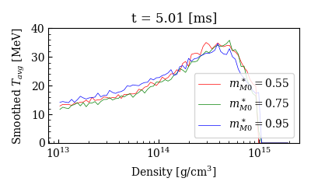
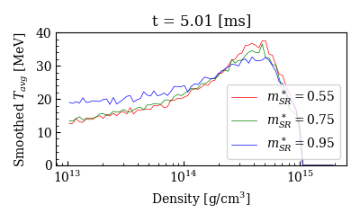
M1 vs. M0

Slide 17
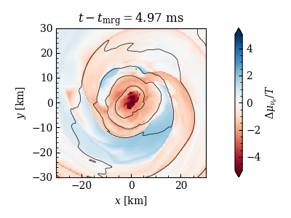
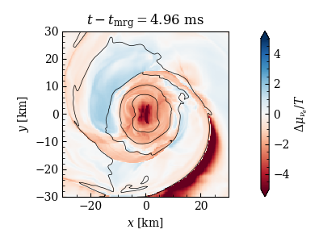
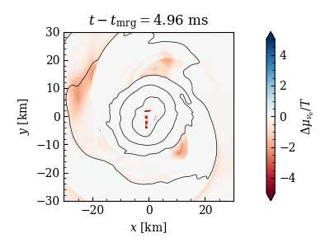
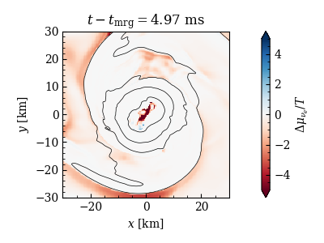
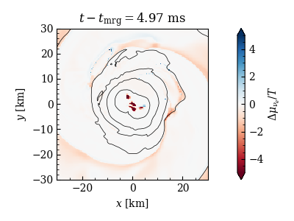
M1 vs. M0 (cont.)
M0
$$m^{∗}=0.55$$
$$m^{∗}=0.75$$
$$m^{∗}=0.95$$
M1

Slide 18
III. Future Directions and Related Work

Slide 19
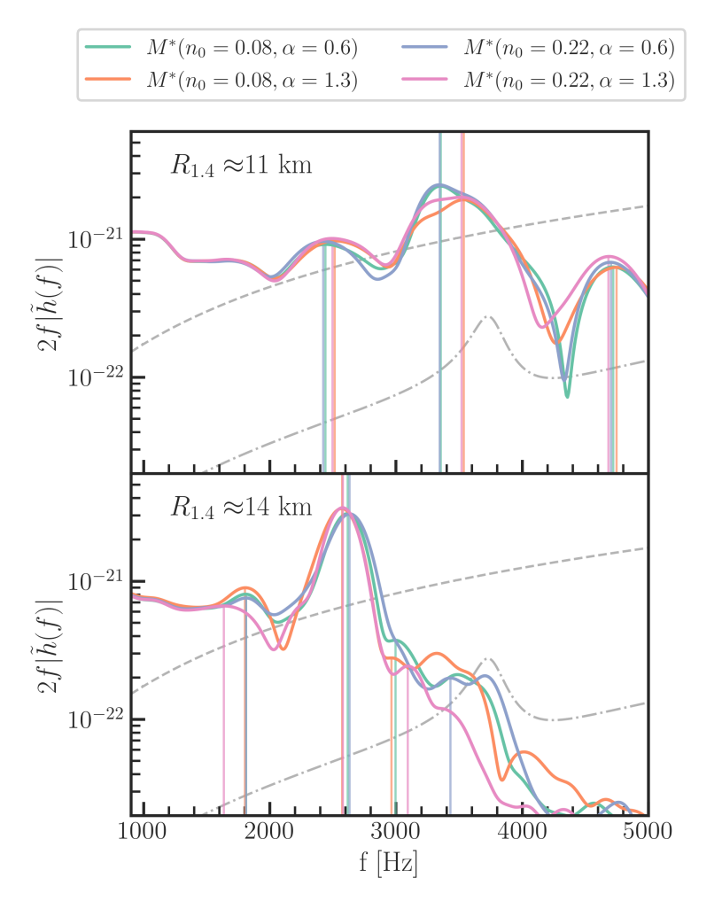
Alternate finite-T models
C. Raithel and V. Paschalidis, PRD 108 (2023) 8, 083029.
Behavior of $m^{∗}$ and specific heat not unique
Potentially much more complicated
Recent work from Raithel and Paschalidis (see PRD 108 (2023) 8, 083029; PRD 110 (2024) 4, 043002)
Hybrid EOS with more elaborate finite-T extension
Corroborate shifts from modifying effective mass; suggest effects easier to observe for stiffer EOS

Slide 20
Longer, higher-resolution simulations
Accurate ejecta analysis needs 10s of milliseconds
Collapse time, ejecta mass, disk formation, etc. strongly affected by resolution
Problem: M1 is expensive
Solution: better codes

Slide 21
AthenaK
GPU-capable
Order-of-magnitude speedup for GPUs vs. CPUs
>70% weak scaling efficiency at 65,536 GPUs
Octree block-based AMR
Full GRMHD
Microphysics
Tabulated EOS being tested
Neutrino transport in development
J. Fields et al, in prep.

Slide 22
Summary
Simulated BNS mergers with parameterized finite-temperature EOS and M1 neutrino transport
Higher $m^{∗}$ results in denser, colder cores
Effective mass $m^{∗}$ shows correlation with peak post-merger frequency
Models are distinguishable in future GW detectors at SNR 15
Lots of exciting directions for new research

