Slide 1

Three-dimensional imaging of free and bound nucleons
John Terry
Director’s Fellow Los Alamos National Lab
Based on
Echevarria, Kang, JT JHEP 01, 126 (2021)
Alrashed, Anderle, Kang, JT, Xing PRL 129, 242001
Alrashed, Kang, JT, Xing, Zhang 2312.09226
Ke, Shen, Shao, JT JHEP 05 (2024) 066
Gao, Kang, Shao, JT, Zhang JHEP 10 (2023) 013

Slide 2
Background

Slide 3
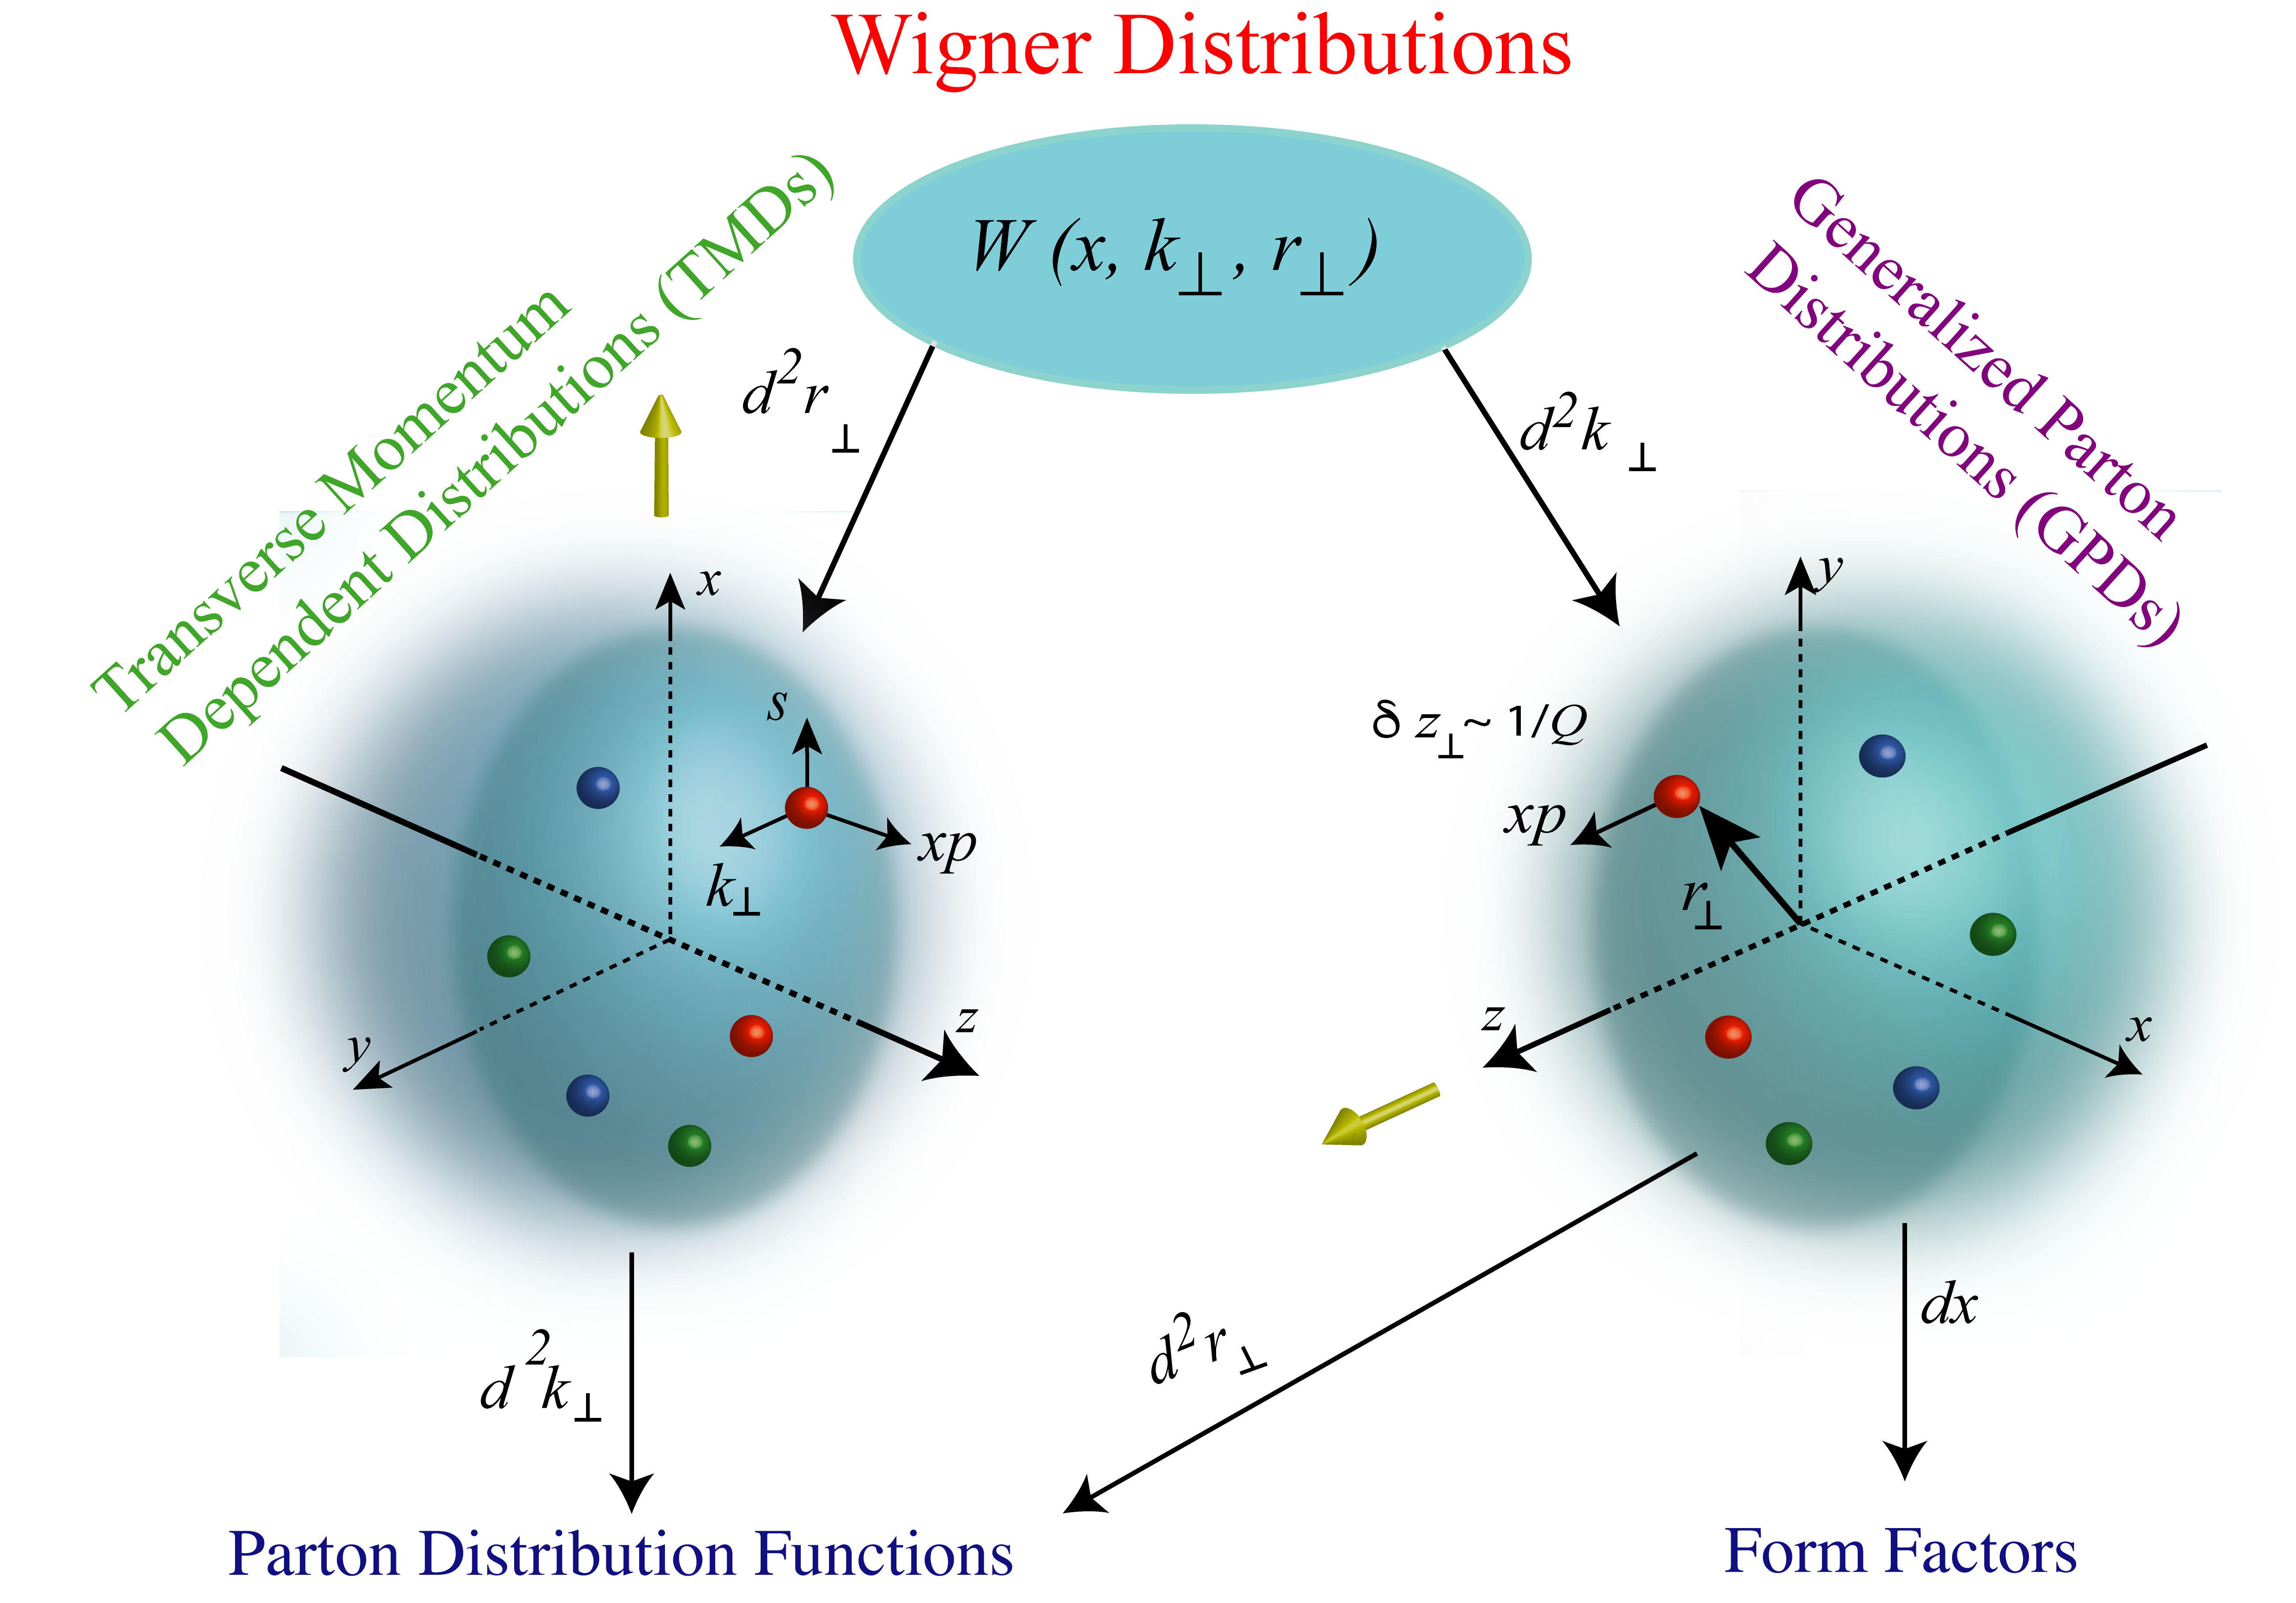
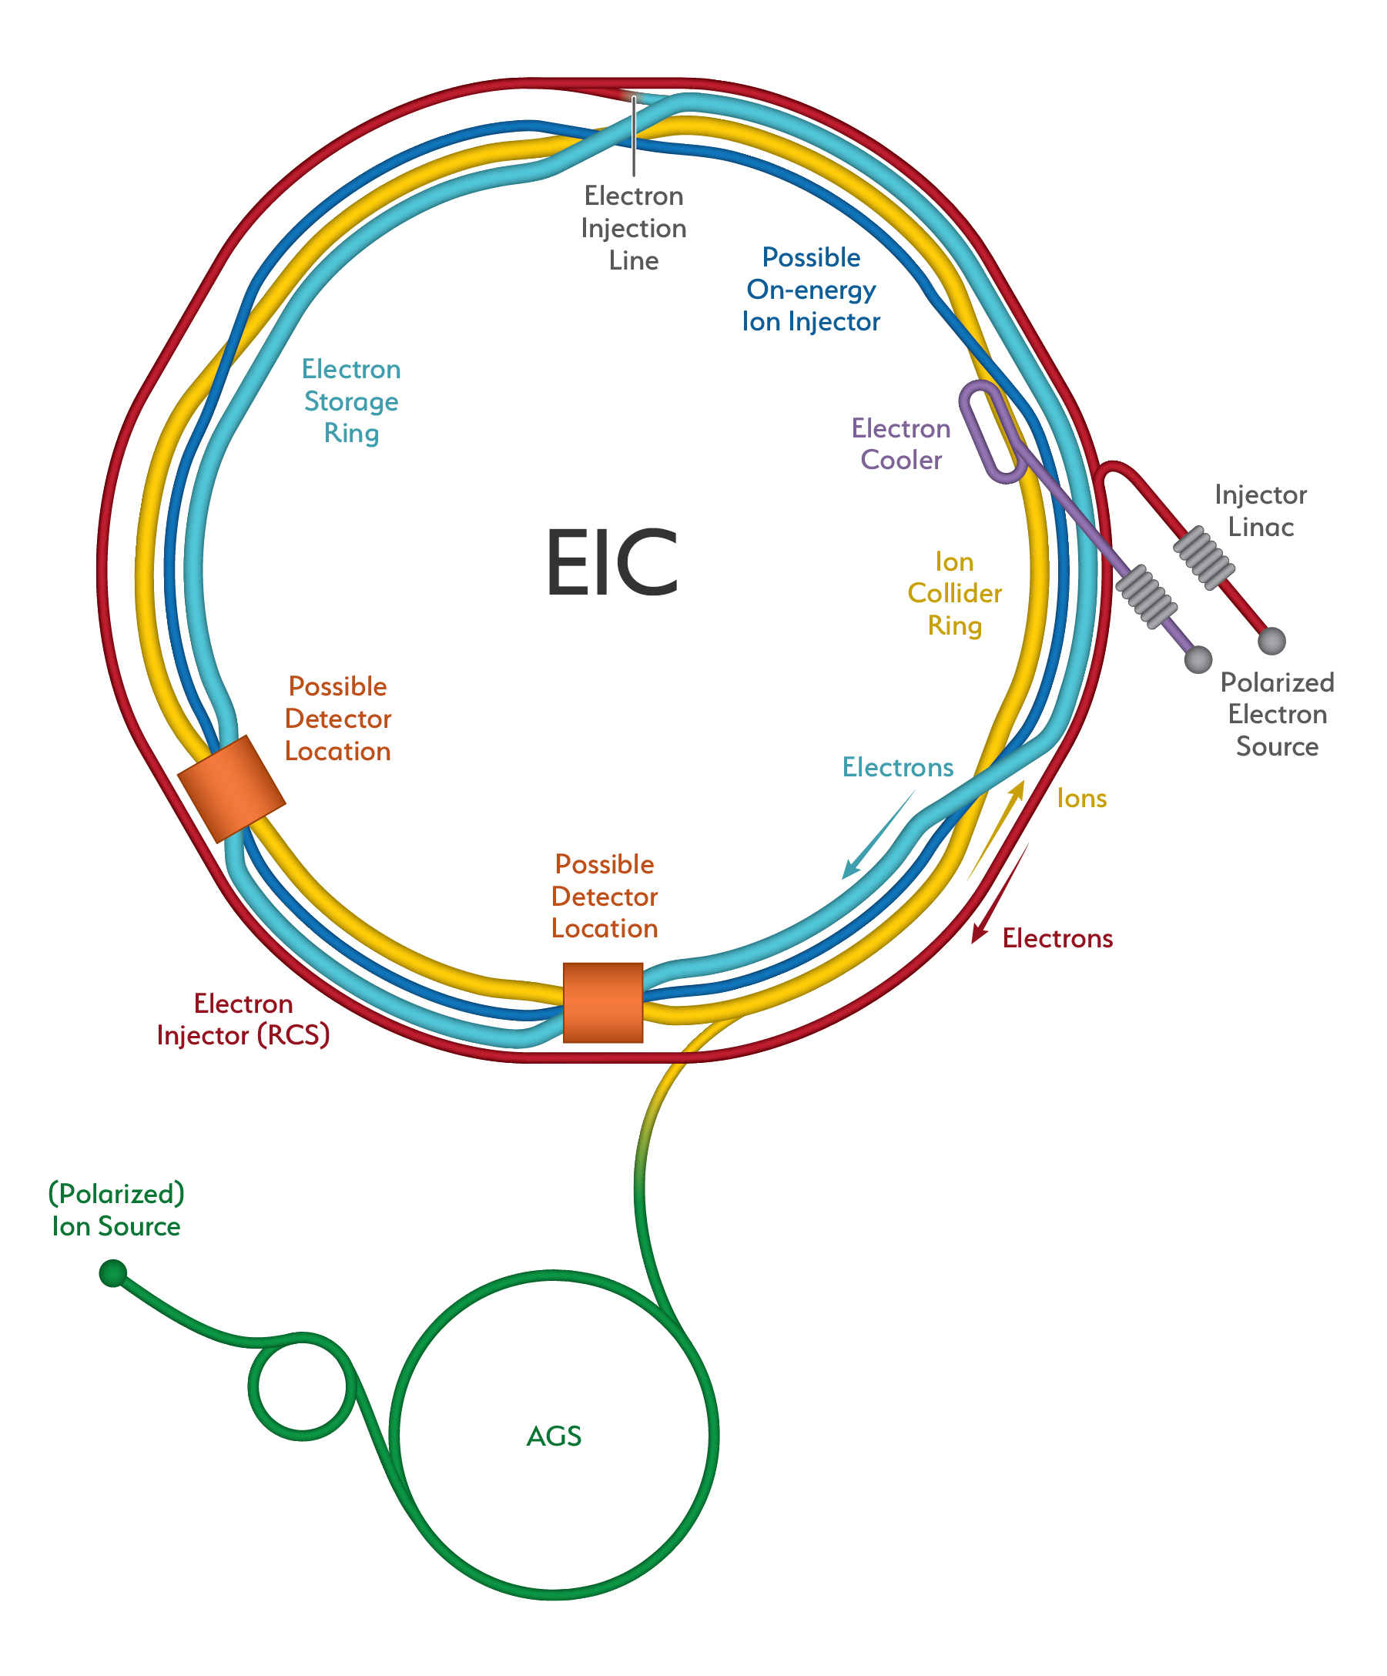
What can we do with the EIC?
Provide information for distributions of partons in hadrons
A new machine for a new frontier in nuclear physics
John Terry

Slide 4
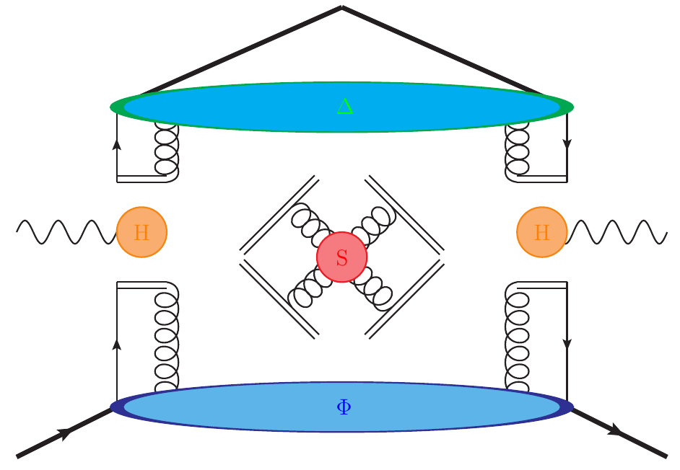
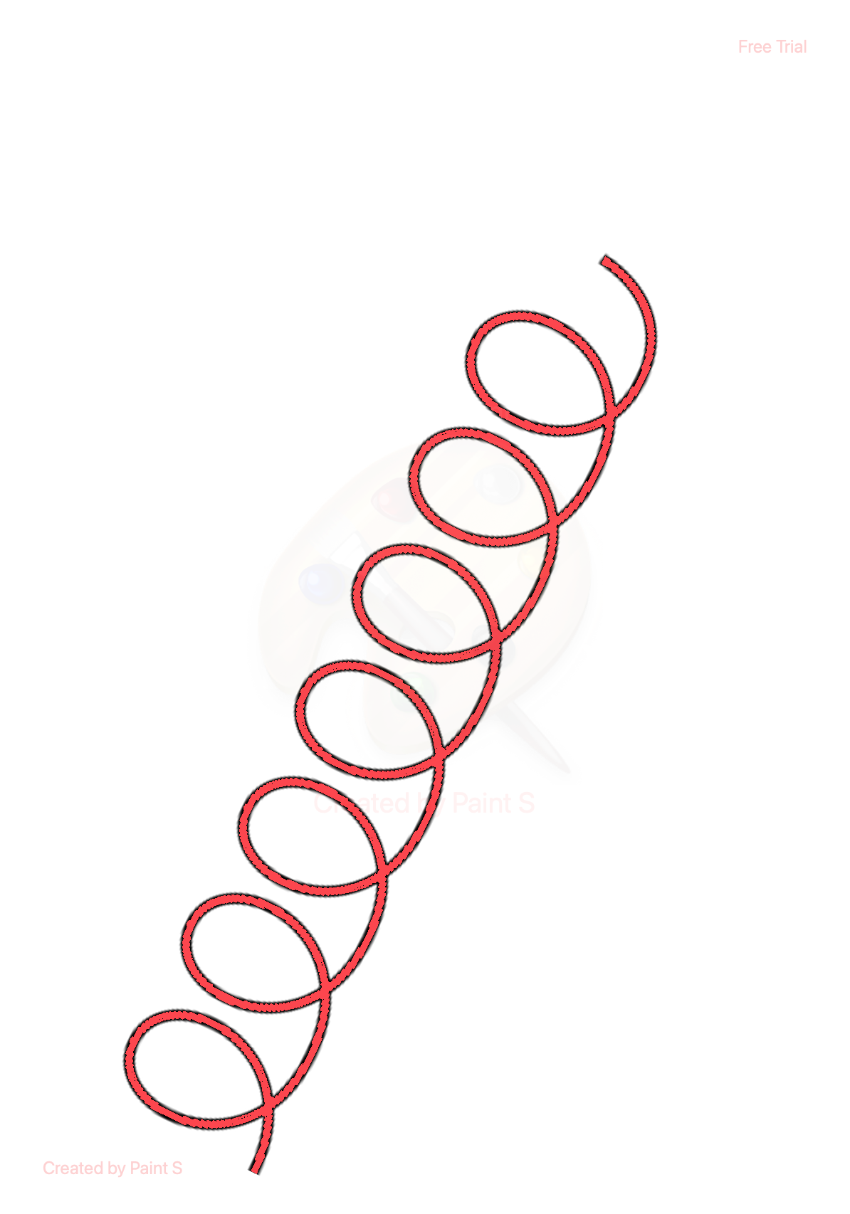
Factorization of physics at different scales
Factorization of the cross section in an OPE
TMD FF
Hard
Contains fixed order and large logs
Soft
Factorization of IR modes
TMD PDF
Matching coefficient contains fixed order and
large logs
Collinear PDF
John Terry

Slide 5
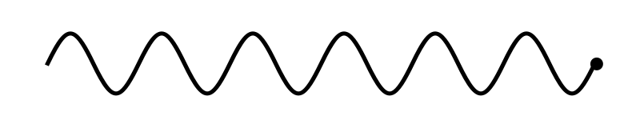
Perturbative background
Perturbative Sudakov: accounts for transverse momenta
generated from soft and collinear emissions
Experiments involve mixture of
Perturbative and non-perturbative
momentum
Perturbative momentum
Intrinsic/non-perturbative momentum
Anomalous dimensions
Obtain intrinsic momentum through a fit to data
John Terry

Slide 6
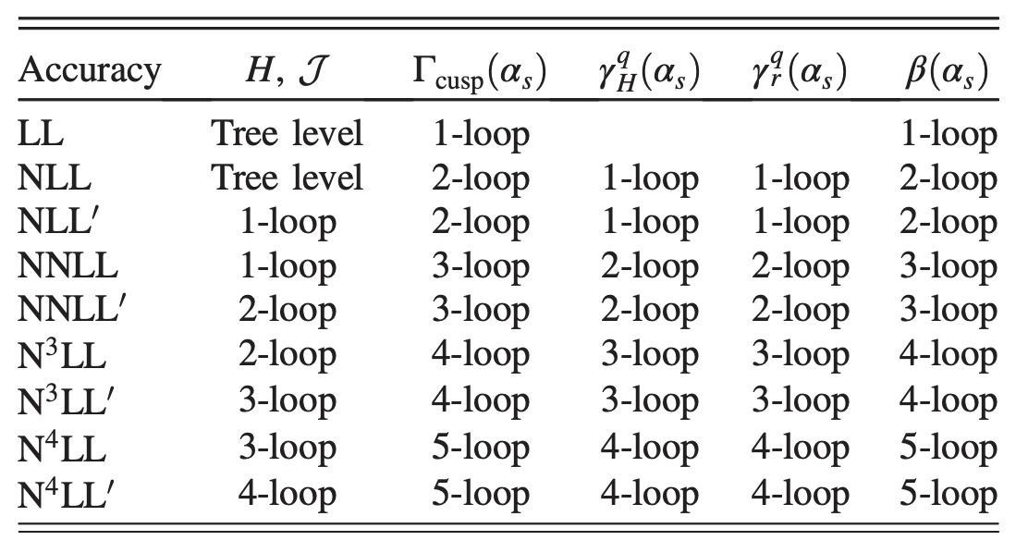
Available perturbative accuracy
Anomalous dimensions
Anomalous dimensions are almost known up to N⁴LL at this point (no 5-loop cusp)
Lee, Smirnov, and Smirnov (2010)
Gehrmann, Glover, Huber, Ikizlerli, and Studerus (2010)
Ebert, Mistlberger, Vita (2020)
Ebert, Mistlberger, Vita (2020)
Agarwal, von Manteuffel, Panzer, and Schabinger (2021)
Duhr, Mistlberger, Vita (2022)
Moult, Zhu, Zhu (2022)
Herzog, Moch, Ruijl, Ueda, Vermaseren, and Vogt (2019)
Baikov, Chetyrkin, and Kuhn (2017)
John Terry

Slide 7
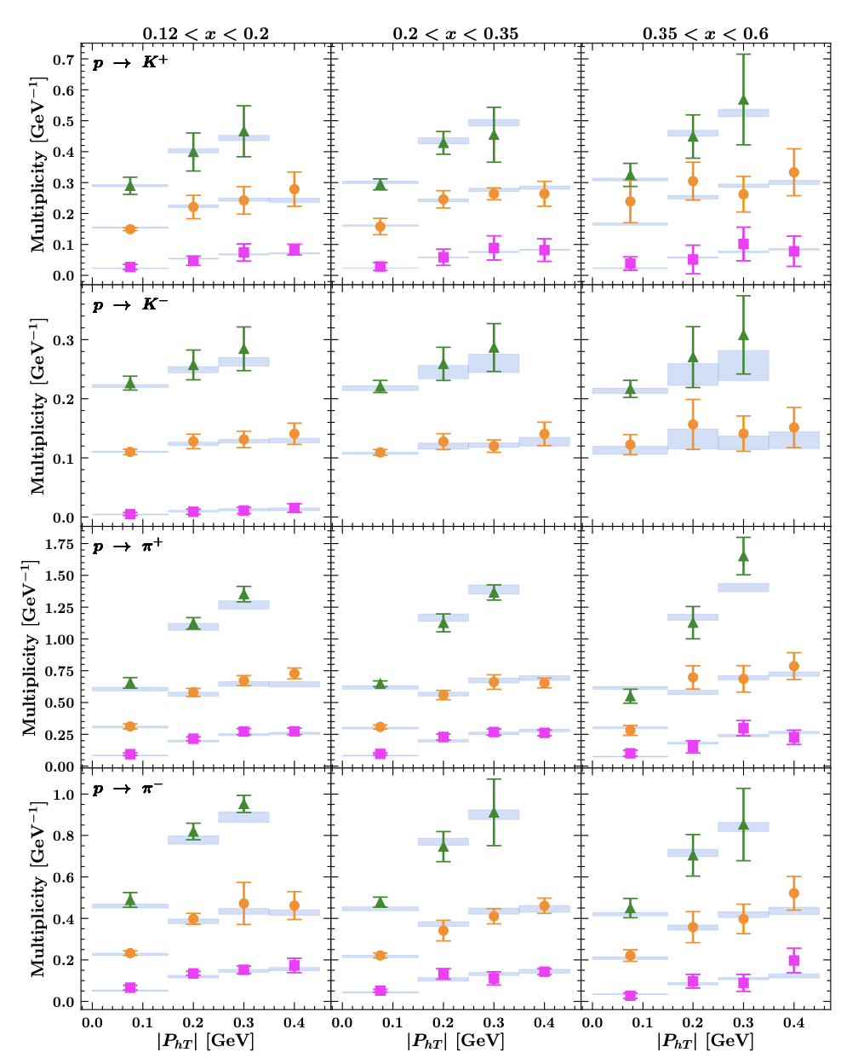
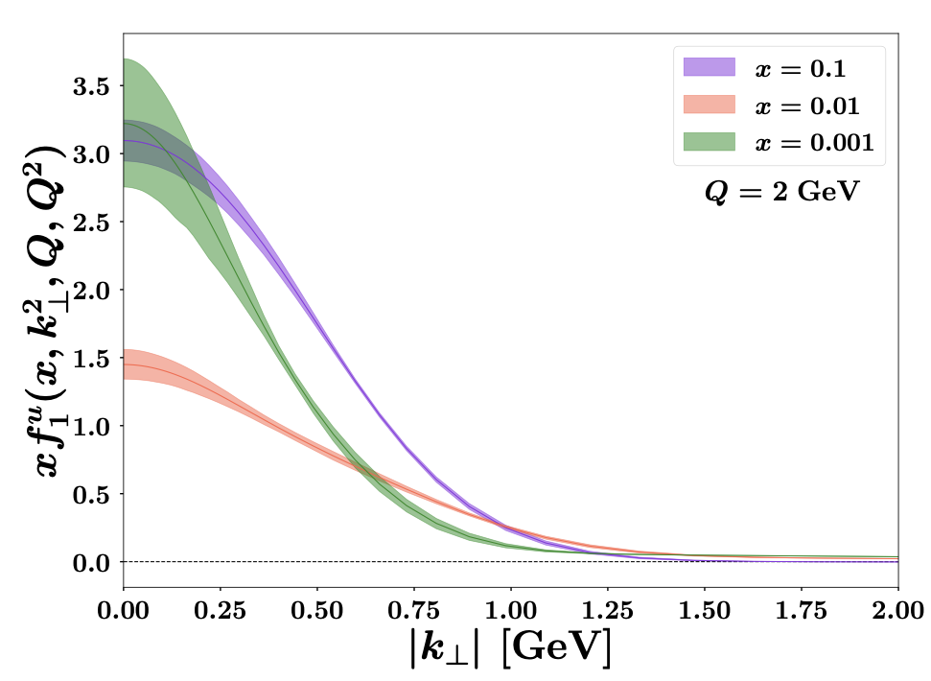
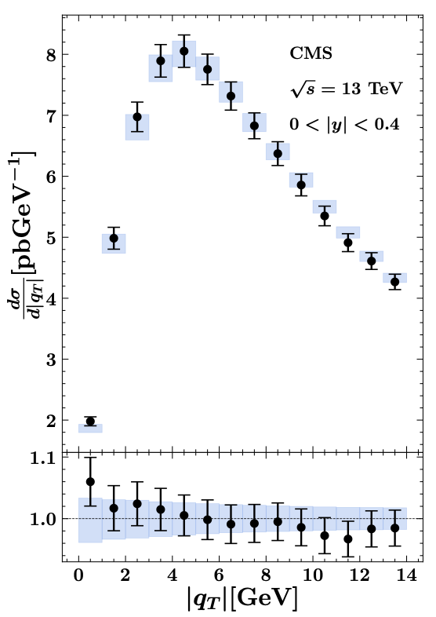
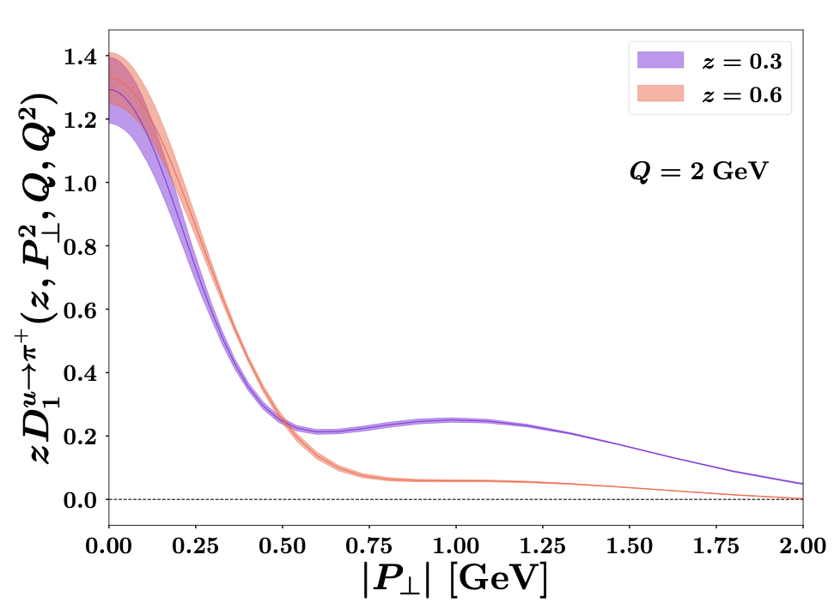
Map Collaboration
Extraction at NNLO+N³LL, SIDIS+DY
Hermes multiplicity data
CMS distribution
TMDs

Slide 8
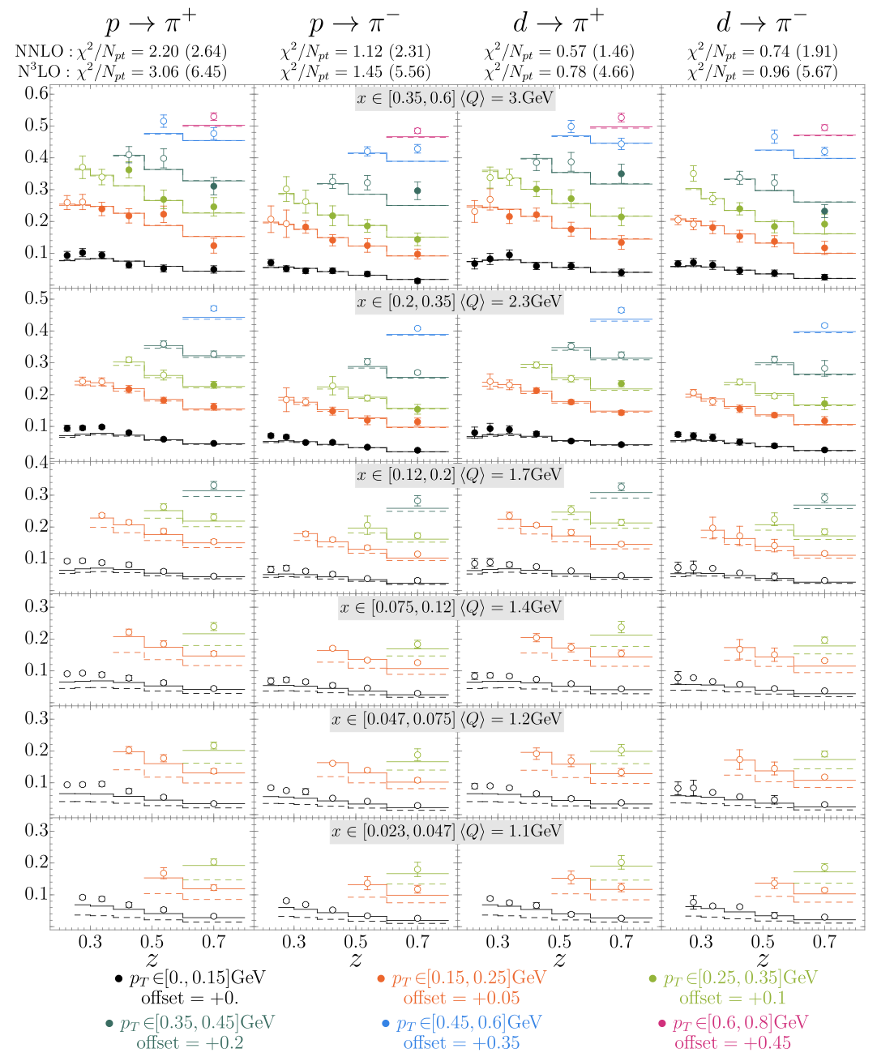
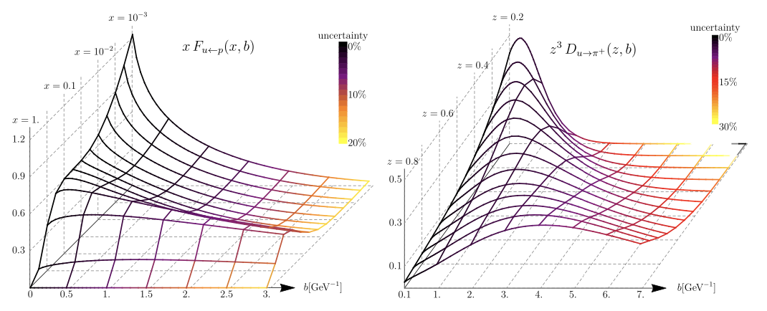
Artemides
Extraction obtained at NNLO+N³LL, SIDIS+DY
Hermes Multiplicity data
TMD PDF
TMD FF

Slide 9
How do polarization effects alter the structure of hadrons?

Slide 10
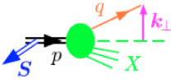
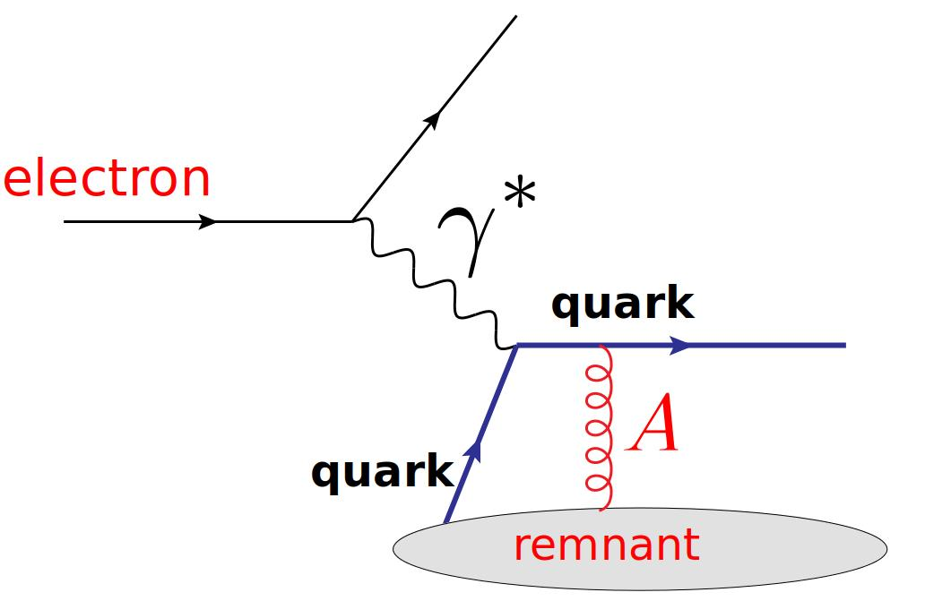
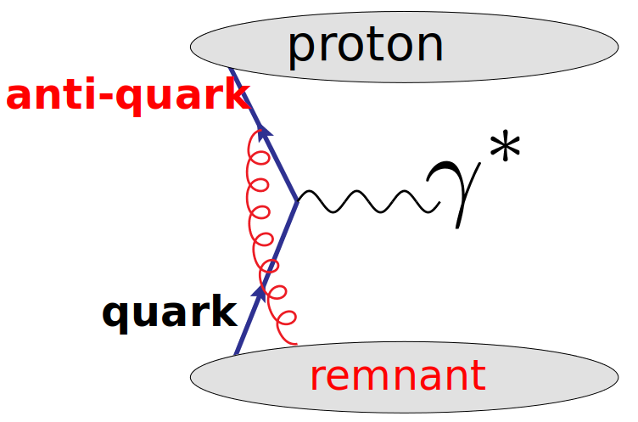
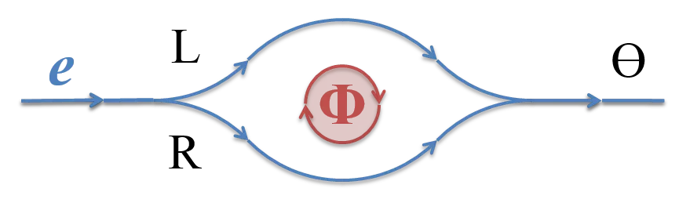
Intro to the Sivers effect
Anomalous dimensions
The Sivers function is process dependent
This long-range correlation is similar to the Aharanov-Bohm effect

Slide 11
Factorization and resummation
Differential cross section for Semi-Inclusive DIS is given by
Hard
TMD PDF
TMD FF
Hard
Sivers function
TMD FF
TMDs can be matched onto the collinear distributions
Perturbative
Non-perturbative
Large logarithms are are resumed to all orders in the perturbative Sudakov
John Terry
8/39

Slide 12
Matching of the Sivers function
Differential cross section for Semi-Inclusive DIS is given by
Hard
Sivers function
TMD FF
TMDs can be matched onto the collinear distributions
Same as the unpolarized
Transverse momentum dependence
Collinear dependence
11 params in total
John Terry
9/39

Slide 13
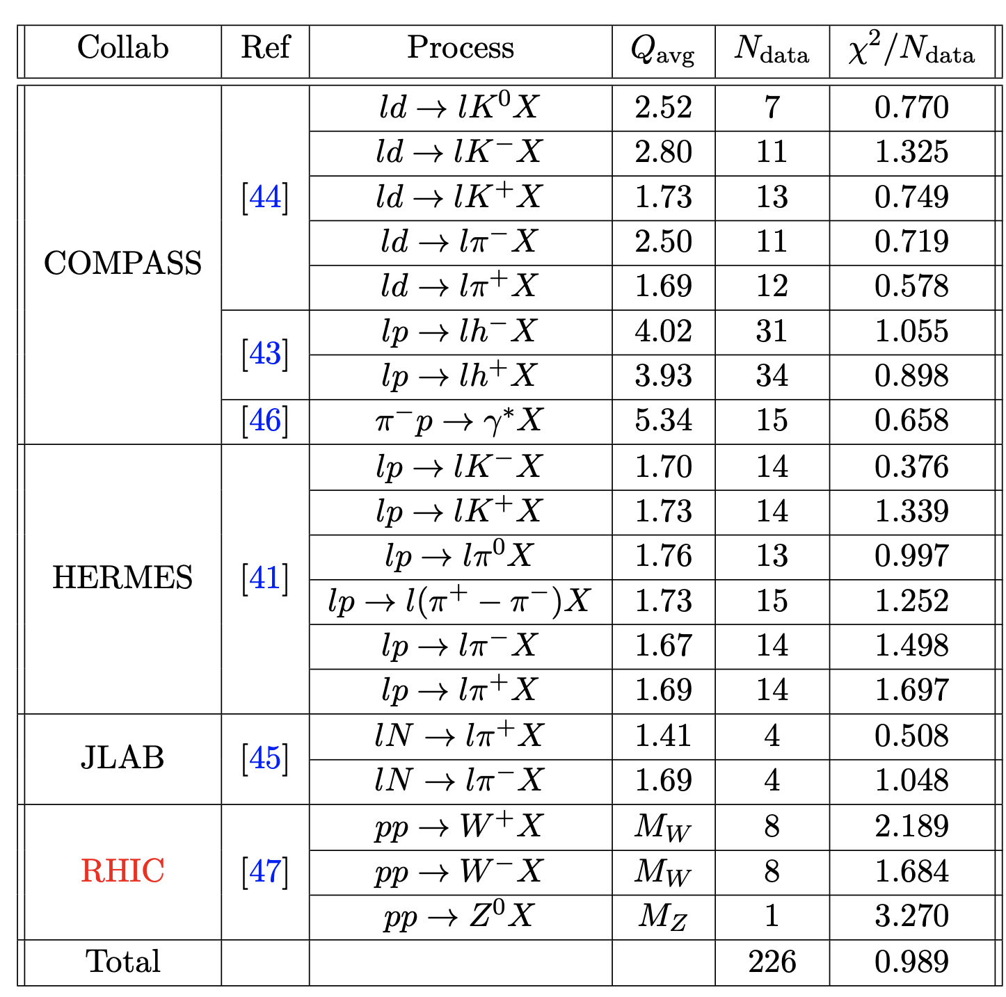
Data description
John Terry
10/39

Slide 14
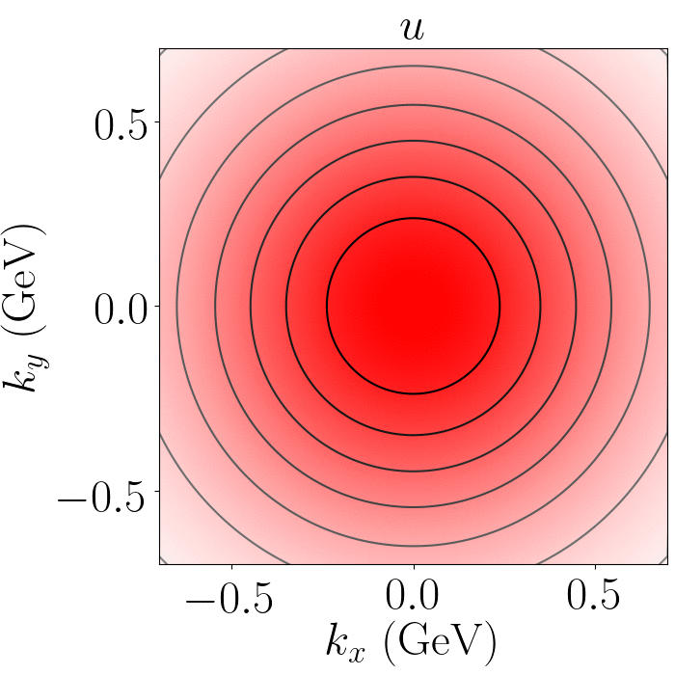
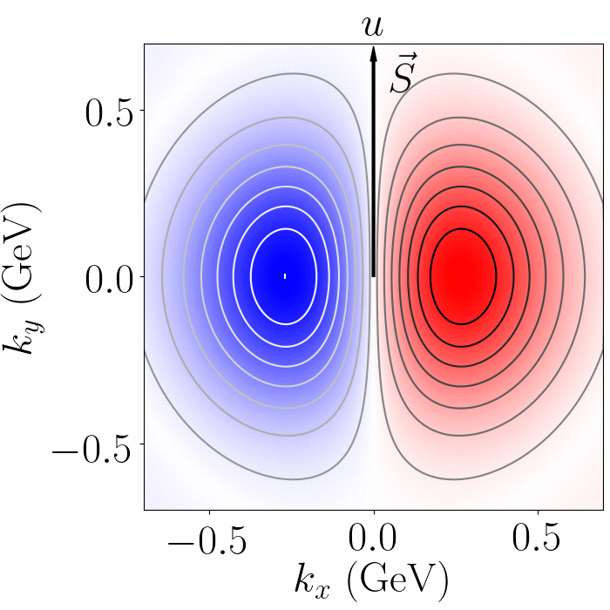
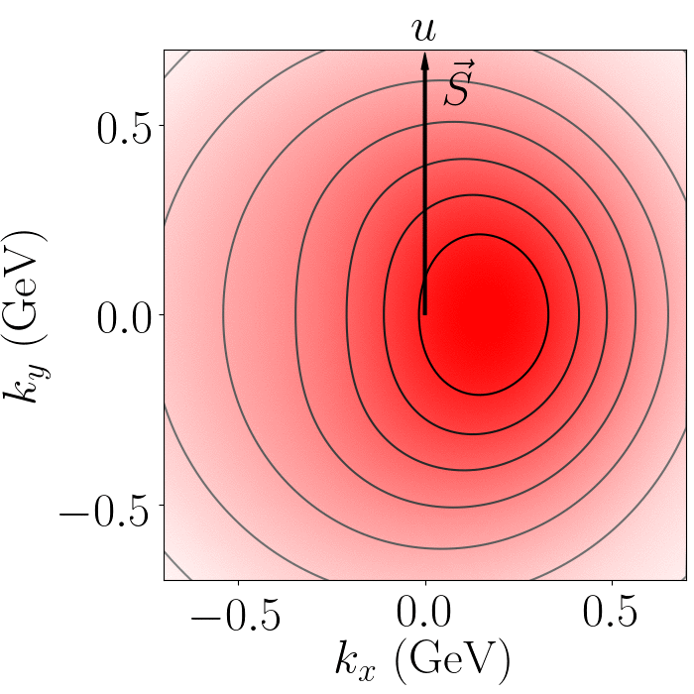

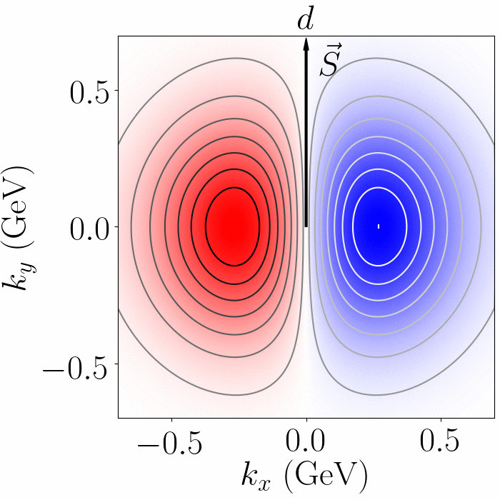
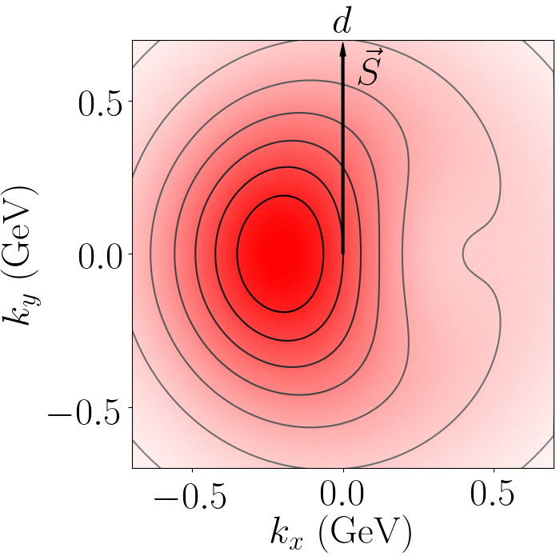
Results
John Terry
11/39

Slide 15
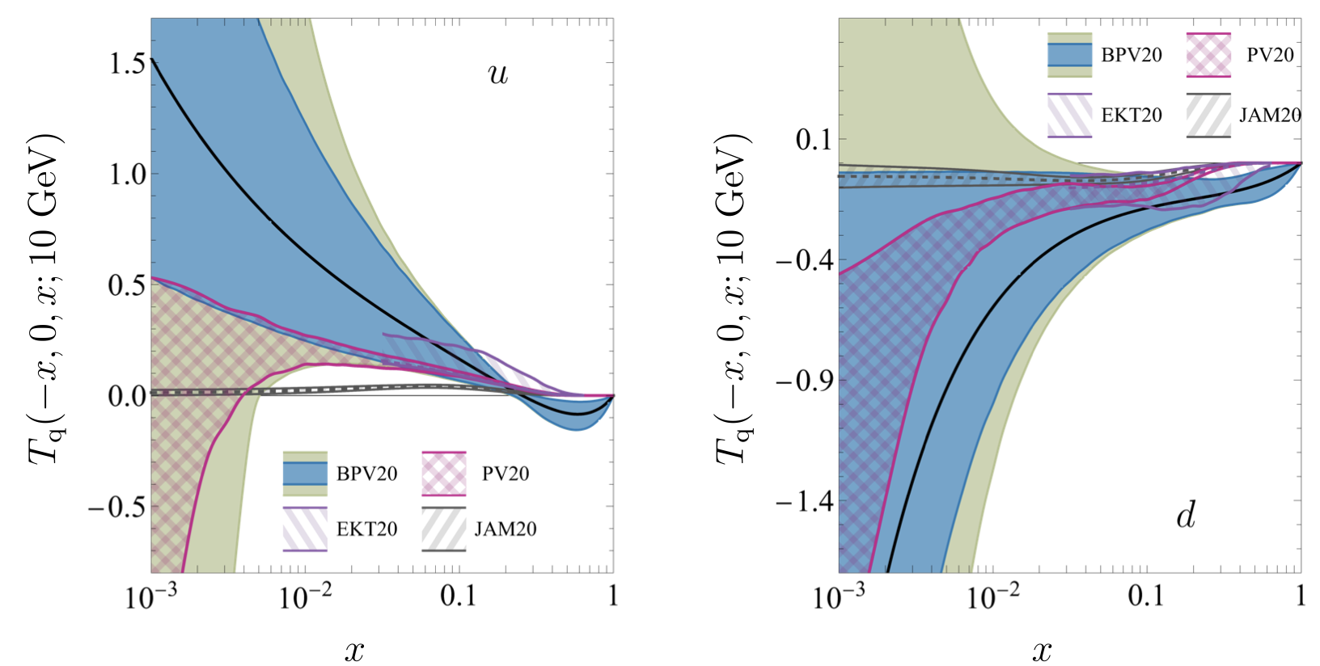
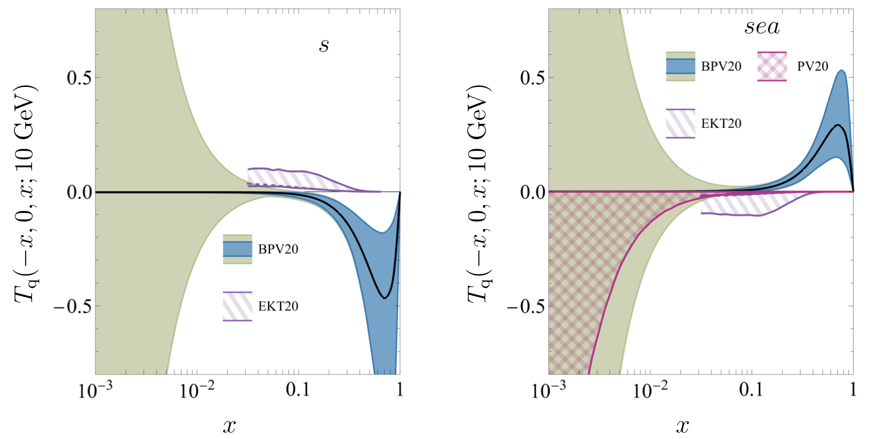
Controversies
Comparison of different extractions shows a large difference
New preliminary RHIC measurement is much smaller than previous one
John Terry
12/39

Slide 16
Structure of nuclear matter

Slide 17
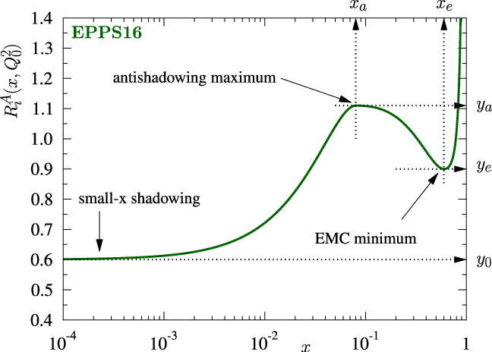
Nuclear modifications to collinear PDFs
Nuclear medium modification via higher twist
Power suppressed by
Nuclear enhancement
LP TMD factorization cannot address how multiple partons are correlated with one another
Eskola, Kolhinen, Ruuskanen (1998)
Eskola, Paakkinen, Paukkunen, Salgado (2017)
John Terry

Slide 18
Method of treating nuclear modifications
Nuclear medium modification via higher twist
LP TMD factorization cannot address how multiple partons are correlated with one another
Eskola, Kolhinen, Ruuskanen (1998)
Eskola, Paakkinen, Paukkunen, Salgado (2017)
Nuclear modifications are absorbed into the non-perturbative parameterization.
John Terry

Slide 19
Effective treatment of medium modifications
Ejected quark undergoes multiple scattering in the nuclear medium, modifies the fragmentation functions
D. de Florian and R. Sassot (2004)
Zurita (2021)
Simultaneous extraction from hadroproduction in p-A collisions from PHENIX and STAR, and Semi-Inclusive DIS (collinear)
from HERMES
Abelev et al. (STAR) (2010)
Adams et al. (STAR) (2006)
Adare et al. (2013)
Airapetian et al. (HERMES) (2007)
John Terry

Slide 20
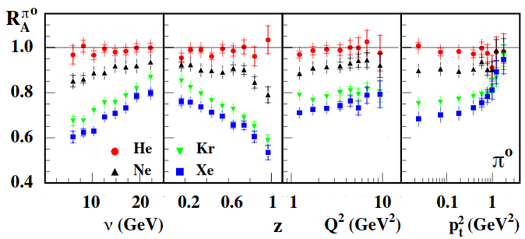
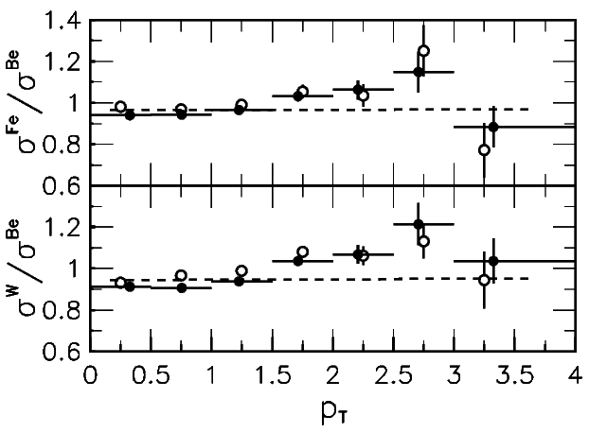
Effective treatment of the transverse momentum broadening
Interaction between partons and interact with the nuclear medium via Glauber exchange
Intrinsic
Medium
Perturbative
Effective intrinsic
John Terry
16/39

Slide 21
Available data
Semi-Inclusive DIS for e-A collisions
Drell-Yan production in p-A collusions
Kinematic coverage of the data
Multiplicity ratio
Cross section and cross section ratio
for p-A collisions
Airapetian et al. (HERMES), Nucl. Phys. B 780, 1 (2007)
Dudek et al., Eur. Phys. J. A 48, 187 (2012)
Burkert, in CLAS 12 RICH Detector Workshop (2008)
Alde et al., Phys. Rev. Lett. 64, 2479 (1990)
Vasilev et al. (NuSea), Phys. Rev. Lett. 83, 2304 (1999)
Leung (PHENIX), PoS HardProbes2018, 160 (2018)
Khachatryan et al. (CMS), Phys. Lett. B 759, 36 (2016)
Aad et al. (ATLAS), Phys. Rev. C 92, 044915 (2015)
SIDIS cross section
E772: A = C; B = D
DIS cross section
E866: A = Fe, W; B = Be
RHIC: A = Au; B = p
HERMES ratio for A = He, Ne, Kr, Xe
h =
ATLAS, CMS: distribution p-Pb
Jefferson Lab ratio for A = C, Fe, Pb
h =
John Terry
17/39

Slide 22
Available perturbative accuracy
Anomalous dimensions
Anomalous dimensions are almost known up to N⁴LL at this point (no 5-loop cusp)
Lee, Smirnov, and Smirnov (2010)
Gehrmann, Glover, Huber, Ikizlerli, and Studerus (2010)
Ebert, Mistlberger, Vita (2020)
Ebert, Mistlberger, Vita (2020)
Agarwal, von Manteuffel, Panzer, and Schabinger (2021)
Duhr, Mistlberger, Vita (2022)
Moult, Zhu, Zhu (2022)
Herzog, Moch, Ruijl, Ueda, Vermaseren, and Vogt (2019)
Baikov, Chetyrkin, and Kuhn (2017)
John Terry

Slide 23
Factorization and resummation in the medium
Differential cross section for Semi-Inclusive DIS is given by
Hard
nTMD PDF
nTMD FF
TMDs can be matched onto the collinear distributions
Perturbative
Non-perturbative
Large logarithms are are resumed to all orders in the perturbative Sudakov
John Terry
19/39

Slide 24
Non-perturbative treatment
Non-perturbative contributions given by
EPPS21
In house FF (new), previous analysis used LIKEn
Non-perturbative Sudakov given by
Parameterization for the medium modified fragmentation
John Terry
20/39

Slide 25
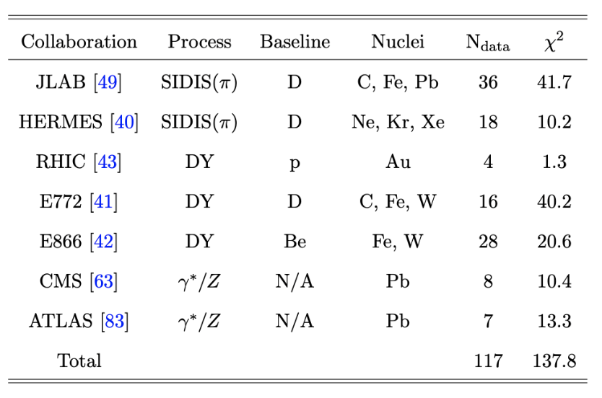
Description of the experimental data
HERMES
JLab
LHC
John Terry

Slide 26
Three-dimensional images
Ratios defined for nPDF and nFF
John Terry
22/39

Slide 27
Di-jet decorrelations in pp
Azimuthal angle decorrelations of di-jets measured at the CMS, are sensitive to nTMDs
Back-to-back region is sensitive to the 1+1 dimensional TMDs
CMS Measurements in pp and pA collisions
Phys.Rev.Lett.106:122003,2011
Eur. Phys. J. C 74 (2014) 2951
Phys. Rev. Lett. 121, 062002 (2018)
John Terry
23/39

Slide 28
Di-jet decorrelations in pp continued
Additional measurements of the integrated azimuthal angle decorrelation
Integration in region performed using a collinear approximation. However, there are issues with this approach
as due to large logarithms.
John Terry
24/39

Slide 29
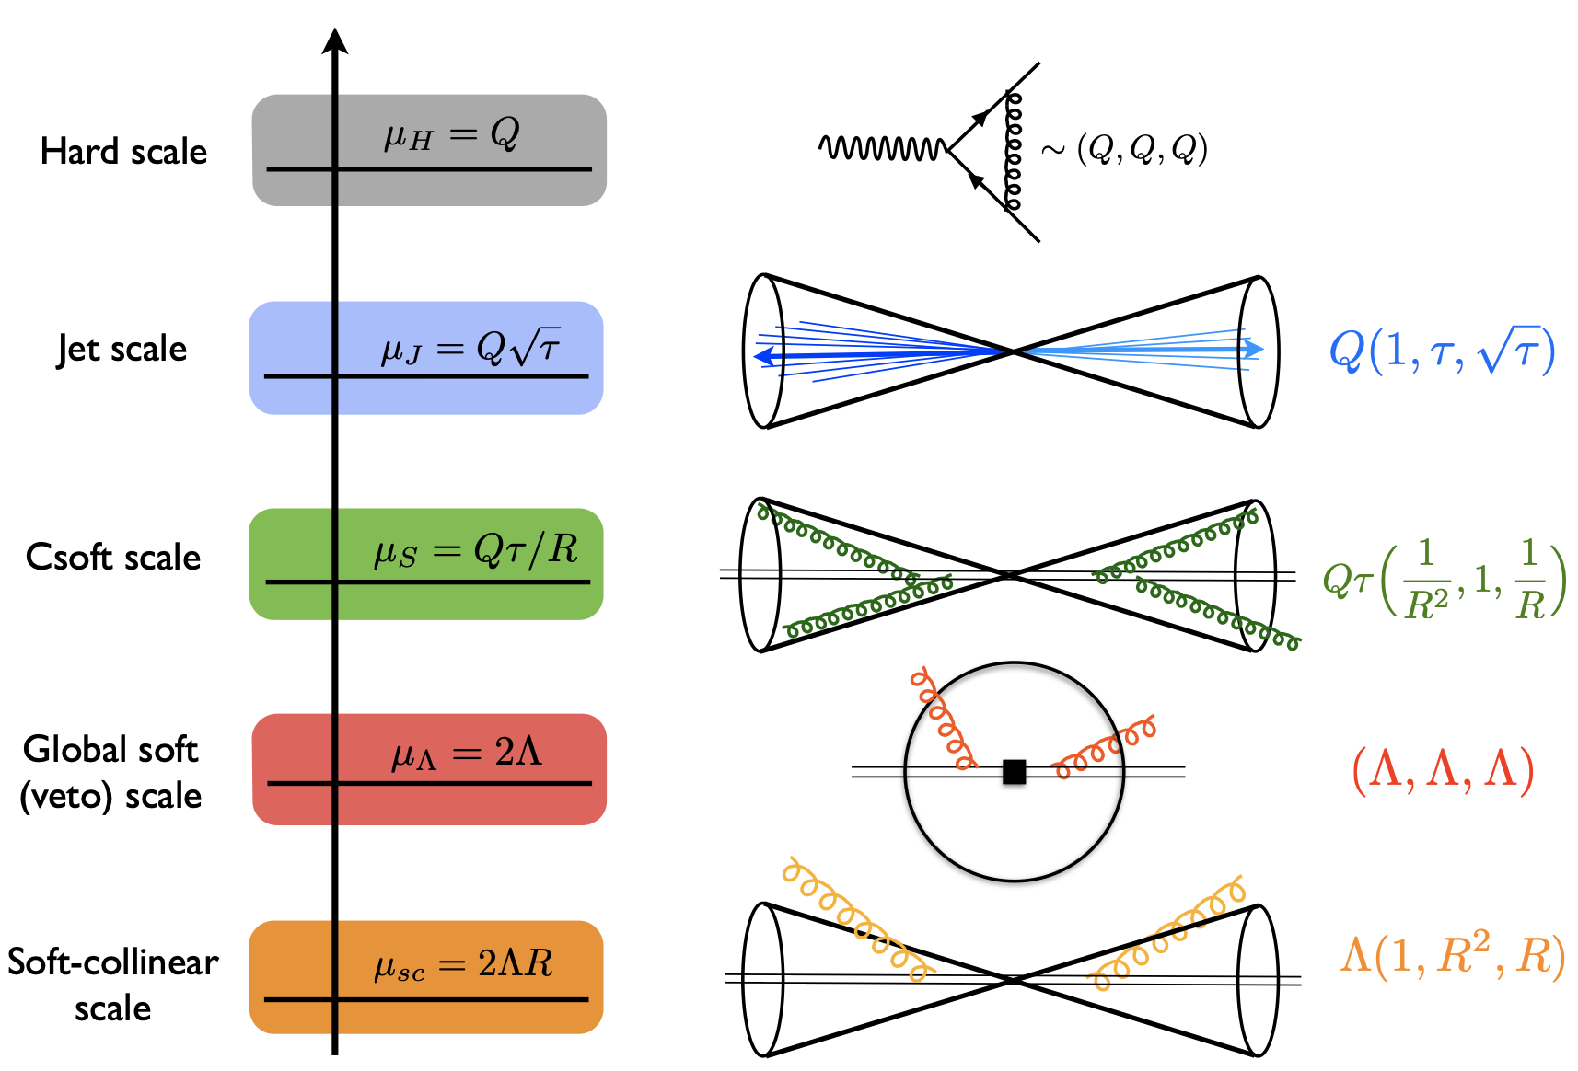
QCD modes in SCET
SCET is an EFT which captures soft and collinear emissions along the directions
Bauer, Fleming, Luke 2000
Bauer, Fleming, Pirjol, Stewart 2001
Bauer, Stewart 2001
Bauer, Pirjol, Stewart 2002
Beneke, Chapovsky, Diehl, Feldmann 2002
Beneke, Feldmann 2003
Hill, Neubert 2003
Echevarria, Idilbi, Scimemi 2011
Chien, Hornig, Lee 2015
John Terry

Slide 30
Factorization in SCET
Azimuthal angle decorrelations of di-jets measured at the CMS, are sensitive to nTMDs
Factorization and resummation derived in a SCET framework
John Terry
26/39

Slide 31
Factorization in SCET
Azimuthal angle decorrelations of di-jets measured at the CMS, are sensitive to nTMDs
Factorization and resummation derived in a SCET framework
John Terry
26/39

Slide 32
Factorization in SCET
Azimuthal angle decorrelations of di-jets measured at the CMS, are sensitive to nTMDs
Factorization and resummation derived in a SCET framework
John Terry
26/39

Slide 33
Factorization in SCET
Azimuthal angle decorrelations of di-jets measured at the CMS, are sensitive to nTMDs
Factorization and resummation derived in a SCET framework
John Terry
26/39

Slide 34
Factorization in SCET
Azimuthal angle decorrelations of di-jets measured at the CMS, are sensitive to nTMDs
Factorization and resummation derived in a SCET framework
John Terry
26/39

Slide 35
Factorization in SCET
Azimuthal angle decorrelations of di-jets measured at the CMS, are sensitive to nTMDs
Factorization and resummation derived in a SCET framework
Factorization and resummation at NLL:
John Terry
26/39

Slide 36
Do we observe factorization breaking effects?
Glauber mode note treated in our paper
Factorization breaking effects in dijet production studied in
Collins, Qiu Phys.Rev.D75:114014,2007
Collins (2007)
The experimental data is well-described by the experimental data in the back-to-back region, within the error bars
Phys.Rev.Lett.106:122003,2011
Phys. Rev. Lett. 121, 062002 (2018)
John Terry
27/39

Slide 37
Nuclear modifications to this process
Azimuthal angle decorrelations of di-jets measured at the CMS, are sensitive to nTMDs
nTMDs can be matched onto the collinear distributions
Perturbative
Non-perturbative: Contains all medium contributions
We ignore all final-state interactions between the jets and the medium.
High energy jets are not expected to be affected by the medium
Li, Vitev (2021)
John Terry
28/39

Slide 38
Factorization in pA
Azimuthal angle decorrelations of di-jets measured at the CMS, are sensitive to nTMDs
Factorization and resummation derived in a SCET framework
Factorization and resummation:
John Terry
29/39

Slide 39
Description of pA data
Strong consistency with the CMS measurements of the azimuthal angle decorrelation in pA and the ratio of the integrated
azimuthal angle decorrelation.
Eur. Phys. J. C 74 (2014) 2951
Phys. Rev. Lett. 121, 062002 (2018)
Red band is the uncertainty from the EPPS sets, small blue band from the uncertainty of the nTMDs and is very small for
high pT jet production.
John Terry
30/39

Slide 40
Predictions at ATLAS, ALICE, and sPHENIX
At the LHC, the collinear uncertainties are more dominant due to the large perturbative transverse momenta that are
generated. Uncertainty band of the broadening becomes larger at lower center of mass energies
John Terry
31/39

Slide 41
Back-to-back lepton-jet production
Process proposed by: Liu, Ringer,Vogelsang, Yuan (2019)
Less sensitive to non-perturbative physics
Lepton-jet transverse momentum imbalance
TMD region
Better than SIDIS in that there is no sensitivity to FFs
Worse due to the perturbative accuracy
Novel factorization using recoil-free jets
Hard:
Collinear:
Jet:
Global soft:
John Terry

Slide 42
Winner take all jet axis
Direction of recoil-free jet is insensitive all soft emissions, jet points in direction of most energetic hadron. Thus no NGLS
Larkoski, Neill, and Thaler (2014)
Direction of jet and total jet momentum have a transverse momentum relative to one another, contains rapidity divergence
John Terry
33/39

Slide 43
Treatment of medium modifications to the jet
We want to take the jets to be energetic so that
Single gluon exchange
Infinite number of gluon exchanges
Modified jet function under this approximation
We consider an infinite chain of Glauber gluons
Jet
Collinear sources
Modification to the jet
John Terry
34/39

Slide 44
Predictions at the EIC
Comparison of our results with Pythia at NNLL
Perturbative ingredients are known to have N3LL accuracy.
Only missing the 3-loop jet function and the 5-loop
cusp anomalous dimension to reach N4LL
John Terry
35/39

Slide 45
Fragmentation in the medium from first principles
Medium introduces three length scales to the problem
Thin medium: NP input only from medium properties
Large medium: requires additional NP input from hadronization
also require input from hadronic collisions
Number of collisions goes like
Dilute limit: Opacity expansion or higher twist
Dense limit: Opacity expansion or higher twist
Gyulassy-Levai-Vitev (2000)
Guo, Wang (2000)
Baier, Dokshitzer, Mueller, Peigné, Schiff (1996) Zakharov (1997)
Can be treated in Glauber SCET
Ovanesyan and Vitev (2011)
John Terry

Slide 46
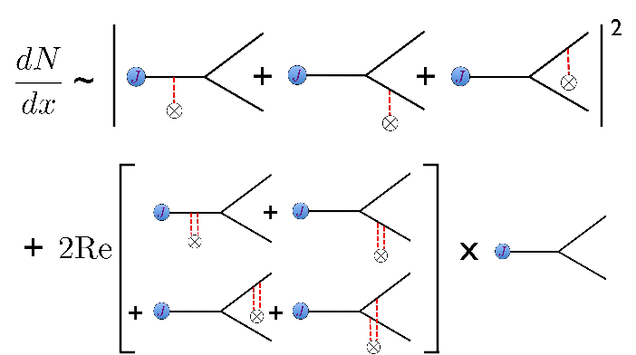
Medium modified DGLAP evolution
Previous work has been done in QCD and SCET to derive medium modified evolution equations
Ovanesyan, Vitev (2012)
Medium modification can be implemented into the fit, but introduces additional scales. Future work in this community
will involve including the medium modified DGLAP into the fit, as well as calculating the medium modifications to the
RG and Collins-evolution of the TMDs.
John Terry

Slide 47
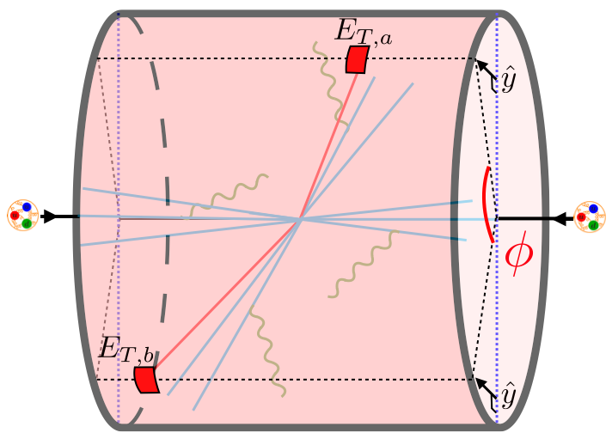
Future work
Graphs for medium modified evolution can be applied to final-state functions for TMD measurements (exclusive jet functions, EECs)
Medium modified DGLAP can be applied in a global analysis
Medium modified spin physics as a new probe of medium properties
John Terry
38/39

Slide 48
Conclusion
We performed the first global extraction of Sivers function.
We demonstrated that the RHIC measurement was not consistent with the positivity bound, the new data is consistent with our extraction.
We generalized the assumptions that are used for global extraction of nPDFs to extract nTMDs.
Our new analysis took into consideration the JLab data which allowed us to extract the collinear nFFs.
We have improved the perturbative accuracy of lepton-jet correlations and used this process to make predictions at the EIC.
We studied jet production in pA collisions at the LHC and sPHENIX and find good agreement with the data.
John Terry
39/39

Slide 49
Power counting and factorization
Intrinsic transverse momentum is non-perturbative
Experiments involve mixture of
Perturbative and non-perturbative
momentum
Inject large
current
Perturbative momentum
Intrinsic/non-perturbative momentum
Perturbative and non-perturbative contributions decouple using factorization theorems
TMD FF
Fit
Hard
Soft
Calculate
TMD PDF
2/30

Slide 50
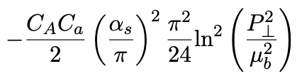
Non-global logs
Standard jets complicate resummation
Dasgupta, Salam (2001)
Larkoski, Moult, Neill (2016)
NGLs for jet at NLL is the same as jet mass in e+ e-
Becher, Neubert, Rothen and Shao (2016)
John Terry
24/30

Slide 51
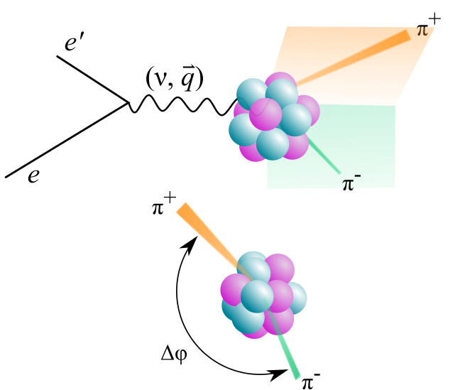
CLAS measurements
Semi-Inclusive DIS
Measurements have been performed for angular decorrelation
Morán et al. (CLAS Collaboration) Phys. Rev. C 105, 015201
Paul et al. (CLAS Collaboration) Phys. Rev. Lett. 129, 182501
Hadron-multiplicity data can be incorporated into the fit
Factorization and resummation has not been established
34/30

Slide 52
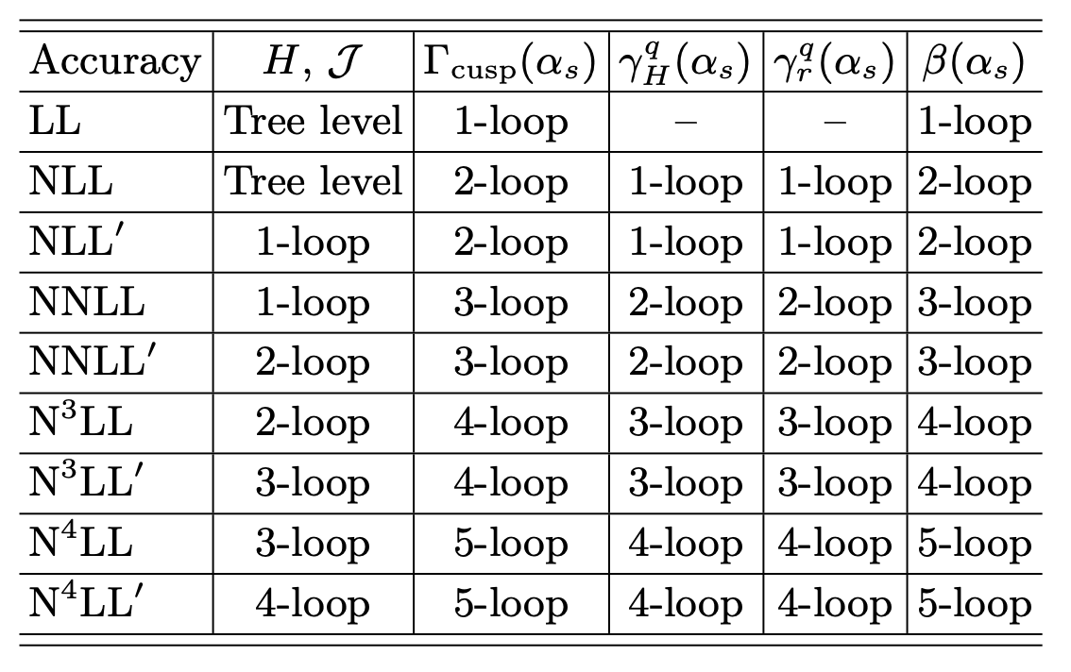
Resummation of large logs
TMD factorization in SCET
UV and IR modes are
separated in dim reg
IR modes all have same invariant mass,
requires additional scale
TMDs and soft functions have double scale evolution

Slide 53
Modes in SCET
SCET is an EFT which captures soft and collinear emissions along the directions
Bauer, Fleming, Luke 2000
Bauer, Fleming, Pirjol, Stewart 2001
Bauer, Stewart 2001
Bauer, Pirjol, Stewart 2002
Beneke, Chapovsky, Diehl, Feldmann 2002
Beneke, Feldmann 2003
Hill, Neubert 2003
Echevarria, Idilbi, Scimemi 2011

Slide 54
The MAP collaboration (Bachetta et al 2022)
Extraction at NNLO+N³LL, SIDIS+DY
Hermes multiplicity data
CMS distribution
TMDs

Slide 55
Artemide (Scimemi, Vladimirov 2019)
Extraction obtained at NNLO+N³LL, SIDIS+DY
Hermes Multiplicity data
TMD PDF
TMD FF

Slide 56
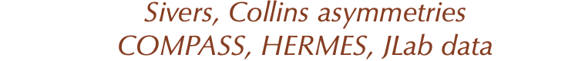
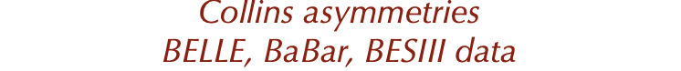
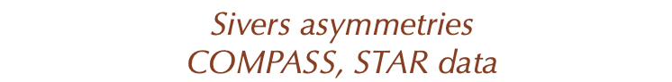
Standard processes and power counting
TMD PDFs and TMD FFs
TMD FFs
TMD PDFs

