Slide 1





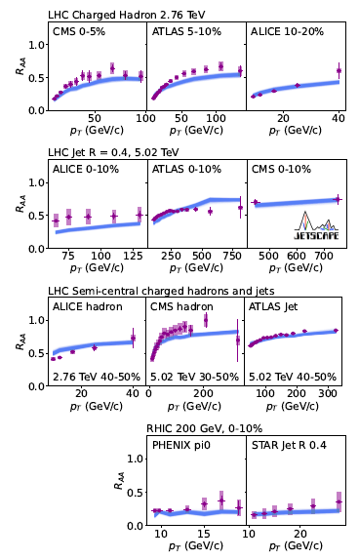
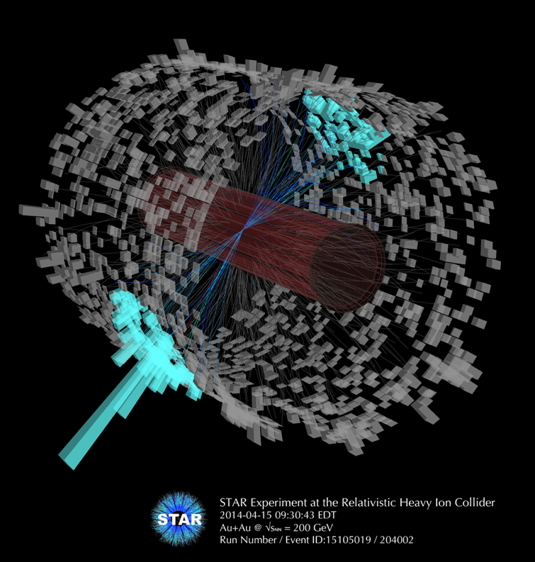
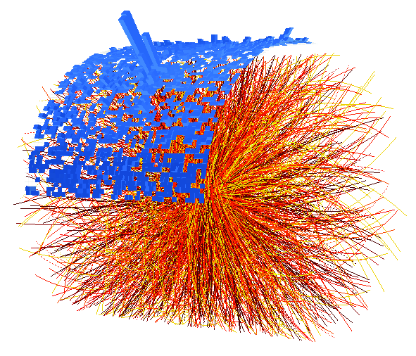
Uncovering the jet wake
Peter Jacobs
Lawrence Berkeley National Laboratory
University of California, Berkeley

Slide 2
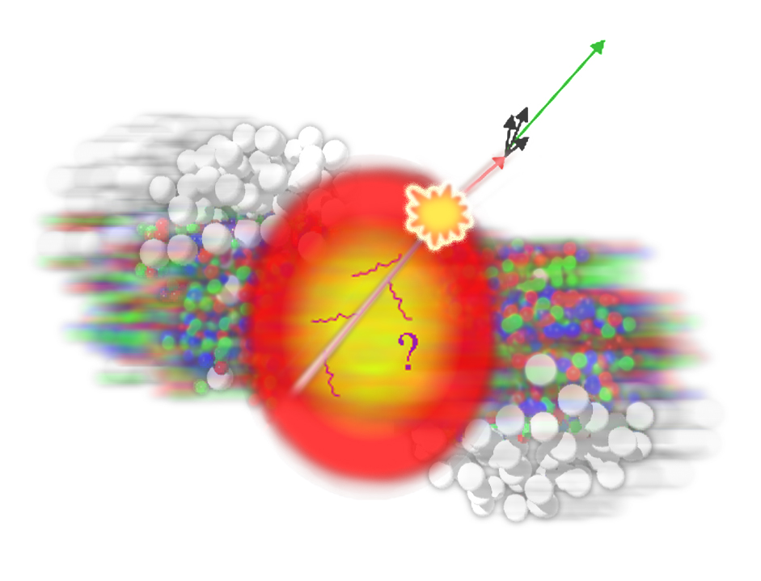
Jet quenching in one slide
Jet shower in-medium
Jet shower in vacuum
Evolution of highly virtual parton via gluon radiation
Quantum interference → angle-ordering
hardest radiation is most collinear with jet axis
Precise understanding in pQCD
Accurately calculable with QCD-based Monte Carlo models
Superposition of
vacuum shower
medium-induced gluon emission
These processes happen simultaneously and interfere
Angle-ordering is modified or destroyed

Slide 3
Jet quenching: observable consequences I
1. Energy loss
ΔE
Yield
suppression
2. Modification of jet substructure

Slide 4
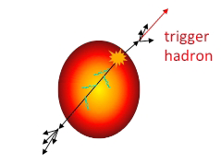
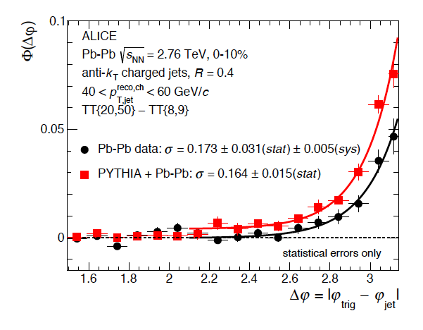
Jet quenching: observable consequences II
3. Jet deflection
Δ𝜑
4. Recovery of large-angle radiation

Slide 5
Jet quenching: observable consequences III
Four distinct manifestations of jet quenching:
Jet energy loss
Jet substructure modification
Jet deflection
Large-angle radiation
Different manifestations of same underlying physics
All must occur if any of them does
Probe different aspects of jet quenching
Different experimental systematics as fn of kinematics and collision system
Different theoretical sensitivity as fn of kinematics and collision system
Jet quenching is multi-messenger physics!
  Measure the same physics multiple ways and require a consistent picture

Slide 6
Taxonomy of current jet quenching measurements
Driven by experimental considerations: arrows connect observables with just one thing changed
Incl hadron suppression (ch, π⁰)
Di-hadron I_{AA} (high p_{T})
Incl D/B-meson R_{AA}
Light hadron v_{n}
Incl γ/Z production
Incl jet suppression
D-meson v_{n}
Jet v₂
Jet+h: large-angle
radiation
γ/Z+hadron I_{AA}
h+jet I_{AA}
Incl D/B-jet R_{AA}
Jet profile
Jet+h: FF
γ/Z+jet I_{AA}
Di-jet A_{J}
Small systems
γ/Z+jet x_{J}, energy balance
Groomed jet substructure
Jet acoplanarity
RHIC vs LHC

Slide 7
Taxonomy of current jet quenching measurements
Driven by experimental considerations: arrows connect observables with just one thing changed
Incl hadron suppression (ch, π⁰)
Di-hadron I_{AA} (high p_{T})
Incl D/B-meson R_{AA}
Light hadron v_{n}
Incl γ/Z production
Incl jet suppression
D-meson v_{n}
Jet v₂
Jet+h: large-angle
radiation
γ/Z+hadron I_{AA}
h+jet I_{AA}
So many observables! How to make sense of all this?
Incl D/B-jet R_{AA}
Jet profile
Jet+h: FF
γ/Z+jet I_{AA}
Di-jet A_{J}
Small systems
γ/Z+jet x_{J}, energy balance
Groomed jet substructure
Jet acoplanarity
RHIC vs LHC

Slide 8
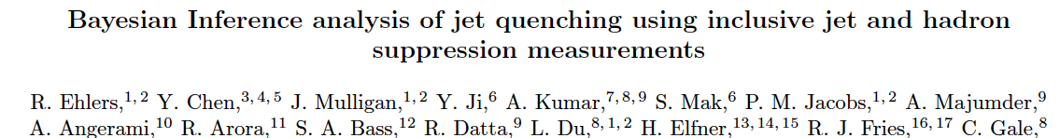
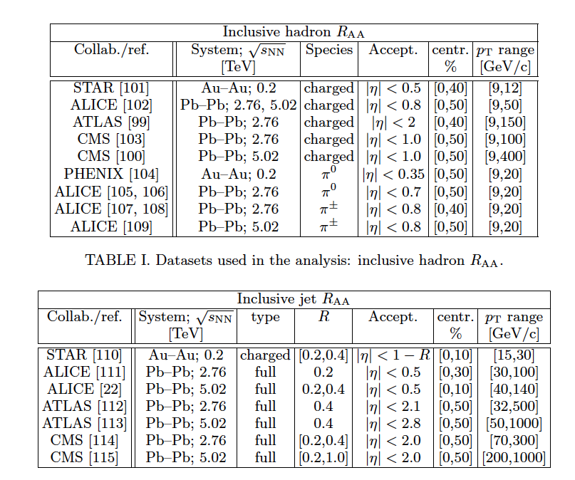
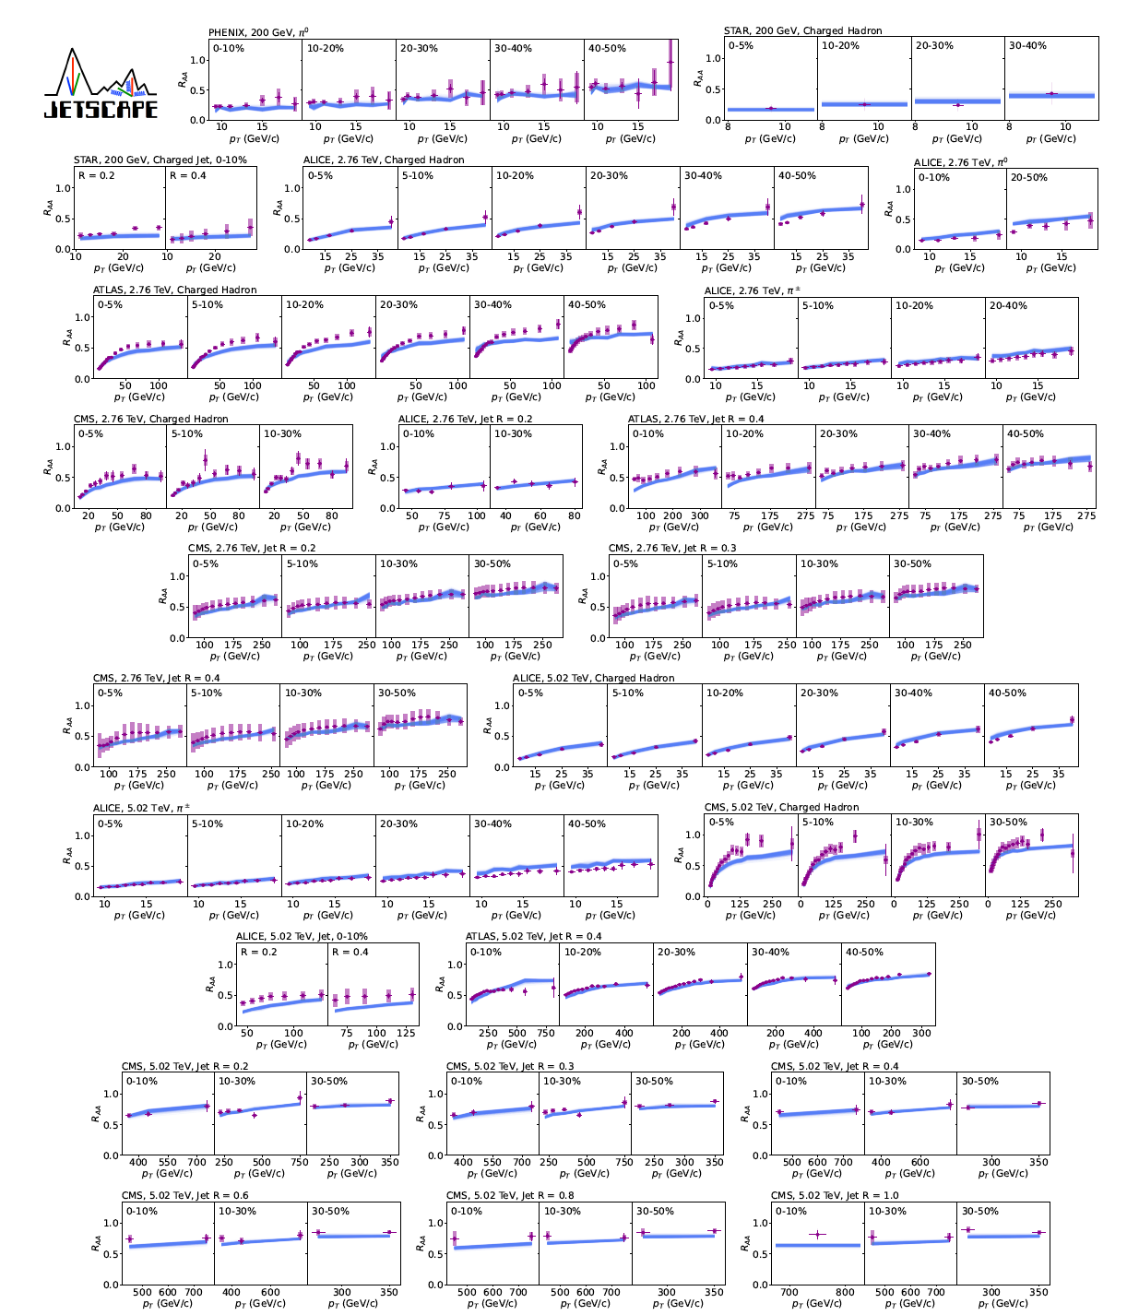
Approach I: explore incrementally
Raymond, Friday a.m.
arXiv:2408.08247

Slide 9
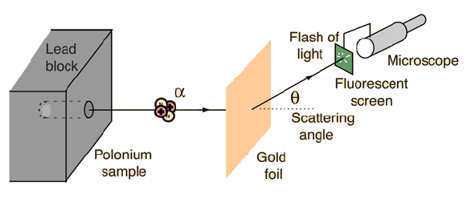
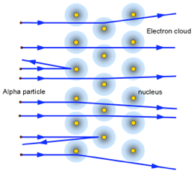

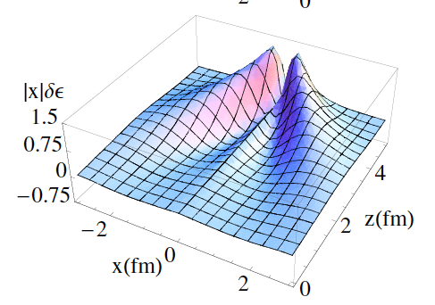
Approach II: ask a targeted question, design targeted measurements
What is the nature of the jet-QGP interaction?
Discrete scattering centers or effectively continuous medium?

Slide 10
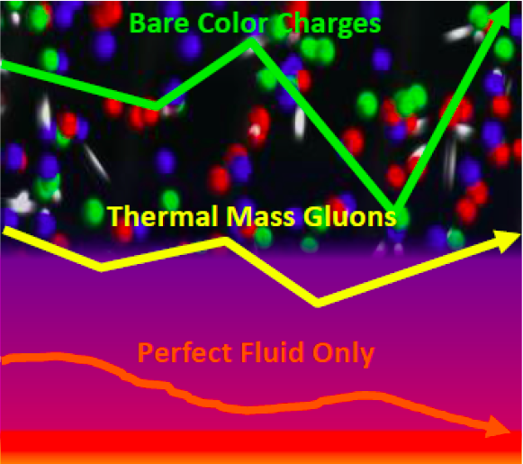
What is the nature of the jet-QGP interaction?
Discrete scattering centers or effectively continuous medium?
Are these pictures distinguishable conceptually?
Are they distinguishable in practice?
?
Experimental tools:
  Substructure modification
  Yield modification
  Jet scattering
  Model comparisons

Slide 11
?
Tools:
  Substructure modification
  Yield modification
  Jet scattering
  Model comparisons

Slide 12

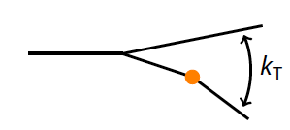
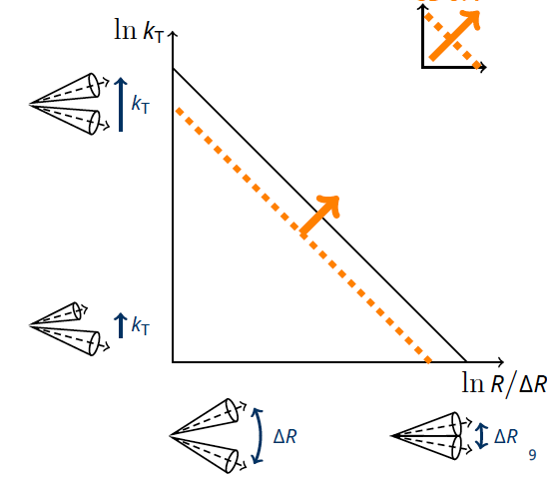
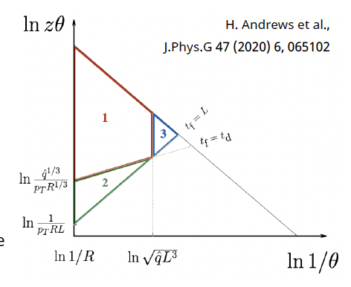
preliminary
Raymond Ehlers talk @ INT-21r-2b
Use jet grooming to isolate hard k_{T} splittings
  → enhanced rate in Pb+Pb?
groom
SoftDrop

Slide 13
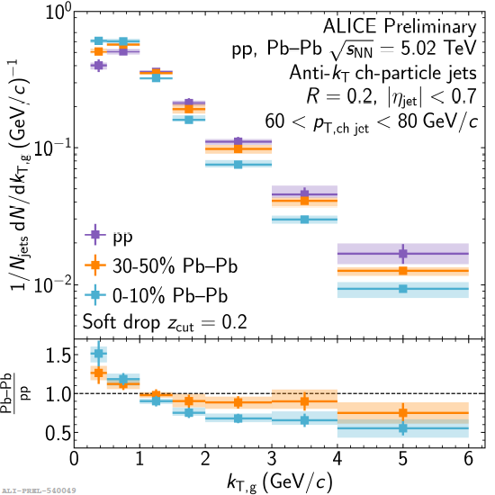
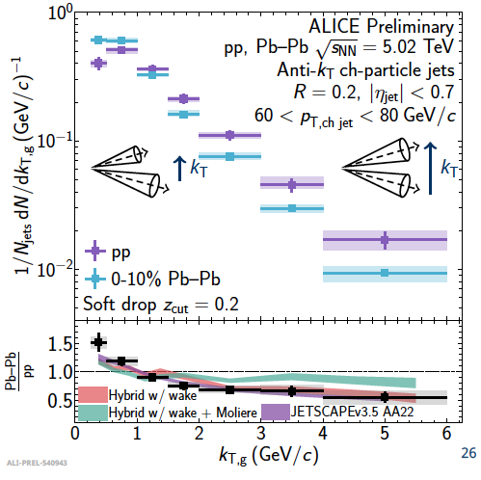
Quasi-particle scattering: enhancement in high-k_{T} splitting rate
high k_{T}: suppression, not enhancement
no direct evidence for Moliere scattering
Model calculations:
Hybrid w/Moliere does not describe data
dominant effect is energy loss (survivor bias)

Slide 14
Interlude: survivor bias and how to avoid it

Slide 15
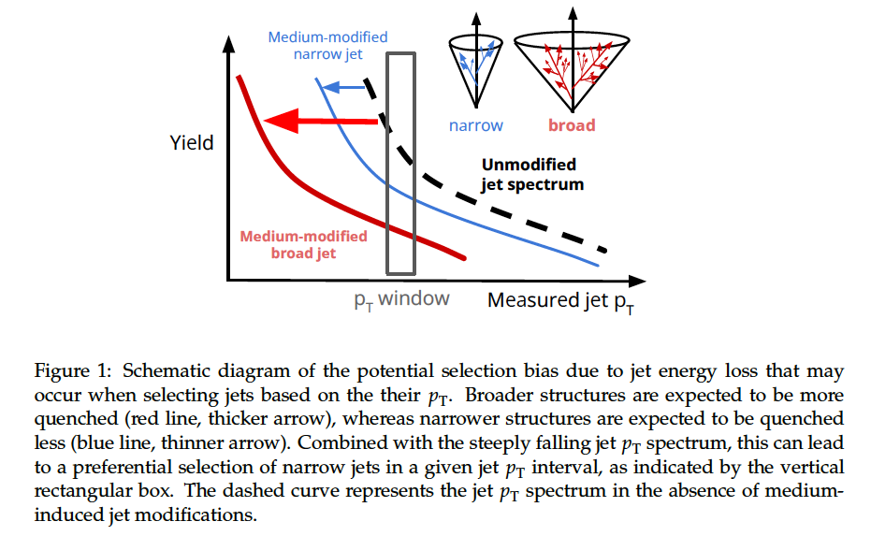
Interpretational issue: survivor bias
CMS
arXiv:240502737
(+ numerous previous theory papers)
Cannot discriminate effects due to:
quenching dependence on q/g
quenching dependence on jet shape
medium response

Slide 16
Interpretational issue: survivor bias
CMS
arXiv:240502737
(+ numerous previous theory papers)
ALICE/STAR solution: don’t do it that way
do not impose a p_{T}^{jet} threshold
Rather, use a statistical approach to measure the jet spectrum to (very) low p_{T}^{jet} and track the yield modification

Slide 17
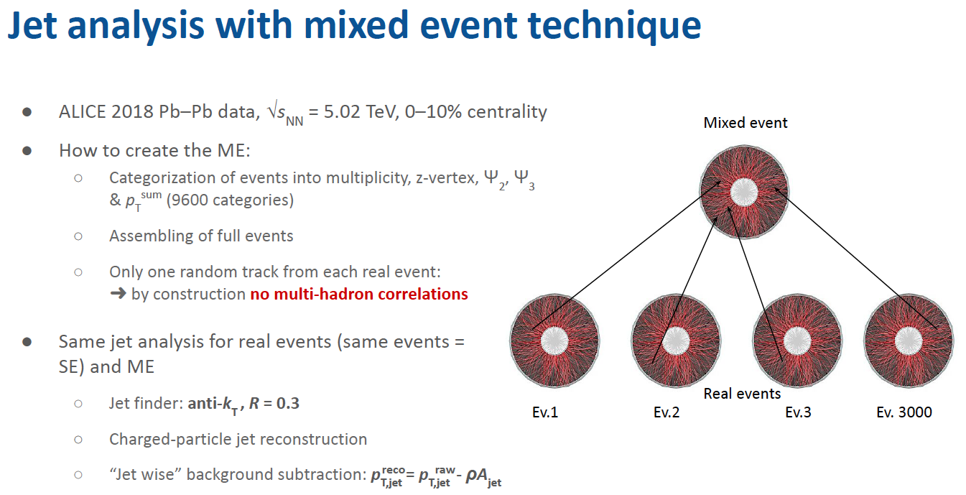
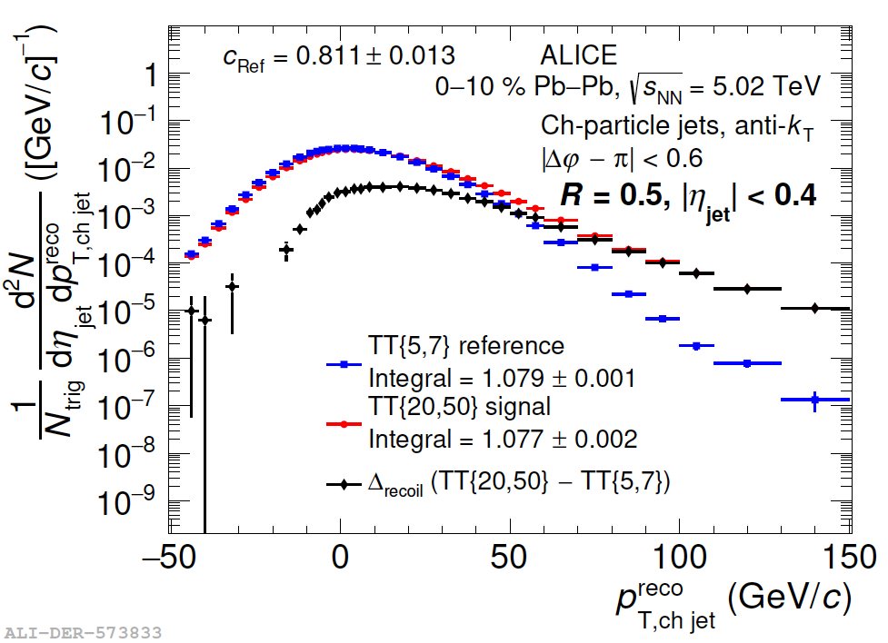
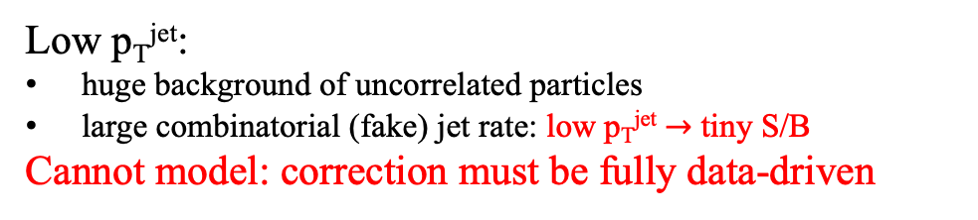
What is the “statistical approach”?
Low p_{T}^{jet}:
huge background of uncorrelated particles
large combinatorial (fake) jet rate: low p_{T}^{jet} $→$ tiny S/B
Cannot model: correction must be fully data-driven
Example: Mixed Events
Real event population (“SE”) segregated into (thousands of) mixing bins: multiplicity, zvtx, Event Plane,…
Only mix constituents within the same SE bin
At most one track from each SE in an ME
Sum over bins
Destroys all multi-hadronic correlations, including jets
Run jet analysis on ME events
Correction at the level of distributions
Related approach: h+jet trigger-differential
Inclusive jets
SE
ME
Difference distribution
True jet yield:
SE-ME

Slide 18
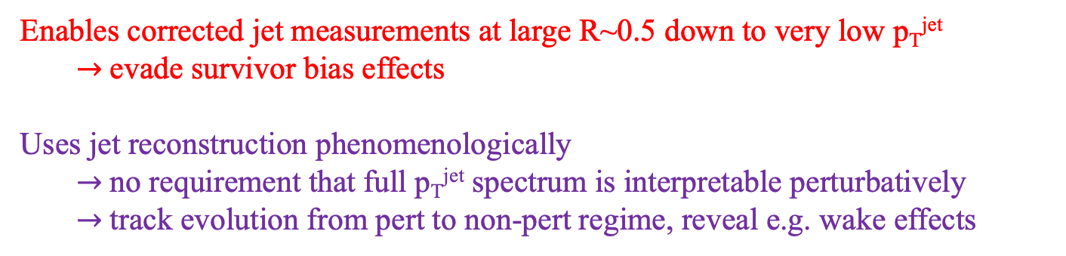
Statistical correction: remarks
Two distinct corrections:
Bkgd yield
must be entirely data-driven
implementations: ME, trig-diff
p_{T}-smearing
implementation: unfolding
Some model dependence: Resp Matrix
extensive systematic studies
Bkgd yield correction
p_{T} smearing correction
Enables corrected jet measurements at large R~0.5 down to very low p_{T}^{jet}
  $→$evade survivor bias effects
Uses jet reconstruction phenomenologically
  $→$no requirement that full p_{T}^{jet} spectrum is interpretable perturbatively
  $→$track evolution from pert to non-pert regime, reveal e.g. wake effects

Slide 19
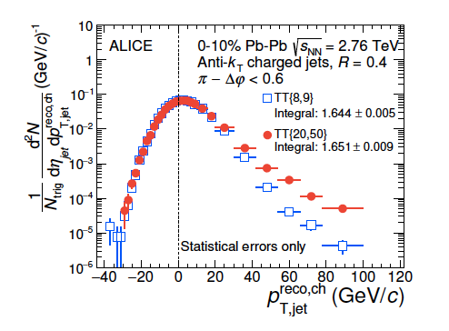
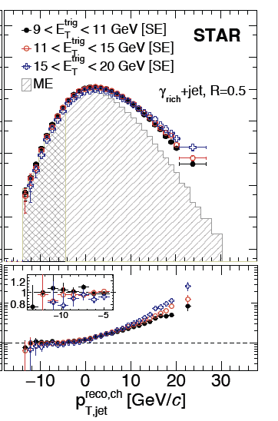
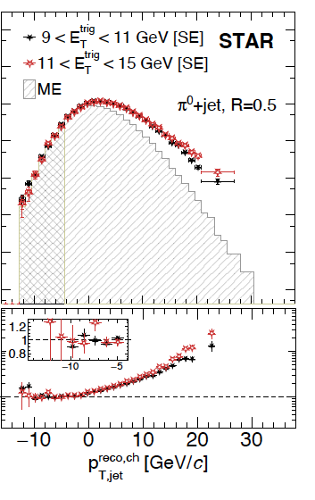
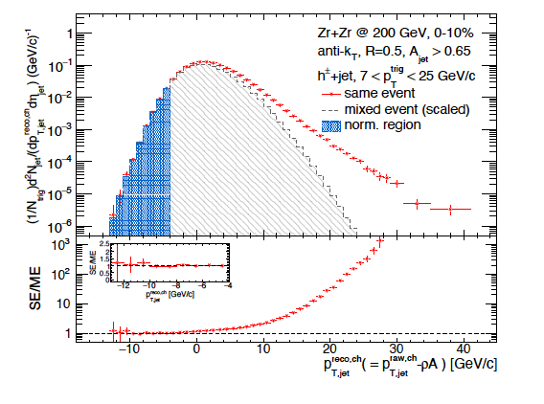
Statistical jet background correction: current analyses
Au+Au; h+jet
Phys. Rev. C 96 (2017) 024905
Au+Au, p+p; γ/π⁰+jet
arXiv:2309.00156
arXiv:2309.00145
Zr+Zr, Ru+Ru; h+jet
PoS HardProbes2023 (2024) 174
PbPb, pp; h+jet
JHEP 09 (2015) 170
Phys.Rev.Lett. 133 (2024) 2, 022301
Phys.Rev.C 110 (2024) 1, 014906
Pb+Pb; incl. jet
EPJ Web Conf. 296 (2024) 11005
p+Pb, HM pp; h+jet
JHEP 05 (2024) 229
Phys.Lett.B 783 (2018) 95-113
+ new analyses at HP24

Slide 20
?
Tools:
  Substructure modification
  Yield modification
  Jet scattering
  Model comparisons

Slide 21

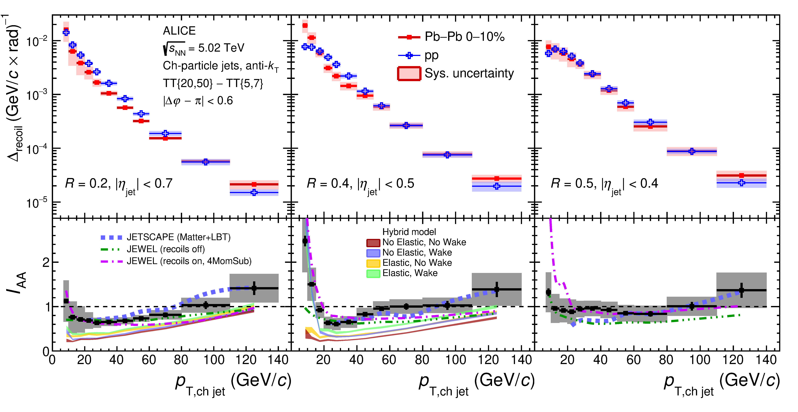
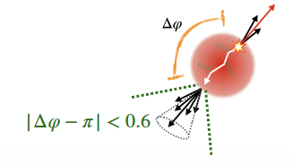
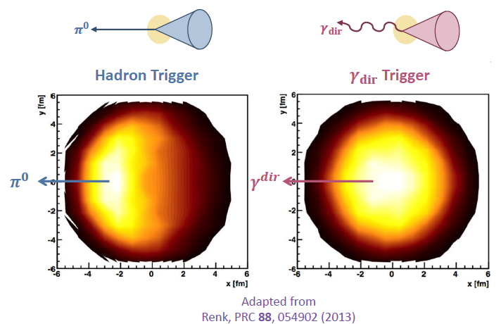
Yield suppression
Phys.Rev.Lett. 133 (2024) 2, 022301
Phys.Rev.C 110 (2024) 1, 014906
(corrected)
Semi-inclusive hadron+jet correlations
Energy loss
Energy recovery
Change in geometric bias
recoil jet
h

Slide 22
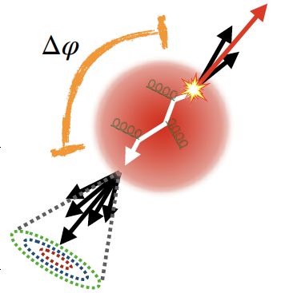


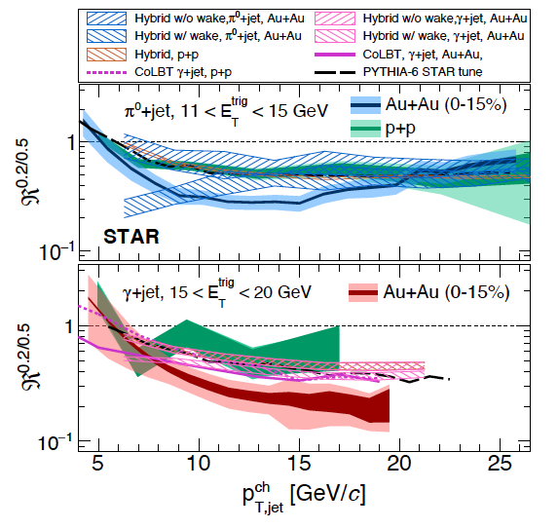
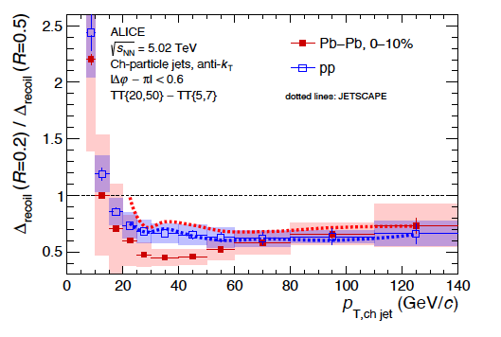
Jet shape modification: recoil spectrum ratio R=0.2/R=0.5
Robust jet shape observable
Phys.Rev.Lett. 133 (2024) 2, 022301
Phys.Rev.C 110 (2024) 1, 014906
arXiv:2309.00156
arXiv:2309.00145
p_{T,jet}
R
h
Medium-induced jet broadening in multiple channels at RHIC and LHC

Slide 23

Inclusive jets: R_{AA} at very low p_{T}^{jet}
First application of ME to inclusive jet measurements
N. Gruenwald QM23
EPJ Web Conf. 296 (2024) 11005
SE/ME
Corrected spectrum
R_{AA}
Compare to STAR@RHIC
Similar suppression at RHIC and LHC
LHC: harder spectrum $→$larger E-loss

Slide 24
?
Tools:
  Substructure modification
  Yield modification
  Jet scattering
  Model comparisons

Slide 25
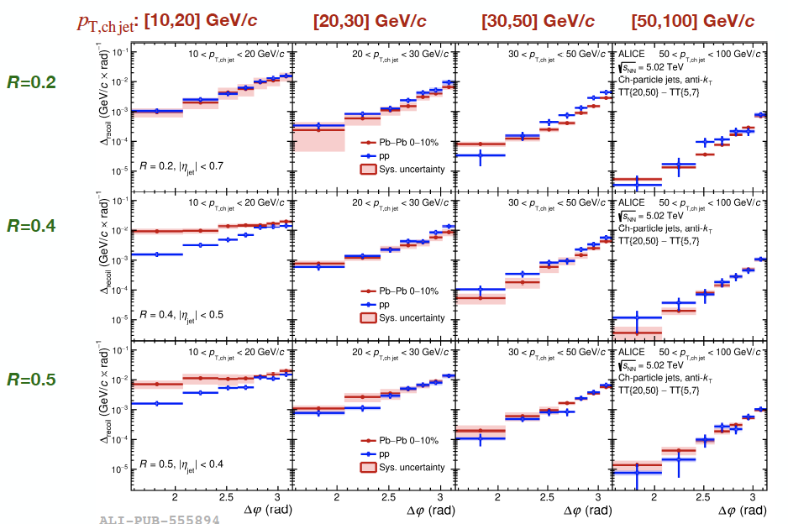
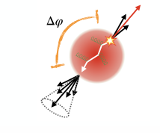
Semi-incl. jet quenching: angular dependence
Phys.Rev.Lett. 133 (2024) 2, 022301
Phys.Rev.C 110 (2024) 1, 014906
h
Large medium-induced azimuthal broadening for large-aperture recoil jets at low p_{T}^{jet} (!)

Slide 26
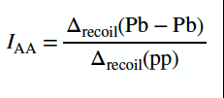
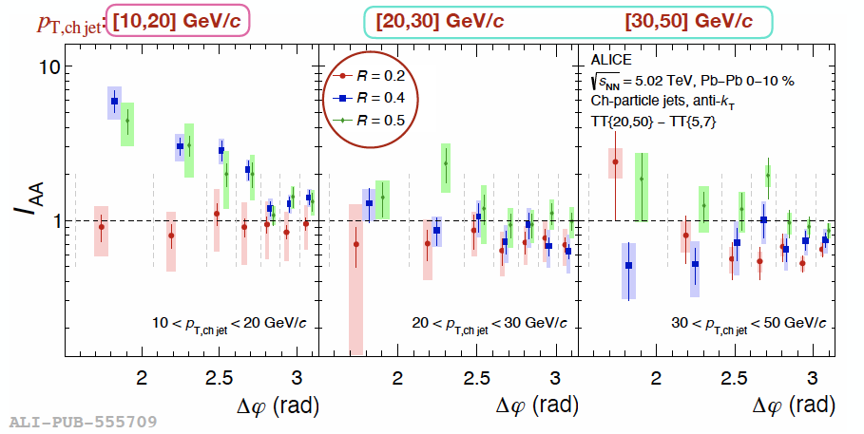
Semi-incl. jet quenching: angular and aperture (R) dependence
Large medium-induced azimuthal broadening
only for large-aperture recoil jets
only at low p_{T}^{jet}
unexpected

Slide 27
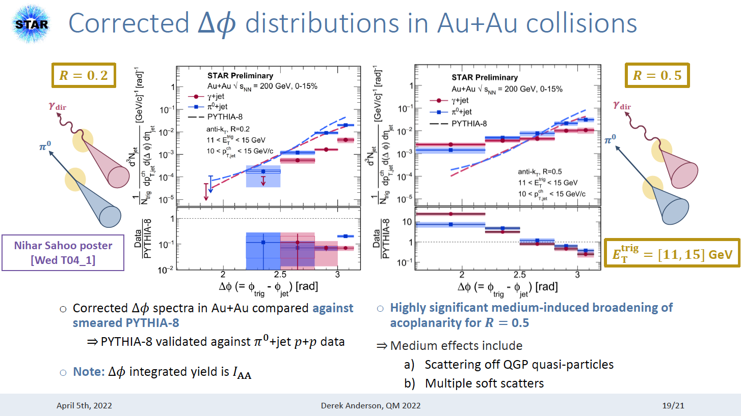
Azimuthal broadening in γ/π⁰+jet at RHIC
!
STAR sees similar medium-induced azimuthal broadening for
large-aperture recoil jets (paper in progress)

Slide 28
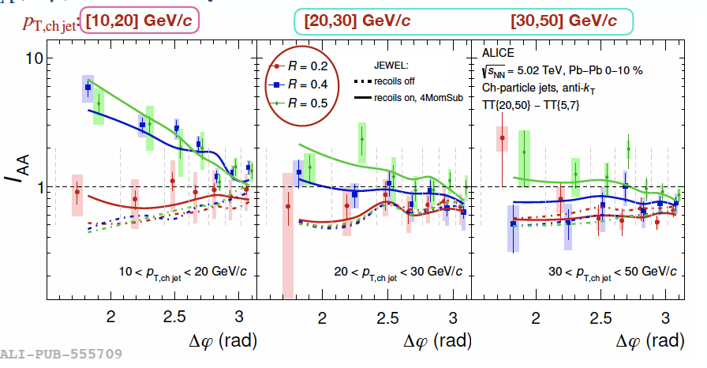
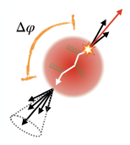
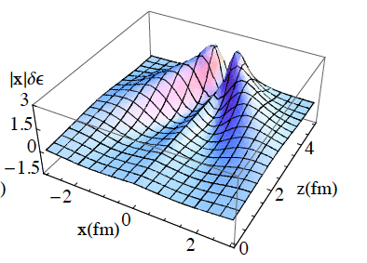
Azimuthal broadening: what have we learned?
?
Why broadening only for large aperture recoil jets?
not compatible with Rutherford scattering (should also affect small R jets)
Rather: characteristic of diffuse large-angle flow of QGP excited by the passage of an energetic reoil
Run 3 analyses: detailed study and validation of this picture
(HP24: substructure)
Jet
G.-Y. Qin, A. Majumder, H. Song and U. Heinz
Phys.Rev.Lett. 103 (2009) 152303

Slide 29
?
Tools:
  Substructure modification
  Yield modification
  Jet scattering
  Model comparisons

Slide 30
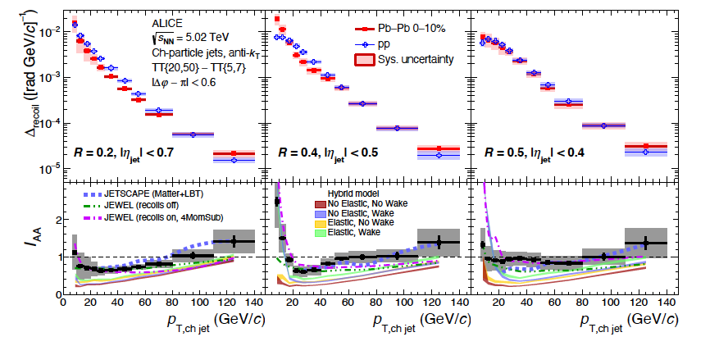
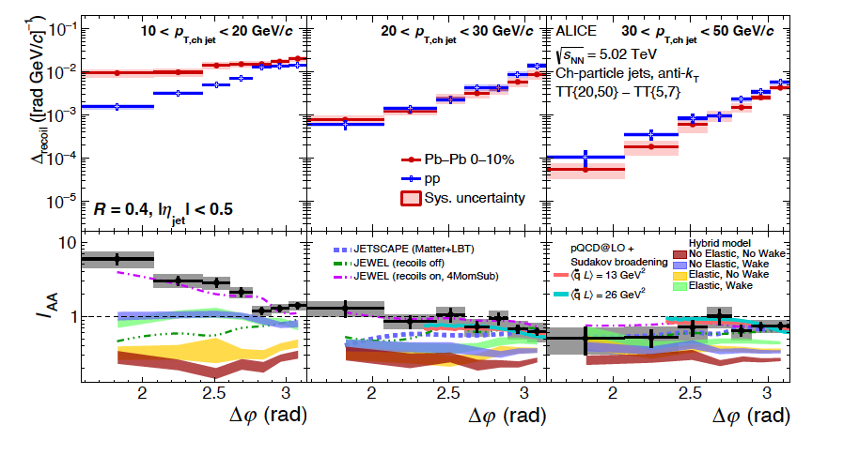

γ/π⁰ recoil R=0.2/R=0.5
h+jet I_{AA}
Hardest k_{T}
h+jet $∆φ$

Slide 31
γ/π⁰ recoil R=0.2/R=0.5
h+jet I_{AA}
h+jet $∆φ$
Semi-incl. yields:
Models qualitatively ~OK but miss quantitatively
Acoplanarity:
most models fail
only Jewel/recoils-on reproduces observations

Slide 32
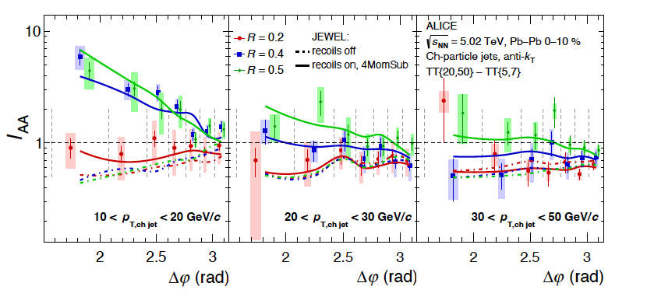

h+jet $∆φ$
JEWEL/recoils-on reproduces detailed features
Incl. jet R_{AA}
JEWEL/recoils-on fails!
???
Modeling of medium-induced modification at low p_{T}^{jet}:
back to the drawing board

Slide 33
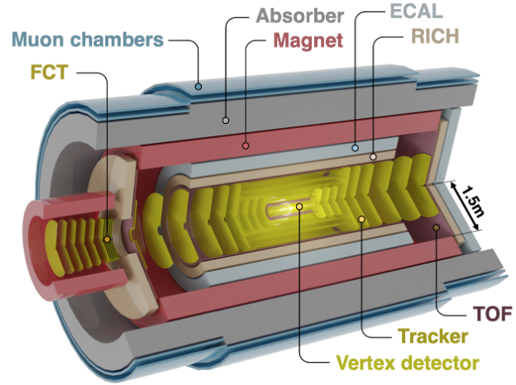
ALICE 3
See Fredi’s talk Monday 9 am

Slide 34
ALICE 3 acceptance
Assuming full Ecal coverage in central barrel (-4<η<4) + FoCal
Unprecedented range in x with continuous coverage
highly complementary to EIC

Slide 35
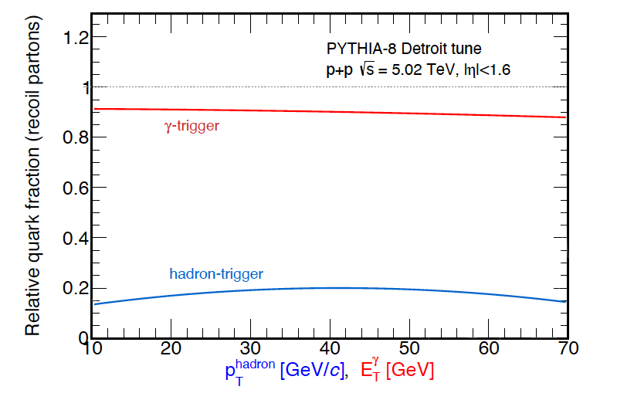
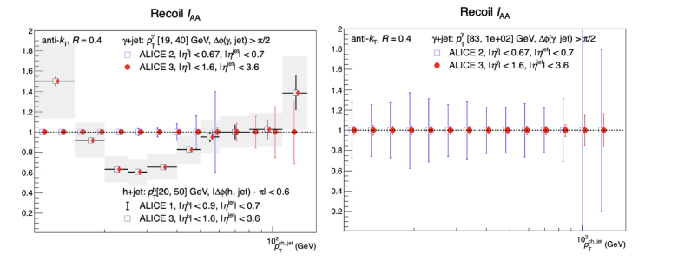
Semi-inclusive measurements in ALICE 3
p_{T}^{γ}>19 GeV
p_{T}^{γ}>83 GeV
Huge gain in statistical precision (acceptance + lumi)
Same capabilities for statistical jet measurement approach
Much more differential measurements
Deeper discrimination of physics pictures:
we don’t know what we will find unless we look

Slide 36
Outlook: What is the nature of the jet-QGP interaction?
Need to explore jet measurements over broad phase space
Including low p_{T}^{jet}, large R
Multiple measurement channels: inclusive, coincident with various triggers, substructure,…
Require consistent model description
Status: experiment
Tools in place based on statistical approach
Applied at RHIC and LHC
Expanding range of observables: inclusive, substr.,…
Models:
Overall not successful, need to reassess approaches
Models + data: Bayesian Inferences
Future:
This is a complex enterprise
Will still be at the forefront during LHC Run 5/ALICE 3

