Slide 1




Hadronization in Vacuum and in Medium using Hybrid Hadronization
Rainer J Fries
Texas A&M University
INT 24r-2b: Heavy Ion Physics in the EIC Era
UW, Seattle, August 23 2024

Slide 2
The Hadronization Problem In Event Generators
No solutions based on first principles.
For Monte Carlos: need models based on reasonable assumptions that can describe data.
Lund string fragmentation and cluster hadronization: Long, successful history for ‘vacuum’ systems; excellent results in e+e- and p+p.
Many features in heavy ion collisions not addressed by these traditional models (baryon chemistry, quark number scaling, etc. )
arXiv:2203.11601

Slide 3
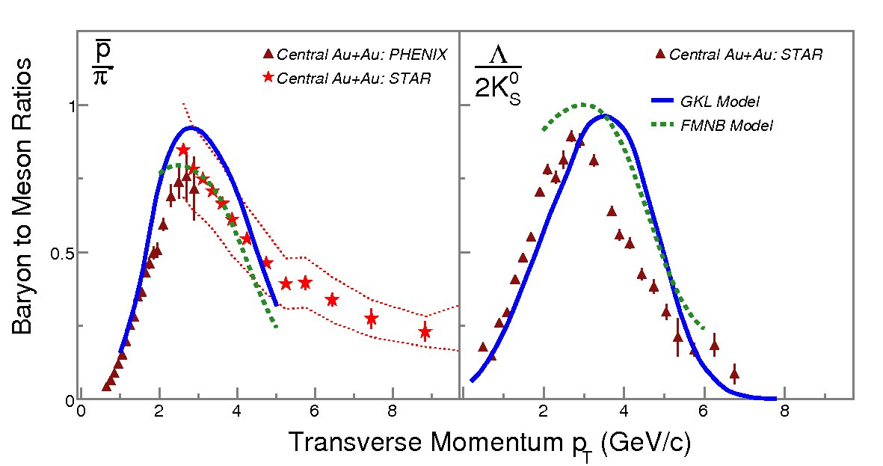

The Hadronization Problem
These features can be explained by quark recombination models.
New data, even in p+p is challenging some models.
Our goal: a comprehensive model that can be consistently applied to all systems from e+e- to A+A collisions $→$ Hybrid Hadronization

Slide 4
Hybrid Hadronization
A hybrid of string fragmentation and recombination.
Interpolates smoothly in between, two limits:
  Dilute systems → Dominance of string fragmentation
  Dense systems → Dominance of quark recombination
Use a physics criterion to separate the domains: recombination probabilities vanish for large phase space distances
String regime
K. C. Han, R. J. Fries, C. M. Ko, Jet Fragmentation via Recombination of Parton Showers, Phys.Rev.C 93, 045207 (2016)
Recombination regime

Slide 5

Hybrid Hadronization Work Flow
Input:
Provide low virtuality partons, including with space-time information and color tags
.
Recombination Step:
Provisionally decay gluons into $q\overline{q}$. Go through the system sampling the recombination probabilities for all possible q-qbar and q-q-q bound states.
Intermediate Step:
Recombined hadrons and remnant partons in a string system (only color singlets were removed).
Fragmentation Step:
Remnant partons tend to be farther apart in phase space. Fragement using PYTHIA 8.

Slide 6
Hybrid Hadronization Work Flow in a medium
Input:
Provide low virtuality partons, including with space-time information and color tags
.
Bath of thermal/soft partons
Recombination Step:
Provisionally decay gluons into $q\overline{q}$. Go through the system sampling the recombination probabilities for all possible q-qbar and q-q-q bound states.
Recombination with thermal/soft partons
Intermediate Step:
Recombined hadrons and remnant partons in a string system (only color singlets were removed).
Remnant strings with thermal/soft partons
Fragmentation Step:
Remnant partons tend to be farther apart in phase space. Fragement using PYTHIA 8.

Slide 7
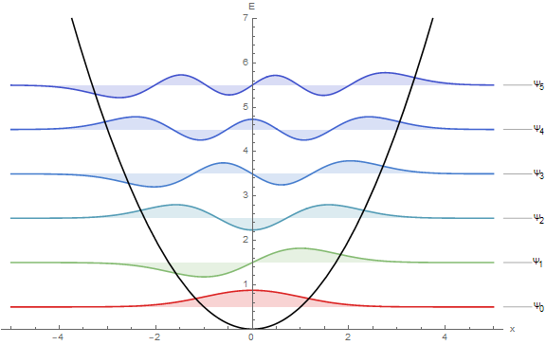


Setting up the Recombination problem
Quarks/antiquarks = wave packets in phase space
For simplicity: Gaussian wave packets around centroid phase space coordinates $\left({\vec{r}}_{i},{\vec{p}}_{i}\right)$, of given width $δ$. Color and spin information might be available (otherwise treated statistically).
Short range interaction modeled by isotropic harmonic oscillator potential of width $1/ν$.
Use the Wigner formalism in phase space. We need angular momentum eigenstates.
Total probability for coalescence $P_{tot}=P_{phase−space}×P_{spin}×P_{color}$

Slide 8

Angular Momentum Eigenstates in Phase space
Wigner distribution in phase space for given wave functions $ψ_{1}, ψ_{2}$:
(Diagonal) results known for angular momentum eigenstates: S. Shlomo, M. Prakash, Phase space distribution of an N –dimensional harmonic oscillator, Nucl. Phys. A 357,157 (1981).
In 2-D closed-form, elegant result from the quantum optics community: R. Simon, G. S. Agarwal, Wigner representation of Laguerre-Gaussian beams, Opt. Lett. 25, 1313 (2000);
Recalculate Wigner distributions using an expansion of angular momentum eigenstates in products of 1D-states.
Here summed over magnetic quantum number $m$ (no polarization).
M. Kordell, R. J. Fries, C. M. Ko, Annals Phys. 443, 168960 (2022)

Slide 9
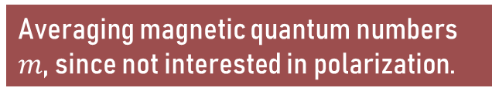
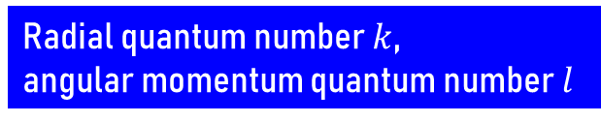
3d-Harmonic Oscillator in Phase space
Use the well-studied 1D-phase space distributions to build the 3D ones
The off-diagonal 1-D Wigner distributions are known [T. Curtright, T. Uematsu, C. K. Zachos, J. Math. Phys. 42 (2001)]
Three off-diagonal 1-D Wigner distributions
Radial quantum number $k$,
angular momentum quantum number $l$
Expansion coefficients for angular momentum eigenstates in terms of products of 1-D states
Averaging magnetic quantum numbers $m$, since not interested in polarization.

Slide 10

Wigner Distributions
Recall that Wigner distributions can be negative.
When summed over $m$, they only depend on magnitudes of position $r$and momentum $q$, and the relative angle $θ$ between.
Examples of a few lowest states

Slide 11

Coalescence
Probability for coalescence of Gaussian wave packets using the Wigner distributions.
Again sum over $m$, since we are not interested in polarization here (see remark later).
Results discussed here for $1/ν=2δ$ (relation between quark wave packet width $δ$ and harmonic oscillator length scale $1/ν)$.
Bound state Wigner distribution;
only depends on relative phase
space corrdinates
Wigner distributions of two Gaussian wave packets.
Wigner for center of mass motion.

Slide 12

Coalescence Probabilities
Probabilities depend on the relative coordinates of the wave packet centroids, called $r$ and $p$ here.
$θ$ = angle between $r$ and $p$.

Slide 13

Coalescence Probabilities
Probabilities can be written in terms of just two variables: total phase space distance squared $v$ and total angular momentum squared $t$.
If summed over states with the same energy, the probabilities are simply Poissonian given by phase space distance
Energy degeneracy broken by orbital angular momentum of the quarks. $t$ makes an intuitive connection between the relative angular momentum of the incoming quarks and the quantum number $l$ of their bound state.
Both are states with N=3

Slide 14
Remnant Partons: String repair
Recombination only removes color singlets. Remaining strings “snap together” the right way automatically.
Remnant partons with color tag 0 (e.g. from LBT) must be introduced into strings; unused gluons are restored.
If the initial system was not a color singlet extra partons must be introduced to balance color (this could be thermal partons, beam partons, or extra partons with zero momentum).
Suppose these two partons recombine.
and
=

Slide 15
Remnant STRINGS: FRAGMENTATION
Strings are handed to PYTHIA 8 for fragmentation.
Decays of excited states can happen in PYTHIA or (in JETSCAPE) by invoking the hadronic transport model SMASH.
In a vacuum system all partons hadronize.
As intended fragmentation dominates this dilute system, in particular for high energy hadrons.

Slide 16
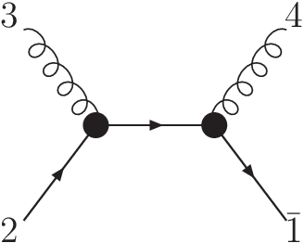

Adding A Medium
The formalism stays the same, just take care of these additional points
Some shower partons (e.g. LBT) arrive with randomized color (color tag 0)
Thermal partons can be sampled from a specified $T=T_{c}$ hypersurface, or a brick.
Recombination from only thermal partons, or strings with only thermal partons are disabled. Shower partons are always hadronized.
HH can process “negative partons” separately, if needed for background subtraction. Depending on the shower MC they can be used to track “holes” left in the medium through processes like q (shower) + g (medium) -> q (shower) + g (shower).
T
S
S
S

Slide 17
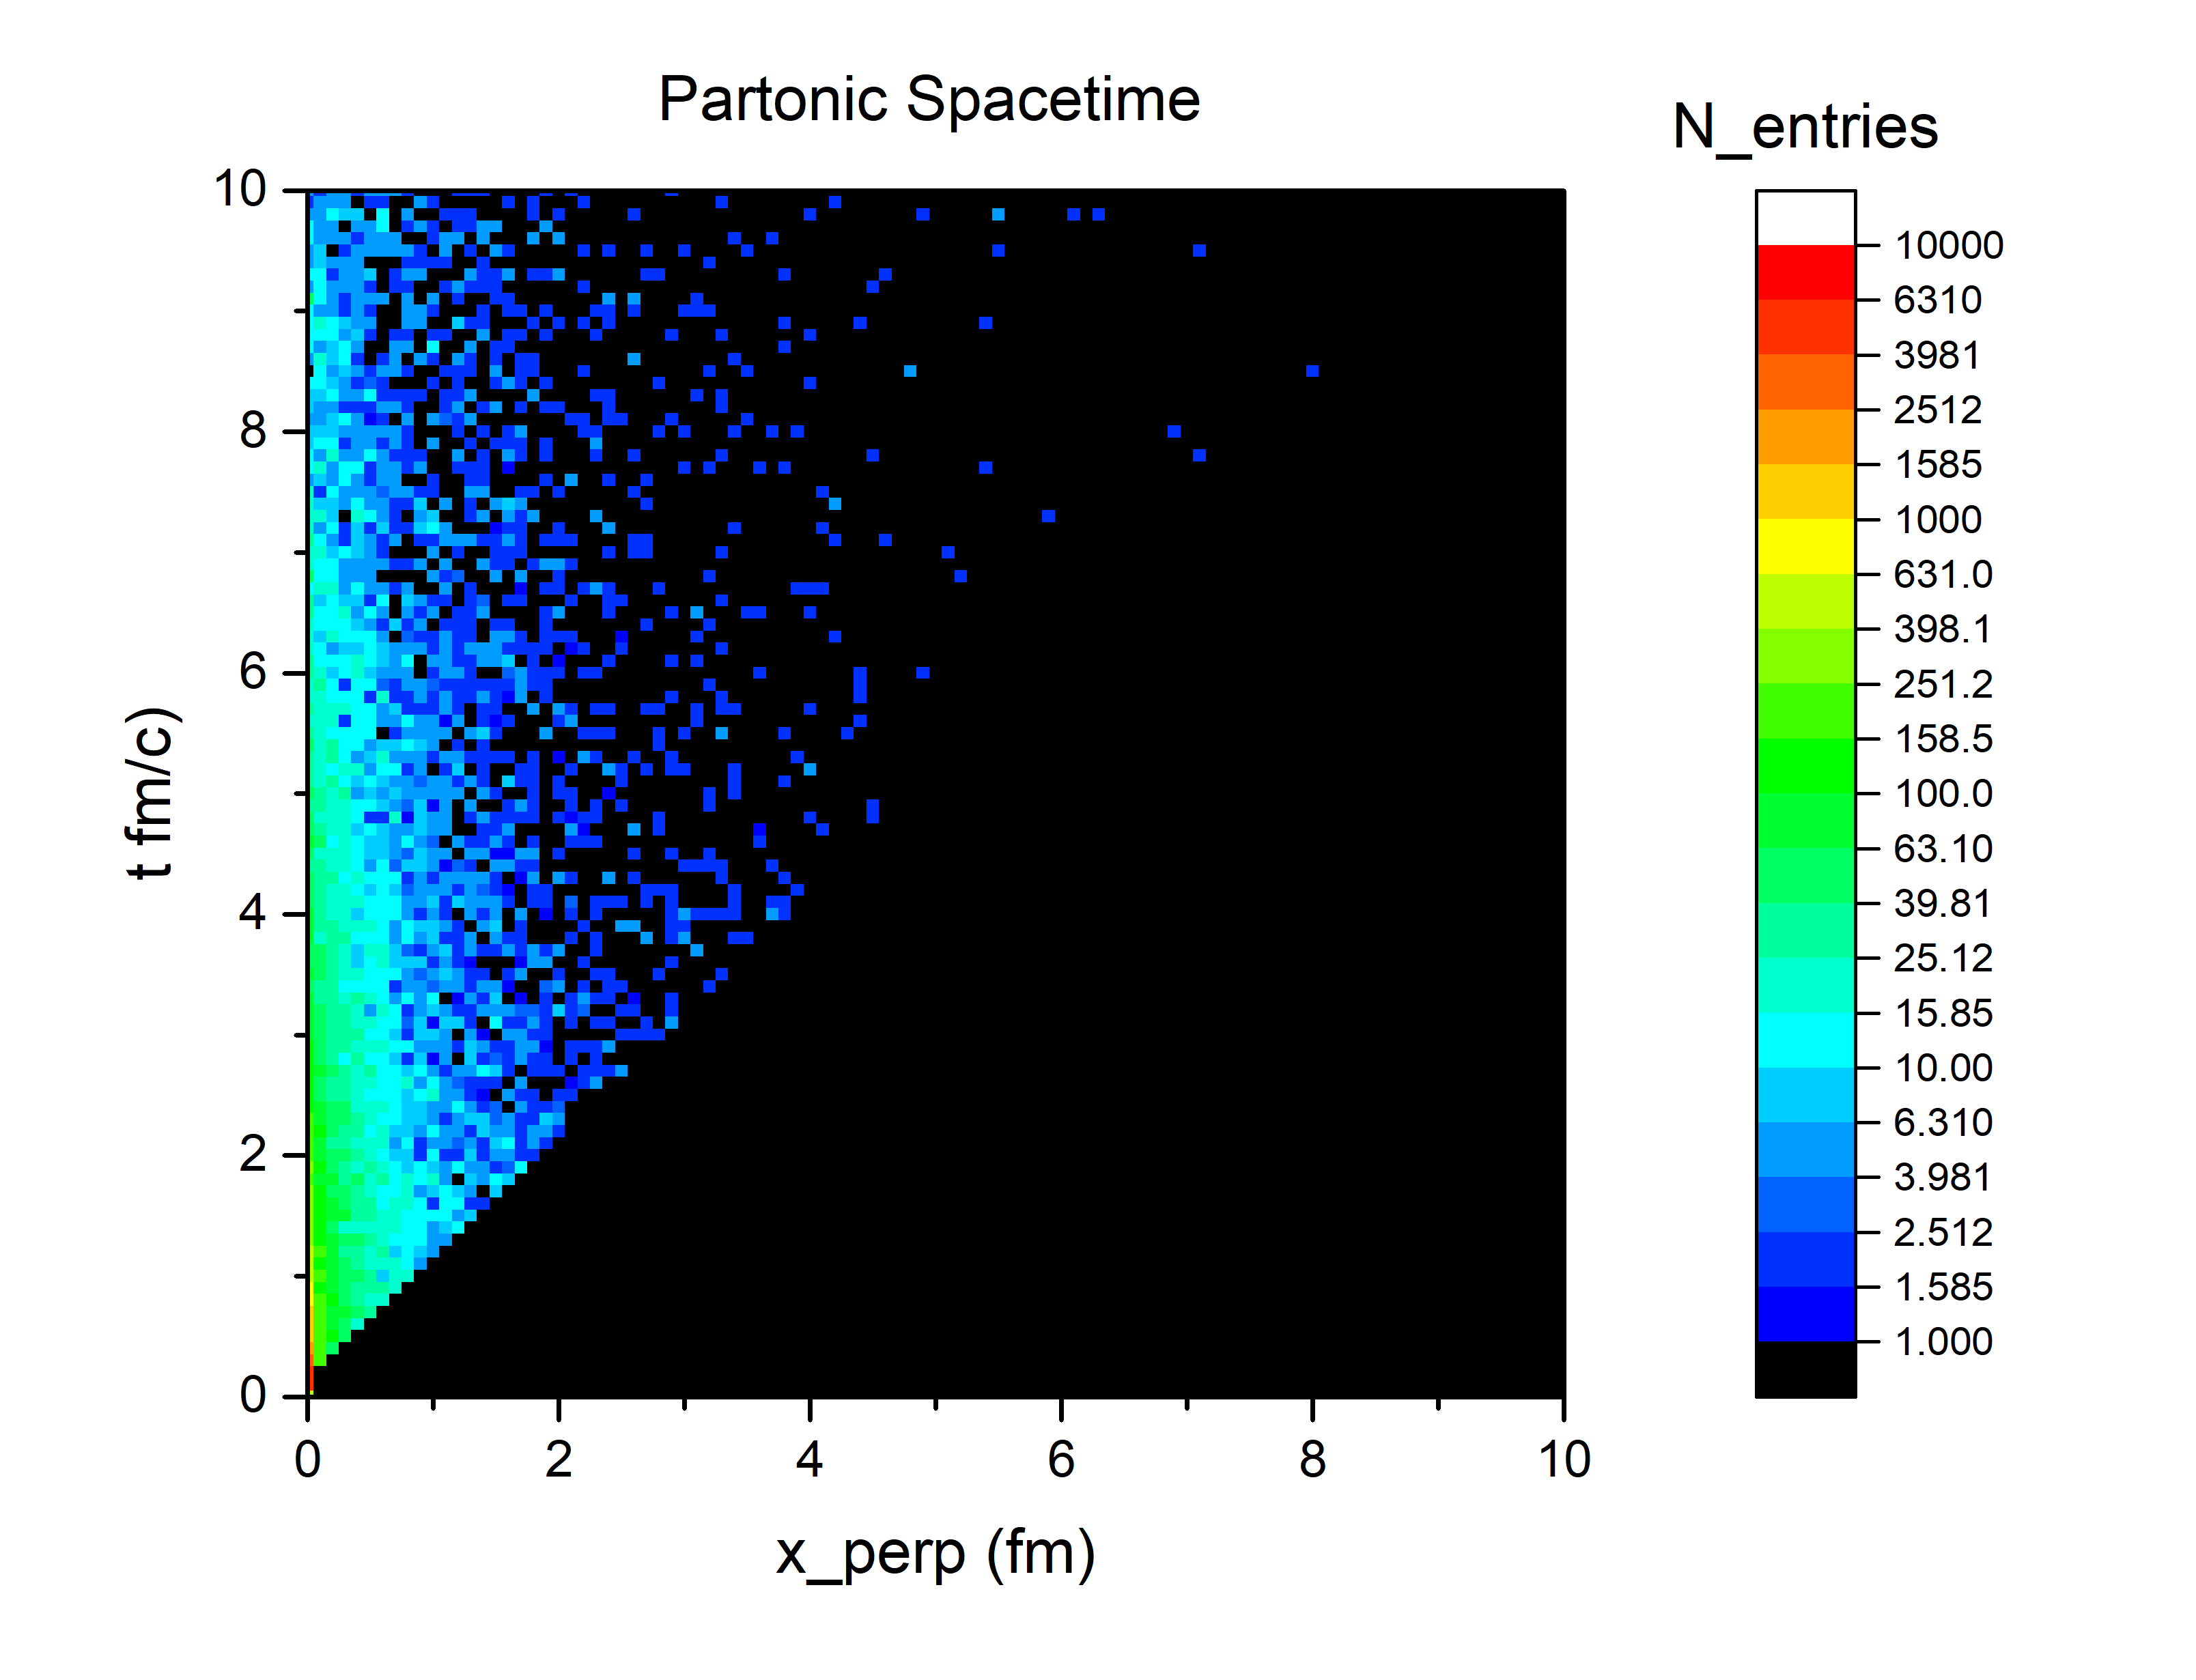
In-Medium Jets: Space-Time Considerations
Sampled spatial positions of shower partons after shower evolution for 100 GeV jets (arb. normalization)
Here: JETSCAPE:pGun+MATTER
100 GeV vacuum jet
Time since jet was created
Direction transverse to the jet

Slide 18
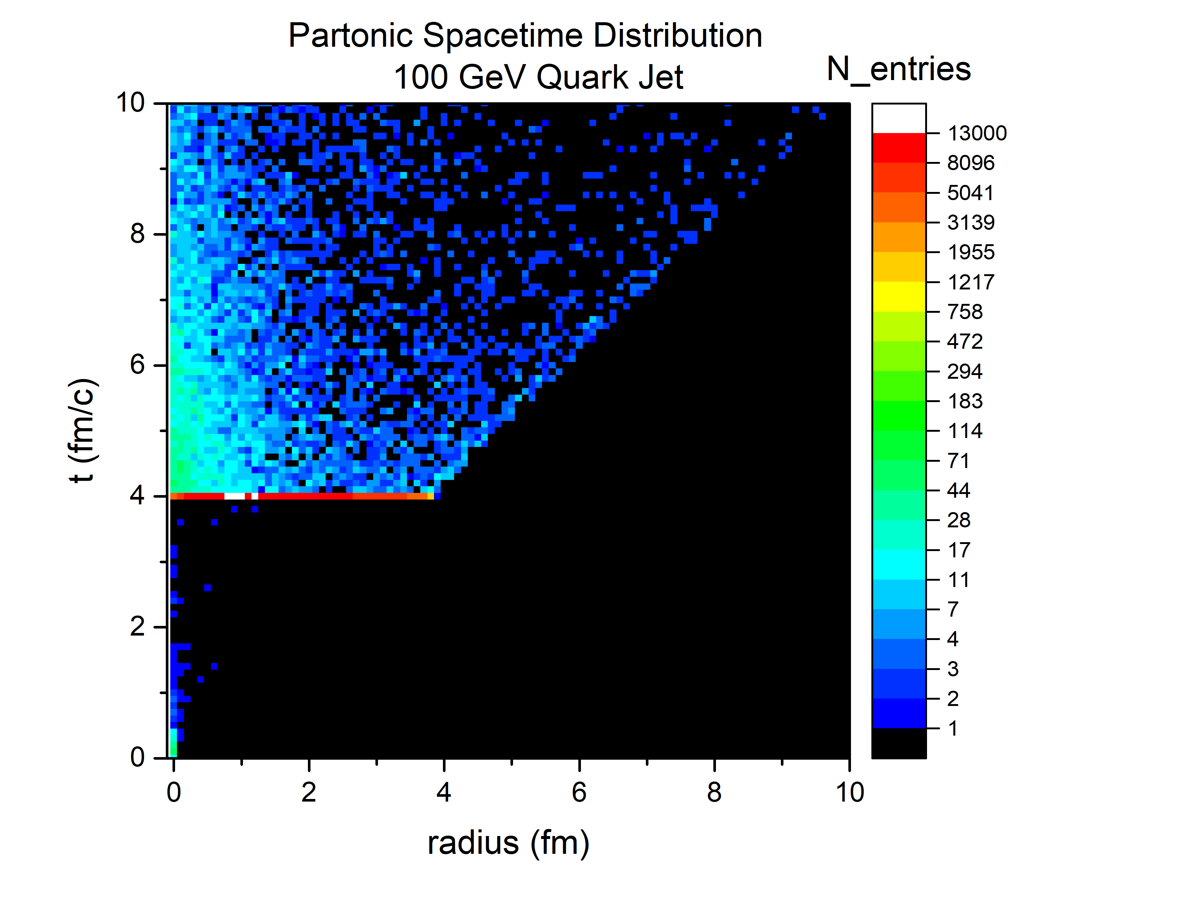

In-Medium Jets: Space-Time Considerations
Sampled spatial positions of shower partons after shower evolution for 100 GeV jets (arb. normalization)
Here: JETSCAPE:pGun+MATTER+LBT+Brick
The cores of 100 GeV jets punch through 4 fm of QGP
Time since jet was created
Shower partons inside QGP are absorbed by the medium or accumulate on the hypersurface;
color is randomized
QGP Medium
The jet starts in QGP; the temperature is set to drop below $T_{c}$ after 4 fm/c
Direction transverse to the jet

Slide 19

Excited Mesons and their decays
We include excited mesons up to $N=2k+l=4$.
When using PYTHIA 8 for decays: available excited states are limited, but the user can easily add more.
Many more resonances in the PDG -> add
Add as of yet unconfirmed bound states in a multiplet: extrapolate properties.
PDG states
Unconfirmed states

Slide 20
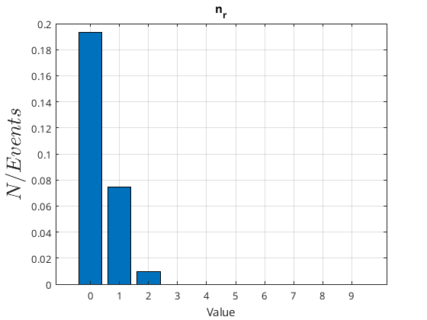
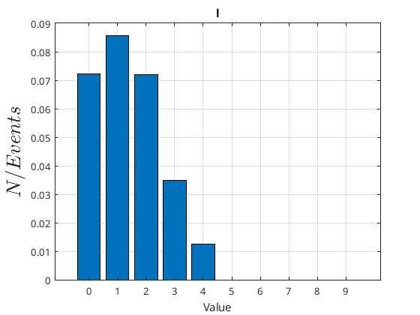
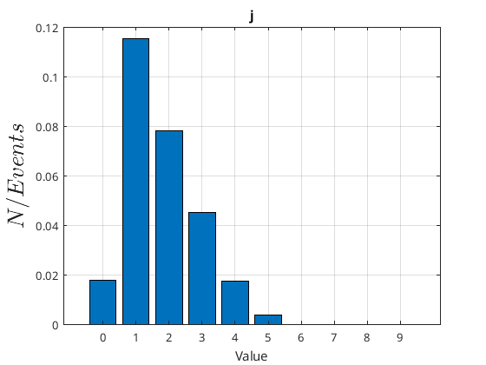

Excited Hadron States are important
In the recombination channel, occupation numbers of excited hadron states are determined by their respective probabilities.
Here: meson states up to $N=2k+l=4$. Parton input from PYTHIA 8 e+e- at 91 GeV
No decays. Spin treated statistically, color flow from PYTHIA.
(Hadrons from recombination only)
Radial
Orbital angular mom.
Total angular mom.

Slide 21
Results: Vacuum Systems
Hadronization can only be tested and tuned in conjunction with the codes that create the parton input
Ongoing effort to create a new set of vacuum tune for JETSCAPE 3.6:PYTHIAgun+MATTER+HH
Bayesian Inference with a blend of parameters from MATTER, HH and PYTHIA 8 fragmentation

Slide 22
JETS IN Four Different Systems
ALEPH data for e+e- at 91.2 GeV
STAR pp at 200 GeV, CMS at 2.76 TeV, ATLAS at 13 TeV
ALEPH: https://doi.org/10.17182/hepdata.47582
Preliminary

Slide 23
Adding Identified Hadrons
ALEPH data for e+e- at 91.2 GeV
Preliminary

Slide 24
In Medium Behavior: Channels
Preliminary

Slide 25
In-Medium Jets: Baryon enhancement
We recover a key signature of quark recombination: baryon/meson enhancement in a medium
Hadronization is sensitive to medium flow.
Preliminary

Slide 26
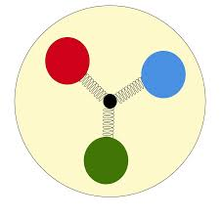

Small Systems and EIC
In principle, the existing HH Monte Carlo code is suitable for p+A and e+A
Key question: Modeling of the underlying/soft event (hydro? partons and strings? …)
E.g. in cold nuclear matter: replace nucleons by valence quarks with string junctions → can be handled by existing code

Slide 27
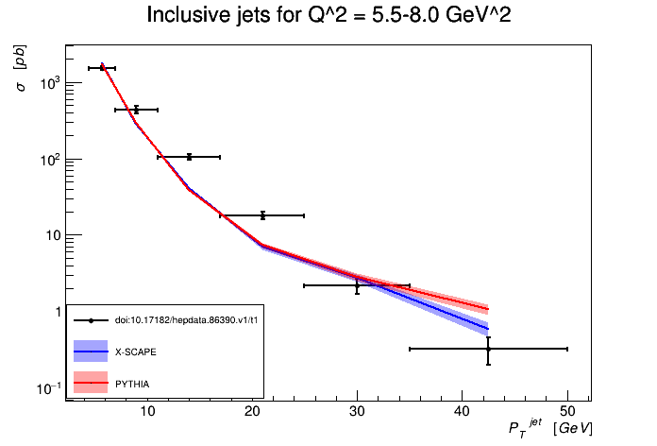
XSCAPE in the EIC ERA
A “ep-gun” will be added to XSCAPE, allowing for event generation photoproduction and DIS processes.
The new module is undergoing testing right now.
One example: H1 jets
Preliminary

Slide 28




Polarized HADRONS
If we don’t sum recombination probabilities over magnetic quantum numbers they are sensitive to the angular momentum component $L_{z}$ of the quarks.
If the collective motion of the quarks carries net orbital angular momentum, hadronization can give you correspondingly polarized $p$- and $d$-wave mesons.
Not yet implemented in a Monte Carlo.
$P_{011}=e^{−v}\left(\frac{1}{2}v_{T}+\frac{L_{z}}{2ℏ}\right)$
$P_{011}=e^{−v}v_{L}$
$P_{01 −1}=e^{−v}\left(\frac{1}{2}v_{T}−\frac{L_{z}}{2ℏ}\right)$
$L_{z}$ selects a preferred polarization of the meson
$v_{T}$, $v_{L}$: squared phase space distance perpendicular and parallel to the quantization axis.

Slide 29
Work in Progress hadronic Rescattering for JETS
HH in JETSCAPE has not the capability to send hadrons from hard processes to an hadronic afterburner (in addition to sending soft hadrons)
Ongoing work: Follow up the pion jet + hadron gas study by Dorau et al. Phys.Rev.C 101, 035208 (2020) using SMASH.
J. Weil et al., Phys. Rev. C 94, 054905 (2016)
Slide by D. Oliinychenko

Slide 30


Work in Progress hadronic Rescattering for JETS
$e^{+}+e^{−}$ charged hadrons at 91.2 GeV: Hybrid Hadronization + SMASH
Runs: SMASH decays only and SMASH rescattering with two assumptions about the duration of the hadronization process
Up to 15% effets observed depending on system density (explored by the time parameters)
Preliminary
Preliminary
$$with H. Roch, H. Elfner$$

Slide 31
summary
Hybrid Hadronization is an attempt to model particle-by-particle hadronization consistently from very small to very large systems
Recombination in Wigner formalism + string fragmentation
Vacuum systems (e+e-, pp) computed with HH in JETSCAPE
Clear medium effects: baryon enhancement and manifestation of flow
Hadronic rescattering study for hard probes
Ready to be explored for small systems and EIC

Slide 32
Backup

Slide 33
JETS in Hybrid Hadronization
Decay gluons provisionally into qqbar pairs (gluons whose quarks don’t recombine are later reformed)
Go through all possible quark pairs/triplets, compute the recombination probability and sample it. Recombine the pair/triplet if successful.
Rejected partons again form acceptable string systems (only color singlets removed!)
Remnant strings are fragmented by PYTHIA 8.
Remnant strings from color flow
String Fragmentation

Slide 34
Background subtraction example
Example for subtraction of “negative” particles for jet in a 2 fm brick.

