Slide 1
Bayesian Methods for Finding Jets in
Heavy Ion Collisions
Ron Soltz
Lawrence Livermore National Laboratory

Slide 2
Outline
Why are we here ?
Heavy Ion Collisions & Finite T QCD
Jets in Heavy Ion Collisions
Bayesian Methods for Finding Jets
Other Applications

Slide 3
Why are we here (at the INT) ?
It’s the QCD Lagrangian (our most perfect theory)
Analytic Solution Exists for one Problem
  high energy scattering (jet production)
Models and/or Numerical Techniques needed for
  nuclear structure/reactions
  nuclear astrophysics
  finite temperature phenomena
Bayesian Methods are good fit for (messy) Nuclear Physics

Slide 4
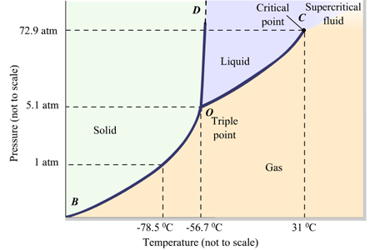
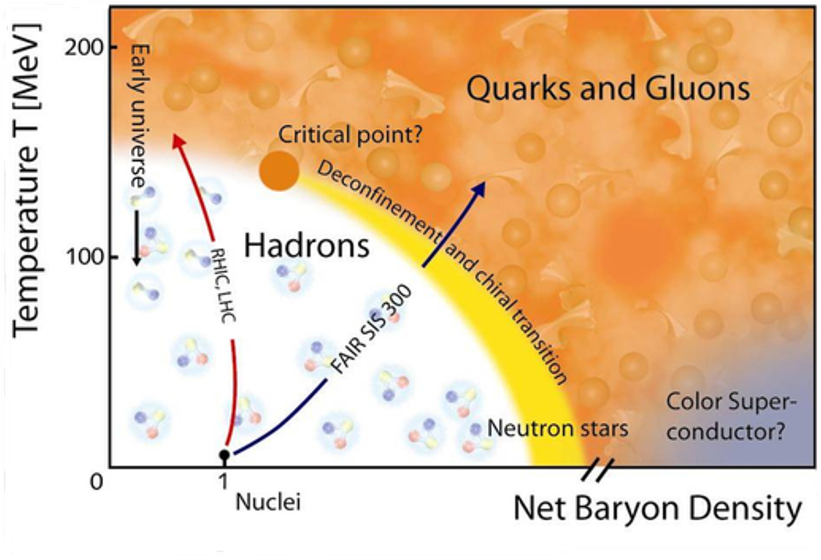
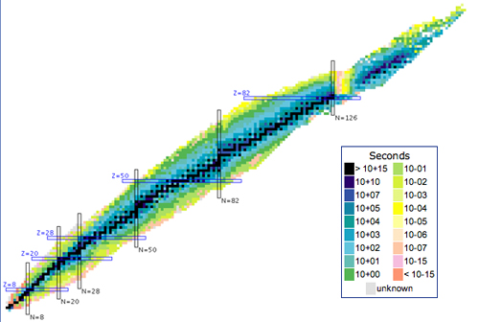
Quark Gluon Plasma (QGP) Phase Diagram
H₂O
(10¹⁰ K)
Heavy Ion Models
7*
*from Kyle’s talk, 1.4 m_{sol}/(4/3 π (12km)³ = 7

Slide 5
Digression
How we now know that there is no true phase transition separating quark-gluon plasma from nucleons
Pratt (15), Moreland (16), W-B and HotQCD (14)

Slide 6
Relativistic Heavy Ion Collision History
First theory: Chapline et al. (73), Bjorken (83)
Experimental Program
  LBL-Bevalac 1980s
  BNL-AGS/CERN-SPS 80s and 90s
  BNL-RHIC 2000 – 2025 1st Compelling Results
  CERN-LHC 2009 – 20?? Flow and Jet Quenching
First attempt at Bayesian Methods began in 2009.
Jets
p+p vs. Au+Au
Flow
Both initial results are measurements of asymmetry

Slide 7
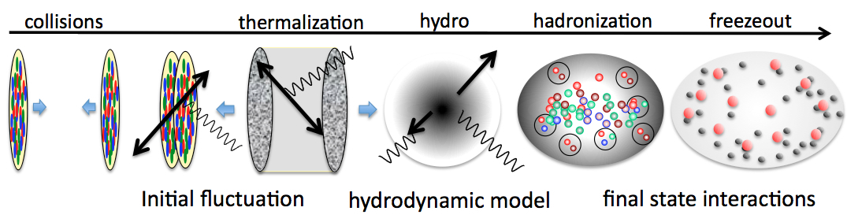
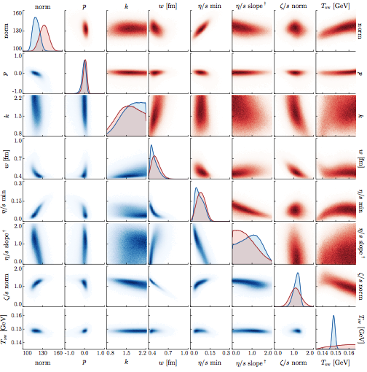
The Heavy Ion Model
Bulk properties (T,V,ρ,η/s,ξ) now constrained →
  previous talks by Scott, Steffen/Jonah
Remaining questions require jets (& heavy quarks)
  What are the (strongly interacting) constituents ?
  How does the QGP form (thermalize) ?

Slide 8
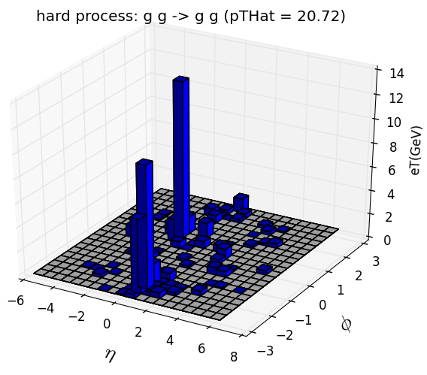
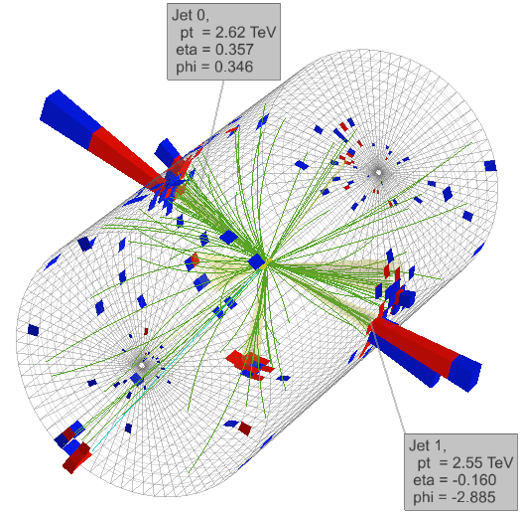
Jet Production in p+p collisions
Jets = highly collimated streams of produced by hard scattering of quarks/gluons
  jet production calculated precisely in perturbation theory
  fragmentation into particles (hadrons) modeled with PYTHIA Monte Carlo model of Lund String Fragementation
  For our purpose, p+p jet models have no tunable parameters
Experiment
Pythia Model
φ
η=-½ln(tan(θ/2)

Slide 9
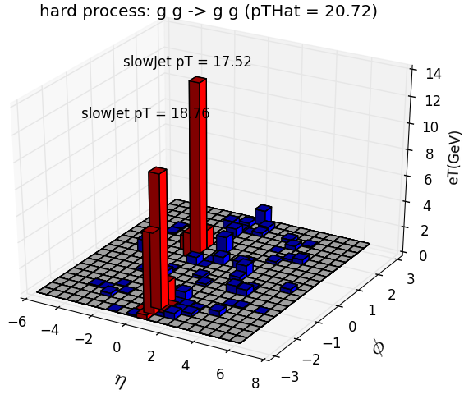
Analyzing Jets in p+p collisions
Experimentalists rely on jet-finding algorithms to identify and study jets
  particles are combined in pair-wise fashion for small values of (ΔR_{ij})²/R² = [(y_{i}-y_{j})²+(ϕ_{i}-ϕ_{j})²]/R², R=jet-cone radius
  jet-finding proceeds until all particles above specified momentum (p_{T}) within radius (R) are combined
  this works well for p+p and e+e- collisions
jet finder

Slide 10


Jets fragmentation in vacuum and QGP
use photon-quark jet as example
  photon escapes unscathed, with unmodified jet energy
  quark jet modified by plasma
  jet-finder to contend with reduced energy jet within high multiplicity backgrounds
p+p
Au+Au
jet processes in p+p
quark (parton) distribution function – measured with DIS
QCD scattering cross-sections – calculated perturbatively
string fragmentation – modeled, parameters tuned with data
jet processes in QGP
first two process same as p+p
full jet evolution model under construction →
Pythia
Present theory depends on

Slide 11
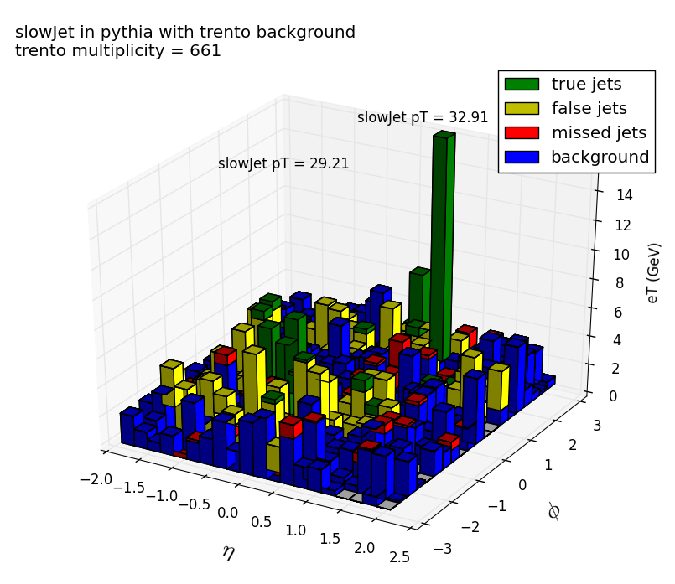
Jets in Heavy Ion Collisions
Jets scatter, radiate, loss energy as they traverse QGP
This process is governed by parameters
  diffusion: q = <p_{T}>², drag: e = <p_{z}>/L
  and higher moments of <p⁴_{T}>, <p²_{z}>, etc.
Energy loss + backgrounds will challenge jet finding algorithms
^
^
R=0.4 RHIC Simulation
LHC Data

Slide 12
My goals for this workshop (and beyond)
Understanding jets in heavy ion physics depends on our ability to find them using algorithms developed for simpler environments (p+p and e+e-)
The most interesting jets are the hardest to find
  the ones that couple most strongly to the medium
Can we develop simple model to apply jet-modification to Pythia outputs, add heavy ion backgrounds, and compare directly to particle distributions ?
Bayesian approach to extract jet quench parameters from data

Slide 13
Develop simple model to test idea
Use 3 Component Model
  Generate photon-quark jets with Pythia
  Modify jet-outputs with q, e parameters
    loop over particle list
      rescale momenta || to jet axis (drag)
      add to momenta | to jet axis (diffusion)
  Generate heavy ion background particles
    Multiplicity = number of particles
    Geometry = generate L for transport
    Particle Flow = determined by geometry
Have all we need for heavy ion backgrounds in initial state

Slide 14
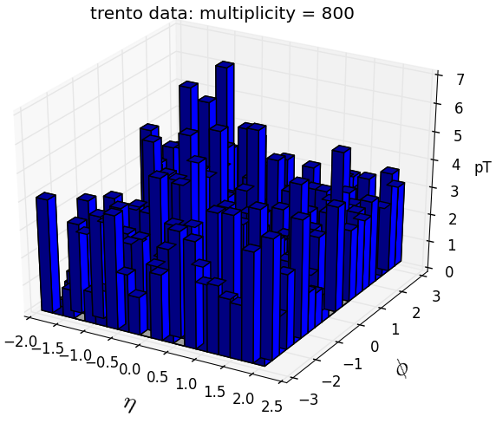
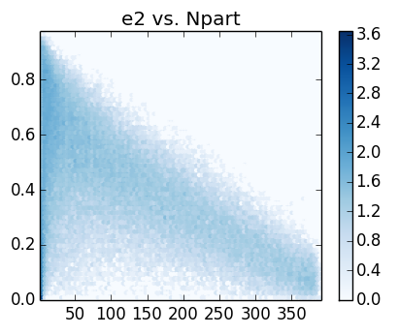
Heavy Ion Backgrounds with T_{R}ENTO
T_{R}ENTO = Thickness_{Reduced} Event Nuclear Topology
Monte Carlo samples reduced nuclear thickness
  Settings : input nuclei, energy dependent n-n cross-section
  Parameters : p=0 (weights), k=1.4 (binomial factor)
    constrained independently
  Outputs : entropy=multiplicity, ε₂, ε₃, ε₄, ε₅
φ

Slide 15
T_{R}ENTO Multiplicity Study
Joseph Simpson, USNA

Slide 16
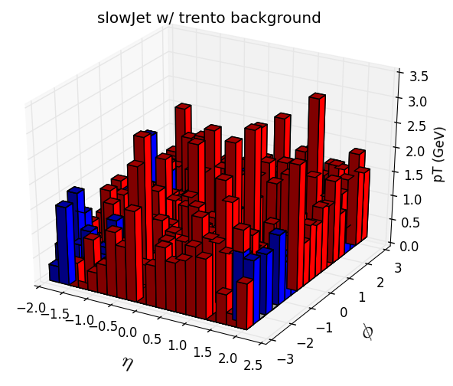
T_{R}ENTO with Flow and Jet-Finder
anti-k_{T}
with R=0.7

Slide 17
Bayesian Formulation
Model θ = Pythia + Re-Scaling + T_{R}ENTO
Model Parameters to Constrain: q, e
Other Parameters: mult, L, ε₂, p_{CM},R
  mult can be measured, and L inferred
  R = cone-like radius opposite photon-jet
Measurements: p_{jet} (photon), p_{i} for particles/cells
Bayesian formulation
  P[θ(e,q, ε₂);mult,p_{jet}, p_{i}] ≈ exp –Σ[y_{i}^{model}(x)-y_{i}^{exp}(x)]/(2σ_{i}²)
  errors are from summing particle/cells (Poisson)

Slide 18
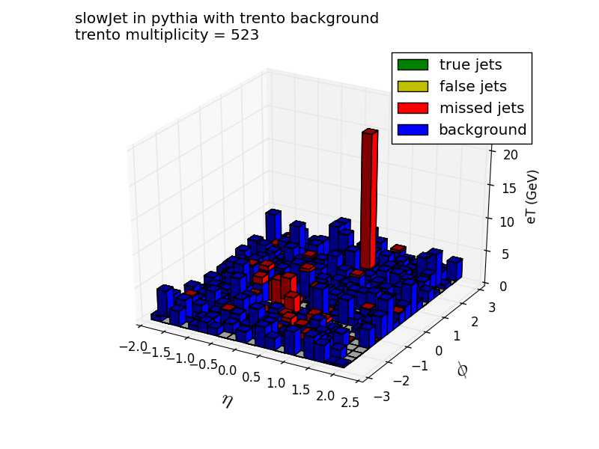
Figure for discussion
sum over cells
and compare to
model for same
p_{jet} and mult

Slide 19
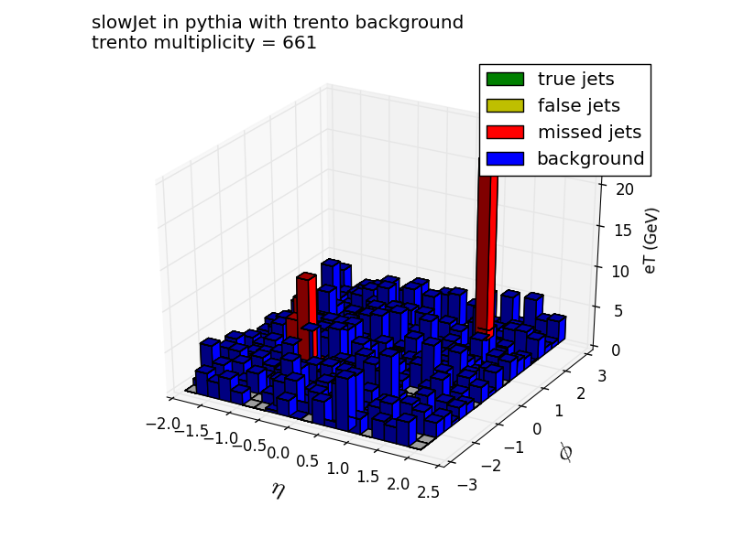
Another figure for discussion

Slide 20
Questions
Is this approach sensible ?
Which assumptions are suspect ?
What have I missed ?
Has this approach already been attempted ?
  see DataScience@LHC2015 talk by SLAC scientists
Where do I get started : MADAI, mtd@github ?
How does this relate to nuclear detection/attribution ?

Slide 21
JETSCAPE Collaboration (2016-2020)
Jetscape plans develop new event generator to model full physics of jets in QGP, constrain with data
Data comparison may benefit from this work

