Slide 1


Basis Light-front Approach to Nuclear Physics
Xingbo Zhao
With Yang Li, Guangyao Chen,
Bolun Hu, Anton Ilderton, James Vary
Institute of Modern Physics
Chinese Academy of Sciences
Lanzhou, China
Institute of Nuclear Theory, Seattle, May. 27, 2016

Slide 2
Outline
Basis Light-Front Quantization (BLFQ)
Time-dependent Basis Light-Front Quantization (tBLFQ)
  Formalism
  Examples: nonlinear Compton scattering, electron-ion collision
Time-dependent Basis Function (tBF)

Slide 3
Ab initio Shell Model vs BLFQ
Hamiltonian formalism
Low-energy Nuclear Physics
Quantum mechanics
Nucleon degrees of freedom
Nonrelativistic system
Particle number is conserved
Renormalization is tractable
Galilean boost invariant
Effective Hamiltonian: complicated
Hamiltonian formalism
Hadron Physics
Quantum field theory
Parton degrees of freedom
Relativistic system
Particle number is not conserved: multi-Fock sectors
Renormalization is difficult: divergences beset
Lorentz boost invariant
Gauge theory: gauge symmetry
Fundamental Hamiltonian

Slide 4


Light-front vs Equal-time Quantization
[Dirac 1949]
equal-time dynamics vs v light-front dynamics
Kinematic Generators: $\vec{P},\vec{J}$
Kinematic Generators: $P^{⊥},P^{+},E^{⊥},K^{3},J^{3}$
Notes:
The approach I am introducing today is based on the Light-front field theory. Its basic idea is to solve the Schrodinger equation numerically for the quantum field. The difference from the traditional equal time formalism is that we redefine our light-front time to be the linear combination of the regular time and one of the spatial direction, usually we choose z direction. In the traditional equal time formalism we specify the initial state on a equal time plane and the Schroedinger equation will tell us its evolution time on future times. In the light front theory we specify the initial state on the equal light front surface and the Schrodinger equation will evolve afterwards. The benefits of the lightfront theory includes the fact that the Hamiltonian operator does not have the square root in it. also its amplitude is boost invariant and has simpler vacuum structure.

Slide 5
Common Variables in Light-front Dynamics
Light-front time
Light-front Hamiltonian
Longitudinal coordinate
Longitudinal momentum
Transverse coordinate
Transverse momentum
Equal-time dispersion relation
Light-front dispersion relation

Slide 6
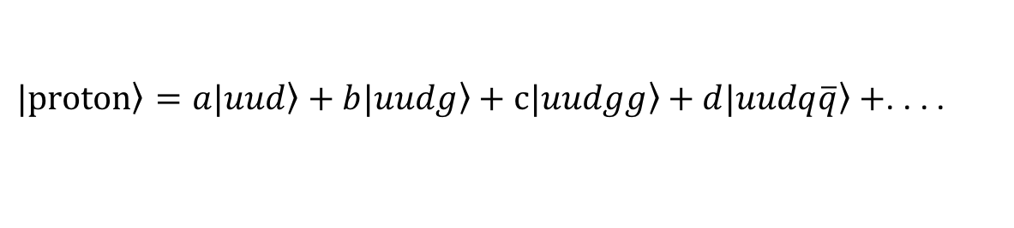
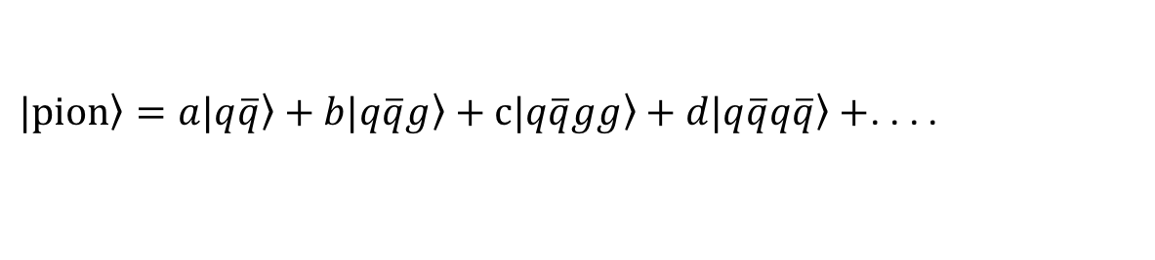

Why Light-front?
Boost invariant light-front wave-function
Simple light-front vacuum $≈$ free theory vacuum
Parton interpretation “gene” of hadron physics
$\left.|proton\right\rangle =a\left.|uud\right\rangle +b\left.|uudg\right\rangle +c\left.|uudgg\right\rangle +d\left.|uudq\overline{q}\right\rangle +$. . . .
$\left.|pion\right\rangle =a\left.|q\overline{q}\right\rangle +b\left.|q\overline{q}g\right\rangle +c\left.|q\overline{q}gg\right\rangle +d\left.|q\overline{q}q\overline{q}\right\rangle +$. . . .
. . . .

Slide 7
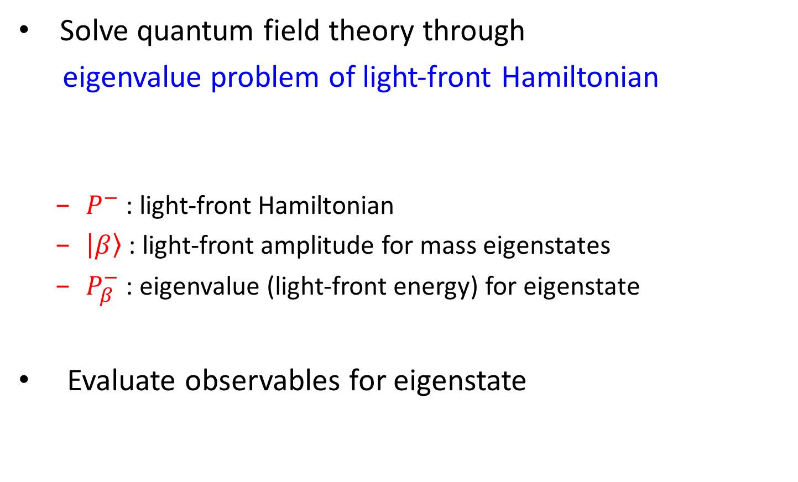
Basis Light-front Quantization
  Solve quantum field theory through
  eigenvalue problem of light-front Hamiltonian
    $P^{−}$ : light-front Hamiltonian
    $\left|\left.β\right\rangle \right.$ : light-front amplitude for mass eigenstates
    $P_{β}^{−}$ : eigenvalue (light-front energy) for eigenstate
  Evaluate observables for eigenstate

Slide 8
General Procedure for BLFQ
Derive LF-Hamiltonian from Lagrangian
Construct basis states
Calculate Hamiltonian matrix elements
Diagonalize (solve ) and obtain its eigenspectrum
Evaluate observables

Slide 9
General Procedure for BLFQ
Derive LF-Hamiltonian from Lagrangian
Construct basis states
Calculate Hamiltonian matrix elements
Diagonalize (solve ) and obtain its eigenspectrum
Evaluate observables

Slide 10
Example: Obtain LF QED Hamiltonian
QED Lagrangian
Derived Light-front Hamiltonian
kinetic energy terms
vertex interaction
instantaneous photon interaction
instantaneous fermion interaction

Slide 11

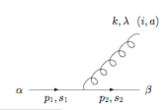

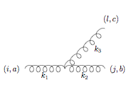
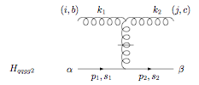
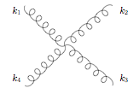
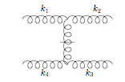
Elementary vertices in LF gauge
QED & QCD
QCD

Slide 12
General Procedure for BLFQ
Derive LF-Hamiltonian from Lagrangian
Construct basis states
Calculate Hamiltonian matrix elements
Diagonalize (solve ) and obtain its eigenspectrum
Evaluate observables

Slide 13
General Procedure for BLFQ
Derive LF-Hamiltonian from Lagrangian
Construct basis states
Calculate Hamiltonian matrix elements
Diagonalize (solve ) and obtain its eigenspectrum
Evaluate observables
Fock-sector expansion + 2D Harmonic Oscillator + 1D Planewave

Slide 14
Basis Construction
Example: single physical electron in QED
  Fock-space expansion
e.g.
  For each Fock particle:
    transverse: 2D-HO basis ( ), labeled by n,m quantum number (HO basis parameter )
    longitudinal: plane-wave basis, labeled by k
  e.g.
  with and

Slide 15
General Procedure for BLFQ
Derive LF-Hamiltonian from Lagrangian
Construct basis states
Calculate Hamiltonian matrix elements
Diagonalize (solve ) and obtain its eigenspectrum
Evaluate observables

Slide 16
QED Hamiltonian in BLFQ Basis
QED LF-Hamiltonian in a small basis: , N_{max}=2, K=1.5
(MeV)
 | 0.3482 (kinetic energy) | -0.0119 ( )
 | -0.0119 ( ) | 0.9139 (kinetic energy)

Slide 17
General Procedure for BLFQ
Derive LF-Hamiltonian from Lagrangian
Construct basis states
Calculate Hamiltonian matrix elements
Diagonalize (solve ) and obtain its eigenspectrum
Evaluate observables

Slide 18
QED Hamiltonian in BLFQ Basis
QED LF-Hamiltonian in a small basis: , N_{max}=2, K=1.5
(MeV)
 | 0.3482 (kinetic energy) | -0.0119 ( )
 | -0.0119 ( ) | 0.9139 (kinetic energy)
Eigenstates:

Slide 19
Eigenspectrum of QED (N_{f}=1) after Renormalization and Removing CM Motion
invariant mass (MeV)
invariant mass (MeV)
N_{max}=K-1/2
N_{max}=K-1/2
Lagrangian multiplier method removes cm motion induced copies
Upon renormalization, physical electron mass (0.511MeV) is achieved

Slide 20
General Procedure for BLFQ
Derive LF-Hamiltonian from Lagrangian
Construct basis states
Calculate Hamiltonian matrix elements
Diagonalize (solve ) and obtain its eigenspectrum
Evaluate observables

Slide 21
Outline
Basis Light-Front Quantization (BLFQ)
Time-dependent Basis Light-Front Quantization (tBLFQ)
  Formalism
  Examples: nonlinear Compton scattering, electron-ion collision
Time-dependent Basis Function (tBF)

Slide 22
Time-dependent Basis Light-front Quantization
BLFQ: for quantum field eigenspectrum
tBLFQ: for quantum field evolution
Real-time framework: BLFQ tBLFQ
tBLFQ is designed for:
  time-dependence in dynamical processes
  in strong/time-dependent background field
BLFQ
tBLFQ

Slide 23
General Procedure for tBLFQ
Derive Light-front Hamiltonian from Lagrangian
Switch to the interaction picture
Prepare the initial (‘in’) state
Evolve the initial state until the background field subsides
Project the scattering final state onto ‘out’ states (constructed out of QED eigenstates) and obtain S-matrix element

Slide 24
General Procedure for tBLFQ
Derive Light-front Hamiltonian from Lagrangian
Switch to the interaction picture
Prepare the initial (‘in’) state
Evolve the initial state until the background field subsides
Project the scattering final state onto ‘out’ states (constructed out of QED eigenstates) and obtain S-matrix element

Slide 25
QED in background EM field
Start from QED Hamiltonian
Replace and obtain

Slide 26
General Procedure for tBLFQ
Derive Light-front Hamiltonian from Lagrangian
Switch to the interaction picture
Prepare the initial (‘in’) state
Evolve the initial state until the background field subsides
Project the scattering final state onto ‘out’ states (constructed out of QED eigenstates) and obtain S-matrix element

Slide 27
QED in background EM field
Time dependence is in external field only
In interaction picture, one need only treat external field induced evolution
Need to work in the eigenstate basis of , obtained by solving

Slide 28
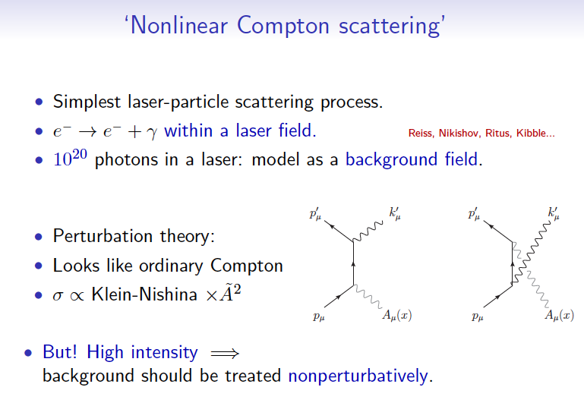
Application to Strong QED:
Nonlinear Compton Scattering
10²⁰ photons in a laser: model as background field
Perturbation theory:
At high intensity:
non-perturbative
treatment needed

Slide 29
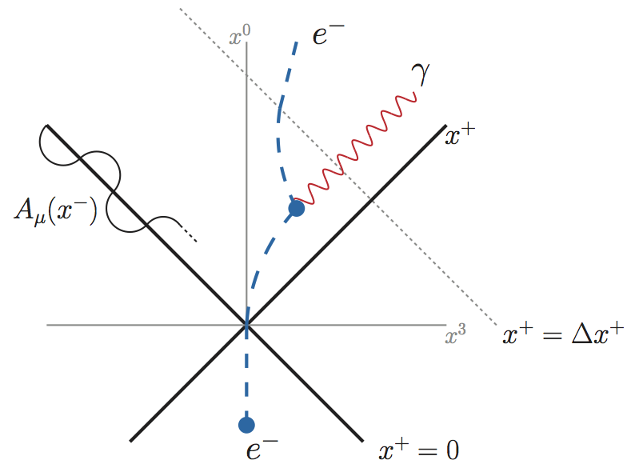
Setup for Nonlinear Compton Scattering
Space-time structure
Two effects: acceleration and radiation
[Zhao, Ilderton, Maris, Vary, PRD 88, 035205 (2013)]
Notes:
The specific process we study is called the nonlinear compton effect, in which an electron absorbs multiple photons from the background laser field and emits a single photon with a frequency which is usually different from the laser frequency. The specific experimental setup in our test case is as follows: initially we put an electron rest in the lab frame and shoot a laser beam to it. At x^0=0 it starts interacting with the laser field, it is accelerated by the laser field as seen from the fact that its trajectory is deflected toward the lightfront surface, in the mean time the electron emits a photon due to bremstrauhlung, after the photon emission the electron continued to be accelerated until leaving the laser area. We also note that the propagating laser beam in the equal-time coordinates sweep out a trajectory between x^+=0 and x^+=Deltax^+ two lines, so propagating

Slide 30
Setup for Nonlinear Compton Scattering
Space-time structure
Two effects: acceleration and radiation
Laser trajectory
[Zhao, Ilderton, Maris, Vary, PRD 88, 035205 (2013)]
Notes:
The specific process we study is called the nonlinear compton effect, in which an electron absorbs multiple photons from the background laser field and emits a single photon with a frequency which is usually different from the laser frequency. The specific experimental setup in our test case is as follows: initially we put an electron rest in the lab frame and shoot a laser beam to it. At x^0=0 it starts interacting with the laser field, it is accelerated by the laser field as seen from the fact that its trajectory is deflected toward the lightfront surface, in the mean time the electron emits a photon due to bremstrauhlung, after the photon emission the electron continued to be accelerated until leaving the laser area. We also note that the propagating laser beam in the equal-time coordinates sweep out a trajectory between x^+=0 and x^+=Deltax^+ two lines, so propagating

Slide 31

Test Case in $|\left.e\right\rangle$ Sector
Test background field profile:
[Hu et al, in preparation]

Slide 32
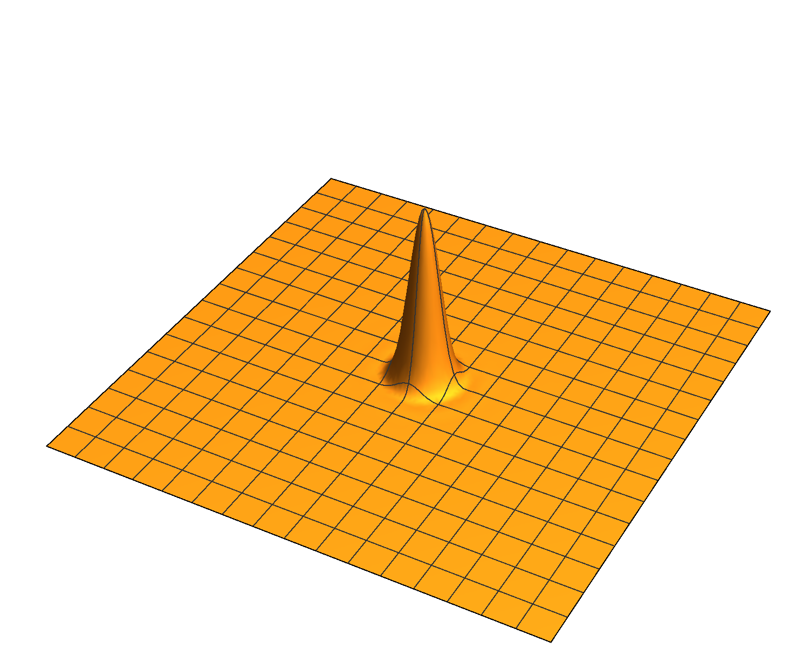
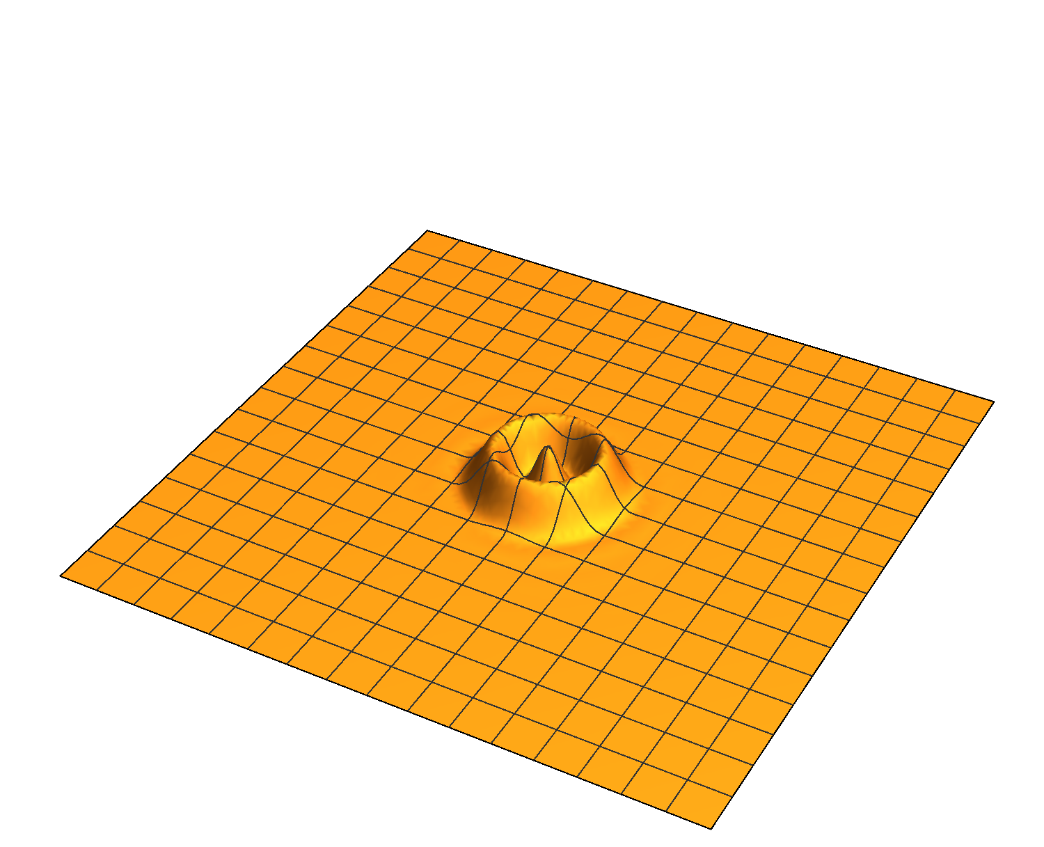
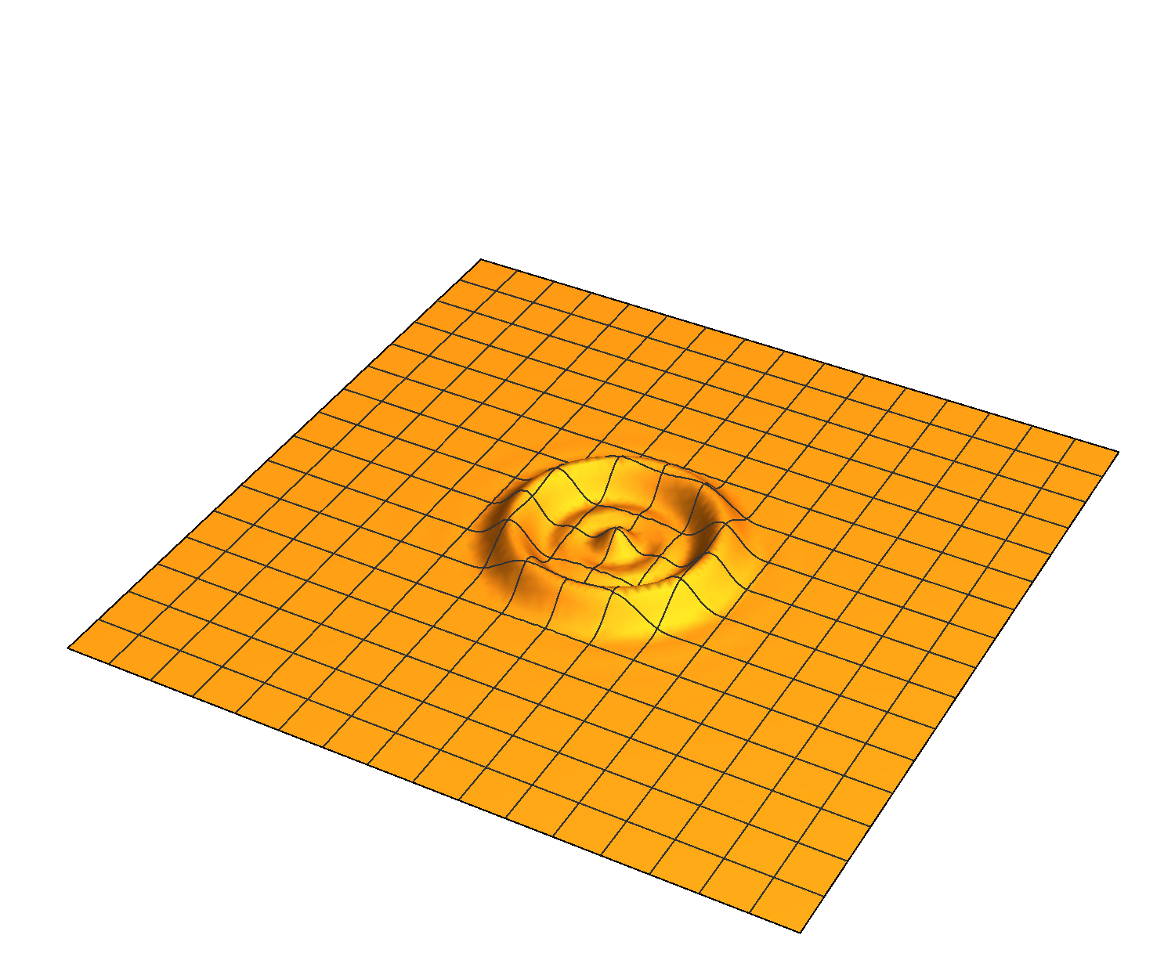
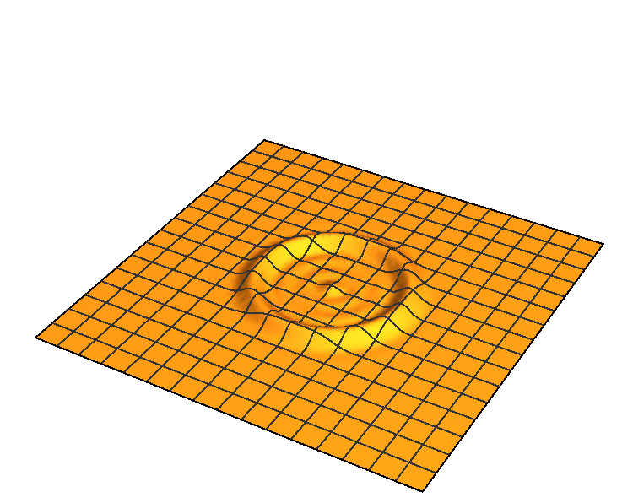
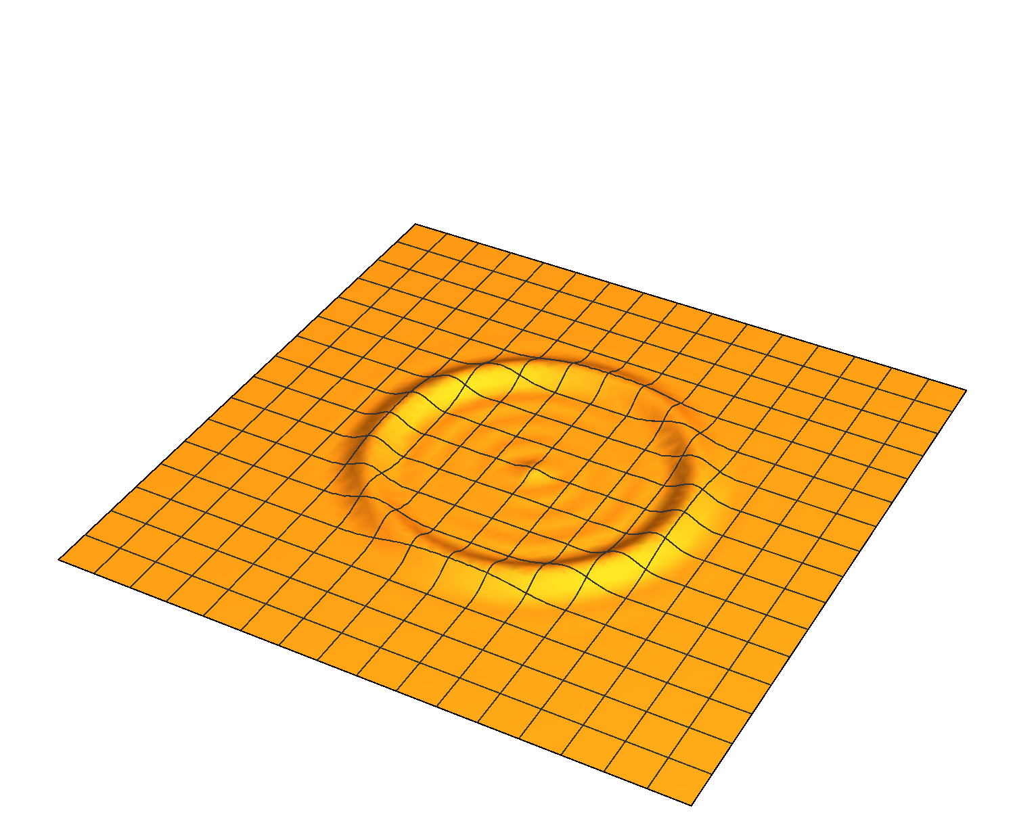
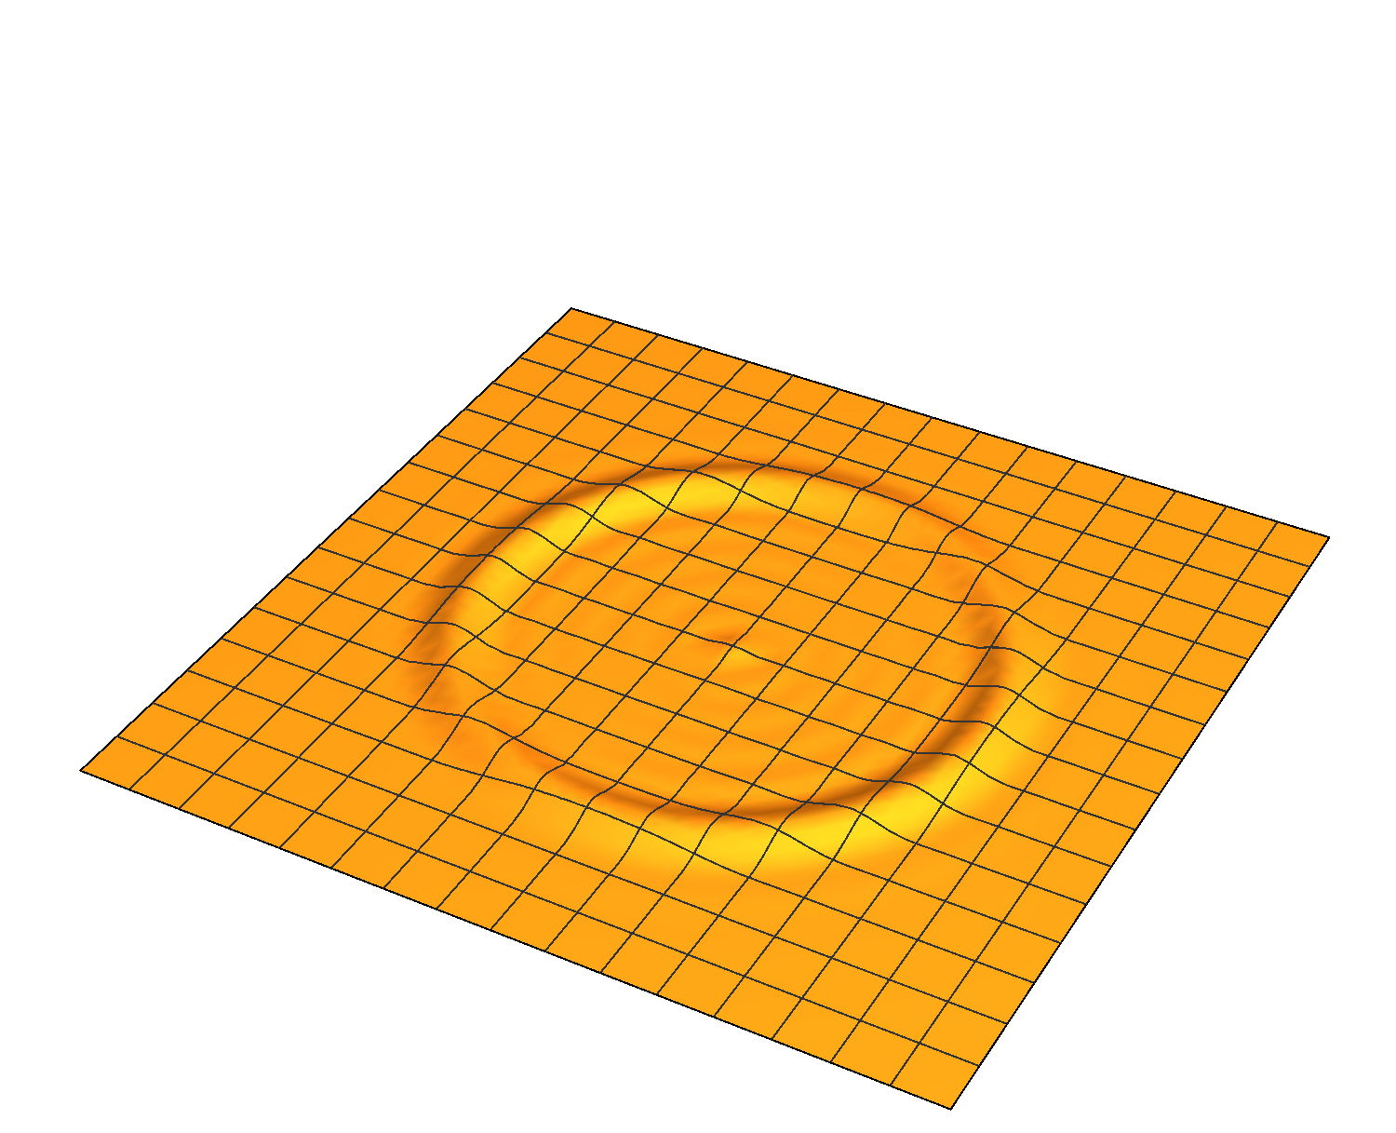


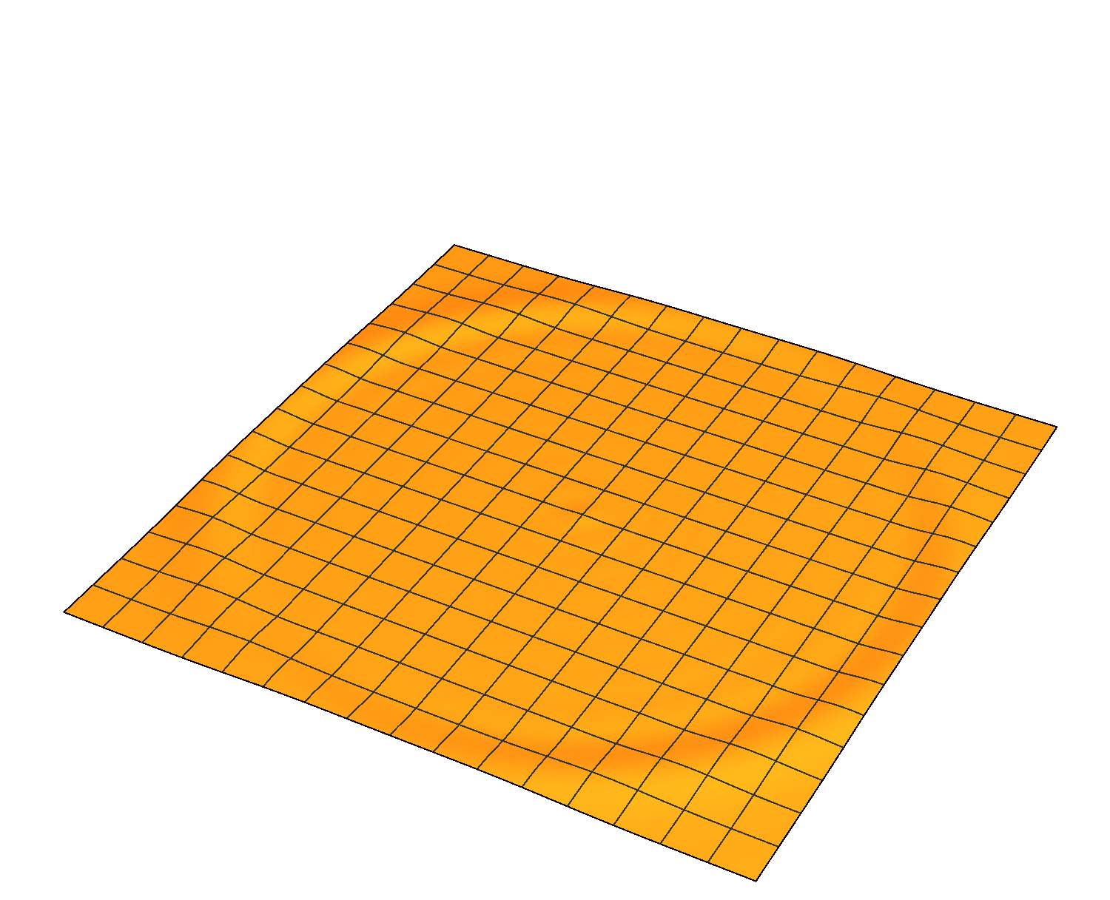
Test Case in $|\left.e\right\rangle$ Sector
[Hu et al, in preparation]
tBLFQ basis states at N_{max}=18:

Slide 33
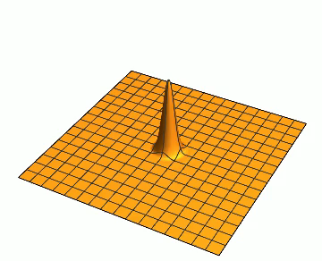
Test Case in $|\left.e\right\rangle$ Sector
Momentum distribution spreads out due to interaction with background EM field
[Hu et al, in preparation]

Slide 34
Results: Nonlinear Compton Scattering
[Zhao, Ilderton, Maris, Vary, PRD 88, 035205 (2013)]
Laser profile: with
Basis space: , N_{max}=8, K: 1.5+3.5+5.5 (three segments)
Initial state (x⁺=0): ground state electron in K=1.5 segment
time (x⁺) evolution
invariant mass (MeV)
invariant mass (MeV)
Notes:
Now let’s come to the numerical results. In this case the laser amplitude is on the same order of the electron mass, so it is expected to be in the nonperturbative regime. The basis includes states with three different longitudinal momenta, 1,4,7 MeVs. The initial state is an electron with longitudinal momenta K=1 MeV. These figures are snapshots of the evolving electron system. In these figures each dot represents a basis state for the system. The y-axis represents its probability and the x-axis represents its invariant mass. The states with invariant mass=0.6 are single-electron states. And the states with invariant mass >0.6 are the electron-photon pair states. Initially the only state in the system is the initial state K=1 ground state electron, no excited states. As time evolves, the single electron states with K=4 eventually 7 emerge as the result of the acceleration by the laser field. At the same time we see excited states populated as a result of the bremsstrahlung.

Slide 35
Results: Nonlinear Compton Scattering
single e states in K=1.5,3.5,5.5 segments
eγ states in K=1.5,3.5,5.5 segments
Acceleration and radiation are treated in the same Hilbert space
Entire process is nonperturbative (initial state changes significantly)
time (x⁺) evolution
invariant mass (MeV)
invariant mass (MeV)
[Zhao, Ilderton, Maris, Vary, PRD 88, 035205 (2013)]
Notes:
From this series of snapshots we can see that the two key effects in the nonlinear Compton scattering acceleration and radiation, are treated in a unified framework. We notice that at the end of evolution the initial state is almost gone.. So it is not a perturbation to the initial state, it is indeed a nonperturbative process.

Slide 36
Invariant Mass Increases Over Time
Invariant mass increases due to photon emission, reflecting energy injection by the background laser field
Experimentally accessible by measuring and
[Zhao, Ilderton, Maris, Vary, PRD 88, 035205 (2013)]

Slide 37
Application to Relativistic Heavy-ion Physics
Classical fields generated by a moving heavy-ion from Maxwell equations
Electron in BLFQ as a quantum object
e
Ion
[Guangyao Chen, et al, in preparation]

Slide 38
Non-perturbative Effects
[Guangyao Chen, et al, in preparation]
Transition rates between two energy Eigenstates
Notes:
Plot shows transition rates between two energy eigen states (E_i=0.0648 GeV and E_f=1.886 GeV) of electron enters e.m. fields at t=0 and exit the e.m. fields at t=T. The e.m. fields are generated by a gold nucleus moving along z axis with rapidity y \approx 5.3. The eigen energy of electron is obtained by diagonalization the BLFQ basis using parameters given above. Nmax=30, K=30, b=1000 m_e, L=10 GeV^{-1}.
We could conclude that tBLFQ calculation agrees with LFPT calculation when the coupling between fields and electron is small. And the higher order effects are significant for the case of heavy nucleus, which are included by tBLFQ formalism.

Slide 39
Transverse Momentum
[Guangyao Chen, et al, in preparation]
Evolution of transverse momentum distribution
Notes:
Plot shows snap shots of the transverse momentum distribution of electron evolving in e.m. fields generated by a gold nucleus moving along z axis with rapidity y \approx 5.3. Initially the transverse momentum in BLFQ basis, k=1/2, n=m=0, helicity \lambda=1/2. After exposed to the fields for ~10 fm/c, the peak depleted by about 30% according to tBLFQ calculation, which is sizable modification. We also notice tBLFQ calculation lies between LO and NLO LFPT calculation.

Slide 40
Longitudinal Momentum
[Guangyao Chen, et al, in preparation]
Evolution of longitudinal momentum distribution
Notes:
Plot shows snap shots of the longitudinal momentum distribution of electron evolving in e.m. fields generated by a gold nucleus moving along z axis with rapidity y \approx 5.3. Initially the transverse momentum in BLFQ basis, k=1/2, n=m=0, helicity \lambda=1/2. After expose to the fields for ~10 fm/c, the probability that the electron stays at initial longitudinal momentum is roughly 70%, according to tBLFQ calculation. Again, we also notice tBLFQ calculation lies between LO and NLO LFPT calculation. Only 5 out of 30 longitudinal momentum are shown.
Bars on markers indicates the fact that the discretized treatment of longitudinal momentum. Not necessarily the actually bins.

Slide 41
Helicity Configuration
[Guangyao Chen, et al, in preparation]
Since helicity-flip process ~ m/pT, study the helicity configuration of tauon instead
Helicity survival probability of tauon in the e.m. fields
Notes:
Plot shows evolution of the helicity configuration of electron evolving in e.m. fields generated by a gold nucleus moving along z axis with rapidity y \approx 5.3. Initially the transverse momentum in BLFQ basis, k=1/2, n=m=0, helicity \lambda=-1/2.

Slide 42
Outline
Basis Light-Front Quantization (BLFQ)
Time-dependent Basis Light-Front Quantization (tBLFQ)
  Formalism
  Examples: nonlinear Compton scattering, electron-ion collision
Time-dependent Basis Function (tBF)

Slide 43
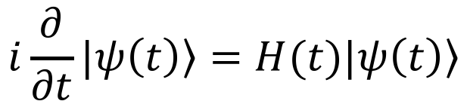
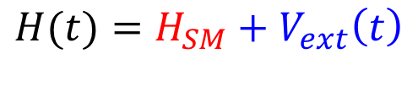
Time-dependent Basis Function Approach
Apply the idea behind tBLFQ to nuclear physics
Study nuclear scattering in a background field
tBLFQ
tBF
$$i\frac{∂}{∂t}|\left.ψ\left(t\right)\right\rangle =H(t)|\left.ψ\left(t\right)\right\rangle$$
$$H(t)=H_{SM}+V_{ext}\left(t\right)$$
Background field

Slide 44
Test Case: d+¹²⁴Sn
In the lab-frame:
Physical motivation: study EoS of nuclear matter, esp. symmetry energy term
Relative momentum between n and p in the final state is affected by the symmetry energy term in the target nuclear potential
Both ImQMD simulation and experimental results available
[Ou Li et al, PRL 115, 212501 (2015)]
¹²⁴Sn
d
n
p

Slide 45
In Deuteron Center-of-Mass Frame
n
[Ou Li et al, PRL 115, 212501 (2015)]
d
¹²⁴Sn
¹²⁴Sn
p
The target approaches the projectile and the classical background field is time-dependent
Trajectory is estimated by ImQMD calculation
Background potential is obtained by Skyrme energy density functional approach

Slide 46
Summary
Basis Light-front Quantization:
  Nonperturbative evaluation of hadron structure
  Natural framework for exotic hadrons
Time-dependent Basis Light-front Quantization:
  Nonperturbative time evolution of quantum field on the amplitude level
  Potential applications in relativistic heavy-ion physics, strong field QED, electron-ion collision physics
Time-dependent Basis Function:
  Nonperturbative time evolution of nucleon wavefunction
  Potential applications in nuclear scattering

Slide 47
Thank you!

