Slide 1
Some developments in few-particle scattering
R. Lazauskas

Slide 2
Contents
Solution of the 5-body Faddeev-Yakubovski equations for nuclear systems
Application of the complex-scaling method to solve scattering problems in Coulombic 3-body systems
25/05/2016
2
2
R. Lazauskas
R. Lazauskas
Notes:
2

Slide 3
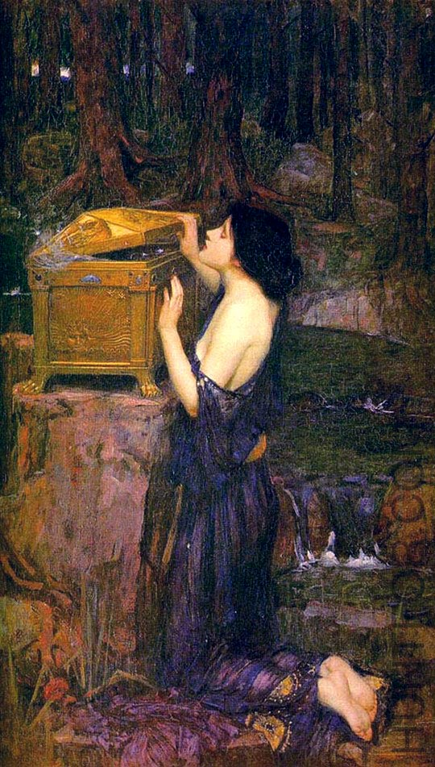
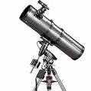
Introduction
Collisions
What to do?
In configuration space wave functions extend to infinity!
Increasingly complex asymptotic behaviour for A>2 systems!!
Take care of the boundary condition
Faddeev-Yakubovsky equations efficiently separates asymptotes of the binary channels
…
J.W. Waterhouse : « Pandora »
25/05/2016
3
3
R. Lazauskas
R. Lazauskas
Notes:
3

Slide 4
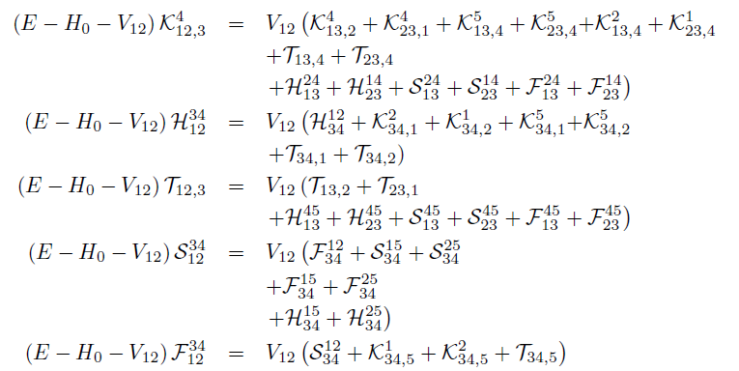
5-body Faddeev-Yakubovski eq
2
1
2
1
2
1
2
1
3
4
3
2
1
3
4
3
4
4
4
3
5
5
5
5
5
25/05/2016
4
4
R. Lazauskas
R. Lazauskas
Notes:
4

Slide 5
5-body Faddeev-Yakubovski eq
2
1
2
1
2
1
2
1
3
4
3
2
1
3
4
3
4
4
4
3
5
5
5
5
5
NUMERICAL SOLUTION
*R.L., PhD Thesis, Université Joseph Fourier, Grenoble (2003).
PW decomposition of the components K,H,T,S,F
Radial parts expanded using Lagrange-mesh method
D. Baye, Physics Reports 565 (2015) 1
Resulting linear algebra problem solved using iterative methods
Observables extracted using integral relations
25/05/2016
5
5
R. Lazauskas
R. Lazauskas
Notes:
5

Slide 6
Numerical costs
2
1
2
1
2
1
2
1
3
4
3
2
1
3
4
3
4
4
4
3
5
5
5
5
5
Problem | Number eq. (ident particles) | Number eq. (diff. particles) | PW basis. | Radial disc.
NN | 1 | 1 | 2 | N
3N | 1 | 3 | ~100 | N²
4N | 2 | 18 | ~10⁴ | N³
5N | 5 | 180 | ~10⁶ | N⁴
NUMERICAL SOLUTION
*R.L., PhD Thesis, Université Joseph Fourier, Grenoble (2003).
PW decomposition of the components K,H,T,S,F
Radial parts expanded using Lagrange-mesh method
D. Baye, Physics Reports 565 (2015) 1
Resulting linear algebra problem solved using iterative methods
Observables extracted using integral relations
25/05/2016
6
6
R. Lazauskas
R. Lazauskas
Notes:
6

Slide 7
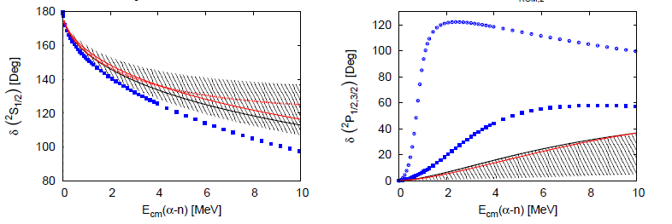
n-⁴He scattering
πEFT LO pot.
J. Kircher, PhD Thesis, FA Universitat, Erlangen (2006)
25/05/2016
7
7
R. Lazauskas
R. Lazauskas
Notes:
7

Slide 8
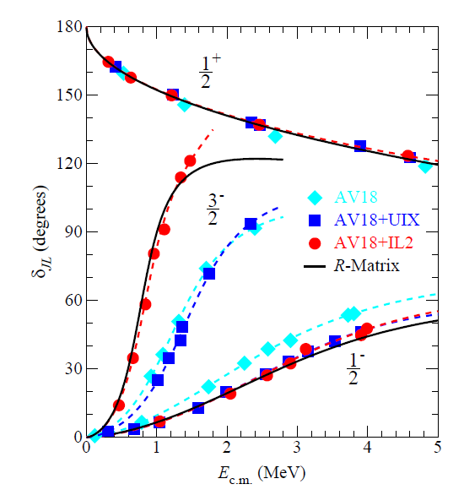
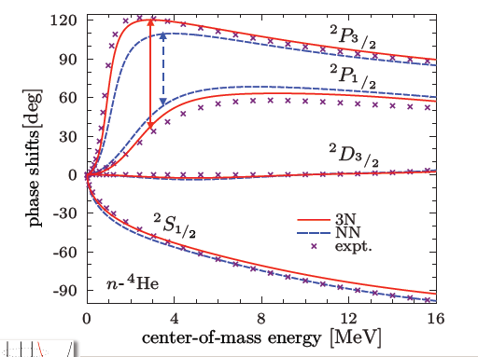
n-⁴He scattering
Idaho N3LO pot.
K.M. Nollett et. al., Phys.Rev.Lett.99:022502,2007
P. Navratil presentation
25/05/2016
8
8
R. Lazauskas
R. Lazauskas
Notes:
8

Slide 9
n-³H total cross section
25/05/2016
9
9
R. Lazauskas
R. Lazauskas
Notes:
9

Slide 10
25/05/2016
10
10
R. Lazauskas
R. Lazauskas
Notes:
10

Slide 11
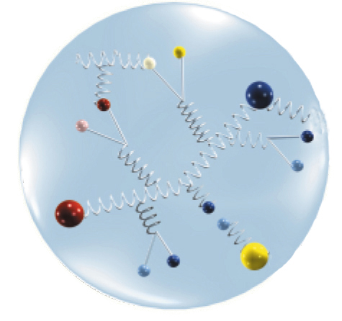
Nucleon
Excitation: ~260 MeV
Binding per N: ~8 MeV
α-particle
p
π
ρ
n
?
n
p
η
Excitation: ~20 MeV
Binding per α: ~3.5 MeV
25/05/2016
11
11
R. Lazauskas
R. Lazauskas
Notes:
11

Slide 12
Physics of α clusters
Ali-Bodmer αα potential
Is it possible to parametrize single
pot. for all waves?
Yes
But you have to project out the deep-lying
2-body bound states!
Buck potential:
$$V=−122.6225\exp\left(−0.22x2\right)+\frac{5.76erf\left(0.75∗x\right)}{x}$$
S-wave: -72.625 MeV; -25.617 MeV
D-wave: -22.00 MeV
S: 79.1%
D: 19.8 %
G: 1.13%
Problem | Ali-Bodmer | Buck | Papp-Moszkowski (fish-bone)* | Exp. (MeV)
⁸Be (0⁺) αα | 0.0828 | 0.179 | 0.0918 | 0.0918
¹²C (0⁺) ααα | -1.52 | -0.28 | -7.27 | -7.275
¹⁶O (0⁺) αααα | -36.3 |  | -57.0 | -14.4
S: 7.5%
D: 24.0 %
G: 64.9%
*Mod.Phys.Lett.B22:2201-2215,2008
25/05/2016
12
12
R. Lazauskas
R. Lazauskas
Notes:
12

Slide 13
Introduction
Collisions
What to do?
In configuration space wave functions extend to infinity!
Increasingly complex assymptotic behavior for A>2 systems!!
Take care of the boundary condition
Faddeev-Yakubovsky equations efficiently separates assymptotes of the binary channels
BUT
Number of the reaction channels increases rapidly with A
Even for 3-body systems there may exist infinite number of binary channels e+H→e+H(n=1,2,…,∞)
Complex behavior of the breakup assymptotes
FIND SOME TRICKS TO AVOID PROBLEMS AT BOUNDARY!
…
25/05/2016
13
13
R. Lazauskas
R. Lazauskas
Notes:
13

Slide 14
Complex scaling: resonances, reactions & bound states in an unified formalism
In Quantum-Mechanics problem of N-particle dynamics may be often formulated in time-independent formalism and for the wave functions whose asymptotes contain only nontrivial outgoing waves
$$\left(E_{sc}−H_{0}−\sum_{i>j}{V_{ij}(r_{ij})}\right)ψ\left(r_{i}\right)=S\left(r_{i}\right)$$
$$k_{I}$$
Bound state problem: $S\left(r_{i}\right)≡0$
Resonances$: S\left(r_{i}\right)≡0$
Reactions due to external probe$: S\left(ρ→∞\right)=0$
Collisions:$S\left(r_{i}\right)≡0$
B. States
Scattering
$$k_{R}$$
Resonances
$k_{res}= k_{R}− ik_{I}$= ${|k}_{res}|e^{−iη_{res}}$
$$ψ(ρ→∞)∝e^{ik_{x}r_{x}}$$
$$ψ_{sc}(ρ→∞)∝{ψ_{in}\left(r_{i}\right)+\sum_{c}{A_{c}({\hat{k}}_{c})}e}^{i{|k}_{c}|r_{c}}$$
25/05/2016
R. Lazauskas
R. Lazauskas
Notes:
14

Slide 15
Complex scaling: resonances, reactions & bound states in an unified formalism
R. Hartree , J.G. L. Michel, P. Nicolson (1946)
J. Nuttal and H. L. Cohen, Phys. Rev. 188 (1969) 1542
Complex scaling kills outgoing waves in the assymptote
$$\tilde{ψ} \left(ρ→∞\right)∝e^{ik_{x}r_{x}e^{iθ}}=e^{ik_{x}r_{x}cosθ}e^{−k_{x}r_{x}sinθ}$$
25/05/2016
R. Lazauskas
R. Lazauskas

Slide 16
Complex scaling: resonances, reactions & bound states in an unified formalism
In Quantum-Mechanics problem of N-particle dynamics may be often formulated in time-independent formalism and for the wave functions whose asymptotes contain only nontrivial outgoing waves
$$\left(E_{sc}−H_{0}−\sum_{i>j}{V_{ij}(r_{ij})}\right)ψ\left(r_{i}\right)=S\left(r_{i}\right)$$
Bound state problem: $S\left(r_{i}\right)≡0$
Resonances$: S\left(r_{i}\right)≡0$
Reactions due to external probe$: S\left(ρ→∞\right)=0$
Collisions:$S\left(r_{i}\right)≡0$
$$ψ(ρ→∞)∝e^{ik_{x}r_{x}}$$
$$ψ_{sc}(ρ→∞)∝{ψ_{in}\left(r_{i}\right)+\sum_{c}{A_{c}({\hat{k}}_{c})}e}^{i{|k}_{c}|r_{c}}$$
Diverges
25/05/2016
R. Lazauskas
R. Lazauskas
Notes:
16

Slide 17
Complex scaling: resonances, reactions & bound states in an unified formalism
R. Hartree , J.G. L. Michel, P. Nicolson (1946)
J. Nuttal and H. L. Cohen, Phys. Rev. 188 (1969) 1542
Complex scaling kills outgoing waves in the assymptote
$$\tilde{ψ} \left(ρ→∞\right)∝e^{ik_{x}r_{x}e^{iθ}}=e^{ik_{x}r_{x}cosθ}e^{−k_{x}r_{x}sinθ}$$
exp. bound if 0<θ<π
Schrödinger equation in a driven form:
$$rΨ\left(r\right)={F_{l}^{}}_{}^{in}\left(r\right)+{F_{l}^{}}_{}^{sc}(r)$$
$$\frac{ℏ^{2}}{2μ}\left(−\frac{d^{2}}{dr^{2}}+\frac{l\left(l+1\right)}{r^{2}}−k^{2}\right){F_{l}^{}}_{}^{in}\left(r\right)=0$$
$\frac{ℏ^{2}}{2μ}\left(−\frac{d^{2}}{dr^{2}}+\frac{l\left(l+1\right)}{r^{2}}+V_{l}\left(r\right)−k^{2}\right){F_{l}^{}}_{}^{sc}\left(r\right)=$-$V_{l}\left(r\right)$ ${F_{l}^{}}_{}^{in}\left(r\right)$
Complex scaling
$\frac{ℏ^{2}}{2μ}\left(−\frac{d^{2}}{e^{2iθ}dr^{2}}+\frac{l\left(l+1\right)}{{e^{2iθ}r}^{2}}+V_{l}\left(re^{iθ}\right)−k^{2}\right){{\tilde{F}}_{l}^{}}_{}^{sc}\left(r\right)=$-$V_{l}\left(re^{iθ}\right)$ ${F_{l}^{}}_{}^{in}\left(re^{iθ}\right)$
exp. bound for the short
range pot. term V^{s}
17
25/05/2016
R. Lazauskas
R. Lazauskas

Slide 18
Complex scaling: resonances, reactions & bound states in an unified formalism
Presence of Coulomb (or long range interaction)
$V_{l}\left(r\right)$= $V_{l}S\left(r\right)\text{+}{Vl}_{}^{long}\left(r\right)$
$$\frac{ℏ^{2}}{2μ}\left(−\frac{d^{2}}{dr^{2}}+\frac{l\left(l+1\right)}{r^{2}}−k^{2}+{Vl}_{}^{long}(r)\right){F_{l}^{}}_{}^{in}\left(r\right)=0$$
Schrödinger equation in a driven form:
$$rΨ\left(r\right)={F_{l}^{}}_{}^{in}\left(r\right)+{F_{l}^{}}_{}^{sc}(r)$$
$\frac{ℏ^{2}}{2μ}\left(−\frac{d^{2}}{dr^{2}}+\frac{l\left(l+1\right)}{r^{2}}+V_{l}\left(r\right)−k^{2}\right){F_{l}^{}}_{}^{sc}\left(r\right)=$-$V_{l}S\left(r\right){F_{l}^{}}_{}^{in}\left(r\right)$
$$\left(V_{l}\left(r\right)−{Vl}_{}^{long}\right)$$
Complex scaling
$\frac{ℏ^{2}}{2μ}\left(−\frac{d^{2}}{e^{2iθ}dr^{2}}+\frac{l\left(l+1\right)}{{e^{2iθ}r}^{2}}+V_{l}\left(re^{iθ}\right)−k^{2}\right){{\tilde{F}}_{l}^{}}_{}^{sc}\left(r\right)=$- $V_{l}S \left(re^{iθ}\right)$ ${F_{l}^{}}_{}^{in}\left(re^{iθ}\right)$
exp. bound for the short
range pot. term V^{s}
18
25/05/2016
R. Lazauskas
R. Lazauskas

Slide 19
Complex scaling: reactions
Subtelties for N>2 case A. Deltuva, R.L. et al.,PPNP 74 (2014)
Complex scaling parameter is limited
Incorporation of long range interactions
Inhomogenious term in the driven Schrödinger eq:
$$a$$
$${\vec{r}}_{a,b}$$
$$b$$
$$\left[\sum_{i∈a;j∈b}^{N}{V_{ij}\left({\vec{r}}_{ij}\right)−}V{}_{ij}^{C}{{(r}_{a,b}})\right]ψ_{bs}{\left({\vec{r}}_{a},{\vec{r}}_{b}\right)F}_{l}in({q_{a,b}r}_{a,b})$$
$$fcut(r_{a,b})$$
Long-range residual terms ~$\frac{1}{{{(r}_{a,b})}^{n}}$with n≥2 for problems including Coulomb
For the problem dominated by short-range interactions these residual terms are not important! Clearly we may screen this term!
R. Lazauskas
Notes:
19

Slide 20
Review of the method*
Complex scaling method is very functional, adaptable to almost any b.s. technique. Already successfully applied using:
Spline basis
Laguerre, HO, Gaussian, correlated Gaussian, Sturmian basis functions
Lagrange mesh method
T. Myo, Y. Kikuchi, and K. Katō, Phys. Rev. C 85, 034338 (2012) , Attila Csótó, Phys. Rev. C 49, 2244 (1994), B. Gyarmati and A. T. Kruppa, Phys. Rev. C 34, 95 (1986)
External probes
2-body, 3-body,4-body systems, including repulsive Coulomb
T.M, K. Kato, S. Aoyama and K. Ikeda PRC63(2001)054313, T.Myo, K. Kato, H. Toki, K. Ikeda, PRC76(2007) 024305
Collisions, demonstrated to work for:
2-body collisions including Coulomb interaction, Optical potentials, $\frac{1}{r^{n}}$ potentials with n$≥$4
3-body scattering including the break-up
3-body scattering with Optical potential
3-body scattering for the systems, where two-particles (clusters) are charged
3-body break-up amplitude for n-d & p-d scattering
4-body scattering in 4N systems, including Coulomb
…
R.L. & J. Carbonell, Phys. Rev. C 84, 034002 (2011); A. Deltuva, R.L., A.C. Fonseca, “Clusters in Nuclei Vol.3 –LNP 875, 1 (2013); A. Deltuva, R.L. et al.,PPNP 74 (2014) ; R.L., Phys. Rev. C 91, 041001(R) (2015),..
20
R. Lazauskas
Notes:
20

Slide 21
And at extreme (Coulombic systems)??
What if all particles are charged, purely Coulombic system?
Exterior complex scaling method
Workable for 3-body sytem, however success is limited
M.V. Volkov et al.: EPL, 110 (2015) 30006, C.W. McCurdy, PRA 63, 022711
Difficult/impossible to extend beyond n=3
In conflict with PW decomposition
Smooth CS
Exterior CS
θ
r
Can we make smooth CS to work in Coulombic systems?
Notes:
21

Slide 22
And at extreme (Coulombic systems)??
1
1
1
Faddeev equation:
$${\vec{x}}_{2}$$
L.D. Faddeev: Zh. Eksp. Teor. Fiz. 39, (1960. 1459
[Sov. Phys. JETP 12, (1961) 1014.]
$${\vec{y}}_{3}$$
$${\vec{y}}_{1}$$
$${\vec{x}}_{3}$$
$$F_{α}\left({\vec{x}}_{α},{\vec{y}}_{α}\right)=G_{0}V_{α}\left({\vec{x}}_{α}\right)Ψ$$
$${\vec{y}}_{2}$$
3
3
for short range potentials separate assymptotes of the binary scattering channels
$${\vec{x}}_{1}$$
2
2
2
$${(E−H_{0}−V_{α}\left({\vec{x}}_{α}\right))F}_{α}\left({\vec{x}}_{α},{\vec{y}}_{α}\right)=V_{α}\left({\vec{x}}_{α}\right)\left[F_{β}\left({\vec{x}}_{β},{\vec{y}}_{β}\right)+F_{γ}\left({\vec{x}}_{γ},{\vec{y}}_{γ}\right)\right]$$
does not workt for Coulomb interaction
Generalized by Merkuriev :
S.P. Merkuriev: Ann. Phys. (N.Y.) 130 (1980) 395
Potential is split into two parts
$V_{α}\left(x_{α}\right)$= $V_{α}long\left(x_{α},y_{α}\right)$+ $V_{α}short\left(x_{α},y_{α}\right)$
Long range parts forms 3-body potential, which is added to H₀
$${(E−H_{0}−\sum_{i=1}^{3}{V_{i}long}{−V}_{α}short)\tilde{F}}_{α}\left({\vec{x}}_{α},{\vec{y}}_{α}\right)={{−V}_{α}short}_{}\left[{\tilde{F}}_{β}\left({\vec{x}}_{β},{\vec{y}}_{β}\right)+{\tilde{F}}_{γ}\left({\vec{x}}_{γ},{\vec{y}}_{γ}\right)\right]$$
Notes:
22

Slide 23
And at extreme (Coulombic systems)??
$${(E−H_{0}−\sum_{i=1}^{3}{V_{i}long}{−V}_{α}short)\tilde{F}}_{α}\left({\vec{x}}_{α},{\vec{y}}_{α}\right)={{−V}_{α}short}_{}\left[{\tilde{F}}_{β}\left({\vec{x}}_{β},{\vec{y}}_{β}\right)+{\tilde{F}}_{γ}\left({\vec{x}}_{γ},{\vec{y}}_{γ}\right)\right]$$
Solution with smooth CS:
We separate incomming wave ${\tilde{F}}_{α}\left({\vec{x}}_{α},{\vec{y}}_{α}\right)={{Fα}_{}^{in}\left({\vec{x}}_{α},{\vec{y}}_{α}\right)+{{Fα}_{}^{sc}\left({\vec{x}}_{α},{\vec{y}}_{α}\right)}_{}}_{}$
with
where $V_{α}R$ tries to approximate assymptotics of
There remains one troubling term, before performing smooth CS:
$${\left(E−H_{0}−V_{α}R{−V}_{α}short\right)}_{}{Fα}_{}^{in}\left({\vec{x}}_{α},{\vec{y}}_{α}\right)=0$$
$$\sum_{i=1≠α}^{3}{V_{i}long}$$
$$\left[V_{α}R−\sum_{i=1≠α}^{3}{V_{i}long}\right]{Fα}_{}^{in}\left({\vec{x}}_{α},{\vec{y}}_{α}\right)$$
$$fcut(yα)$$
Notes:
23

Slide 24
Numerical solution
Solution: FY equations=PW decomposition
+ Lagrange-mesh discretization of the radial parts
+Iterative methods to solve linear algebra problem
D. Baye, Phys. Stat. Sol. B 243 (2006) 1095
+Khon variational principle to extract scattering amplitudes
C. Romero-Redondo et al., Phys. Rev. A 83, 022705 (2011)
R. Lazauskas
Notes:
24

Slide 25
e-Ps scattering
Elastic e-Ps(1s) cross section
Inelastic e-Ps(1s) cross section
R. Lazauskas
Notes:
25

Slide 26
e-H scattering
Inelastic e-H(1s) cross section
Elastic e-H(1s) cross section
R. Lazauskas
Notes:
26

Slide 27
e⁺ -H/p-Ps scattering
e⁺-H(1s)
p – Ps(1s)
e⁺-H(1s)
p – Ps(1s)
e⁺-H(1s) cross section
p - PS(1s) cross section
R. Lazauskas
Notes:
27

Slide 28
e⁺ -H/p-Ps scattering
p – Ps(1s)
e⁺-H(1s)
R. Lazauskas
Notes:
28

Slide 29
Conclusion
In a few last years several different methods have been developed enabling to solve one of the most challenging few-body problems, related with many-body breakup
In particular, complex-scaling method has been revived in nuclear physics. This method enables to solve few-body scattering problem employing standard bound state techniques (feasible by almost any config. space bound state technique and requires very limited effort to be implemented)
Simple extension of the formalism to many-body scattering case
Very accurate results are already obtained for 3-body and 4-body elastic and breakup scattering
Solution of the Coulombic problems is possible
Acknowledgements: The numerical calculations have been performed at IDRIS (CNRS, France). We thank the staff members of the IDRIS computer center for their constant help.
29
R. Lazauskas
Notes:
29

Slide 30
Complex scaling method, collisions
Solution (using standard bound state techniques)
Expand c.s. outgoing wave in your favorite basis
Convert c.s. Schrödinger equation into linear algebra problem
Solve linear algebra problem to determine coefficients $c_{i}$
Spectral expansion (Y.Suzuki, W.Horiuchi, K. Kato): determine all eigenvalues/eigenvectors
(Iterative) linear algebra methods
Extract scattering observables from obtained solution(s)
Complex coefficients
$${\tilde{Ψ}}_{}^{sc}\left(r\right)≈\sum_{i=1}^{N}{c_{i}{ ψ}_{i}(r)}$$
square integrable basis functions
$$\int{{ ψ}_{j}\left(r\right)dr}⋮$$
$$j=1,..N$$
$${\tilde{H}}_{j,i}c_{i}=b_{j}$$
R. Lazauskas
Notes:
30

