Slide 1
N3LO NN interaction adjusted to light nuclei in ab exitu approach : Daejeon 16
Youngman Kim (RISP, IBS)
In collaboration with:
A. M. Shirokov, I. J. Shin, M. Sosonkina, P. Maris, J. P. Vary
May 11, 2016, INT Program: Nuclear Physics from Lattice QCD

Slide 2
Why Daejeon?
Ab initio NCSM in short
Daejeon 16
Prospect

Slide 3
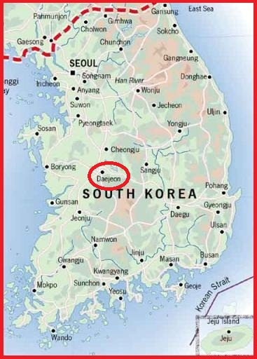
What is going on in Daejeon?

Slide 5
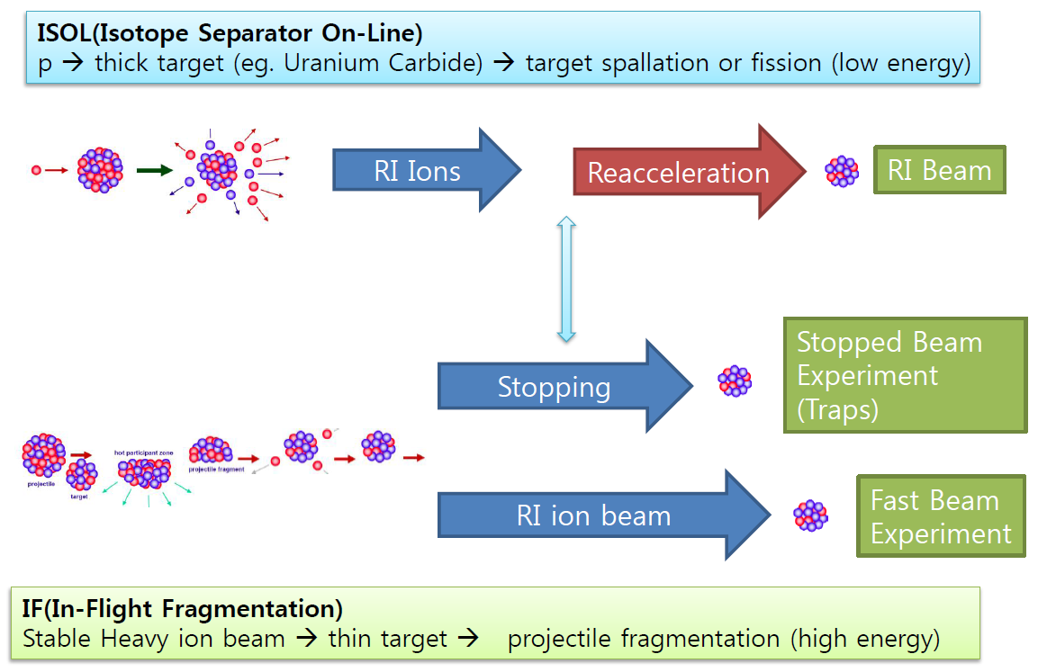
* ISOL-type facilities: radioactive ions are produced at rest in a thick target either by direct bombardment with particles from a driver accelerator or via fission induced both by fast and thermal secondary neutrons.
* In-flight (IF) facilities: a high energy ion beam is fragmented in a suitable thin target and the reaction products are and then transported to the secondary target.

Slide 6
RAON Concept
High intensity RI beams by ISOL & IF & KOBRA
ISOL : direct fission of ²³⁸U by 70MeV proton
IF by 200MeV/u, 8.3pμA ²³⁸U
KOBRA by ~ 20 MeV/u, stable ion beams
High quality neutron-rich RI beams
¹³²Sn with up to ~250MeV/u, up to ~10⁸ pps
More exotic RI beams by ISOL+IF
20m
ECR-IS (10keV/u, 12 pμA)
128.5m
LEBT
RFQ (300keV/u, 9.5 pμA)
MEBT
100m
SCL1 (18.5 MeV/u, 9.5 pμA)
Driver LINAC
Chg. Stripper
SCL2 (200 MeV/u, 8.3 pμA for U⁺⁷⁹)
(600MeV, 660 μA for p)
375m
100m
80m
70m
20m
ISOL
Target
MEBT
RFQ
CB
HRMS
IF Target
μSR,
Bio-medical
250m
SCL3
RF Cooler
Cyclotron
(p, 70 MeV, 1mA)
KOBRA system
ECR-IS
High-precision
Mass Measurement
Gas Catcher
IF Separator
Post Accelerator
ISOL system
IF system
100m
110m
Low Energy Experiments
Nuclear Astrophysics
CB : Charge Breeder
HRMS : High Resolution Mass Separator
High Energy Experiments
Nuclear Structure/
Symmetry Energy

Slide 7
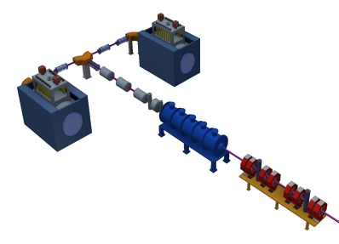
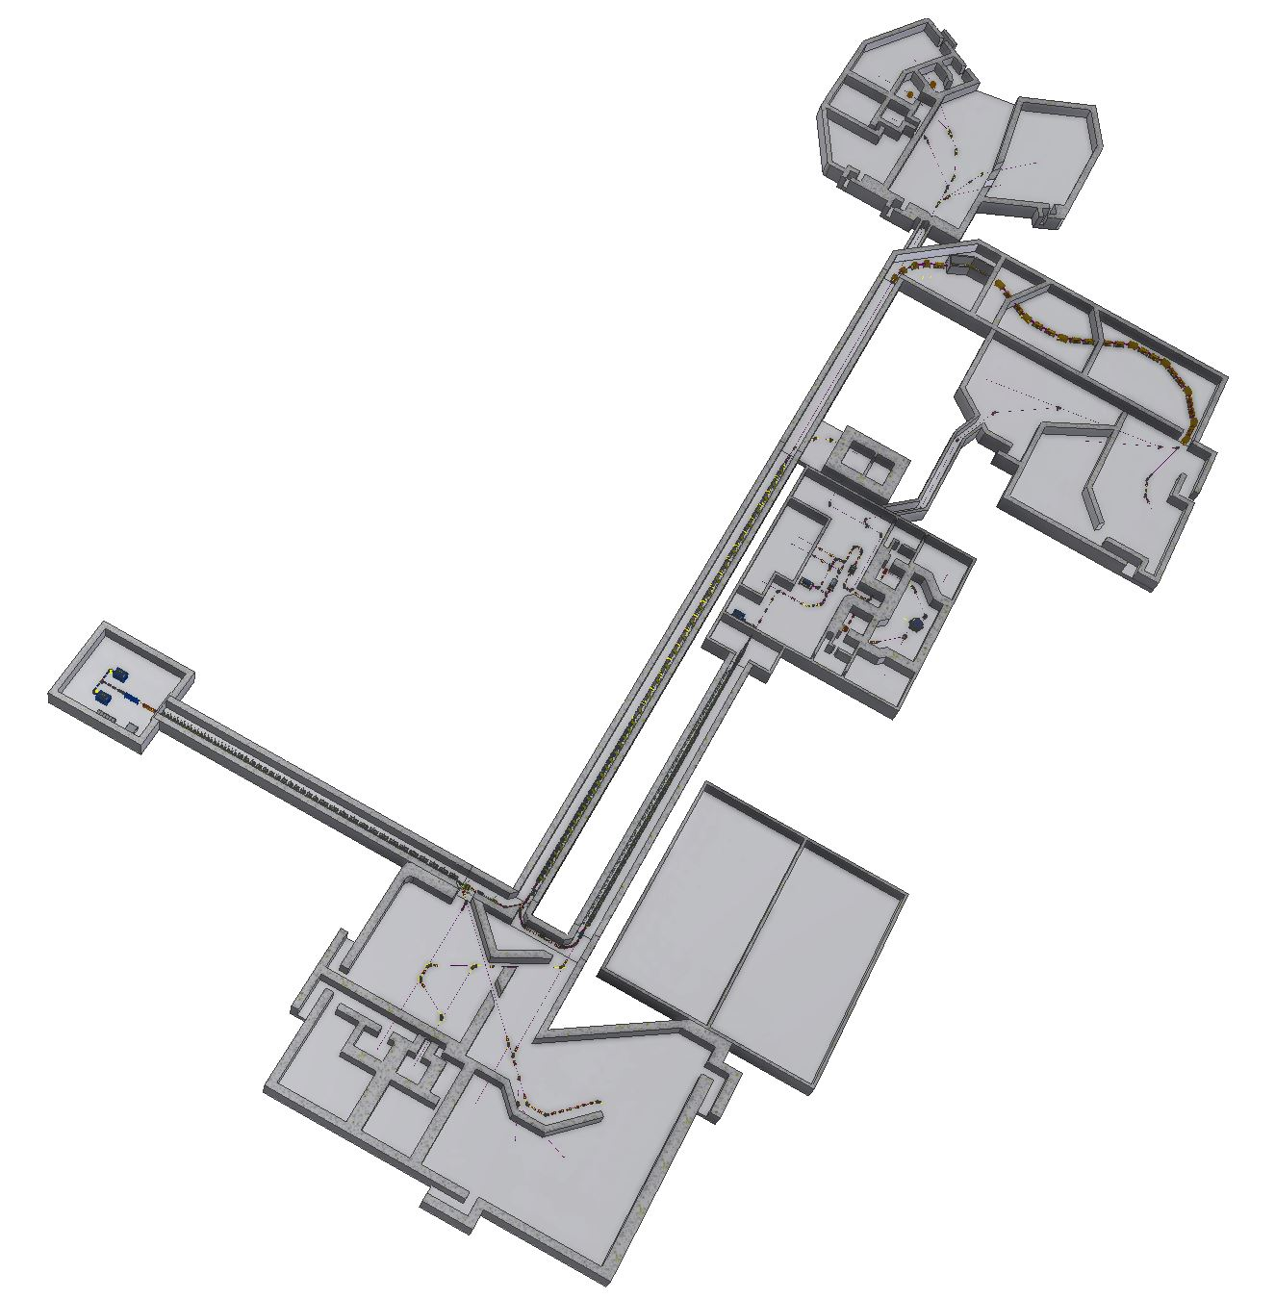
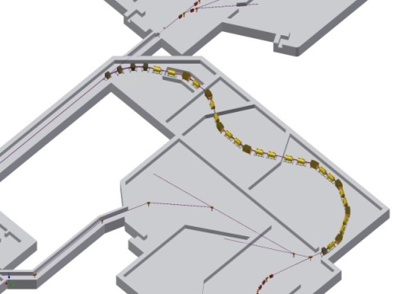
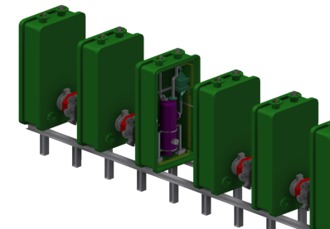
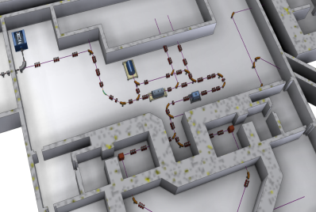
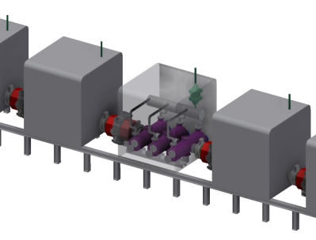
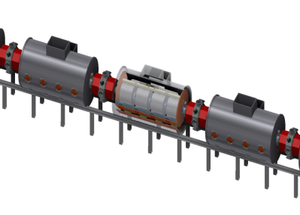
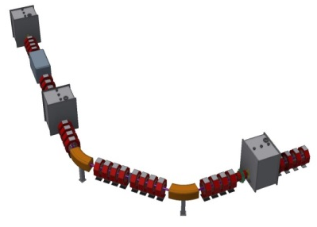
RAON Layout and Beam Parameters
 | Driver Linac |  |  |  | Post Acc.
Particle | H⁺ | O⁺⁸ | Xe⁺⁵⁴ | U⁺⁷⁹ | RI beam
Beam energy (MeV/u) | 600 | 320 | 251 | 200 | 18.5
Beam current (pμA) | 660 | 78 | 11 | 8.3 | -
Power on target (kW) | > 400 | 400 | 400 | 400 | -
High Energy Exp. 2
Injector
High Energy Exp. 1
IF SYSTEM
SCL1(QWR)
ISOL SYSTEM
SCL3(QWR/HWR)
SCL1(HWR)
Cyclotron
Cryogenic System
SCL2(SSR)
Low Energy Exp.
Charge Stripper

Slide 8
Expected RIBs at RAON
IF
ISOL
KOBRA
ISOL+IF
RAON will provide access to unexplored regions of the nuclear chart
8

Slide 9
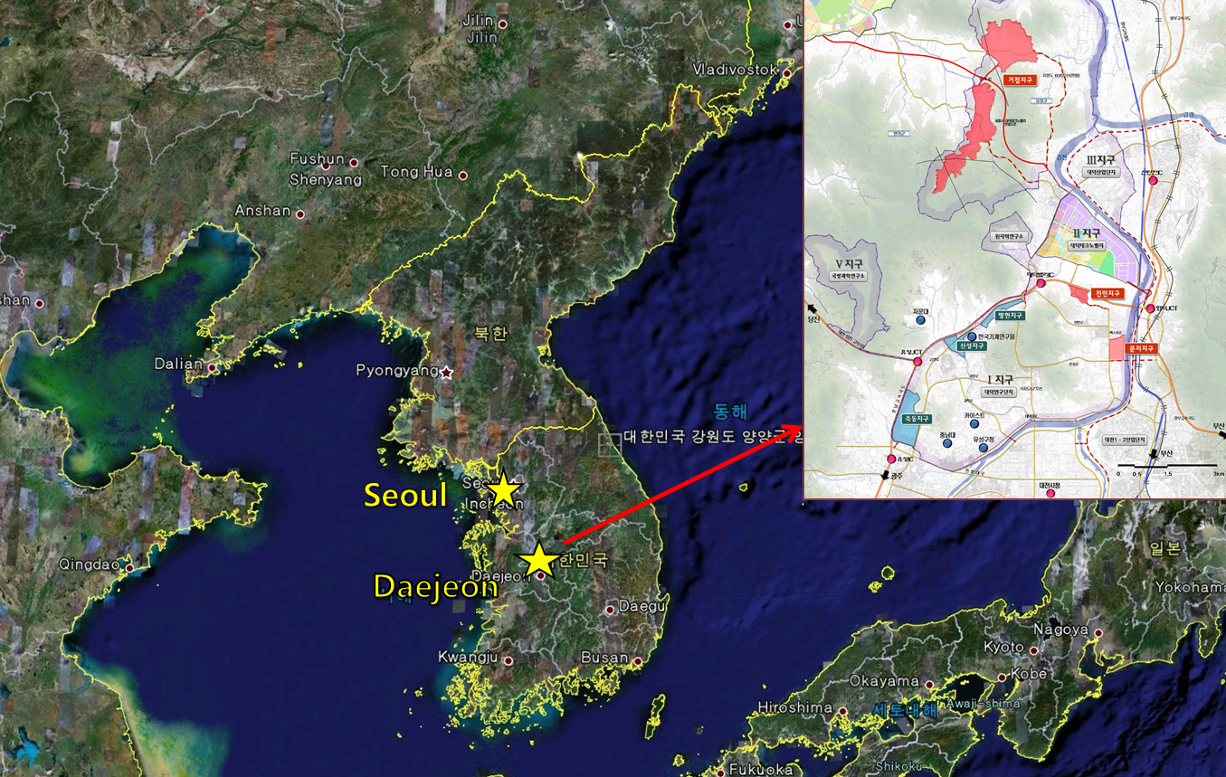
RAON Site
Bird’s-eye view
~11 km
Current RISP Office
Area (Lot/Bldg): 952,066 m² / 130,257 m²

Slide 10
Ab initio No Core Shell Model
Ab initio: nuclei from first principles considering fundamental interactions without uncontrolled approximations.
No core: all nucleons are active, no inert core.
Shell model: harmonic oscillator basis
Point nucleons

Slide 13
Ab initio structure and NN interaction
Unfortunately, the NN interaction at low energies needed for nuclear physics applications cannot be directly derived from QCD at the moment
Ab initio theory requires, of course, a realistic NN interaction accurately describing NN scattering data and deuteron properties
Nice to avoid NNN forces? Yes

Slide 14
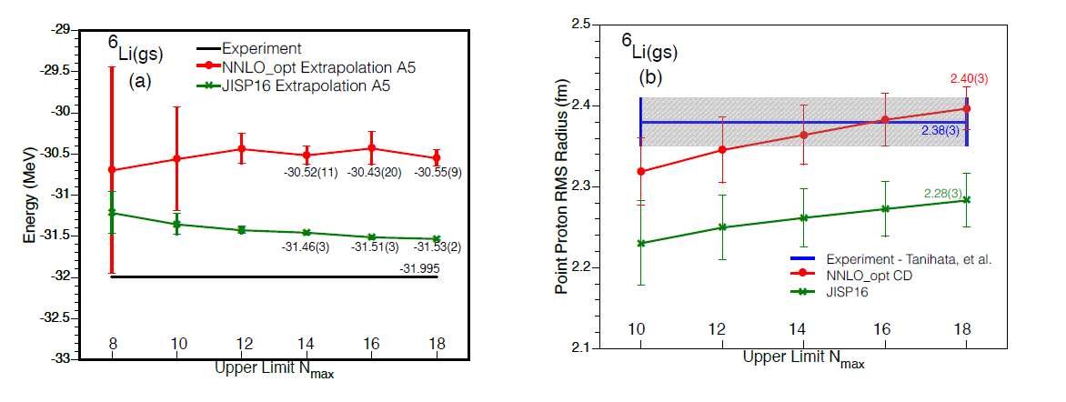
Ik Jae Shin, Y. Kim, P. Maris, J. P. Vary, C. Forssén, J. Rotureau, N. Michel, arXiv:1605.02819
Ab initio NCFC & ab initio GSM with a natural orbital single-particle basis

Slide 15
Daejeon 16
We use phase-equivalent transformations to adjust off-shell properties of similarity renormalization group evolved chiral effective field theory NN interaction (Idaho N3LO) to describe binding energies and spectra of light nuclei without NNN forces.
W. Polyzou and W. Glöckle theorem [Few-body Syst. 9, 97 (1990))]
H=T+V_{ij} ⇒ H’=T+V’_{ij}+V_{ijk}
where V_{ij} and V’_{ij} are phase-equivalent, H and H’ are isospectral.
Is it possible to transform as
H’=T+V’_{ij}+V_{ijk} ⇒ H=T+V_{ij}
with (approximately) isospectral H and H’ to minimize the need for the explicit introduction of three and higher body forces?
"N3LO NN interaction adjusted to light nuclei in ab exitu approach,"
A.M. Shirokov, I.J. Shin, Y. Kim, M. Sosonkina, P. Maris, J.P. Vary. e-Print: arXiv:1605.00413 [nucl-th]

Slide 16
PET (phase equivalent transformation)
Assume unitary matrix [U] has only a finite matrix mixing of a few selected basis function. Then H and H’ have identical eigenvalues, and also asymptotic behavior of their eigenvector wave functions are same.
do not change scattering phase shifts and bound state energies of two-body system
but are supposed to modify two-body bound state observables such as the rms radius and electromagnetic moments
ex) JISP16 [A.M. Shirokov, J.P. Vary, A.I. Mazur and T.A. Weber, Phys. Lett. B 644 (2007) 33]

Slide 17
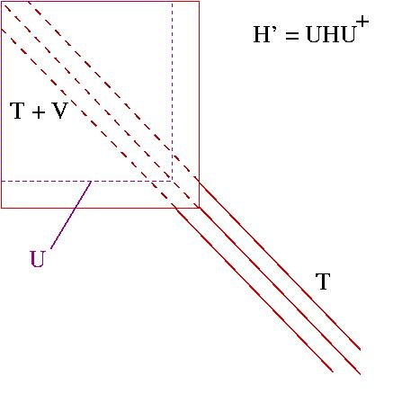
Phase-equivalent transformations (PETs)
PETs are generated by unitary transformations of the two-nucleon Hamiltonian
A. Shirokov

Slide 18
JISP16 vs Daejeon16
ISTP
(inverse scattering tridiagonal potential)
N3LO interaction
SRG
(similarity renormalization group)
SRG-evolved N3LO
PET (phase equivalent transformation)
JISP16
(J-matrix inverse scattering potential)
Daejeon16

Slide 19
PET angles (in degrees) defining the Daejeon16 NN interaction in various NN partial waves.
binding energies of ³H, ⁴He, ⁶Li, ⁸He, ¹⁰B, ¹²C, ¹⁶O
excitation energies of ⁶Li [(3⁺,0), (0⁺,1)], ¹⁰B[(1⁺,0)], ¹²C[(2⁺,0)]

Slide 20
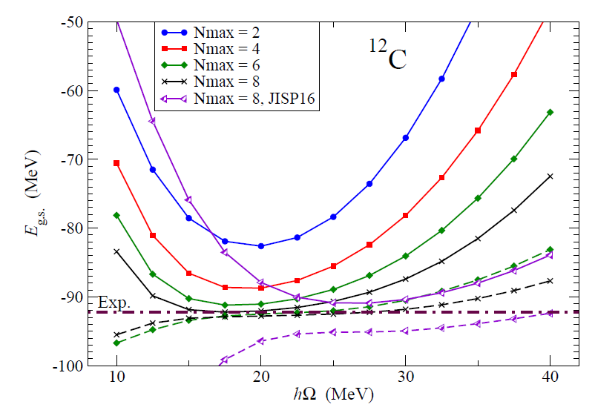
¹²C ground state energy in NCSM calculations obtained with Daejeon16 NN interaction

Slide 21
Extrapolation B
P. Maris, J. P. Vary, and A. M. Shirokov, PRC 79, 014308 (2009)

Slide 22
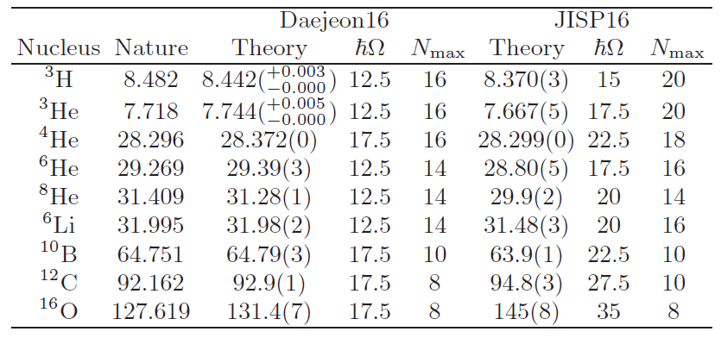
Binding energies (in MeV) of nuclei obtained with Daejeon16 NN interaction using Extrapolation B with estimated uncertainty of the extrapolation.

Slide 23
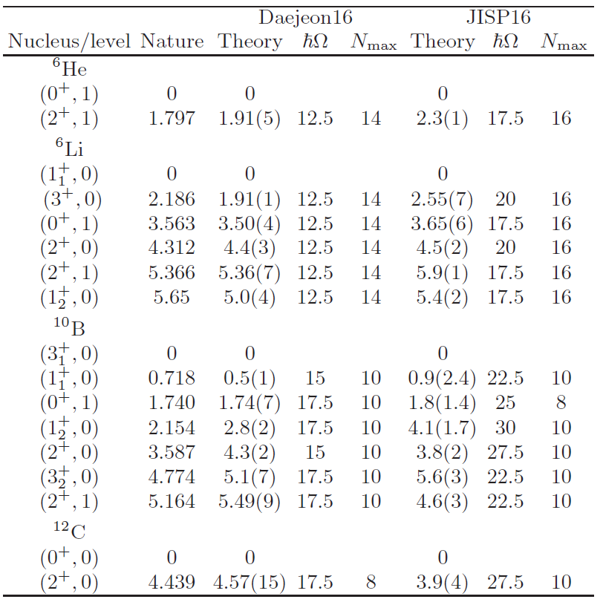
Excitation energies (in MeV) of some nuclei obtained with Daejeon16 NN interaction.

Slide 24
Our calculations with Daejeon16 demonstrate that the ¹⁰B ground state spin can be obtained using only two-nucleon interaction which, however, mimics the effects of NNN forces by modification of its off-shell properties by means of PETs.

Slide 25
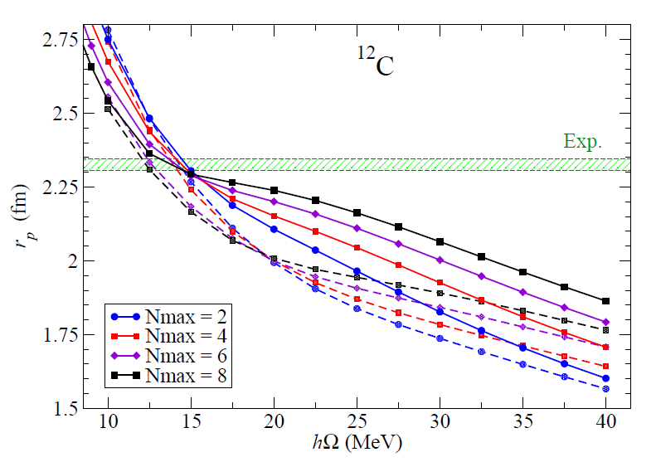
¹²C point-proton radius obtained with Daejeon16 (solid lines) and JISP16 (dashed lines) NN interactions in NCSM calculations.
We use these crossing points as rough estimates of the converged radius as has been suggested
in M. A. Caprio, P. Maris, J. P. Vary, PRC 90, 034305 (2014)

Slide 26
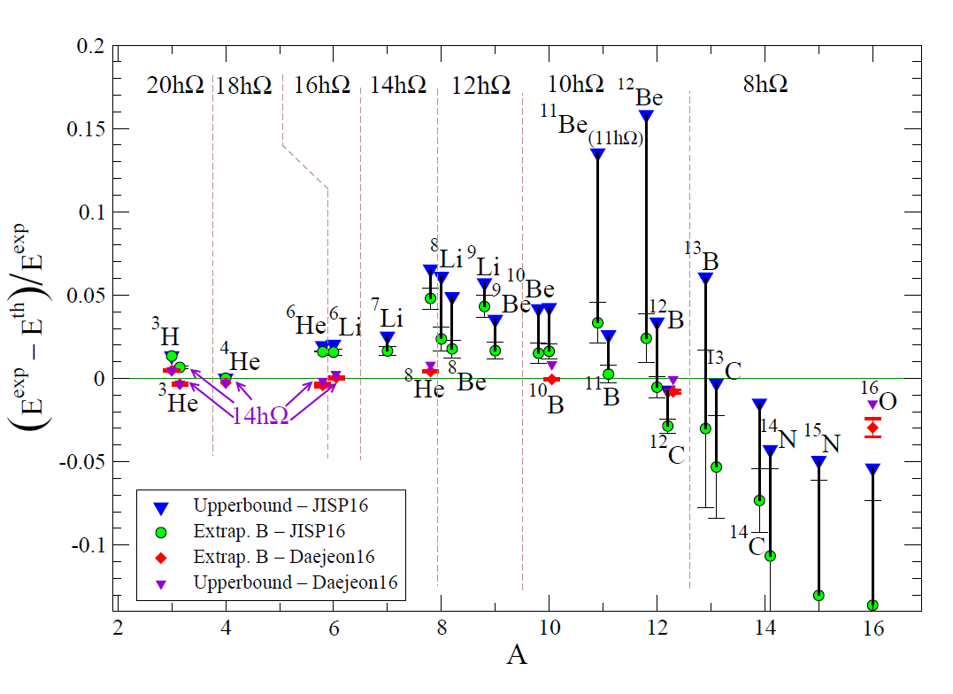
Binding energies

Slide 27
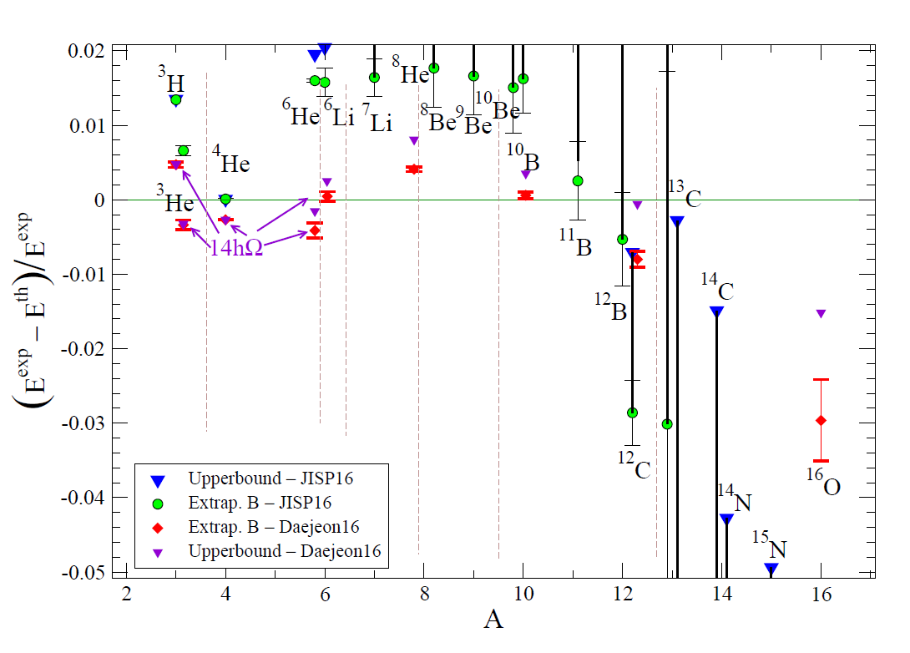
Binding energies (expanded scale)

Slide 28
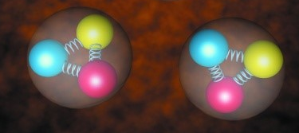
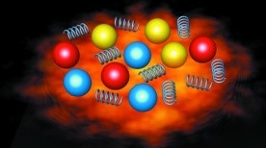
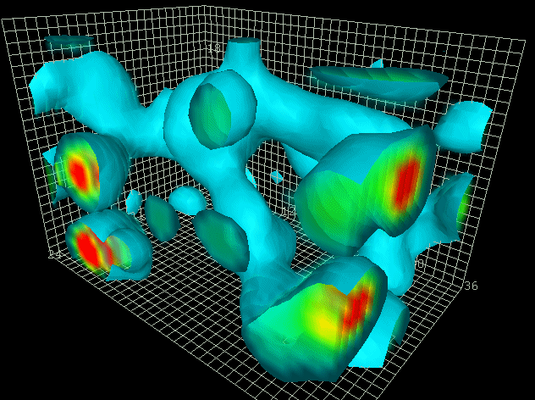
“Intense” RI beams
Chemical history of the universe
Limits of nuclear existence
Simplicity from complex systems
Infrared slavery
Origin of elements
beyond the Standard Model
Origin of nucleon mass
Properties of neutron stars
Quantum tunneling
Stellar explosions
Phases of nuclear matter
Energy generation in stars
Strong interactions at work
Hadrons
Supercomputers
Quarks and gluons
Asymptotic freedom
vacuum
http://www.physics.adelaide.edu.au/theory/staff/leinweber/VisualQCD/QCDvacuum/

