Slide 1
“Ab initio” description of mid-mass nuclei
Extending the reach of “ab initio” nuclear many-body methods
Thomas DUGUET
CEA/SPhN, Saclay, France
IKS, KU Leuven, Belgium
NSCL, Michigan State University, USA
Collaborators: V. Somà (Saclay) P. Navratil (TRIUMF)
A. Signoracci (Oak Ridge) G. Hagen (Oak Ridge)
C. Barbieri (Surrey) G. R. Jansen (Oak Ridge)
INT workshop on Nuclear Physics from Lattice QCD
Seattle, March 21st – May 27th 2016

Slide 2
Plan
Situating « ab initio » A-nucleon calculations
Ab initio nuclear many-body methods
  Elementary inter-nucleon interactions
  Solving the A-body Schrödinger equation
  Applications: binding energies and radii in ^{A}O and ^{A}Ca isotopes
Speculations
  Questions about χ-EFT and implications for the nuclear A-body problem

Slide 3
Plan
Situating « ab initio » A-nucleon calculations
Ab initio nuclear many-body methods
  Elementary inter-nucleon interactions
  Solving the A-body Schrödinger equation
  Applications: binding energies and radii in ^{A}O and ^{A}Ca isotopes
Speculations
  Questions about χ-EFT and implications for the nuclear A-body problem

Slide 4
« Ab initio » A-nucleon problem as of today
Perturbative QCD
Ab initio = In medias res
Effective structure-less nucleons (+Δ?)
  May add hyperons
Interact via contacts and pions (π-full EFT)
Interact only via contacts (π-less EFT)
Taken from data/underlying theory
  Symmetries (i.e. χ-symmetry breaking)
  Nucleon properties
  Pion properties
  Nucleon-pion interactions
~1GeV = M_{QCD}
Scale separation
More reductionist/elementary/”fundamental” description
Emergent phenomena amenable to effective descriptions
Implement in A-body sector
« Ab initio » nuclear A-body problem
Solve
Emerging nuclear phenomena

Slide 5
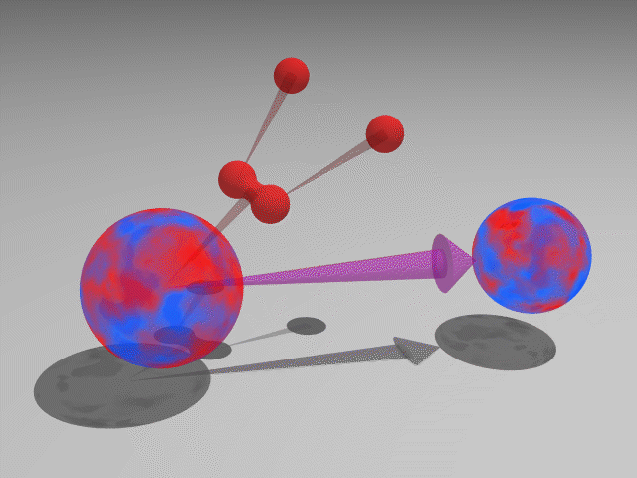
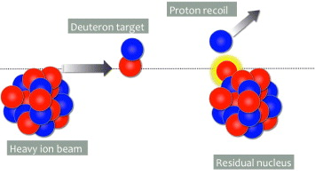
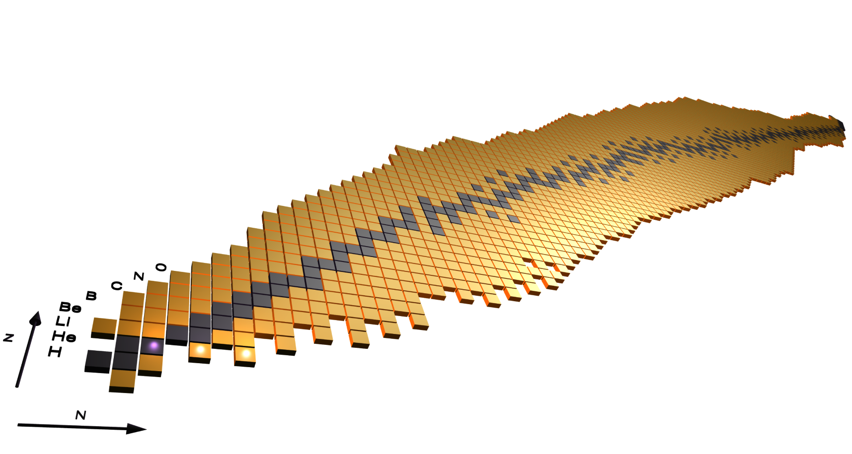

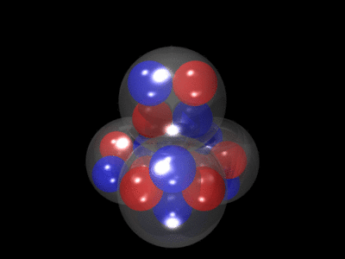
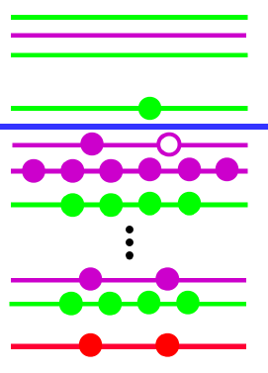
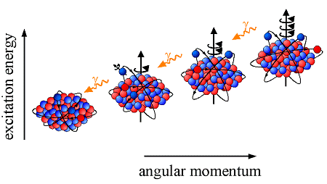
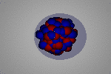
Huge diversity of nuclear phenomena
Radioactive decays
Reaction processes
(2)β, α, (2)p, fission…
Fusion, transfer, knock-out…
Ground state
Mass, size, deformation, superfluidity…
Ab initio A-body problem viewpoint
=
How does this rich phenomenology emerge
from basic interactions between the nucleons?
↓
But is it reasonable to expect that it does
with reasonable uncertainties as A increases?
Limits
Drip lines, mass, clusters, halos…
Spectroscopy
Excitation modes

Slide 6
From nuclear models…
→ Useful to identify relevant d.o.f and symmetries
→ Decent account of phenomena based on employed d.o.f
BUT
① No systematic improvement towards accuracy
② No proper understanding of their intrinsic limitations
③ No clear path to connect them
Conventional
energy density functional method
Liquid drop and mic-mac models
Collective and algebraic
models
Conventional
shell model
Landau theory
Cluster models
ab initio methods
based on
conventional interactions
Tension between reductionist and emerging viewpoints not appropriately articulated

Slide 7
…towards a tower of effective theories
Rationale of effective theories
① Identify energy scales / d.o.f / symmetries appropriate to phenomena
② All interactions complying with symmetries are compulsory
③ Naturalness provides power counting (+ possible fine tuning)
④ Fix LECs from data or from underlying effective theory
Reductionist description
Emerging phenomena
Effective theory-based
energy density functional method
Effective theory for
emerging symmetry breaking
Effective theory-based
shell model
Halo effective field theory
Pion-less effective field theory
In 2N, 3N… AN sectors
Effective theory-based
Laudau theory
χ-effective field theory
in 2N, 3N… AN sectors
ab initio methods
Quantum Chromodynamics
Appropriate epistemic scheme to articulate
reductionist and emerging viewpoints

Slide 8
Plan
Situating « ab initio » A-nucleon calculations
Ab initio nuclear many-body methods
  Elementary inter-nucleon interactions
  Solving the A-body Schrödinger equation
  Applications: binding energies and radii in ^{A}O and ^{A}Ca isotopes
Speculations
  Questions about χ-EFT and implications for the nuclear A-body problem

Slide 9
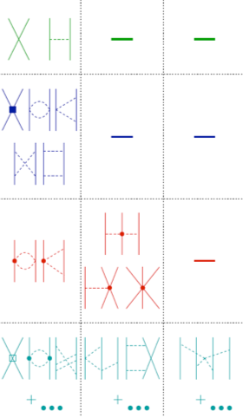


Link to QCD via (pseudo?) χ-EFT = current paradigm
2N
3N
4N
Key features
LO
✪ Separation of scales: DOFs are nucleons&pions (+ contact)
✪ Relevant QCD information: chiral symmetry (breaking)
NLO
✪ Weinberg PC: NDA organizes Lagrangian in (Q_{low}/Λ_{χ})^{ν}
✪ Fit LECs of BN operator on BN observables via Schrod. Eq.
Unique promises
πN
✪ Consistent ππ + πN + 2N, 3N, 4N… int. + electroweak op.
N²LO
✪ Systematic (improvable) + provides error estimates
A-nucleon sector: fits the standard view of A-body problem
ππ
N³LO
Two-step process
Set up at order ν
Solve to all orders

Slide 10
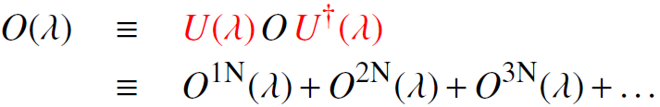
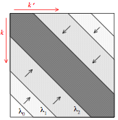
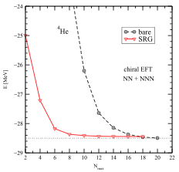
Similarity transformation of H
Chiral effective field theory
Traditional nuclear interactions
⦿ Links nuclear physics with QCD
⦿ Arbitrary number of parameters
⦿ Systematic, provides error estimates
⦿ Feature a « hard core »
⦿ Consistent many-body forces
⦿ Three-body forces phenomenological
⦿ Usually less but still rather « hard »
SRG transformation to « soften » nuclear interactions [Bogner et al. 2010]
⦿ Decouples low from « high » momenta
⦿ Unitary transformation
[E.D Jurgenson et al. PRL103 (2009) 082501]
⤋
Observables unchanged in principle
A-body convergence with dim H_{A} much improved
But k-body (k≤A) interactions induced
NCSM
VSRG
⤋
Unitarity broken by droping beyond k=3 in practice

Slide 11
Two sets of 2N+3N χ-EFT interactions
✪ N³LO 2N (NLR - 500MeV) + N²LO 3N (LR - 400MeV) = « EM »
¤ SRG-evolved down to 1.88-2.0 fm⁻¹
[Entem, Machleidt 2003; Navrátil 2007; Roth et al. 2012]
EM
Sequential optimization of 2N and 3N
LECs fitted on A=2,3,4
Conventional
NNLO_{sat}
Simultaneous optimization of 2N and 3N
LECs fitted on A≤25
Unconventional
✪ N²LO 2N+3N (NLR - 450MeV) = « NNLO_{sat} »
¤ Bare
[Ekstrom et al. 2015]

Slide 12
Plan
Situating « ab initio » A-nucleon calculations
Ab initio nuclear many-body methods
  Elementary inter-nucleon interactions
  Solving the A-body Schrödinger equation
  Applications: binding energies and radii in ^{A}O and ^{A}Ca isotopes
Speculations
  Questions about χ-EFT and implications for the nuclear A-body problem

Slide 13

Historical view on ab-initio many-body theories
Nuclear Hamiltonian
Ab-initio many-body theories
Effective structure-less nucleons
2N + 3N + … inter-nucleon interactions
Solve A-body Schrödinger equation
Thorough assessment of errors needed
Many-body observables
¹⁰⁰Sn
¹³²Sn
Comp
data
Input
⁵⁶Ni
⁴⁰Ca
⁴⁸Ca
Inter-nucleon interactions
χ−EFT based
Soften through RG
2003-2016
CC, Dy-SCGF, IMSRG
Doubly closed-shell nuclei
A<132
¹⁶O
^{22,24}O
protons
1980-2016
FY, GFMC, NCSM, LEFT…
All nuclei A<12
Based on expansion scheme
Polynomial scaling
Truncation error
Cross-benchmarks needed
neutrons

Slide 14
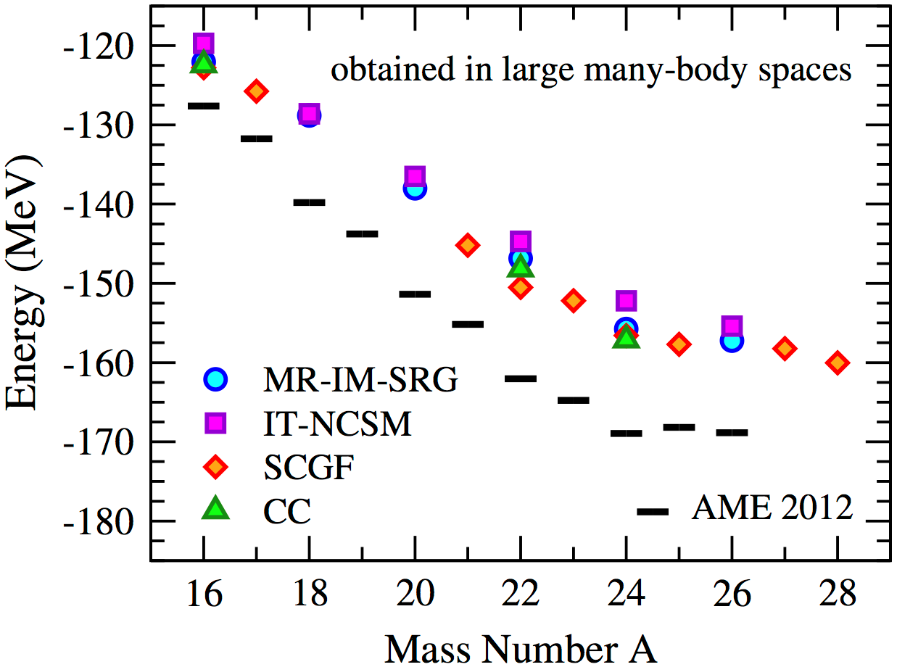
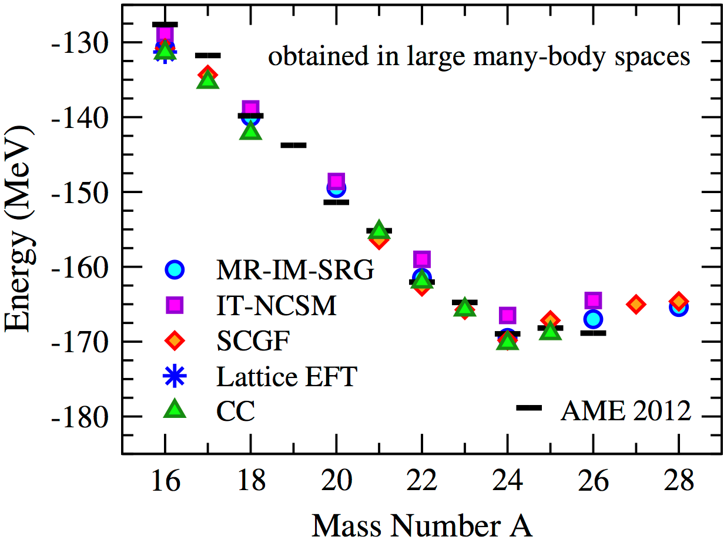
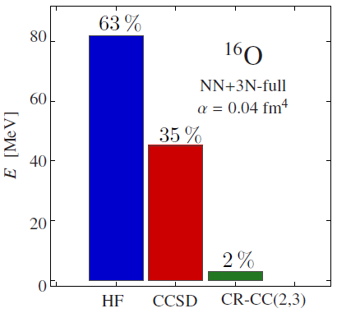
Landmark result of ab-initio methods
Binding energy of ^{A}O
IMSRG, IT-NCSM, SCGF, CC
E_{max} = 15 HO shells
E_{3max} = 14
2N only
[K. Hebeler et al., Ann. Rev. Nucl. Part. Sci., in press]
Input
3N interaction mandatory
Correct trend and drip-line location
2N+3N
EM
A-body methods
Excellent cross-benchmarks!
Converging expansions to ~2%
Various systematic errors ~1-2%
  Omitted induced BN forces for B>3
  Basis truncations (SRG, 3NF, NO2B)
λ = 2.25 fm⁻¹
[S. Binder et al., PLB 736 (2014) 119]

Slide 15
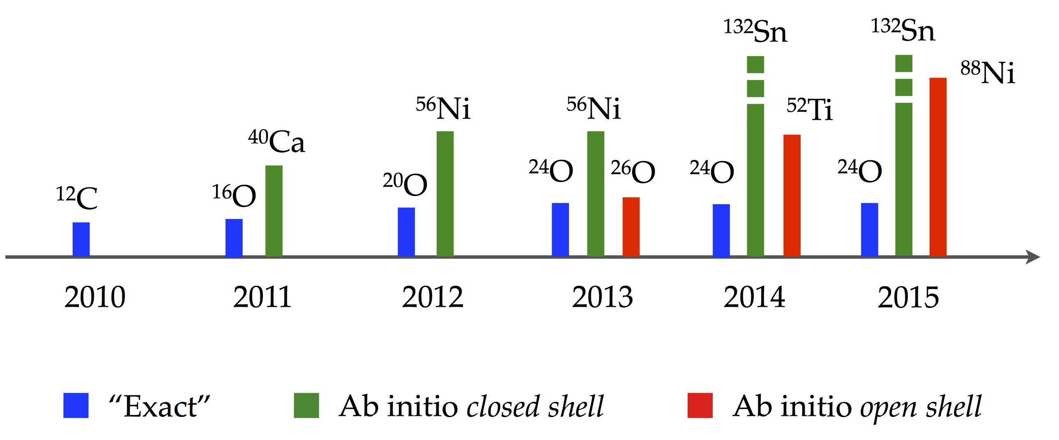

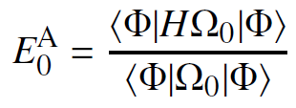
Ab-initio methods for open-shell nuclei
1. Required extension of many-body methods available for closed shell
2. Many 100s of nuclei can be eventually described
3. Revisit basic/investigate new questions from an ab initio perspective
Extended / novel many-body methods
Gorkov-SCGF
[Somà, Duguet, Barbieri 2011]
MR-IMSRG
[Hergert et al. 2013]
Bogoliubov CC
[Signoracci et al. 2015]
Symmetry-restored Bogoliubov CC
[Duguet 2015 ; Duguet, Signoracci 2016]
Recast empirical shell model
IMSRG-based valence shell model
[Bogner et al. 2014]
CC-based valence shell model
[Jansen et al. 2014]
^{A}Sn
Nuclear structure at/far from β stability
Emergence of magic numbers and their evolution?
Limits of stability on neutron-rich side beyond Z=8?
Mechanisms for nuclear superfluidity?
Emergence and evolution of quadrupole collectivity?
Role and validation of AN forces?
^{A}Ni
^{A}Ca
^{A}O
Chains of singly open-shell nuclei
Expansion around symmetry-breaking reference
Overcome degeneracy of standard reference states
Non-perturbative diagrammatic methods
Symmetry must eventually be restored
NN+3N
Exact diagonalization within truncated H_{tr}
Ab initio many-body method provides inputs
Benefit in full from mature technology
Still display factorial scaling with A/dim H_{tr}
protons
neutrons

Slide 16
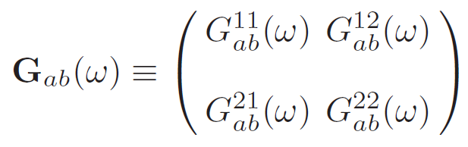
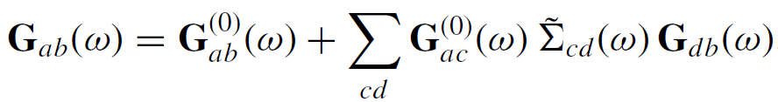
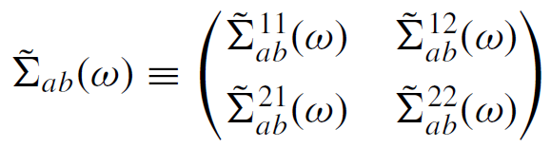









Self-consistent Green’s function theory
[Gorkov 1958]
A-body Schroedinger → Dyson/Gorkov
with
⦿ Gorkov scheme allows breaking of global U(1) symmetry to capture pairing correlations
⦿ Self-energy Σ(ω) expanded via Algebraic Diagrammatic Construction (ADC) [Schirmer et al. 1983]
Dyson
Gorkov
ADC(1)
ADC(2)
ADC(3)
…
work in progress
[Dickhoff, Barbieri 2004]
[Somà, Duguet, Barbieri 2011]
○ Observables of A-body ground state (N & Z even)
○ Spectroscopic information on A±1 systems

Slide 17
Plan
Situating « ab initio » A-nucleon calculations
Ab initio nuclear many-body methods
  Elementary inter-nucleon interactions
  Solving the A-body Schrödinger equation
  Applications: binding energies and radii in ^{A}O and ^{A}Ca isotopes
Speculations
  Questions about χ-EFT and implications for the nuclear A-body problem

Slide 18
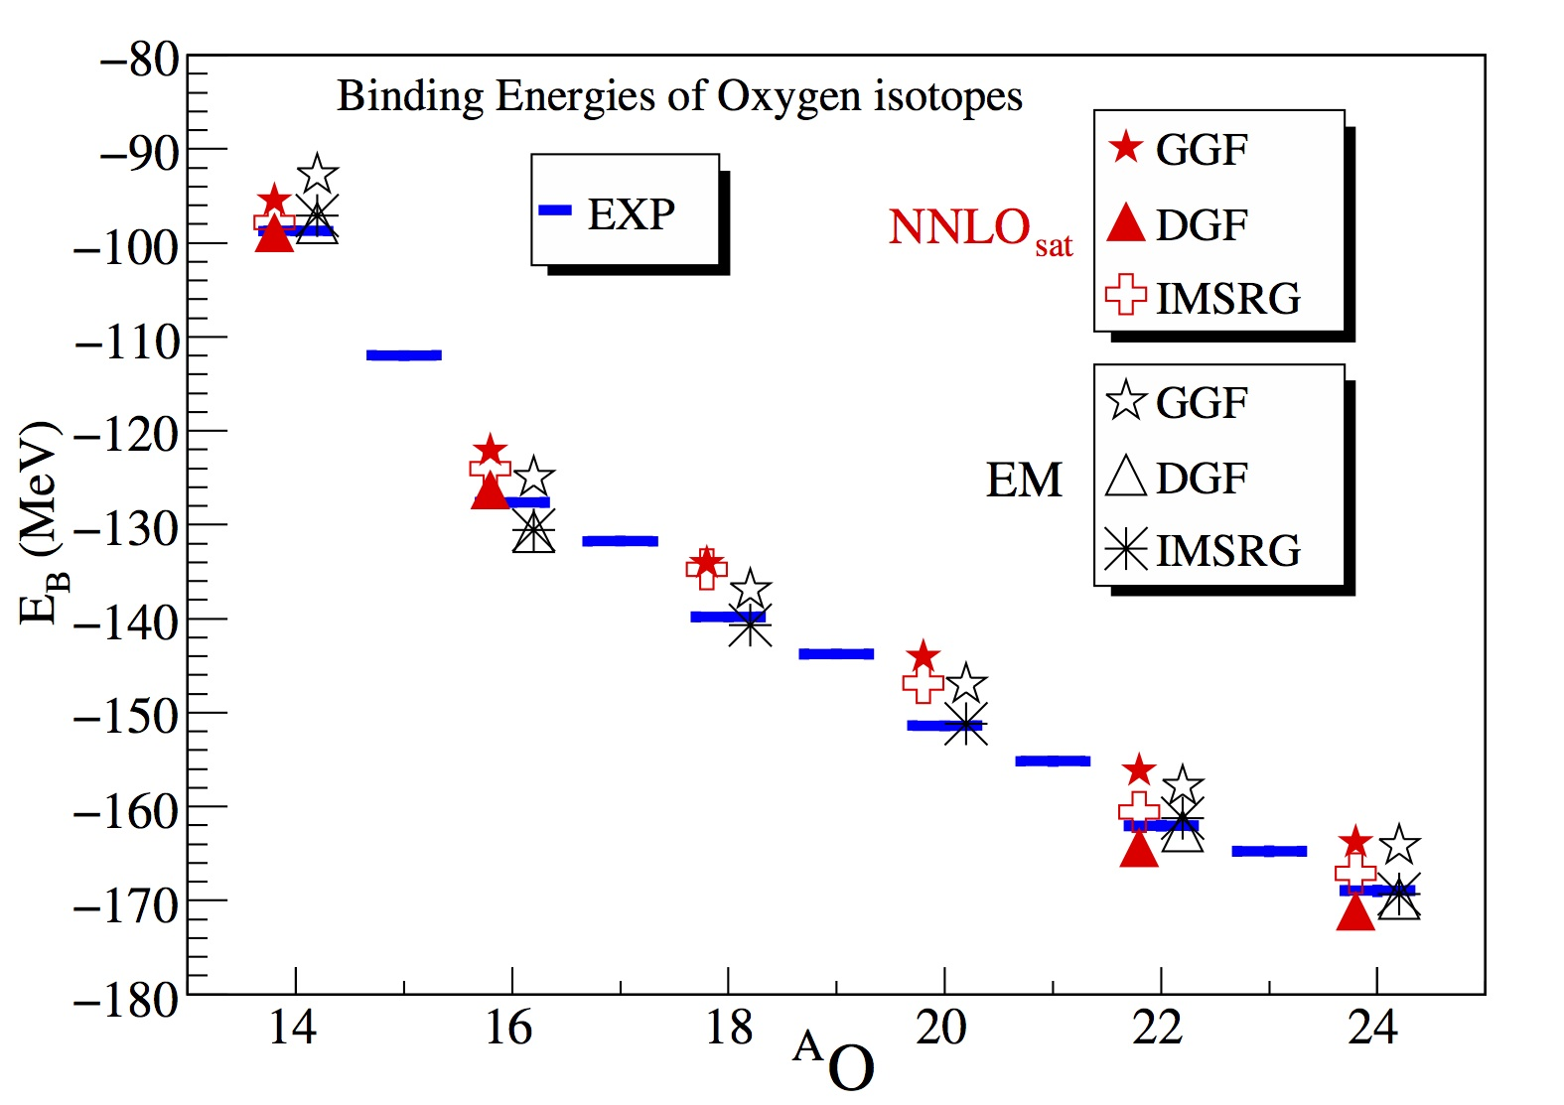
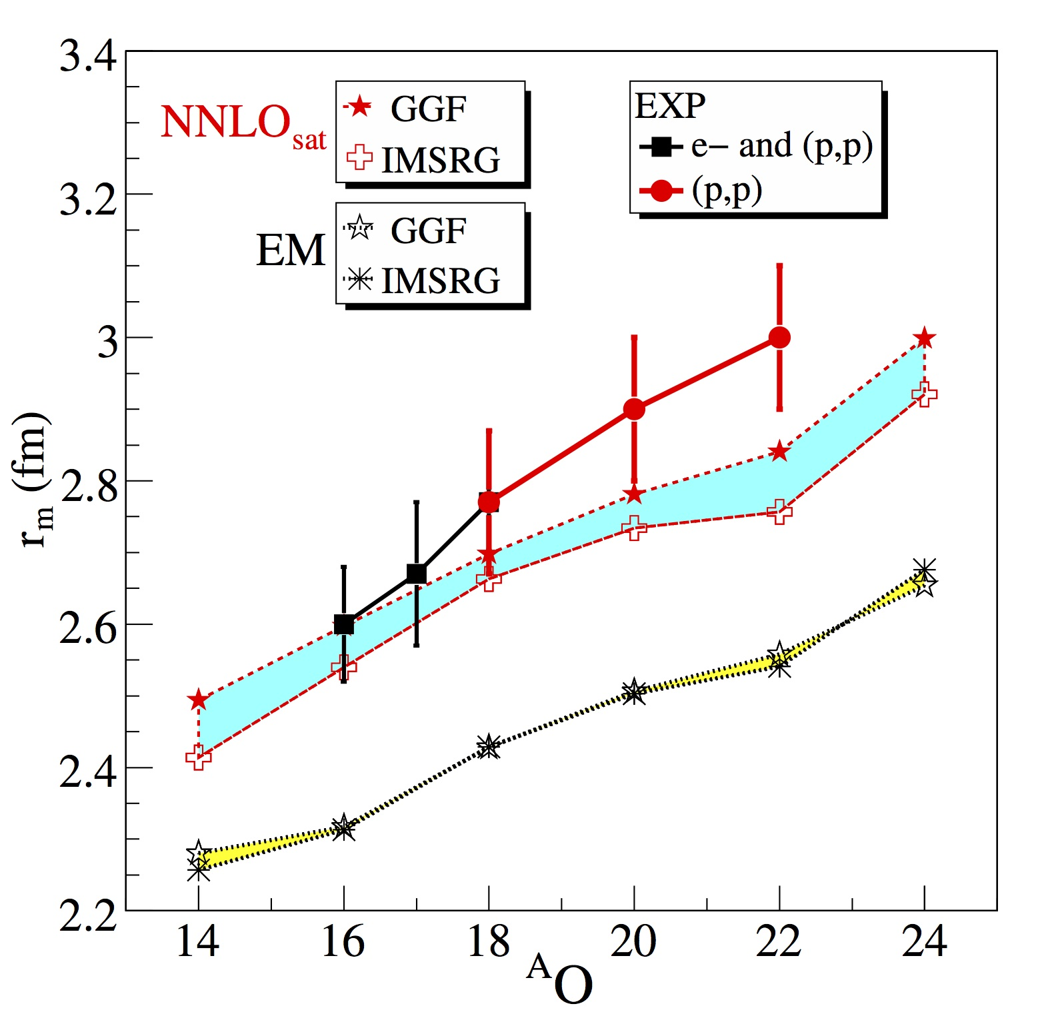
Binding energies and matter radii in ^{A}O
Absolute binding energies
Matter radii
✪ EM and NNLO_{sat} equally good for E(^{A}O) [ΔE(MB) <4%]
Analysis of (p,p) elastic scattering (±0.1fm)
✪ Absolute r_{m} with EM 11-14% (0.3-0.4fm) systematically too low but NNLO_{sat} corrects for it
¤ Radii dot not improve with N-Z beyond ¹⁶O whose r_{ch} is in the fit
✪ Δr_{m} (MB) (<0.1fm ~ 3%) « Δr_{m} (exp) and Δr_{m} (int)
Word of caution
Extrapolation to ∞ basis dim
2-body part of r²_{ch}
¤ Gorkov calculations need to be further improved to ADC(3)
[Lapoux et al. 2016, unpublished]

Slide 19
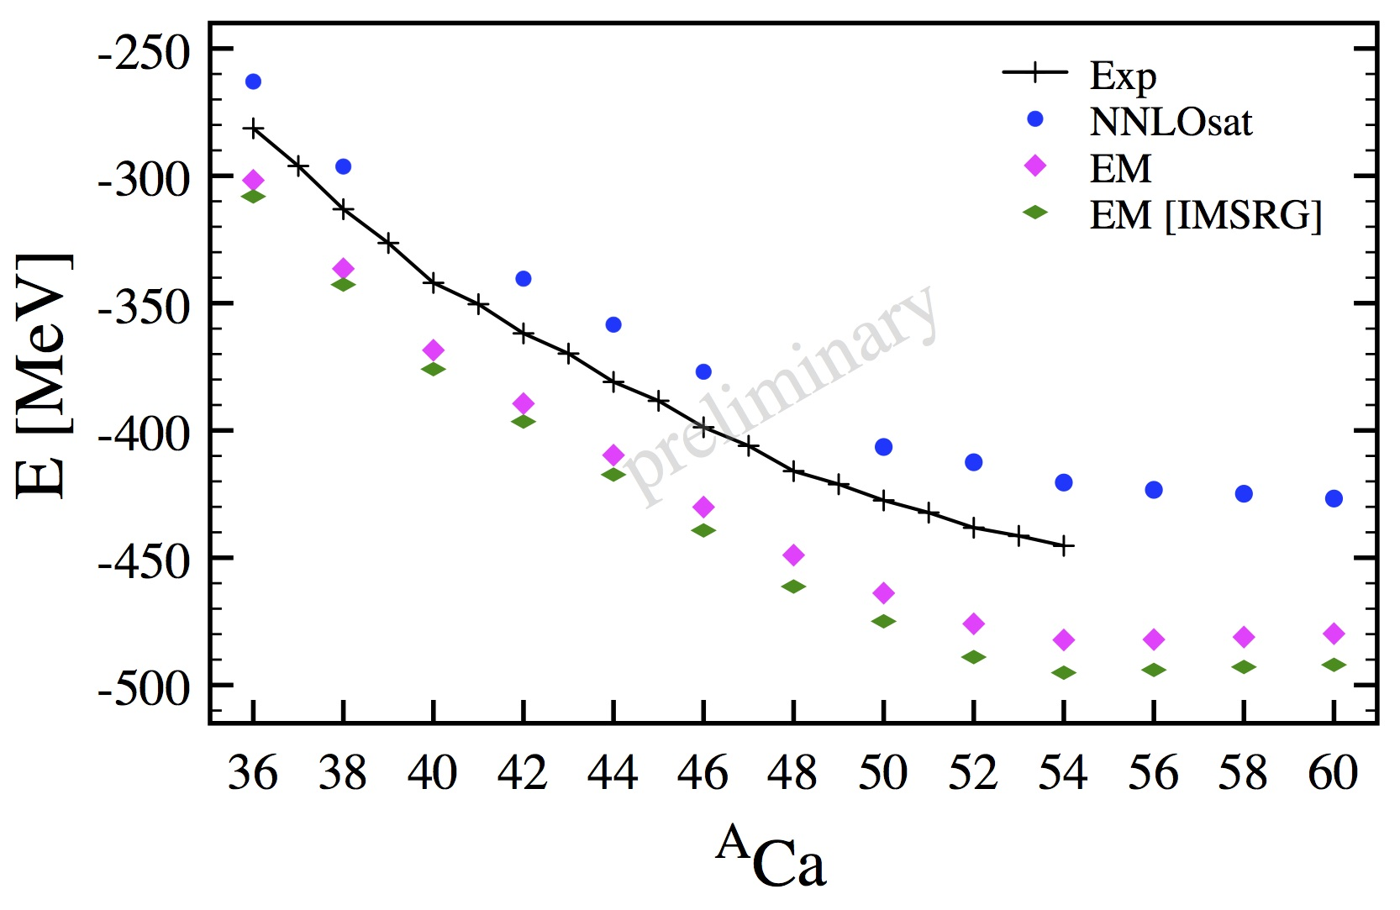
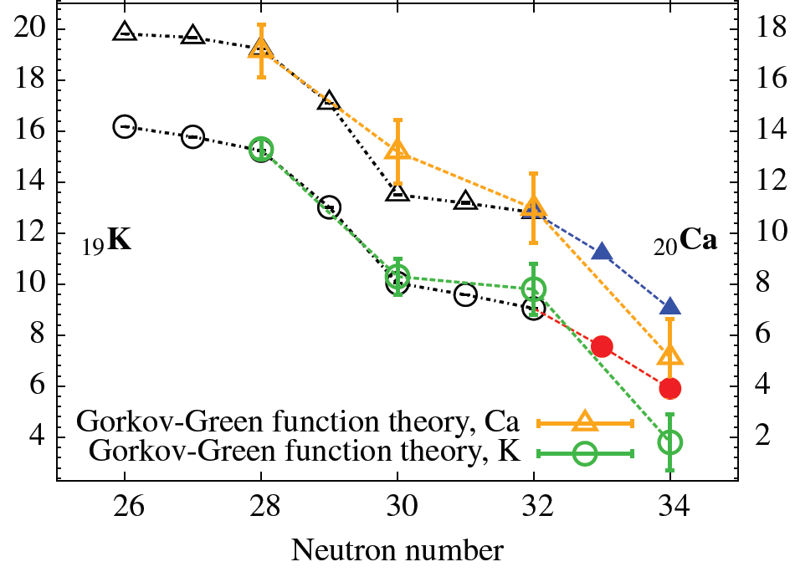
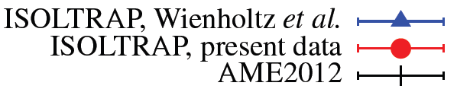
Binding energies in Ca region
Absolute binding energies
Two-neutron separation energies
S_{2N} [MeV]
[Rosenbusch et al.. 2015]
EM
Extrapolation to ∞ basis dim
✪ EM overbinds by up to 10% but NNLO_{sat} corrects for it
¤ ~5/10 MeV to further capture in GGF calculations going to ADC(3)
✪ S_{2N} equally good for EM and NNLO_{sat}
¤ 3NF essential and moves drip line back from N=40 to N=34 in Ca
✪ N=20 and N=28 magicity emerge ⬄ 3NF essential (mandatory for N=28 and reduce N=20)
¤ N=20 is too pronounced along with N=32
[Somà et al. 2016, unpublished]

Slide 20
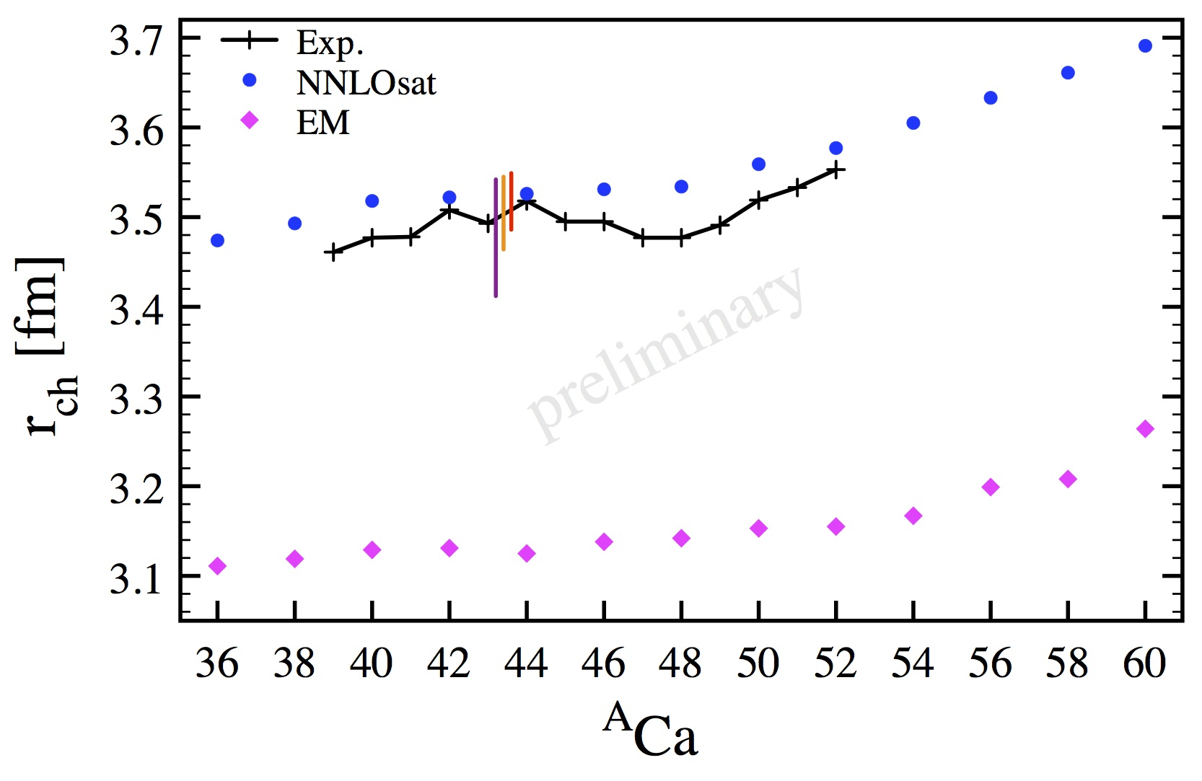
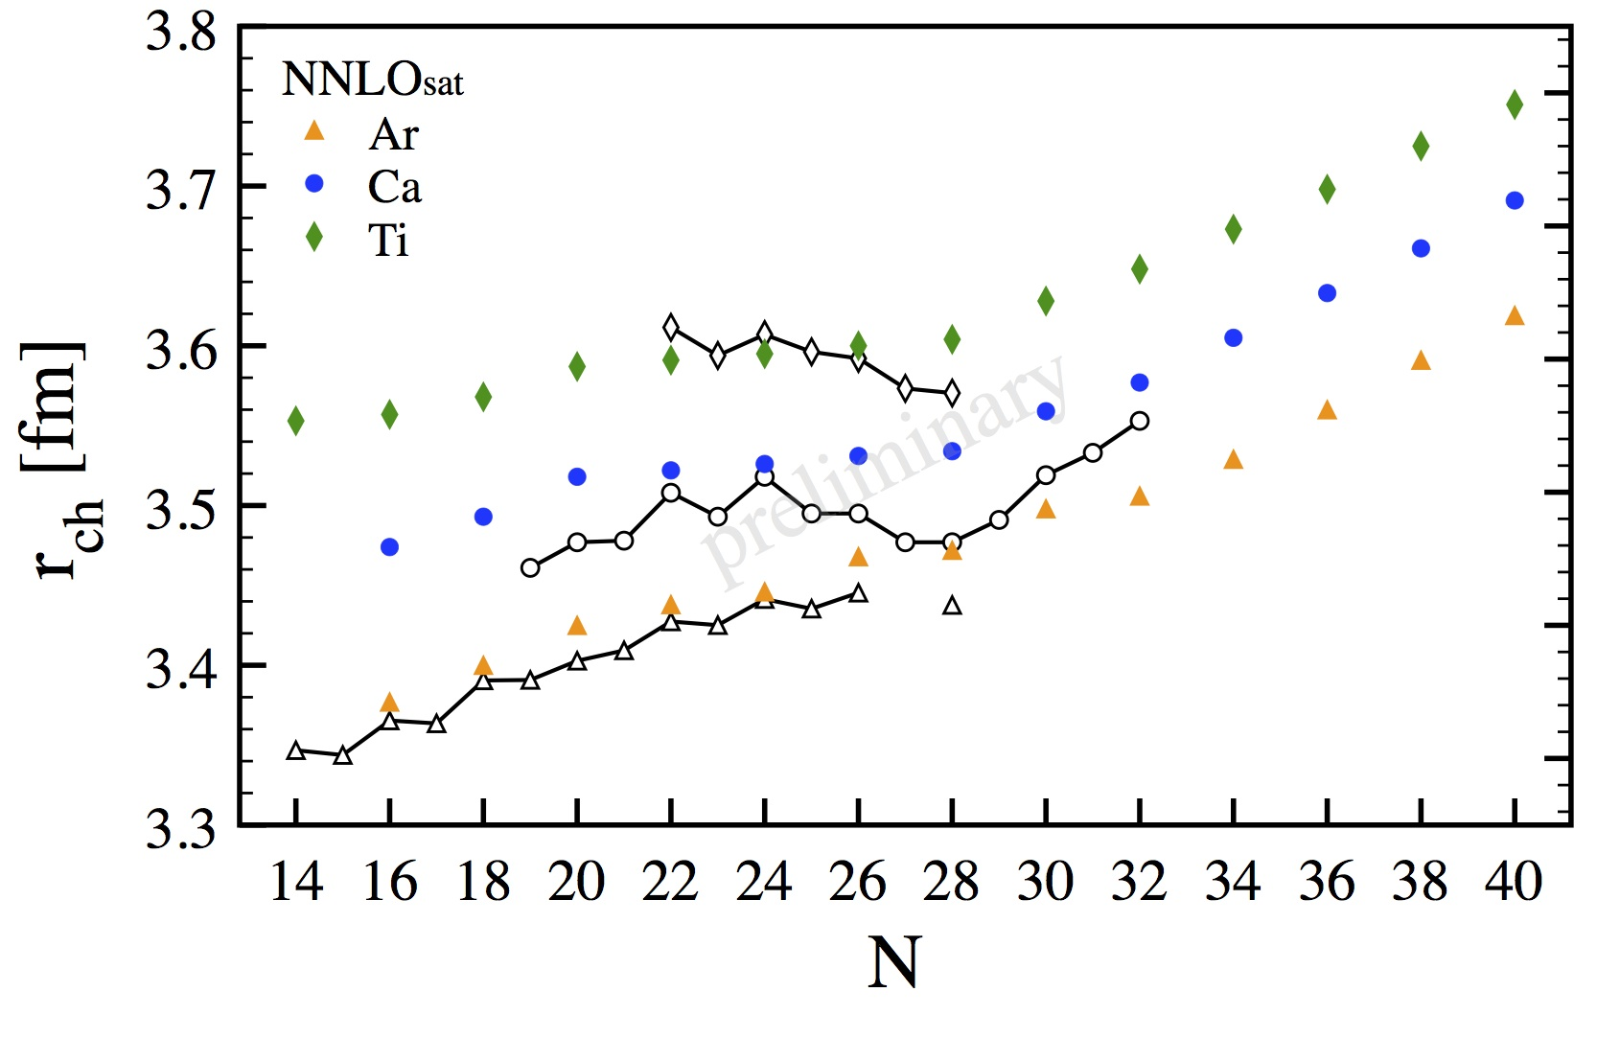
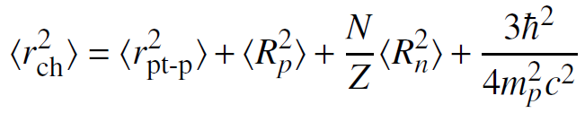
Charge radii in Ca region
Charge radii in Ca
Charge radii in neighboring chains
[Somà et al., unpublished]
[Somà et al., unpublished]
✪ EM systematically too low by ~12% (0.4fm) but NNLO_{sat} corrects it (pattern extends to Ni)
¤ Radii improved in relative terms as well beyond ⁴⁸Ca
✪ Parabolic behaviour between ⁴⁰Ca and ⁴⁸Ca remains a challenge
Word of caution
Extrapolation to ∞ basis dim
2-body part of r²_{ch}
✪ Hints of the nontrivial behaviour as a function of N and Z
[Somà et al. 2016, unpublished]

Slide 21
Plan
Situating « ab initio » A-nucleon calculations
Ab initio nuclear many-body methods
  Elementary inter-nucleon interactions
  Solving the A-body Schrödinger equation
  Applications: binding energies and radii in ^{A}O and ^{A}Ca isotopes
Speculations
  Questions about χ-EFT and implications for the nuclear A-body problem

Slide 22
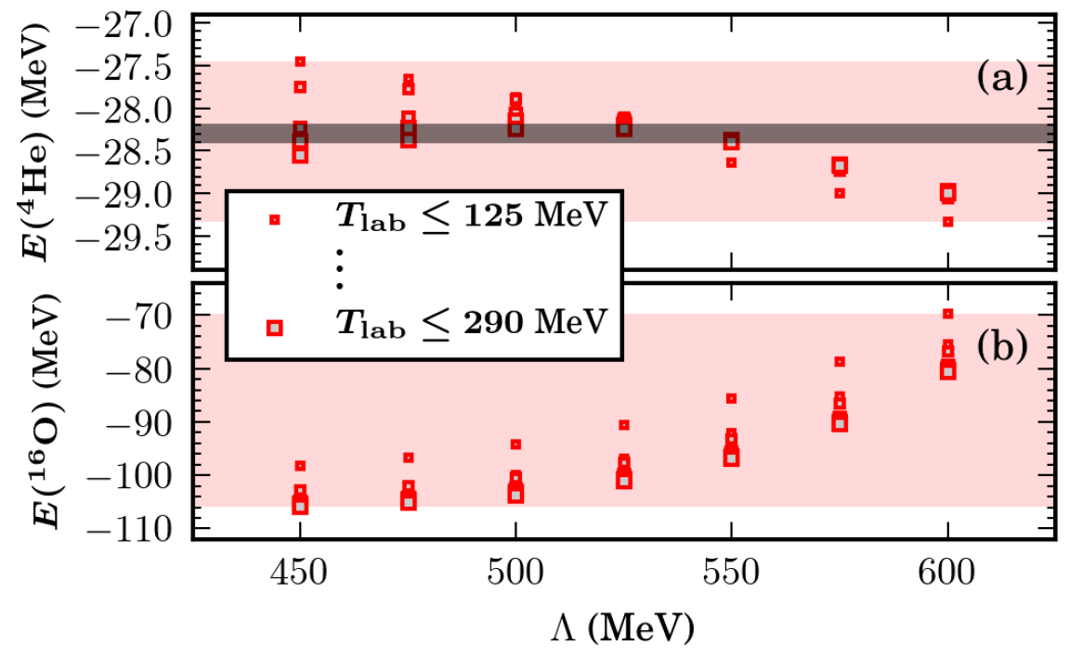
Uncertainty from χ-EFT 2N+3N in AN sector
Protocole
LO, NLO, NNLO in Weinberg PC
Simultaneous optimization
NLR for 2N+3N ; Λ = 450-600 MeV
« Conventional » fit of LECs on
  Scattering πN: 10.6 MeV < T_{lab} < 70 MeV
  Scattering NN: 125MeV<T^{max}_{lab}<290MeV
  Bound state: ²H, ³H, ³He
Syst. uncertainty on scatt. C(p_{cm}/Λ_{χ})^{ν+1}
Systematic uncertainty
NNLO
125<T^{max}_{lab}<290MeV/450<Λ<600 MeV
42 simultaneous optimizations
Equally good on A≤4 data
→Propagate to E(⁴He) and E(¹⁶O)
Rather small variation in [Q,Λ_{χ}]
NCSM
7% of BE (~1% of PE)
» statistical uncertainties
Encompasses exp.
30% of BE (~10% of PE)
» statistical uncertainties
» A-body uncertainties
Outside exp. (127.6MeV)
Λ-CCSD(T)
Large prop. uncertainty
« Covered up » by NNLO_{sat}
Sign of « pseudo EFT »?
Just need to add next order!?
Unexpected breakdown?
[Carlsson et al. 2016]

Slide 23


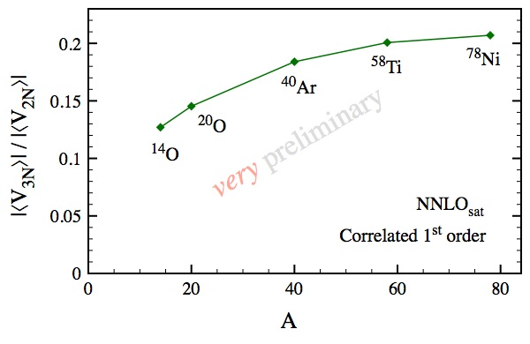
Points of interest to make further progress?
I. Base ab-initio A-body calculations on« true », e.g. renormalizable, EFTs
χ-EFT based on WPC is not renormalizable [Cohen et al. 1996 ; Nogga, et al. 2005 ; Birse 2006...]
¤ Alternative power counting exist [Birse 2005 ; Pavon Valderrama, Ruiz Arriola 2006 ; Long, Yang 2012…]
Start with pion-less EFT [Bedaque, van Kolck 1997 ; Kaplan, Savage, Wise 1998 ; Bedaque, Hammer, van Kolck 1999…]
Treated non-perturbatively
Interesting/non-trivial consequences
for the solving of the A-body problem
Treated in « DWBA »
Unconventional for a many-body physicist
II. Do we need to revisit the EFT on a deeper level to go to « large » A?
Have to abandon nucleonic degrees of freedom (at least for bulk properties)?
« Simply » account for a new scale k_{F} that could, e.g., promote k-nucleon forces?
¤ Dealing with kN forces would be problematic for k>3 except if reduced to 2-body normal ordered
¤ Is there a sign that N²LO 3N interaction becomes unnaturally large as A increases?
[Somà et al. 2016, unpublished]

Slide 24
Theoretical perspectives and challenges
Inter-nucleon interactions
⦿ EFT order-by-order convergence + systematic uncertainty estimates
⦿ Control size of B-body forces induced by SRG for 3˂B≤A
⦿ Power counting issues and feedback on ab initio many-body methods
Solving the A-body Schroedinger equation
⦿ Going to heavier systems: treatment of 3NF is a computational bottleneck
⦿ More systematic account of spectroscopy and coupling to decay channels
⦿ Improved many-body convergence for high precision (e.g. ν-less double β-decay)?
⦿ Moving towards doubly open-shell nuclei and reaction many-body theories
Uncertainty evaluations
⦿ Propagating interaction uncertainties: from 1 to M (>>1) ab initio calculations
⦿ Controlled extrapolation of many-body results to infinite dimension of H₁
⦿ Mathematical characterization of many-body convergence
Is the ab initio paradigm limited with A?

