Slide 1
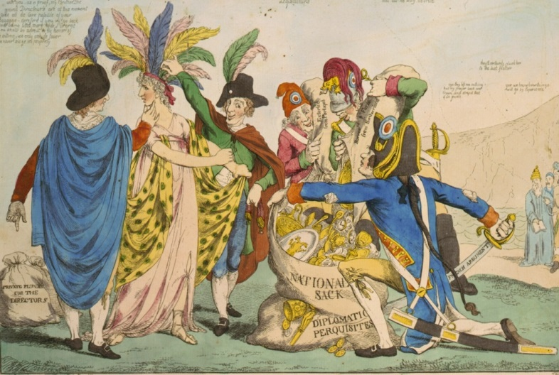

A New Dynamical Picture for the Production and Decay of the X, Y, Z, and P_{c} Charmoniumlike Exotics
QCD
BELLE
BES III
Y(4260)
Richard Lebed
Modern Exotic Hadrons
Institute for Nuclear Theory
November, 2015
X(3872)
Z(4475)
BABAR
CLEO
CDF, DØ
LHCb
CMS

Slide 2
Outline
Discovery of the exotic hadrons X,Y,Z, P_{c}
How are the tetraquarks X,Y,Z assembled?
A new dynamical picture for the X,Y,Z
Puzzles resolved by the new picture
The pentaquarks P_{c}
Conclusions

Slide 3
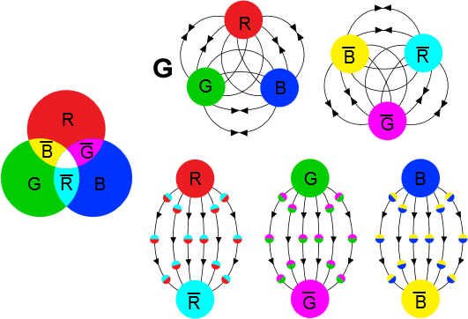
Whenever teaching the Particle & Nuclear Physics undergraduate survey class, I always say:
“Quarks and gluons are never seen in isolation, a phenomenon called color confinement. Instead, they are always found in compounds called hadrons, either as quark-antiquark pairs (mesons), or triples of quarks (baryons).”
R = red color
G = green color
B = blue color
because color charge
provides two distinct
ways to make
color-neutral states

Slide 4
Every now and then, a really sharp student asks:
“Aren’t there any other ways to make other color-neutral states?”
Sure; they are called exotics: (g = gluon, q = quark)
gg, ggg, … (glueball)
qq̄g, qq̄gg, … (hybrid meson)
qq̄qq̄, qq̄qq̄qq̄, … (tetraquark, hexaquark, …)
qqqqq̄, qqqqqqqq̄, … (pentaquark, octoquark, …)
i.e., (# of q) – (# of q̄) = 0 mod 3, any number of g except one by itself

Slide 5
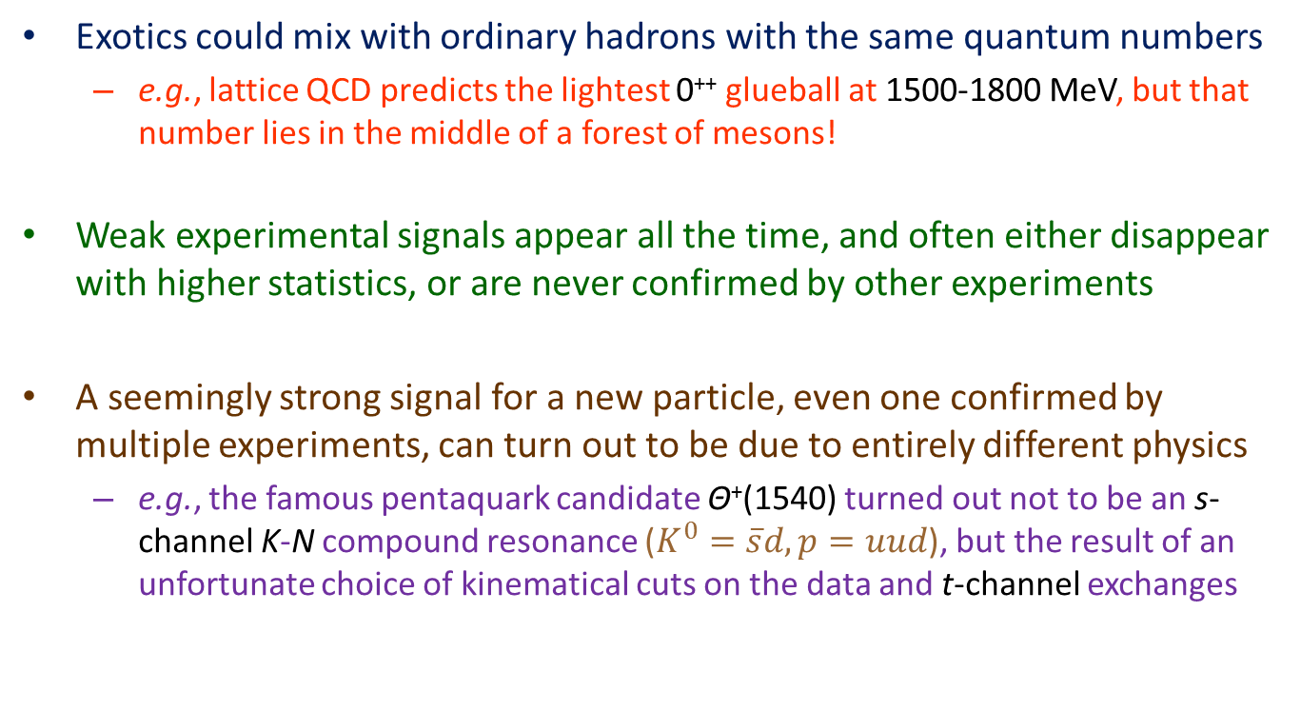
“So why haven’t they been found?”
Exotics could mix with ordinary hadrons with the same quantum numbers
  e.g., lattice QCD predicts the lightest 0⁺⁺ glueball at 1500-1800 MeV, but that number lies in the middle of a forest of mesons!
Weak experimental signals appear all the time, and often either disappear with higher statistics, or are never confirmed by other experiments
A seemingly strong signal for a new particle, even one confirmed by multiple experiments, can turn out to be due to entirely different physics
  e.g., the famous pentaquark candidate Θ⁺(1540) turned out not to be an s-channel K-N compound resonance ($K^{0}=\overline{s}d, p=uud$), but the result of an unfortunate choice of kinematical cuts on the data and t-channel exchanges

Slide 6
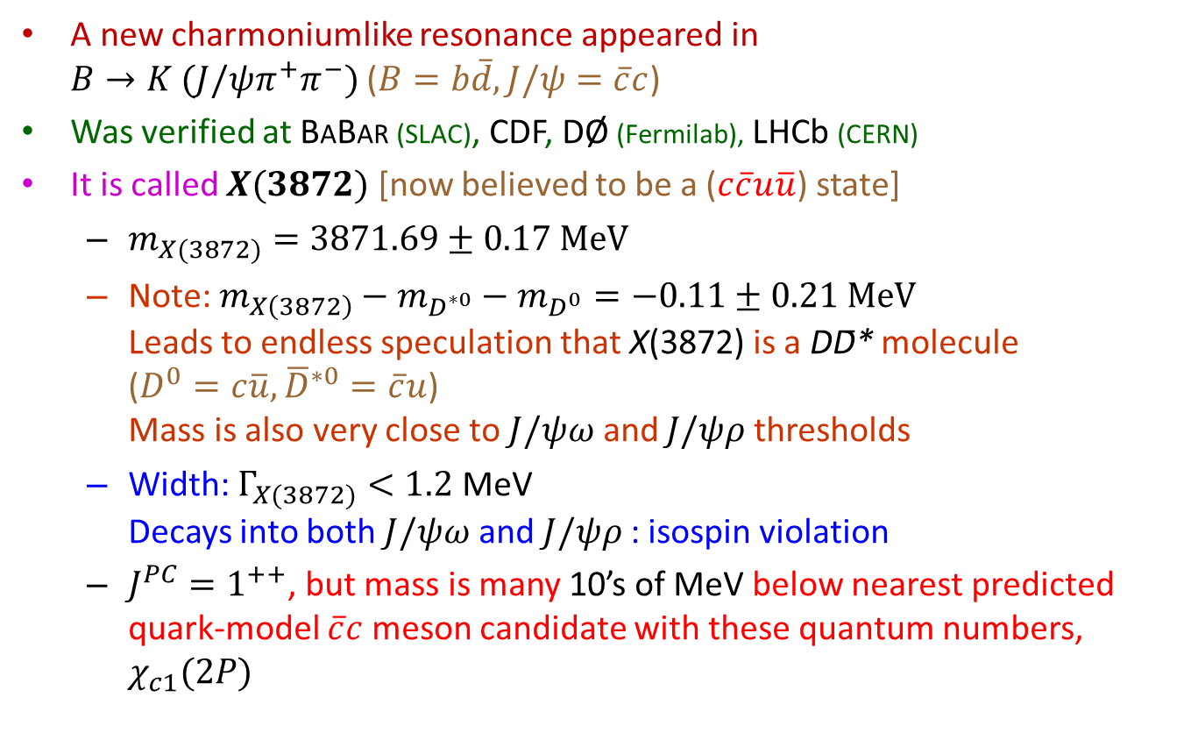
…Until 2003: X
Belle Collaboration (S.-K. Choi et al., PRL 91 262001 [2003])
A new charmoniumlike resonance appeared in
$B→K (J/ψπ^{+}π^{−})$ ($B=b\overline{d}, J/ψ=\overline{c}c$)
Was verified at BABAR (SLAC), CDF, DØ (Fermilab), LHCb (CERN)
It is called $X(3872)$ [now believed to be a ($c\overline{c}u\overline{u}$) state]
  $m_{X(3872)}=3871.69±0.17 MeV$
  Note: $m_{X\left(3872\right)}−m_{D^{∗0}}−m_{D^{0}}=−0.11±0.21 MeV$
  Leads to endless speculation that X(3872) is a DD̄* molecule
  ($D^{0}=c\overline{u}, {\overline{D}}^{∗0}=\overline{c}u$)
  Mass is also very close to $J/ψω$ and $J/ψρ$ thresholds
  Width: $Γ_{X(3872)}<1.2$ MeV
  Decays into both $J/ψω$ and $J/ψρ$ : isospin violation
  $J^{PC}=1^{++}$, but mass is many 10’s of MeV below nearest predicted quark-model $\overline{c}c$ meson candidate with these quantum numbers, $χ_{c1}(2P)$

Slide 7

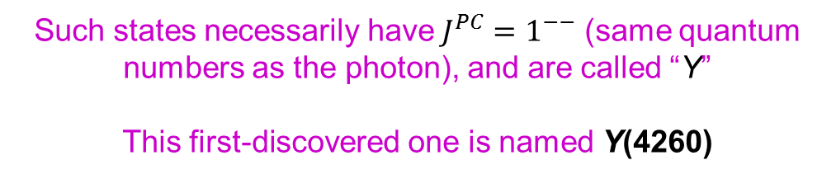
…And in 2005: Y
BABAR Collaboration (B. Aubert et al., PRL 95, 142001 [2005])
Charmoniumlike states started to show up
in initial-state radiation (ISR)${ e}^{+}e^{−}$ annihilation:
= photon
Figure from Nielsen et al.,
Phys. Rept. 497 (2010) 41
Such states necessarily have$J^{PC}=1^{−−}$ (same quantum numbers as the photon), and are called “Y”
This first-discovered one is named Y(4260)

Slide 8
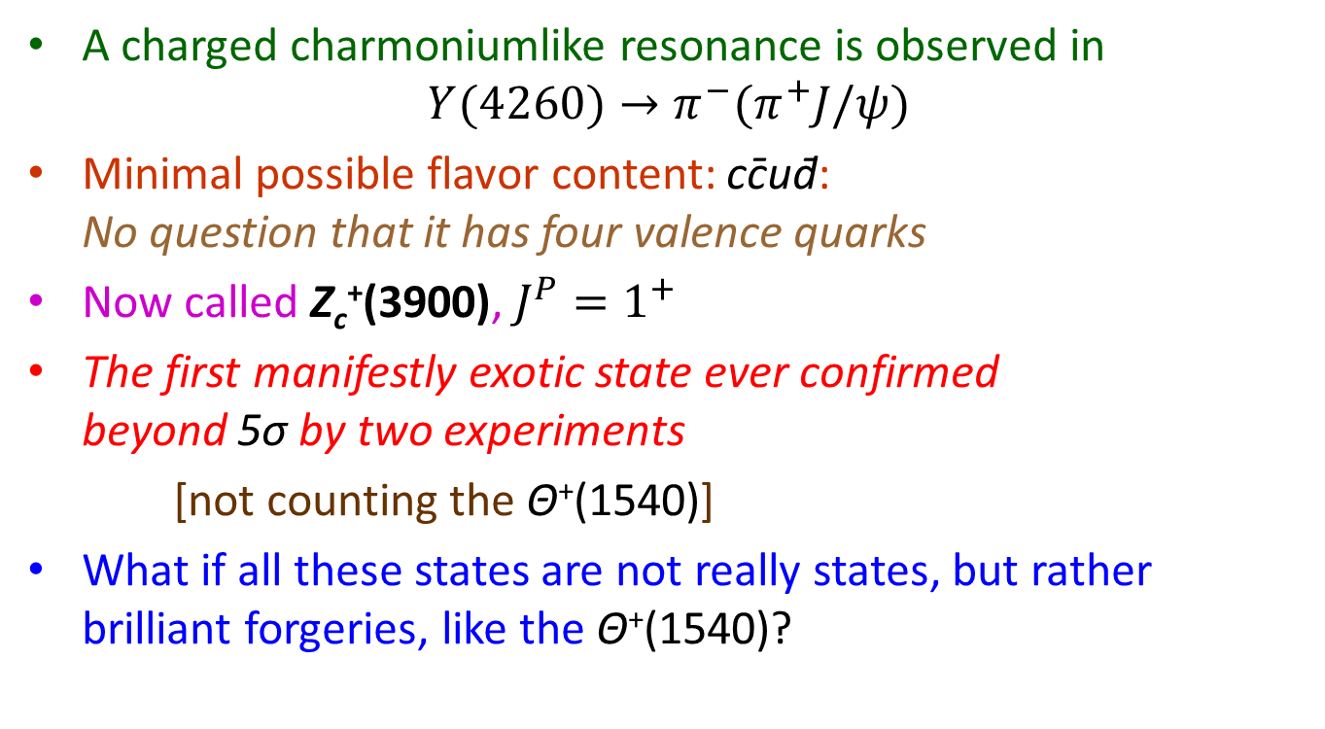
…And in 2013: Z
BESIII Collaboration [Beijing] (M. Ablikim et al., PRL 110, 252001 [2013]),
Belle Collaboration (Z. Liu et al., PRL 110, 252002 [2013])
A charged charmoniumlike resonance is observed in
$Y(4260)→π^{−}(π^{+}J/ψ)$
Minimal possible flavor content: cc̄ud̄:
No question that it has four valence quarks
Now called Z_{c}⁺(3900), $J^{P}=1^{+}$
The first manifestly exotic state ever confirmed
beyond 5σ by two experiments
[not counting the Θ⁺(1540)]
What if all these states are not really states, but rather brilliant forgeries, like the Θ⁺(1540)?

Slide 9
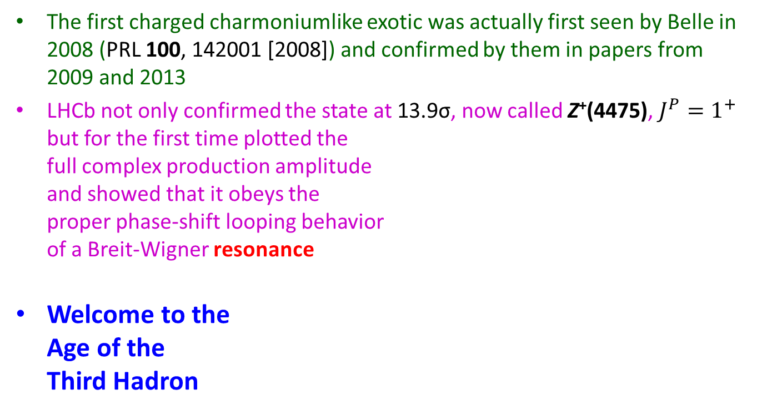
…And in 2014: Resonance
LHCb Collaboration (R. Aaij et al., PRL 112, 222002 [2014])
The first charged charmoniumlike exotic was actually first seen by Belle in 2008 (PRL 100, 142001 [2008]) and confirmed by them in papers from 2009 and 2013
LHCb not only confirmed the state at 13.9σ, now called Z⁺(4475), $J^{P}=1^{+}$
but for the first time plotted the
full complex production amplitude
and showed that it obeys the
proper phase-shift looping behavior
of a Breit-Wigner resonance
Welcome to the
Age of the
Third Hadron

Slide 10
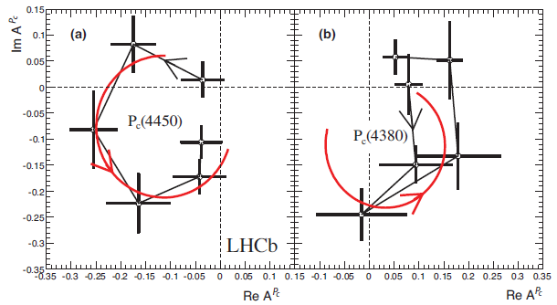

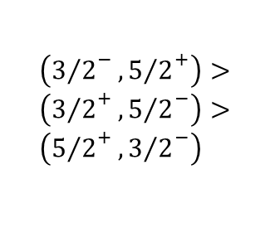
…And now in 2015: P_{c}
LHCb Collaboration [R. Aaij et al., PRL 115 (2015) 072001]
The first two baryonic charmoniumlike exotics, P_{c}⁺(4450), P_{c}⁺(4380)
Decay to $J/{ψ+p⟶}$Valence structure $c\overline{c}uud$: Pentaquarks!
$m_{1}=4380 ±8 ±29$ MeV, $Γ_{1}=205±18±86$ MeV, $9σ$ significance
$m_{2}=4449.8±1.7±2.5$ MeV, $Γ_{2}= 39 ±5± 19$ MeV, $12σ$ significance
Preferred $J^{P}$
assignments:
Welcome to
the Age of the
Fourth Hadron
$$\left({3/2}^{−},{5/2}^{+}\right)> \\ \left({3/2}^{+},{5/2}^{−}\right)> \\ \left({5/2}^{+},{3/2}^{−}\right)$$

Slide 11
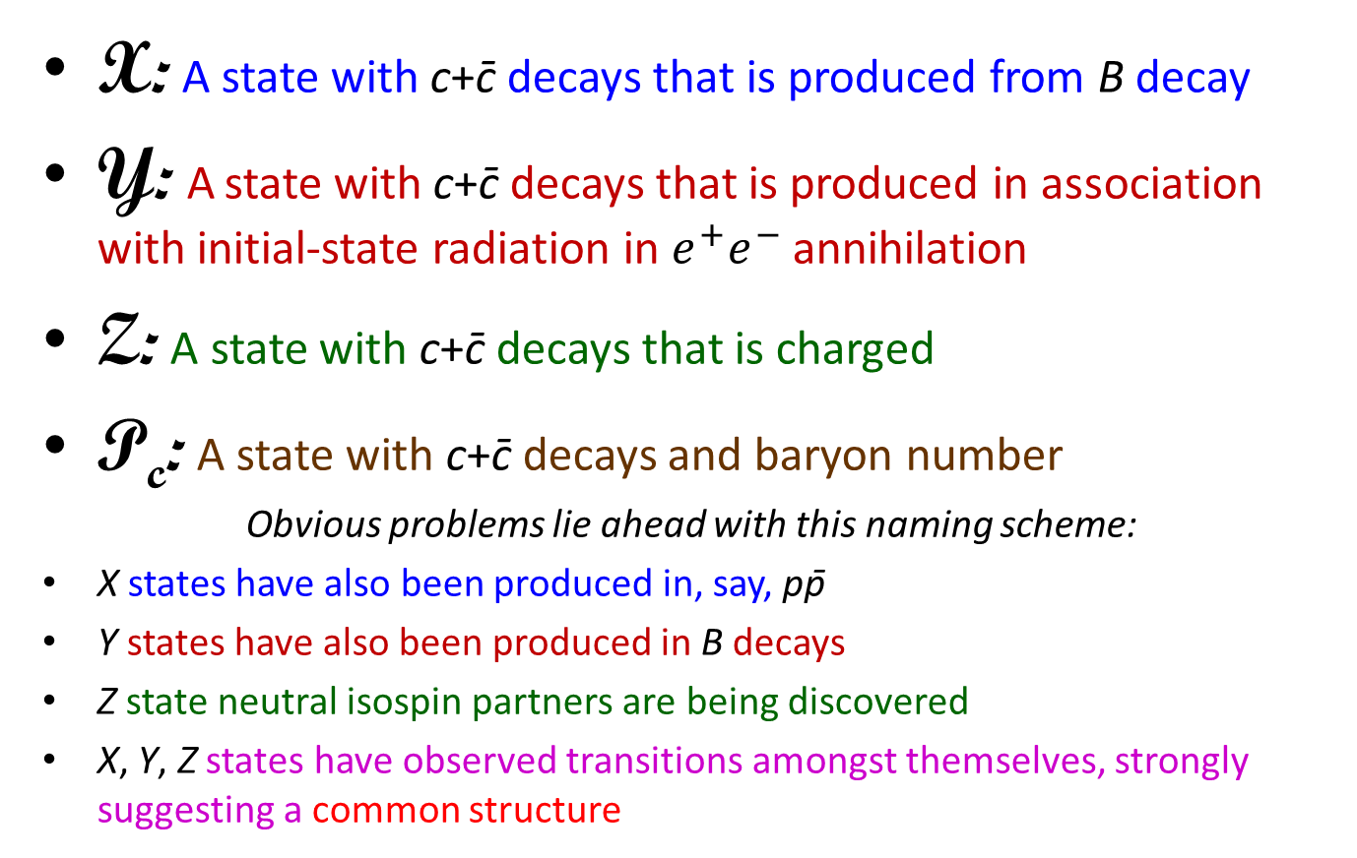
Our limited nomenclature
X: A state with c+c̄ decays that is produced from B decay
Y: A state with c+c̄ decays that is produced in association with initial-state radiation in $e^{+}e^{−}$ annihilation
Z: A state with c+c̄ decays that is charged
P_{c}: A state with c+c̄ decays and baryon number
Obvious problems lie ahead with this naming scheme:
X states have also been produced in, say, pp̄
Y states have also been produced in B decays
Z state neutral isospin partners are being discovered
X, Y, Z states have observed transitions amongst themselves, strongly suggesting a common structure

Slide 12
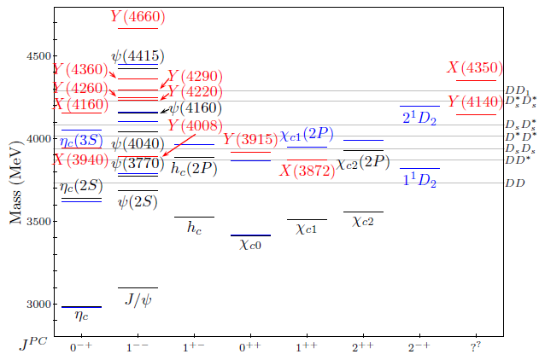
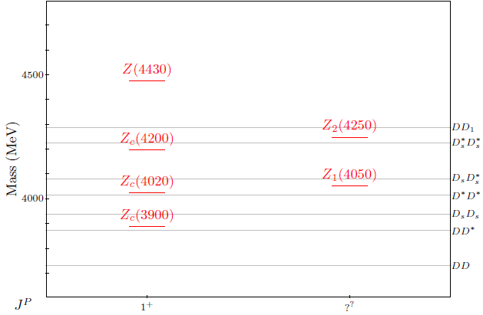
Charmonium: November 2014
Esposito et al., Int. J. Mod. Phys. A30 (2014)1530002
Neutral
Charged
Black: Observed conventional cc̄ states
Blue: Predicted conventional cc̄ states
Red: Exotic cc̄ states

Slide 13
How are tetraquarks assembled?
u
c̄
c
_
u
hadrocharmonium
cusp effect:
Resonance created by rapid
opening of meson-meson threshold
Image from Godfrey & Olsen,
Ann. Rev. Nucl. Part. Sci. 58 (2008) 51

Slide 14
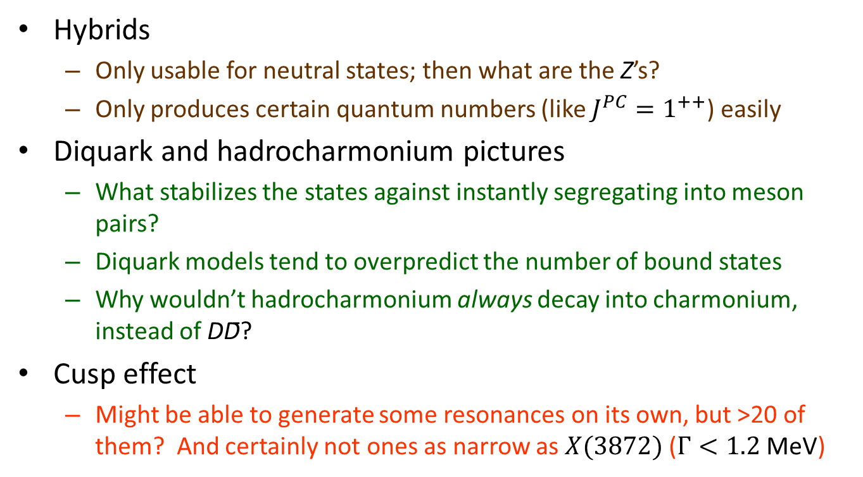
Trouble with the dynamical pictures
Hybrids
  Only usable for neutral states; then what are the Z’s?
  Only produces certain quantum numbers (like $J^{PC}=1^{++}$) easily
Diquark and hadrocharmonium pictures
  What stabilizes the states against instantly segregating into meson pairs?
  Diquark models tend to overpredict the number of bound states
  Why wouldn’t hadrocharmonium always decay into charmonium, instead of DD̄?
Cusp effect
  Might be able to generate some resonances on its own, but >20 of them? And certainly not ones as narrow as $X(3872)$ ($Γ<1.2$ MeV)

Slide 15
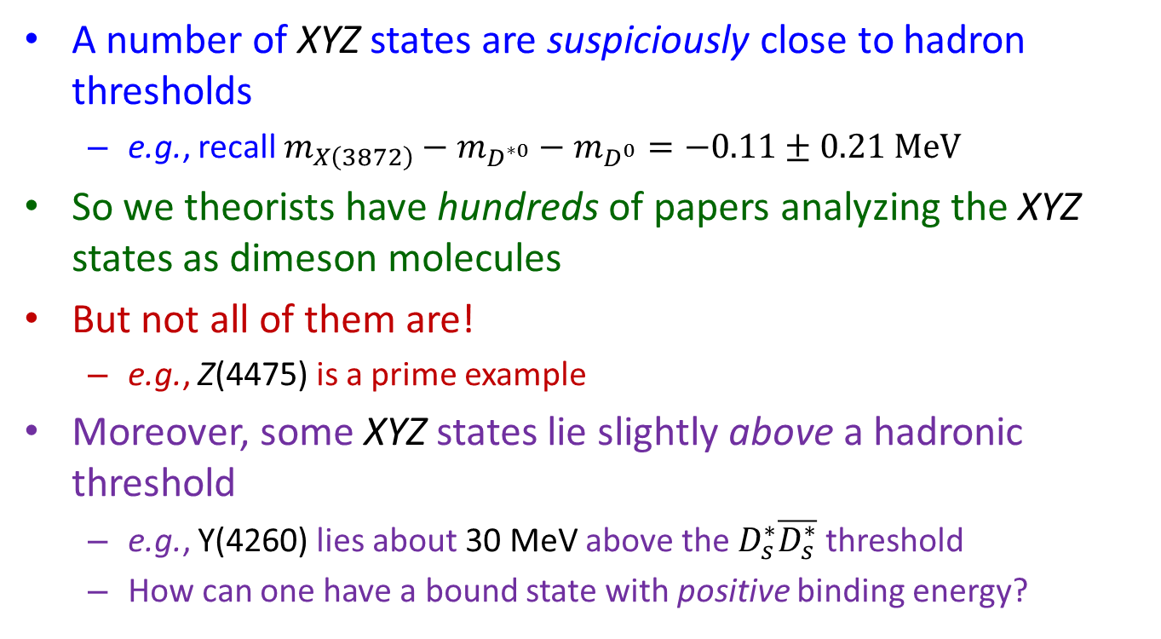
The hadron molecular picture
A number of XYZ states are suspiciously close to hadron thresholds
  e.g., recall $m_{X\left(3872\right)}−m_{D^{∗0}}−m_{D^{0}}=−0.11±0.21 MeV$
So we theorists have hundreds of papers analyzing the XYZ states as dimeson molecules
But not all of them are!
  e.g., Z(4475) is a prime example
Moreover, some XYZ states lie slightly above a hadronic threshold
  e.g., Y(4260) lies about 30 MeV above the $D_{s}^{∗}\overline{D_{s}^{∗}}$ threshold
  How can one have a bound state with positive binding energy?

Slide 16
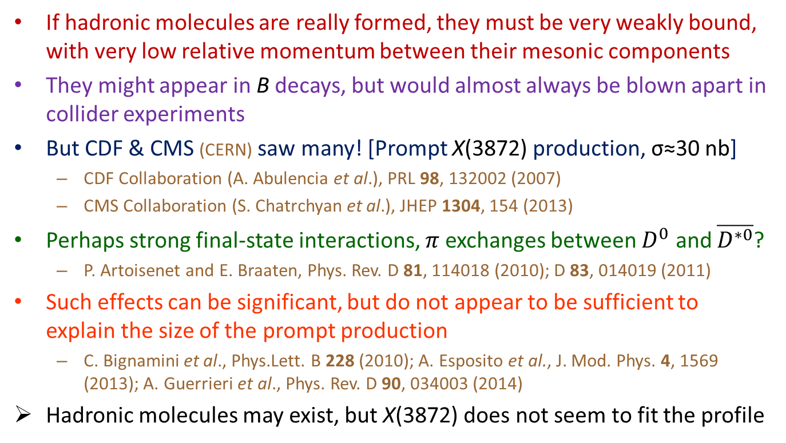
Prompt production
If hadronic molecules are really formed, they must be very weakly bound, with very low relative momentum between their mesonic components
They might appear in B decays, but would almost always be blown apart in collider experiments
But CDF & CMS (CERN) saw many! [Prompt X(3872) production, σ≈30 nb]
  CDF Collaboration (A. Abulencia et al.), PRL 98, 132002 (2007)
  CMS Collaboration (S. Chatrchyan et al.), JHEP 1304, 154 (2013)
Perhaps strong final-state interactions, $π$exchanges between $D^{0}$ and $\overline{D^{∗0}}$?
  P. Artoisenet and E. Braaten, Phys. Rev. D 81, 114018 (2010); D 83, 014019 (2011)
Such effects can be significant, but do not appear to be sufficient to explain the size of the prompt production
  C. Bignamini et al., Phys.Lett. B 228 (2010); A. Esposito et al., J. Mod. Phys. 4, 1569 (2013); A. Guerrieri et al., Phys. Rev. D 90, 034003 (2014)
Hadronic molecules may exist, but X(3872) does not seem to fit the profile

Slide 17
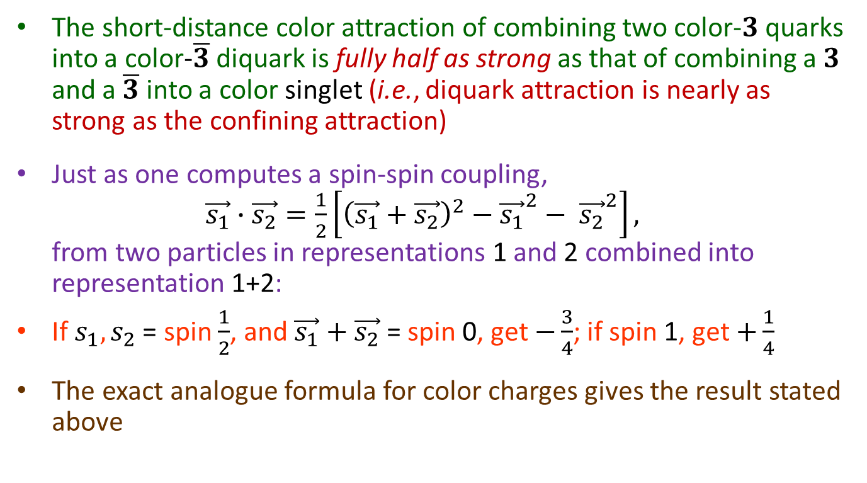
Amazing (well-known) fact about color:
The short-distance color attraction of combining two color-$3$ quarks into a color-$\overline{3}$ diquark is fully half as strong as that of combining a $3$ and a $\overline{3}$ into a color singlet (i.e., diquark attraction is nearly as strong as the confining attraction)
Just as one computes a spin-spin coupling,
$\vec{s_{1}}∙\vec{s_{2}}=\frac{1}{2}\left[{\left(\vec{s_{1}}+\vec{s_{2}}\right)}^{2}−{\vec{s_{1}}}^{2}− {\vec{s_{2}}}^{2}\right],$
from two particles in representations 1 and 2 combined into representation 1+2:
If $s_{1},s_{2}$ = spin $\frac{1}{2}$, and $\vec{s_{1}}+\vec{s_{2}}$ = spin 0, get $−\frac{3}{4}$; if spin 1, get $+\frac{1}{4}$
The exact analogue formula for color charges gives the result stated above

Slide 18
A new tetraquark picture
Stanley J. Brodsky, Dae Sung Hwang, RFL
Physical Review Letters 113, 112001 (2014)
CLAIM: At least some of the observed tetraquark states are bound states of diquark-antidiquark pairs
BUT the pairs are not in a static configuration; they are created with a lot of relative energy, and rapidly separate from each other
Diquarks are not color neutral! They cannot, by confinement, separate asymptotically far
They must hadronize via large-r tails of mesonic wave functions, which suppresses decay widths

Slide 19
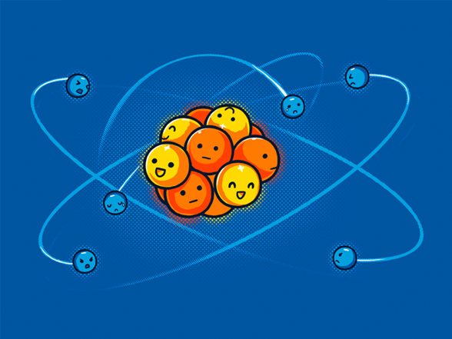
A new tetraquark picture
Stanley J. Brodsky, Dae Sung Hwang, RFL
Physical Review Letters 113, 112001 (2014)
CLAIM: At least some of the observed tetraquark states are bound states of diquark-antidiquark pairs
BUT the pairs are not in a static configuration; they are created with a lot of relative energy, and rapidly separate from each other
Diquarks are not color neutral! They cannot, by confinement, separate asymptotically far
They must hadronize via large-r tails of mesonic wave functions, which suppresses decay widths
Want to see this in action? Time for some cartoons!

Slide 20
Nonleptonic B⁰ meson decay
_
B.R.~22%
c
b
s
W─
d̄
c̄

Slide 21
What happens next?
Option 1: Color-allowed
B.R.~5%
(& similar 2-body)
c
s
D^{(*)+}
d̄
c̄
―
D_{s}^{(*)-}

Slide 22
What happens next?
Option 1: Color-allowed
B.R.~5%
(& similar 2-body)
c
s
D^{(*)0}
Each has P
~1700 MeV
d̄
c̄
―
D_{s}^{(*)-}

Slide 23
What happens next?
Option 2: Color-suppressed
B.R.~2.3%
c
s
d̄
c̄

Slide 24
What happens next?
Option 2: Color-suppressed
B.R.~2.3%
charmonium
c
K̄^{(*)0}
s
d̄
c̄

Slide 25

What happens next?
Option 3: Diquark formation
u
ū
cu
c
s
K^{(*)‾}
d̄
c̄
c̄d̄

Slide 26
What happens next?
Option 3: Diquark formation
ū
cu
s
K^{(*)‾}
c̄d̄

Slide 27
Driven apart by kinematics, yet bound together by confinement, our star-crossed diquarks must somehow hadronize as one
c̄
d̄
charmonium Ψ(2S)
c
u
Z⁺(4475)
π⁺

Slide 28

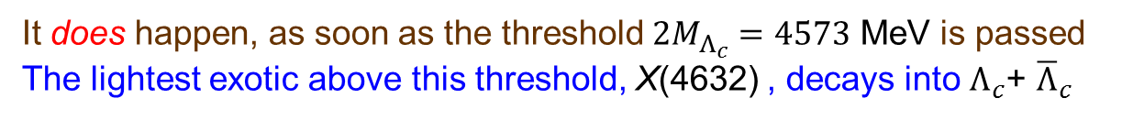

Why doesn’t this just happen?
It’s called baryonium
c̄
d̄
c
d
$$Λ_{c}$$
$${\overline{Λ}}_{c}$$
ū
u
It does happen, as soon as the threshold ${2M}_{Λ_{c}}=4573$ MeV is passed
The lightest exotic above this threshold, X(4632) , decays into $Λ_{c}$+ ${\overline{Λ}}_{c}$

Slide 29

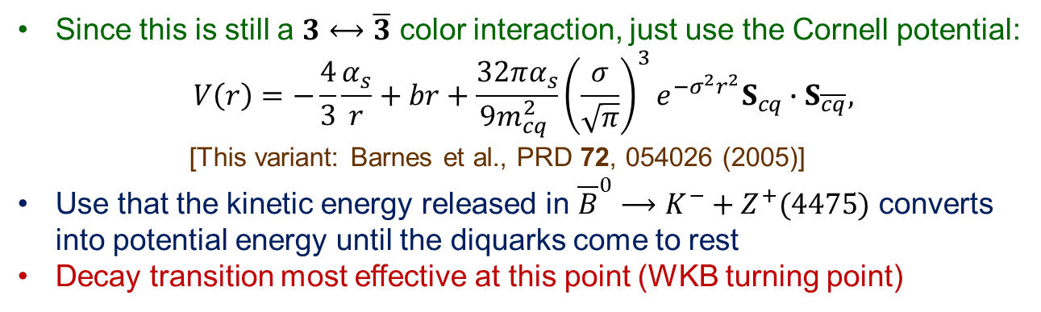
How far apart do the diquarks actually get?
Since this is still a $3⟷\overline{3}$ color interaction, just use the Cornell potential:
$V\left(r\right)=−\frac{4}{3}\frac{α_{s}}{r}+br+\frac{32πα_{s}}{9m_{cq}^{2} }{\left(\frac{σ}{\sqrt{π}}\right)}^{3}e^{−σ^{2}r^{2}}S_{cq}∙S_{\overline{cq}},$
[This variant: Barnes et al., PRD 72, 054026 (2005)]
Use that the kinetic energy released in ${\overline{B}}^{0}⟶K^{−}+Z^{+}(4475)$ converts
into potential energy until the diquarks come to rest
Decay transition most effective at this point (WKB turning point)
$$r_{Z}=1.16 fm$$
c̄
d̄
c
u

Slide 30
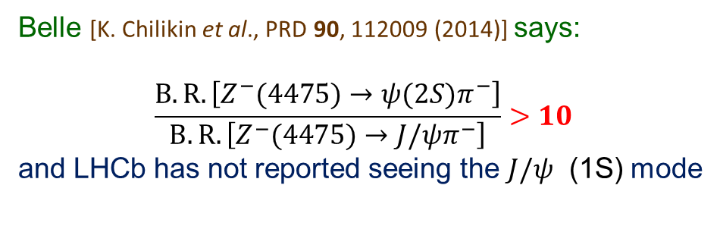


Fascinating Z(4475) fact:
Belle [K. Chilikin et al., PRD 90, 112009 (2014)] says:
$$\frac{B.R.\left[Z^{−}(4475)→ψ(2S)π^{−}\right]}{B.R.\left[Z^{−}(4475)→J{/ψπ}^{−}\right]}>10$$
and LHCb has not reported seeing the $J/ψ$ (1S) mode
$$\left\langle r_{ψ(2S)}\right\rangle =0.80 fm$$
$$r_{Z}=1.16 fm$$
c̄
d̄
c
u
$$\left\langle r_{J/ψ}\right\rangle =0.39 fm$$

Slide 31
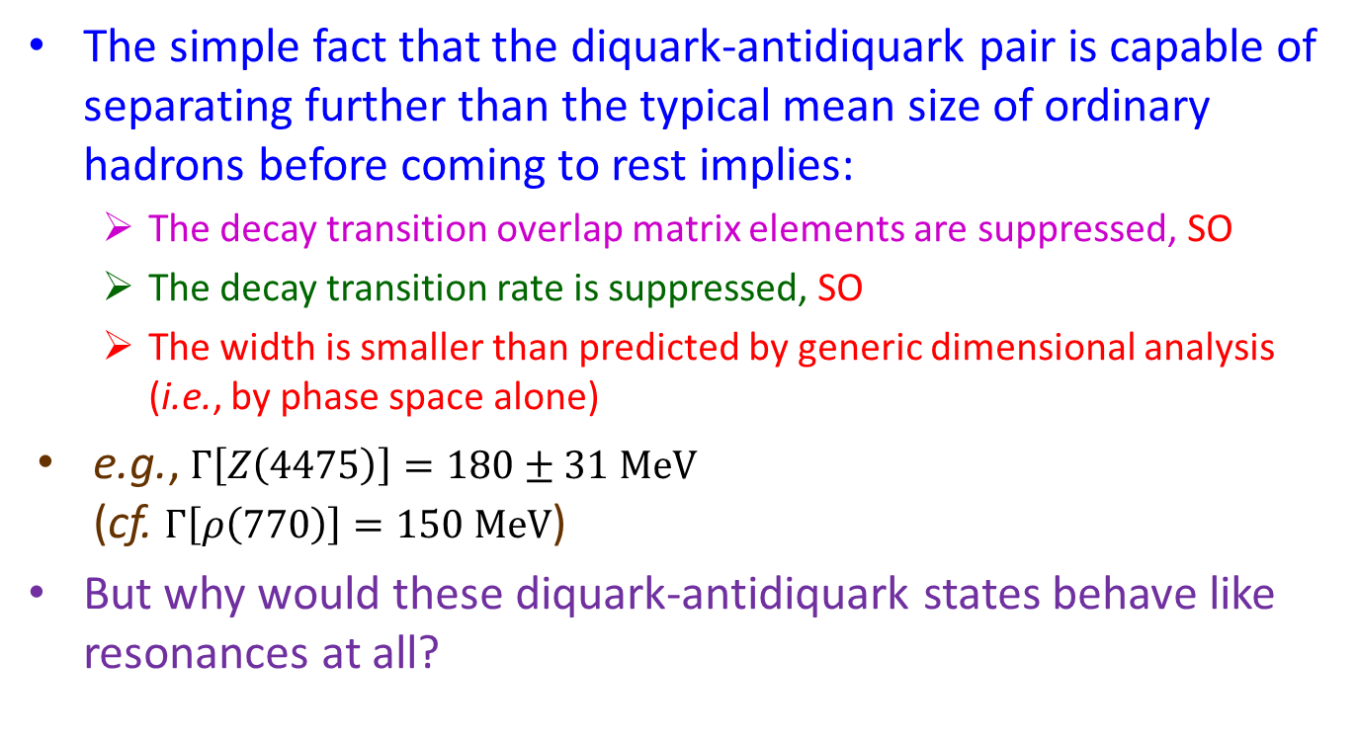
The large-r wave function tails and resonance widths
The simple fact that the diquark-antidiquark pair is capable of separating further than the typical mean size of ordinary hadrons before coming to rest implies:
  The decay transition overlap matrix elements are suppressed, SO
  The decay transition rate is suppressed, SO
  The width is smaller than predicted by generic dimensional analysis
  (i.e., by phase space alone)
e.g., $Γ\left[Z\left(4475\right)\right]=180±31 MeV$
(cf. $Γ\left[ρ\left(770\right)\right]=150 MeV$)
But why would these diquark-antidiquark states behave like resonances at all?

Slide 32
For one thing,
Diquark-antidiquark pairs create their own bound-state spectroscopy [L. Maiani et al., PRD 71 (2005) 014028]
  Simple Hamiltonian with spin-spin interactions among the four quarks
  Once one bound state is found, a whole multiplet arises
  Then compare predicted spectrum to experiment
  Original version predicts states with quantum numbers and multiplicities not found to exist (XYZ phenomenology not very well developed then), but a new version of the model [L. Maiani et al., PRD 89 (2014) 114010] appears to be much more successful
  Crucial revision: Dominant spin-spin couplings are within each diquark
  e.g., Z(4475) is radial excitation of Z(3900);
  Y states are L=1 color flux tube excitations

Slide 33
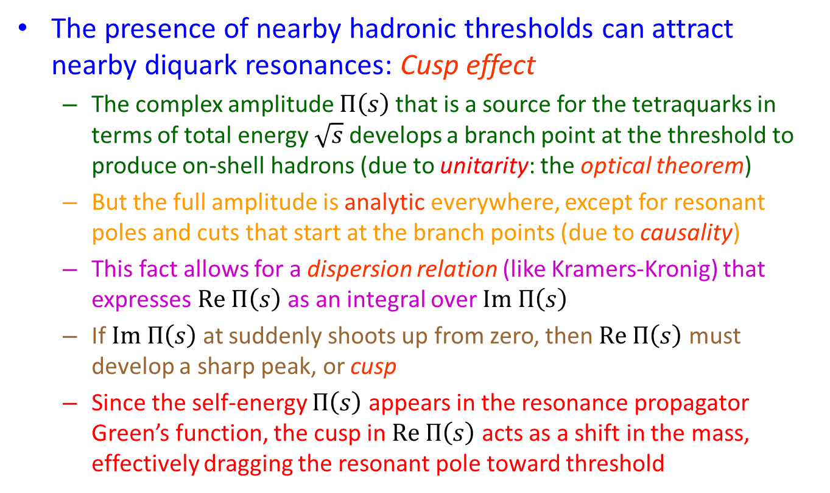
And furthermore,
The presence of nearby hadronic thresholds can attract nearby diquark resonances: Cusp effect
  The complex amplitude $Π\left(s\right)$that is a source for the tetraquarks in terms of total energy $\sqrt{s}$ develops a branch point at the threshold to produce on-shell hadrons (due to unitarity: the optical theorem)
  But the full amplitude is analytic everywhere, except for resonant poles and cuts that start at the branch points (due to causality)
  This fact allows for a dispersion relation (like Kramers-Kronig) that expresses $Re Π\left(s\right)$ as an integral over $Im Π\left(s\right)$
  If $Im Π\left(s\right)$ at suddenly shoots up from zero, then $Re Π\left(s\right)$ must develop a sharp peak, or cusp
  Since the self-energy $Π\left(s\right)$ appears in the resonance propagator Green’s function, the cusp in $Re Π\left(s\right)$ acts as a shift in the mass, effectively dragging the resonant pole toward threshold

Slide 34
The Cusp
Im Π(s)
$$P(s)=\frac{i}{s−M_{0}^{2}+Π(s)}$$
Re Π(s)
(Normalized
to unity at s_{th})

Slide 35
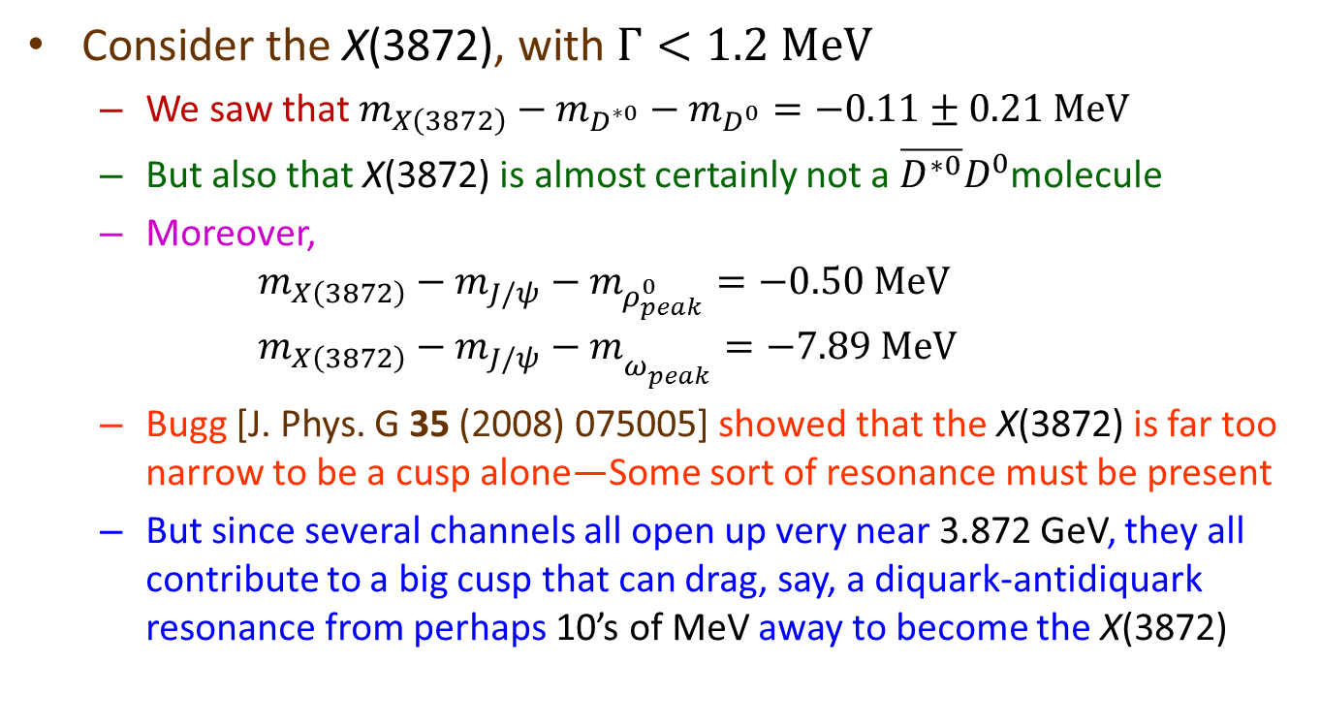
How closely can cusps attract thresholds?
Consider the X(3872), with $Γ<1.2 MeV$
  We saw that $m_{X\left(3872\right)}−m_{D^{∗0}}−m_{D^{0}}=−0.11±0.21 MeV$
  But also that X(3872) is almost certainly not a $\overline{D^{∗0}}D^{0}$molecule
  Moreover,
  $m_{X\left(3872\right)}−m_{J/ψ}−m_{ρ_{peak}^{0}}=−0.50 MeV$
  $m_{X\left(3872\right)}−m_{J/ψ}−m_{ω_{peak}^{}}=−7.89 MeV$
  Bugg [J. Phys. G 35 (2008) 075005] showed that the X(3872) is far too narrow to be a cusp alone—Some sort of resonance must be present
  But since several channels all open up very near 3.872 GeV, they all contribute to a big cusp that can drag, say, a diquark-antidiquark resonance from perhaps 10’s of MeV away to become the X(3872)

Slide 36
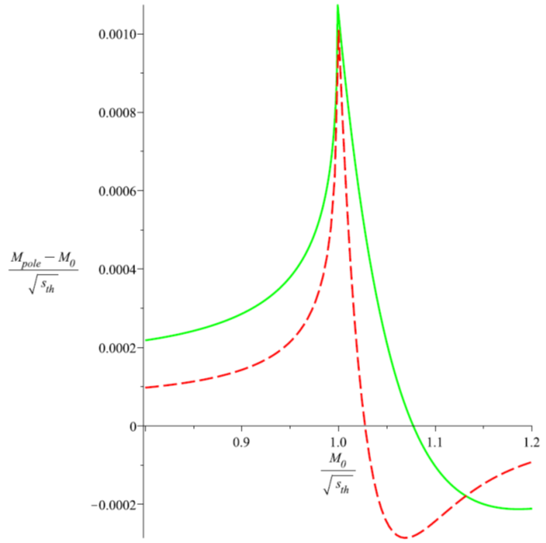
Example cusp effects
S. Blitz & RFL, Phys. Rev. D 91 (2015) 094025
M₀: Bare resonant pole mass
S_{th}: Threshold s value [here (3.872 GeV)²]
M_{pole}: Shifted pole mass
Relative size of
pole shift (about
0.12% near S_{th},
or 5 MeV)
..
At the charm scale,
a cusp from an opening
diquark pair threshold
is more effective than
one from a meson pair!

Slide 37
Does the dynamical diquark picture have anything to say about the P_{c} states?
Yes. RFL, Phys. Lett. B 749 (2015) 454

Slide 38
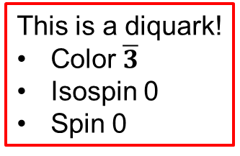
Nonleptonic Λ_{b} baryon decay
c
b
d
s
W─
This is a diquark!
Color $\overline{3}$
Isospin 0
Spin 0
c̄
ud
u

Slide 39
What happens next?
Diquark and triquark formation
u
ū
cu
c
s
K^{(*)‾}
ud
c̄
c̄ud

Slide 40
What happens next?
Diquark and triquark formation
ū
cu
s
K^{(*)‾}
c̄ud

Slide 41
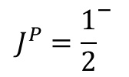
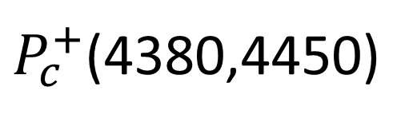


The same color triplet mechanism, supplemented with the fact that the ud in Λ baryons themselves act as diquarks, predicts a rich spectrum of pentaquarks
c̄
ud
J/Ψ
c
u
$P_{c}^{+}$(4380,4450)
p
$$J^{P}={\frac{1}{2}}^{−}$$
$$J^{P}=L^{{(−1)}^{L}}$$
$$J^{P}=0^{+},1^{+}$$

Slide 42

Any quantitative work?
Yes. Zhu & Qiao, 1510.08693
Hamiltonian approach:
P_{c}(4380) is $J^{P}={\frac{3}{2}}^{−}$and broad since it is a higher S-wave state
P_{c}(4450) is $J^{P}={\frac{5}{2}}^{+}$and narrow since it is a lower P-wave state

Slide 43
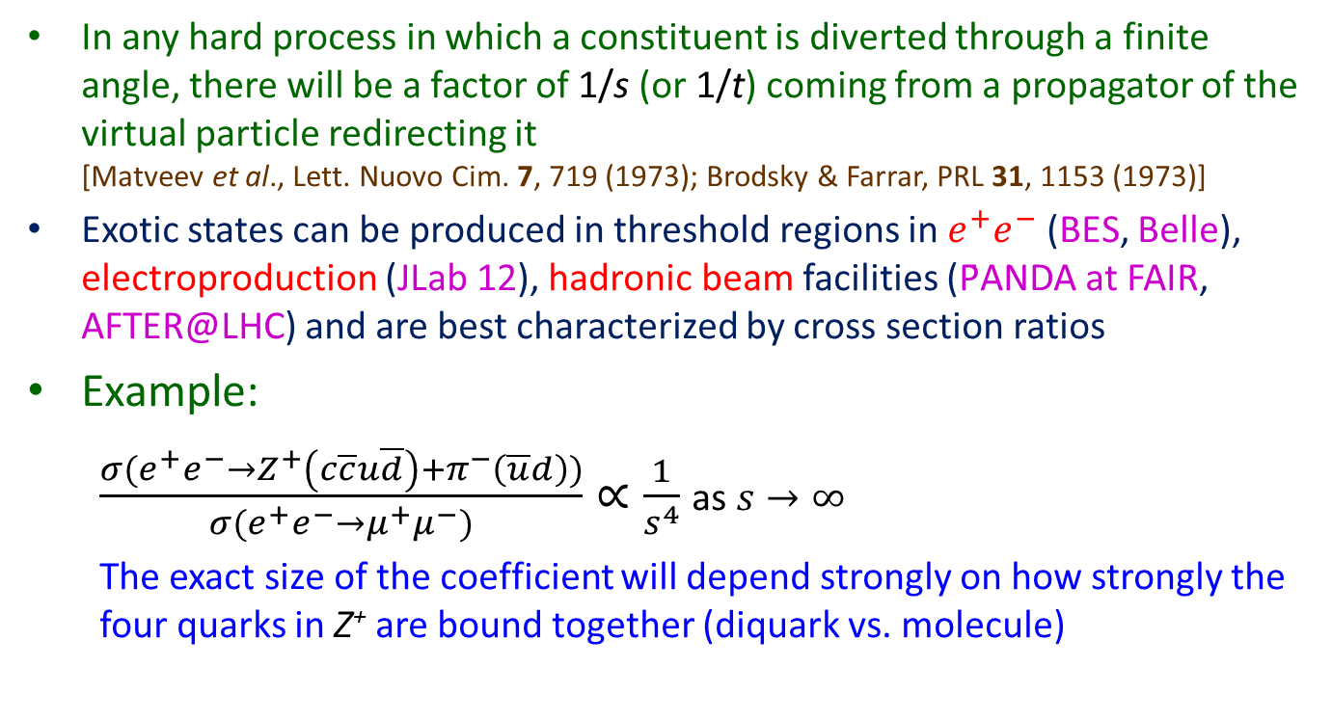
QCD counting rules for cross sections
S. Brodsky and RFL, Phys. Rev. D 91 (2015) 114025
In any hard process in which a constituent is diverted through a finite angle, there will be a factor of 1/s (or 1/t) coming from a propagator of the virtual particle redirecting it
[Matveev et al., Lett. Nuovo Cim. 7, 719 (1973); Brodsky & Farrar, PRL 31, 1153 (1973)]
Exotic states can be produced in threshold regions in $e^{+}e^{−}$ (BES, Belle), electroproduction (JLab 12), hadronic beam facilities (P̄ANDA at FAIR, AFTER@LHC) and are best characterized by cross section ratios
Example:
  $\frac{σ(e^{+}e^{−}→Z_{}^{+}\left(c\overline{c}u\overline{d}\right)+π^{−}\left(\overline{u}d\right))}{σ(e^{+}e^{−}→μ^{+}μ^{−})}∝\frac{1}{s^{4}}$ as $s→∞$
  The exact size of the coefficient will depend strongly on how strongly the four quarks in Z⁺ are bound together (diquark vs. molecule)

Slide 44

Why not ss̄ pentaquarks?
In $γN→φN$ (RFL, 1510.01412)
In $Λ_{c}→φπ^{0}p$ (compare to $Λ_{b}→J/ψK^{−}p$) (RFL, 1510.06648)

Slide 45
Conclusions
The past two years have provided confirmation of the existence of the tetraquark and observation of the pentaquark, the third and fourth classes of hadron
Over 20 such states (X, Y, Z, P_{C}) have thus far been observed
All of the popular physical pictures for describing their structure seem to suffer some imperfection
We propose an entirely new dynamical picture based on a diquark-antidiquark (or triquark) pair rapidly separating until forced to hadronize due to confinement
Then several problems, e.g., the widths of X, Y, Z, P_{C} states and their couplings to hadrons, become much less mysterious
Much new work is underway, and many opportunities remain!

Slide 46
Backup slides

Slide 47
Quantum Chromodynamics (QCD)
QCD is the quantum field theory of the strong nuclear force that holds atomic nuclei together
Its fundamental particles of matter are called quarks
Its particles responsible for force exchanges are called gluons
Quarks exchange gluons because quarks carry color charge
Analogy: QED (Quantum Electrodynamics, the quantum field theory of electricity & magnetism) includes electrons among its fundamental matter particles, which interact by exchanging photons, possible because electrons carry electric charge
A huge difference: No problem in separating electrons from neutral atoms, but quarks cannot be separated from the compounds (hadrons) in which they occur: color confinement

Slide 48
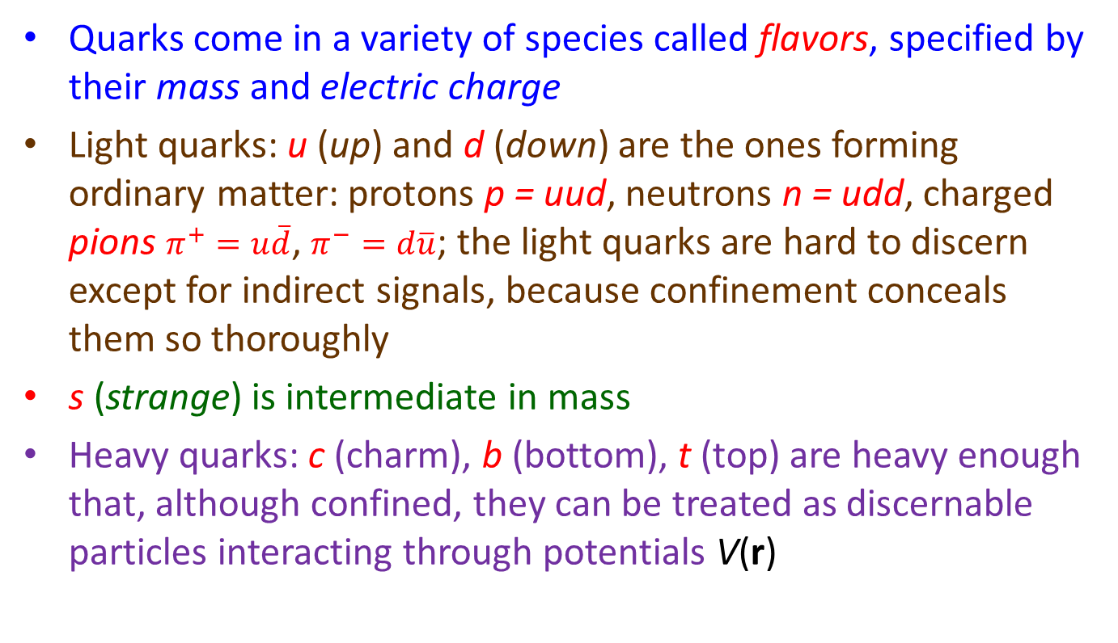
Quantum Chromodynamics (QCD)
Quarks come in a variety of species called flavors, specified by their mass and electric charge
Light quarks: u (up) and d (down) are the ones forming ordinary matter: protons p = uud, neutrons n = udd, charged pions $π^{+}=u\overline{d}$, $π^{−}=d\overline{u}$; the light quarks are hard to discern except for indirect signals, because confinement conceals them so thoroughly
s (strange) is intermediate in mass
Heavy quarks: c (charm), b (bottom), t (top) are heavy enough that, although confined, they can be treated as discernable particles interacting through potentials V(r)

Slide 49
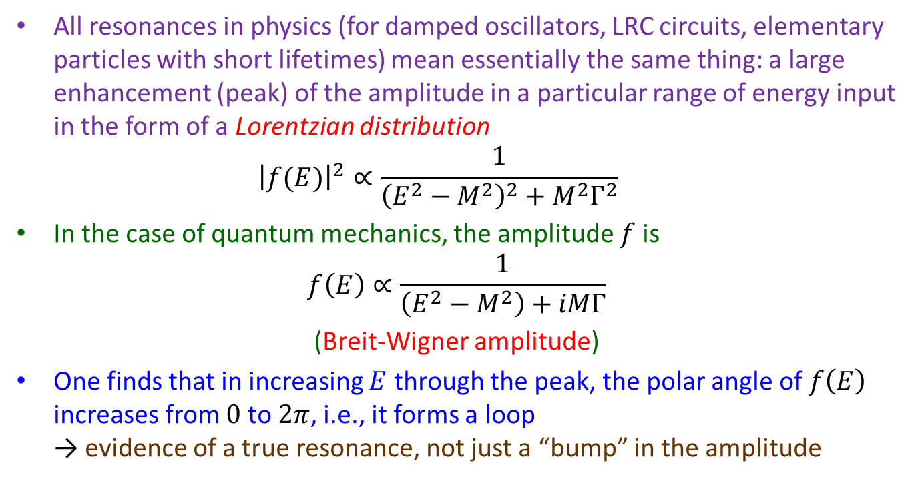
The Breit-Wigner resonance
All resonances in physics (for damped oscillators, LRC circuits, elementary particles with short lifetimes) mean essentially the same thing: a large enhancement (peak) of the amplitude in a particular range of energy input in the form of a Lorentzian distribution
${\left|f(E)\right|}^{2}∝\frac{1}{{\left(E^{2}−M^{2}\right)}^{2}+M^{2}Γ^{2}}$
In the case of quantum mechanics, the amplitude $f$ is
$f\left(E\right)∝\frac{1}{\left(E^{2}−M^{2}\right)+iMΓ}$
(Breit-Wigner amplitude)
One finds that in increasing $E$ through the peak, the polar angle of $f\left(E\right)$ increases from $0$ to $2π$, i.e., it forms a loop
→ evidence of a true resonance, not just a “bump” in the amplitude

Slide 50

Belle Leads the Way
Confirmed states (by > 1 experiments or > 1 modes) | Belle confirms?
X(3823) = ψ₂(1D)?
X(3872)
Z_{c}⁺(3885)/Z_{c}⁺(3900)
Z_{c}⁰(3885)/Z_{c}⁰(3900)
χ_{c0}(3915)
Y(4260)
Y(4360)
Z⁺(4430)
Y(4660)
Z_{b}(10610)
Z_{b}(10650)
Only seen, or best seen, at Belle
X(3940)
Y(4008)
Z⁺(4050)
X(4160)
Z⁺(4200)
Z⁺(4250) (also LHCb?)
X(4350)
X(4630)
Y_{b}(10888)

Slide 51

The large-r wave function tails and resonance widths
The simple fact that the diquark-antidiquark pair is capable of separating further than the typical mean size of ordinary hadrons before coming to rest implies:
  The decay transition overlap matrix elements are suppressed, SO
  The decay transition rate is suppressed, SO
  The width is smaller than predicted by generic dimensional analysis
  (i.e., by phase space alone)
e.g., $Γ\left[Z\left(4475\right)\right]=180±31 MeV$
(cf. $Γ\left[ρ\left(770\right)\right]=150 MeV$)
But why would these diquark-antidiquark states behave like resonances at all?

Slide 52
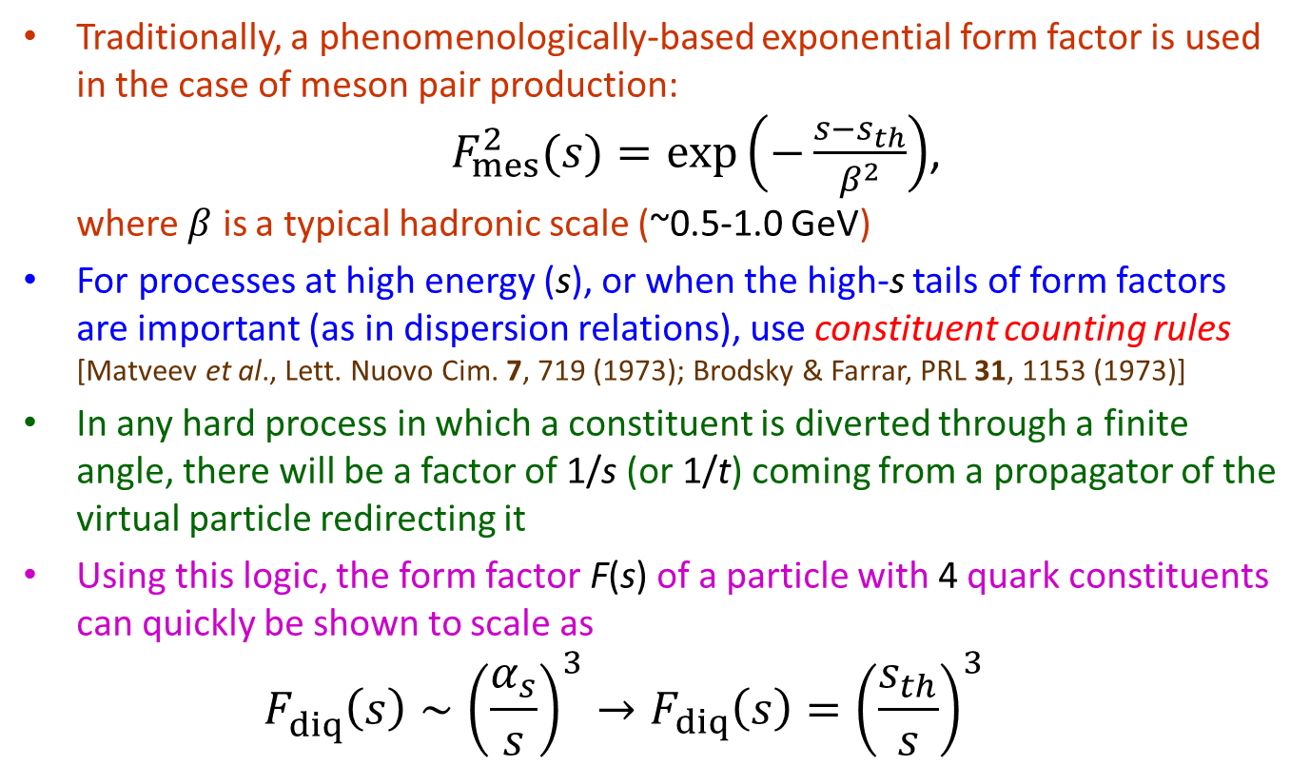
What determines cusp shapes?
Traditionally, a phenomenologically-based exponential form factor is used in the case of meson pair production:
$F_{mes}^{2}(s)=\exp\left(−\frac{s−s_{th}}{β^{2}}\right)$,
where $β$ is a typical hadronic scale (~0.5-1.0 GeV)
For processes at high energy (s), or when the high-s tails of form factors are important (as in dispersion relations), use constituent counting rules
[Matveev et al., Lett. Nuovo Cim. 7, 719 (1973); Brodsky & Farrar, PRL 31, 1153 (1973)]
In any hard process in which a constituent is diverted through a finite angle, there will be a factor of 1/s (or 1/t) coming from a propagator of the virtual particle redirecting it
Using this logic, the form factor F(s) of a particle with 4 quark constituents can quickly be shown to scale as
$F_{diq}^{}\left(s\right)∼{\left(\frac{α_{s}}{s}\right)}^{3}→{F_{diq}\left(s\right)=\left(\frac{s_{th}}{s}\right)}^{3}$

Slide 53
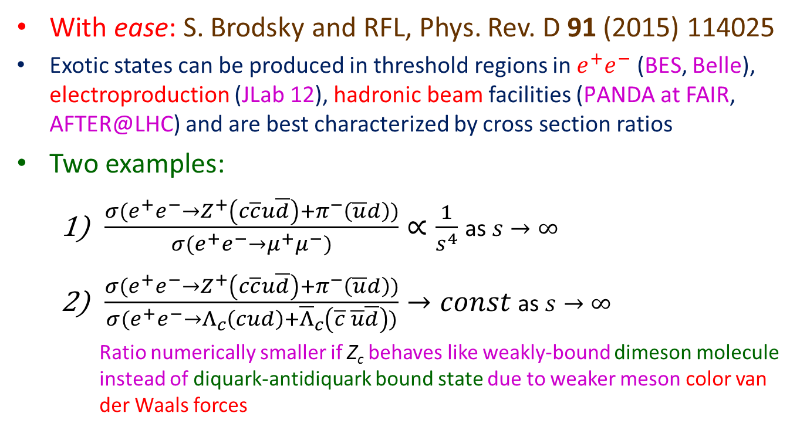
Can the counting rules be used for cross sections as well?
With ease: S. Brodsky and RFL, Phys. Rev. D 91 (2015) 114025
Exotic states can be produced in threshold regions in $e^{+}e^{−}$ (BES, Belle), electroproduction (JLab 12), hadronic beam facilities (P̄ANDA at FAIR, AFTER@LHC) and are best characterized by cross section ratios
Two examples:
  $\frac{σ(e^{+}e^{−}→Z_{}^{+}\left(c\overline{c}u\overline{d}\right)+π^{−}\left(\overline{u}d\right))}{σ(e^{+}e^{−}→μ^{+}μ^{−})}∝\frac{1}{s^{4}}$ as $s→∞$
  $\frac{σ(e^{+}e^{−}→Z_{}^{+}\left(c\overline{c}u\overline{d}\right)+π^{−}\left(\overline{u}d\right))}{σ(e^{+}e^{−}→Λ_{c}\left(cud\right)+{\overline{Λ}}_{c}\left(\overline{c} \overline{u}\overline{d}\right))}→const$as $s→∞$
    Ratio numerically smaller if Z_{c} behaves like weakly-bound dimeson molecule instead of diquark-antidiquark bound state due to weaker meson color van der Waals forces

