Slide 1
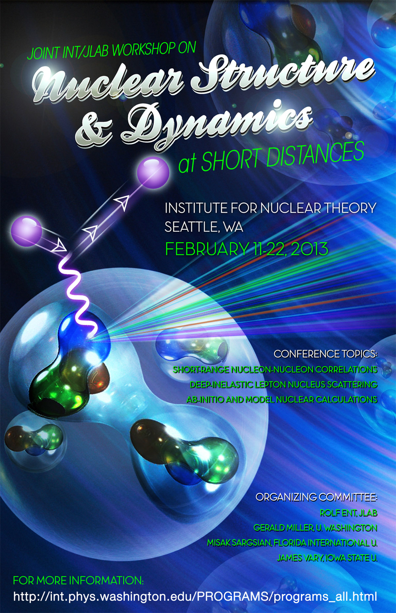
Nuclear Structure and Dynamics at Short Distances
Two-week workshop
INT, Seattle
February 11 – 22, 2013
Organizers:
Rolf Ent (JLab)
Jerry Miller (U Washington)
Misak Sargsian (FIU)
James Vary (Iowa State U)
Topics:
Short-Range Nucleon-Nucleon Correlations
Deep-Inelastic Lepton-Nucleus Scattering
Ab-Initio and Model Nuclear Calculations
With gratitude to the INT for having us here!

Slide 2
Nuclear Structure and Dynamics at Short Distances
Experimental background:
There has been significant progress in observing the effects of two-nucleon correlations, in studying quasi-elastic scattering off nuclei at large values of Bjorken x, and in detailing the nuclear dependence of deep-inelastic scattering.
  Quantitative relationships have been found between these apparently disconnected processes that point to a local-density, short-ranged nuclear effect.

Slide 3
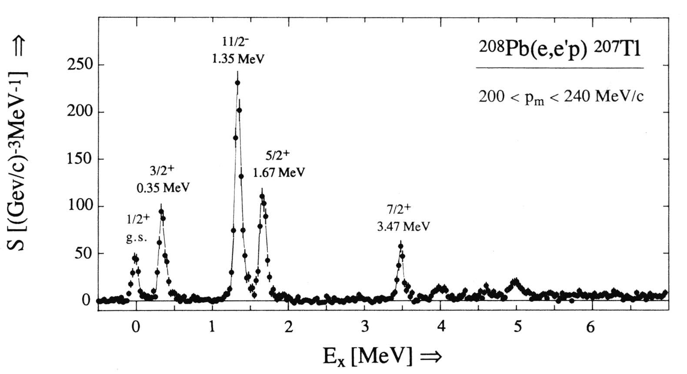
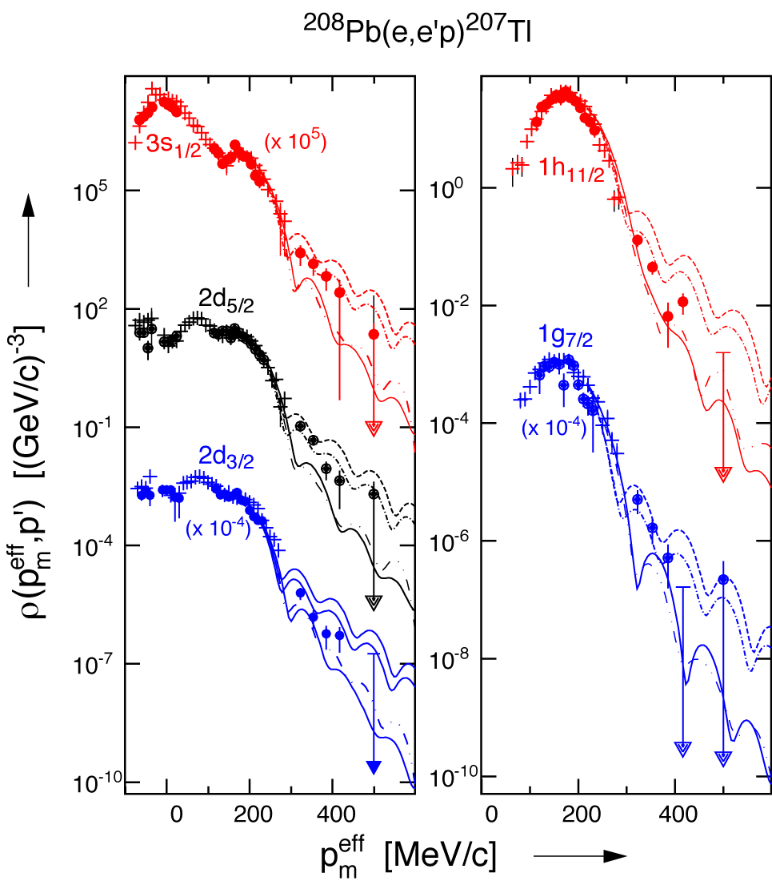
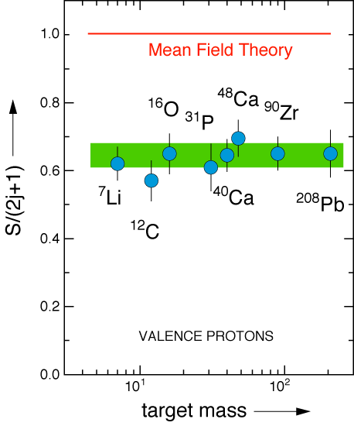
History - Proton Knock-out
ν
in binding
Visualizing the nuclear shell model
in momentum
Missing 20+% in the integral???

Slide 4
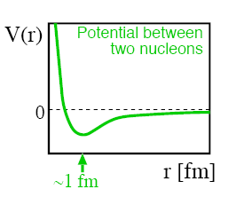
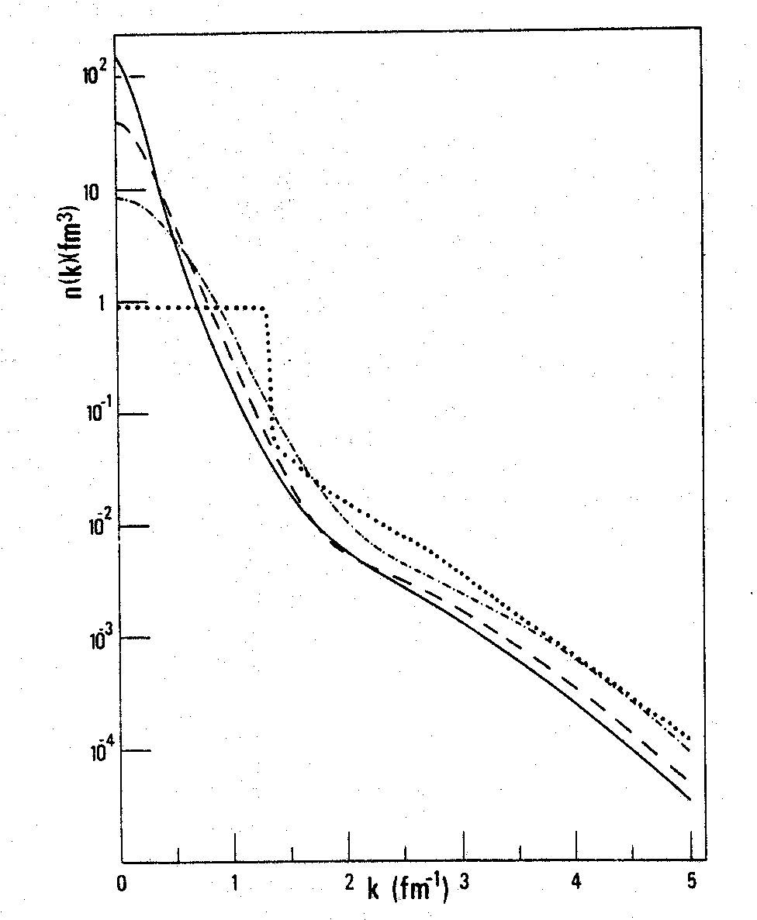

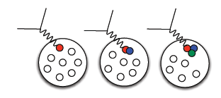
History: Proton Momenta in the nucleus
Similar shapes for few-body nuclei and nuclear matter at high k (=p_{m}).
Nuclear Matter
Short-range repulsive core gives rise to high proton momenta
²H
p
n
³He
⁴He
0 200 400 600 800 1000
P (MeV/c)

Slide 5
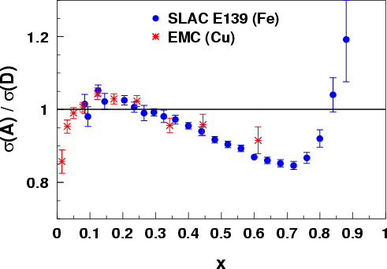
History: Parton Dynamics - the EMC Effect
Observation that structure functions are altered in nuclei stunned much of the HEP community almost 30 years ago
~1000 papers on the topic; the early models explained the curve by change of nucleon structure, BUT more data were needed to uniquely identify the origin
What is it that alters the quark momentum in the nucleus?
J. Ashman et al., Z. Phys. C57, 211 (1993)
J. Gomez et al., Phys. Rev. D49, 4348 (1994)
x
Notes:
Explain what the EMC effect is.
Point out the three regions and their conventional explanations.
Cannot be fully explained by conventional nuclear physics
Amazing that we still don’t know the answer after nearly a quarter of a century
Coverage extends at least to x=1.5

Slide 6
CEBAF’s Original Mission Statement
Key Mission and Principal Focus (1987):
The study of the largely unexplored transition between the nucleon-meson and the quark-gluon descriptions of nuclear matter.
The Role of Quarks in Nuclear Physics
Related Areas of Study:
Do individual nucleons change their size, shape, and quark structure in the nuclear medium?
Pushing the Limits of the Standard Model of Nuclear Physics
How do nucleons cluster in the nuclear medium?
What are the properties of the force which binds quarks into nucleons and nuclei at distances where this force is strong and the quark confinement mechanism is important?
The Onset of the Parton Model
Use the Nuclear Arena to Study QCD
Two separate questions …

Slide 7
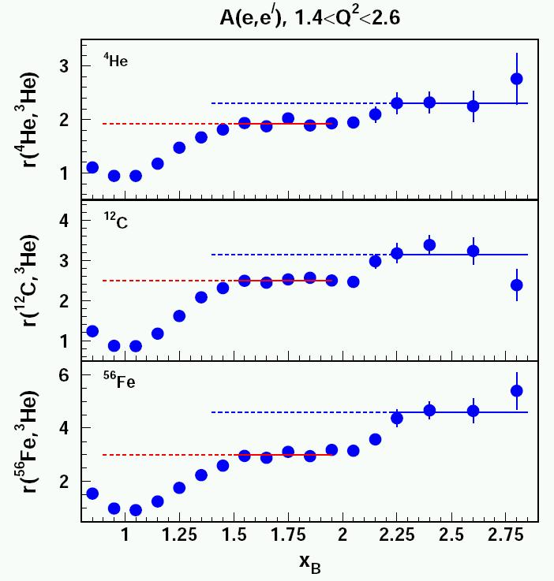
Short Range Correlations in Nuclei
Hall B
CLAS
A(e,e’)X, A = ³He, ⁴He, ¹²C, ⁵⁶Fe
K. Egiyan, et al, (CLAS), PRC 68:014313,2003;
PRL 96, 082501,2006.
Measured Composition ( %)
 | 1N state | 2N SRC | 3N SRC
²H | 96 ± 0.7 | 4.0 ± 0.7 | ---
³He | 92 ± 1.6 | 8.0 ± 1.6 | 0.18 ± 0.06
⁴He | 86 ± 3.3 | 15.4 ± 3.3 | 0.42 ± 0.14
¹²C | 80 ± 4.1 | 19.3 ± 4.1 | 0.55 ± 0.18
⁵⁶Fe | 76 ± 4.7 | 23.0 ± 4.7 | 0.79 ± 0.25
Q²/2Mν

Slide 8

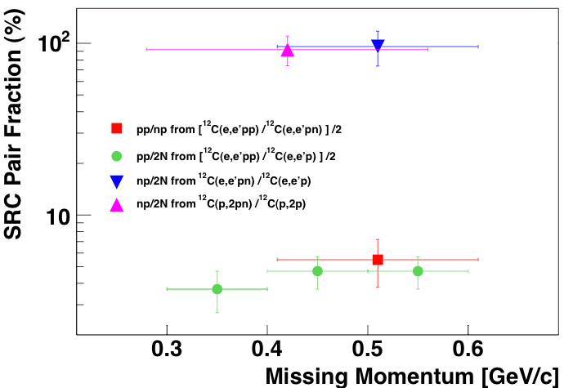
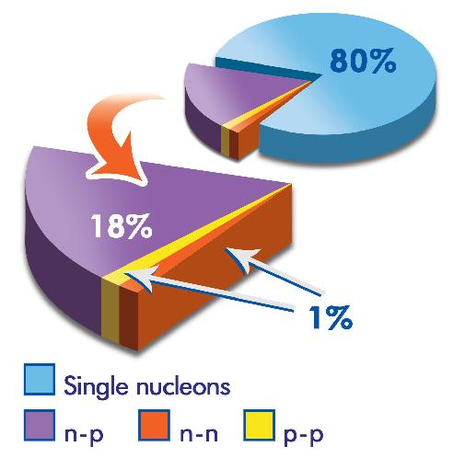
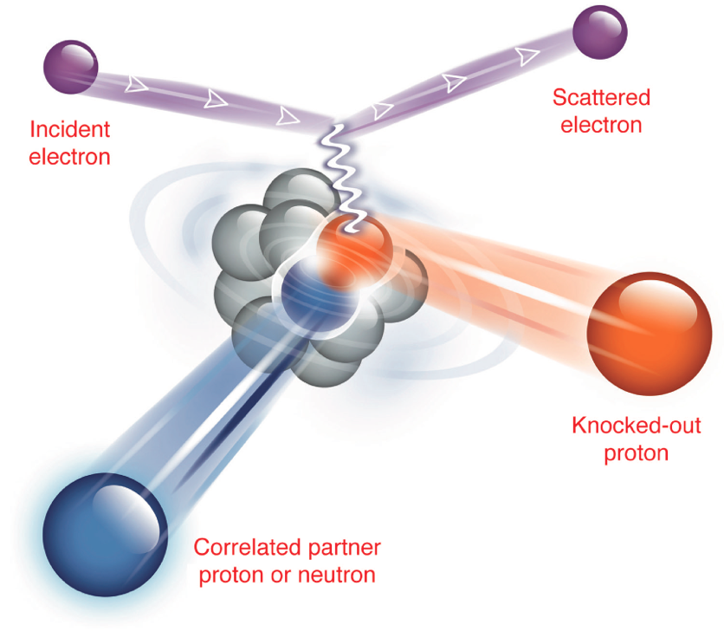
Short Range Correlations in Nuclei
Hall A
Experiment demonstrated appreciable amount of short-distance ( ~ fm ) correlations between the nucleons in the nucleus. This experiment also showed that these pairs were almost entirely made up of proton-neutron pairs. Expected to be due to (short-range) tensor correlations.
A(e,e’pN)X, A =¹²C
R. Subedi et al., Science 320 (2008) 1476.

Slide 9

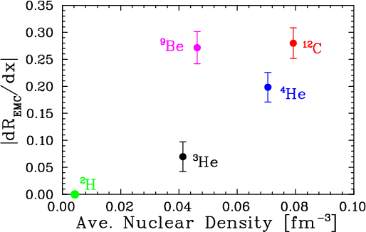
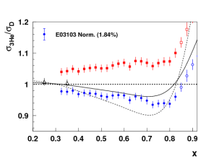
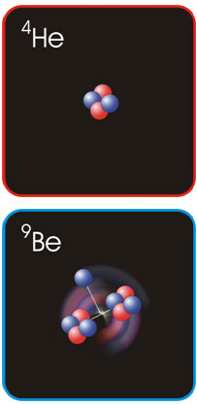
EMC Effect in very light nuclei
EMC effect scales with average nuclear density but not for ⁹Be
?
Be = 2 α clusters (⁴He nuclei) + “extra” neutron
Suggests EMC effect depends on local nuclear environment
dR/dx = slope of line fit to A/D structure function ratio over region x= 0.3 to 0.7
Nuclear density extracted from ab initio GFMC calculation – scaled by (A-1)/A to remove contribution to density from “struck” nucleon
C. Seely, A. Daniel et al., PRL 103, 202301 (2009)

Slide 10
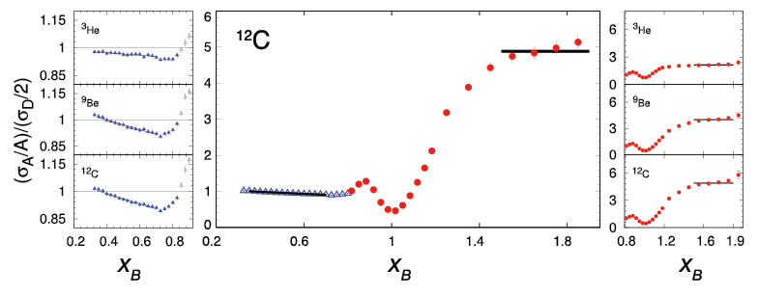
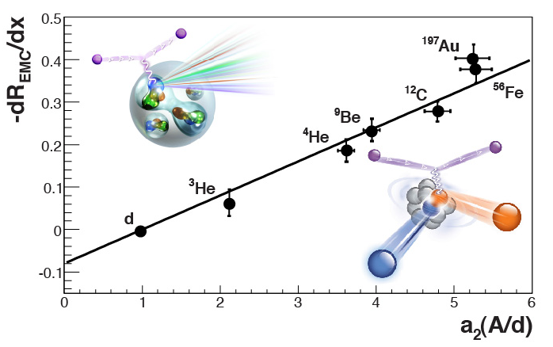
Short-Range Correlations (SRC) and European Muon Collaboration (EMC) Effect Are Correlated
EMC Slopes
0.35 ≤ x_{B} ≤ 0.7
Fomin et al., PRL 108, 092502 (2012)
SRC Scaling factors x_{B} ≥ 1.4
SRC: nucleons see strong repulsive core at short distances
EMC effect: quark momentum in nucleus is altered
Weinstein et al., PRL 106, 052301 (2011)

Slide 11
Nuclear Structure and Dynamics at Short Distances
Experimental background:
There has been significant progress in observing the effects of two-nucleon correlations, in studying quasi-elastic scattering off nuclei at large values of Bjorken x, and in detailing the nuclear dependence of deep-inelastic scattering.
  Quantitative relationships have been found between these apparently disconnected processes that point to a local-density, short-ranged nuclear effect.
Main goal of workshop:
Propel a better theoretical underpinning of these phenomena by taking stock both of the progress in ab-initio and modern model calculations of nuclear structure and dynamics at short distances, and the quark/gluon description of high-energy nuclear processes.
Can we make a breakthrough in understanding a connection, if any, between short range nuclear structure and parton dynamics?

Slide 12
Nuclear Structure and Dynamics at Short Distances
Main goal of workshop:
Propel a better theoretical underpinning of these phenomena by taking stock both of the progress in ab-initio and modern model calculations of nuclear structure and dynamics at short distances, and the quark/gluon description of high-energy nuclear processes.
Can we make a breakthrough in understanding a connection, if any, between short range nuclear structure and parton dynamics?
Secondary goals:
Can the many-body effects appearing in the interaction current be separated from those appearing in the wave function?
Can modern nuclear theory provide calculations of the observables measured in the x > 1 and coincidence experiments?
What is the role of quark, as opposed to nucleon-meson, effects in understanding the plateau and the EMC effect?
What is the role of relativistic effects in the present context?
Which other reactions can be used to elucidate these effects?
Can experiments determine the role of short-range three-nucleon correlations?

Slide 13
Nuclear Structure and Dynamics at Short Distances
Week 1
Monday, February 11 Nuclear Physics and the Many-Body Problem
(Vary, Fomin, Mosel, Furnstahl, Ryckebusch, Neff)
Tuesday, February 12 Nuclear Physics and QCD
(Brodsky, Hoyer, Detmold, Liuti, Granados, Zhao)
(Monday and Tuesday are set up like an introductory workshop)
Wednesday, Febr. 13 Short Range Correlations in Nuclei
(Ciofi degli Atti, Mezzetti, Solvignon, Benhar)
Thursday, February 14 Hadrons in the Nuclear Medium/EMC Effect
(Miller, Gaskell, Strauch, Hen)
Friday, February 15 Short Range Correlations and Infinite Nuclear Matter
(Sargsian, Dickhoff)

Slide 14
Nuclear Structure and Dynamics at Short Distances
Week 2
Monday, February 18 Quarks in the Nuclear Medium
(Vary, Keppel, Avakian, Honkanen)
Tuesday, February 19 Nuclear Structure at Short Distances
(Strikman, Boeglin, Kumano, Coon)
Wednesday, Febr. 20 Data Mining and New Experiments in SRC/EMC Studies
(Weinstein, Hen, Boeglin, VanHalst, Sulkovsky, Cosyn,
Korover, Higinbotham, Wood, Freese)
(Wednesday is set up as a collaboration meeting of the Data Mining Group)
Thursday, February 21 Universality of Short Range Correlation Dynamics
(Sargsian, Piasetzky, Steiner, Bulgac)
Friday, February 22 Opportunities at non-US facilities
(Strikman, Kumano)

