Slide 1
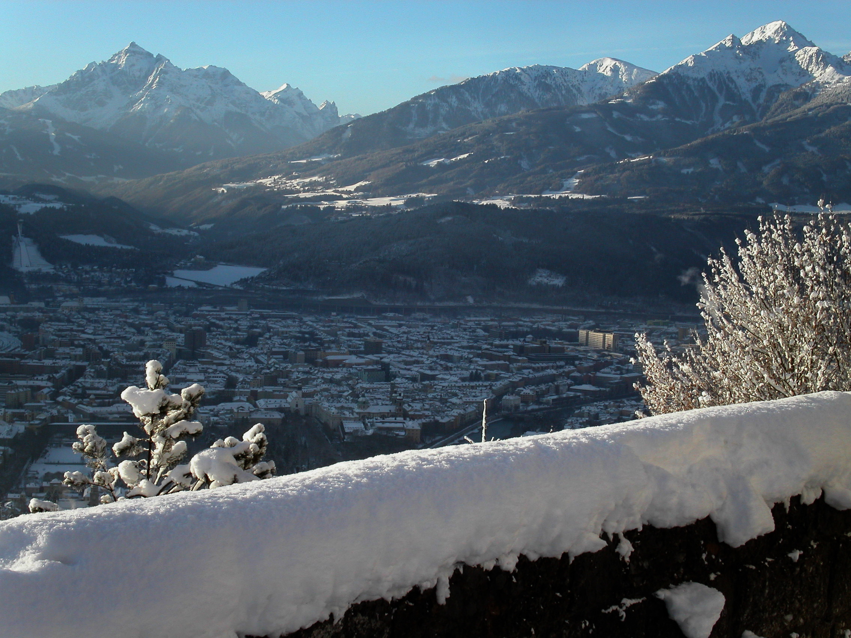

The Efimov Effect in Ultracold Gases
Weakly Bounds Systems in Atomic and Nuclear Physics
March 8 - 12, 2010
Martin Berninger, Francesca Ferlaino, Alessandro Zenesini,
Walter Harm, Hanns-Christoph Nägerl, Rudi Grimm
Institut für Experimentalphysik, Universität Innsbruck

Slide 2
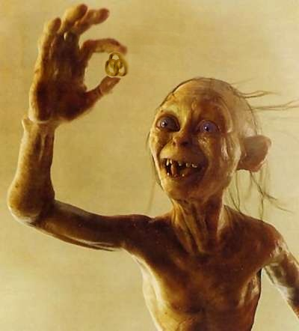

The Efimov Puzzle (an experimentalists view...)
Efimov States in the molecules and nuclei, Rome 2009
Weakly-Bound Systems in Atomic and Nuclear Physics, Seattle 2010
Experiment
Theory
Notes:
2

Slide 3
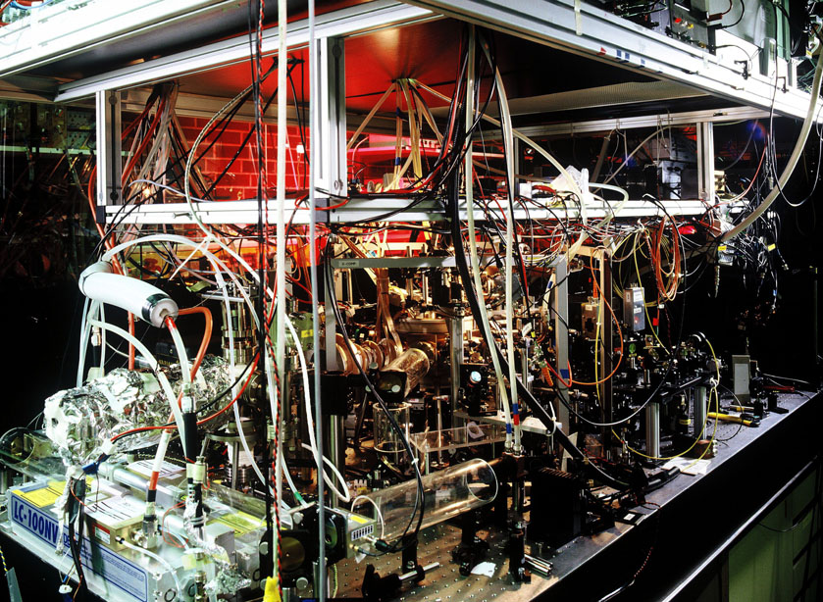
Outline
Introduction atomic few-body physics
The Efimov scenario
Experimental Efimov physics with Cs
Overview experimental Efimov physics
New results in caesium samples
(preliminary)
Collisions in Dimer-Dimer samples
Ultracold exchange reactions

Slide 4
Few-body physics
2-body
3-body
4-body
Cs
Cs
Cs
Cs₂
Cs
Cs
Cs₂
Cs
Cs
Cs
Cs
Cs
Cs
Cs
U(r)
ψ(r)
Cs₂
Cs₃
halo dimer
Cs₂
Cs
In general complex problem:
  strong dependence on potential
kHz
last bound level
Universal regime
many
vib.
levels
scattering length a>>r₀
r₀: range of the potential
r₀ ~ l_{vdW} ~ 100a₀ for Cs
U(r)~1/r⁶
non-universal dimer
THz
schematic drawing
r
s­wave scattering length:
Universal connection:
Halo
dimers
dimers
ϕ
Efimov
trimers
Universal
tetramers
trimers
?
tetramers

Slide 5
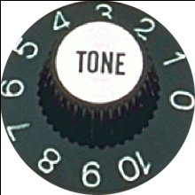
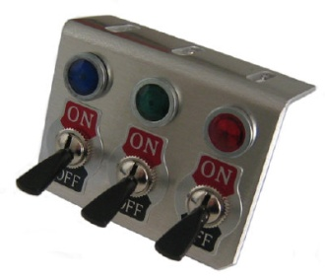
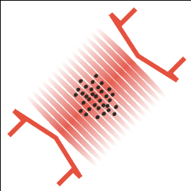
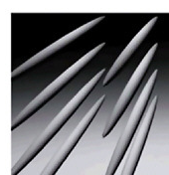
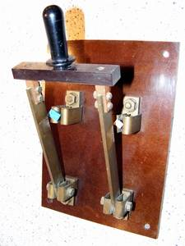
Ultracold atomic gases as a model system
Control knobs
caesium
m_{F}=4
3
F=4
2
Quantum gas
Classical gas
T ~ 1µK – 20nK
MW transfer
Temperature
State
F=3
crossed-beam trap
1D
m_{F}=3
3D
2D
different interactions
different mass ratios
Bosonic / Fermionic systems
ω_{y} ≈ ω _{z} ≈ ω_{x}
„pancake“ trap
Geometry
optical lattice
Mixtures
Interaction strength a
Interactions

Slide 6
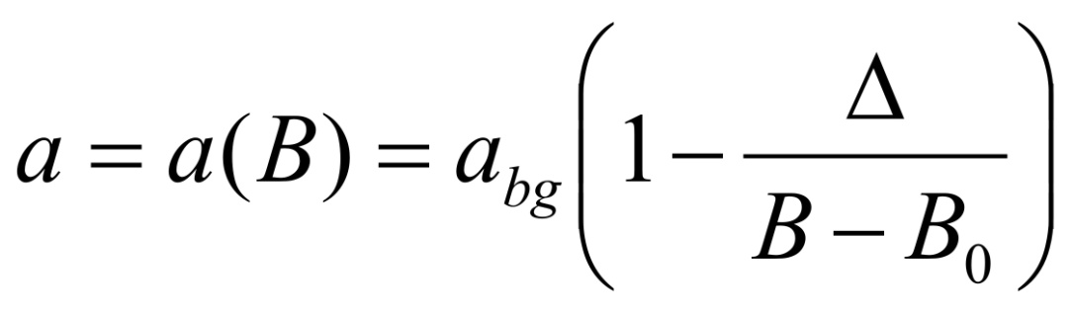
Magnetic tunability of the scattering length
U(r)
F=4+F=4
incident channel
F=3+F=4
bound state
F=3+F=3
(example Cs)
a
r
magnetic moment of bound state
differs from the magnetic moment
of the incident channel
Feshbach resonance
Tunable interaction:
a_{bg}
B₀
B

Slide 7
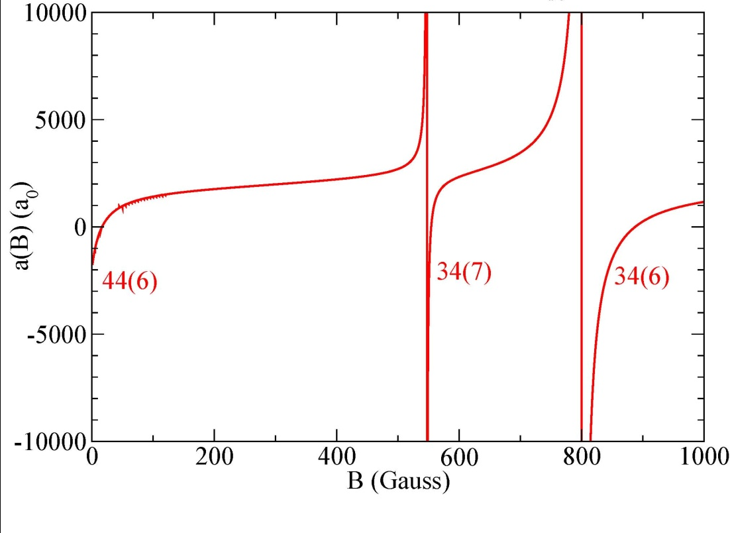

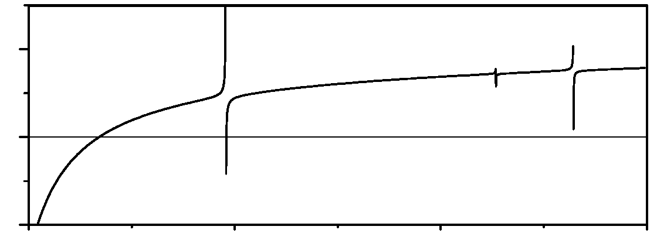
Two-particle picture
a < 0
energy
a > 0
attractive
repulsive
s-wave resonances for Cs in F₁=3 F₂=3 channel
s-wave + d-wave resonances in Cs
halo
dimer
3000
2000
1000
0
scattering length (a₀)
E_{b}
-1000
bound state in open channel:
E_{B}~10kHz
background scattering length
a_{bg}~2000a₀
B
-2000
0
50 G
100 G
150 G
44(6)
34(7)
magnetic field (G)
34(6)
E. Tiesinga et al.
F1 F2 (F1+F2)

Slide 8
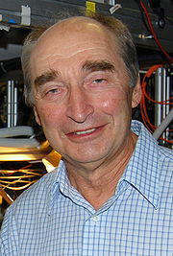
The Efimov scenario
a < 0
energy
a > 0
×22.7
even more weakly
bound trimer
halo
dimer
×(22.7)²
„Efimov – states“
weakly bound trimer
...there exists an infinite series of weakly
bound trimer states for resonant
two-body interaction...
V. Efimov, Phys. Lett. B 33, 563-664 (1970)

Slide 9
Trap loss
a < 0
energy
deeply bound dimer

Slide 10
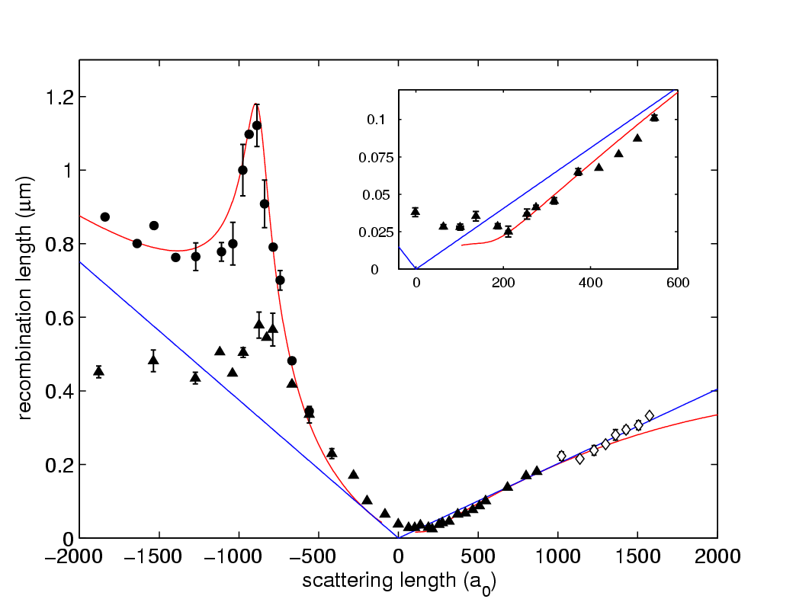
3-atomic Efimov resonance
energy
∝ a⁴
three-body recombination rate
OFF resonance
recombination
length:
3-Atomic Efimov resonance
10nK
ON resonance
new decay channel
⇒ Enhancement of losses
200nK
Ultracold sample of ¹³³Cs atoms
in atomic ground state: F=3, m_{F}=3
N ~ 10⁵ atoms
T = 10/200nK
Kraemer et al., Nature 440, 315 (2006)

Slide 11
3-atomic Efimov resonance
energy
for a<0, a → ∞:
∝ a⁴
three-body recombination rate
recombination
length:
for a>0, a → ∞:
3-Atomic Efimov resonance
a_{AAA}=-850 a₀
a_{min}=210 a₀
10nK
s₀=1.00624
C(a)=C(22.7a)
Atom-Dimer relaxation rate β:
Braaten-Hammer theory
200nK
L₃^{max}=5.7*10⁻²² cm⁶/s
L₃^{min}=1.33*10⁻²⁸ cm⁶/s
Braaten & Hammer
Kraemer et al., Nature 440, 315 (2006)

Slide 12
3-atomic Efimov resonance
E
a > 0
energy
for a<0, a → ∞:
for a>0, a → ∞:
halo
dimer
s₀=1.00624
C(a)=C(22.7a)
Atom-Dimer relaxation rate β:
Braaten & Hammer

Slide 13
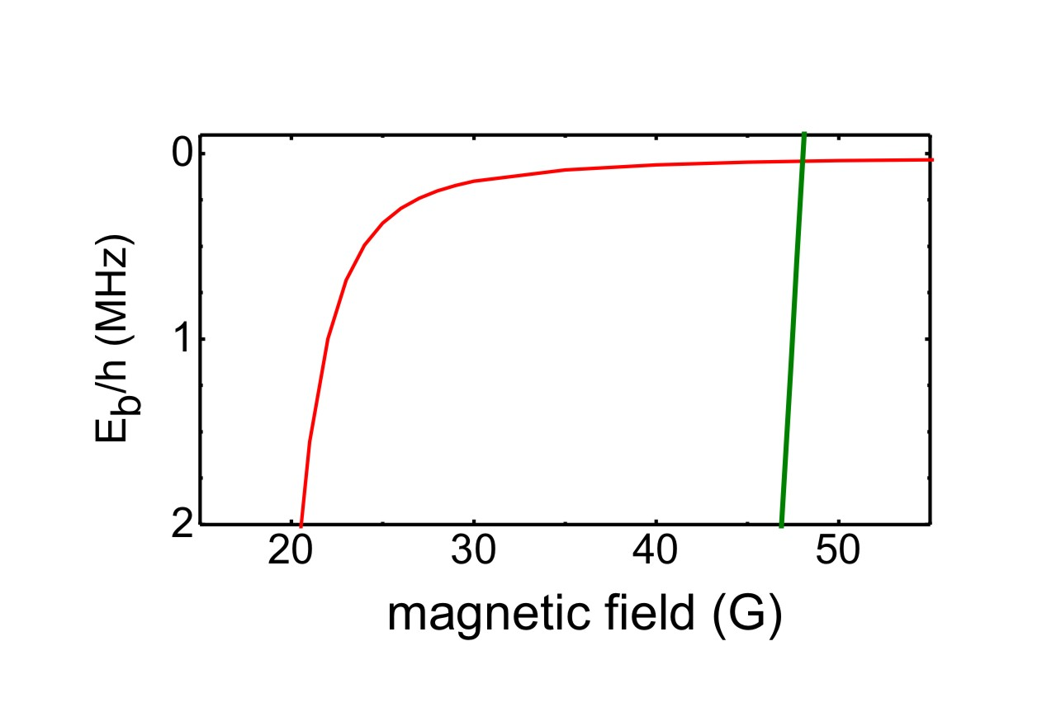
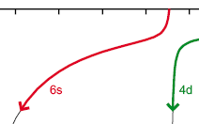

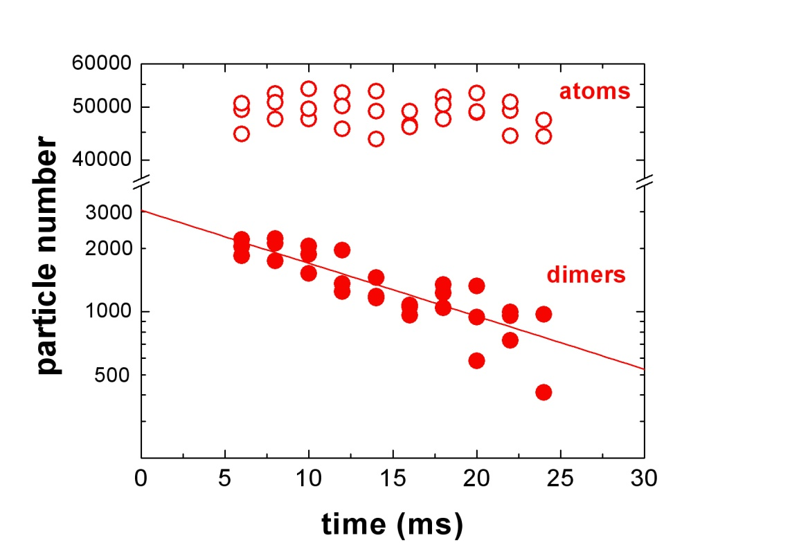
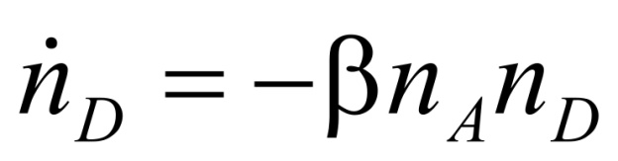
Atom-dimer Efimov resonance
# dimer: ~ 4000
# atoms: (3-6)x10⁴
T = 30-300 nK
Production
of 6s-molecules via
Feshbach association
s-wave state
d-wave
state
Separate atoms and dimers by magnetic gradient field before imaging
Measure the time-evolution & extract atom-dimer relaxation rate coefficient β

Slide 14
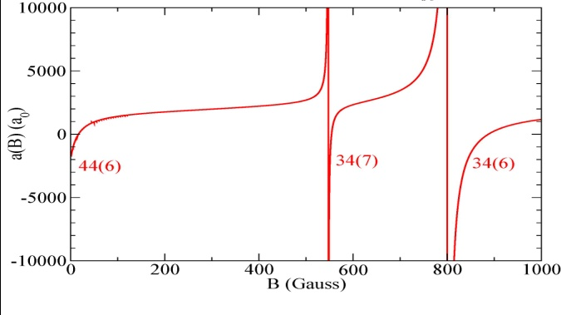
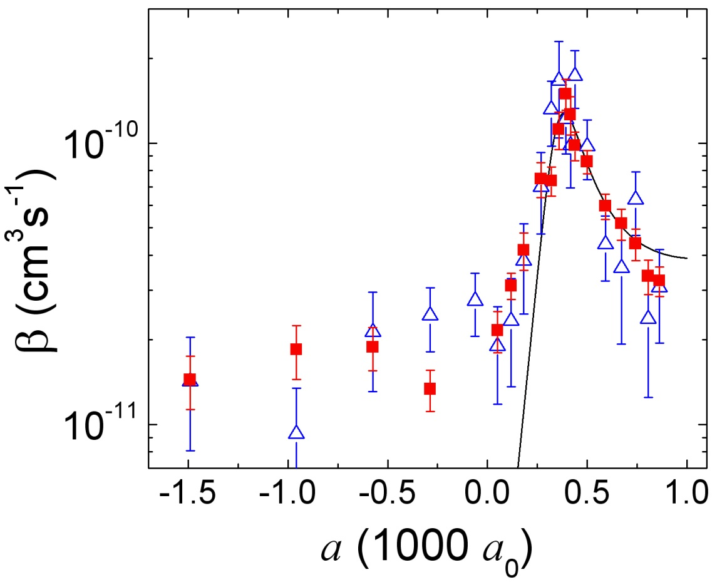
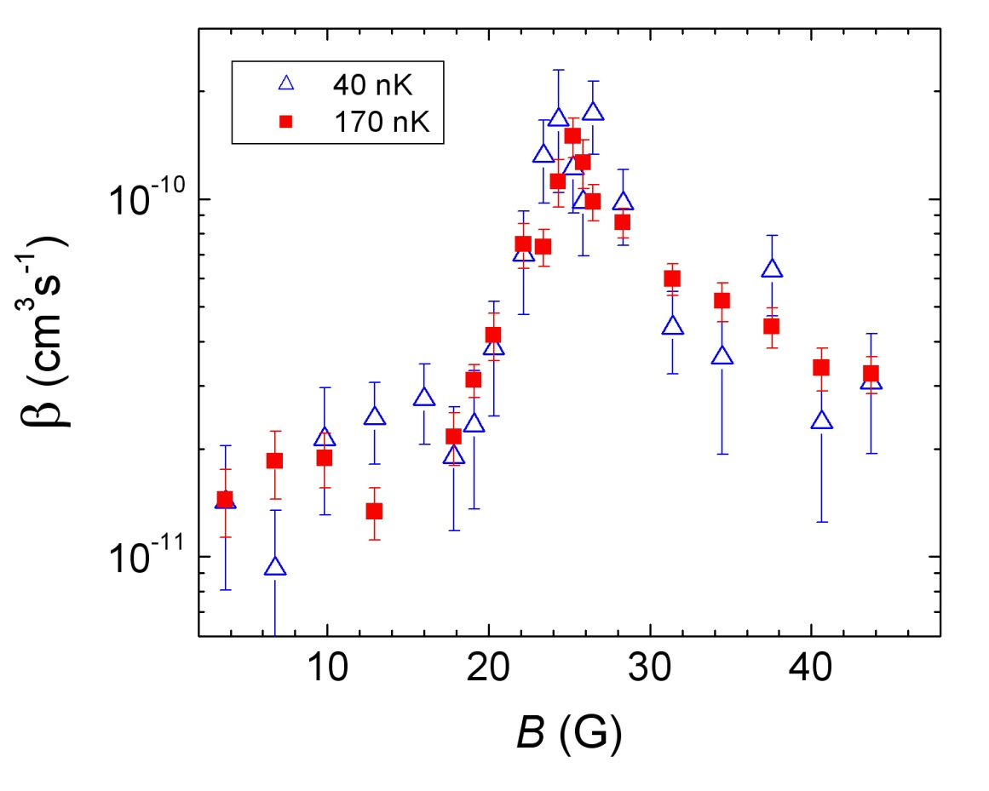
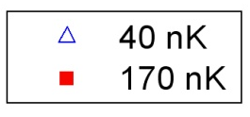

Atom-dimer Efimov resonance
Atom-dimer resonance at B=25 G
a_{AD}=+400 a₀
a < 0
a > 0
1/a
Universal relation via pole:
universality a>0 and a<0 via a=0 ?
transition universal to non-universal ?
(r₀~100a₀)
any relation to Efimov physics at different
Feshbach resonances (@800G)?
for n=0, n‘=1 ⇒ a_{AD}/a_{AAA}= 0.47
Knoop et. al., Nature Physics 5, 227 (2009)

Slide 15
The extended Efimov scenario
a < 0
energy
a > 0
Tetra2
Prediction of two
universal 4-body states
tied to each Efimov trimer!
Tetra1
H. Hammer and L. Platter, Eur. Phys. J. A 32, 113 (2007)
J. von Stecher, J. P. D’Incao, and C. H. Greene, Nature Physics 5, 417 - 421 (2009)

Slide 16
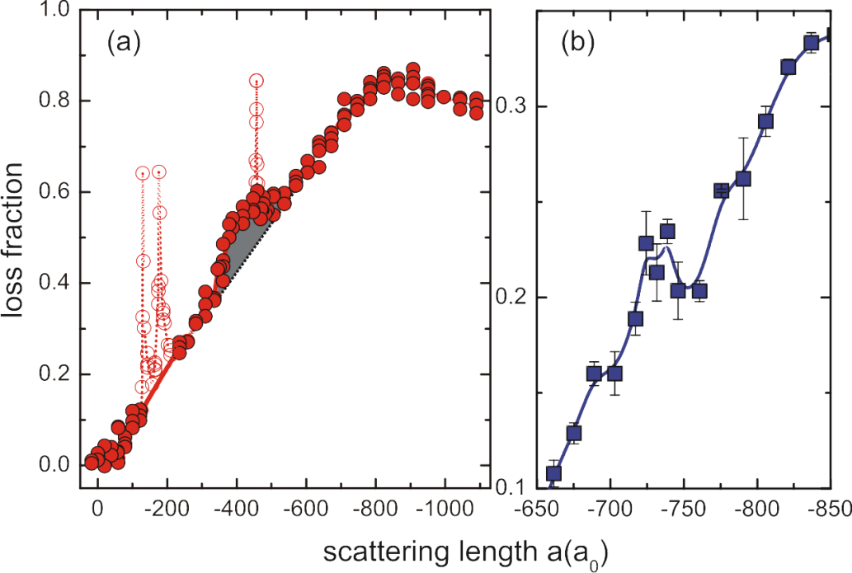
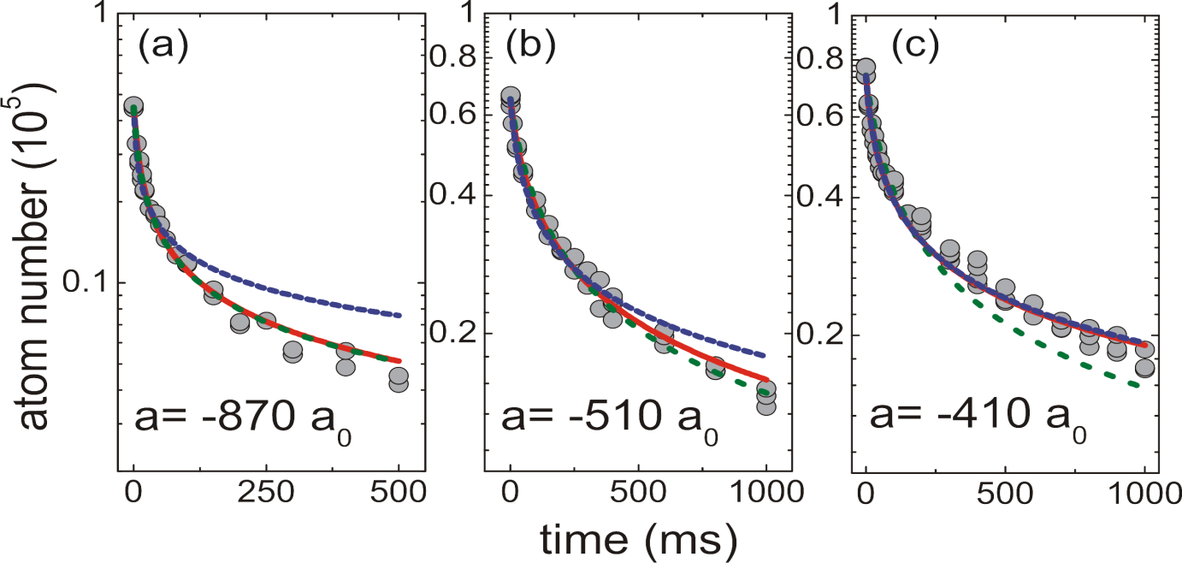
Four-body states - experimental results
t_{hold}=250ms
t_{hold}=8ms
Position of the
universal 4-body states
Theory
a*_{Tetra1} ~ 0.43 a*_{T}
a*_{Tetra2} ~ 0.9 a*_{T}
Experiment
~ 0.47 a*_{T}
~ 0.84 a*_{T}
Tetra1
Tetra2
3-body
mixed
4-body
Fitting function
simple 3 body
simple 4 body
3 + 4 body
F. Ferlaino et. al., PRL 102, 140401 (2009)

Slide 17
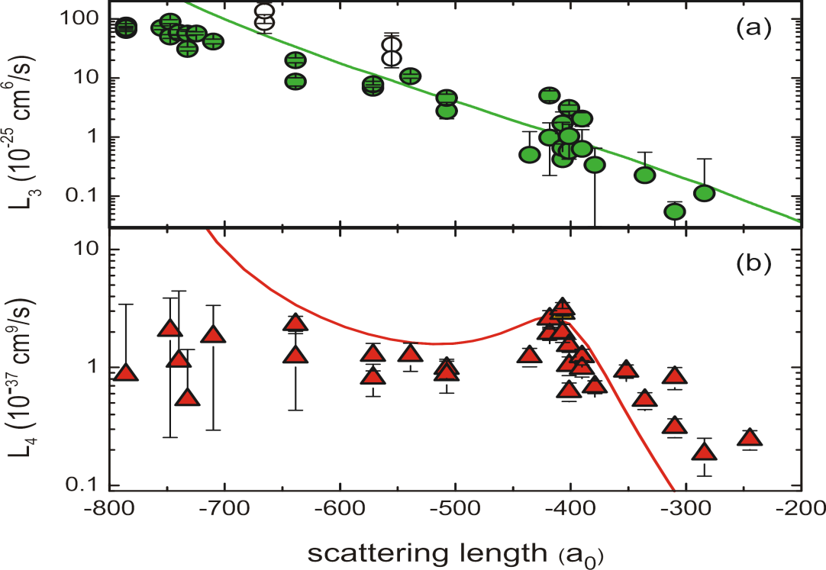






Four-body states - experimental results
t_{hold}=250ms
t_{hold}=8ms
Position of the
universal 4-body states
Theory
a*_{Tetra1} ~ 0.43 a*_{T}
a*_{Tetra2} ~ 0.9 a*_{T}
Experiment
~ 0.47 a*_{T}
~ 0.84 a*_{T}
Tetra1
Tetra2
F. Ferlaino et. al., PRL 102, 140401 (2009)

Slide 18

Overview experimental Efimov physics
Bosonic systems
Kraemer et al., Nature 440, 315 (2006)
Knoop et. al., Nature Physics 5, 227 (2009)
F. Ferlaino et. al., Phys. Rev. Lett. 102, 140401 (2009)
¹³³Cs
³⁹K
Zaccanti et al., Nature Physics 5, (2009)
⁷Li
F=1, m_{F}=1
Pollack et al., Science 326 (2009)
F=1, m_{F}=0
Gross et al., Phys. Rev. Lett 103, 163202 (2009)
Bosonic mixtures
⁴¹K + ⁸⁷Rb
Barontini et al., Phys. Rev. Lett. 103, 043201 (2009)
Fermionic systems
Ottenstein et al., Phys. Rev. Lett. 101, 203202 (2008)
Huckans et al., Phys. Rev. Lett. 102, 165302 (2009)
Williams et al., Phys. Rev. Lett. 103, 130404 (2009)
Wenz et al., Phys. Rev. A 80, 040702(R) (2009)
⁶Li

Slide 19
Successive Efimov Features – bosonic system (³⁹K)
Florence-Group
Experiment with ³⁹K atomic sample
across Feshbach resonance, r₀=64a₀
⇒ atomic threshold
Res:
 | Loss |  | a (a₀)
a<0 | 3B Max | a₁⁻ | -1500
 | 4B Max | a_{T}* | -650
a>0 | 3B Min | a₁⁺ | 224
 |  | a₂⁺ | 5650
 | AD Max | a₁* | 30
 |  | a₂* | 930
second order process: A+A+A ⇒ D*+A
  a_{AD*} → ∞ losses in an atom sample
  due to elastic scattering
Comparison with universal theory:
Valid only for |a|>>r₀
⇒ Model for finite-range interactions?
Zaccanti et al., Nature Physics, Vol. 5 (2009)

Slide 20
Efimov physics in 39K: AD resonances
Thanks to M. Zaccanti & Co-Workers for the slides!
Usually, in the three-body process 3 particles are lost
Notes:
20

Slide 21
Efimov physics in 39K: AD resonances
Thanks to M. Zaccanti & Co-Workers for the slides!
…but if AD cross section is large particle losses can be >>3!!!
Notes:
21

Slide 22
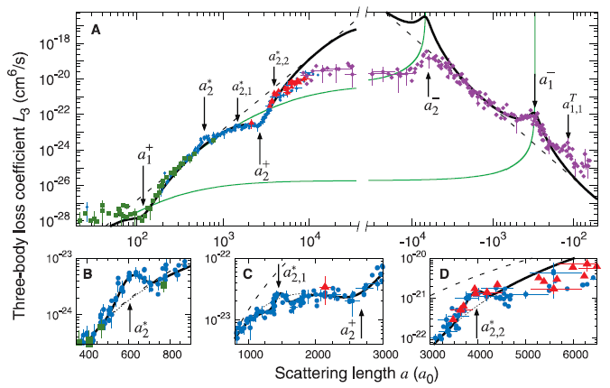
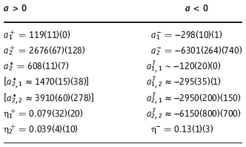
Successive Efimov Features – bosonic system (⁷Li – F=1,m_{F}=1)
Rice-Group
atomic sample ⁷Li (F=1,m_{F}=1)
across Feshbach resonance, r₀=33a₀
a>0
Res:
 | Loss |  | a (a₀) |  | a (a₀)
a<0 | 3B Max | a₁⁻ | -298 | a₂⁻ | -6301
 | 4B Max | a^{T}_{1,1} | -120 | a^{T}_{1,2} | -295
 |  | a^{T}_{2,1} | -2950 | a^{T}_{2,2} | -6150
a>0 | 3B Min | a₁⁺ | 224
 |  | a₂⁺ | 5650
 | AD Max indirect | a₂* | 608
 | DD Max debate | a*_{2,1} | 1470
 |  | a*_{2,2} | 3910
a<0
a→±∞
Comparison universal theory
Valid only for each side,
systematic discrepancy (factor 2)
⇒ Variation in the short range phase across
the Feshbach resonance?
Pollack et al., Science 326 (2009)

Slide 23
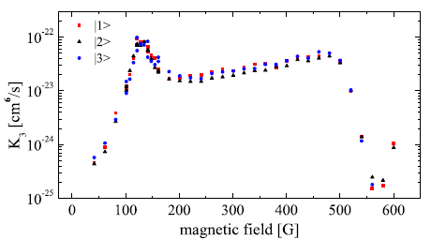
Efimov features in fermionic spin mixtures (⁶Li)
Jochim & O‘Hara
⁶Li 3 component
Fermi-Spin-mixture:
|3> m_{F}= -3/2
|2> m_{F}= -1/2
|1> m_{F}= 1/2
Res:
 | Loss | state | B(G)
a<0 | 3B Max | n=0 | 127
 |  | n=0 | 500
 |  | n‘=1 | 895
Comparison with universal theory
Using fit results for high field resonance
(895G)reproduces low field resonances
accurately: 125(3)G & 499(2)G
No change in the three body parameter
for ΔB ~ 750G?
for a_{ij} ~ l_{vdw}?
Ottenstein et al., PRL 101, 203202 (2008)
Huckans et al., PRL 102, 165302 (2009)
Williams et al., PRL 103, 130404 (2009)
Wenz et al., PRA 80, 040702(R) (2009)
Braaten et al., PRL 103, 073202 (2009)
Naidon et al., PRL 103, 073203 (2009)
Floerchinger et al., PRA 79, 053633 (2009)
Braaten et al., PRA 81, 013605 (2010)

Slide 24
Bosonic system showing universality (⁷Li – F=1,m_{F}=0)
Khaykovich-Group
atomic sample ⁷Li (F=1,m_{F}=0)
across Feshbach resonance
Results:
 | Loss |  | a (a₀)
a<0 | 3B Max | a⁻ | -264
a>0 | 3B Min | a⁺ | 1160
Comparison with universal theory:
a₊/|a₋| = 0.92(14) (Theory=0.96(3))
⇒ Why does ⁷Li agree so nicely in (F=1,m_{F}=0)
and not in (F=1,m_{F}=1)?
Gross et al., PRL 103, 163202 (2009)

Slide 25
Efimov Resonances – Heteronuclear systems (⁴¹K + ⁸⁷Rb)
Florence-Group
System composed of distinguishable
particles with different masses
Experiment with bosonic mixture of ⁴¹K and ⁸⁷Rb
at a interspecies Feshbach resonance
Two resonantly interacting pairs are
sufficient for Efimov physics
Existence of two Efimov series:
  KRbRb: exp (π/s₀) = 131
  KKRb: exp (π/s₀) = 3.51 ⋅10⁵
Results:
 | Loss |  | a (a₀)
a<0 | 3B Max | KRbRb | -246
 | 3B Max | KKRb | -22000
a>0 | AD Max indirect | a* | 667
KKRb-resonance
No oscillations for a>0 observed
Barontini et al., Phys. Rev. Lett. 103, 043201 (2009)

Slide 26
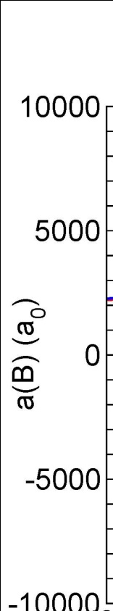


Lifetime measurements @ high magnetic fields
Recombination rate @
6s6 resonance ~ 800G, width ~ 90G
T~200nK
Unitarity limit:
preliminary
L₃
Another piece to the puzzle!
6d6
Resonance!
preliminary
L₃
K3
f l m_{f}
B (Gauss)

Slide 27
Experimental results: dimer-dimer collisions
Sample of universal dimers in 6s-state:
crossed dipole trap (1060nm)
N_{D} ~ 4000
T ~ 40 – 350 nK
k_{B}T << E_{B} ~ h⋅50kHz << E_{vdW} ~ h⋅2.7MHz
2 atoms in F=3, m_{F}=3
microwave
10⁵ ultracold ¹³³Cs atoms (40nK)
⇒ Feshbach association
Removal of atoms with microwave
Sample of ultracold dimers
s-wave state
energy
a > 0
a < 0
d-wave
state
Measuring relaxation rate L₂:
n_{D}= -L₂ n_{D} ²
Tetra2
?
Tetra1
2-body reaction cross section (Wigner 1948)
scattering length (a₀)
Ferlaino et al., PRL 101, 023201 (2008)

Slide 28
Exchange reactions with distinguishable particles
m_{F}=4
3
F=4
2
A + A₂
B + A₂
MW transfer
F=3
F=3, m_{F}=3
Feshbach molecule / halo dimer
2x (F=3, m_{F}=3)
F=4, m_{F}=2, 3 or 4
m_{F}=3
?

Slide 29
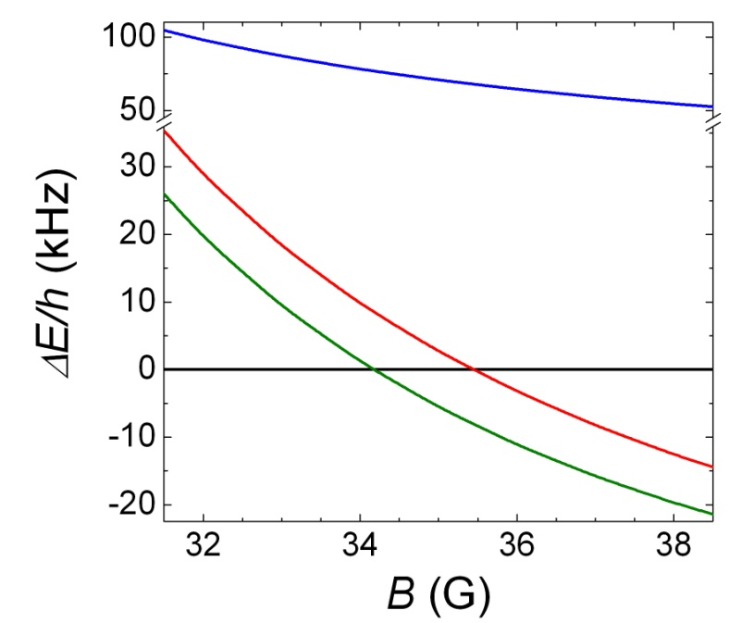
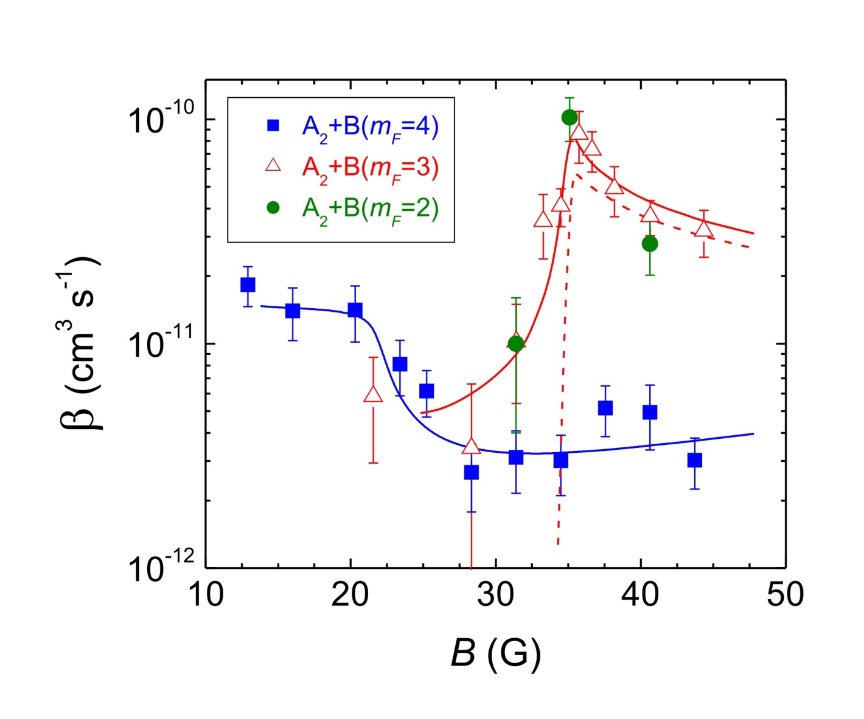

Exchange reactions loss rates
A+B
β: atom-dimer loss
rate coefficient
m_{F}=4
AB
T=50 nK
E
m_{F}=3
m_{F}=2
A+A
A₂
B
A+A+B
E
A+AB
new decay channel
ΔE
A₂+B
resonance @ 35 G:
opening exchange channel
total loss
exchange
B
Knoop et al., Phys. Rev. Lett. 104, 053201 (2010)
Theory: Jose D’Incao & Brett Esry

Slide 30
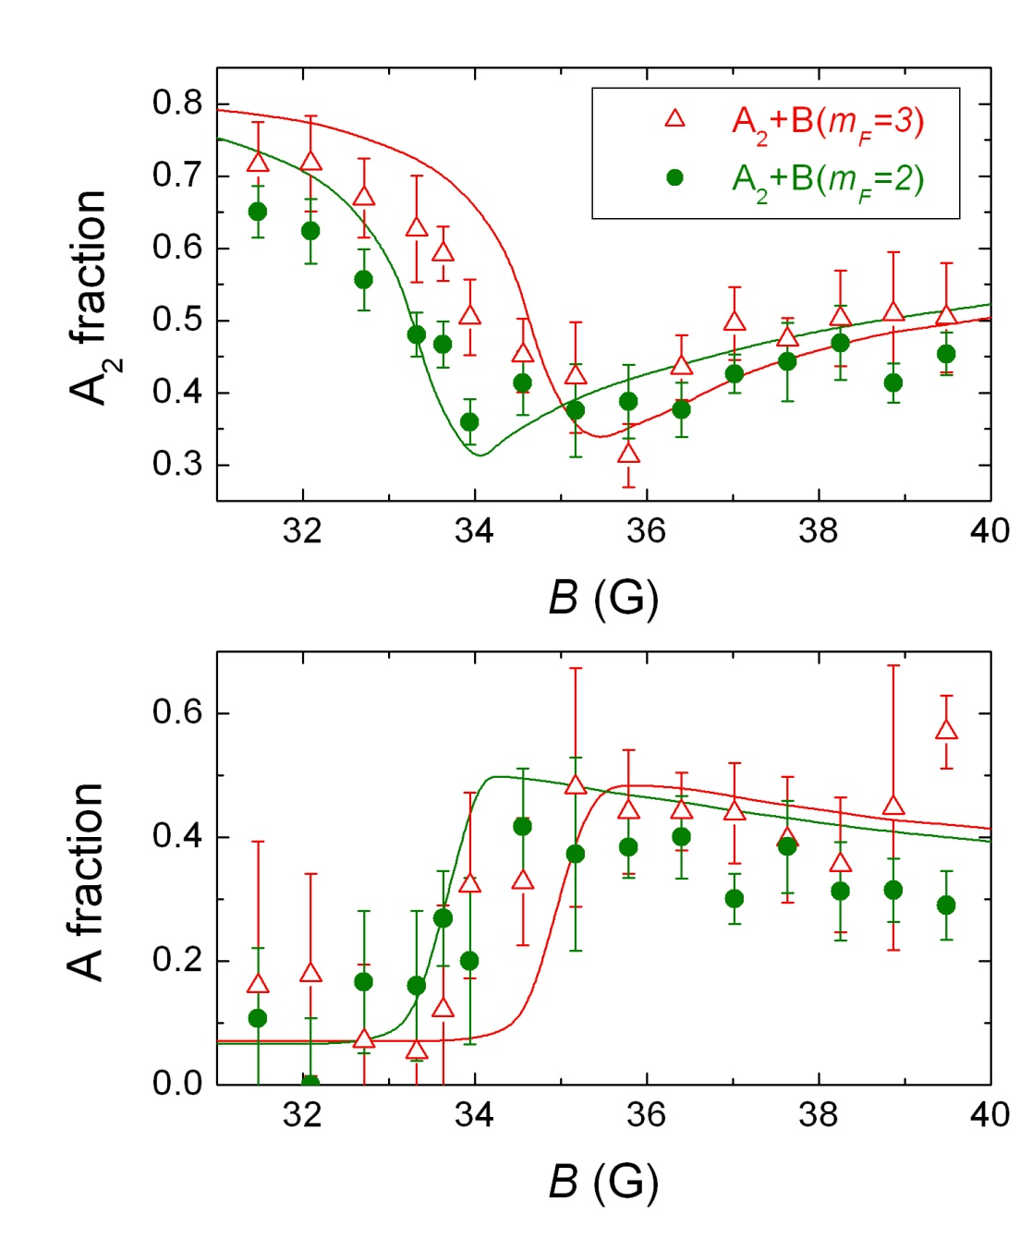
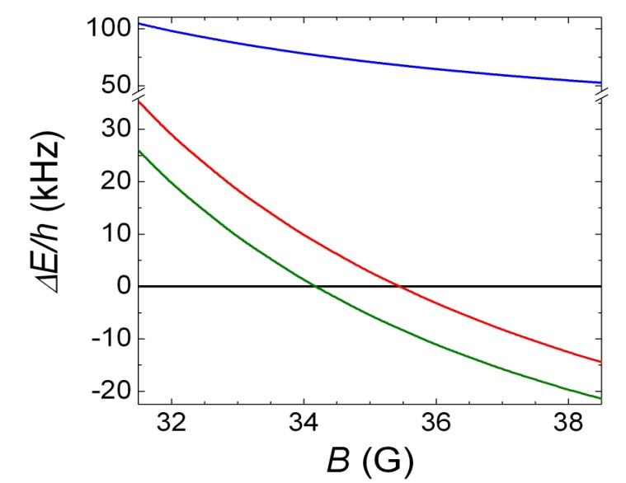
Closer look around 35 G
m_{F}=4
m_{F}=3
m_{F}=2
appearance of trapped atoms in state A!
A₂(v=-1)+B → A+AB(v=-1)
Ultracold exchange reaction
T=100 nK, t_{hold}=22ms
controlled by magnetic field

Slide 31
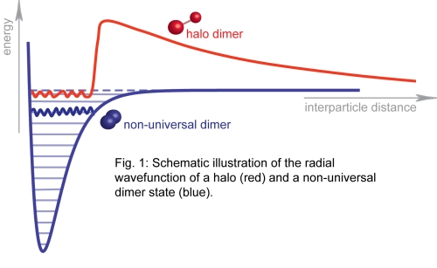
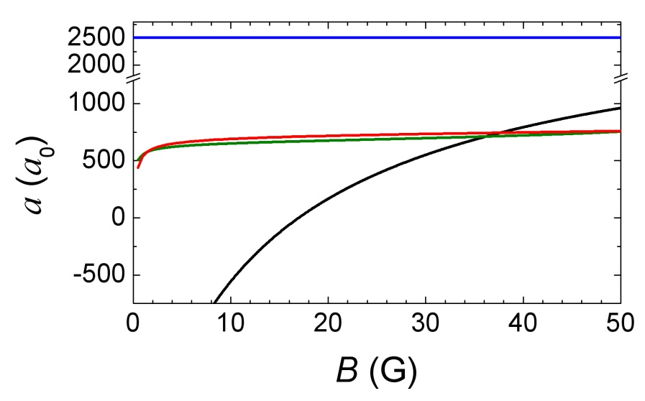
Role of the large scattering length
A₂(v’<v)+B
A+AB(v’<v)
A₂(v=-1)+B
A+AB(v=-1)
ψ(r)
A+B(m_{F}=4)
A+B(m_{F}=3)
A+B(m_{F}=2)
A+A

Slide 32
Experimentalists wish list for Theory
Coming soon:
Cs data for
800G resonance
Experiment
a << ∞
a→ ∞
Theory
⇒ Model for finite-range interactions, transition universal to non-universal (³⁹K & ¹³³Cs)?
⇒ Any connection of Efimov physics from a>0 to a<0 via a=0 (¹³³Cs)? – Factor 1/2?
⇒ Variation in the short range phase across the Feshbach resonance (⁷Li)
– Factor 2?
⇒ Is there any relation for Efimov physics at different Feshbach resonances
(¹³³Cs low fields and Feshbach resonance @ 800G)?
⇒ Why there is no change in the three body parameter in ⁶Li spin mixture for
ΔB ~ 750G and/or for a_{ij} ~ l_{vdw}?
⇒ Why does ⁷Li agree so nicely in (F=1,m_{F}=0) and not in (F=1,m_{F}=1)?
⇒ Temperature dependence in ¹³³Cs halo molecules?

Slide 33
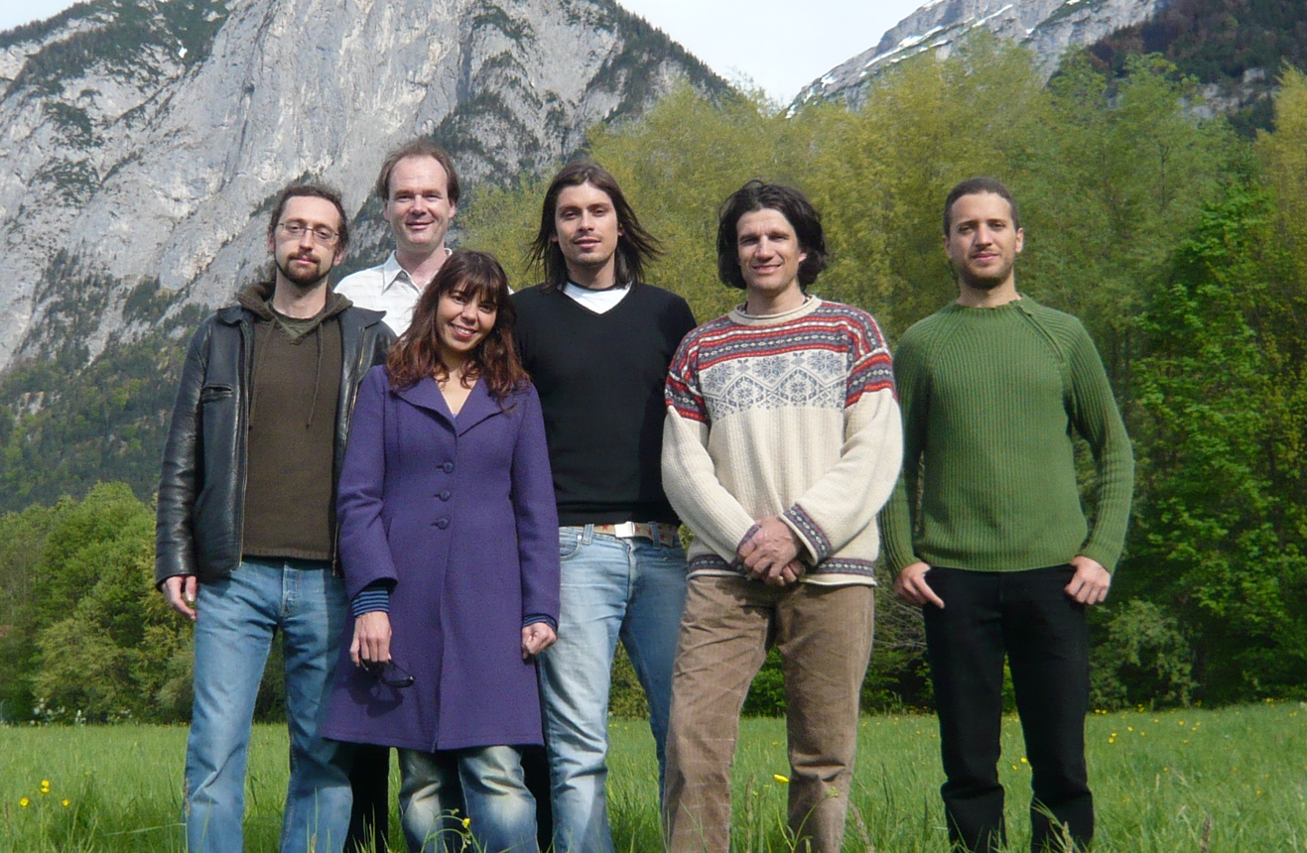
The Caesium-Efimov-Team
Francesca
Ferlaino
Hanns-Christoph Nägerl
Rudi
Grimm
Walter
Harm
Alessandro
Zenessini
M.B.

