Slide 1
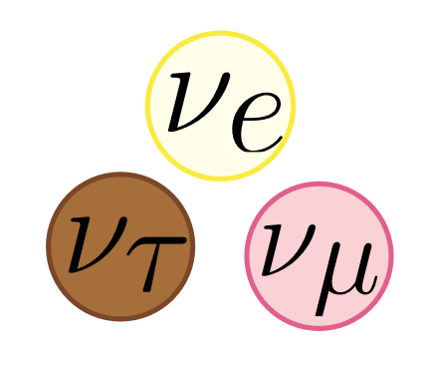
Neutrino Oscillations
Michelle Thran, University of Chicago
August 16, 2023

Slide 2
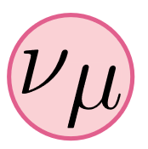
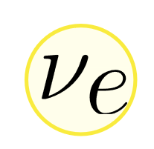

Outline:
Introduction to neutrinos
Solar neutrino problem and MSW
Early Universe neutrinos

Slide 3
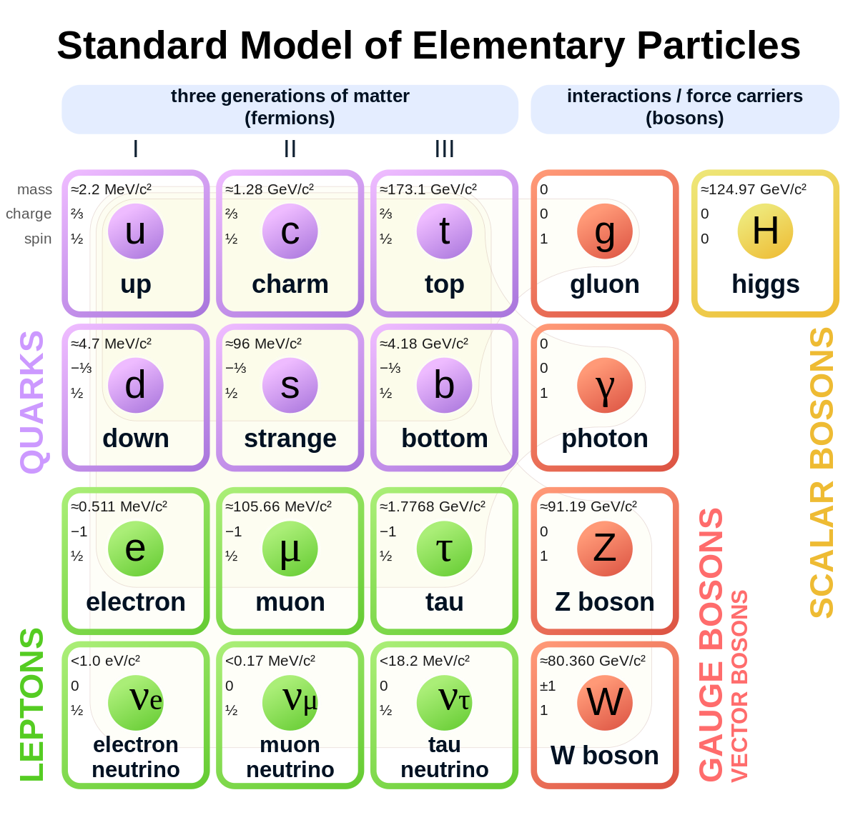



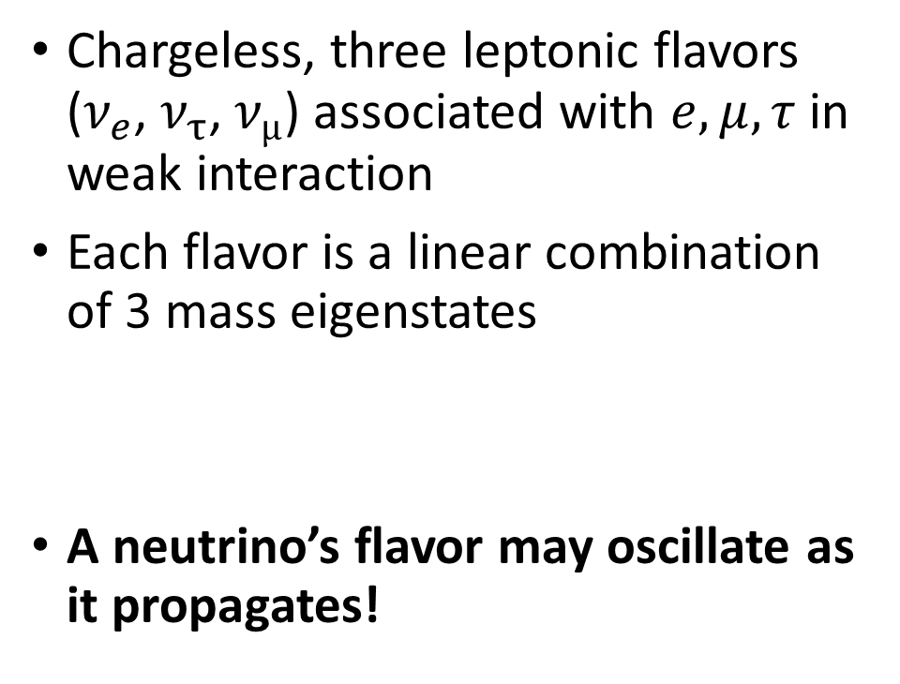
Neutrinos
Chargeless, three leptonic flavors ($ν_{e}$, $ν_{τ}$, $ν_{µ}$) associated with $e,μ,τ$ in weak interaction
Each flavor is a linear combination of 3 mass eigenstates
A neutrino’s flavor may oscillate as it propagates!
$$W→ν_{α}+ℓ_{α}$$

Slide 4


Two flavor/mass state approximation?
Practical! Far less computation
Not difficult to scale up

Slide 5
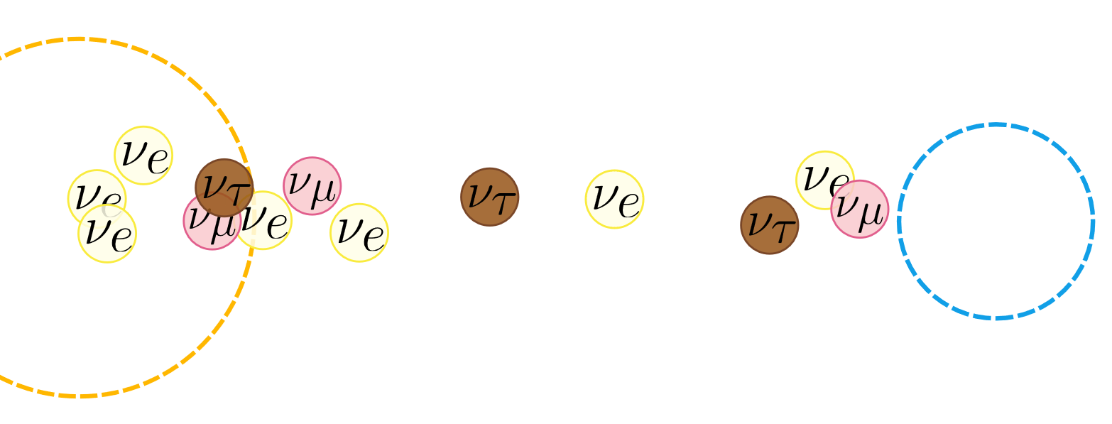

Solar Neutrino Problem
$ν_{e}$ produced in nuclear fusion (proton-proton chain reaction)
$ν_{e}$-flux measured on Earth from Sun a third of theorized value!
Resolution: flavor oscillation!

Slide 6

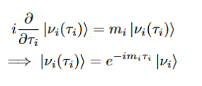



Flavor Oscillation Mechanism
Time evolution of mass eigenstates
Relativistic approximation
Time evolution of flavor eigenstate
Amplitude of flavor oscillation

Slide 7

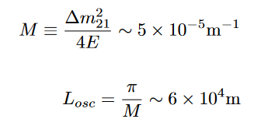
Effective Hamiltonian
Flavor oscillation dynamics can be modeled with “effective Hamiltonian” and Schrodinger equation
“vacuum effective Hamiltonian” is related to relationship between mass and flavor eigenstates

Slide 8





Density Matrix (bear with me!)
Vanilla formalism
Time evolution (Schrodinger eq!)
Density Matrix formalism
i-th diagonal gives probability of observing i-th state
Time evolution

Slide 9
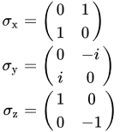
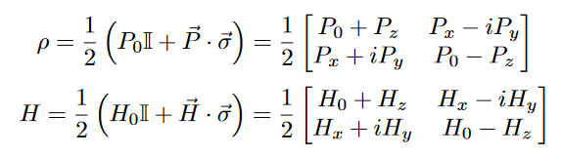


Bloch Form (bear with me pt 2!)
Time evolution in Pauli-basis

Slide 10

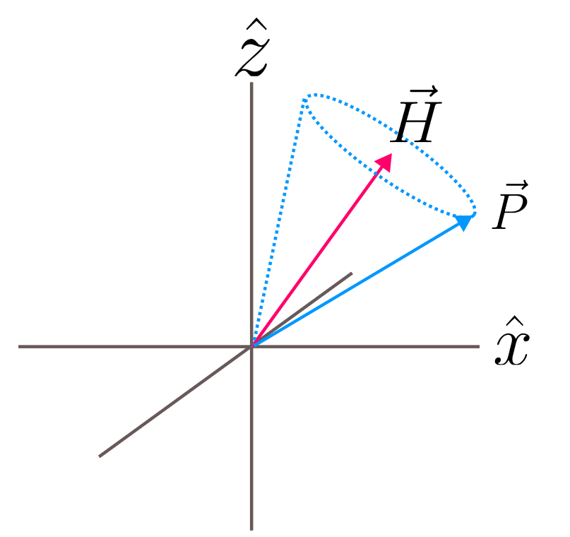

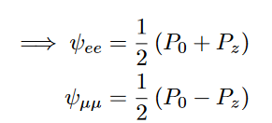
Geometric Picture
Projection determines probability of flavor oscillation

Slide 11
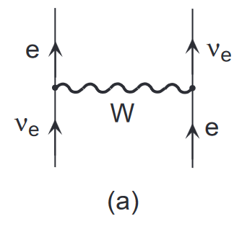
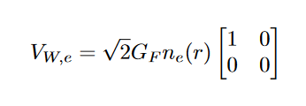

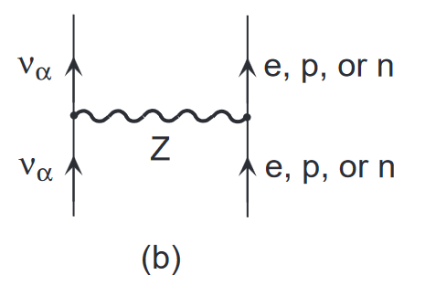


Mikheyev Smirnov Wolfenstein (MSW) Effect
Introduces “matter potential” to effective Hamiltonian
Case of sun:
Image credit: Kayser (2001)

Slide 12
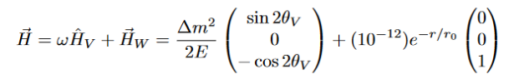
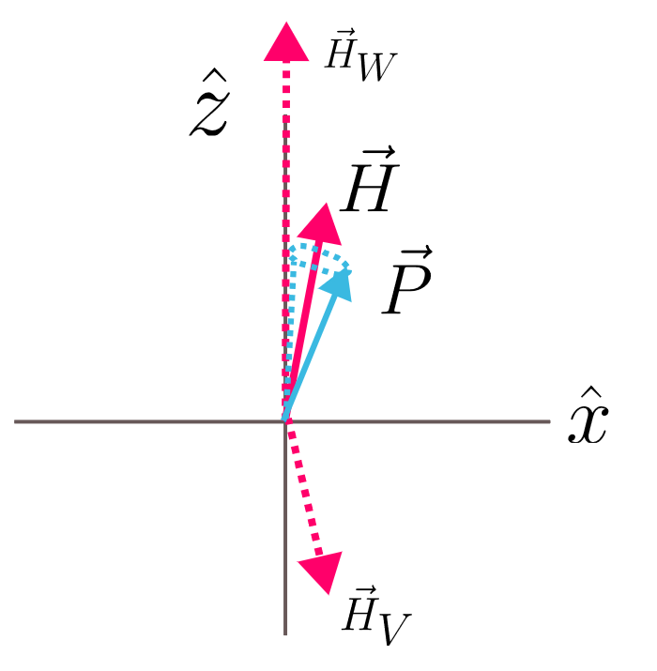
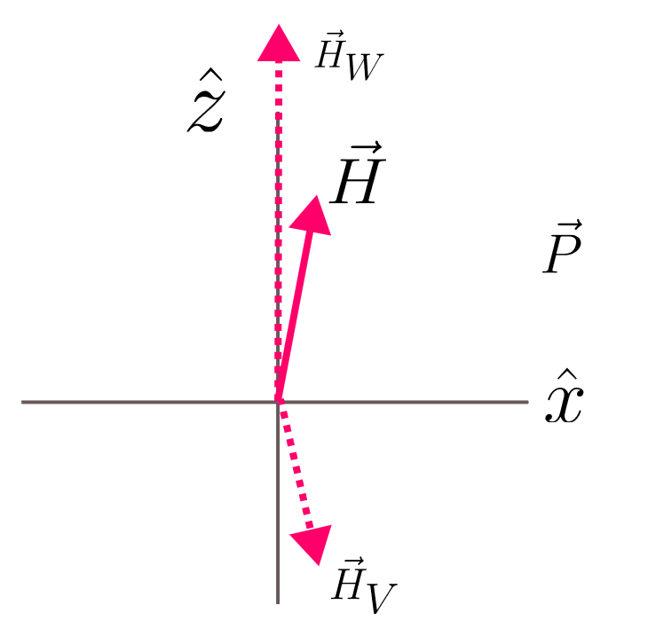
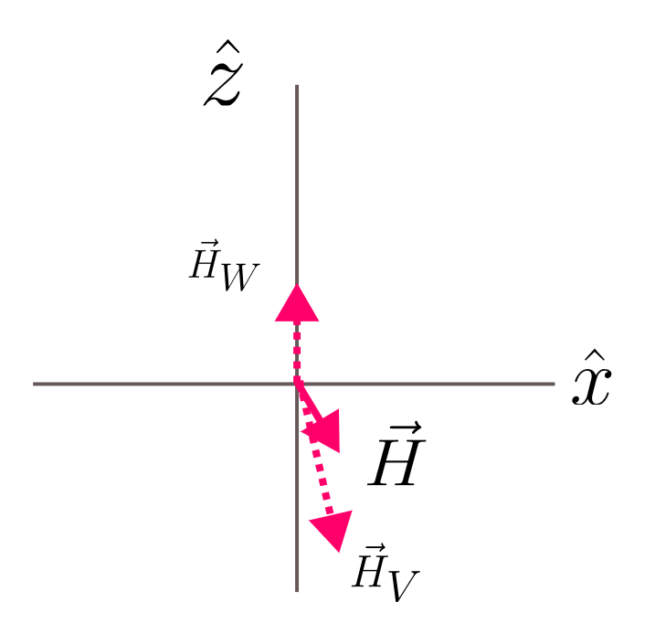
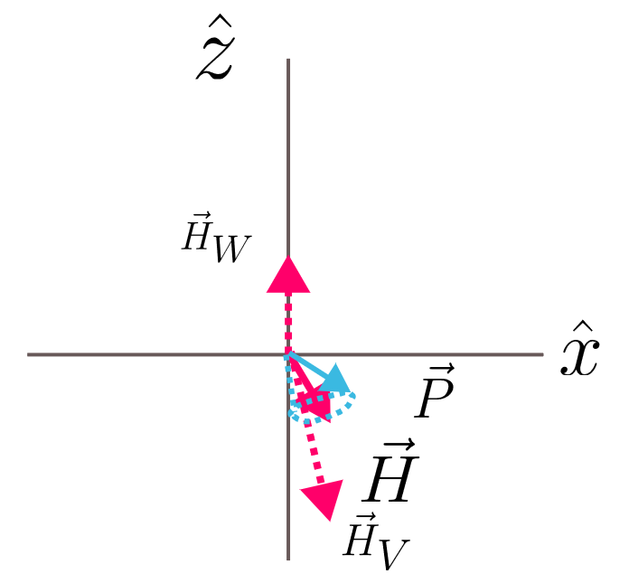
Geometric Picture
Later time

Slide 13
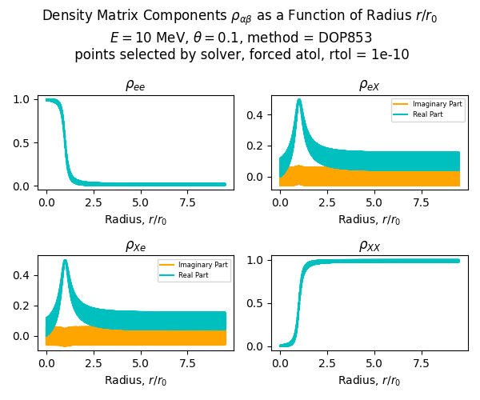
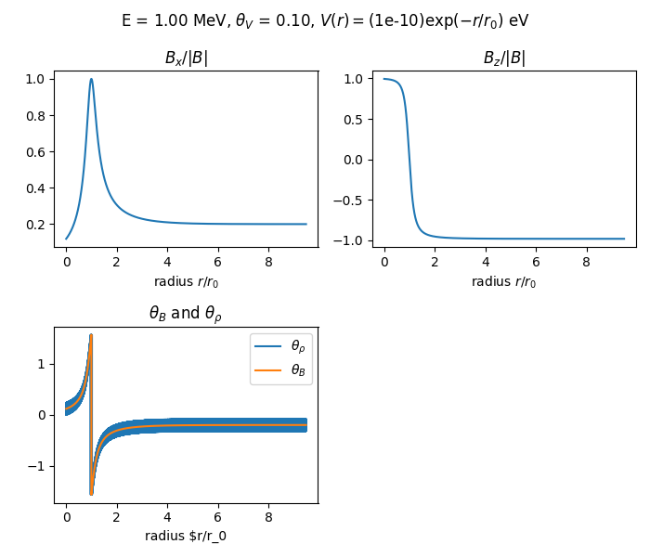

Slide 14
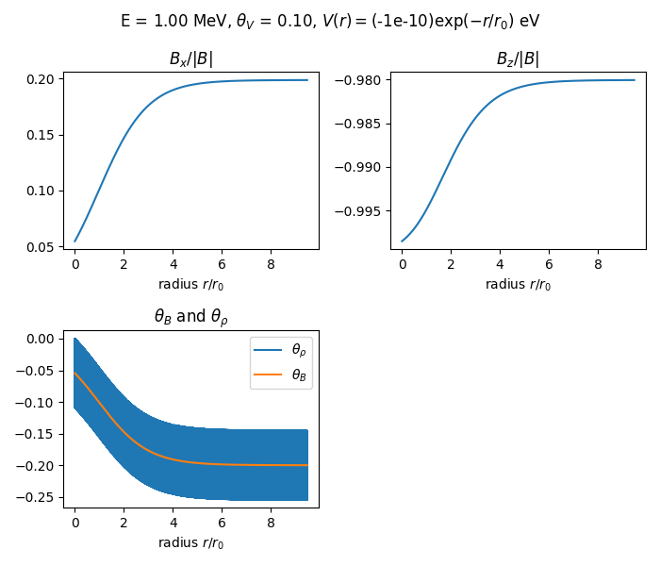
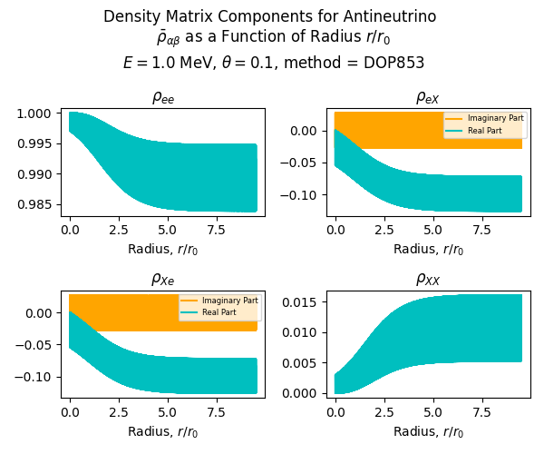
MSW Antineutrinos

Slide 15



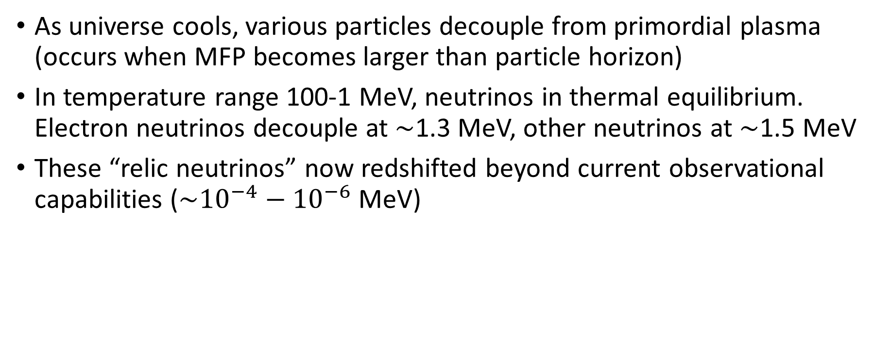
Early Universe Neutrinos
As universe cools, various particles decouple from primordial plasma (occurs when MFP becomes larger than particle horizon)
In temperature range 100-1 MeV, neutrinos in thermal equilibrium. Electron neutrinos decouple at $\sim$1.3 MeV, other neutrinos at $\sim$1.5 MeV
These “relic neutrinos” now redshifted beyond current observational capabilities ($\sim {10}^{−4}−{10}^{−6}$ MeV)
What is the spectrum and flavor content of these neutrinos when they decouple in the early universe?

Slide 16

Early Universe Toy Model
Hamiltonian with vacuum and “thermal potential” terms from electron-positron and neutrino-antineutrino scattering potentials
Assume 2 flavors and neglect spin degrees of freedom
Allow for “simple” inelastic collision terms that may have flavor-dependent scattering amplitudes
Assume non-degenerate bath of neutrinos and targets (i.e. ignore Pauli blocking)
Instead of continuous energy distribution, assume n discrete “energy bins”
Work in Bloch form

Slide 17
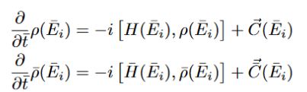

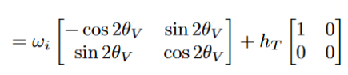






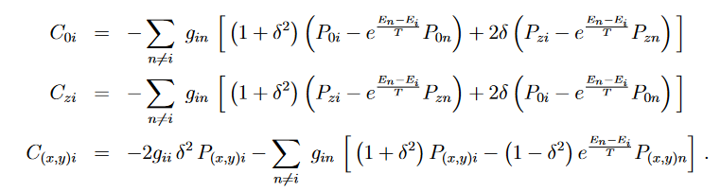

Form of QKEs
Effective Hamiltonian
Thermal terms dominate at
higher temperatures
Familiar time evolution term
Collision terms
Bloch form (for neutrino)
Collisions

Slide 18
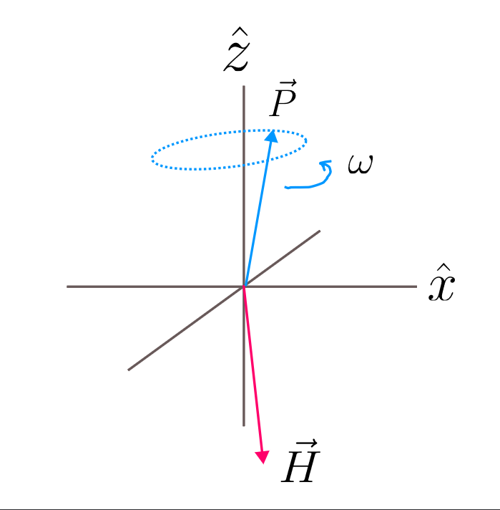
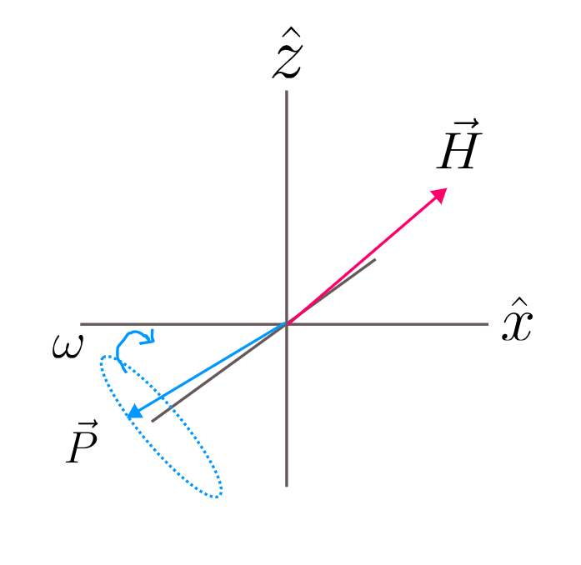
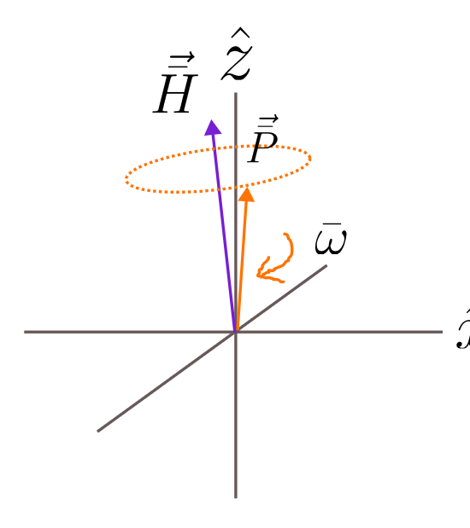
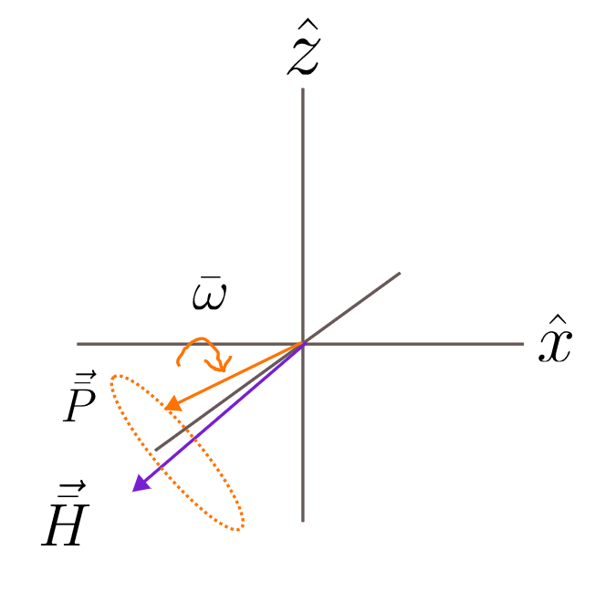
neutrino
antineutrino

Slide 19
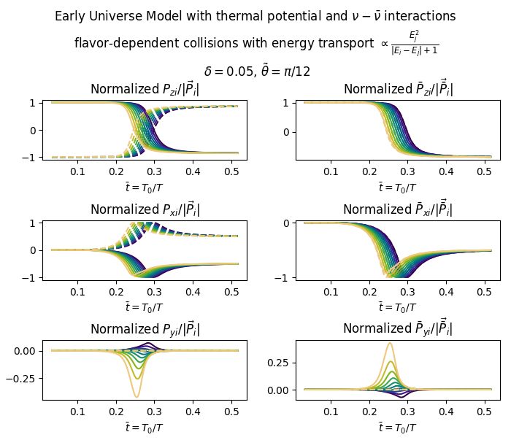
Takeaways:
Mass basis does not correspond to flavor basis!
Mass (anti-)/alignment for neutrino/antineutrino
Precession is adiabatic (polarization vectors “track” Hamiltonian vector”

Slide 20
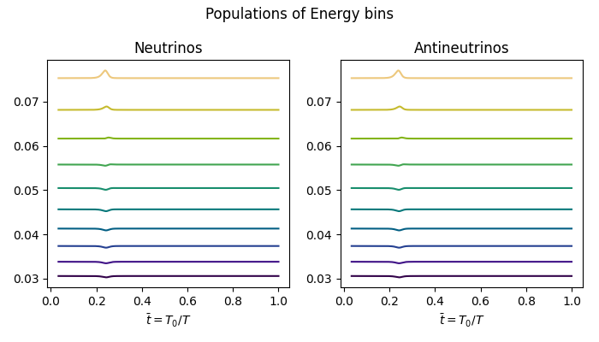

Slide 21
Thank you!
Special thanks to:
Vincenzo Cirigliano
NSF
All of you :)

