Slide 1
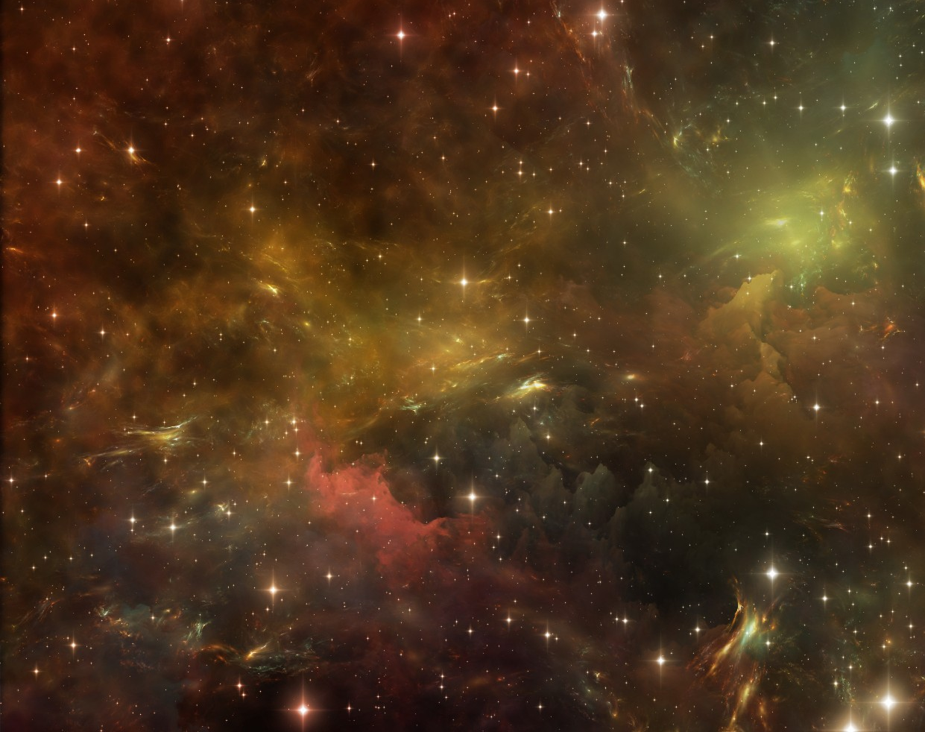
New Ways for Finding Axion Dark Matter
Kiara Ruffin
University of Virginia
Advisor: Dr. Gray Rybka
17 August 2023

Slide 2
Overview
Dark Matter
Properties and Definition of Dark Matter
Candidates for Dark Matter
The Axion
Properties and Discovery of the Axion
The Axion Haloscope
Relationship between electrodynamics and Axions
My Research: Alternative Methods and Findings
RF Axion Haloscope
Axion Parametric Amplification and Other Phenomena
Future Work and Reflections
The Future of the Project and Questions that I have
Pictures of my time at ADMX

Slide 3
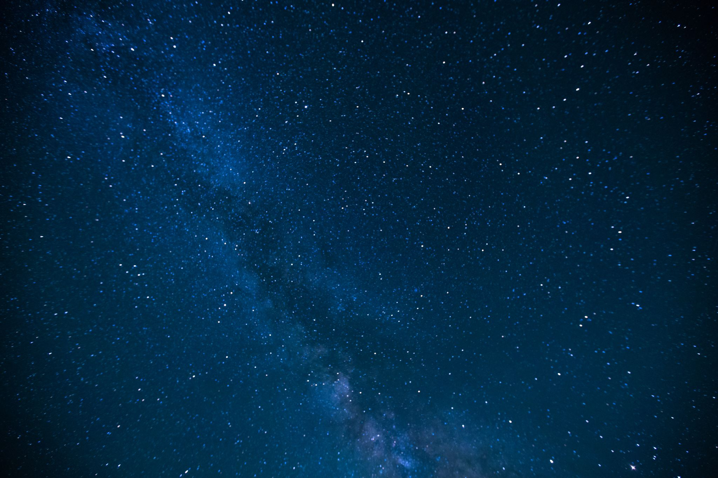

Why Do All of This?
The universe is vast and there is so much that we have yet to discover.

Slide 4
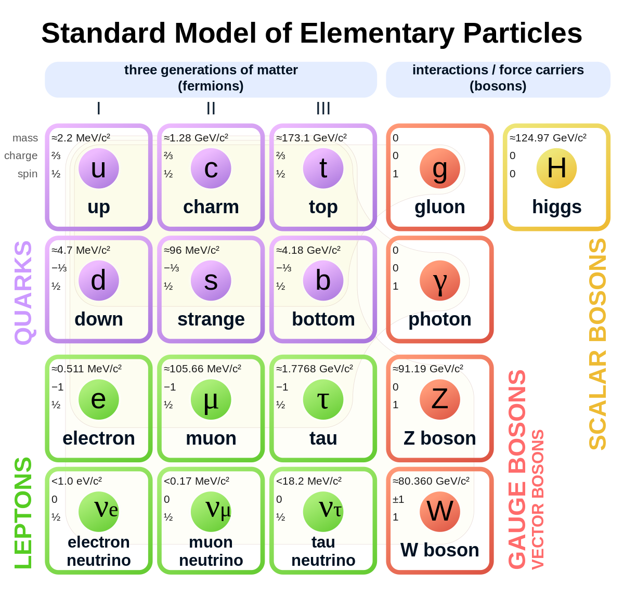
The Standard Model as we currently know it, is incomplete!
It’s missing dark matter!
Notes:
One of the most popular

Slide 5
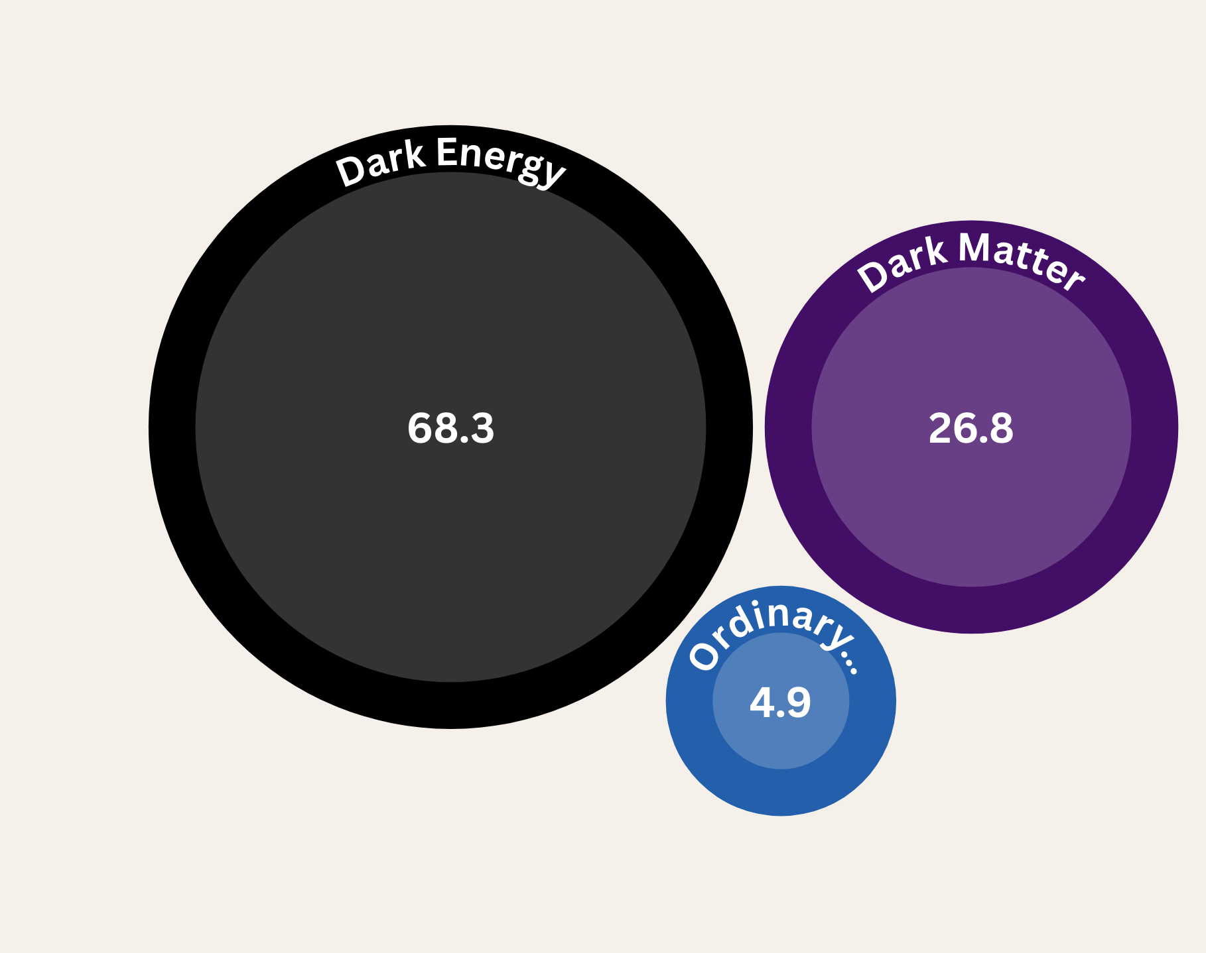
What is Dark Matter?
Dark Matter is comprised of a series of hypothetical particles that react gravitationally to the objects around it. You cannot see it due to its minimal interactions with photons.

Slide 6
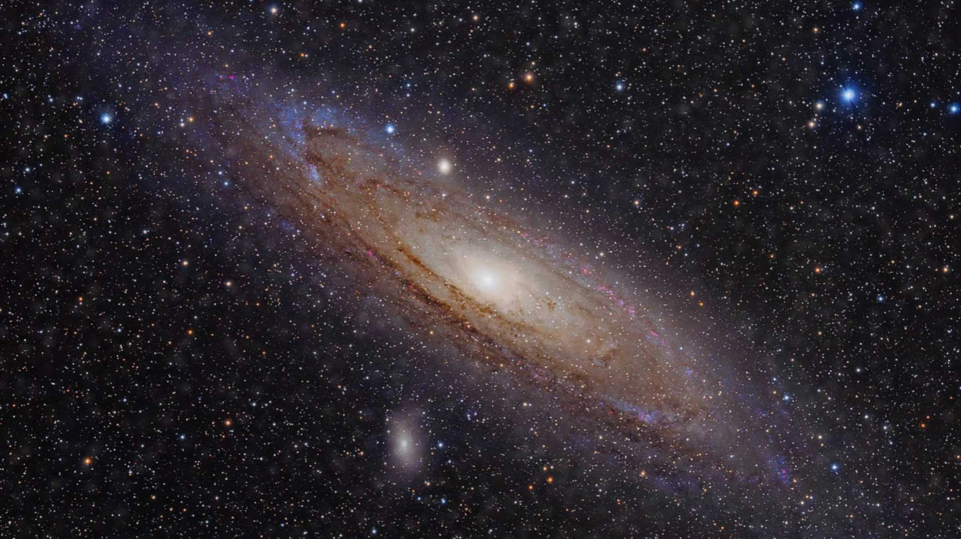
Probable Candidates for Dark Matter Particles
Some Proposed Dark Matter Particles are:
Weakly Interacting Massive Particles (WIMPs)
Sterile Neutrinos
Axions ( QCD Axions or ALPs)

Slide 7
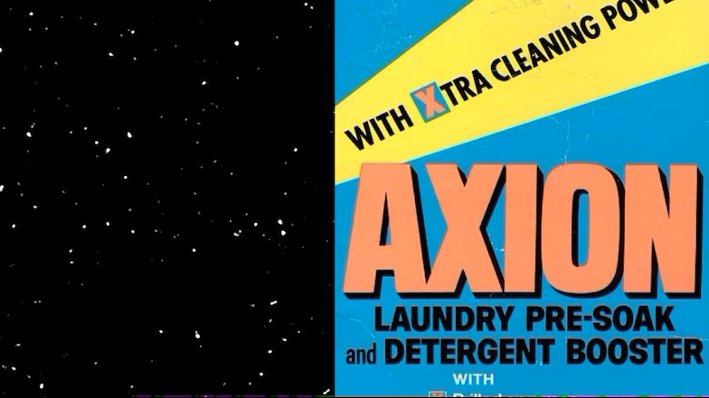
The Axion

Slide 8
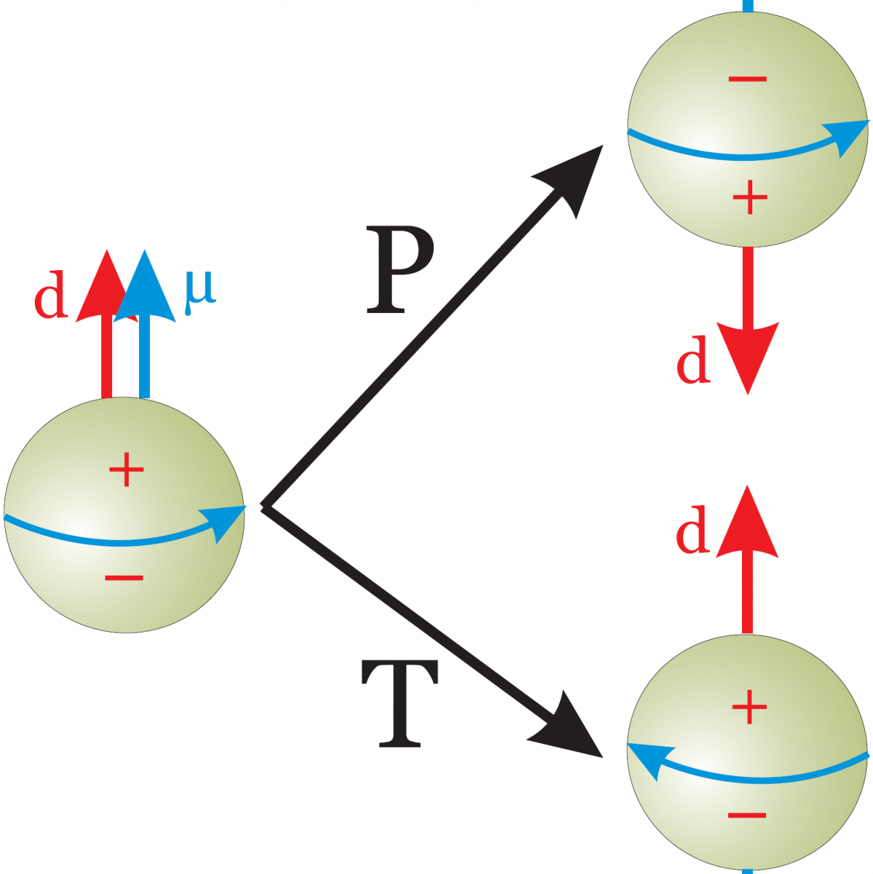
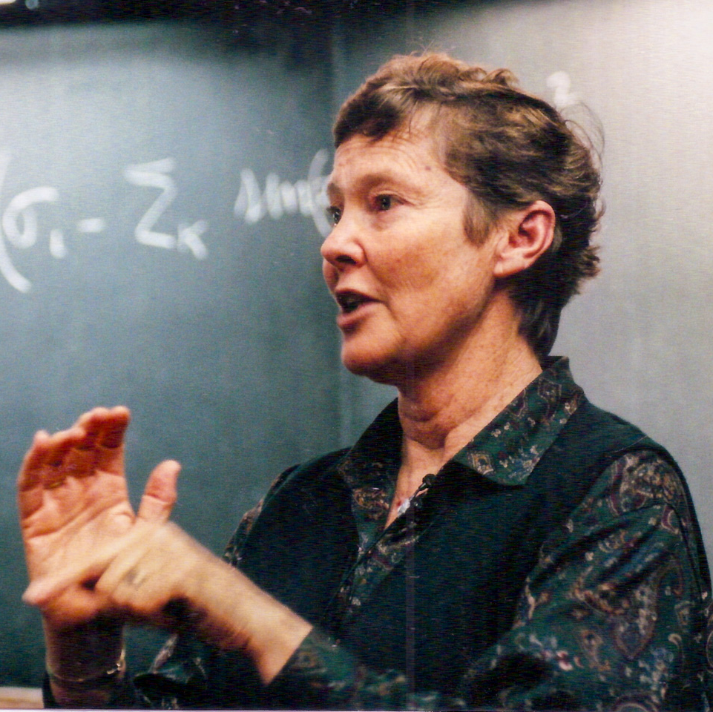
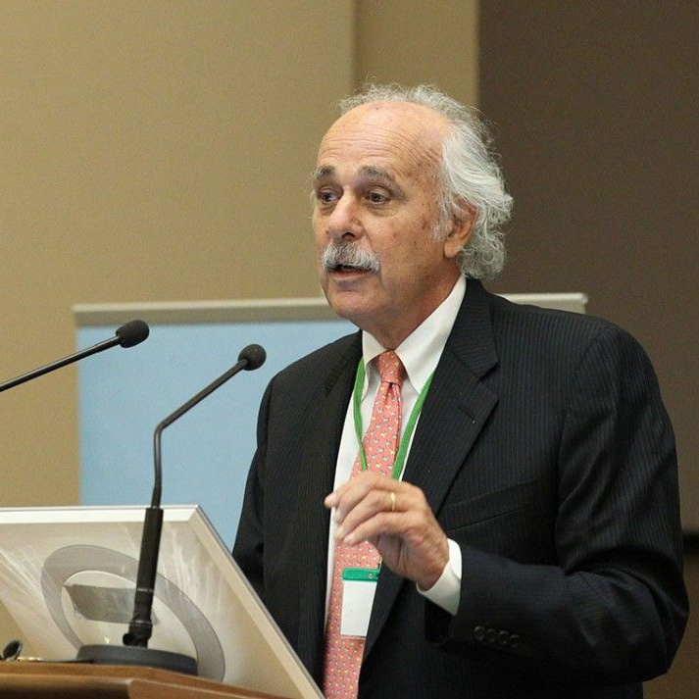
The Beginning
The Axion was first proposed by theoretical physicists Roberto Peccei and Helen Quinn in 1977. It came as a solution to a long-standing issue in Quantum Chromodynamics (QCD) known as the Strong CP problem.

Slide 9
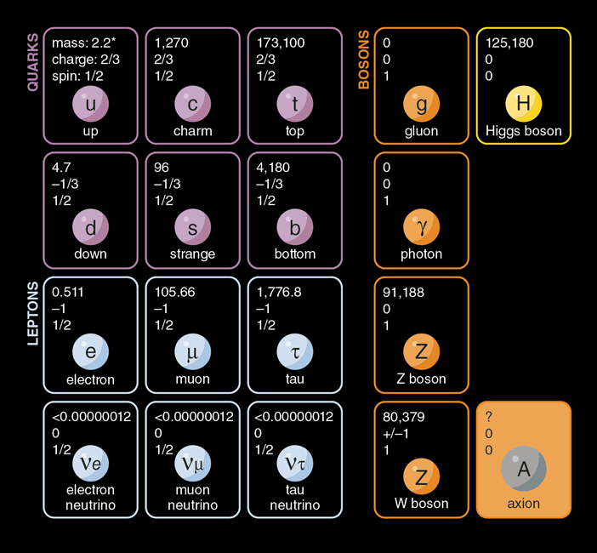
Properties of the Axion
QCD (Cold Dark Matter) Axions are:
Low Kinetic Energy/ Non-relativistic (Cold)
Low Mass
Neutrally Charged
Wave-like particle (long De Broglie wavelength)
Boson like particle
Notes:
kkmnkkmnnp

Slide 10
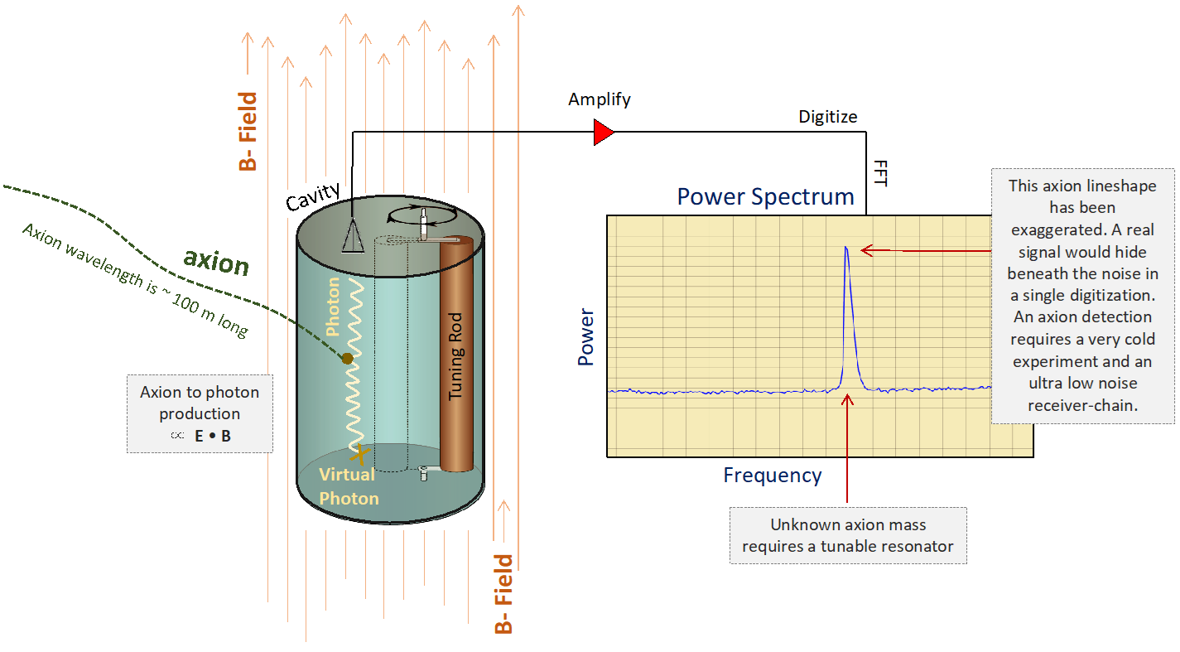
The Axion Haloscope

Slide 11
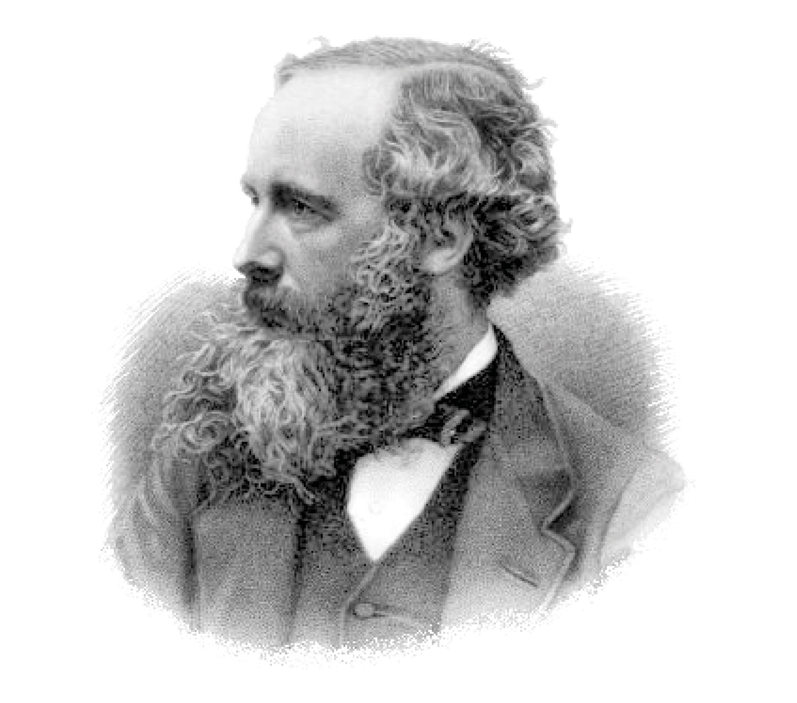


Maxwell’s Equations
Gauss’ Law: $∇⋅E=\frac{ρ}{ε_{0}}$
Gauss’ Law of Magnetism: $∇⋅B=0$
Faraday’s Law: $∇×E=−\frac{∂B}{∂t}$
Ampere’s Law: $∇×B=μ_{0}J+μ_{0}ε_{0}\frac{∂E}{∂t}$

Slide 12

Axion Electrodynamics
Maxwell’s Equations are a huge component of Axion electrodynamics. There is an incidence of coupling between the Axion and the Photon.
$$∇⋅E=ρ−g_{aγγ}B⋅∇a$$
$∇×B=\frac{∂E}{∂t}+J−g_{aγγ}$(E $×∇a−B\frac{∂a}{∂t})$
$$∇⋅B=0$$
$$∇×E=−\frac{∂B}{∂t}$$
*the highlighted region indicates the Axion and Photon coupling present in the equation.

Slide 13

Axions and the Electromagnetic Field
The principals of Gauss’ Law and Ampere’s Law are combined leaving you with the derived Helmholtz Wave Equation:
$$∇^{2}E−\frac{∂^{2}E}{∂t^{2}}={−g}_{aγγ}B_{0}\frac{∂_{a}^{2}}{∂t^{2}}+\frac{∂J}{∂t}\hat{z}$$
Axions can simulate a current propagating through a wire by acting like electromagnetic waves with the added current term.

Slide 14
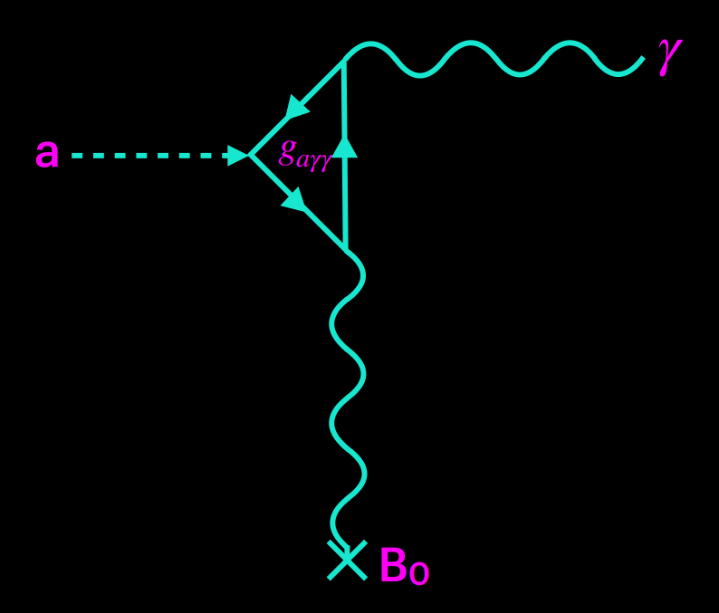
Coupling between Axions and Photons
When using a resonant cavity, there is an incidence of coupling between Axions and Photons.
The Axion elastically scatters into a photon obtained from a source with an external magnetic field. Another photon is then released from this interaction. This is known as the inverse Primakoff Effect.

Slide 15
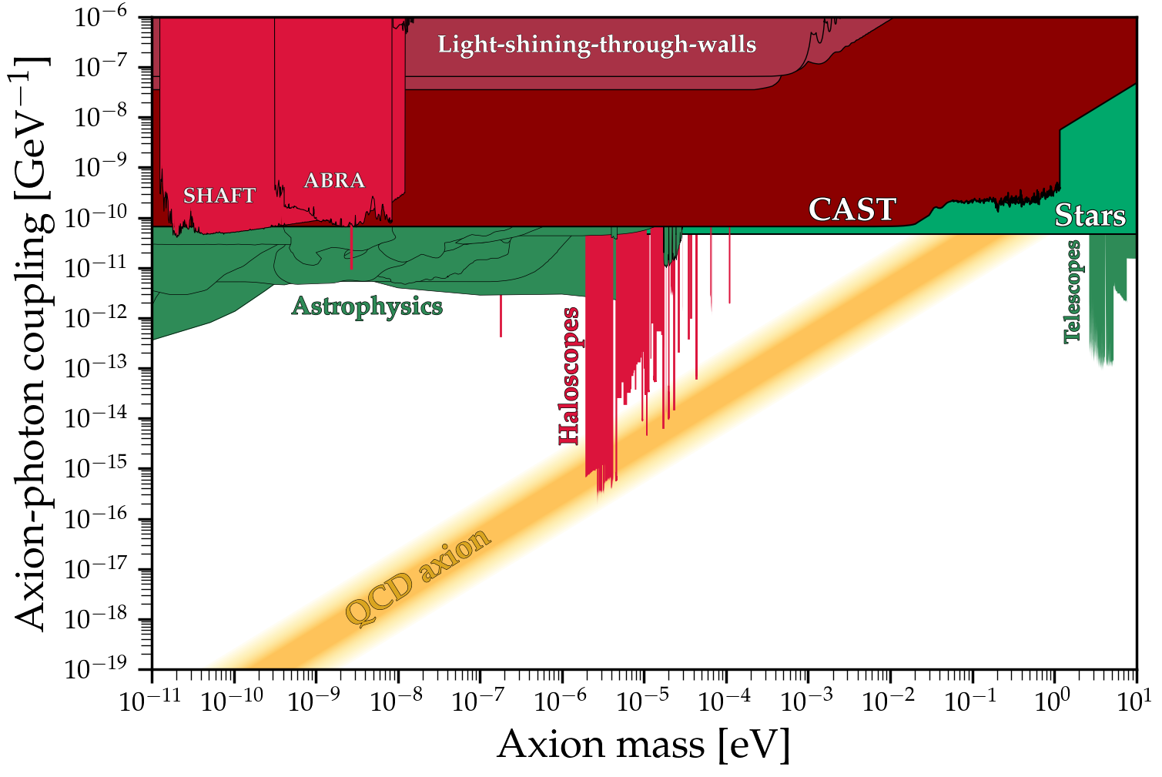
Axion Mass and Coupling

Slide 16

Axion Power Equation
$$P_{a}=g_{aγγ}^{2}VB_{0}^{2}C_{mnl}Q_{L}ω_{c}ρ_{a}$$
Terms:
$g_{aγγ}$ - The Coupling Constant
V - Volume of the Cavity
$B_{0}$ - Magnetic Field Strength
$C_{mnl}$ - The Form Factor
$Q_{L}$ - The “Quality of the Cavity”
$ρ_{a}$ - Dark Matter Density
The Axion Signal Power is ≂${10}^{−23}$Watts
*Assumes Axion frequency is on resonance

Slide 17

Quality and Energy Loss in the Cavity
$$Q=\frac{U}{P_{loss}}ω_{c}$$
The Quality factor or Q quantifies how little loss there is in the cavity.
Having a higher Q means that there is less loss in the cavity
It also means that a larger incidence of stored energy in cavity points to a small amount of power being distributed within the cavity.

Slide 18
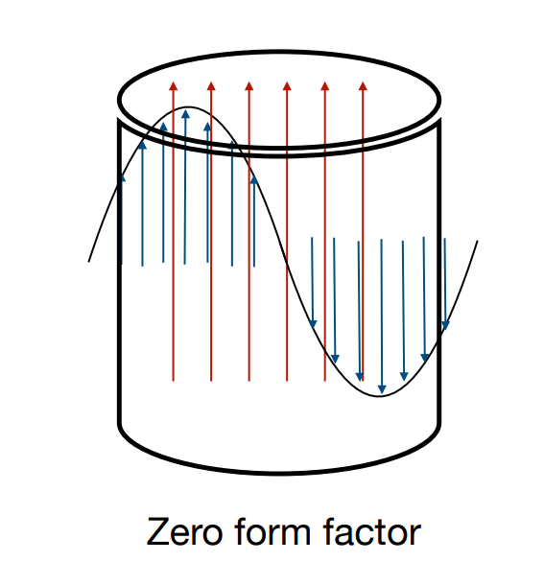
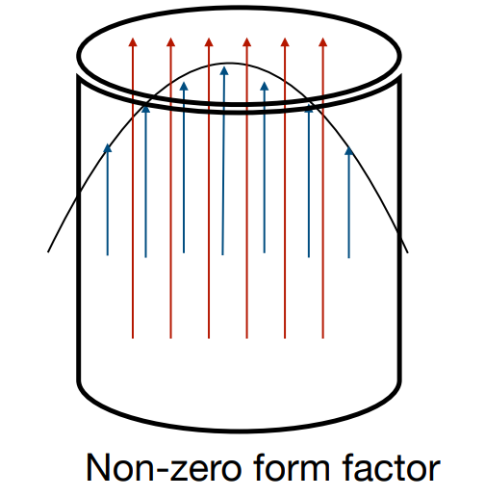

The Form Factor
The form factor ($C_{nml})$represents the overlap of the E and B fields.
If the E and B fields cancel out or neglect to, then the form factor is zero.
If there is overlap between the E and B field, the form factor is near 1.
*The red lines represent the B Field, and the blues lines represent the E Field.

Slide 19
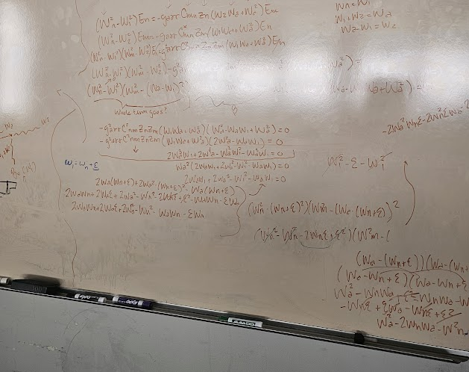
My Research: Alternative Methods and Findings

Slide 20

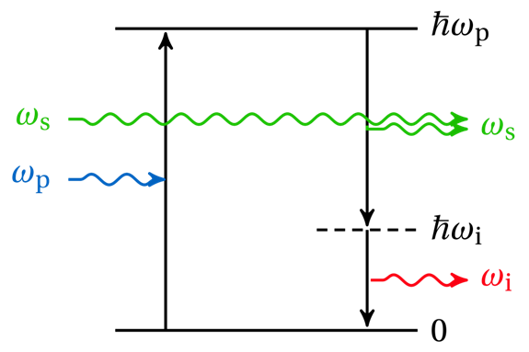
Parametric Amplification
In the Axion Radio Frequency Haloscope, you have an occurrence that would be comparable to Parametric Amplification where the Axions amplify signals already in the cavity.
Part of my project consisted of studying the effects and tracking the behavior Axion signal re-amplification.
Notes:
Pump tone

Slide 21
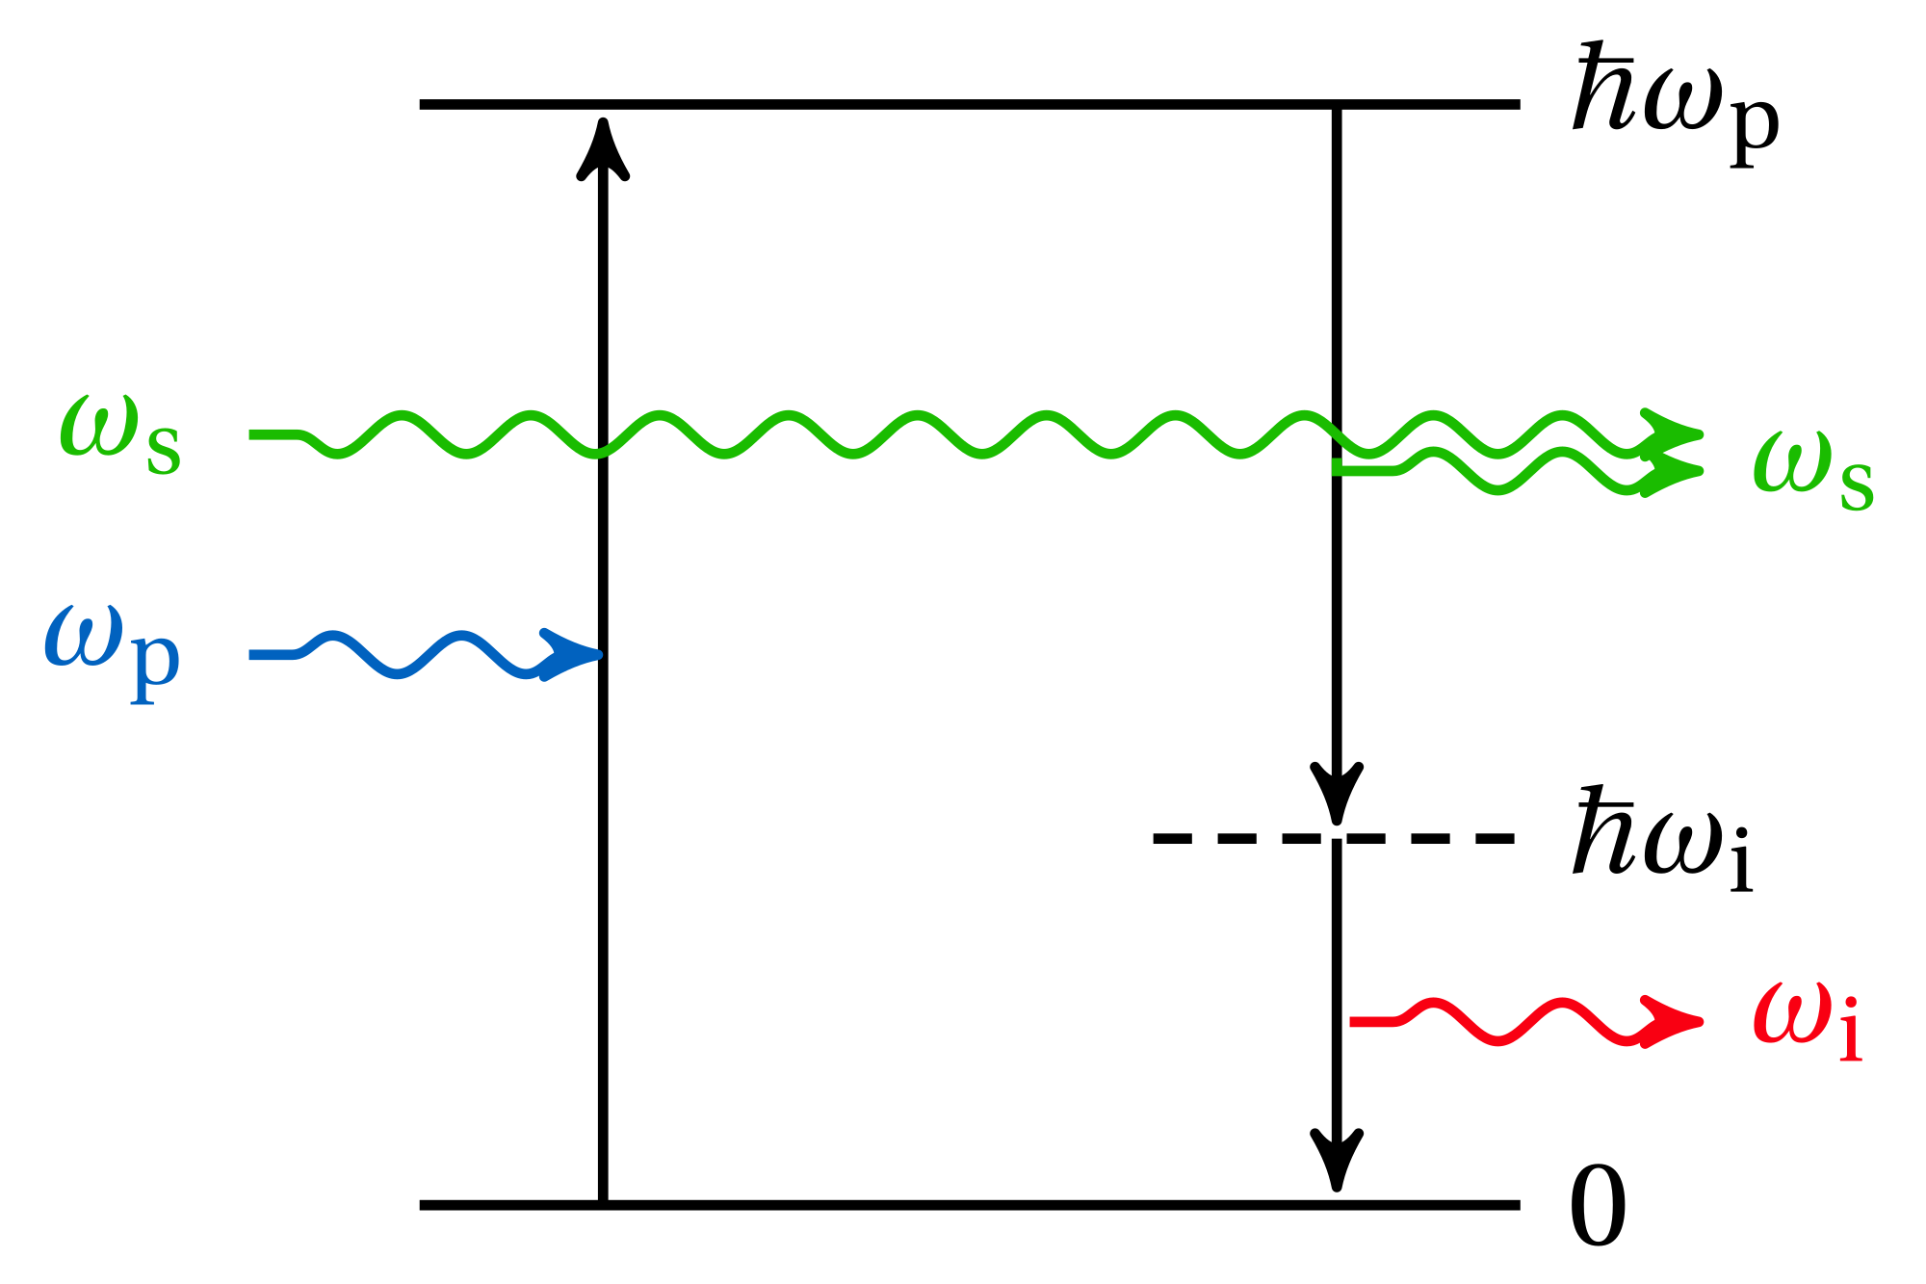

Run-Away Amplification
Axion Wave Equation written in terms of Parametric Amplification:
$$\left(ω_{0}^{2}−ω^{2}−ⅈ\frac{ω_{0}ω}{Q}\right)E_{n}={−ig}_{aγγ}z_{n}a_{0}CE_{n}$$
$$\left(ω_{0}^{2}−ω^{2}−ⅈ\frac{ω_{0}ω}{Q}+{ig}_{aγγ}z_{n}a_{0}C\right)E_{n}=0$$
Conditions:
Loss Term: $\frac{1}{Q}= −ⅈ\frac{ω_{0}ω}{Q}$
Gain Term: ${G=ig}_{aγγ}z_{n}a_{0}C$
If $G>\frac{1}{Q}$, then there is growth
If $G<\frac{1}{Q}$, then there is decay

Slide 22
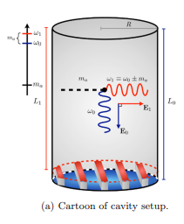

RF Axion Haloscope
The RF Axion Haloscope takes the idea of the standard Axion Haloscope and expands it to the notion that every field is dynamic.
The Axion Field becomes
  $a\left(t\right)=a_{0}ⅇ^{ⅈω_{a}t}$
The Magnetic Field becomes
  $B\left(t\right)=B_{0}ⅇ^{ⅈω_{1}t}$
The Electric Field becomes
  $E\left(t\right)=E_{0}ⅇ^{ⅈω_{2}t}$

Slide 23

Input = Output
What if we made an output photon the same as the input photon?
We found a mode that has a non-zero form factor with itself.
The cavity is tuned to a frequency of ∆$ω=\frac{ m_{a}}{2}.$
We find that more and more photons produced with this method!
Notes:
Pump tone

Slide 24


Will Run-Away Amplification Happen?
  Scenario #1: Not Likely
  Resonators with a $Q>{10}^{20}$ for run-away amplification to occur.
  Currently, the highest superconducting resonators can only produce $Q>{10}^{11}.$
  Scenario #2: Possibly
  Some theoretical models suggest there is a potential for extra-dense (approximately ${10}^{9}$ times as dense as normal) dark matter clumps.
  Chance for future advancement and production in high Q resonators are possible

Slide 25
Future Work and Reflections

Slide 26
Future Questions
What if E and B are different modes?
What if the modes are not dependent upon one another?
Are there any ways of reducing the Q requirements?

Slide 27
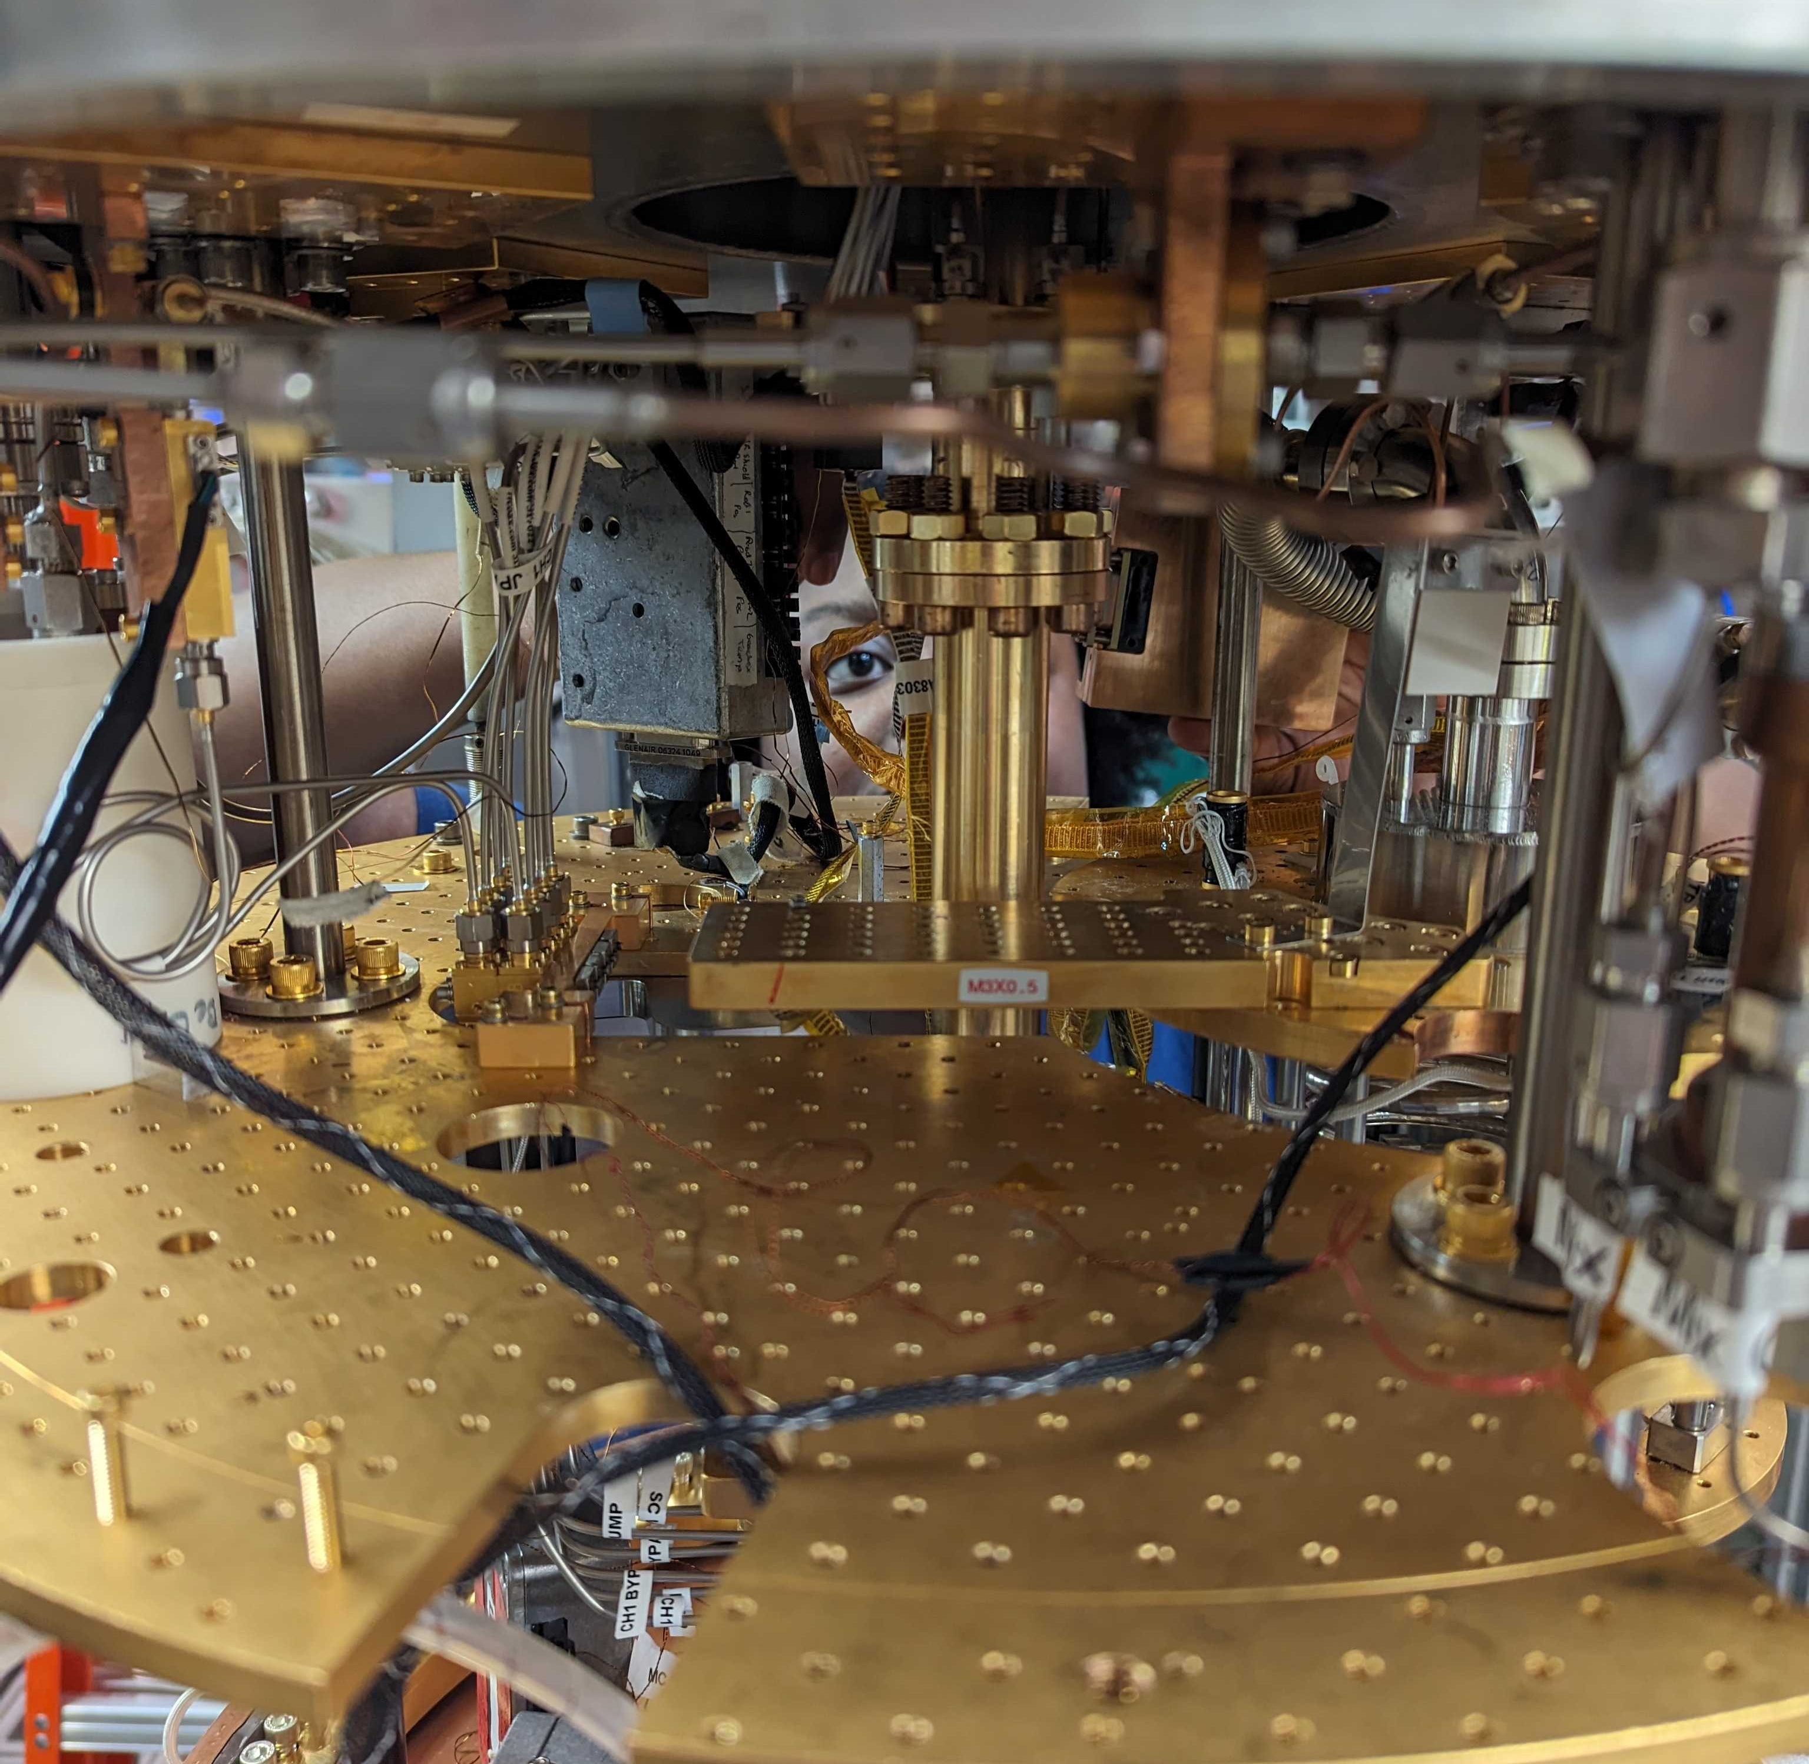
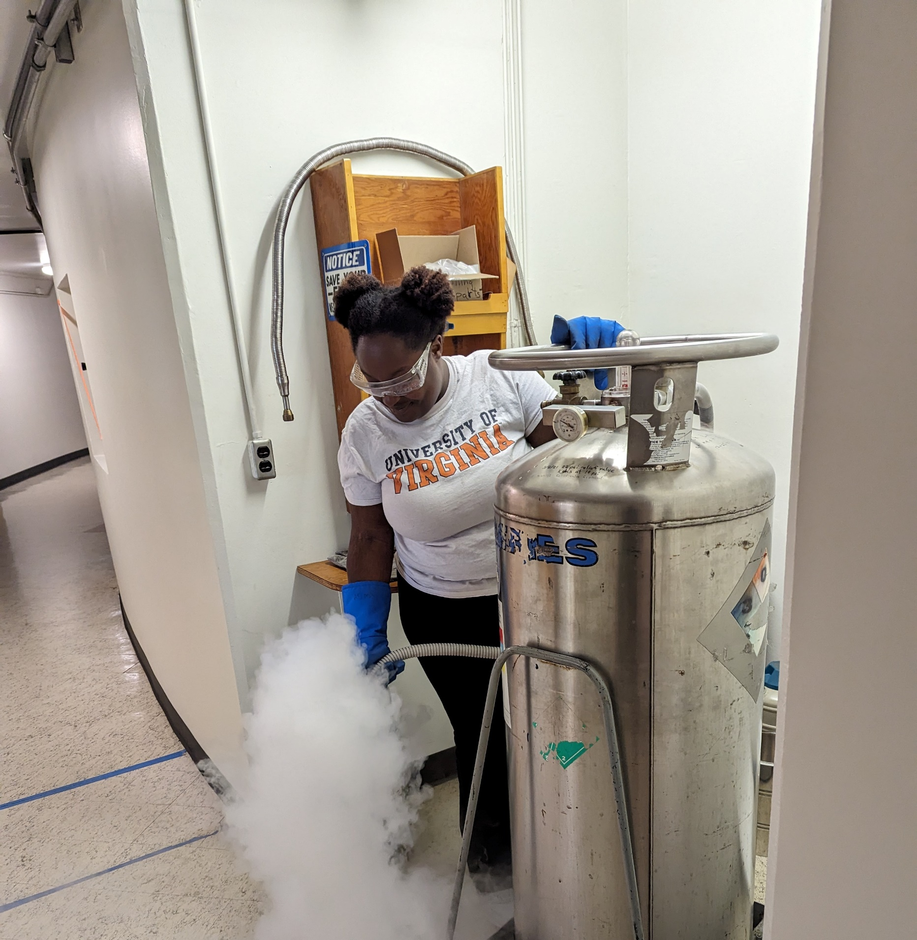
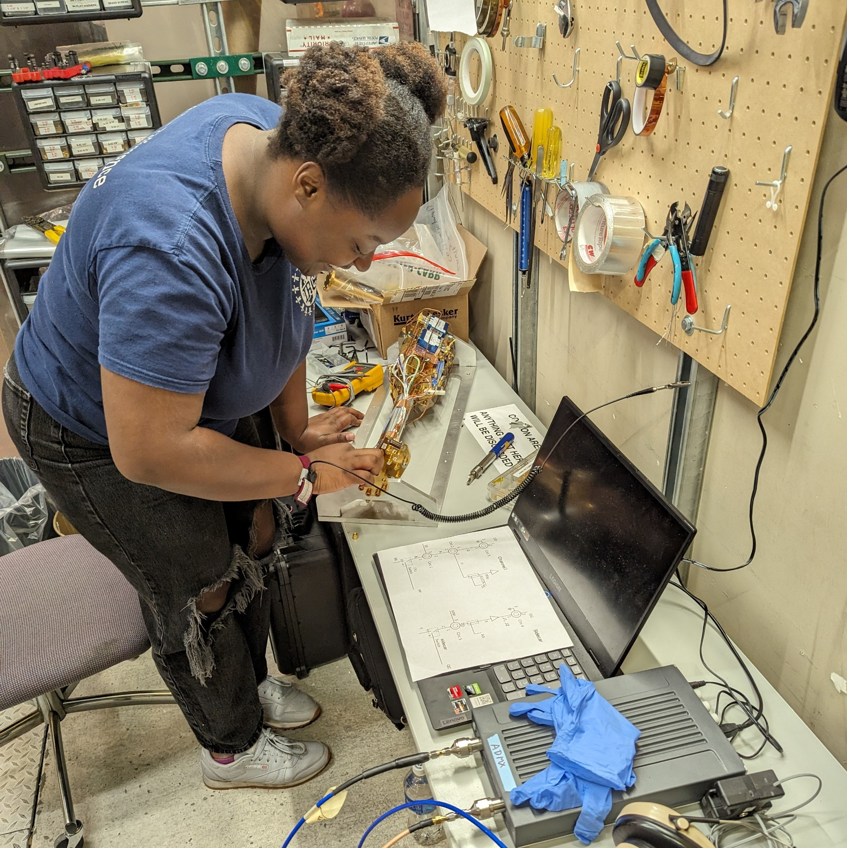
Pictures of my Time at ADMX

Slide 28



Acknowledgements
I would like to give thanks to the National Science Foundation (NSF) and the University of Washington for providing this opportunity. I would also like to thank those in my REU cohort!

Slide 29

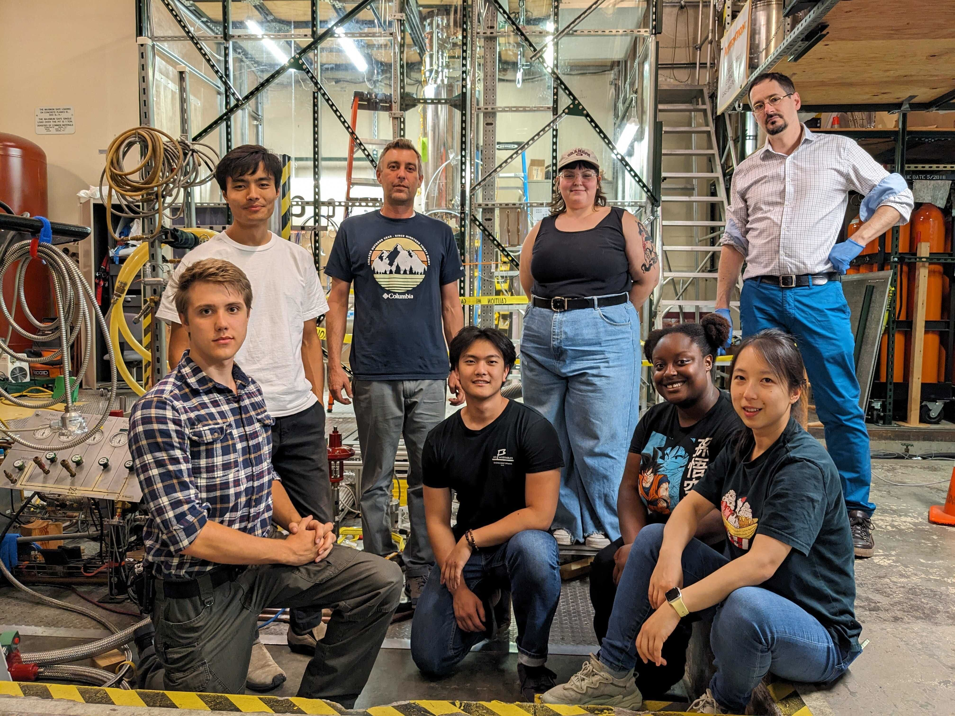
Acknowledgements
Lastly, I would like to special thanks to Dr. Gray Rybka and the rest of the ADMX Team for making my time here an amazing experience.

