Slide 1

Study of the Light Front Quantum Harmonic Oscillator in Tilted Coordinates
$$Anne {Lashbrook}^{1}$$
$$Advisors: Gerald {Miller}^{2} and Adam {Freese}^{2}$$
$$^{1}Saint Louis University$$
$$^{2}University of Washington$$
Notes:
Hi, my name is Anne Lashbrook, and I am an undergraduate student at Saint Louis University. This summer, I worked under the guidance of Dr. Miller and Dr. Freese here at the University of Washington to study the light front quantum harmonic oscillator in tilted coordinates. I will get into what that means exactly in the coming slides.

Slide 2
Overview
Motivation
Finding the Wavefunction
Approximating Hamiltonian Matrix
Notes:
Before diving into things, I want to give a quick overview of this presentation. I’ll begin with the motivation for this research giving the lay of the land for theoretical nuclear physics and introducing the light front formalism. After that, I will discuss the process of finding the wavefunction for this system. Then, I will discuss the eventual approximation techniques used in constructing the Hamiltonian matrix.

Slide 3
Motivation
The field of nuclear physics and the light front formalism
Notes:
Beginning with the motivation for this research…

Slide 4
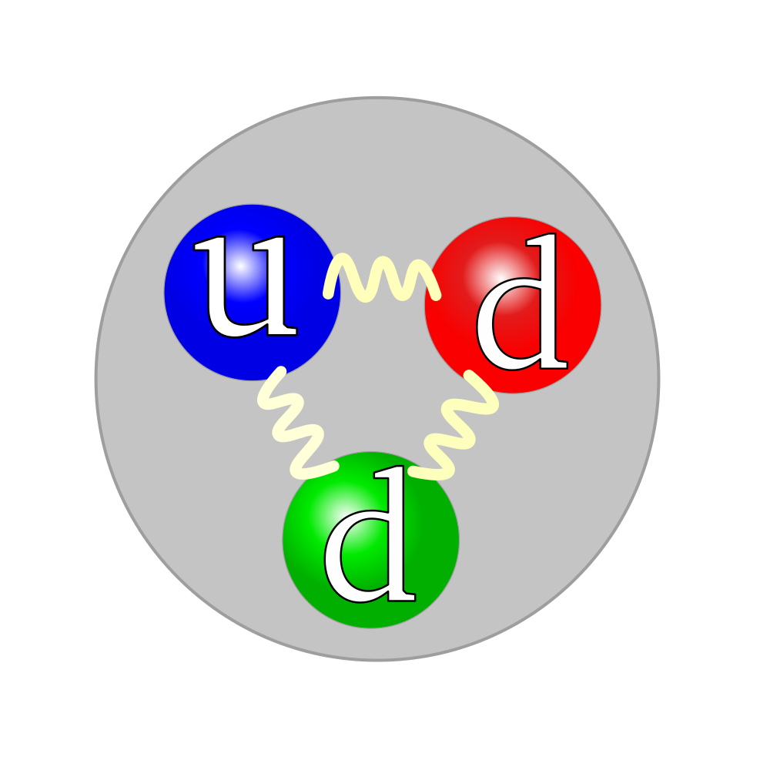
Nuclear Physics
Systems of hadrons and nuclei from quantum chromodynamics (QCD)
Problem : analytic or perturbative solutions at low-energy are difficult or impossible to obtain.
Lattice QCD
Computationally intensive
https://energywavetheory.com/wp-content/uploads/2016/08/quarks-and-neutron-300x300.png
Notes:
The goal of theoretical nuclear physics today is to provide a sound description of systems of hadrons and nuclei. Hadrons are subatomic particles consisting of quarks held together by the strong force such as protons and neutrons. Ideally, these descriptions would come directly from quantum chromodynamics, abbreviated as QCD. Quantum chromodynamics is the theory of strong interactions which are the forces at work between quarks which are mediated by gluons. However, oftentimes approximation methods are necessary.
The path integrals from quantum chromodynamics physicists encounter to describe these systems are analytically difficult. And analytic or perturbative solutions for low-energy QCD are difficult or impossible to obtain due to the nonlinear nature of the strong force and the large coupling constant, the number that determines the strength of a force, at low energies. So, a popular technique widely used in nuclear physics to alleviate this issue is Lattice QCD. Lattice QCD is a lattice gauge theory formulated on a grid of points in spacetime. Using Lattice QCD, physicists can turn their analyses of systems of hadrons and nuclei from difficult integrals into numerical computation problems. Then, as the lattice is taken to be infinitely large, its sites becoming infinitely closer together, continuous QCD is recovered.
However, Lattice QCD calculations are computationally intensive. It is a promising approach as our ability to perform intensive computations improves what with a large interest in the future of quantum computing and machine learning, but what other methods are available with which to formulate descriptions of systems of nuclear physics?

Slide 5
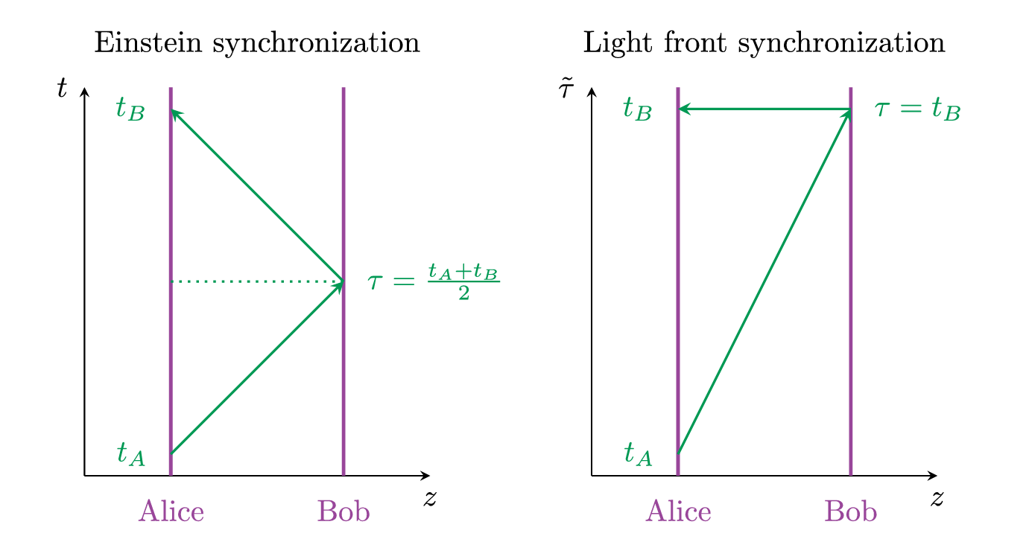

The Light Front Formalism
Light Front Formalism:
Introduced by Paul Dirac in 1949
Alternative synchronization convention
New conventions may be more likely to solve certain problems.
Tilted Coordinates:
Tilted light front coordinates:
$\tilde{τ}={\tilde{x}}_{0}≡x^{+}=t+z$
${\tilde{x}}^{1}≡x$
${\tilde{x}}^{2}≡y$
${\tilde{x}}^{3}≡z$
          Light travels instantaneously in the –z direction.
Image Credit: Adam Freese
Notes:
At the University of Washington, Dr. Miller is interested in describing the spatial densities of hadrons using the light-front formalism, a front-form representation of local relativistic quantum field theory. Originally introduced by Paul Dirac in 1949, the light front formalism employs an alternative synchronization convention to provide a different description of the physics within the atomic nucleus. Rather than using the Einstein synchronization convention, the light front formalism utilizes light front synchronization.
To describe the difference between the two synchronization conventions, let’s imagine we have two people standing apart from each other, Alice and Bob, each with their own clock. Under the Einstein synchronization convention, a signal traveling between Alice and Bob takes the same amount of time to travel in either direction. If Alice sends her signal at time A and receives a signal from Bob at time B, then the time Bob received her signal must have been the average of those two times. Under light front synchronization, we assume a signal can travel instantly in the negative z-direction. So, if Alice sends her signal at time A and receives a signal from Bob at time B, then the clocks are synchronized assuming Bob sent the signal at the exact same time Alice received it, at time B. It still takes the same amount of time for the signal to travel between Alice and Bob. Ultimately, the physical predictions of a relativistic theory are independent of whatever synchronization convention you use. Using light front synchronization instead of Einstein synchronization just means changing the rules for how clocks are synchronized. The use of a particular convention is arbitrary, but using new conventions may be more likely to solve certain problems.
Physicists have raised some concerns about the light front formalism. One being that densities calculated in the light front may describe physical systems moving at the speed of light and are therefore distorted. Another concern is that the negative components of four-vectors and tensors have no clear physical meaning in the light front.
To resolve these concerns, Dr. Miller introduced tilted coordinates which is a coordinate system using light front time but ordinary spatial coordinates. With tilted coordinates, both of these concerns are resolved. We use the tilde above tilted coordinates to distinguish them from normal coordinates. Now, how can we actually employ tilted coordinates to describe physical systems?

Slide 6

The Light Front Formalism (cont.)
Standard Coordinates:
$E=\sqrt{m^{2}+p^{2}}$
Klein-Gordon equation gives energy-momentum relation:
$\tilde{E}=\frac{m^{2}+{\tilde{\overset{⃑}{p}}}^{2}}{2{\tilde{p}}_{z}}$
Hamiltonian Operator:
$\hat{\tilde{H}}=\frac{m^{2}+{\tilde{\overset{⃑}{p}}}^{2}}{2{\tilde{p}}_{z}}+V$
Notes:
This slide provides a quick background into how we can apply tilted coordinates to the Schrodinger equation. How can we construct the appropriate Hamiltonian operator for tilted coordinates compared to that for standard coordinates?
As you may be familiar, under standard coordinates, the energy of a relativistic system is equal to the square root of the mass squared plus the momentum squared (setting the speed of light equal to one). Under tilted light front coordinates, this relation looks different.
There is some theoretical background I won’t fully get into, but ultimately we can recover the tilted light-front analog of the relativistic energy-momentum relation from the Klein-Gordon equation. The Klein-Gordon equation is a relativistic wave equation that comes from the relativistic energy-momentum relation. For tilted light front coordinates, instead of energy equaling the square root of the mass squared plus the momentum squared, we have a rational expression: m-squared plus p-squared all over 2 times the momentum in the z-direction. Having a rational expression rather than one with a square root could prove promising in solving some problems of quantum chromodynamics.
With an expression for the energy-momentum relation for tilted coordinates, we can now construct the Hamiltonian operator: the sum of the kinetic energy and the potential energy of a system. With an expression for the Hamiltonian operator for tilted coordinates, we can now use the Schrodinger equation to calculate the wavefunction for a physical system in tilted coordinates.
Metric gives Laplace operator:
$$∂^{2}=−\frac{2∂^{2}}{∂\tilde{τ}∂\tilde{z}}−{\tilde{∇}}^{2}$$

Slide 7

This Summer: The Quantum Harmonic Oscillator
Quantum Harmonic Oscillator Review
$V=\frac{1}{2}mω^{2}{\hat{x}}^{2}$
Plan of Attack:
  If analytic solution:
    Find wavefunction and energy eigenvalues given Hamiltonian.
  If approximation necessary:
    Find approximate wavefunction.
    Calculate Hamiltonian matrix and approximate energy eigenvalues.
Notes:
In understanding the light-front formalism as applied in tilted coordinates and its possible applications, it is important to test its Hamiltonian in simple theories. So, this summer, my project was to apply the light front formalism to the quantum harmonic oscillator.
The quantum harmonic oscillator is the quantum-mechanical analog to the classical harmonic oscillator. It is a relatively simple quantum mechanical system, and it is one of the few for which an analytical solution is known making the quantum harmonic oscillator a great system with which to explore tilted coordinates. Just to review, potential component we will be adding to our Hamiltonian will be the same as that from the quantum harmonic oscillator: one half m omega squared x-squared where m is the particle’s mass and omega is the angular frequency.
So what was the plan of attack for this project? First, given the Hamiltonian operator for the quantum harmonic oscillator in tilted coordinates, I had to find the wavefunction for this system. I first wanted to see if I could find it analytically rather than using approximation methods because if an analytical solution to the Schrodinger equation could be found, that would directly give us the energy eigenvalues for this system. However, if approximation methods proved necessary, I would have to find an approximate wavefunction and then calculate a Hamiltonian matrix to find approximate energy eigenvalues.

Slide 8
Finding the Wavefunction
Analytic Attempt and Approximation
Notes:
Moving onto the second part of my presentation, I’ll discuss the methods I used to find an expression for the wavefunction for this system. I initially looked for analytical solutions, but eventually had to find a suitable approximation.

Slide 9

Time-Independent Schrödinger Equation
$\hat{H}ψ=Eψ$ where $\hat{\tilde{H}}=\frac{m^{2}+{\tilde{\overset{⃑}{p}}}^{2}}{2{\tilde{p}}_{z}}+V$
$$\hat{\tilde{H}}ψ=\frac{m^{2}+{\tilde{\overset{⃑}{p}}}^{2}}{2{\tilde{p}}_{z}}ψ+\frac{1}{2}{mω}^{2}{\overset{⃑}{x}}^{2}ψ$$
Notes:
To find the wavefunction for the quantum harmonic oscillator in tilted coordinates, we need to use the Schrodinger equation. Following Dirac’s development of quantum mechanics, we can view the Schrodinger equation as an eigenvalue equation. The Hamiltonian operator acting on the wavefunction is set equal to the total energy, a scalar value, acting on the wavefunction. This forces the wavefunction to be that for stationary states, cases where it does not depend on time. In this case, the Hamiltonian operator is given by the energy-momentum relation for tilted coordinates, m-squared plus p-squared over 2 pz plus the potential. Since this project is concerned with the quantum harmonic oscillator, we will put in that potential: one half m omega squared x-squared.
Now, we are staring at the appropriate partial differential equation to use to solve for the wavefunction. Recall that in quantum mechanics physical quantities like momentum and position are represented as observables which are operators. We can substitute in the operator identities for the momentum, -i h-bar partial derivative with respect to position. This leaves us with a partial differential equation where the wavefunction depends on position. Since we want to look at this system in three spatial dimensions, it depends on the variables x, y, and z.

Slide 10

Analytical Solution?
Separation of Variables: $ψ(x,y,z)=X\left(x\right)Y\left(y\right)Z(z)$
$H=\frac{m^{2}+{\overset{⃑}{p}}^{2}}{{2p}_{z}}$ mixes orthogonal and z-component of momentum operator
RHS:
$…+ψ_{p_{z}}\left(m^{\frac{1}{2}}p_{z}^{\frac{3}{2}}+2iEm^{\frac{1}{2}}p_{z}^{\frac{1}{2}}+\frac{m^{\frac{5}{2}}}{p_{z}^{\frac{1}{2}}}−\frac{5m^{\frac{3}{2}}ω^{2}}{4p_{z}}+λp_{z}^{\frac{1}{2}}m^{\frac{1}{2}}\right)=0$
Faced with difficult equation for the pz-component of the wavefunction, so let’s try an approximation method
Notes:
To tackle this partial differential equation, I applied the method of separation of variables. Just to refresh, in separation of variables, we define the function we are solving for as a product of functions of the independent variables in the partial differential equation. In this case, setting the wavefunction equal to a product of functions of the x, y, and z components. An interesting difficulty that arose in trying to separate out the Schrodinger equation was that the Hamiltonian operator mixes together the orthogonal and z-components of the momentum operator as you can see in the expression m-squared plus p-orthogonal-squared all over 2pz. This caused the equation to be inseparable using the variables x, y, and z, so Dr. Freese pointed me towards a coordinate transformation where we redefined the wavefunction as a product of u (a function of x), v (a function of y), and the momentum in the z-direction. Using a coordinate transformation, the equation is now separable.
Still, another difficulty arose. The ordinary differential equation for the pz-component of the wave function looks pretty scary. I left out the terms for the first and second derivatives of the wavefunction with respect to pz, but here is the third term in the ordinary differential equation where we have the pz component of the wavefunction multiplied by the sum of various fractional powers of pz: 3/2, ½, -1/2, -1… This is a big obstacle in the way to getting an analytical solution for the wavefunction of the light front quantum harmonic oscillator. Therefore, it proved necessary to find an approximation for the wavefunction instead.
P per squared and pz mixed up

Slide 11

Wavefunction Approximation
Breaking Hamiltonian into radial and z components:
$H=H_{0}+V$
$H_{0}=\frac{p_{⊥}^{2}+m^{2}+p_{z}^{2}}{2p_{z}}+\frac{mω^{2}r_{⊥}^{2}}{2}$
$V=\frac{mω^{2}z^{2}}{2}$
Can treat H0 as modified planar harmonic oscillator.
Find wavefunction for H0.
Goal: calculate energy eigenvalues.
Notes:
Dr. Miller introduced me to an approximation method where the Hamiltonian is broken into two parts: H0 and a potential part. The H0 part is defined as p-perp squared plus m-squared plus pz-squared over 2 pz plus m omega-squared r-perp-squared over 2, and the V part is m omega-squared z-squared over 2. Redefining the z-component of the momentum to depend on integer values, this breaks the Hamiltonian operator into a radial part and a part along the z-axis. Now, the good thing about this method is that we can treat the radial part of the Hamiltonian, H0, as a modified planar harmonic oscillator. Which has known solutions! The problem will be accounting for the additional m-squared over 2-pz and pz-squared over 2 pz terms.
The goal now is to solve the Schrodinger equation with H0 and then add on the V part later. Ultimately, we’ll have a wavefunction that approximates the complete Hamiltonian which we can use to approximate the energy eigenvalues of this system.
Redefine pz in terms of n: (2n+1)pi/2L

Slide 12

Aside: Planar Quantum Harmonic Oscillator
Solution should resemble that of the 2D planar QHO in cylindrical coordinates:
Laguerre Polynomials:
  $L_{n}^{a}\left(x\right) satisfies:$
  $xL^{′′}+\left(a+1−x\right)L^{′}+nL=0$
Notes:
Radial component of wavefunction should resemble that of the 2D planar QHO
Assuming radial symmetry lets us get rid of phi dependence?
Could get rid of this slide.
A quick aside to the planar quantum harmonic oscillator: I mentioned that it has known solutions. Those solutions for the planar quantum harmonic oscillator in cylindrical coordinates consist of a type of polynomial called Laguerre polynomials. Laguerre polynomials are a type of polynomial that solve the following ordinary differential equation: x times y double prime plus a plus 1 minus x times y prime plus n times y set equal to zero. A sign that I did my work correctly would be that the solution for the Schrodinger equation with H0 contains Laguerre polynomials. And eventually, the solution did!

Slide 13

Wavefunction Approximation (cont.)
Radial solution:
$R\left(r\right)=k e^{−\frac{\sqrt{p_{n}mω^{2}}r^{2}}{2}}L_{l}\left(\sqrt{p_{n}mω^{2}}r^{2}\right)$
Wavefunction:
$ψ\left(r,z\right)=ke^{−\frac{ar^{2}}{2}}L_{l}\left(ar^{2}\right)\frac{e^{ip_{n}z}}{\sqrt{2L}}$
Notes:
Sparing the gruesome details, I was able to get the radial part of the Schrodinger equation to follow the form for which Laguerre polynomials are solutions. The wavefunction for the radial component of the Hamiltonian ended up being the product of an exponential function and a Laguerre polynomial with both parts of the function depending on an integer value n and the Laguerre polynomial also depending on an integer value l. Now we need to add on the V part of the Hamiltonian. This is done by tagging on another exponential function e to the i pn z which is the solution of the Schrodinger equation with just one half m omega-squared z-squared as the Hamiltonian operator. Altogether, this gives us the wavefunction for the light front quantum harmonic oscillator in cylindrical, tilted coordinates. But, we’re not quite done with the wavefunction yet.
I had to normalize the wavefunction. Recall that under the probabilistic interpretation of quantum mechanics, the wavefunction squared gives you the probability amplitude of your system. So, integrating over the entire wavefunction squared must equal one. Dividing by the square root of 2L does this for the added on part of the potential, and multiplying by the constant k does this for the radial part, the H0 part. Due to the form of the normalization integral for the radial part of the wave function, this value had to be calculated for each individual matrix element rather than using a general formula for k.
Sparing the gruesome details:
$$xy^{′′}+\left(1−x\right)y^{′}+ly=0$$
$$where l=\frac{2Ep_{n}−m^{2}−p_{n}^{2}}{4\sqrt{p_{n}mω^{2}}r^{2}}−\frac{1}{2}$$
$$where a=\sqrt{p_{n}mω^{2}}$$

Slide 14
Approximating Hamiltonian Matrix
Obtaining the energy eigenvalues
Notes:
Now that I had a wavefunction and a means with which to normalize it, it was time to construct the Hamiltonian matrix for this system from which I could obtain an approximation for the energy eigenvalues.

Slide 15
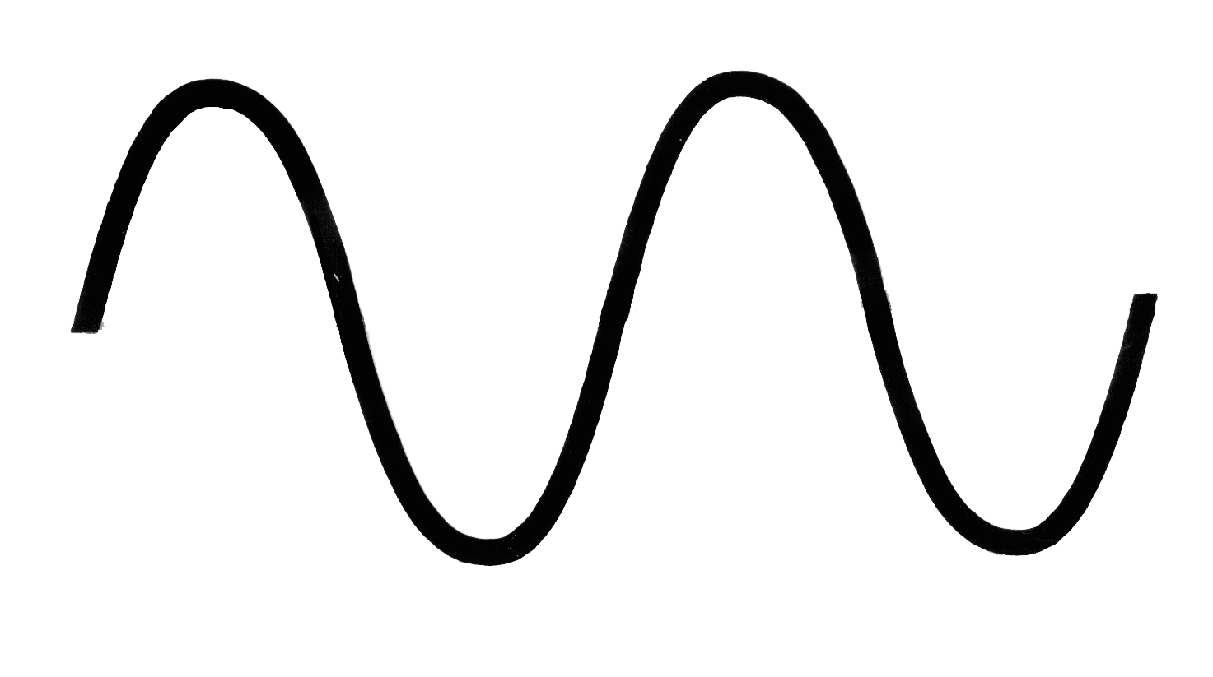

Construction
H0 + V
  $E_{n,l}=\frac{\left(l+\frac{1}{2}\right)(\sqrt{p_{n}mω^{2}}+m^{2}+p_{n}^{2}}{2p_{n}}$
Calculating V:
$\left\langle ψ′ | V | ψ\right\rangle$
$$\int_{0}^{∞}{\int_{−L}^{L}{rψ_{n,l}^{∗}\frac{1}{2}mω^{2}z^{2}ψ_{n,l}dzdr}}$$
2L
Notes:
Just to provide context again. Why did I need to construct a Hamiltonian matrix? This comes from looking at the Schrodinger equation as an eigenvalue problem. Ultimately, we want to find the energy values for which the wavefunction does not depend on time. Since the approximation method used breaks the Hamiltonian into two separate parts, the Hamiltonian matrix is going to be the sum of two separate matrices: one for H0 and one for the potential, V. The matrix for H0 is not too difficult to construct. An analytic solution for the radial component of the wavefunction does exist when H0 is used in the Schrodinger equation. Therefore, it will consist of the energy eigenvalues of the Schrodinger equation for H0 going down the diagonal with the rest of the elements being zero. The expression here gives the formula for those values demonstrating their dependence on two integer values: n and l.
The potential matrix, V, takes a little more effort to construct. We need to construct a potential matrix using the same wavefunction as the basis. The potential matrix is most likely not going to be diagonal, so I had to calculate these integrals for every single matrix element however far out I wanted to go. However big I wanted this matrix to be. This is something important to note about the approximation method being used. For a wavefunction found analytically, the Hamiltonian matrix would be infinite. Since we are approximating the Hamiltonian matrix of this system, we don’t have a general formula for the matrix elements, so it’s going to be finite for however far out I calculate it., and in this case it also has a dependence on the value L which confines the wavefunction along the z-axis. Here I have a picture to help visualize what’s going on. For a wavefunction found analytically, it would go to zero as z goes to negative and positive infinity. Since this approximation method confines the wavefunction along the z-axis, we are forcing it go to zero at negative and positive values L. The next slide shows what the summation of H0 and V looks like.
$$, p_{n}=\frac{\left(2n+1\right)π}{2L}$$

Slide 16
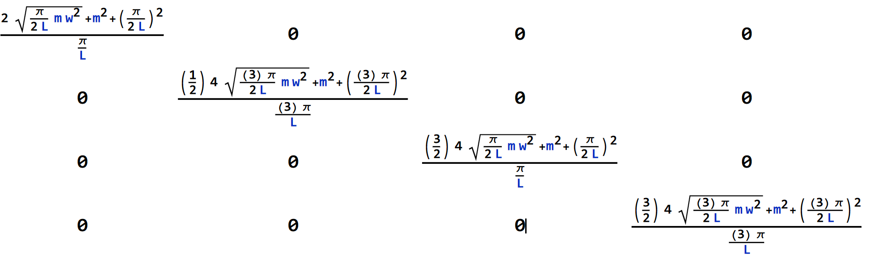
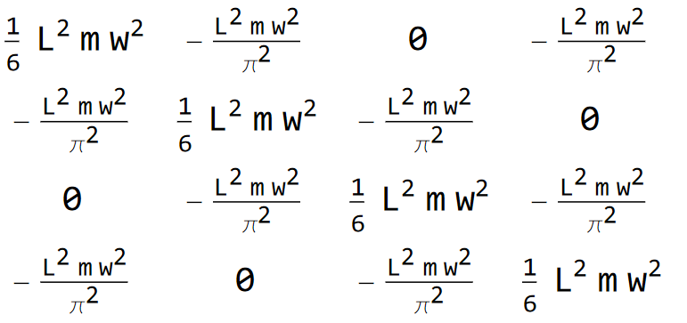
Hamiltonian Matrix
H0
V
Notes:
Here are the 4 by 4 versions of the H0 and V matrices. For H0, we see the energy eigenvalues down the diagonal, and the potential matrix consists of one sixth L-squared m omega-squared down the diagonal with various off-diagonal values. To find the energy eigenvalues of the combined Hamiltonian, we would have to diagonalize the sum of these two matrices. Using my personal laptop, I could do this symbolically for the 4x4 and 9x9 cases. I would need to put in more time to study Hamiltonian matrices with larger dimensions.

Slide 17
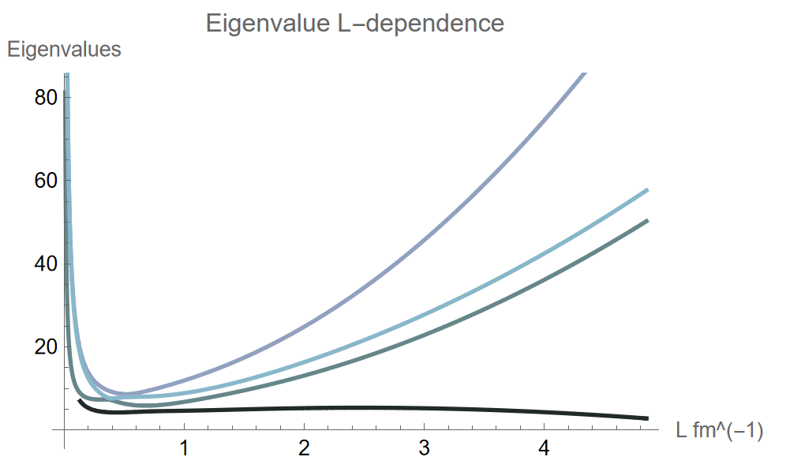
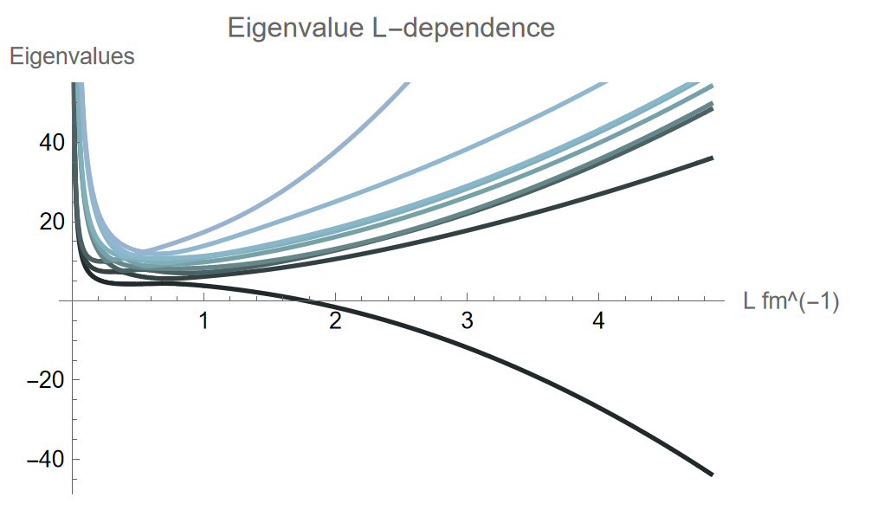
L-Dependence
4x4:
Approximation to the actual wavefunction.
Eigenvalue approximations break down for large or small values L.
Increasing Hamiltonian matrix size leads to better approximations.
9x9:
Notes:
May be more illuminating ultimately to overlay 4x4 ground state and 9x9 ground state.
In diagonalizing both the 4x4 and 9x9 Hamiltonian matrices, we found that they both contained a dependence on L-squared and this would most likely continue for larger matrix dimensions. L was an arbitrary length scale value we introduced with which to integrate over the z-axis confining the wavefunction. Therefore, for large or small values L, the energy eigenvalue approximations will break down which we can see in the graphs on this slide. These graphs portray the eigenvalues on the y-axis and the value L on the x-axis. The darkest color is the ground state eigenvalue while lighter colors go towards higher eigenvalues. We can see for both the 4x4 and 9x9 Hamiltonian matrices That eigenvalues above the ground state go off towards infinity for large values L. Interestingly, the ground state eigenvalue, the darkest color goes towards negative infinity for large values L. As the Hamiltonian matrix dimensions increase, we get closer to the actual Hamiltonian of this system, so I would be interested in looking into this dependence on L for larger matrix dimensions to see how these trends develop.

Slide 18
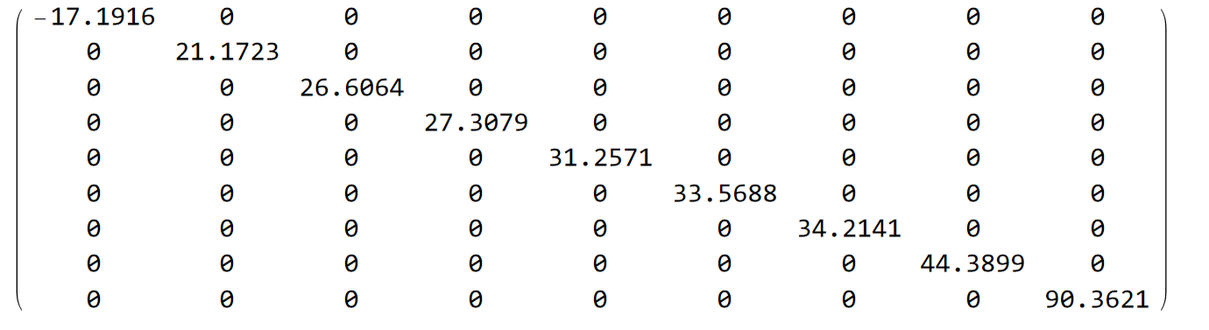
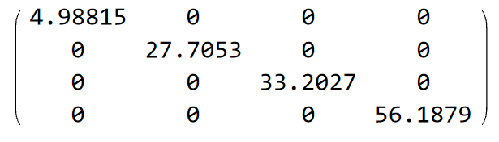
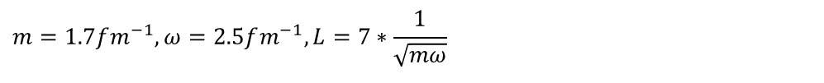
Hamiltonian Matrix
$$m=1.7fm^{−1}, ω=2.5fm^{−1}, L=7∗\frac{1}{\sqrt{mω}}$$
4x4: 9x9:
Interested in seeing how these values develop for increasing matrix size.
Notes:
Substituting in appropriate values for the mass, angular frequency, and length scale, we can achieve approximate numerical values for the energy eigenvalues. For the mass, I used 1.7 femtometers, for the angular frequency, 2.5 femtometers, and for the length scale, about 7 times one over the square root of m times omega. These are values commonly used at the scale of nuclear physics research. These matrices are the diagonalized 4x4 and 9x9 Hamiltonian matrices. Again, I would be interested in seeing how these values develop for increasing matrix size.

Slide 19
Conclusion and Next Steps
Compute larger Hamiltonian matrices to track trend of L-dependence and eigenvalues.
Apply tilted coordinates to other potentials and boundary conditions.
Notes:
In conclusion, I calculated an approximate wavefunction for this system from which I could start generating approximate Hamiltonian matrices and eigenvalues. If we can notice a trend in the eigenvalues, that could point us toward the actual wavefunction solution for the light front quantum harmonic oscillator in tilted coordinates. That’s why some good next steps for this project would be to compute larger Hamiltonian matrices to track the eigenvalue dependence on L.
This project proved to be a little more complicated than originally thought. Say, if I could find an analytical solution for the wavefunction right off the bat, then I could try applying tilted coordinates to other potentials and boundary conditions of the Schrodinger equation to study the properties of tilted coordinates further. So, after finishing the study of tilted coordinates applied to the quantum harmonic oscillator, next steps would be to explore other potentials as well.

Slide 20




Acknowledgements
Thank you to Dr. Gerald Miller and Dr. Adam Freese for taking me on this summer!
Thank you to the University of Washington Physics Department and the Institute for Nuclear Theory for hosting this REU.
Thank you to the National Science Foundation for sponsoring this REU.
Notes:
Thank you for your time.

Slide 21
References
[1] Freese, A., & Miller, G. A. (2023). Light front synchronization and rest frame densities of the proton: Electromagnetic densities. Phys. Rev. D, 107(7), 074036. https://doi.org/10.1103/PhysRevD.107.074036

