Slide 1
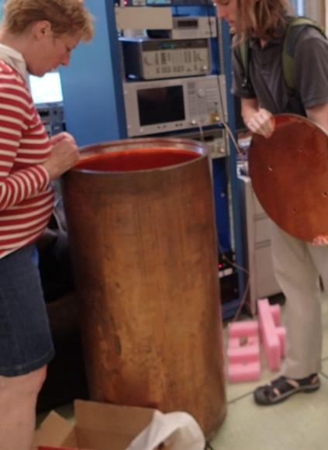
Microwave Cavity Structures for an Axion Search
R.E.U. Presentation
August 13, 2012
Hunter Swan

Slide 2
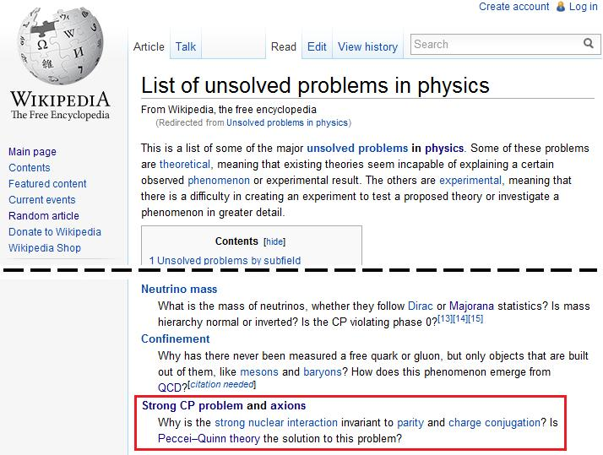
Meet Axion
γ
Strong CP Problem: Why is QCD not CP violating?
L_{QCD} = θ(E · B) + (other stuff)
a
Why is this parameter ≈ 0?
Peccei & Quinn (1977):
Promote θ to a field
As a field, θ tries to minimize itself to 0
Axions grow out of the new field
Axions with appropriate mass make possible dark matter candidate
γ

Slide 3
ADMX: Axion Dark Matter eXperiment
Sikivie Axion Detector:
Axions can interact with a strong B field to produce photons
If the cavity has the right shape, the photons interfere constructively, producing an appreciable electric field
“Right Shape” means:
  Mode frequencies near axion frequencies
  High “form factor” (roughly, ∫ E ⋅B dV is big)
a
B

Slide 4
A “Fine Tuning Problem”
Tuning the cavity’s modes is critical, since the axion mass is unknown
To tune the frequency upwards, copper tuning rods are used
To tune frequency down, use dielectric rods instead of copper
  Can hurt form factor
  Dielectrics lossy, expensive

Slide 5
Idea: Slow Wave Analogy
γ
γ
“Slow wave structures” used widely in waveguides to accommodate longer wavelengths
  Works for TE modes, not TM
Inspiration: add “slow wave structure” to cavity end plates

Slide 6
Before
After
&
E
E

Slide 7
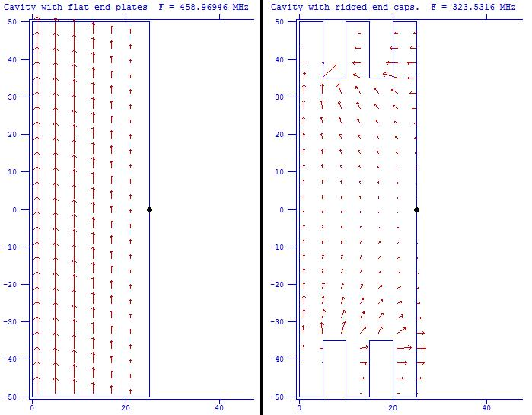
Poisson/Superfish
“My Hero”
Program to model cylindrically symmetric cavities
  Finds frequencies and field patterns of cavity modes

Slide 8
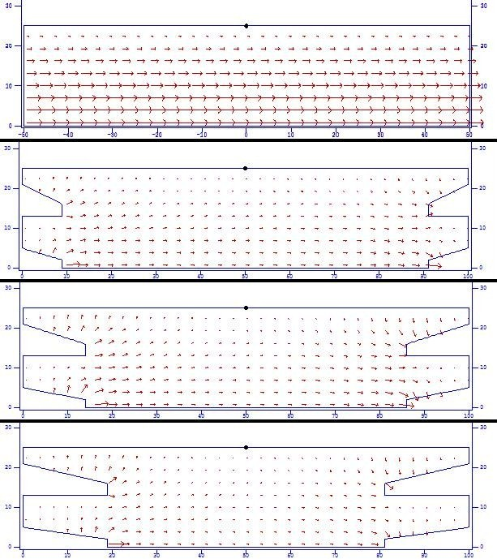
Superfish Predicts Success

Slide 9
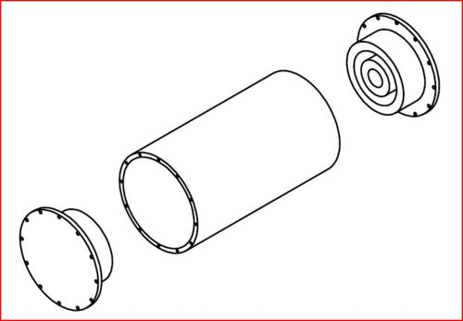
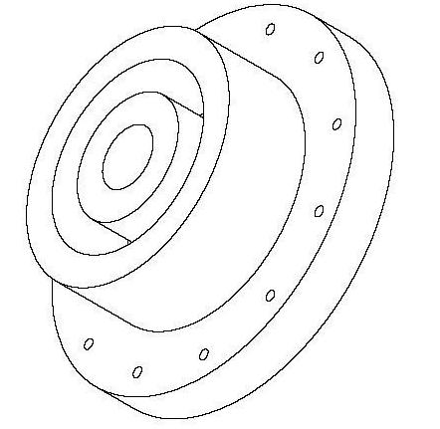
Factoring in the Form Factor
Form factor depended more strongly on ridge configuration than did the frequency
Led to choosing the geometric configuration shown for further testing

Slide 10
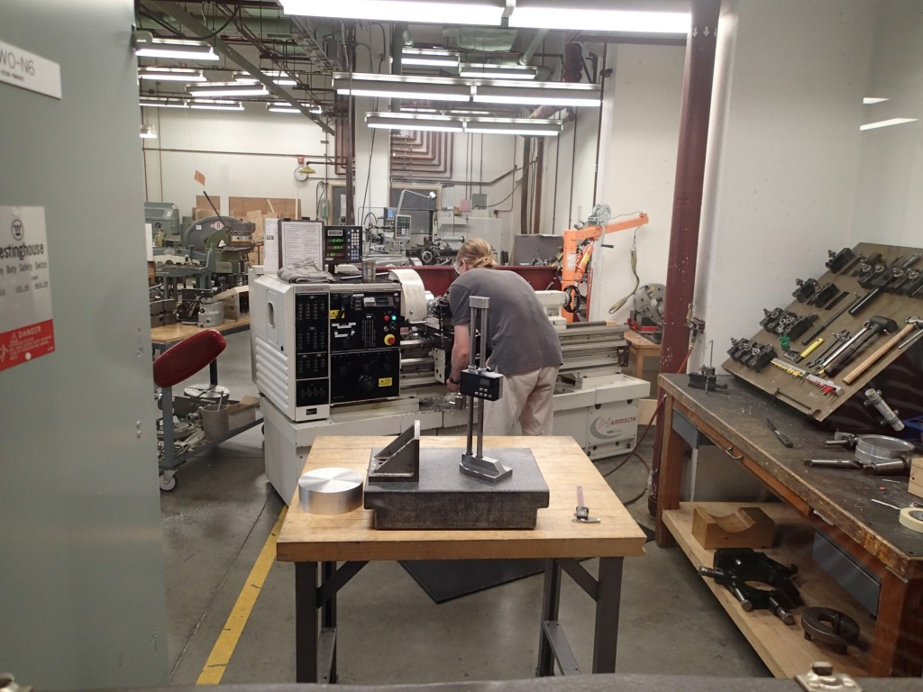

Slide 11
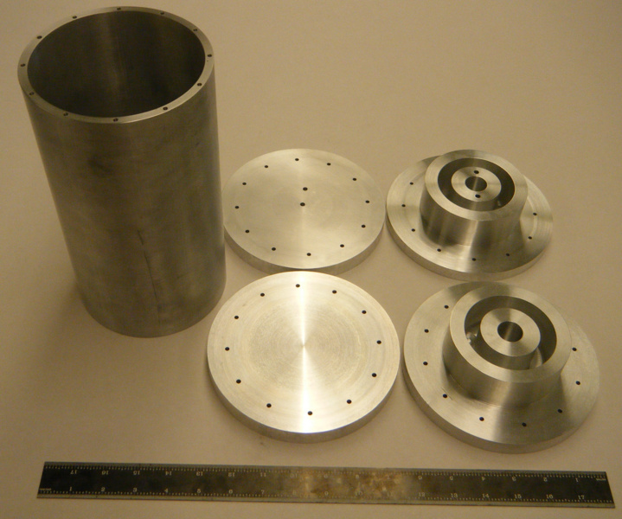

Slide 12
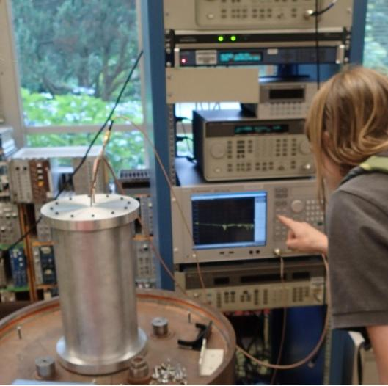
Instructions: Insert antennas into microwave cavity for 30 seconds, or until done.
Network
Analyzer
Log|V_{in}/V_{out}|
(Transmission)
V_{in}
V_{out}
Antenna Probes
γ

Slide 13
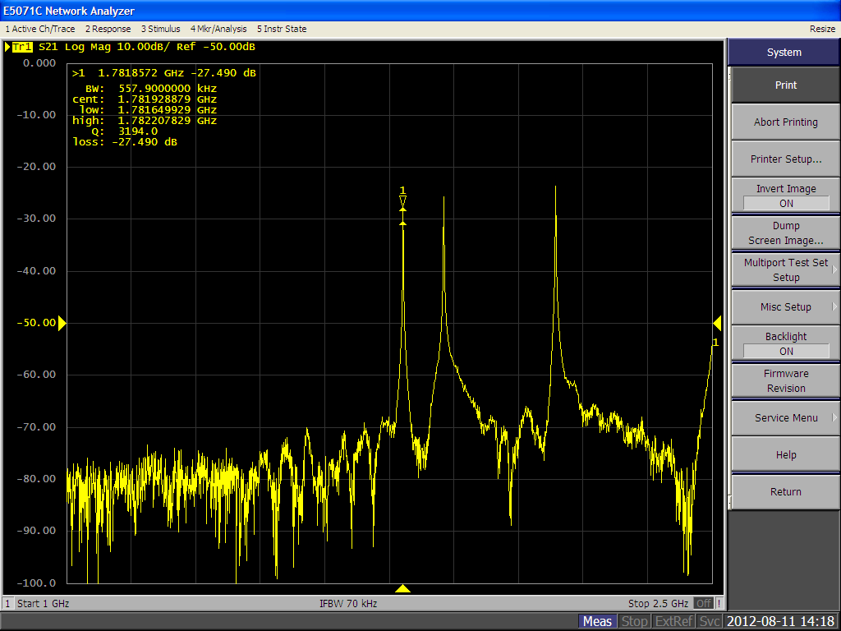
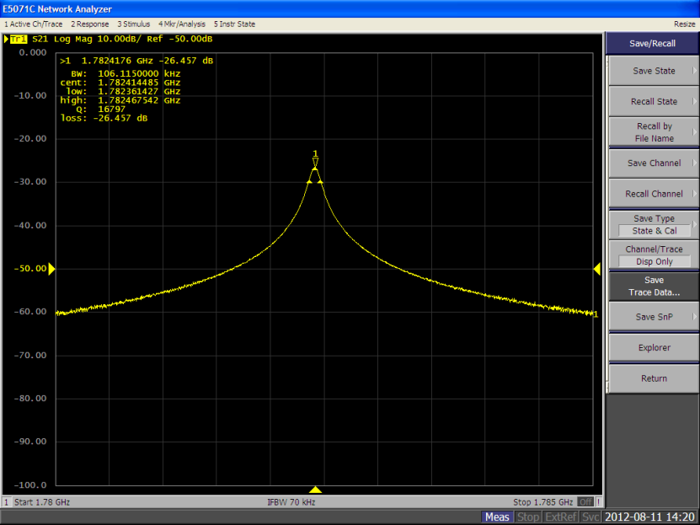
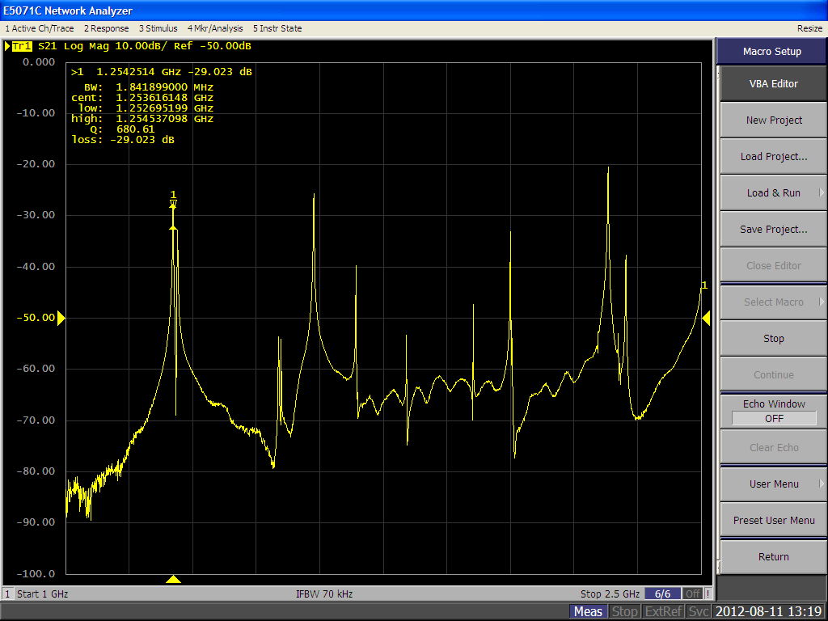
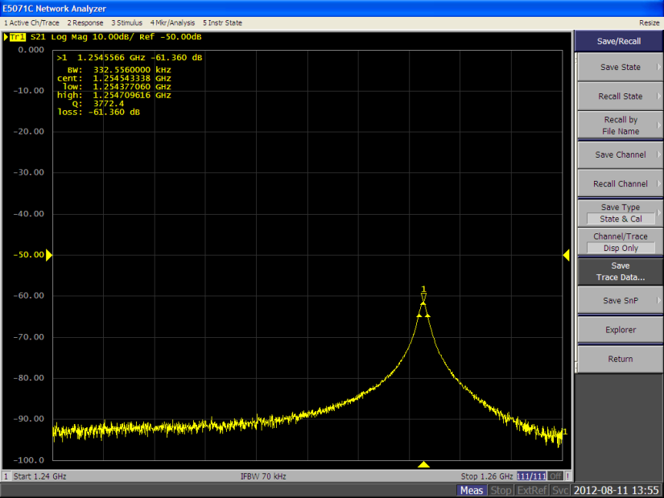

Slide 15
Q: What is the Q?
A: ≈ 17000 (flat end plates); ≈ 3600 (with ridges)
  Quality factor is of expected magnitude
f
Q = f/Δf ≈ 17000
Δf

Slide 16
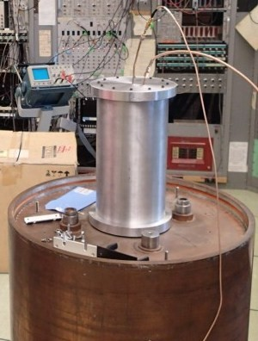
Results
Frequency shift
Form factor
Q
Success

Slide 17
Cavity of the Future
Many more geometries worth investigating
  Frequency, form factor should be optimized
Incorporate into ADMX?

Slide 18
Thanks
Professor Rosenberg, Gray Rybka, Andrew Wagner, Christian Boutan, & Dima Lyapustin—the ADMX fellows.
Deep Gupta, Alejandro Garcia, Janine Nemerever, & Linda Vilett—the REU folks.
Emma, Becca, Emily, Rachel, Eli, Jarrett, & Scott—they’re cool people.
God—your great, and you got me through this presentation.

Slide 19
Disclaimer
The opinions expressed in this presentation are solely the work of those presenting them and do not necessarily reflect the views of ADMX or any of its collaborators, funding agencies, or affiliates. ADMX is not liable for any damage, injury, or ill will that may come about as a result of this presentation or any material contained therein.

