Slide 1
Solid State Spins for Quantum Computation
Emma Lorenzen
Knox College
UW INT REU Program
Advisor: Kai-Mei Fu

Slide 2
Goal: Use optical pumping to control electronic spin states in InP
- Need to test whether this is possible and if so how long does stay in the pumped state.
Uses: Quantum Computing

Slide 3
Indium Phosphide:
III-V semiconductor
Group IV impurity
At room temperatures the electrons are free to move
At low temperatures (~4K) the electrons are bound to the impurity

Slide 4
Excitons:
$$−$$
Electron–hole pair
Hydrogen like
Excited states
Free excitons: can move freely
Bound excitons are bound to a donor atom
$$+$$
Free exciton
$$−$$
$$+$$
$$+$$
$$−$$
Bound exciton

Slide 5
Experiment
Excite electrons and holes into an exciton state by shining laser light on the sample while at cold temperatures
Collect the light that is emitted as the hole and electron recombine
By controlling the polarization of the light we can manipulate the spins of the electrons that we are exciting

Slide 6
Polarization Rules:
Ground state of exciton bound to neutral donor
$$−{ 3}/2$$
$$−{ 1}/2$$
$$+1/2$$
$$+{ 3}/2$$
$$σ^{−}$$
$$σ^{−}$$
$$σ^{+}$$
$$σ^{+}$$
$$π$$
$$π$$
Ground state of electron weakly bound to neutral donor
$$−{ 1}/2$$
$$+1/2$$

Slide 7
Optical Pumping:
$$−{ 3}/2$$
$$−{ 1}/2$$
$$+1/2$$
$$+{ 3}/2$$
$$σ^{+}$$
$$σ^{+}$$
$$−{ 1}/2$$
$$+1/2$$

Slide 8
Optical Pumping:
$$−{ 3}/2$$
$$−{ 1}/2$$
$$+1/2$$
$$+{ 3}/2$$
$$σ^{+}$$
$$σ^{+}$$
$$−{ 1}/2$$
$$+1/2$$

Slide 9
Optical Pumping:
$$−{ 3}/2$$
$$−{ 1}/2$$
$$+1/2$$
$$+{ 3}/2$$
$$σ^{+}$$
$$σ^{+}$$
$$π$$
$$−{ 1}/2$$
$$+1/2$$

Slide 10
Optical Pumping:
$$−{ 3}/2$$
$$−{ 1}/2$$
$$+1/2$$
$$+{ 3}/2$$
$$−{ 1}/2$$
$$+1/2$$

Slide 11
Optical Pumping:
$$−{ 3}/2$$
$$−{ 1}/2$$
$$+1/2$$
$$+{ 3}/2$$
$$σ^{+}$$
$$σ^{+}$$
$$π$$
$$−{ 1}/2$$
$$+1/2$$

Slide 12
Optical Pumping:
$$−{ 3}/2$$
$$−{ 1}/2$$
$$+1/2$$
$$+{ 3}/2$$
$$σ^{+}$$
$$σ^{+}$$
$$π$$
$$−{ 1}/2$$
$$+1/2$$
Notes:
Some relax down

Slide 13
Optical Pumping:
$$−{ 3}/2$$
$$−{ 1}/2$$
$$+1/2$$
$$+{ 3}/2$$
$$σ^{+}$$
$$σ^{+}$$
$$−{ 1}/2$$
$$+1/2$$

Slide 14
Optical Pumping:
$$−{ 3}/2$$
$$−{ 1}/2$$
$$+1/2$$
$$+{ 3}/2$$
$$σ^{+}$$
$$σ^{+}$$
$$−{ 1}/2$$
$$+1/2$$

Slide 15
Optical Pumping:
$$−{ 3}/2$$
$$−{ 1}/2$$
$$+1/2$$
$$+{ 3}/2$$
$$σ^{−}$$
$$σ^{−}$$
$$σ^{+}$$
$$σ^{+}$$
$$π$$
$$π$$
$$−{ 1}/2$$
$$+1/2$$

Slide 16
Set Up:

Slide 17
Setting Up an Optics Table:
Linear polarizer
Quarter wave plate
Mirror
Lens
Cryostat

Slide 18
Data Collection:
Cool down the sample to about 4K
Shine laser at sample
Put in polarization optics and measure relative peak intensities

Slide 19
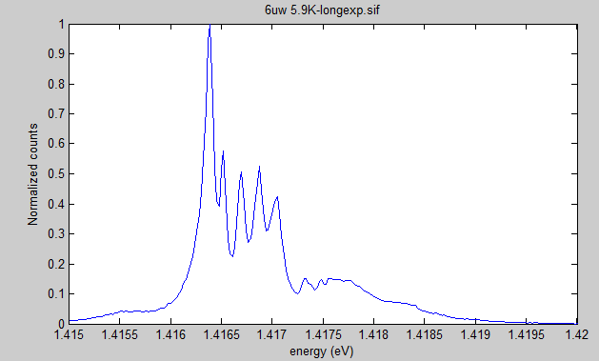
Results so far:

Slide 20
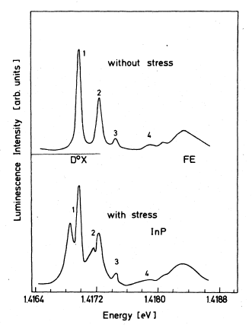
There are extra lines than expected from the literature
5 vs. 3
One explanation is that these come from strain splitting
W Ruhle, W. Klingenstein, PRB 18, 7011 (1978)

Slide 21
What’s next:
Find the cause of all of the peaks
Determine whether optical pumping is possible by seeing whether the spin relaxation rate is long or fast compared to emission rate
Find spin relaxation rate

Slide 22
Acknowledgements:
Kai-Mei Fu
Deep Gupta and Alejandro Garcia
Linda Vilette and Janine Nemerever
Everyone in the Fu Lab
Becca, Rachel, Emily, Hunter, Scott, Eli, and Jarrett
NSF for funding

