Slide 1
Effects of Strain on Vanadium Dioxide Nanobeams
Eli Bingham
University of North Carolina
UW REU 2012
Advisor: David Cobden

Slide 2
Overview of VO₂
Strongly correlated
Band theory breaks down when electrons interact
Metal-insulator transition
Dramatic (4 orders of magnitude)
Ultrafast (~100fs)
Near room T (bulk Tc = 68C)
Applications
Ultrafast optical shutters
Mott transistor
Model system for other strongly correlated materials

Slide 4
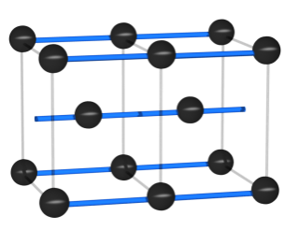
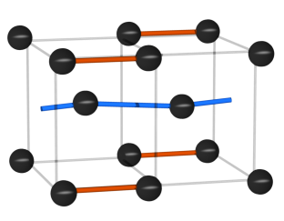
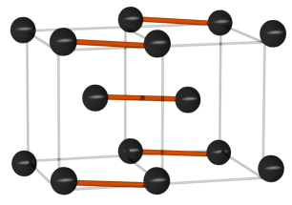
Structure (V atoms only)
R (metallic)
M1 (insulator)
M2 (insulator)
c-axis
a
1.011 a
1.016 a
Notes:
VO2 has been noted for the proximity of its transition temperature to the room temperature, at which the conductivity changes by more than four orders of magnitude. The transition also involves structural change from high temperature rutile to low temperature monoclinic. After some time, it was found that there was more than one insulating phase, namely M2. The key thing to note here is the different lattice constant along the rutile c-axis of the different phases. M1 is about a percent longer than the rutile and M2 about 1.6 percent.

Slide 5
Why nanowires?
Single domains
Simple nucleation
Precise control of strain
Durable

Slide 6
Phase diagram
Not well understood
Main tools: X-ray diffraction, Raman spectroscopy
Triple point location unknown – difficult to pinpoint in bulk
Very close to bulk T_{c} and zero strain, but not equal
Mysterious hysteresis in cooling
Role of doping?
Triclinic: phase or mixture?

Slide 7
Fixed length L
M
High elastic cost
R
R
M
Changing L
R
M
R
M
Δx
ΔL
Notes:
Unlike a VO2 beam that is free, a VO2 beam suspended this way does not turn metallic instantly. Instead it shows coexistence. Remember that the rutile phase is shorter than the monoclinic. If the whole domain changed to the rutile while preserving the length, it would be under very high tensile strain. Instead the system settles by going into coexistence at the cost of interphase boundary creation.
Now sitting at the coexistence, what happens if you change the length of the whole system? At the phase boundary, change in the strain along the beam is compensated by introconversion of the two phases with different lattice constants.

Slide 8
Fabrication
SiO2-Si wafers
Gold contacts placed via photolithography
20 or 40 micron gap etched away
Wire placed across gap with nanomanipulator
Indium contacts from wire to gold
Fix with epoxy
UVC? UVC + heat cure? TEOS? FIB?

Slide 11
Experimental setup

Slide 12
Measurements
Interphase boundary position vs laser position
Isobaric
Isothermal
Holding constant boundary position
Electrical transport (R-T)
Notes:
One of the first groups to see M1-M2 boundary optically

Slide 13
Constant x

Slide 17
Results (preliminary)
Data support triple point below bulk Tc
Ratios of boundary position-laser position slopes allow calculation of relative lattice constants
Direct measurement of undoped phase diagram promising but inconclusive
More/better data needed

Slide 18
Aluminum Doping
How to stabilize M2 phase at room temperature?
Effects of doping on phase diagram?
Poorly documented in literature
Focus on lowering Tc for smart windows (W)
Al doping mainly studied in bulk crystals
Region of interest entirely compressive

Slide 19
Al-doped VO2

Slide 20
Future work
Improved devices
New transfer technique, no indium or epoxy
Improved strain setup
New laser/piezo, integrate Raman into setup
Strain-free devices
Strain other materials
Graphene, MoSe2, MoS2, BN
Tunneling spectroscopy of VO2
Ultrafast pump-probe measurement of MIT on various substrates

