Slide 1
Analysis of Alpha Background in SNO Data Using Wavelet Analysis
Jarrett Moon

Slide 2
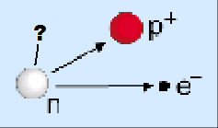
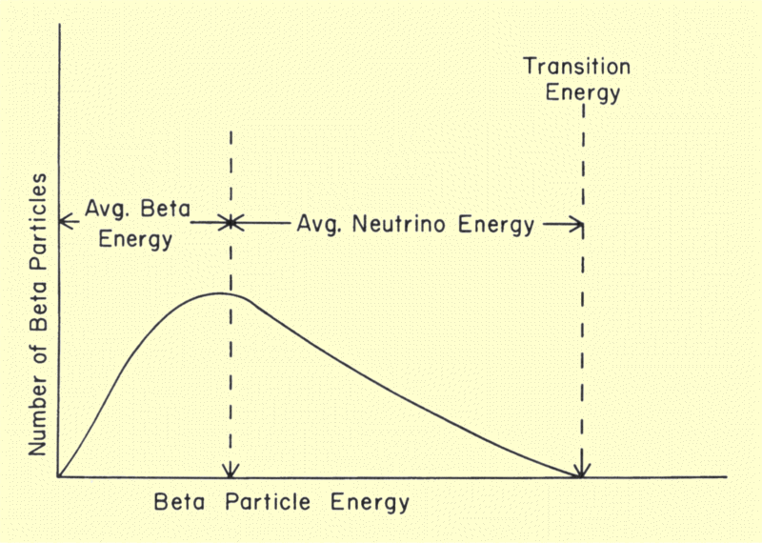
History of Neutrino Detection
Since the 1930’s experiments with beta decay had implied the existence of an unknown subatomic particle
The predicted particle would be charge neutral, and nearly massless
The predicted particle, named the electron anti-neutrino, would interact only via gravity and the weak force

Slide 3
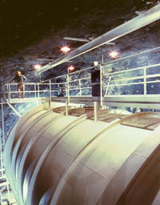
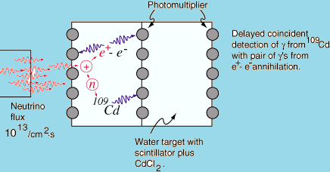
First Attempt at Neutrino Detection
The predicted electron anti-neutrino would interact with a proton via inverse beta decay
Clyde Cowan and Frederick Reines designed an experiment to detect gammas resulting from positron-electron annihilation
Results were inconclusive so they added additional detectors to observe the neutrons as well

Slide 4
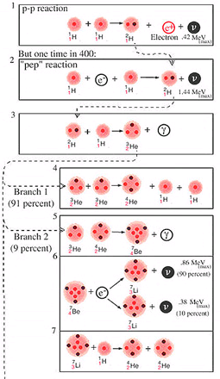
Solar Neutrinos
Modern models of the sun predict several sources of neutrinos
Measuring the flux of solar neutrinos can give confirmation of these solar models
Solar neutrinos are produced in the proton-proton reaction, the proton-electron-proton reaction, and from the decay of several radioactive isotopes
Starting in the 1960’s several solar neutrino detectors were built including the Homestake Experiment, Super-Kamiokande, and the Sudbury Neutrino Observatory

Slide 5
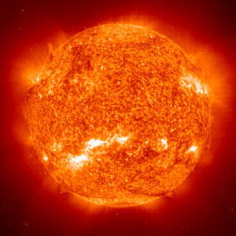
Solar Neutrino Problem
Starting with the Homestake experiment in the 1960s, a discrepancy was measured between predicted and measured neutrino flux
Further experiments confirmed Homestake’s results and consistently observed approximately a third as many solar neutrinos as predicted
Attempts to modify solar models failed, pointing the way toward a modification of our understanding of neutrinos

Slide 6
Neutrino Oscillation
Neutrino oscillation is the phenomenon where a neutrino created with a certain flavor (i.e. electron, tau, or muon) can be measured to have a different flavor
Neutrinos created in the sun as electron neutrinos travel to earth and can change flavors
Experimentally verifying the oscillation theory would not only solve the solar neutrino problem, but would have implications for the standard model as neutrino oscillation requires neutrinos to be massive particles

Slide 7
Introduction to SNO
SNO (Sudbury Neutrino Observatory) was a neutrino observatory located ~2km underground in an old mine in Canada
In order to measure the total solar flux, SNO needed to be sensitive to all flavors of neutrinos
The detector consisted of a large acrylic sphere 12 meters across filled with 1000 metric tons of heavy water
The sphere was surrounded by normal water for buoyancy and radiation shielding purposes, as well as by an array of detectors

Slide 8
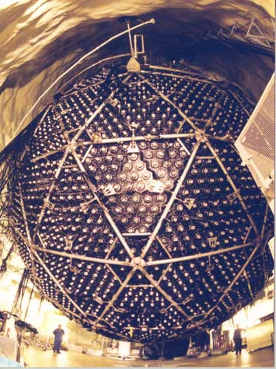
Neutrino Interactions in the Detector
Neutrino interaction with a deuteron was of particular interest as this reaction is equally likely for all three neutrino flavors
Neutrinos passing through the detector can interact with a deuteron as follows
An array of 36 proportional counters were placed inside the sphere to detect the resulting neutron

Slide 9
Background Problem
The neutral current detected ionization caused by charged particles, so they were sensitive to alphas as well as neutrons
All alpha events were background since they came from radioisotopes in the counters rather than a neutrino event
Looking at the voltage vs. time “waveforms” we can try to establish a cut between the two.
Previous methods used cuts which successfully eliminated 98% of alpha events while retaining 74.78% of neutron events

Slide 10
Overview of Wavelet Analysis Method
Our method tried to improve on the previously used cut by employing wavelet analysis of the waveforms
Wavelet transform was used to de-noise the waveforms
The waveforms were then integrated over the signal region
The integrated waveforms were then compared

Slide 11
Process
A waveform was taken from the SNO ROOT data and then de-noised using a Python wavelet analysis package
The initial waveforms were logged and so they were de-noised twice, once on the logged waveform, and then again on the de-logged waveform

Slide 12
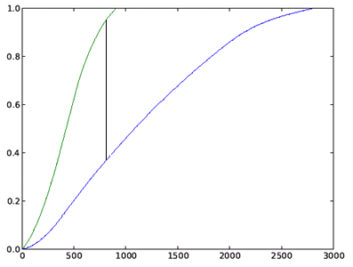
Process cont.
The de-noised waveforms were then integrated over the signal region
This was done by selecting a threshold to define the signal region. The integration was triggered for all values between the first and last signal point past this threshold.
The maximum difference between two integrals was calculated and used as a measure of how different two waveforms were

Slide 13
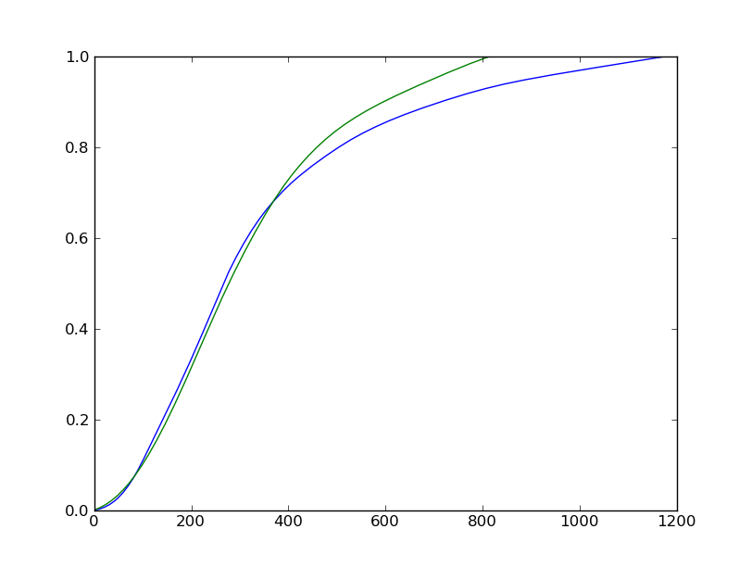
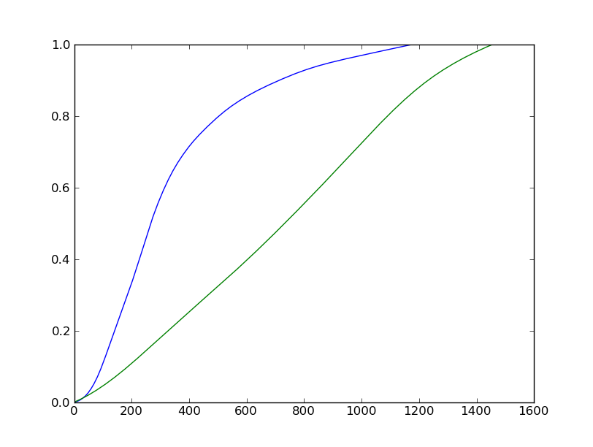
Example Waveform Comparisons

Slide 14
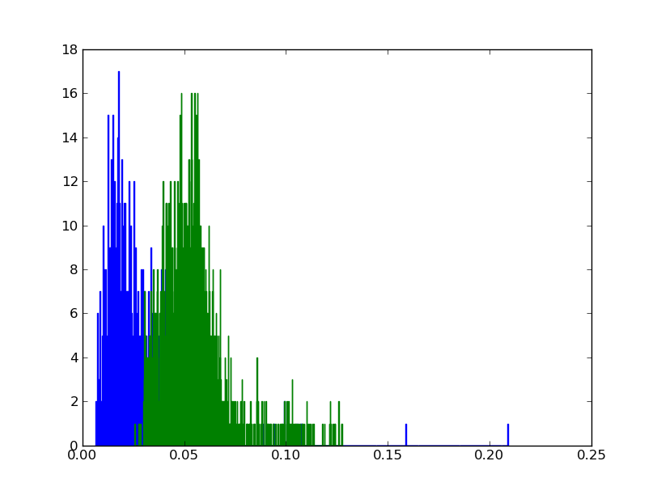
Application to Neutron and Alpha Waveforms
This method was then applied to a sample of neutron and alpha waveforms
The integrals of each waveform were calculated and for each alpha waveform the difference from the nearest neutron match identified

Slide 15
Making the Neutron-Alpha Cut
Using a large collection of waveforms we looked through the neutron waveforms and eliminated those which are a very close match to an alpha waveform
This was repeated until there is little to no overlap between the neutron and alpha waveforms
We next have to determine if this method has been more effective by comparing the neutron-retention/alpha-elimination percentages to those obtained by previous methods

Slide 16
Further Work
We still need to find the optimal combination of thresholds
We need to use larger neutron and alpha libraries to see if the results vary
Once the method has been optimized, we can compare the cuts we made to previous methods

Slide 17
Acknowledgements
Dr Tolich
Dr Gupta
Dr Garcia
Janine
Linda

