Slide 1
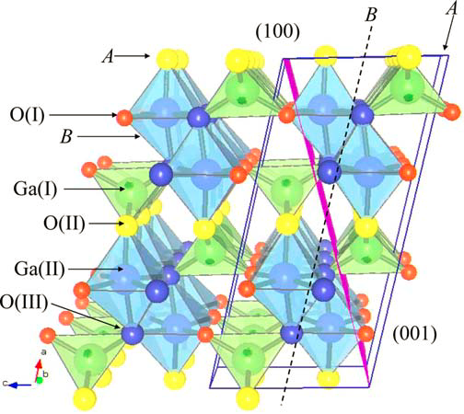
Characterization of Ga₂O₃ Single Crystal and Thin Films
Emily Hommerding
August 13, 2012
NSF REU
Bermudez, V.m. "The Structure of Low-index Surfaces of β-Ga2O3." Chemical Physics323.2-3 (2006): 193-203.

Slide 2
Ga₂O₃
Anisotropic
Unique in that it is transparent, yet conducting
Conductivity and transparency are related to the dielectric constant
Dielectric constant not yet determined
Bermudez, V.m. "The Structure of Low-index Surfaces of β-Ga2O3." Chemical Physics323.2-3 (2006): 193-203.

Slide 3
XPS : X-Ray Photoelectron Spectroscopy
A sample is put in UHV
Cylindrical Hemispherical Analyzer
Incoming x-rays hit the sample
X-rays
Electrons leave the sample
$$e^{−}$$
Electron’s KE is measured by the CHA
Ar Sputter Gun
Argon ions can sputter the sample
Sample in UHV

Slide 4
Generation of a Photoelectron
hν
Vacuum
Conduction Band
EFermi
Valence Band
2p
2s
1s

Slide 5
Conservation of Energy Equation for XPS
$$E_{binding}=E_{photon}−E_{kinetic}−∅$$
Energy of the incoming x-ray
(k-α of Al)
Work function of the spectrometer used to measure kinetic energy
Binding energy of the electron in an atom on the surface
Kinetic energy of the electron that has been excited from the sample
Fadley, Charles S. "X-ray Photoelectron Spectroscopy: From Origins to Future Directions." Nuclear Instruments and Methods in Physics Research Section A: Accelerators, Spectrometers, Detectors and Associated Equipment 601.1-2 (2009): 8-31.

Slide 6
XPS / Sputtering Application
Sputter Gun
Pd deposited on the surface
$${Single Crystal Ga}_{2}O_{3}$$
The Goal: Gradually sputter away a spot of Pd for a future application

Slide 7
XPS Line Scan of the Sputtered Spot
4
x 10
16
Ga 2p high resolution scan
5
x 10
Survey Scan
14
2.5
12
6
2
10
6
c/s
8
1.5
6
c/s
4
1
2
1
0
0.5
1130
1128
1126
1124
1122
1120
1118
1116
1114
1112
1110
4
Binding Energy (eV)
1
x 10
4
Pd High resolution Scan
0
1000
900
800
700
600
500
400
300
200
100
0
3.5
6
Binding Energy (eV)
3
Pd surface coating
2.5
c/s
2
1
2
3
1.5
4
5
6
1
1
0.5
Sputtered Spot
0
350
348
346
344
342
340
338
336
334
332
330
Binding Energy (eV)

Slide 8
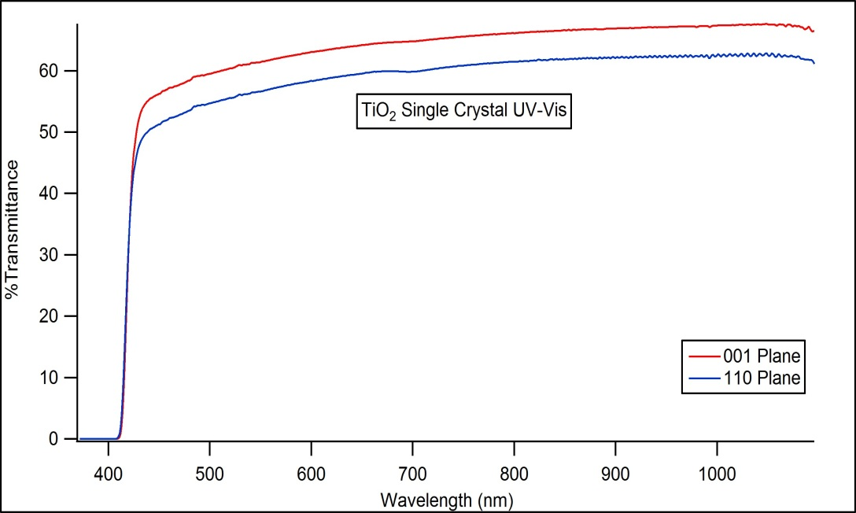
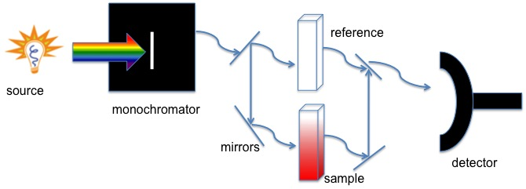
UV Visible Spectroscopy
UV light passes through a sample
A detector lies behind the sample
The percent of light transmitted through the system at a given wavelength is measured and compared with a reference beam
Oliva, Brittany L., and Andrew R. Barron. "Connexions." Connexions. Rice University, 5 June 2010. Web. 27 July 2012. <http://cnx.org/content/m34525/latest/>.

Slide 9
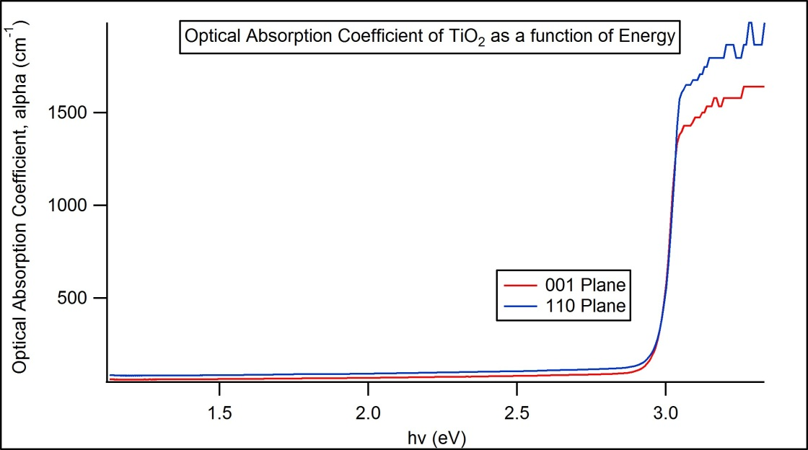
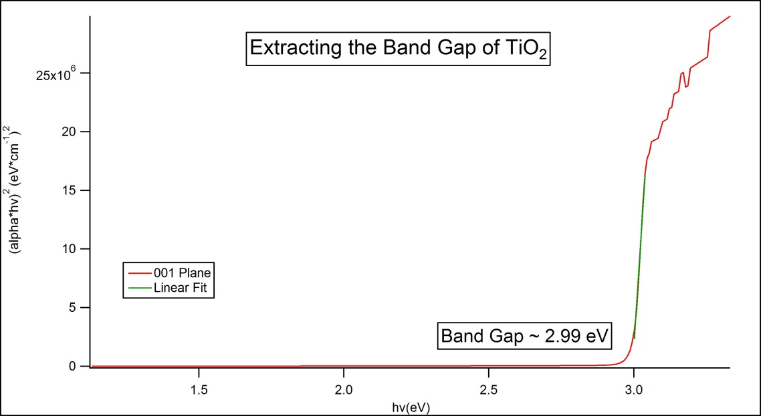
Optical Constants, Band Gap
Optical Absorption Coefficient
Where d is the thickness and
The band gap is related to the optical absorption coefficient in the following way

Slide 10
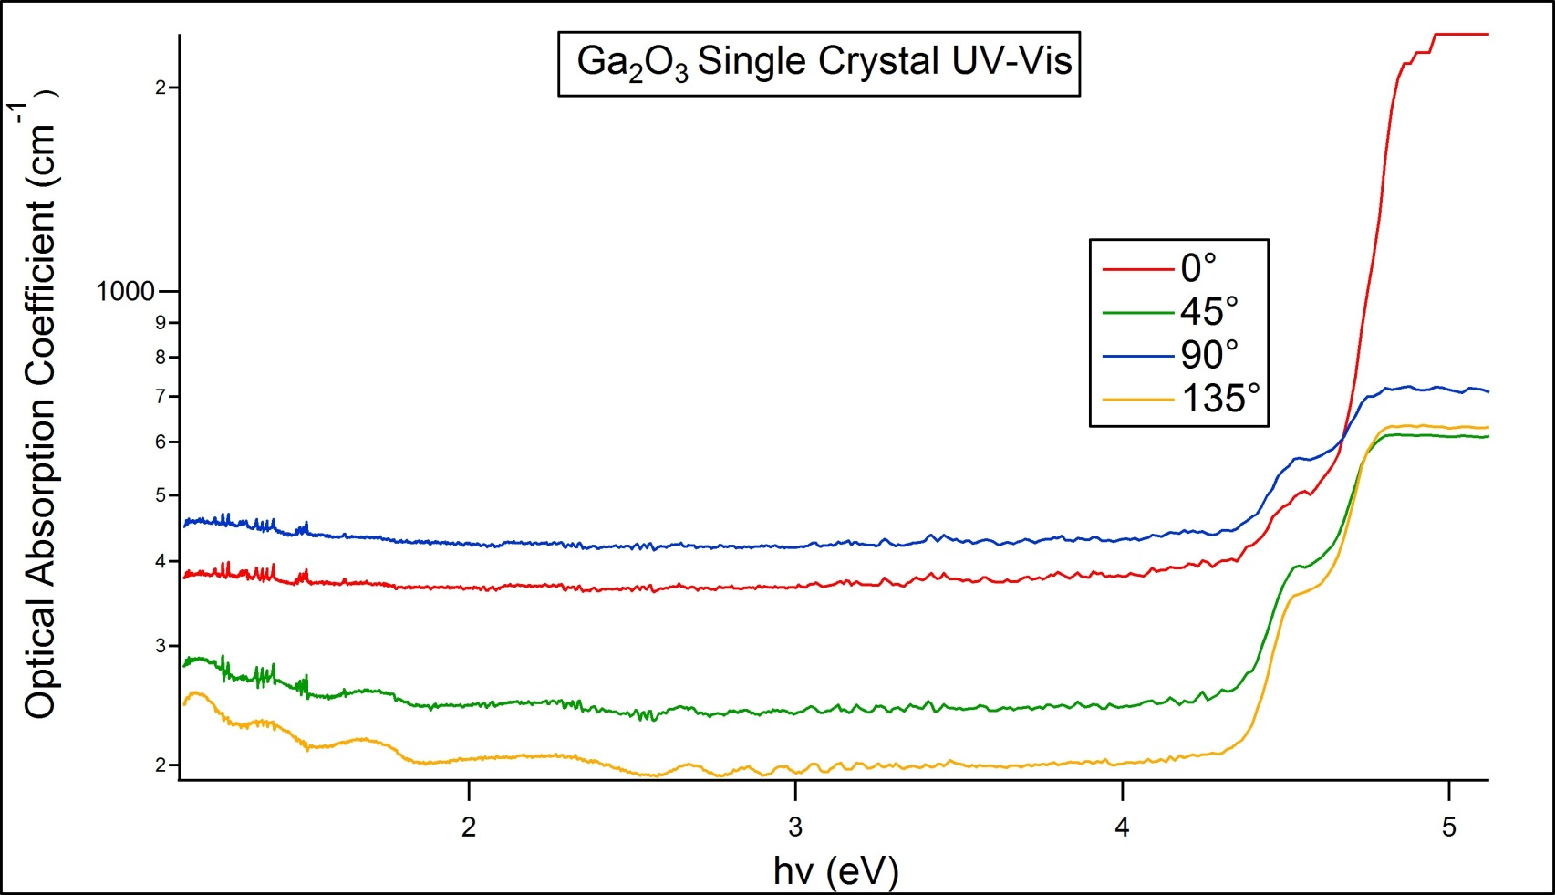
$$Single Crystal \text{Ga}\text{2}\text{O}\text{3}$$
$$UV Visible Spectroscopy$$
00
Rotations of the single crystal produce differing optical properties!

Slide 11
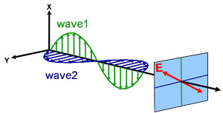
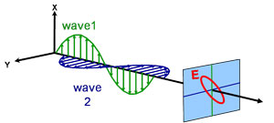
Ellipsometry
Light Source
Incident linearly polarized light of known polarization and amplitude is reflected off the top surface of a sample. Reflected light is elliptically polarized and has a change in amplitude
Detector
Polarizer
Variable angle of incidence
Analyzer
Linearly Polarized Light Incident on Sample
Elliptically Polarized Light Leaves Sample
Sample
"Light & Materials - Part I." Spectroscopic Ellipsometry Tutorial Light and Materials I. J.A. WOOLLAM CO. INC, n.d. Web. 31 July 2012. <http://www.jawoollam.com/tutorial_2.html>.

Slide 12
Optical Properties
Index of Refraction
$$\tilde{n}=n+ik$$
$$v=\frac{c}{n}$$
The phase velocity of light slows down in a material
Dielectric Constant
$$\tilde{ε}=ε_{1}+iε_{2}$$
$$\tilde{ε}={\tilde{n}}^{2}$$
The index of refraction and dielectric constant are related
Optical Absorption Coefficient (again)
$$α=\frac{4πk}{λ}$$
Ellipsometry can be used to determine..
Optical constants
Thickness
Composition
Crystallinity
The optical absorption coefficient is the same as was used to extract band gap information in UV-Visible Spectroscopy

Slide 13
Phase
Amplitude
$$ρ=\tan{ψe^{i∆}=\frac{r_{p}}{r_{s}}}$$
Fresnel Reflectivity Equations
$$θ_{1}$$
$$r_{p}=\frac{n_{1}\cos{θ_{1}−n_{2}\cos{θ_{2}}}}{n_{1}\cos{θ_{1}+n_{2}\cos{θ_{2}}}}$$
Reflected parallel
$$θ_{2}$$
Reflected perpendicular
$$r_{s}=\frac{n_{2}cos{θ_{1}−n_{1}\cos{θ_{2}}}}{n_{1}\cos{θ_{2}+n_{2}\cos{θ_{1}}}}$$
An electric field parallel to the plane of incidence is p-polarized, and perpendicular is s-polarized

Slide 14
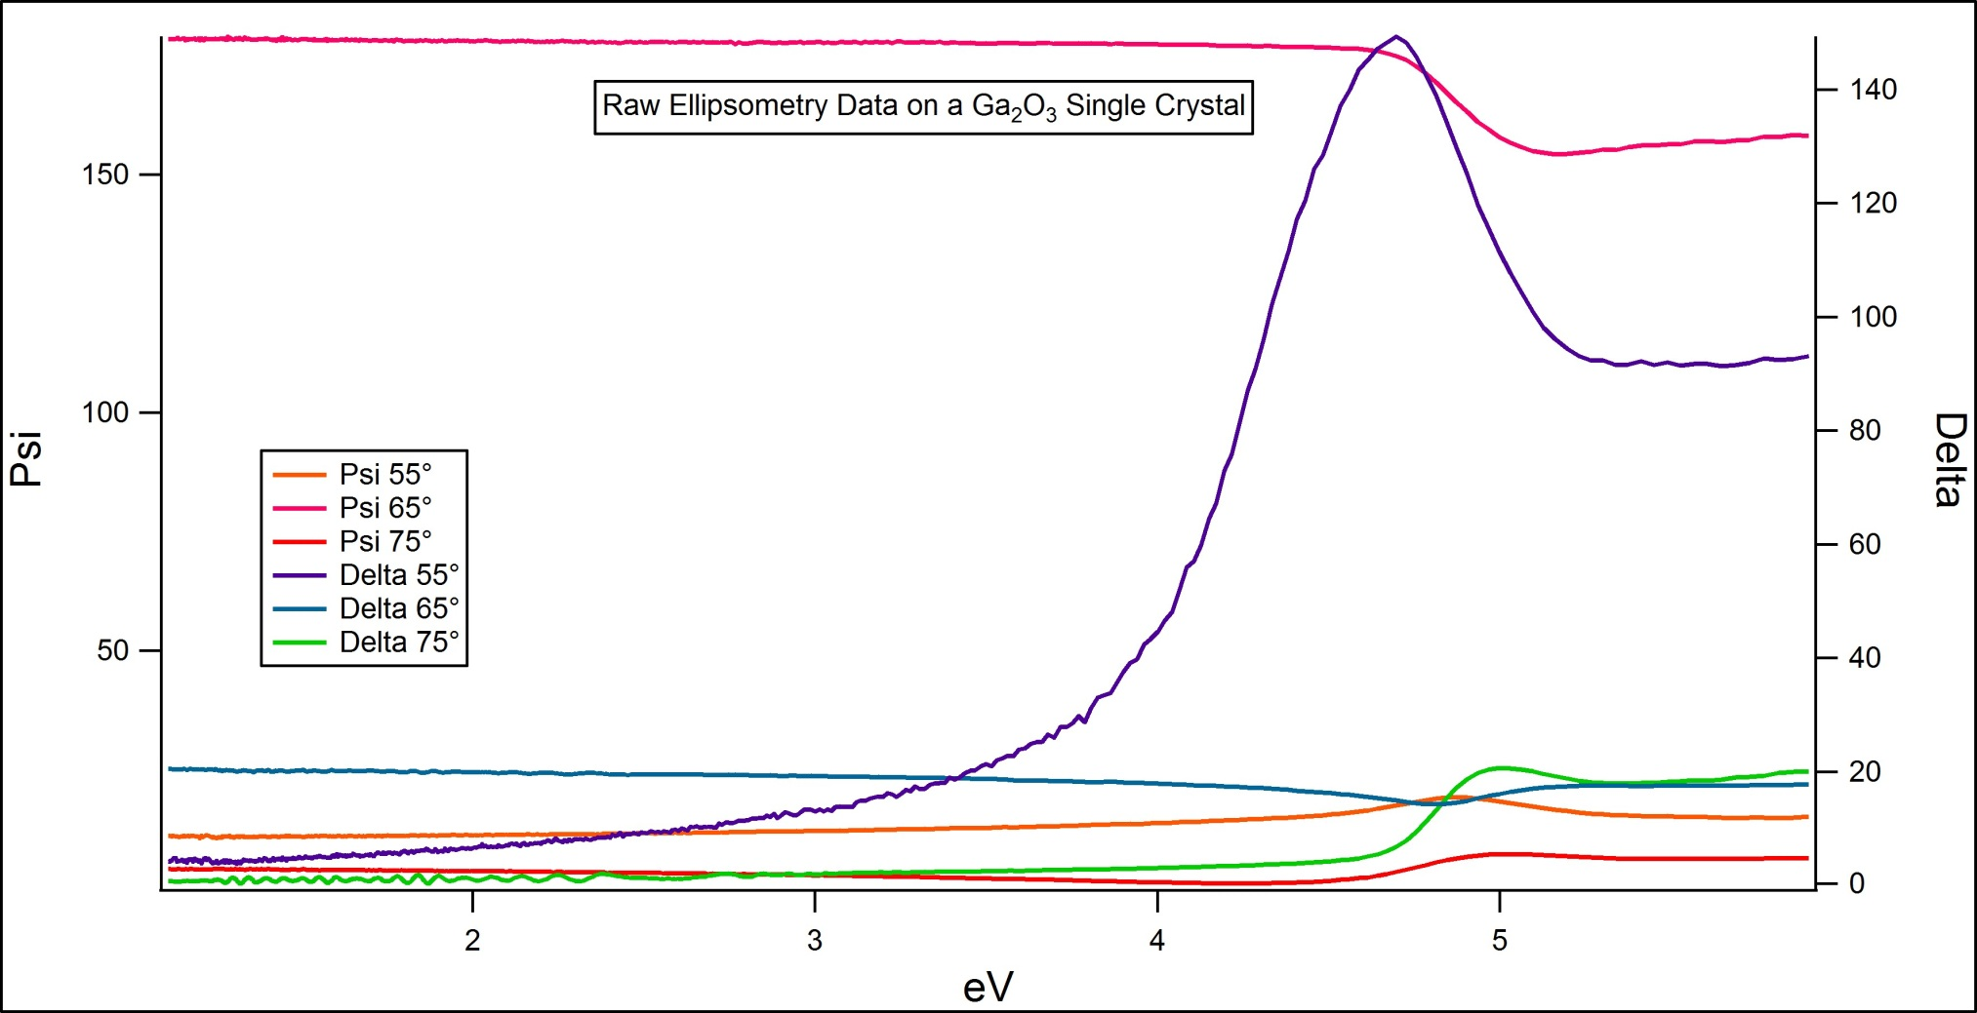
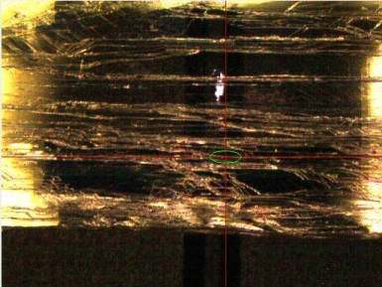
Single Crystal Ga₂O₃ Ellipsometry Data at One Orientation
Angles refer to angle of incidence
Something is ‘turning on’ just under 5eV .. close to Ga2O3’s band gap!
Next steps…
Plot data from other orientations of the single crystal
Use a model to achieve a fit that works for each orientation

Slide 15
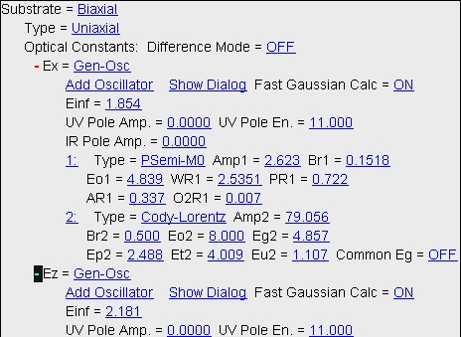
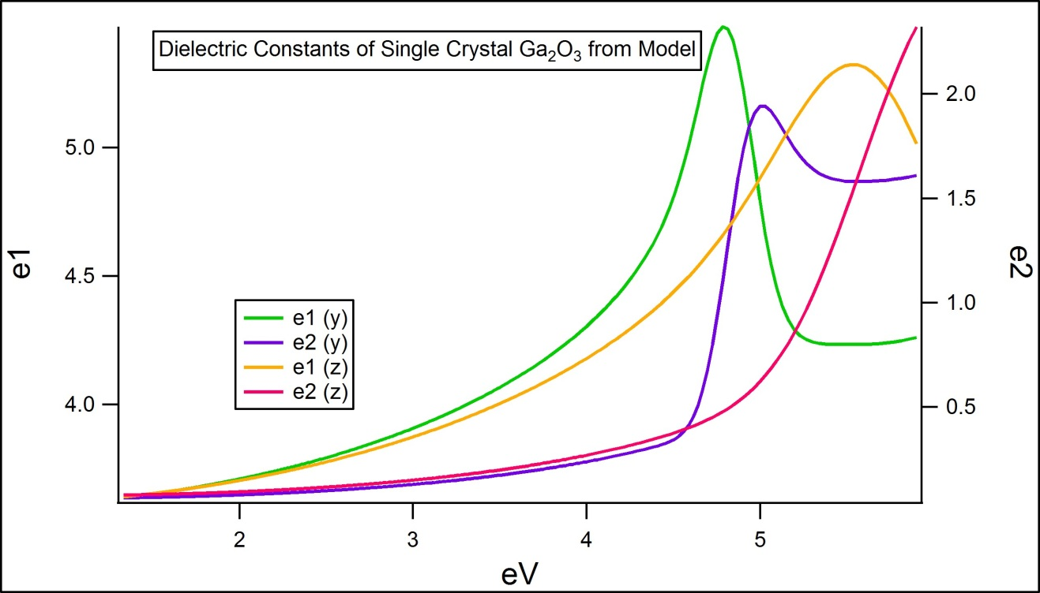
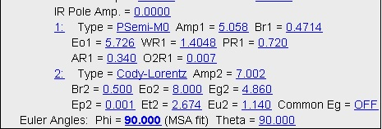
Ga₂O₃ Single Crystal Ellipsometry at Three Orientations
Two oscillator models are used to fit the data
A relatively good fit for three crystal orientations and three angles of incidence is achieved, and the resulting dielectric constants are plotted

Slide 16
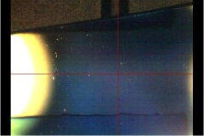
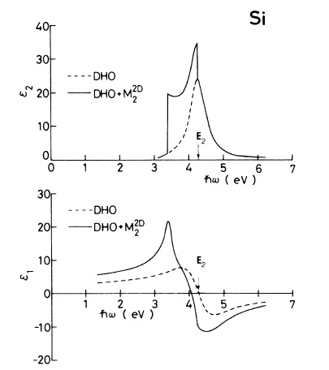
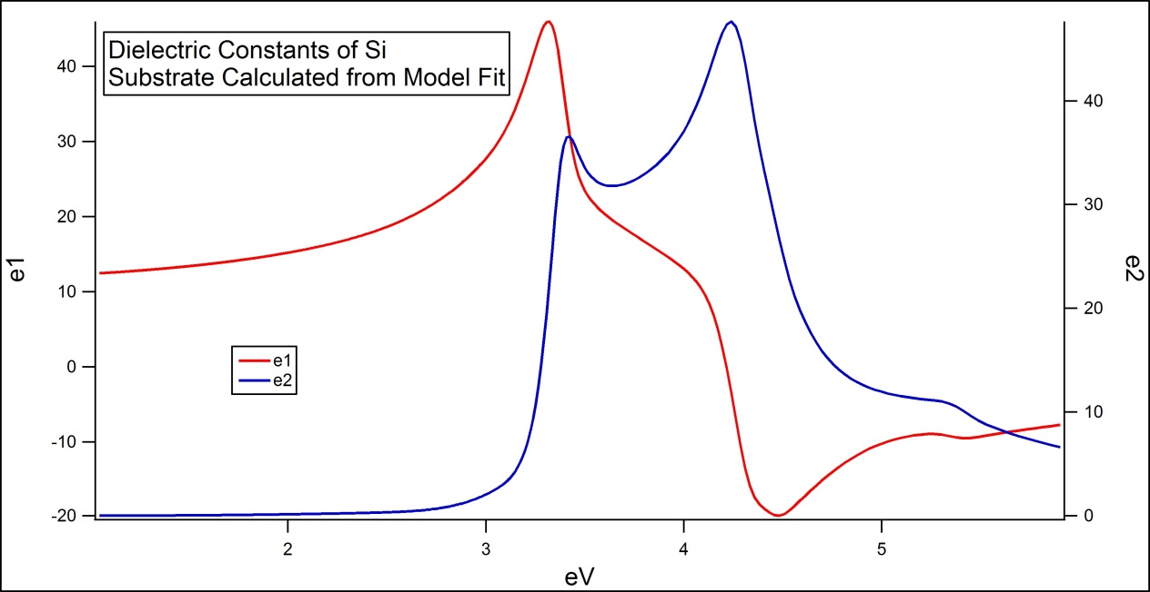
Compare Single Crystal Results to Thin Films
Can we differentiate a crystalline Ga₂O₃ thin film sample from an amorphous one?
Films were deposited on a Si substrate, so it is useful to first examine the substrate by itself
Dielectric constants of Si from literature
Adachi, Sadao. "Model Dielectric Constants of Si and Ge." Physical Review B 38.18 (1988): 12966-2976.

Slide 17
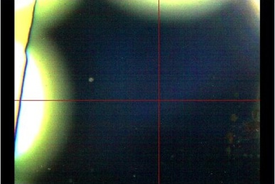
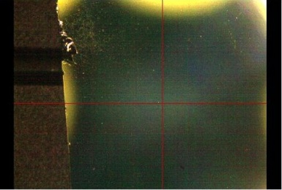
Ga₂O₃ Thin Film Results
Ga2O3 Nominally 100nm thin film deposited on Si; Expected to be amorphous
Ga2O3 Nominally 100nm thin film deposited on Si & annealed; Expected to be polycrystalline

Slide 18
Nominally amorphous film
Modeled using B-Spline with Kramers-Kronig analysis
Thickness = 128 nm Roughness = 9 nm
Dielectric Constants
Nominally polycrystalline film
Modeled using a Psemi M0 oscillator and a Cody Lorentz oscillator
Thickness = 156 nm Roughness =13 nm

Slide 19
Conclusion
Ga2O3’s unique properties can be explored for future device applications
XPS is a powerful tool for examining surface and interface features
UV-Vis can measure band gaps and identify anisotropy
Ellipsometry is a quick optical technique which can determine many material properties and optical constants

Slide 20
Acknowledgements
A special thanks to Marjorie Olmstead and Fumio Ohuchi for advising me in this project
Thanks to Alejandro Garcia and Subhadeep Gupta and the NSF for facilitating the REU program

Slide 21
May I have your questions?

