Slide 1
Krypton source for the Project 8 neutrino mass experiment
Arman Ballado
Advisor: Mike Miller

Slide 2
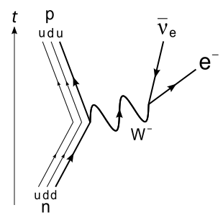
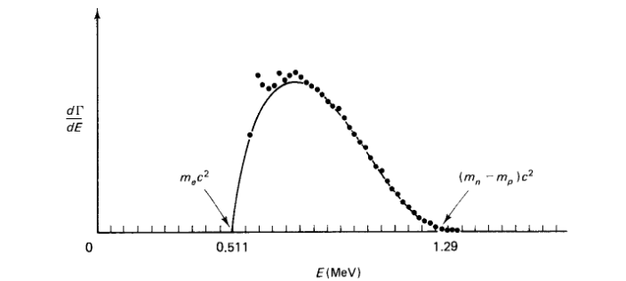
Neutrino mass measurement
Beta Decay $n →p+e+ \overline{ν_{e}}$
$E=\frac{m_{n}^{2}−m_{p}^{2}+m_{e}^{2}}{2 m_{n}}c^{2}$
Griffiths

Slide 3
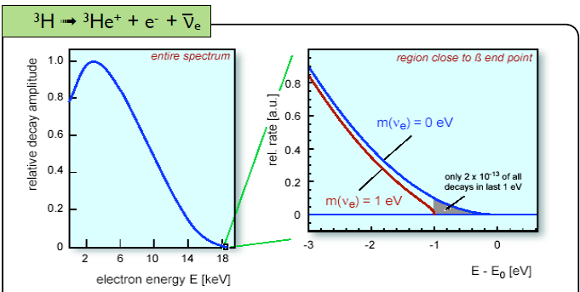
Tritium Beta Decay
Endpoint energy of 18.575 keV
J.A. Formaggio

Slide 4
Project 8 Concept
Use cyclotron frequency to measure energy
Electron will go through cyclotron motion in a magnetic field with a frequency $ω=\frac{ω_{0}}{γ}=\frac{q B}{E+m_{e}}$
For $B=1T$ and $E=18.575keV$ $\frac{ω_{0}}{2 π}=27 GHz$

Slide 5
Calibration using Krypton-83m
Internal Conversion
Releases electron with energy $E=17.800 keV$ (Tritium endpoint energy $E=18.575 keV$)

Slide 6
Concerns with krypton
How does it behave at temperatures near liquid nitrogen or lower?
Does it condense on the cold surface?

Slide 7
Krypton Vapor Pressure

Slide 8
Setup

Slide 9
Temperature Standoff
Viton O-ring minimum temperature: -25°C or 248K
$T_{R}−T_{O}=\dot{Q}\frac{x_{0}}{k A}$
$T_{O}−T_{C}=\dot{Q}\frac{x}{k A}$
$x=\frac{T_{O}−T_{C}}{T_{R}−T_{O}}x_{0}$
$x ≈1.7in$ for $x_{0}=0.5in$

Slide 10
Residual Gas Analyzer
Ionizer -> Quadrupole Mass Filter -> Detector

Slide 11
Background Data

Slide 12
Background Data
Average = $2.93 ×{10}^{−10}$Torr
$σ=1.02 ×{10}^{−10}$Torr

Slide 13
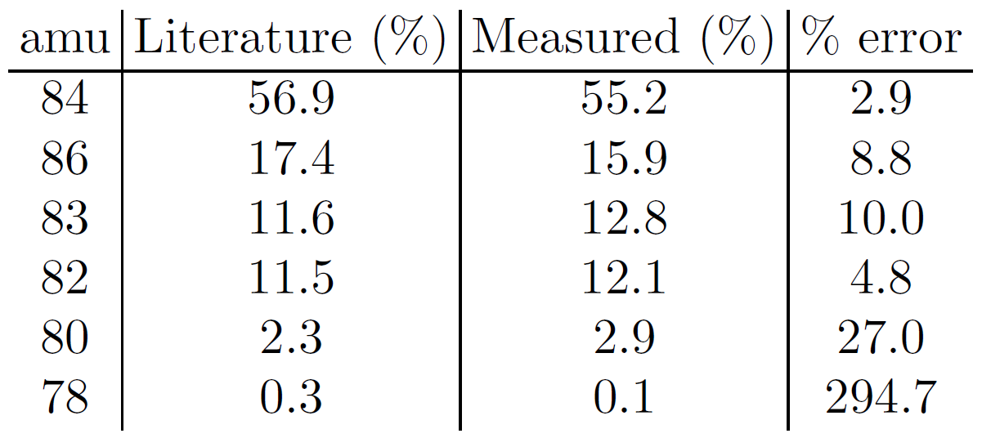
Krypton Abundances

Slide 14
Pressure vs. Time

Slide 15
Estimated Pressure from Radioactive Source
Assuming that the krypton gas behaves like an ideal gas
PV = NkT
Rubidium activity = 0.15mCi = 5.5 x 10⁶ decays/second
N = Activity x time = $0.15mCi ×3hrs=6.0 ×{10}^{10}$
For an experimental volume of 10L at 77K
$P≈5 ×{10}^{−11} Torr$

Slide 16
Conclusion
It appears that no significant condensation of krypton occurs, but more tests are needed to be sure.
It would be very difficult to detect the radioactive krypton using the RGA

Slide 18
Krypton Production
${}_{}^{nat}{Kr}(p, xn){}_{}^{83}{Rb}$
$E_{p}>15 MeV$
To maximize cross-section for ${}_{}^{83}{Rb}$ production: $E\sim 20MeV$
Rb-83 half-life = 86.2 days
Rb-84 lifetime = 33.1 days
Rb-83 decays to Kr-83 by electron capture

