Slide 1
Applications for X-Ray Spectroscopy
Jordan Planillo
Jerry Seidler

Slide 2
Probing Metalloproteins
One of the hardest technical issues is to identify the existence and species of light elements bonded to the (usually) chemically/catalytically active metal sites.
X-ray crystallography (by x-ray diffraction) often falls short:
  Need large single crystals of extremely good quality
  Systematic errors from strains/weak-disorder in crystals (or other limitations in q-resolution) can ‘hide’ light atoms sitting close to heavy atoms

Slide 3
A case in point: nitrogenase
This enzyme, in its various naturally-occurring variants, is the only method by which living things fix nitrogen from the atmosphere, i.e., turn N2 into NH3.
This is important in the life-cycle of many organisms, but is also important as a biomimetic example to be followed for improved production of man-made fertilizers, a key technical issue for the coming century.

Slide 4
A case in point: nitrogenase
While it is energetically-favorable to convert N2 and H2 to NH3, there is an enormous energy barrier posed by the strong triple-bond of N2.
The Mo-Fe co-factor in nitrogenase is the active catalytic site which strips electrons one at a time from N2, thus allowing it to dissociate and react with H2 to form NH3.
N₂ + 8 H⁺ + 8 e⁻ + 16 ATP → 2 NH₃ + H₂ + 16 ADP + 16 P_{i}

Slide 5
A case in point: nitrogenase
Nobody understands how nitrogenase actually obtains such good catalytic properties that it is able to efficiently strip 3 electrons from N2.
Einsle, et al, Science (2002), proposes a new model for the structure of the catalytically-active Mo-Fe cofactor where there is a light atom (maybe C, N, O, or S) in a central cavity of the metal cluster.
Is the atom really there? What element is it? What role does it play in the N2-cracking catalysis?

Slide 6
MoFe co-factor in nitrogenase
Einsle, et al, Science (2002)
Big red dot: Mo
Yellow dots: S
Gray dots: Fe
Central dot (in middle of
  Fe6 cage): ??
If central atom is N, then it likely plays a key role as a charge reservoir in the catalytic process

Slide 7
Applications for X-Ray Spectroscopy
The x-ray emission spectra from metal atoms can often give an unambiguous ‘fingerprint’ of the presence and species of a light ligand.
After a 1s hole is created on the metal, electrons from the ligand have a small, but measureable probablity to fill the 1s hole and emit a fluorescence x-ray.
  When the bonding electrons fall into the hole, this is called Kβ_{2,5} emission.
  When the semicore electrons on the ligand participate, this is called Kβ’’ emission. The Kβ’’ emission energy is directly correlated to the chemical species of the light ligand. But, it is really weak….

Slide 8
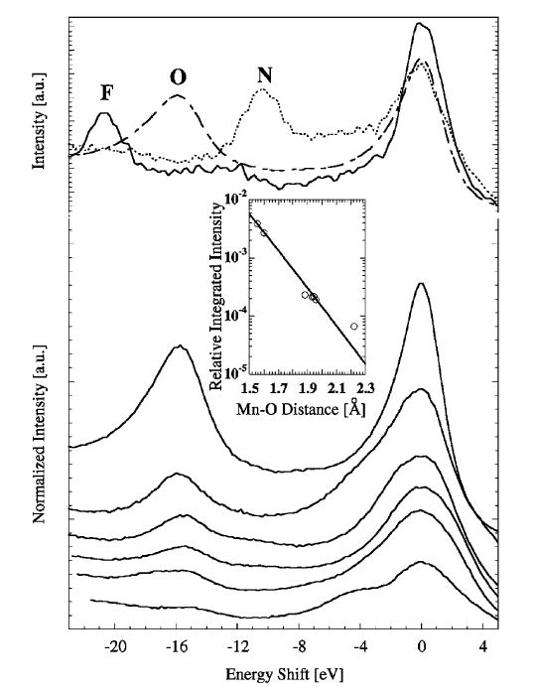


Slide 9
Sequence of Events
Build a really efficient spectrometer which should be able to see the tiny Kβ’’ x-ray emission.
Get a test sample that is really dense in Fe-N bonds, and sort-of mimics the proposed Fe6-N environment in nitrogenase.
Measure the test sample to establish count-rates and total experimental time needed to observe the Kβ’’ feature.
Use this information to design an experiment on nitrogenase: how to optimize measurement times, minimize beam damage, other possible systematics
Request beamtime for the nitrogenase experiment.
Do the measurement.
Write the paper.
Drink.

Slide 10
Off-site Preparation
Calculations – Bragg’s law
Element | Emission Line | Emission line Energy | Low E | High E | Crystal | Low θ | High θ | Average angle
Sc | Kα | 4090.600 | 4065.600 | 4105.600 | Ge(311) | 62.2765 | 63.3691 | 62.8228
Sc | Kα | 4090.600 | 4065.600 | 4105.600 | Si(311) | 67.237 | 68.6204 | 67.9287
Sc | Kβ | 4460.500 | 4415.500 | 4475.500 | Ge (400) | 78.3384 | 83.0569 | 80.69765
Ti | Kα | 4510.800 | 4485.800 | 4525.800 | Ge(400) | 75.5749 | 77.7173 | 76.6461
Ti | Kβ | 4931.810 | 4886.810 | 4946.810 | Ge(311) | 74.9171 | 77.7971 | 76.3571
V | Kα | 4952.200 | 4927.200 | 4967.200 | Ge(331) | 74.0677 | 75.7878 | 74.92775
V | Kβ | 5427.290 | 5382.290 | 5442.290 | Ge(422) | 80.5352 | 85.8537 | 83.19445
Cr | Kα | 5414.700 | 5389.700 | 5429.700 | Ge(422) | 81.3685 | 84.8809 | 83.1247
Cr | Kβ | 5946.710 | 5901.710 | 5961.710 | Ge(511),(333) | 72.7593 | 74.7479 | 73.7536
Cr | Kβ | 5946.710 | 5901.710 | 5961.710 | Si(422) | 69.7171 | 71.357 | 70.53705
Cr | Kβ | 5946.710 | 5901.710 | 5961.710 | Si(511),(333) | 84.2059 | 90 | 87.10295
Mn | Kα | 5898.750 | 5873.750 | 5923.750 | Ge(511),(333) | 74.3258 | 75.7825 | 75.05415
Mn | Kα | 5898.750 | 5873.750 | 5923.750 | Si(422) | 71.0142 | 72.1831 | 71.59865
Mn | Kβ | 6490.450 | 6458.450 | 6505.450 | Si(440) | 83.0123 | 88.8416 | 85.92695
Mn | Kβ | 6490.450 | 6458.450 | 6505.450 | Ge(531) | 85.2091 | 90 | 87.60455
Fe | Kα | 6403.800 | 6378.800 | 6418.800 | Ge(440) | 74.9512 | 76.3513 | 75.65125
Fe | Kβ | 7057.980 | 7012.980 | 7072.980 | Ge(620) | 78.4729 | 81.1944 | 79.83365
Co | Kα | 6930.300 | 6905.300 | 6945.300 | Si(531) | 76.4868 | 77.9453 | 77.21605
Co | Kβ | 7649.430 | 7604.430 | 7664.430 | Ge(444) | 82.1052 | 86.6954 | 84.4003
Co | Kβ | 7649.430 | 7604.430 | 7664.430 | Si(533) | 77.582 | 79.8372 | 78.7096
Ni | Kα | 7478.150 | 7453.150 | 7493.150 | Ge(533) | 73.525 | 74.5989 | 74.06195
Ni | Kα | 7478.150 | 7453.150 | 7493.150 | Si(620) | 74.4618 | 75.6091 | 75.03545
Ni | Kα | 7478.150 | 7453.150 | 7493.150 | Si(533) | 87.3472 | 90 | 88.6736
Ni | Kβ | 8264.660 | 8219.660 | 8279.660 | Ge(642) | 82.049 | 86.043 | 84.046
Ni | Kβ | 8264.660 | 8219.660 | 8279.660 | Si(711),(551) | 79.9148 | 82.6286 | 81.2717
Cu | Kα | 8047.800 | 8022.800 | 8062.800 | Ge(711),(551) | 76.0628 | 77.2648 | 76.6638
Cu | Kα | 8047.800 | 8022.800 | 8062.800 | Si(444) | 78.7668 | 80.31 | 79.5384
Cu | Kβ | 8905.290 | 8860.290 | 8920.290 | Ge(800) | 79.3363 | 81.6443 | 80.4903
Cu | Kβ | 8905.290 | 8860.290 | 8920.290 | Si(731),(553) | 79.3906 | 81.714 | 80.5523

Slide 11
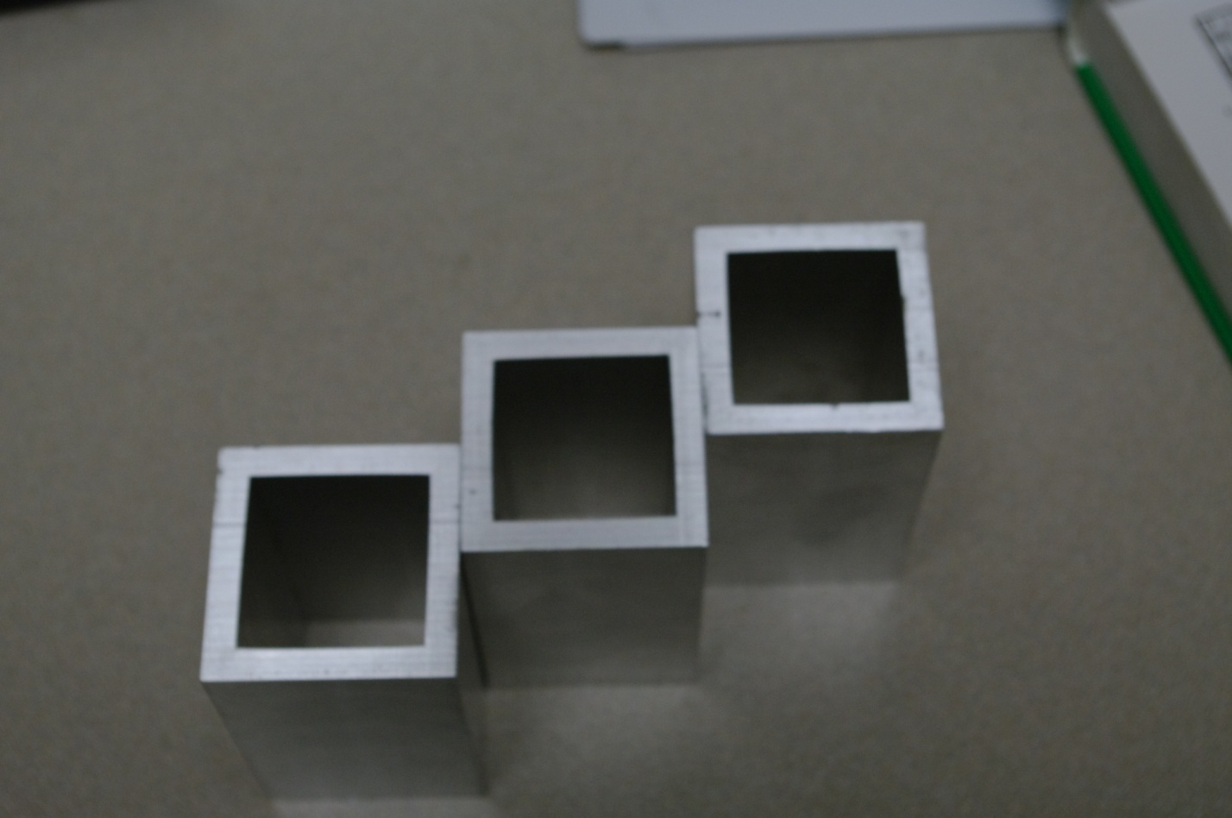
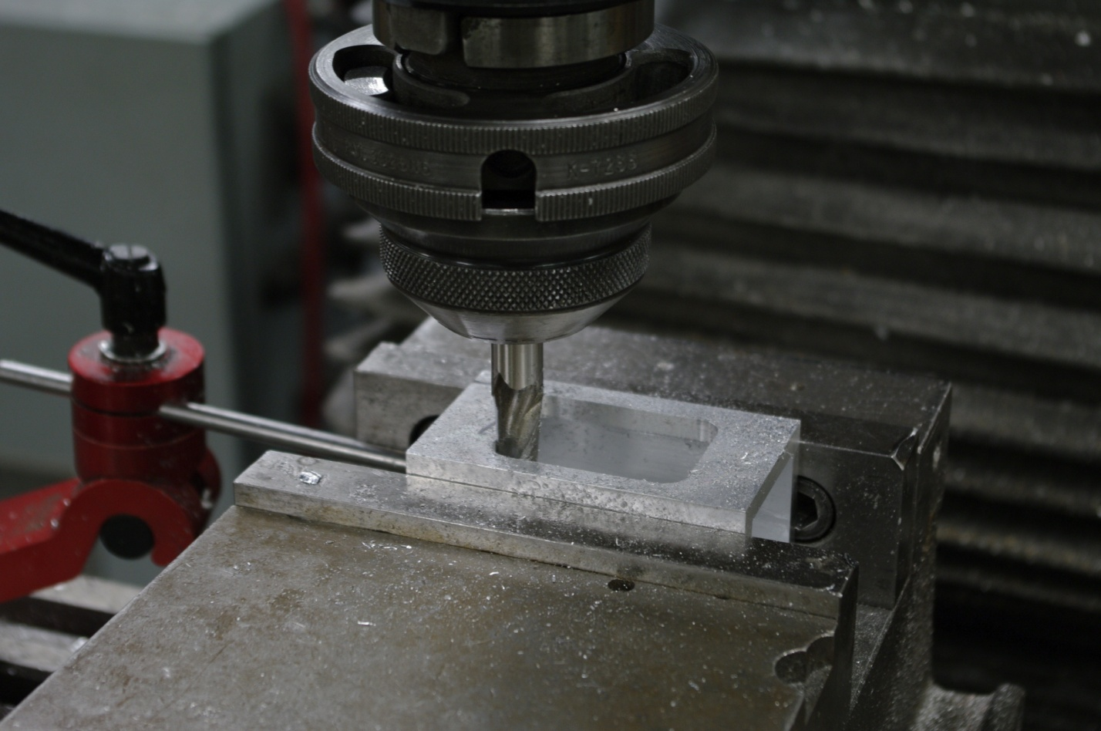
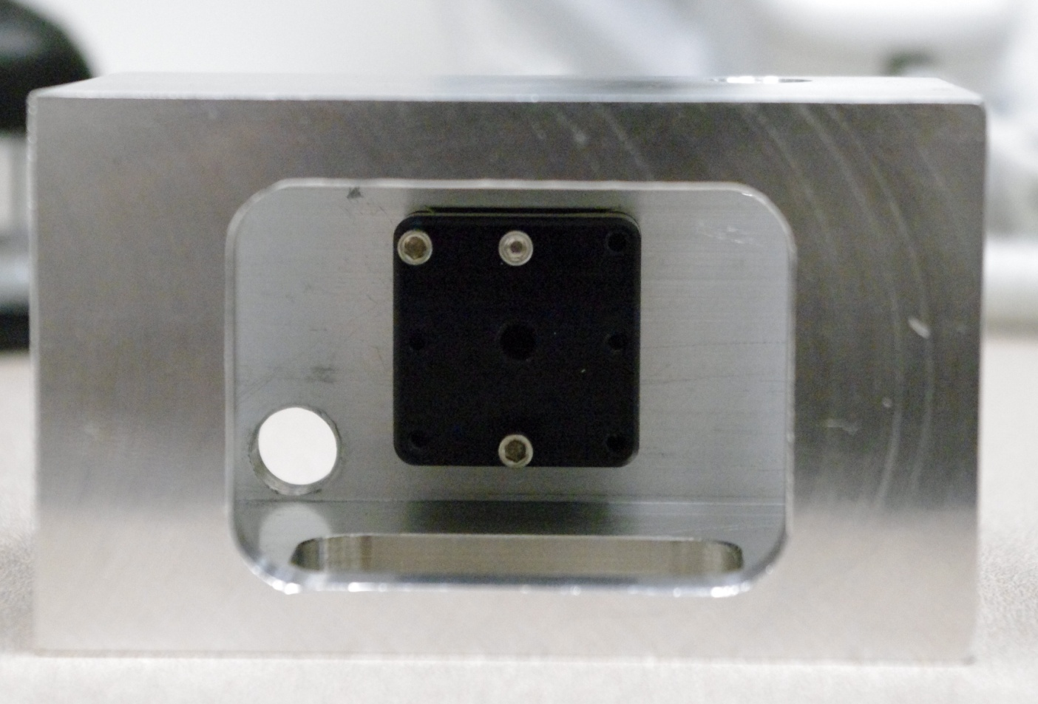
Off-site Preparation
Constructing a sample box

Slide 12
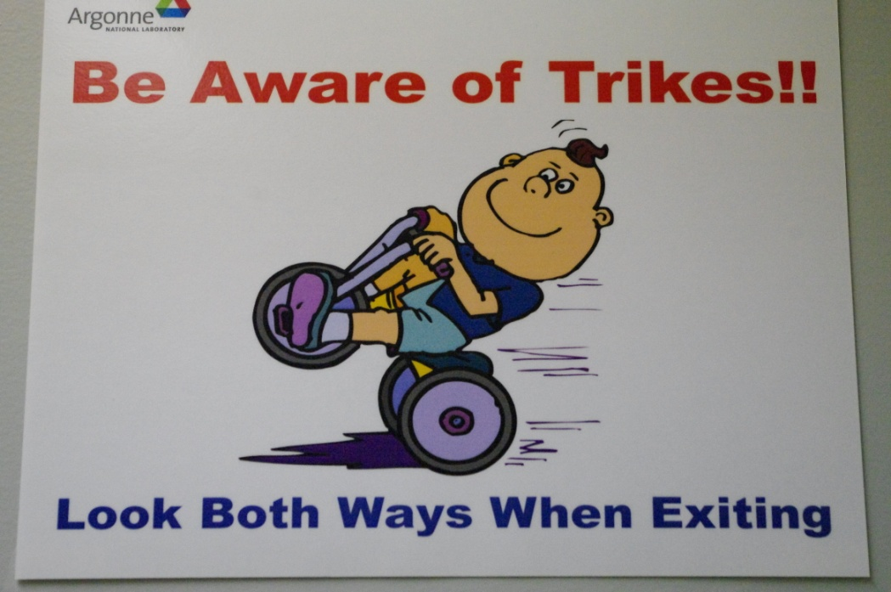
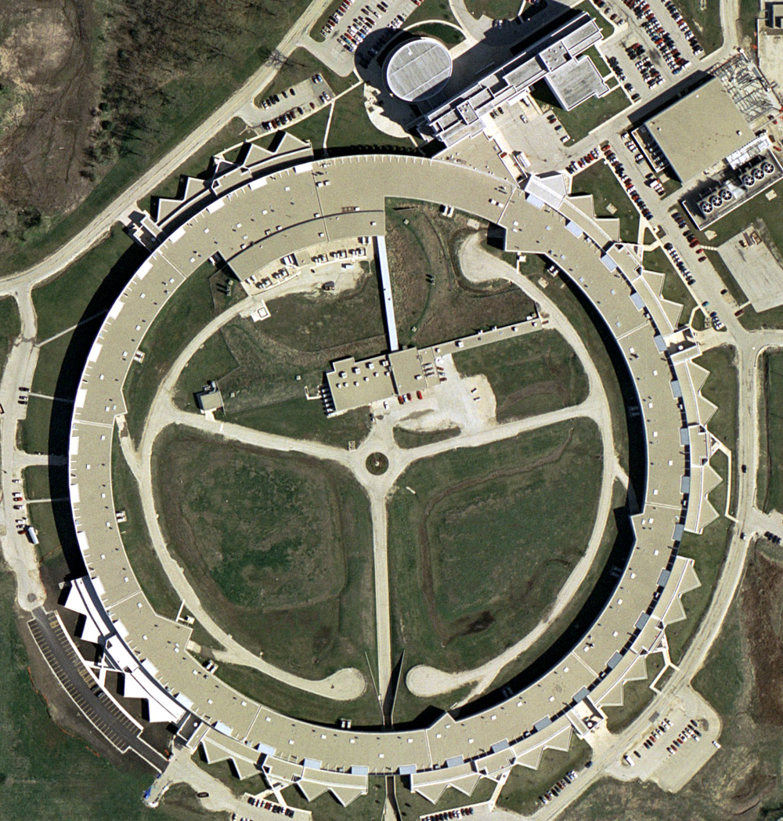
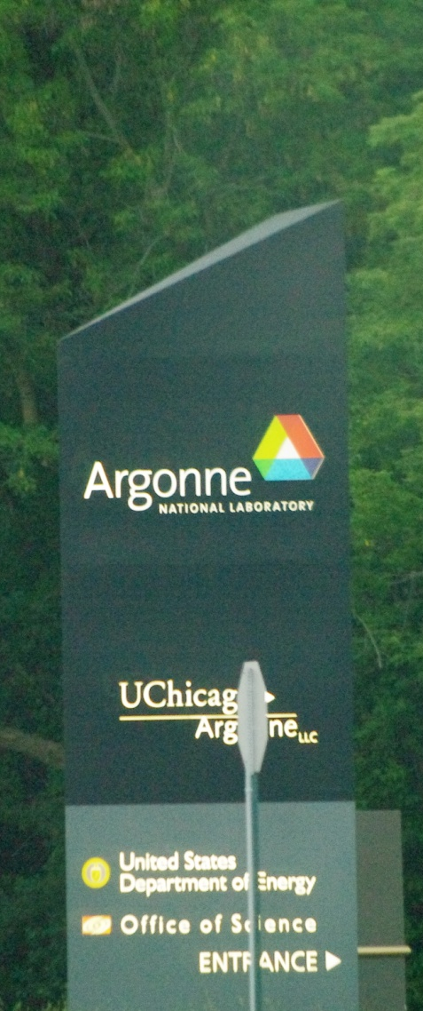
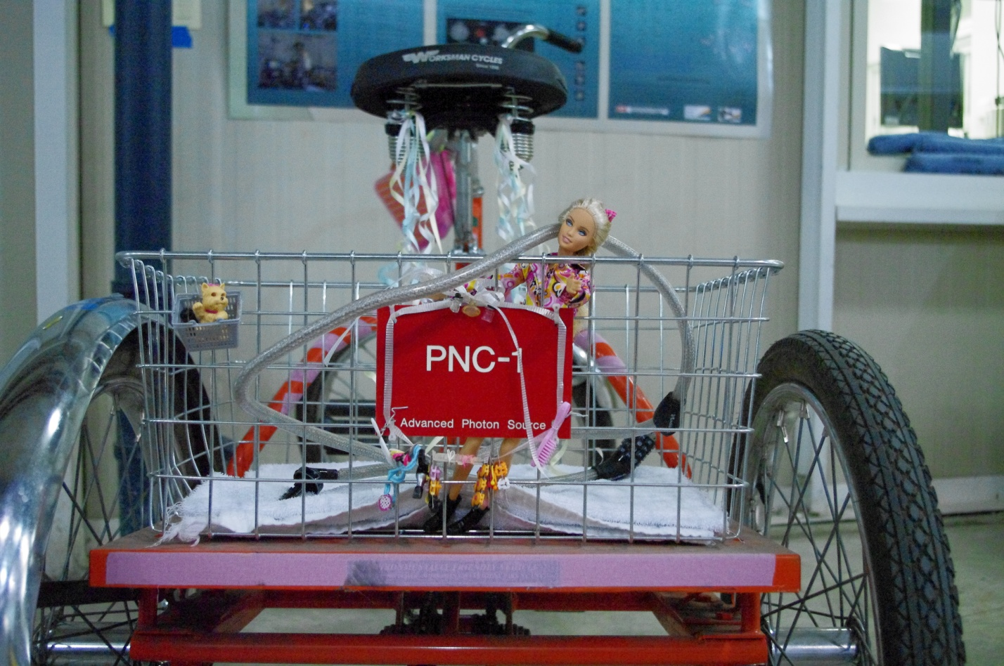
APS @ Argonne

Slide 13
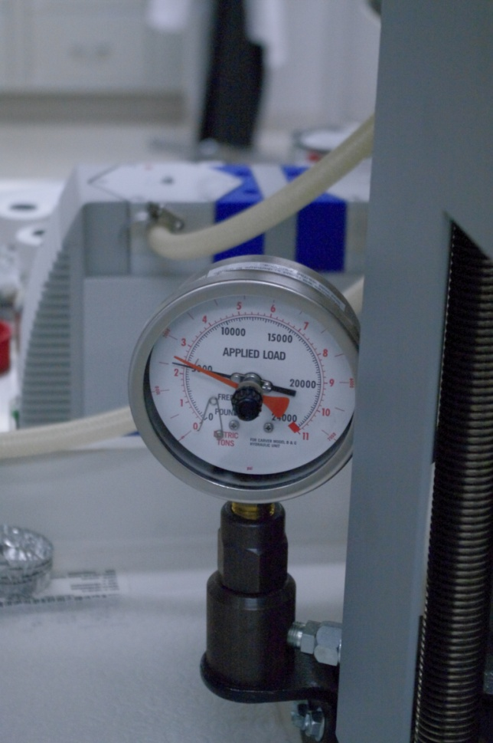
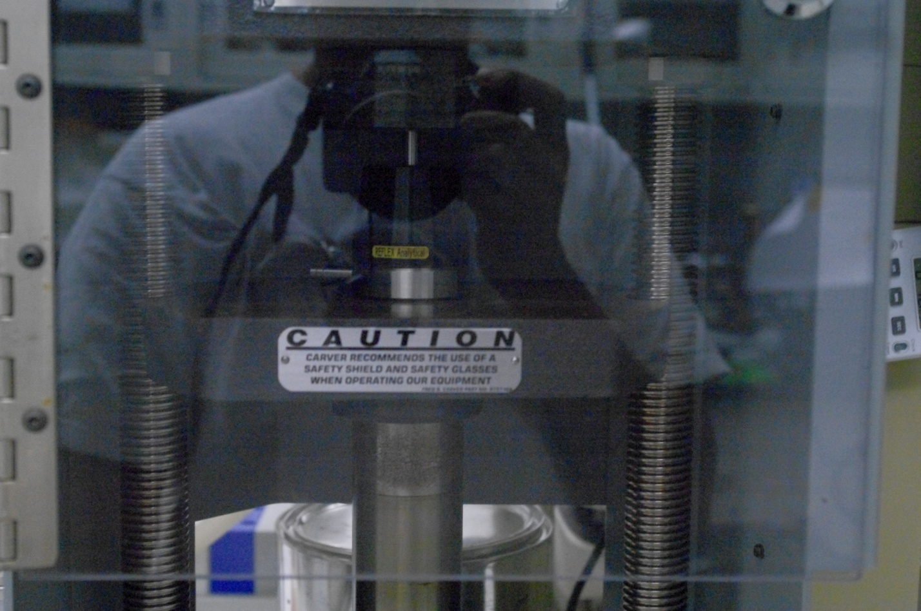
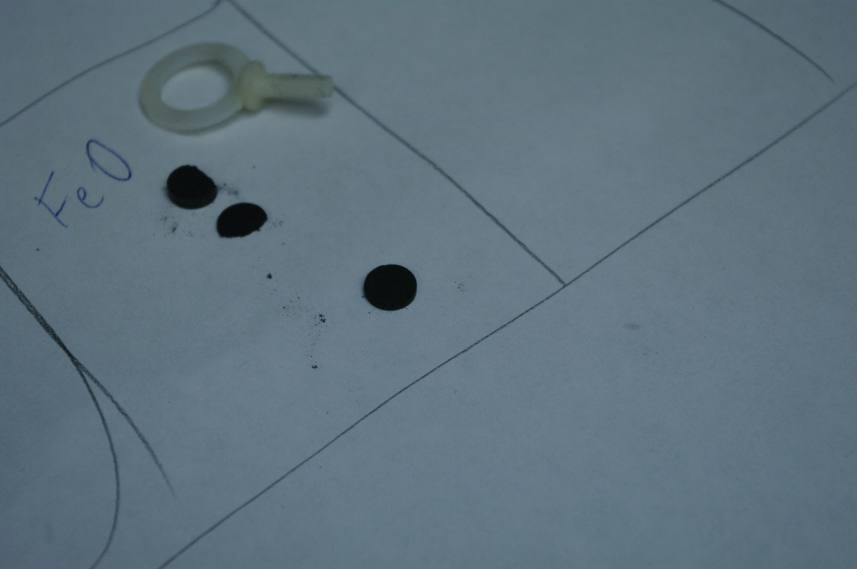
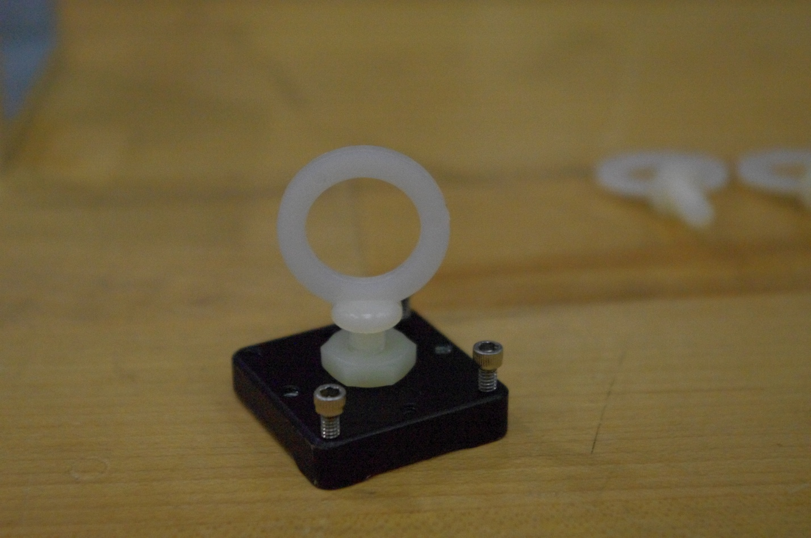
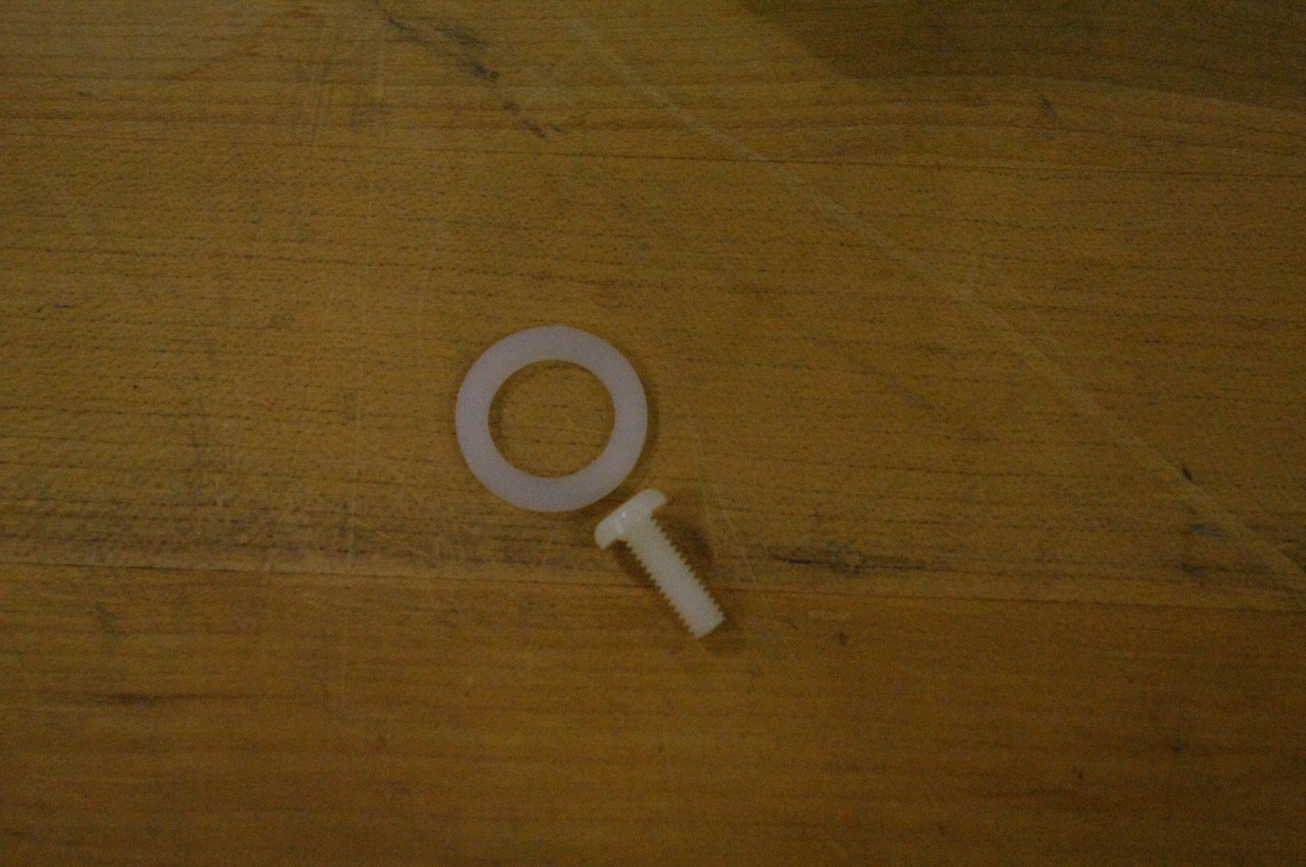
On-site Preparation
Sample holder/Pellet Press

Slide 14
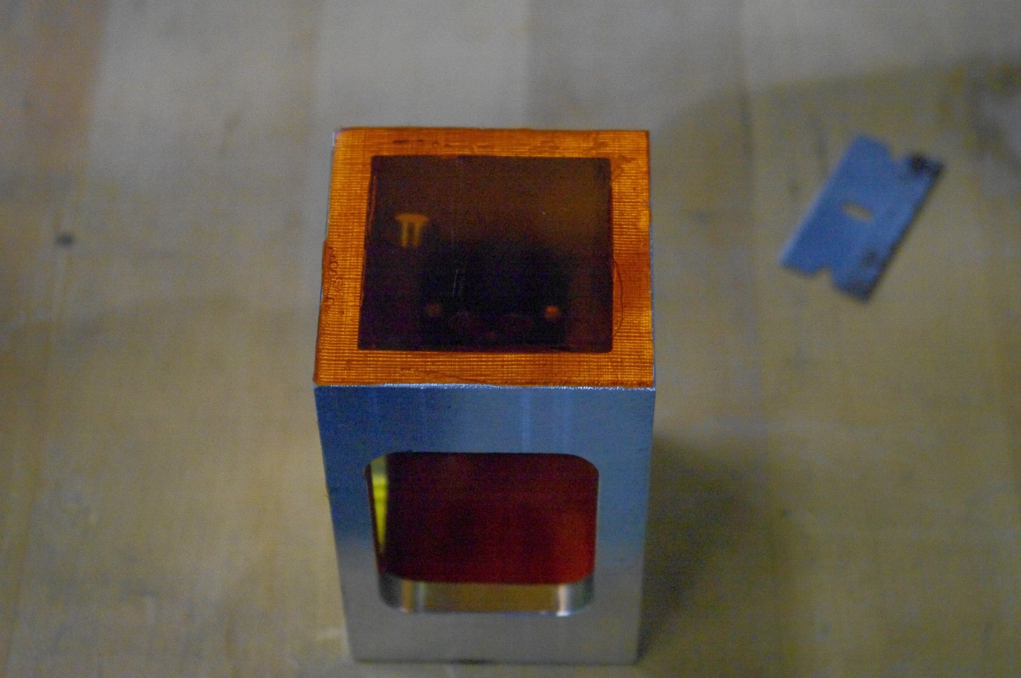
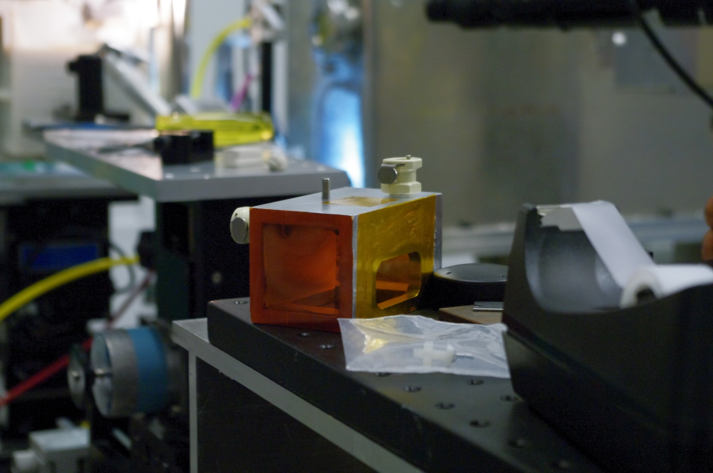


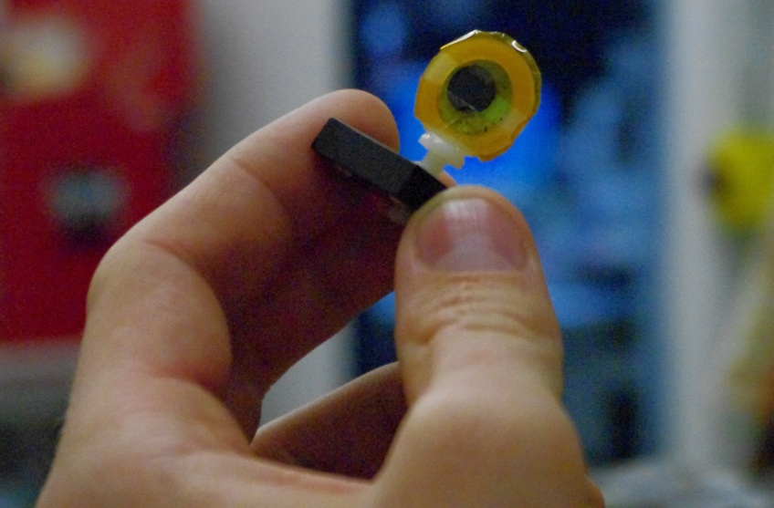
On-site Preparation
Applying Seals

Slide 15
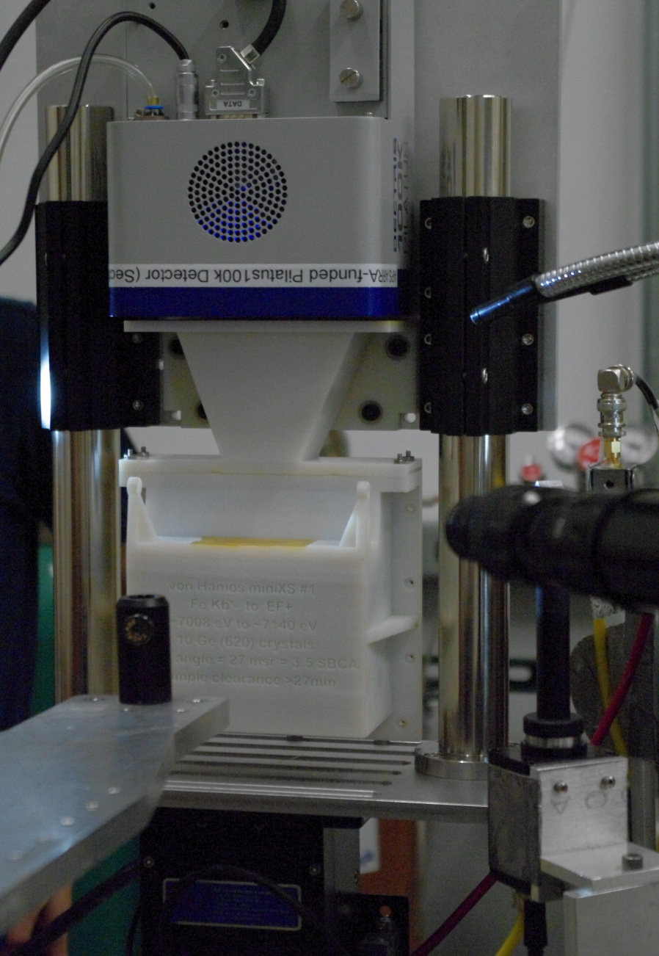
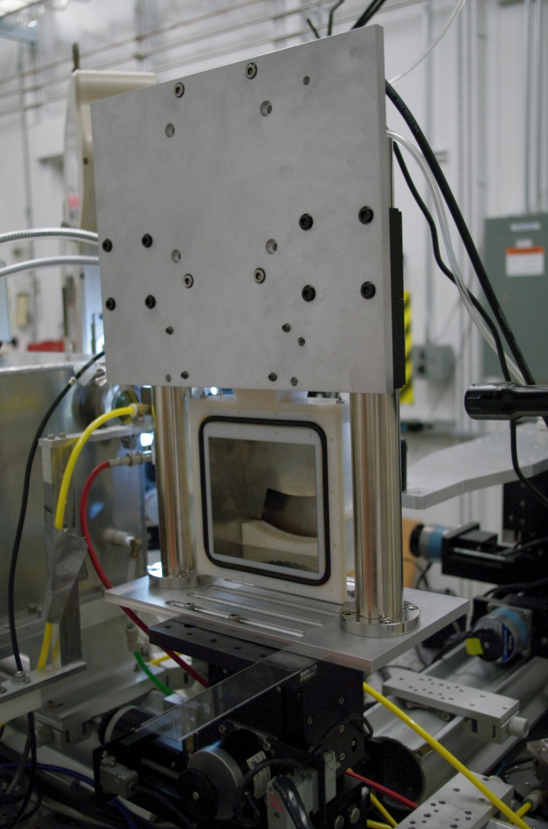
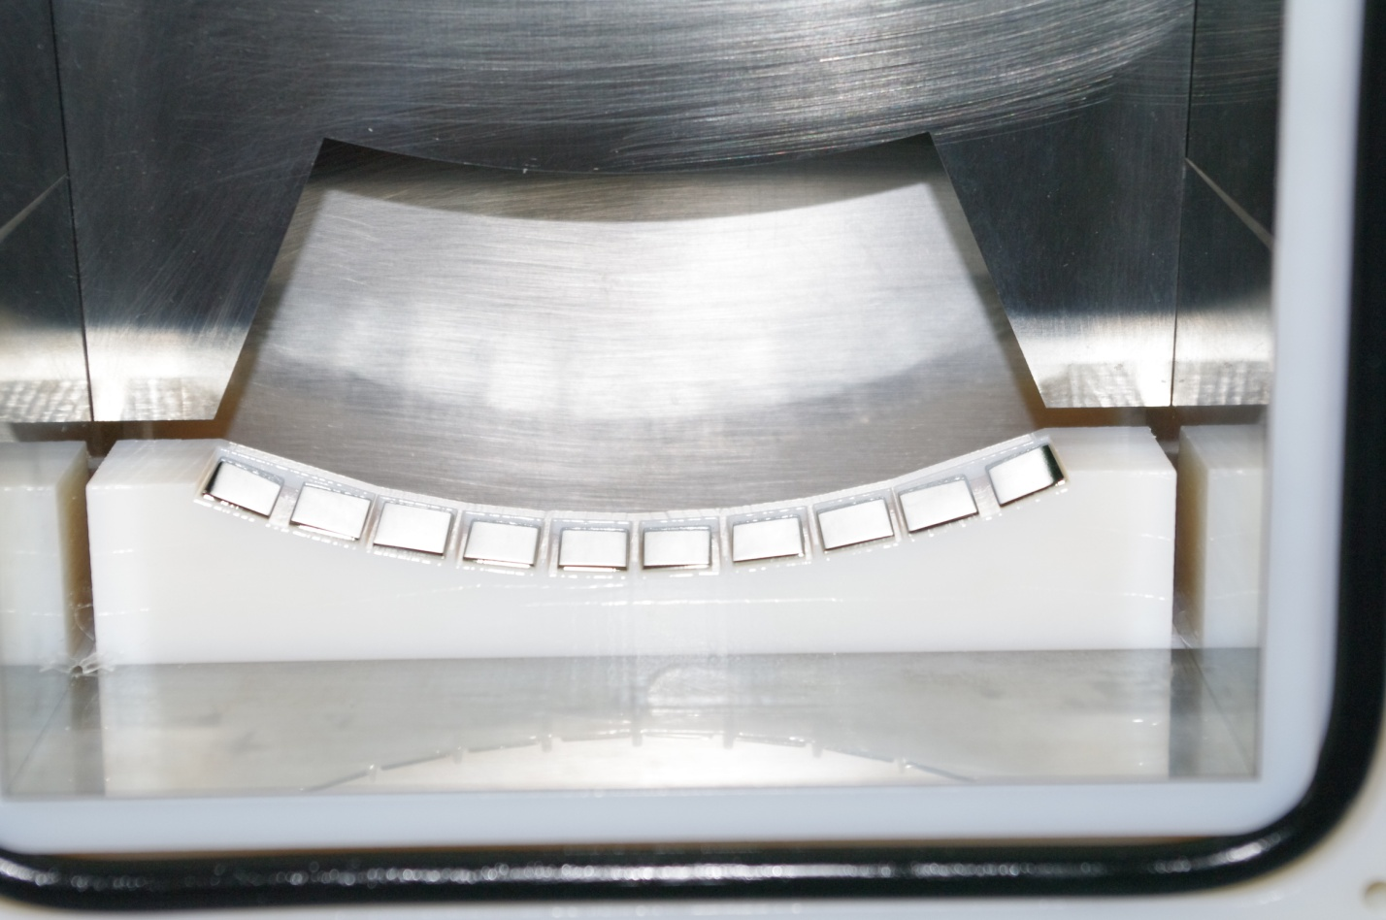
Experiment Setup
Detector
Ge(620)

Slide 16
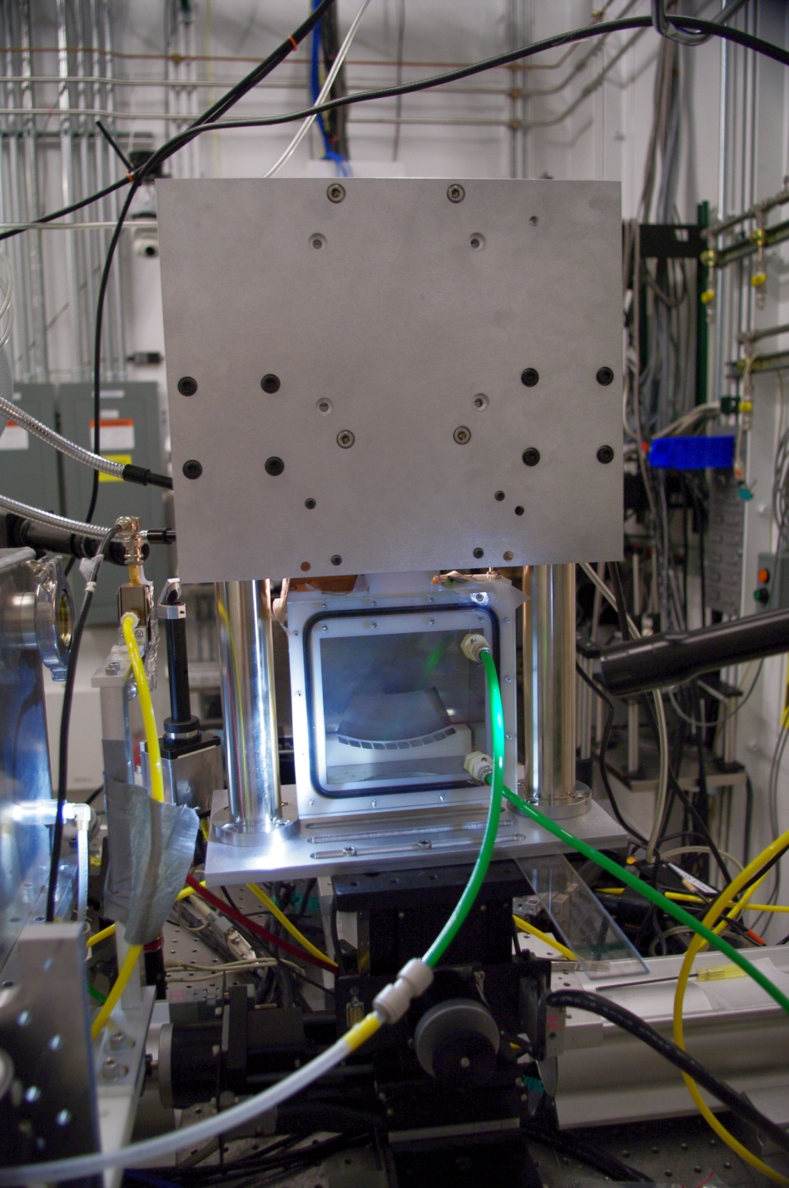
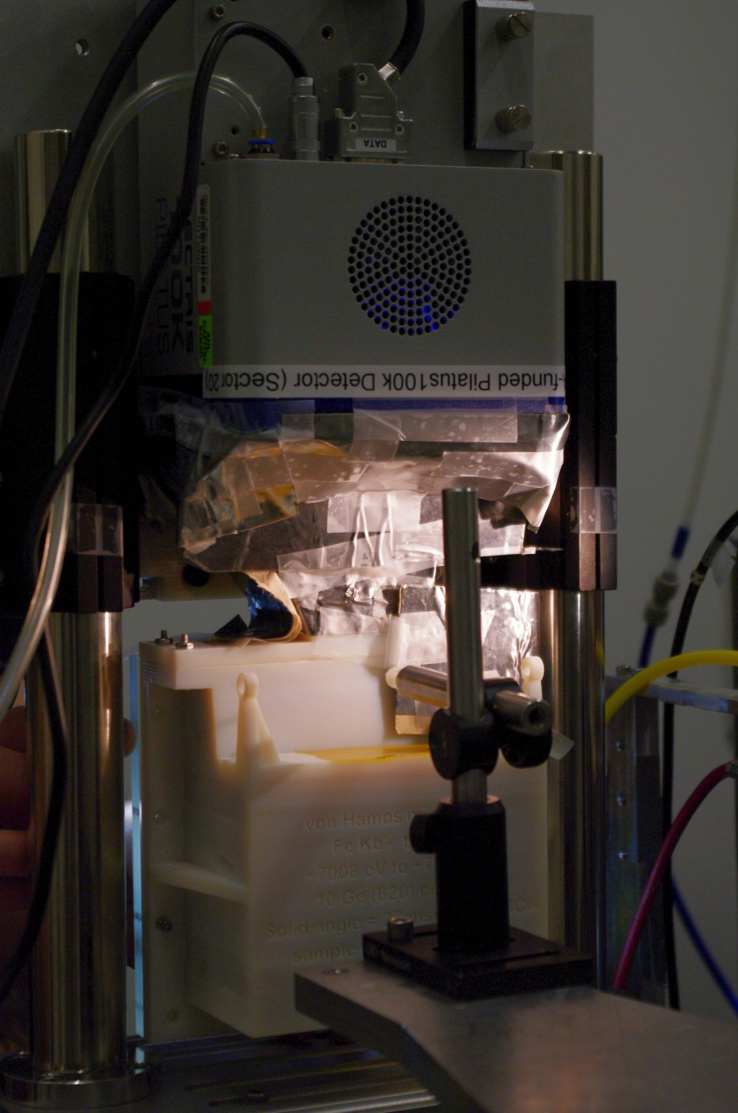
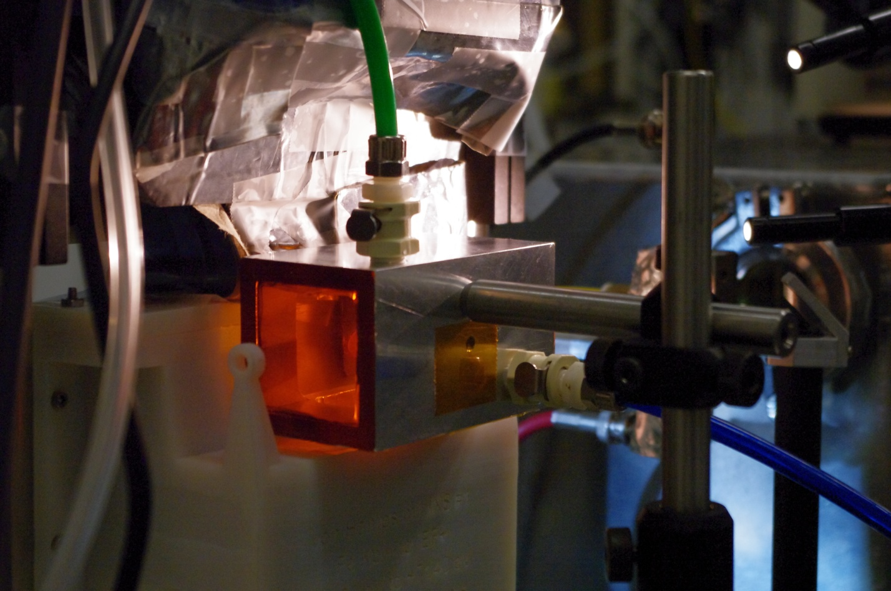
Noise Reduction

Slide 17

Fe Elastic Scattering & Fluorescence

Slide 18
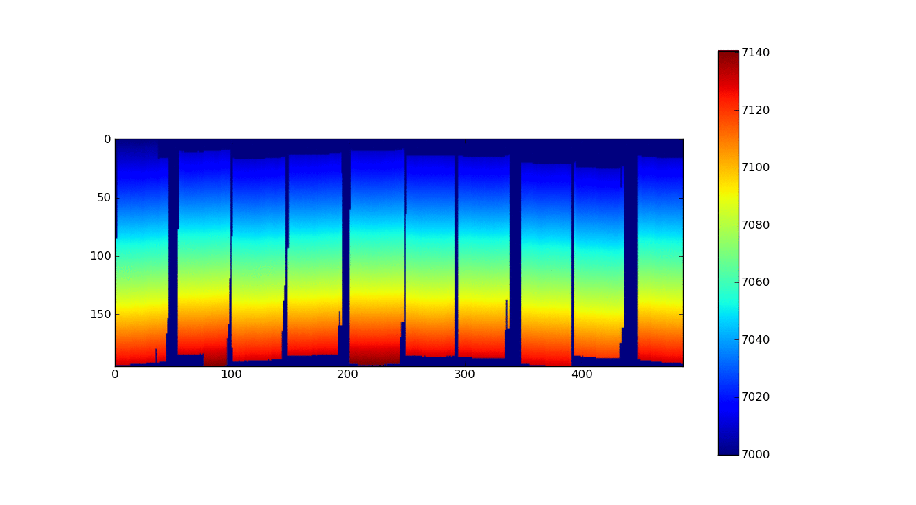
Calibration

Slide 19
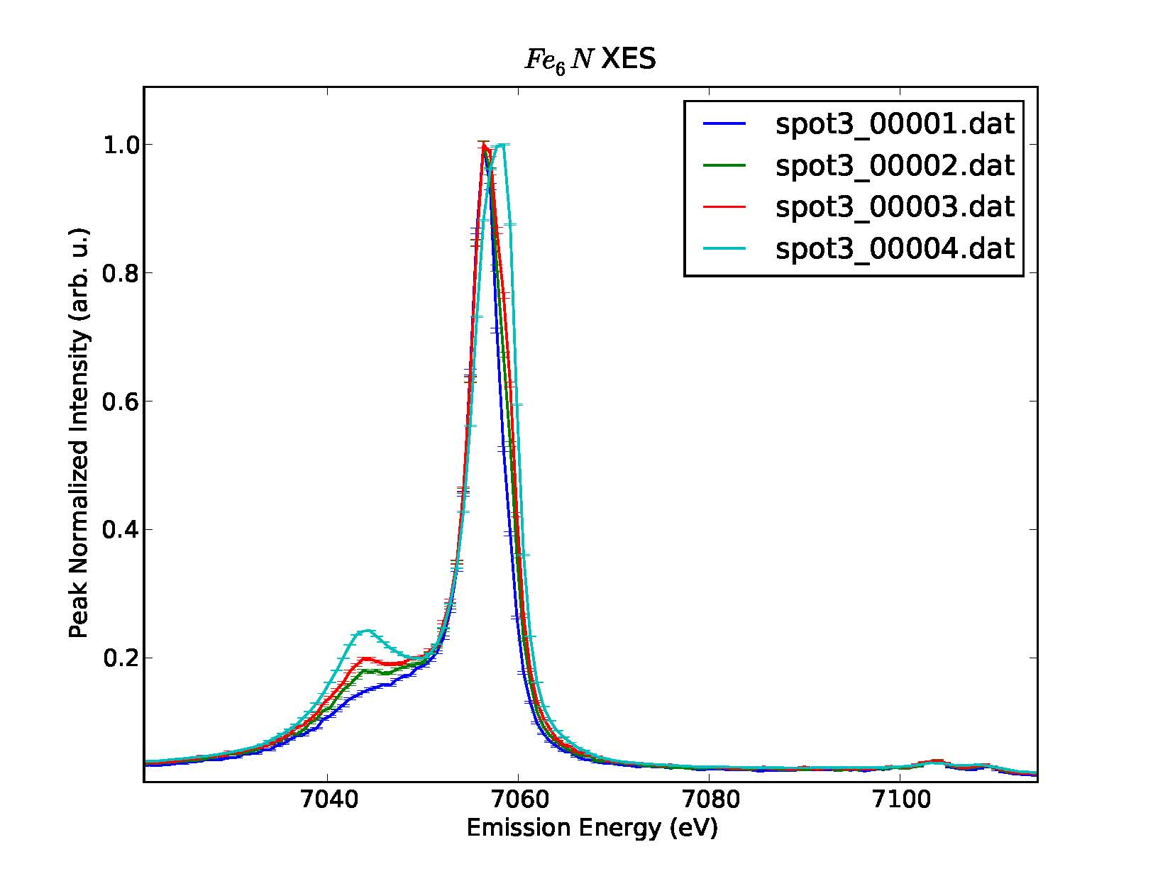
Results
Simulate Nitrogenase with Fe6N
+30s
+30s
+10min
Fermi Level
Fe 3p->1s
HUGE increase in Fe spin
Valence->1s

Slide 20
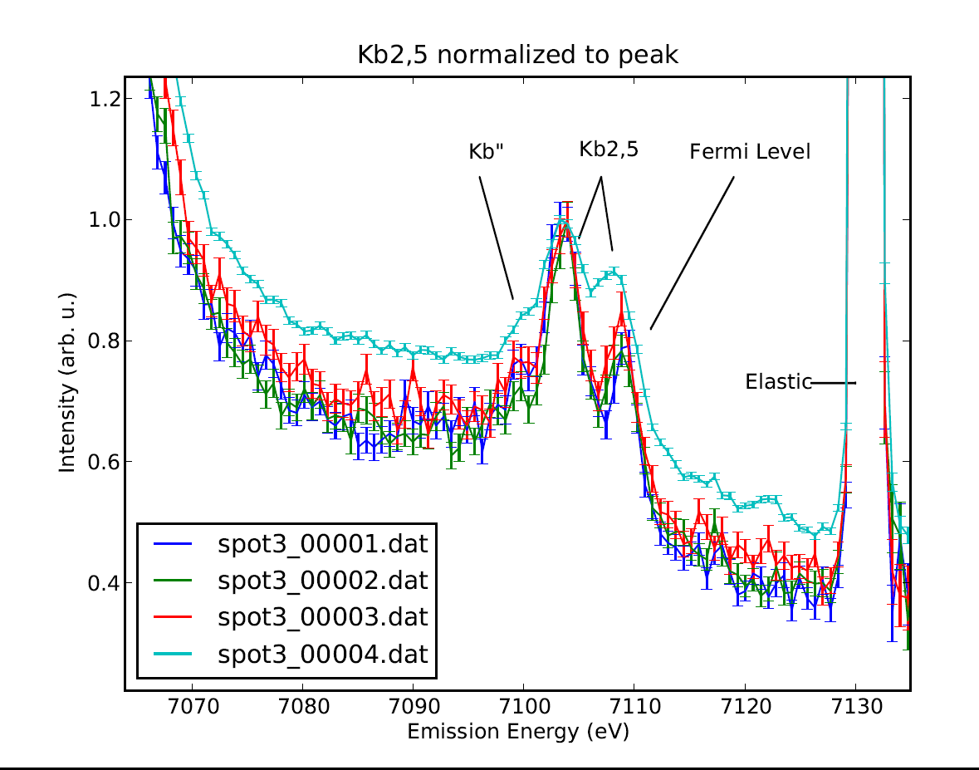

Slide 21
Results
Each subsequent exposure changes the spectrum
Beam damage occurs in Fe6N
  10^16 eV/s to 10^15 atoms in the illuminated region (bond energy ~1eV)
Possibly explained by:
  Spin trapping in long lived non-equilibrium states
  Formation of a new high spin state due to changes in chemical structure (severe chemical damage)

Slide 22
For an Fe Atom
3d_________________
3p_________________
3s_________________
2p_________________
2s_________________
1s_________________

Slide 23
With Crystal field splitting
3d_______________
Or
4
6
4
6
10

Slide 24
Conclusions
Successfully performed room temperature experiments in preparation for studies of local chemical structure in nitrogenase
Likely observed Kβ’’ fingerprint of Fe-N bonding
Discovered important systematic errors
Commissioned a new miniXS variant
Now: Discuss viability of nitrogenase study with collaborators

Slide 25
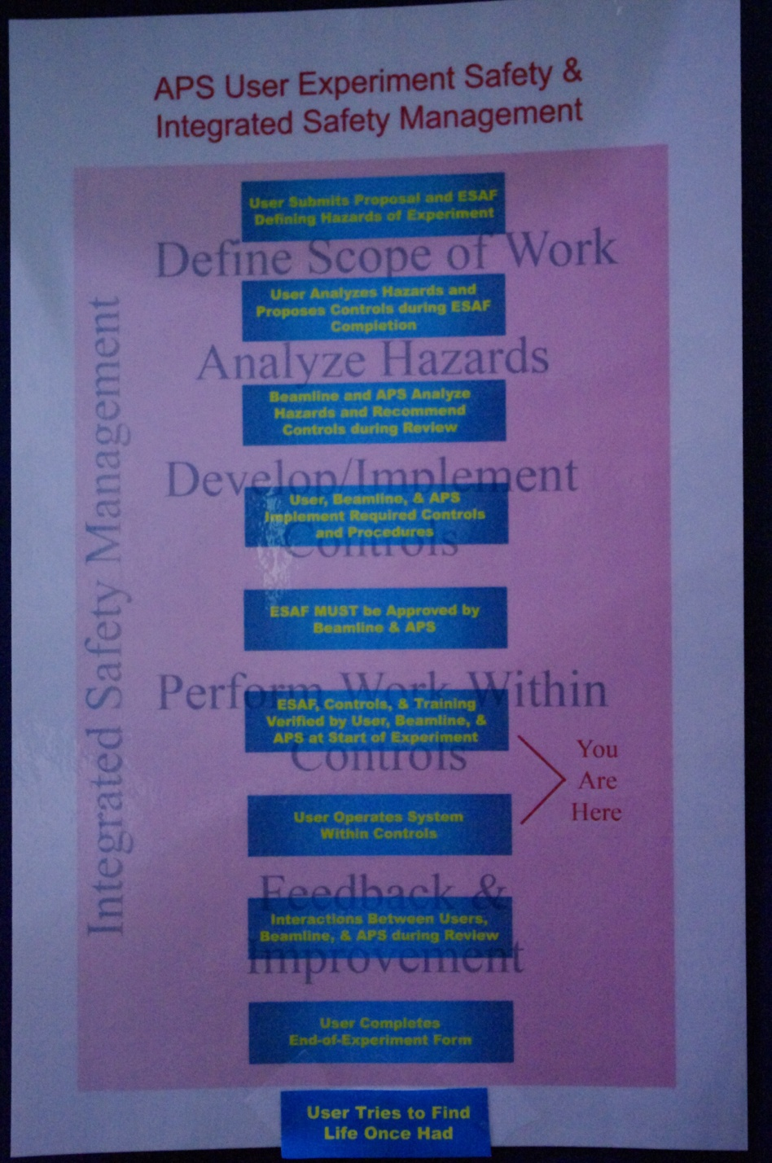
Post Experiment

Slide 26

Post Experiment

Slide 27
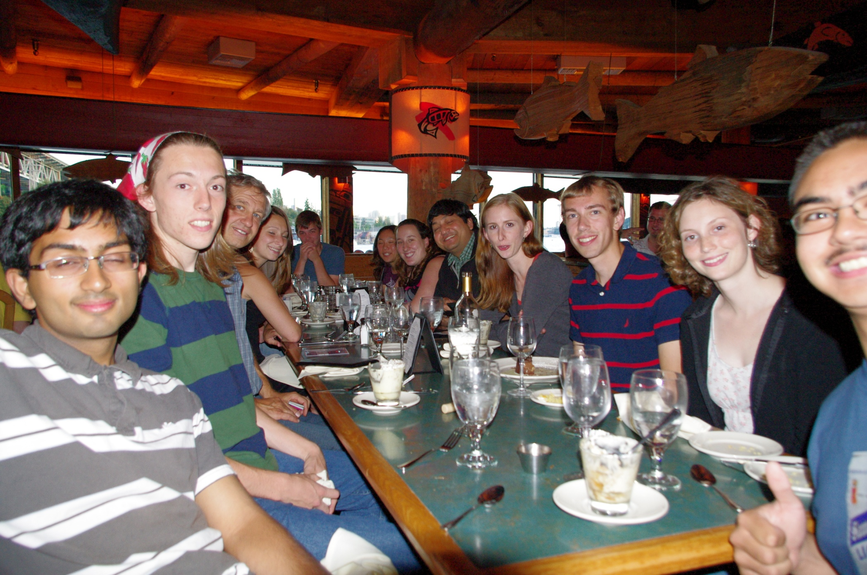
Acknowledgements
Jerry Seidler
Brian Mattern
Joe Pacold
Ron Musgrave
Deep Gupta
Alejandro Garcia

Slide 28
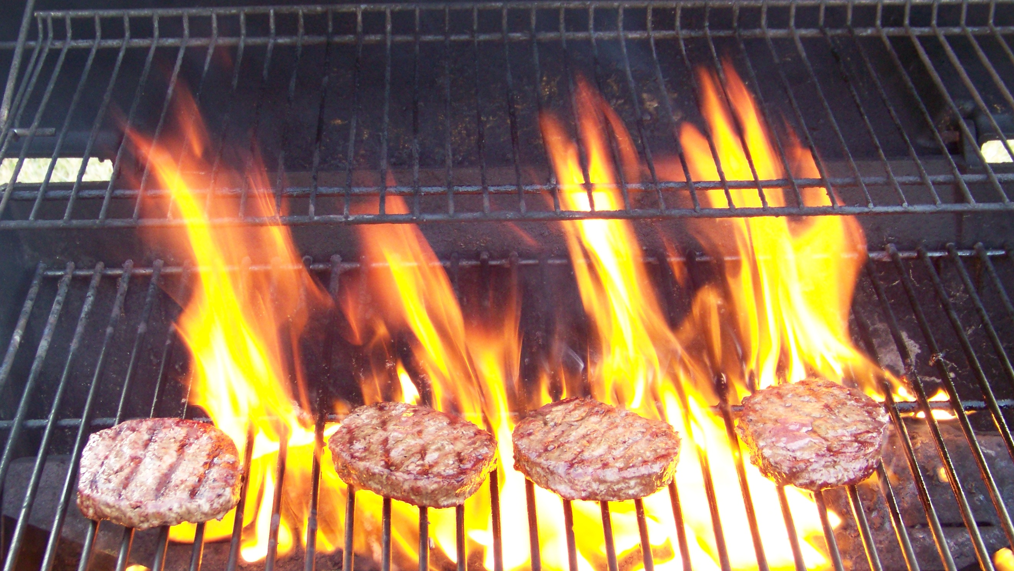
Questions?

