Slide 1
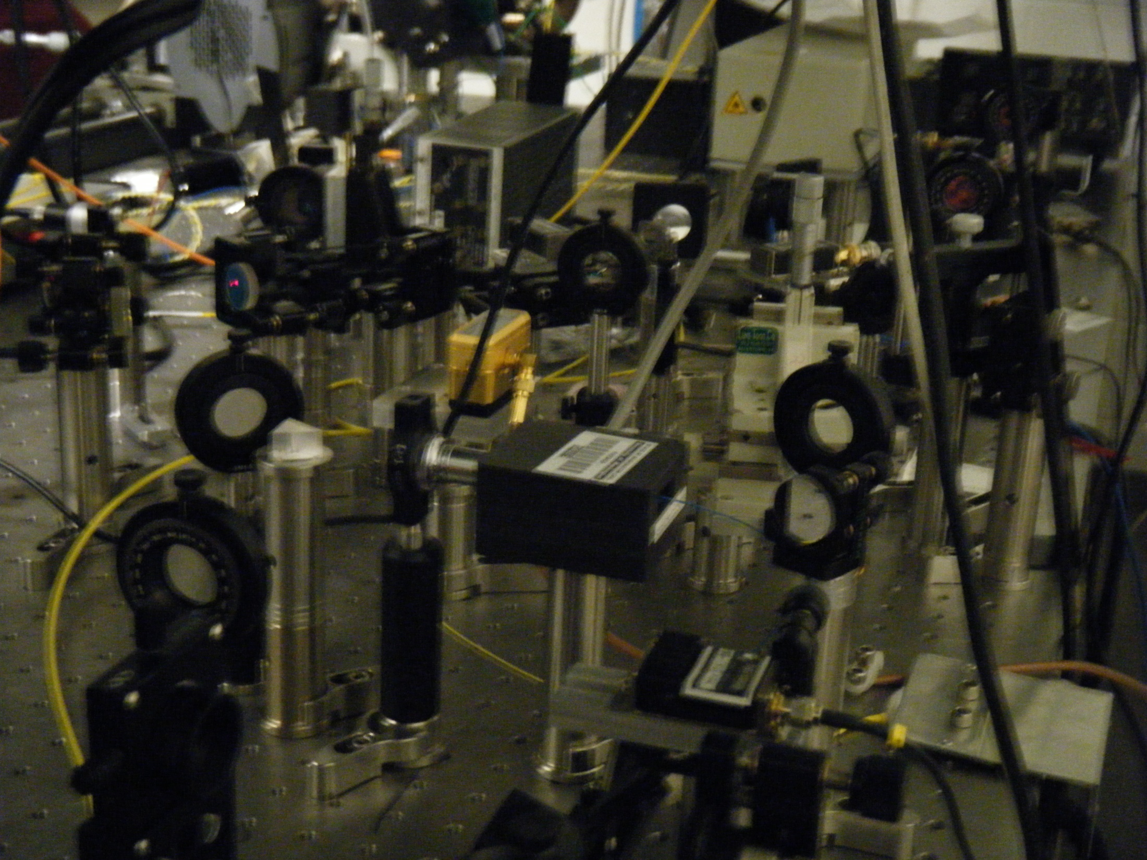
A Better Way to De-shelve ¹³⁷Ba⁺
Andrea Katz
Trinity University
UW REU 2010

Slide 2
Review of Quantum Computing
Traditional computers use bits, which can only be either 0 or 1.
Quantum computing employs qubits, which can be any linear combination of 0 and 1.
Quantum computers could quickly factor large numbers (Shor’s algorithm) and break RSA encryption

Slide 3
How Do We Make a Qubit?
We can implement a qubit by allowing two energy levels in a trapped ion to be the two states of the qubit.
Paul traps:
http://depts.washington.edu/qcomp/pdfs/matt_thesis.pdf

Slide 4
Ba⁺ as a Qubit
Simplified energy level diagram for ¹³⁷Ba⁺

Slide 5
Overview of my project
Produce an orange beam by sending an infrared laser beam through a PPLN waveguide
Align the orange beam and get it to the ion trap
Set up a double passed acousto-optic modulator and a Fabry-Perot cavity to help with laser stabilization

Slide 6
Getting Orange from Infrared
To Ion
PPLN wave-guide
AOM
IR Laser
To Cavity
Coupler
Polarization Paddles

Slide 7
PPLN Waveguides
PPLN (Periodically poled lithium niobate) crystals have a periodic reversal of domain orientation
Non-linearity of the crystal allows for second harmonic generation
PPLN crystals are more efficient than other non-linear crystals for second harmonic generation because of x² nonlinearity
Using a waveguide instead of a regular crystal also increases SHG efficiency

Slide 8
Phase Matching in PPLN
Phase matching is essential for efficient second harmonic generation!
We can adjust temperature to achieve phase matching.
http://www.thorlabs.com/catalogPages/693.pdf

Slide 9
Fabry-Perot Cavities and Stabilization
Only certain wavelengths of light are resonant within the cavity, those in which an integer number of wavelengths fit inside the cavity.
We can “lock” the laser to the transmission peak closest to our desired wavelength.
http://www.int.washington.edu/REU/2009/2009_images/Adams_and_Davis.pdf

Slide 10
Future Steps
Complete laser stabilization at the right wavelength
Use the orange beam to de-shelve ¹³⁷Ba⁺!

Slide 11
Thanks to Boris Blinov and the Trapped Ion Quantum Computing Group!
References:
Adams, Corey and Anya Davis. “Quantum Computing with Trapped Ions and Laser Cooling.” http://www.int.washington.edu/REU/2009/2009_images/Adams_and_Davis.pdf
Dietrich, M.R. Barium Ions for Quantum Computation. http://depts.washington.edu/qcomp/pdfs/matt_thesis.pdf
“Periodically Poled Lithium Niobate (PPLN)- Tutorial.” http://www.thorlabs.com/
catalogPages/693.pdf

