Slide 1
Gravitational Waves: Laser Interferometer Space Antenna (LISA)
Jessica Gifford | August 25, 2010 | Int-Reu

Slide 2
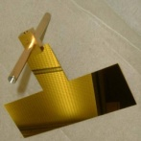
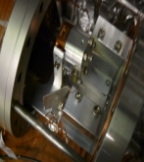
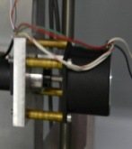
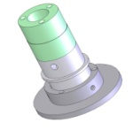
Out Line
Gravity Waves and Lisa
Torsion Pendulum
Old Electron Gun Measurements
New motor
Photocurrent measurements: Data and Design
Autocollimator and Temperature

Slide 3
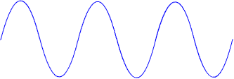
Gravitational Waves
Einstein’s General Relativity
Predicts gravity waves
More massive, more curvature, more gravity
The universe is mostly Minkowski space
Space Time Curvature is only as small effect
t₀
h ~ 10⁻²⁰
t₁
Gravitational Radiation
Detection: Oscillations in space time.
As location of masses change with time so does the curvature
t₂
Notes:
reconsider Space Time Curvature predict gravity waves
also, SPT Curvature is a small effect 1:10^20

Slide 4
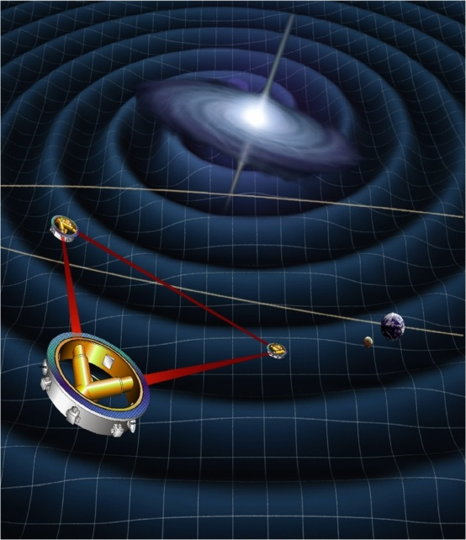
What is LISA?
5 million km
Laser off of masses
50 million km

Slide 5
Torsion Pendulum
Solar rays can charge pendulum causing problems…
Torsion pendulums correct for this:
Pendulum is supported by a thin fiber and is allowed to hang freely
Pendulum reacts to the amount of charge on it from the electrodes
An electron gun is used to negatively charge the pendulum
UV LED is used to positively charge the pendulum
Plates are able to move
Changes in angle are measured using an autocollimator
Feed back loop is used to “catch” the pendulum and keep it on the detector
Notes:
Pendulum reacts to the amount of charge on it.

Slide 6
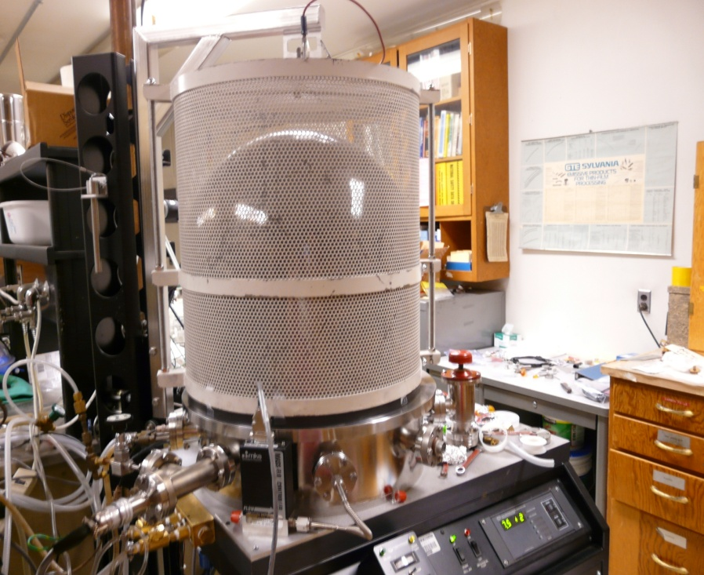
Old electron gun
Electron source
Magnesium that is evaporated onto aluminum
Electron gun
Electrons are ejected from magnesium by the photo effect and negatively charge the pendulum

Slide 7
Charge and Discharge Measurments
Demonstration of charge control
Procedure
Pendulum is locked in feedback using a feedback loop
Also called “catching”
Use the electron gun to charge negatively
Use the UV LED to positively charge the pendulum
Issues
Temperature fluctuations
Timing Gun off and LED on
Data
Intervals of 30seconds dictated by the time used to switch polarity of the plates
Polarity is switched to show that charges are measured from the pendulum
This is to show that the pendulum charge is measured not the electrodes and to show that it is independent of the polarity of the voltage that is applied to these feedback electrodes

Slide 8
Distance dependence
Noise Runs at various positions
V+ + V-
Time (s)
Noise Data
Want to see if there is distance dependence
Taken over night 8 separate days
Taken at 9 different distances ranging from 2mm-8mm in 1mm increments
2mm 3mm
4mm 5mm
6mm 7mm
8mm

Slide 9
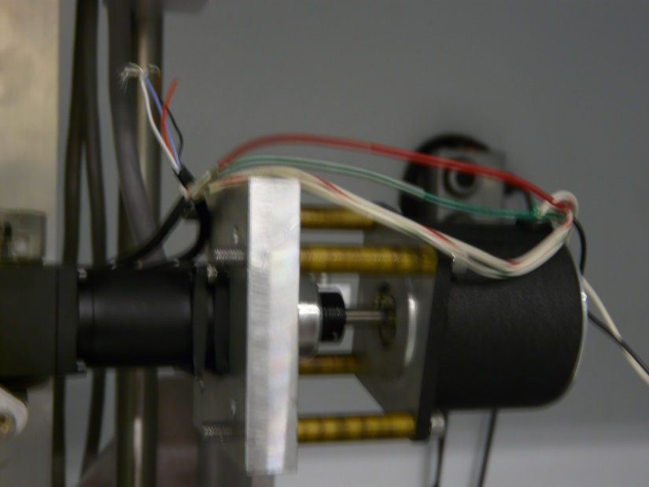
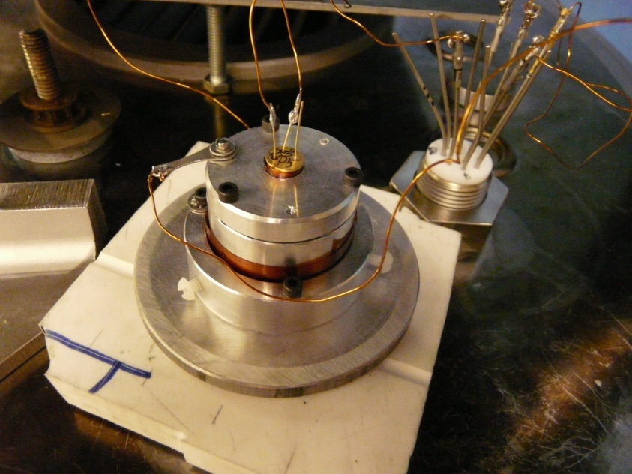
New motor and current measurements
Installed new stepper motor
Built device to measure photo current of our UV LED
Criteria: Compatible with Pontech controller
Bipolar
Need ~5V : 4.2V
No more then 2A: 1.4A (we measured 2A)
Compact size around 4mm : 2mm
Materials
Magnesium Cathode
Aluminum cylinder and lid
Insulation
UV Led

Slide 10
UV LED Photo Current Measurment

Slide 11
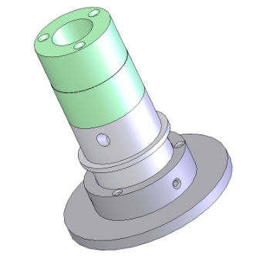
New Design
Cathode Candidates
Element | Work Function
Caesium | 2.10 eV
Rubidium | 2.16 eV
Sodium | 2.28 eV
Pottasium | 2.30 eV
Calcium | 2.90 eV
Lithium | 2.90 eV
Magnesium | 3.66 eV
Insulation
Aluminum Plate
UV Led
(330nm,3.8eV )
(244nm,5.1eV)
Einzel Lens
Mesh
Magnesium

Slide 12
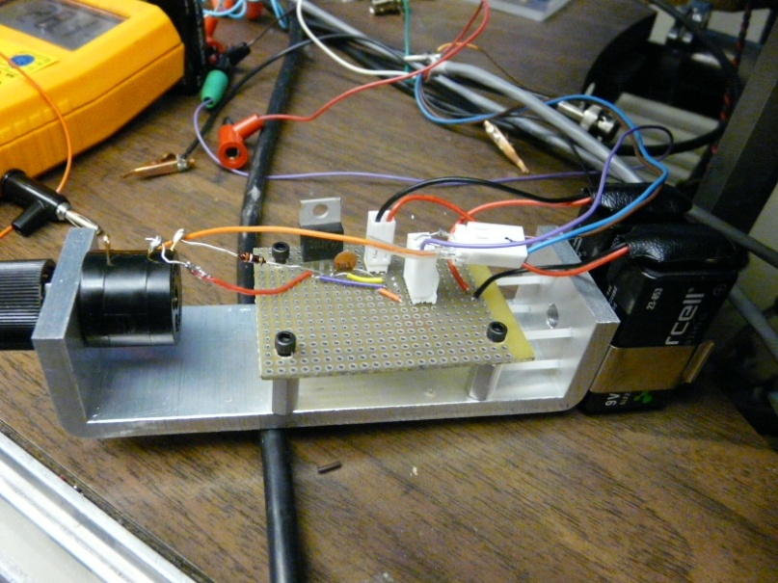
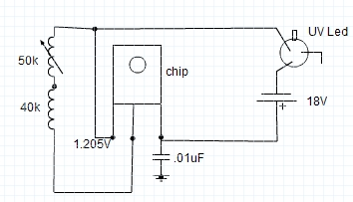
Initial Data
Built battery system for the UV Led power
Fixes current leakage
Used two different Led’s with no Einzel Lens
Current leakage
Noise regime
Signal drastically changes when you are in the room
LM317

Slide 13
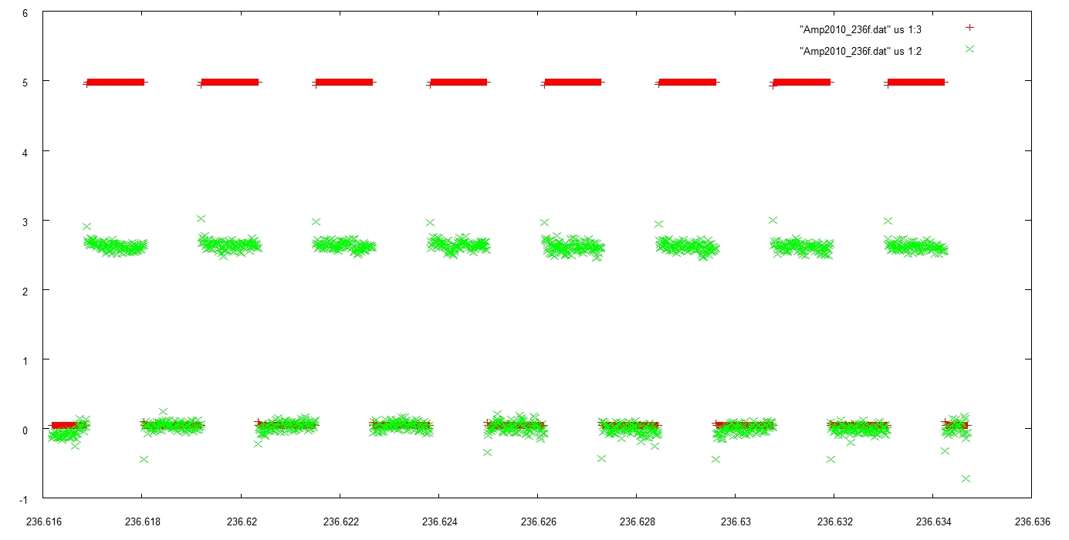
Data with new design
Using a DAQ program: Integrated the power supply to be controlled by program
Time (fraction of day 236)
Current (nA)
Time (fraction of day 236)

Slide 14
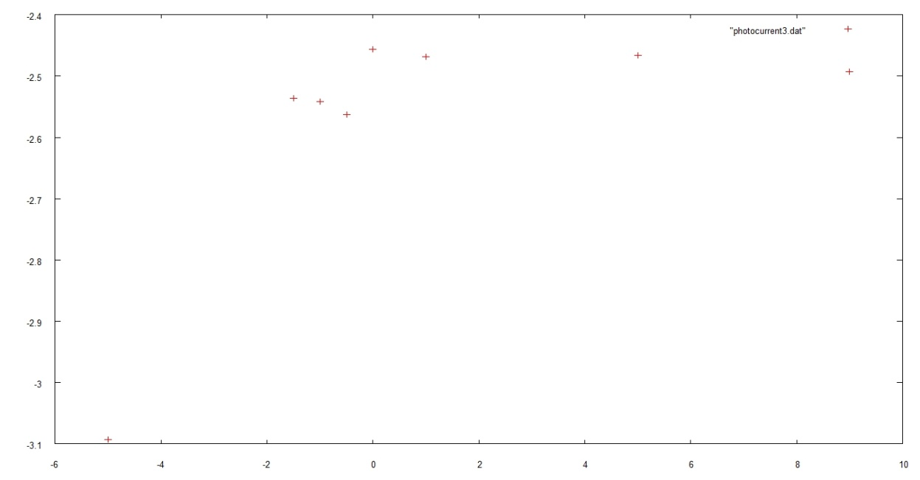
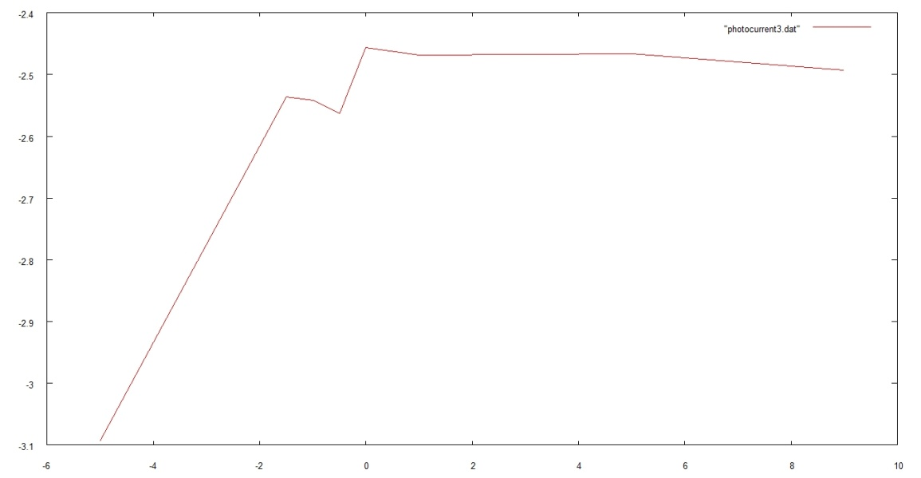
Data with new design
Photo Current Measurements with DAQ
Took current measurements from -5V to 5V
Expect the current to rise at higher voltages and level off at more negative voltages
Do see a drop around -5V
More investigation is needed to see if this is photocurrent and for what ranges of voltages we see the change
Current (nA)
Voltage (v)
Current (nA)
Voltage (v)

Slide 15
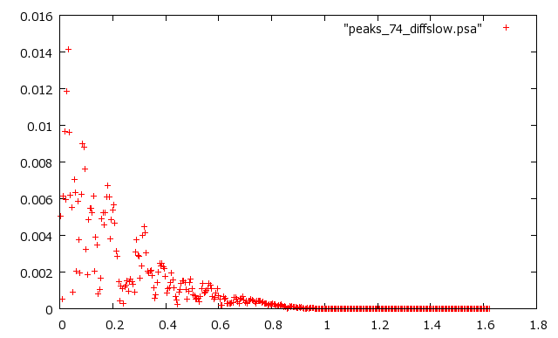
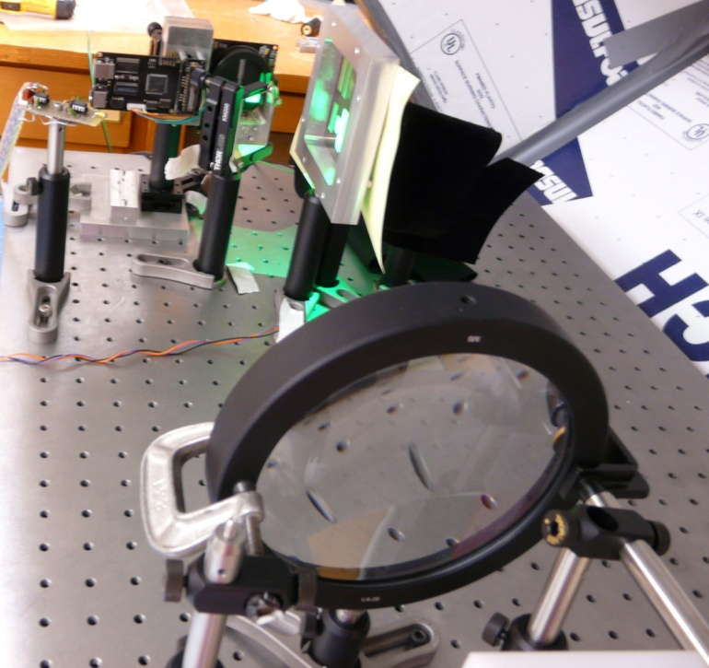
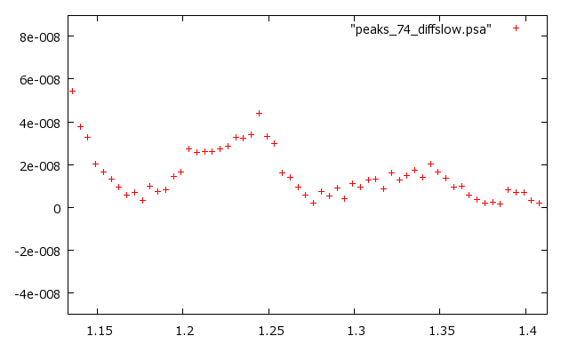
Auto collimator
Torque (pNm)
Frequency ( mHz)
System of two lasers created by a diffraction grating
First laser is stationary and second one moves relative to it
Noise issues:
Sound
Mechanics
Thermal
Torque (pNm)
Frequency ( mHz)

Slide 16
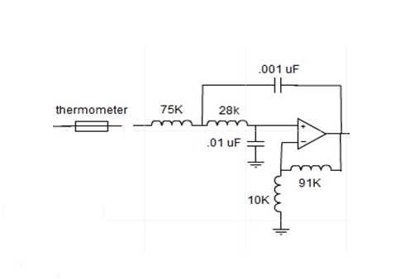
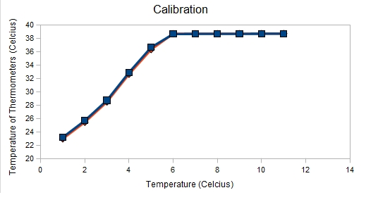
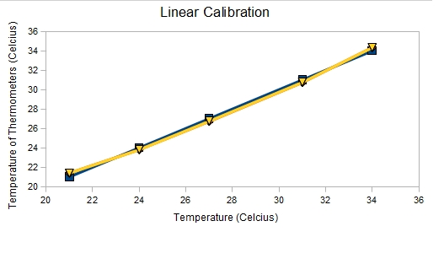
Thermometers
Built a system of two thermometers to measure thermal changes of our set up
Output to DAQ

Slide 17
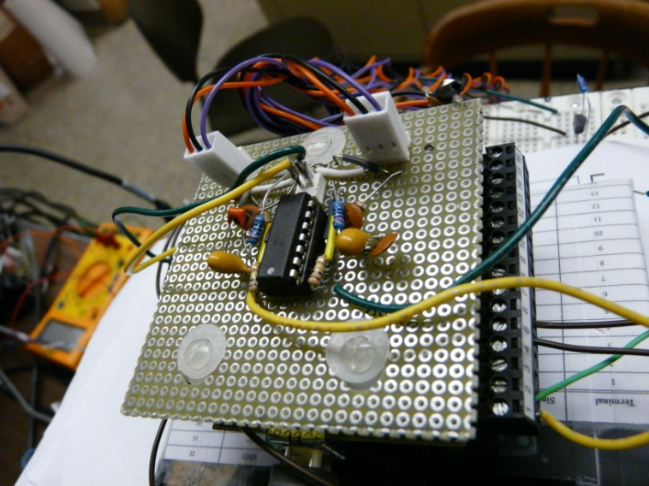
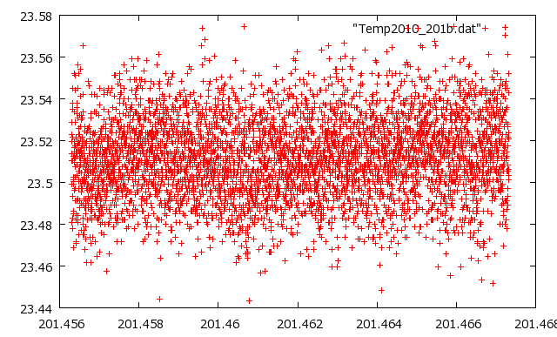
Thermometer data
Temperature (C)
Temperature Data
First took raw temperature data
Data taken inside and outside the box
Peaks represent different noise components
Time (fraction of day 201)

Slide 18
Future
Take power spectral density measurements of the distance data for the LISA pendulum
Take new data with the motor
Vary the voltage between the Mg and Al of the electron gun and take photo current measurements to show that we are in fact measuring photocurrent and for what voltages
Test full design of electron gun with Einzel lens
Integrate the autocollimator and temperature programs so they can be correlated at the same times
Larger goal: Redesign autocollimator after temperature characterization

Slide 19
Acknowledgments
Thank you to:
Stephan Schlamminger: Advisor
-Charlie Hagedorn: Graduate Student
-Jens Gundlach : Professor
-David Hyde: Shop Manager
- Ron Musgrave: Machine Shop Inst.
-Gravity Group Members
CENPA faculty and staff
Special Thanks to :
-Alejandro Garcia
-Deep Gupta
-Janine Nemerever
-Linda Vilett
For making this REU experience possible

