Slide 1
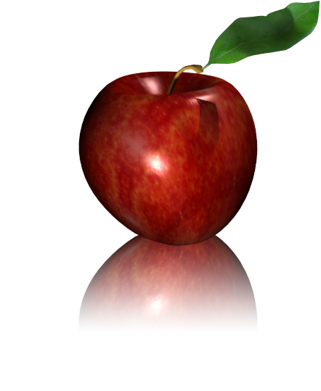
Physics Education Research into Reflection and Transmission in the Context of Waves and Physical Optics
Presented By Claire McKay Chow

Slide 2
Outline
What is Physics Education Research
Data Collected
Data Analyzed
Future Research Possibilities

Slide 3
What is the Goal of Physics Education Research?
.
To improve student learning in physics courses by
Identifying
Addressing
common problems among students on physics concepts.
Notes:
“Physics Education Research (PER) delves into the learning, understanding, and teaching of physics . It tries to find better ways to identify and address common problems among students on physics concepts.”
Talk about what physics education research is about. How it helps students and faculty.

Slide 4
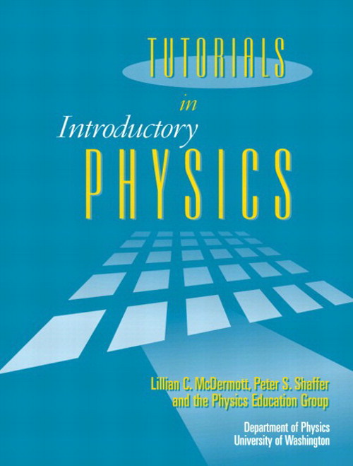
Notes:
How Research, Curriculum, and Instruction all works together in the University of Washington Physics Education Group.
Research: pretests post tests and student interviews
Curriculum: PBI and Tutorials
Instruction: the classes

Slide 5
What is Tutorials in Introductory Physics?
Designed to supplement standard instruction in introductory university physics courses.
It consists of:
Pretests – gauge level of understanding and more.
Worksheets – a guide for students to answer together with others in a group.
Homework assignments - reinforce the ideas from class and the worksheets.
Notes:
Explain what Tutorials in Intro Phys is. State that UW PEG is constantly trying to improve this curriculum based on the pre and post tests (research) to help improve instruction.

Slide 6
Pretest on Reflection and Transmission
Pretests are typically administered after relevant instruction.
Faster Slower
1a) How does the tension of spring B compare to spring A?
1b) How does the linear mass density of spring B compare to spring A?
Less Than, Greater Than, Equal To, or Not Possible with Given Information. Explain.
Equal To
Greater Than
Notes:
To start the research, I have to look at data. It came in the form of pretests. Before analyzing the pretests, I had to know the answers as well as what kind of responses would be considered “completely” correct.

Slide 7
Example of Correct Student Responses
1a)“Neither Spring A nor B are moving (save for wave pulses) so the net force on each of them is zero. The tension force on the right end of A is, by Newton's laws, the same as the tension force on the left end of B. Therefore, the tension force in each spring is the same.”
Notes:
Mention key parts not key words that are looked at for a correct answer.

Slide 8
Example of Correct Student Responses
1b)“There are two ways to increase pulse speed - increase tension or decrease mass/length. Since the pulse was slower on spring b, it must have more mass per unit length than spring a, because the tension in both is the same.”

Slide 9
Analysis of Results
Linear Mass Density
 | Equal To | Greater Than | Less Than | Unable to Tell | Grand Total
Equal To | 5% | 15% | 5% | 0% | 20%
Greater Than | 0% | 5% | 5% | 5% | 10%
Less Than | 5% | 30% | 10% | 15% | 55%
Unable to Tell | 0% | 1% | 0% | 10% | 10%
Grand Total | 10% | 50% | 20% | 25% | 100%
Tension
N = 2676 students
Many different classes and instructors.
Notes:
Point out biggest trends and the answers.

Slide 10
Questions Regarding Trends in Data
Why did so many students answer the question on linear mass density right (50%) compared to tension (20%)?
Why is “Less Than” the most popular answer for tension (55%)?
“More mass means more energy is required to move the spring in a wave motion, thus in spring B with more mass, the wave would travel slower due to more energy needing to be exerted.”
“It was demonstrated last week that a pulse will move faster in a spring that is stretched out more. Because the pulse moves faster in spring A, spring A has more tension.”
Notes:
Student’s have the correct intuition regarding density rather than tension. However, observations can be misleading as they used this for tension.

Slide 11
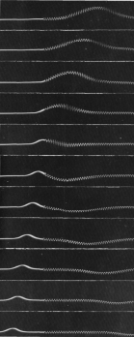
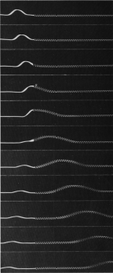
Worksheet on Reflection and Transmission
The tutorial guides students in analyzing two spring systems to:
Predict shape of the springs.
Compare prediction to photographic evidence.
Wave traveling from light to heavy spring.
Students make analogies between
Waves passing from one spring to another and
Pulses in spring with fixed and free ends. (studied in prior tutorial)
Wave traveling from heavy to light spring.
Notes:
Shows photographs on handouts. Students then come to realize that there is always a transmitted and reflected pulse at the boundary of two media. Mention that there was a tutorial before hand about fixed and free ends, use the images to point out the side which the reflected pulse travels on.

Slide 12
Post Test on Reflection and Transmission
1a) How does the tension of spring 1 compare to spring 2?
1b) How does the linear mass density of spring 1 compare to spring 2?
Less Than, Greater Than, Equal To, or Not Possible with Given Information.
Equal To
Greater Than
Question | Pretest | Post Test N = 102
1a) | 20% | 90%
1b) | 50% | 80%
Both | 15% | 75%
Notes:
Instead of pretest where the pulse speed is given, students must now infer from the picture which spring has a faster wave pulse.

Slide 13
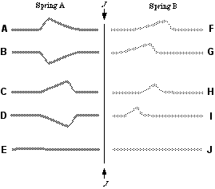
Looking at Pretests Again
Second question on the pretest that relates to the first question by identifying which spring has the higher linear mass density.
Faster Slower
After the pulse has traveled past junction J, what shape(s) do the springs take out of the following options?
C and I
Less than 5% of students answered correctly, 90% answered with a transmitted pulse, 60% had no reflected pulse.
Notes:
Reflection is ever elusive to students.

Slide 14
Post Test on Reflection and Transmission
Post test asked to draw the reflected and transmitted pulses given an incident pulse on two springs. The springs went from heavy to light and vice versa.
 | Heavy to Light | Light To Heavy | Pretest Light to Heavy
Percent of Total Students | 15% | 15% | 60%
Class size of 84 students.
The percent has improved, but some students are still missing reflection.
Notes:
There are still many students that are missing the reflection aspect.

Slide 15
Thin Film Interference
Similar to springs.
The first boundary acts like a fixed end.
The second boundary acts like a free end.
Tutorial aims to make this connection.
Thickness of film is also important.
Fixed
Out of phase
Free
In phase
The incident pulse is perpendicular to the soap film and is tilted for visual purposes.
Notes:
Springs are the bases for thin film interference.

Slide 16
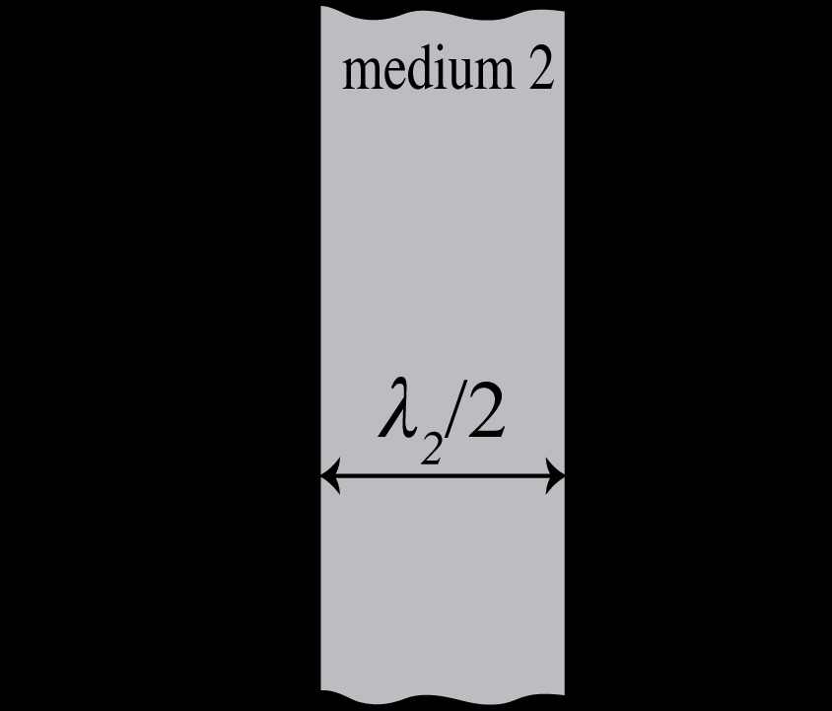
Pre- and Post-test on Thin Film Interference
If n1>n2 and n3>n2, will the observer see a maximum brightness, minimum brightness, or neither? Explain.
medium 1 medium 3
Minimum Brightness

Slide 17
Analysis of the Results
Response | Pretest N = 79 | Idea of Reflection | Post Test N = 149 | Used Reflection
Minimum | 40% | 65% | 50% | 80%
Maximum | 45% | 40% | 50% | 45%
A third of the class believes that changing medium three does not make a difference in reflection.

Slide 18
Going “Back” to the Future
Modify worksheet and homework on thin film to improve scores on post tests.
Compare Teacher and Student Responses
Look more closely into how much students retain the idea of reflection on a boundary over each pretest, tutorial, and posttest.
Expand research into other topics in physical optics and waves.

Slide 19
Credit
Got you Peter!
Couldn’t do any research without the help of my amazing research advisor, graduate students in the “fish bowl,” Donna, Mac, David, and the rest of the PEG Team.

