Slide 1


Nuclear structure IV (nuclear theory, open quantum systems, superheavies)
Witek Nazarewicz (UTK/ORNL)
National Nuclear Physics Summer School 2014
William & Mary, VA
Recent developments
Perspectives

Slide 2
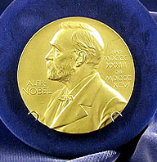
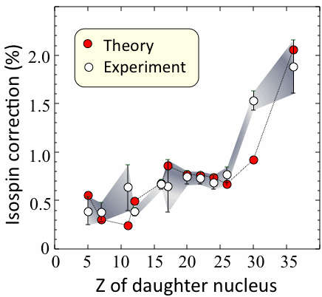
Microscopic calculations of isospin-breaking corrections to superallowed β-decay
W. Satuła et al.,Phys. Rev. Lett 106, 132502 (2011)
Superallowed Fermi 0⁺ →0⁺ β-decay studies
Impressive experimental effort worldwide
Kobayashi and Maskawa: … for "the discovery of the origin of broken symmetry, which predicts the existence of at least three families of quarks in nature."
nuclear
meson decay
Towner and Hardy 2010
0.9999(6)
Notes:
the decays of K and B mesons,
more cases measured… stay tuned…
Advances in isospin mixing calculations

Slide 3
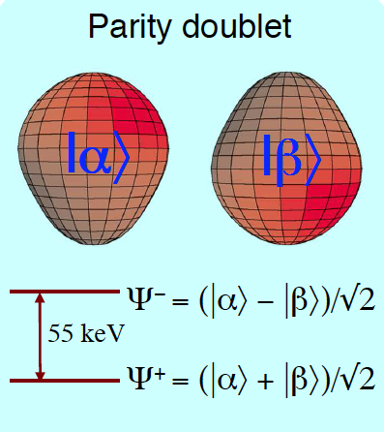

The violation of CP-symmetry is responsible for the fact that the Universe is dominated by matter over anti-matter
Gaffney et al., Nature 199, 497 (2013)
Closely spaced parity doublet gives rise to enhanced electric dipole correlations
Large intrinsic Schiff moment
¹⁹⁹Hg (Seattle, 1980’s – present)
²²⁵Ra (Starting at ANL and KVI)
²²³Rn at TRIUMF
Potential at FRIB (10¹²/s w ISOL target (far future); 10¹⁰ initially
Theory!

Slide 4
The radioactive galaxy demonstrates the continuing formation of new radioactive isotopes
S. Bruenn et al., ApJ 767, L6 (2012)
S. Rosswog et al., MNRAS 430, 2585 (2013)

Slide 5
Quality control
Uncertainty quantification
“Remember that all models are wrong; the practical question is how wrong do they have to be to not be useful”
                (E.P. Box)

Slide 6
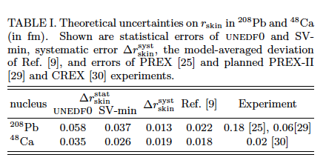
Information content of future measurements
Nuclear theory is developing tools to deliver uncertainty quantification and error analysis for the assessment of new experimental data. Theoretical tools can also be used to assess the information content of an observable with respect to current theoretical models, and evaluate the degree of correlation between different observables.
see “Error Estimates of Theoretical Models: a Guide” (arXiv:1402.4657)
M. Kortelainen et al., Phys. Rev. C 88, 031305 (2013)

Slide 7
Theoretical Tools and Connections to Computational Science
Tremendous opportunities
for nuclear theory!
1teraflop=10¹² flops
1peta=10¹⁵ flops (today)
1exa=10¹⁸ flops (next 10 years)
33.9 pflops
Notes:
K-machine: Fijitsu

Slide 8

“High performance computing provides answers to questions that neither experiment nor analytic theory can address; hence, it becomes a third leg supporting the field of nuclear physics.”
NAS Decadal Study

Slide 9
Future: large multi-institutional efforts involving strong coupling between physics, computer science, and applied math

Slide 10


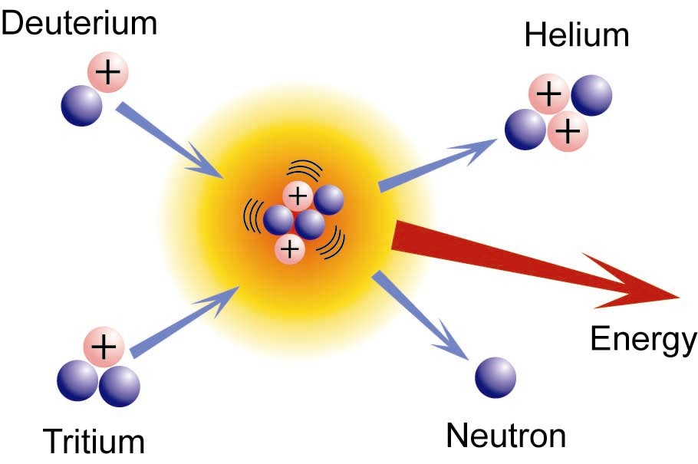
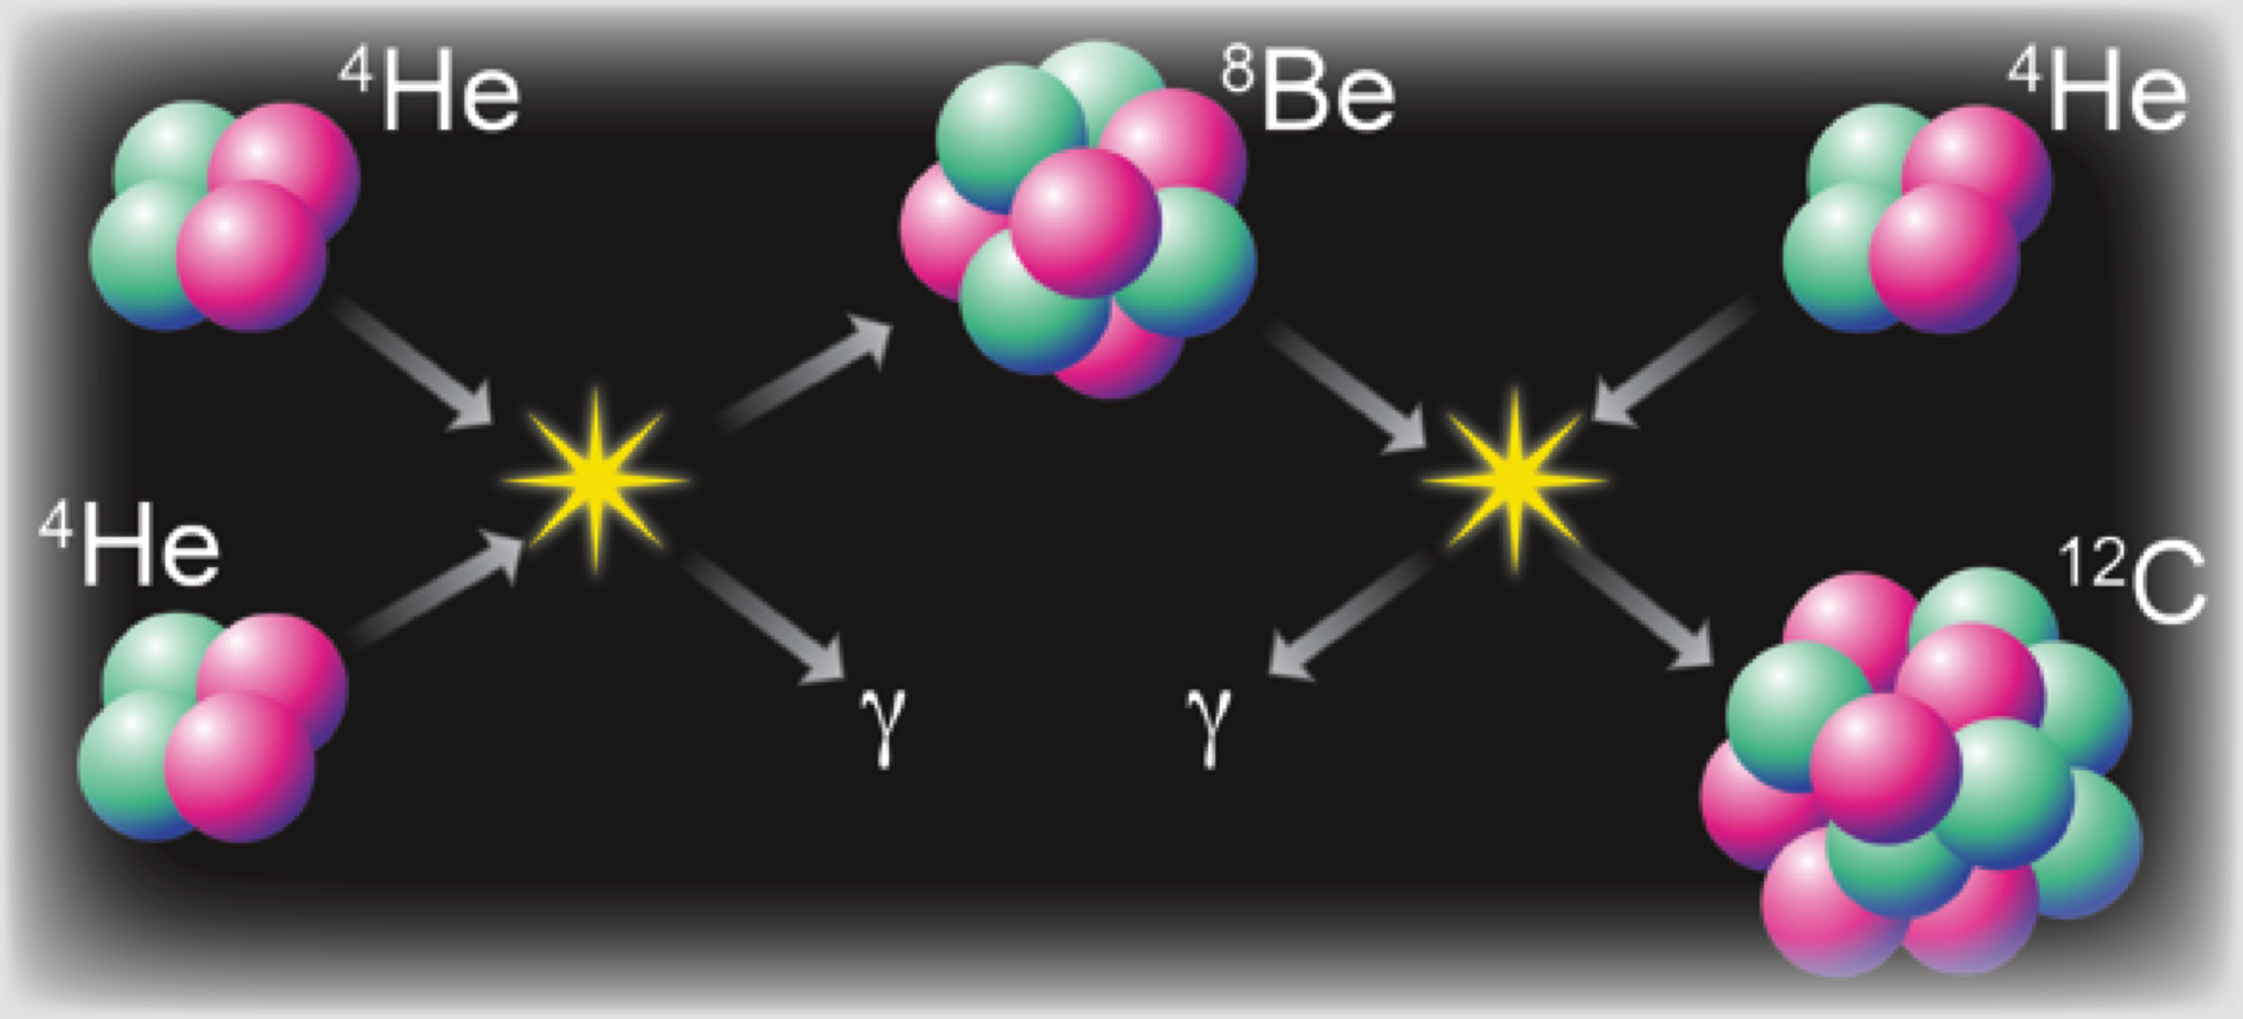
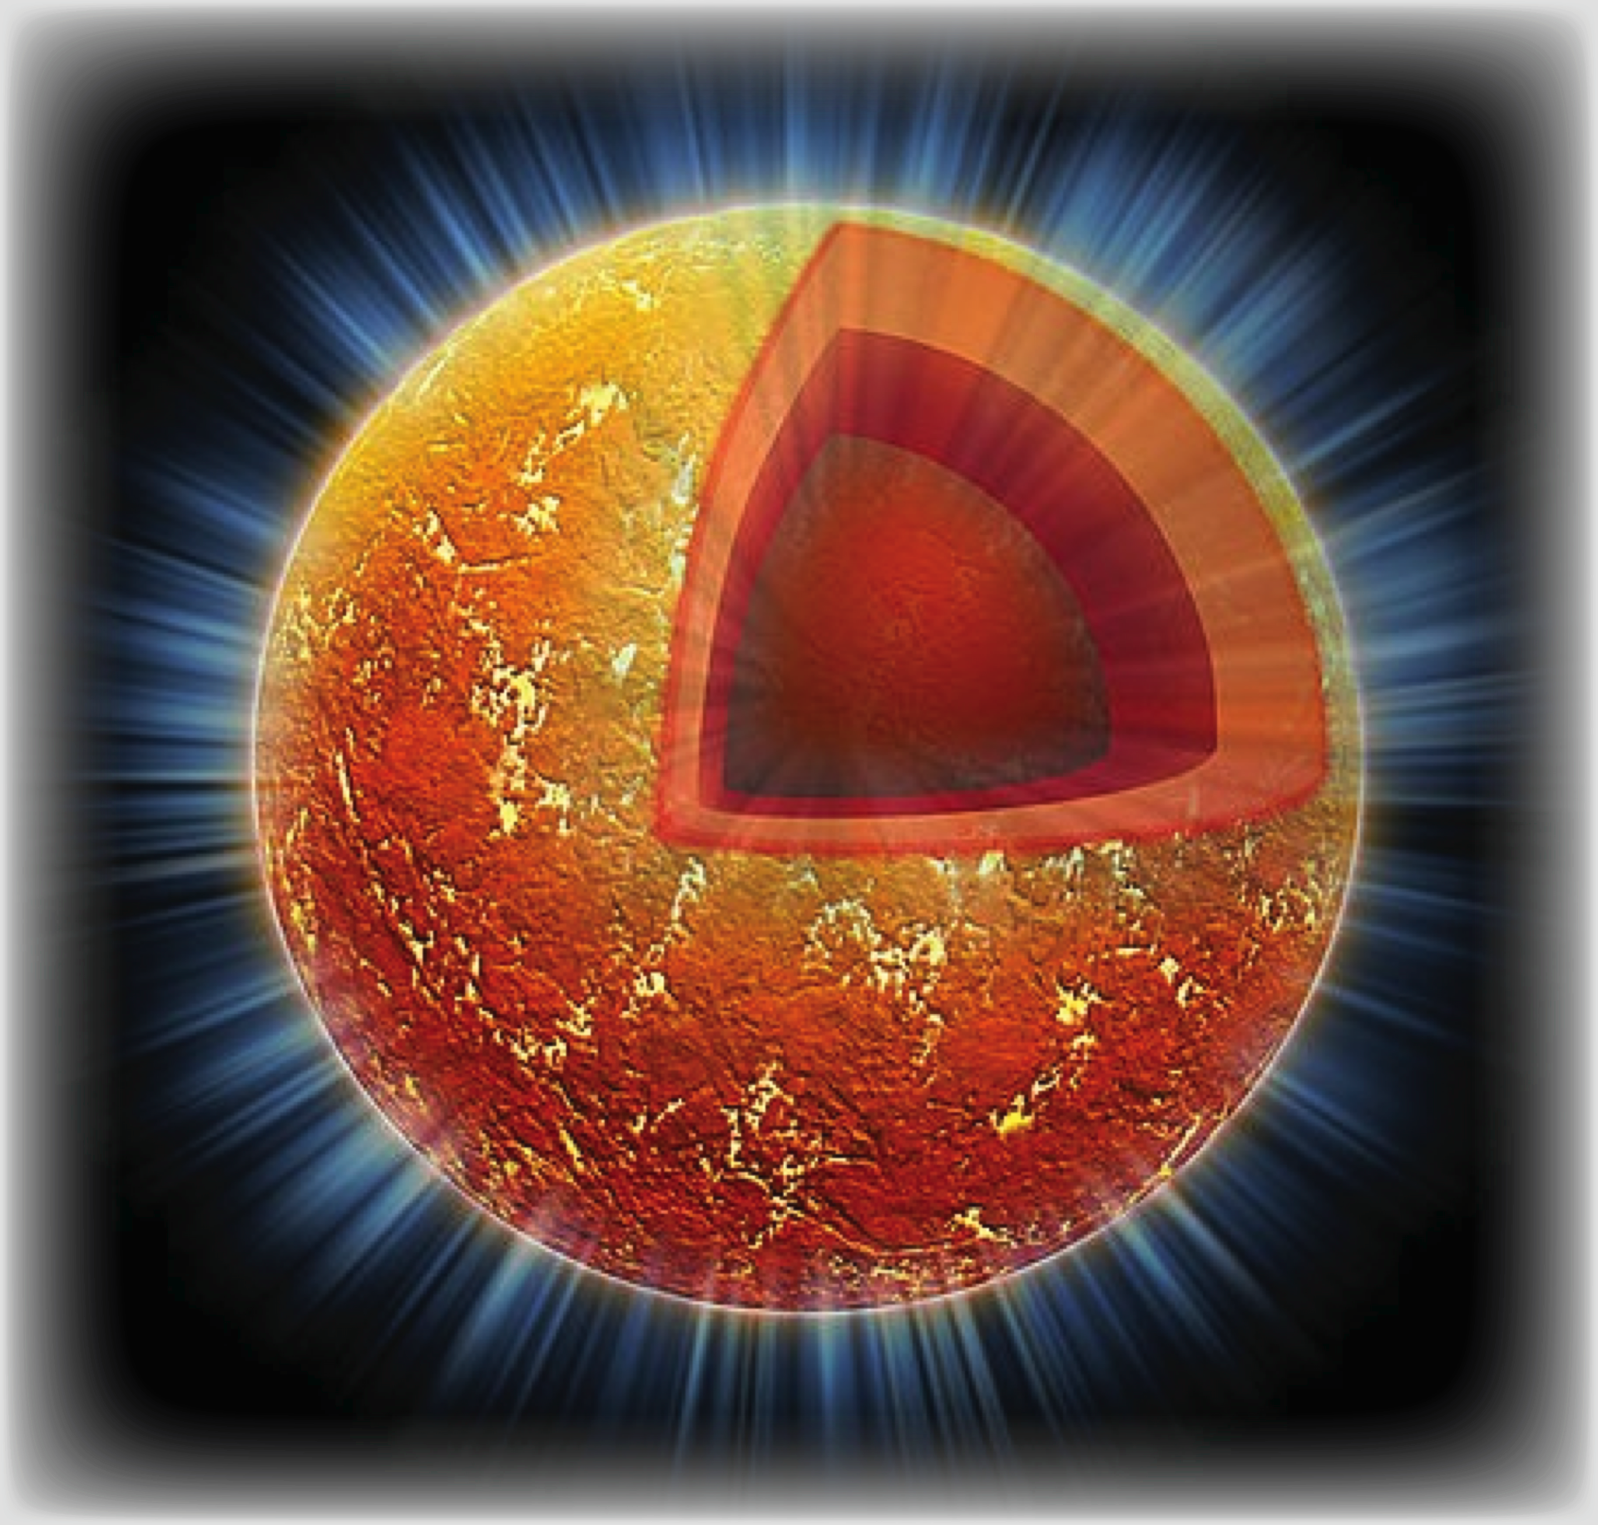
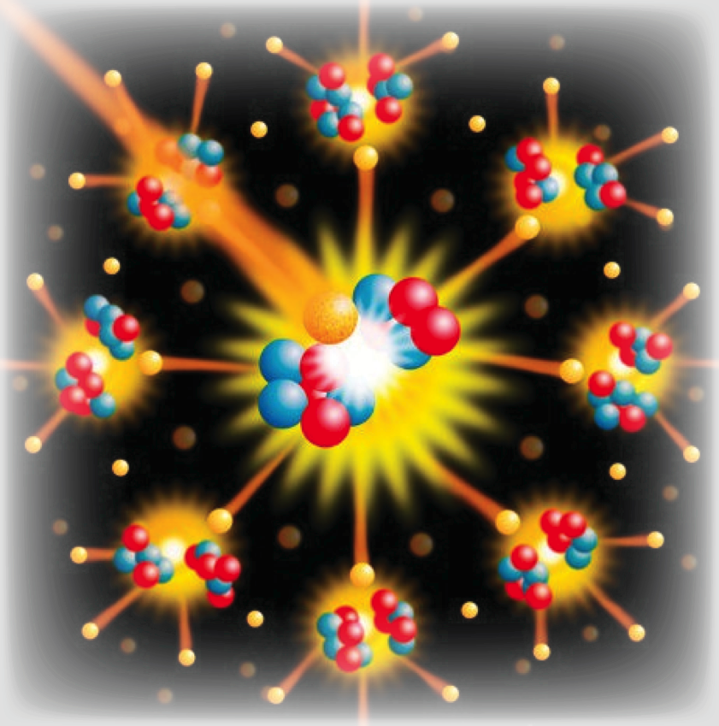
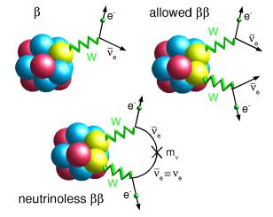
computingnuclei.org
fusion
Validated Nuclear
Interactions
LENP facilities
NIF
TJNAF
Chiral EFT
Ab-initio
Optimization
Model validation
Uncertainty Quantification
FRIB
Structure and Reactions:
Light and Medium Nuclei
Neutron drops
EOS
Correlations
Structure and Reactions:
Heavy Nuclei
Stellar burning
Ab-initio
RGM
CI
Load balancing
Eigensolvers
Nonlinear solvers
Model validation
Uncertainty Quantification
DFT
TDDFT
Load balancing
Optimization
Model validation
Uncertainty Quantification
Eigensolvers
Nonlinear solvers
Multiresolution analysis
Neutrinos and Fundamental Symmetries
Neutron Stars
Fission
SNS
LANL
LLNL
Majorana
EXO

Slide 11
Open quantum systems

Slide 12
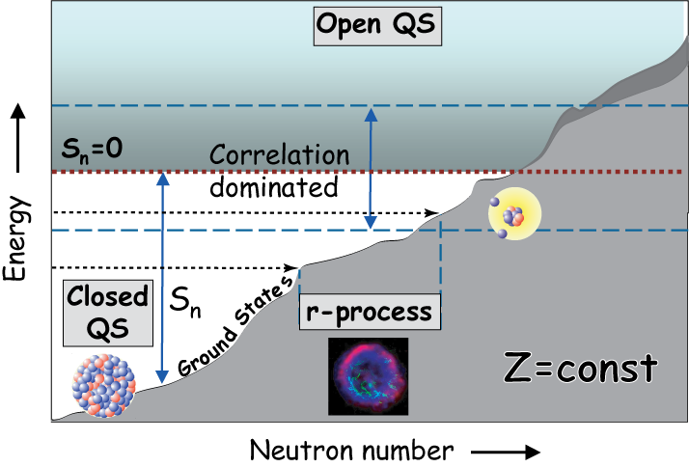
Prog. Part. Nucl. Phys. 59, 432 (2007)

Slide 13
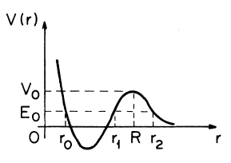
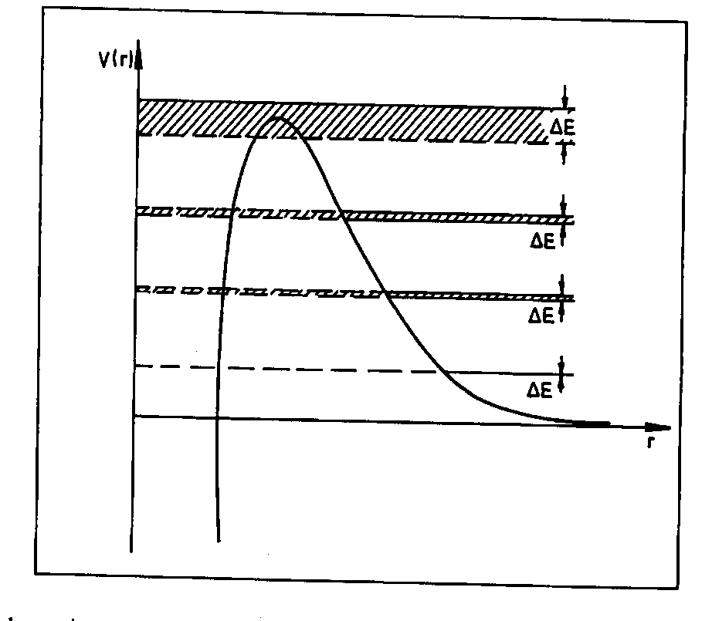
Quasistationary States
(alpha decay)
N is a number of radioactive nuclei, i.e., number of particles inside of sphere r=R:
J.J. Thompson, 1884
G. Gamow, 1928
relation between decay width and decay probability

Slide 14
Basic Equations
Time Dependent (Many Body) Schödinger Equation
+ boundary conditions
Often impractical/impossible to solve but an excellent starting point
Time Independent (Many Body) Schödinger Equation
Box boundary conditions (w.f. vanishes at large distances)
Decaying boundary conditions
Incoming or capturing boundary conditions
Scattering boundary conditions
Absorbing boundary conditions
choice
depends
on
physics
case

Slide 15
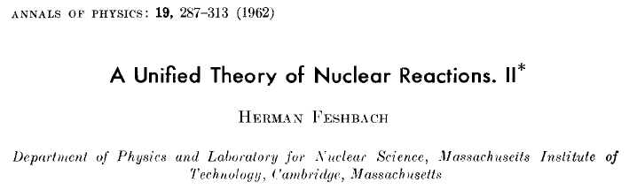
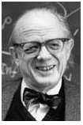

H. Feshbach
…
Basic idea:
SM
Q – nucleus, localized states
P – environment, scattering states
CSM
closed quantum
system
hermitian
anti-hermitian
open quantum
system

Slide 17
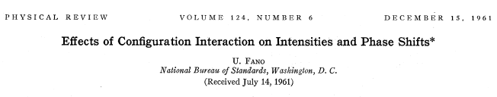

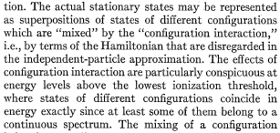
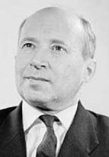

Shell Model for Open Quantum Systems
Gamow Shell Model
U. Fano
It took over 40 years and required the development of:
I.M. Gelfand
T. Berggren
New mathematical concepts: Rigged Hilbert Space (≥1964),…
Generalized completeness relation including s.p. bound states, resonances, and
scattering states (∼1968)
New many-body framework(s): Gamow Shell Model (2002), …

Slide 18
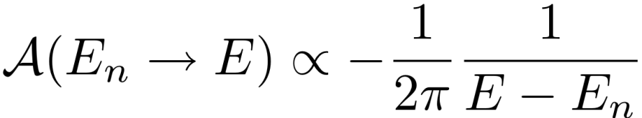
Rigged Hilbert Space: the natural framework to formulate
quantum mechanics
In mathematics, a rigged Hilbert space (Gel’fand triple, nested Hilbert space, equipped Hilbert space) is a construction designed to link the distribution and square-integrable aspects of functional analysis. Such spaces were introduced to study spectral theory in the broad sense. They can bring together the 'bound state' (eigenvector) and 'continuous spectrum', in one place.
Mathematical foundations in the 1960s by Gel’fand et al. who combined Hilbert space
with the theory of distributions. Hence, the RHS, rather than the Hilbert space alone, is
the natural mathematical setting of Quantum Mechanics
I. M. Gel’fand and N. J. Vilenkin. Generalized Functions, vol. 4: Some Applications of Harmonic Analysis. Rigged Hilbert Spaces. Academic
Press, New York, 1964.
The resonance amplitude associated with the Gamow states is proportional to the complex delta function and such amplitude can be approximated in the near resonance region by the Breit-Wigner amplitude (Nucl. Phys. A812, 13 (2008)):
For a pedagogical description, see R. de la Madrid, Eur. J. Phys. 26, 287 (2005)

Slide 19
Resonant (Gamow) states
outgoing
solution
complex pole
of the S-matrix
Humblet and Rosenfeld, Nucl. Phys. 26, 529 (1961)
Siegert, Phys. Rev. 36, 750 (1939)
Gamow, Z. Phys. 51, 204 (1928)
Also true in many-channel case!

Slide 20
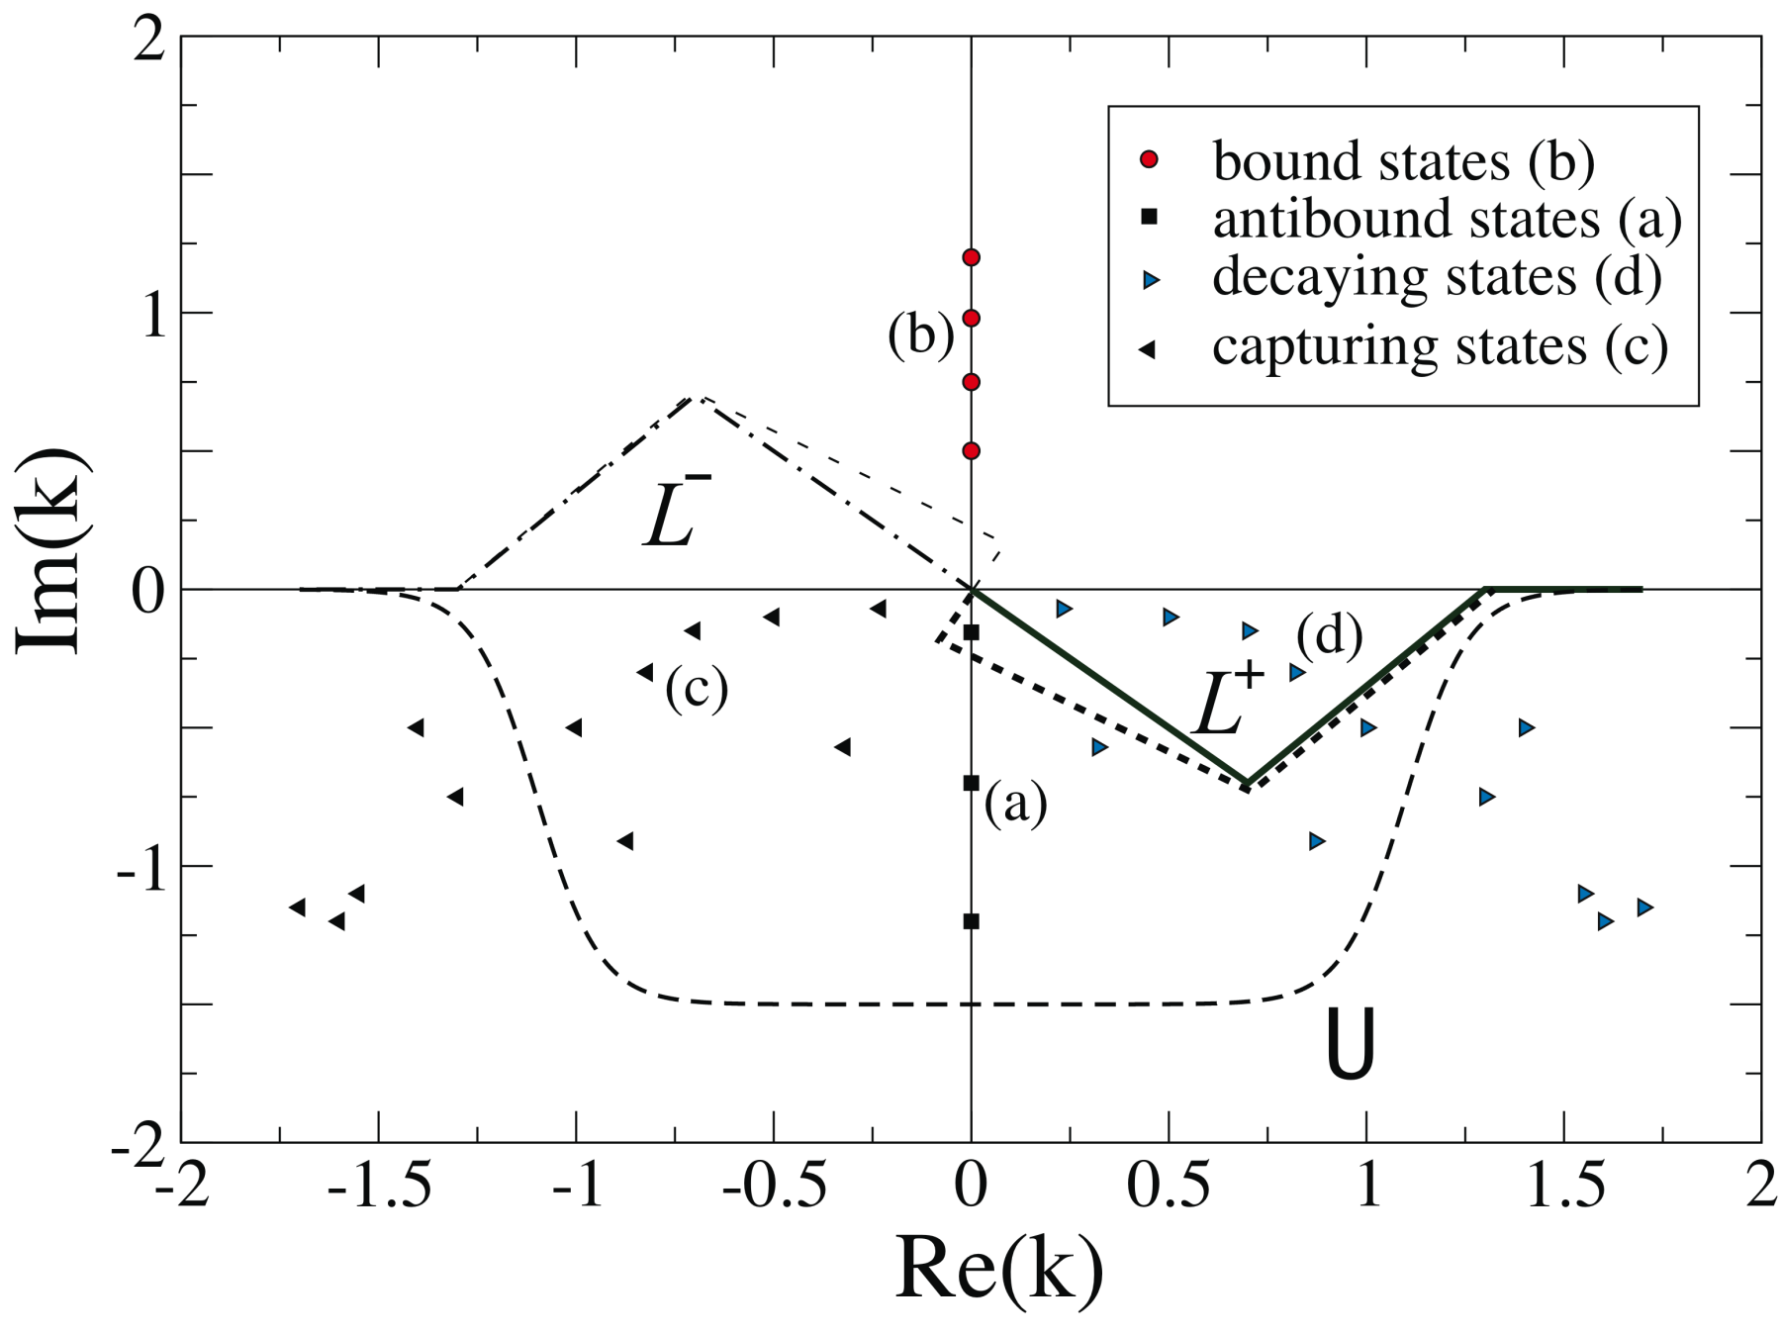
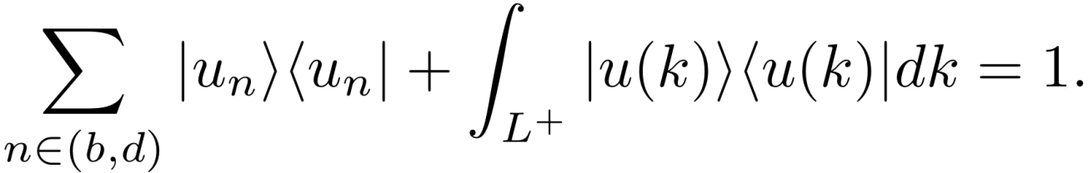
Gamow states and completeness relations
One-body basis
Newton
T. Berggren, Nucl. Phys. A109, 265 (1968)
T. Lind, Phys. Rev. C47, 1903 (1993)
Berggren ensemble for a given jl channel:

Slide 21
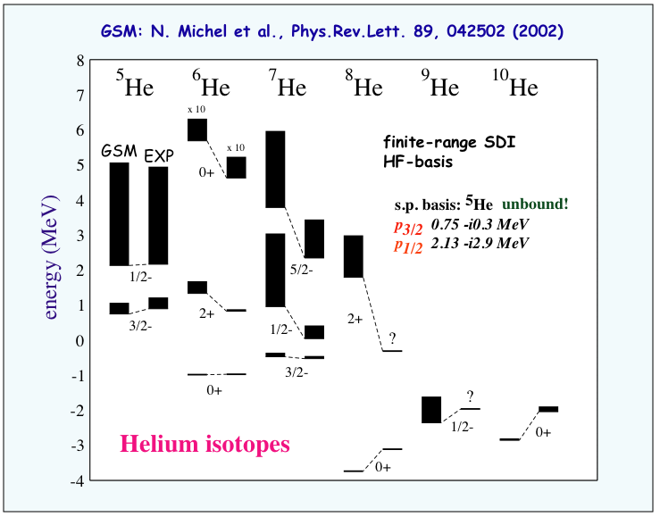
S_{2n} in ⁸He greater than S_{2n} in ⁶He

Slide 22
Open problems in the theory of nuclear open quantum systems
N. Michel et al., J. Phys. G 37, 064042 (2010)
What is the interplay between mean field and correlations in open quantum systems?
What are properties of many-body systems around the reaction threshold?
What is the origin of cluster states?
What should be the most important steps in developing the theory that will treat nuclear structure and reactions consistently?
  How to understand (Rigged) Quantum Mechanics of open quantum systems?
  How are effective interactions modified in open quantum systems?

Slide 23
Superheavy nuclei

Slide 24
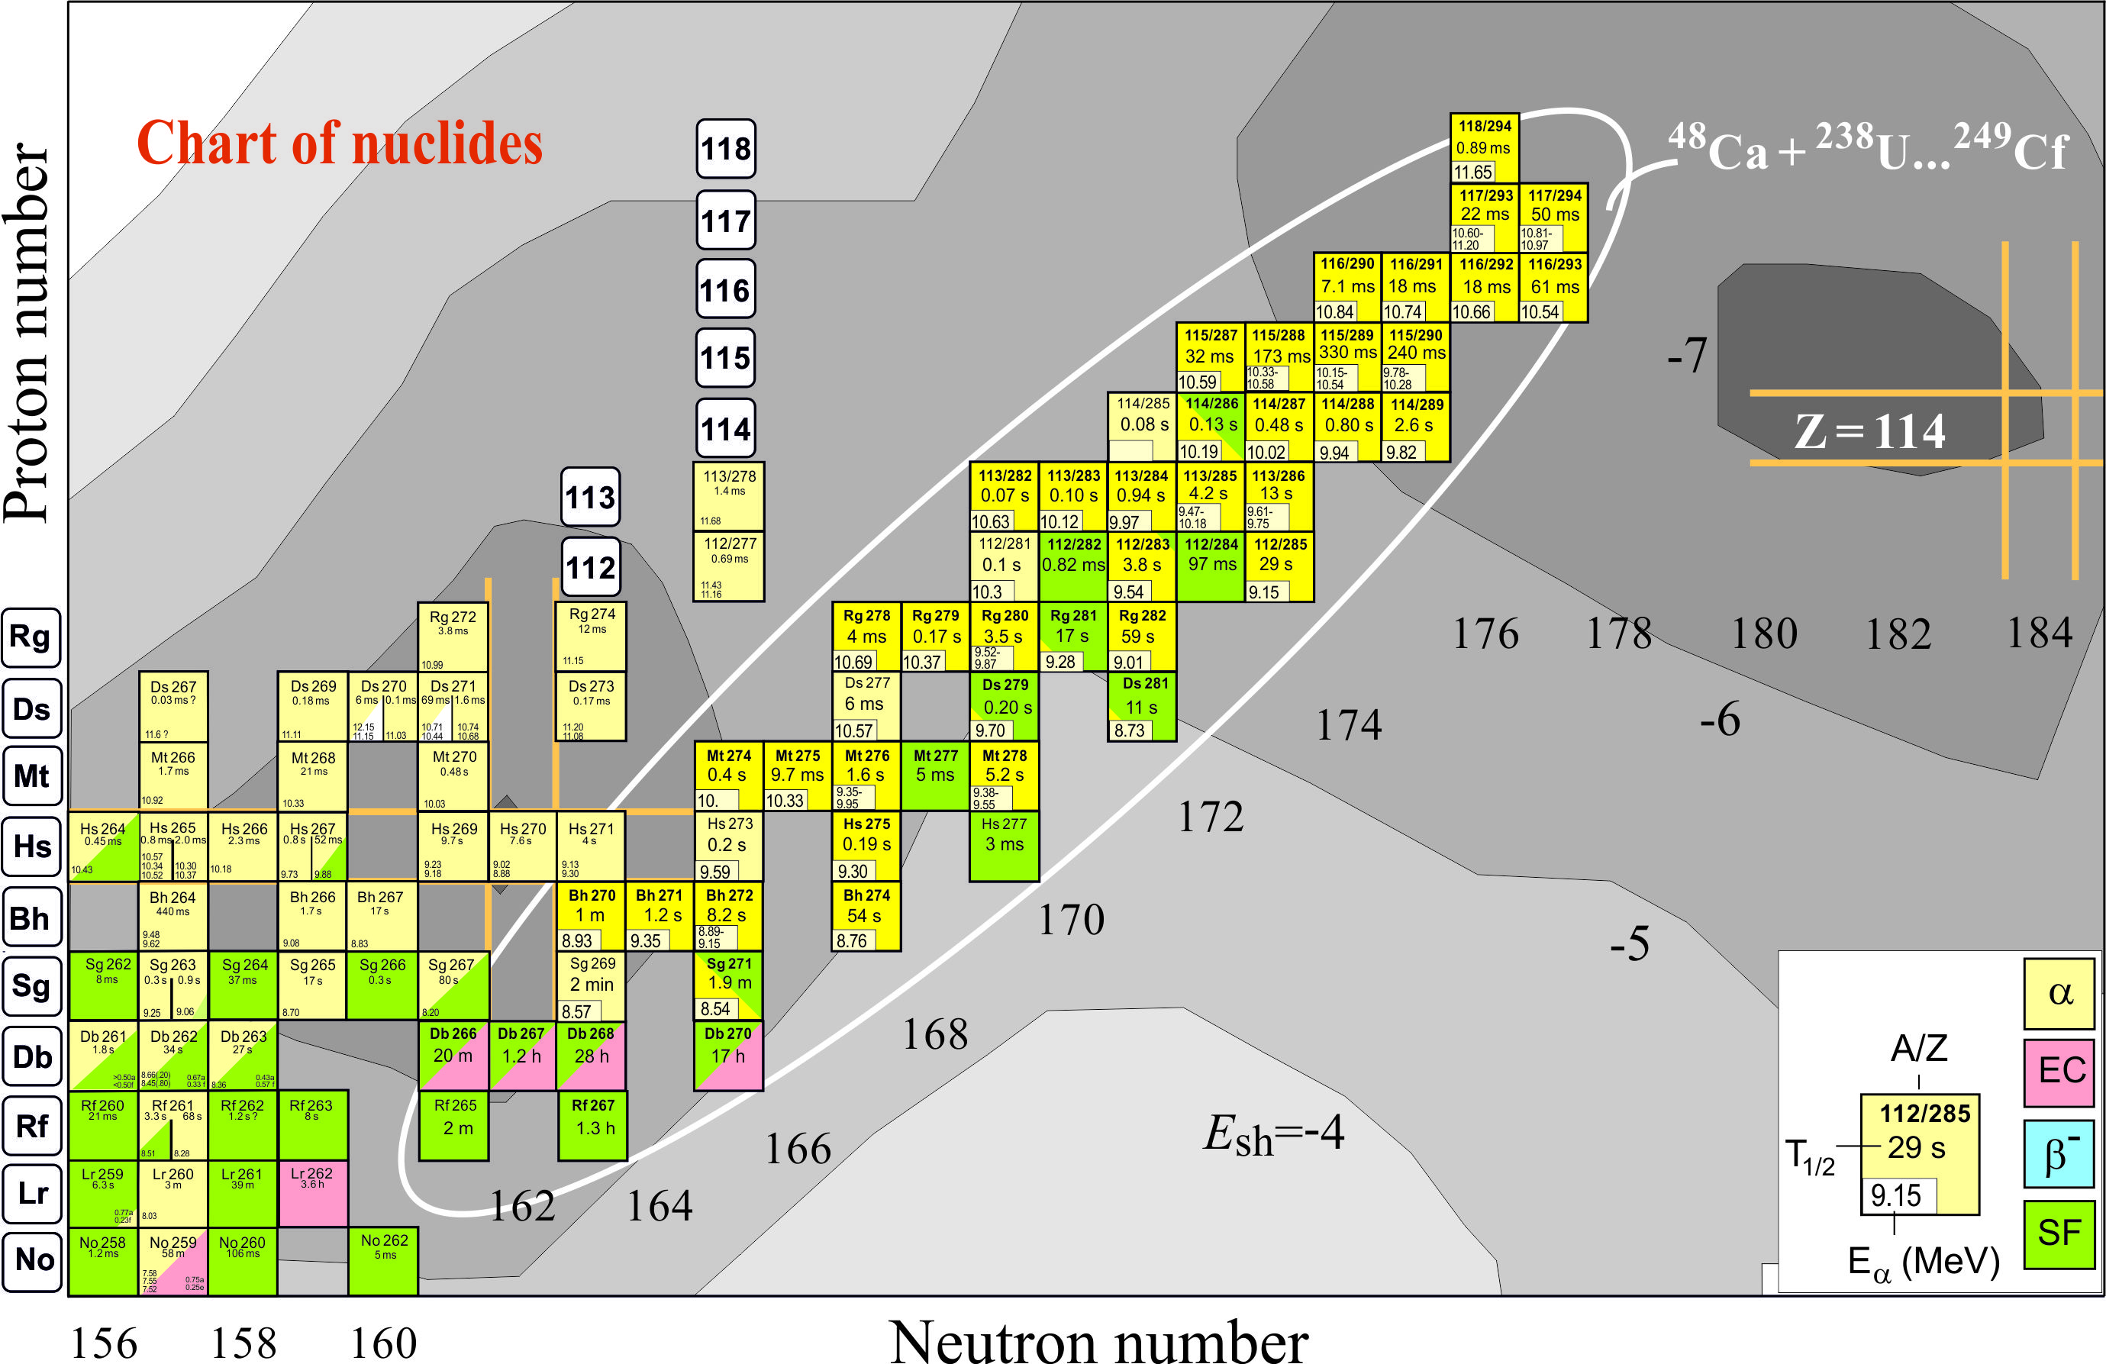
Limits of Mass and Charge: Superheavies
2 events/year
~50 new isotopes
A/Z | Setup | Laboratory | Publication
²⁸³112 | SHIP | GSI Darmstadt | Eur. Phys. J. A32, 251 (2007)
²⁸³112 | COLD | PSI-FLNR (JINR) | Nature 447, 72 (2007)
^{286, 287}114 | BGS | LBNL (Berkeley) | P.R. Lett. 103, 132502 (2009)
^{288, 289}114 ^{292, 293}116 | TASCA SHIP | GSI – Mainz GSI Darmstadt | P.R. Lett. 104, 252701 (2010) Eur. Phys. J. A48, 62 (2012)
²⁹⁴117 ^{287,288}115 | TASCA TASISpec | GSI – Mainz | P.R. Lett. 111, 112502 (2013)
²⁹⁴117 | TASCA | GSI – Mainz | Feb. 2014
Notes:
Extension of the Mendeleev table
Chemistry of the SHE

Slide 25
Are superheavy atoms and nuclei different from lighter species?
Yes!
Very large density of electronic and nucleonic levels
Electromagnetic interaction is huge
Competition between short-range nuclear force and long-range electrostatic repulsion results in the Coulomb
frustration effects

Slide 26
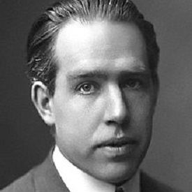
1939: Bohr’s paper on fission

Slide 27
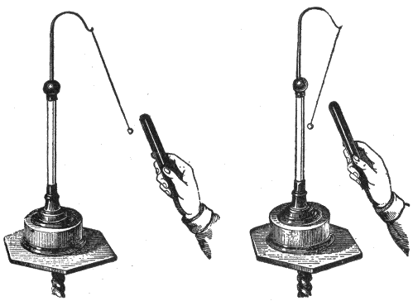
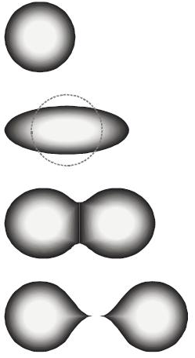
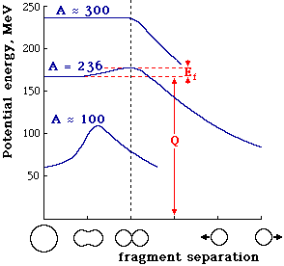
electrostatic (Coulomb)
repulsion
fission of nuclear
droplet
fissility parameter:
The nuclear droplet stays
stable and spherical for x<1.
For x>1, it fissions immediately.
For ²³⁸U, x=0.8

Slide 28
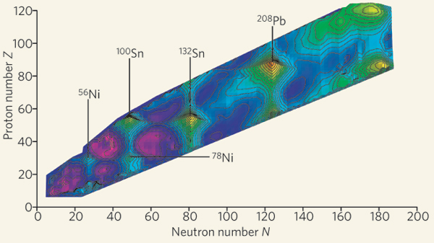
(Z=82, N=126)
(Z=28, N=50)
Nature 449, 411 (2007)
Magic numbers at Z or N= 2, 8, 20, 28, 50, 82,126

Slide 29
Is the concept of magicity
useful in superheavy nuclei?
Probably not!
²⁰⁸Pb (Z=82, N=126) probably the last honest-to-goodness doubly-magic nucleus!

Slide 30
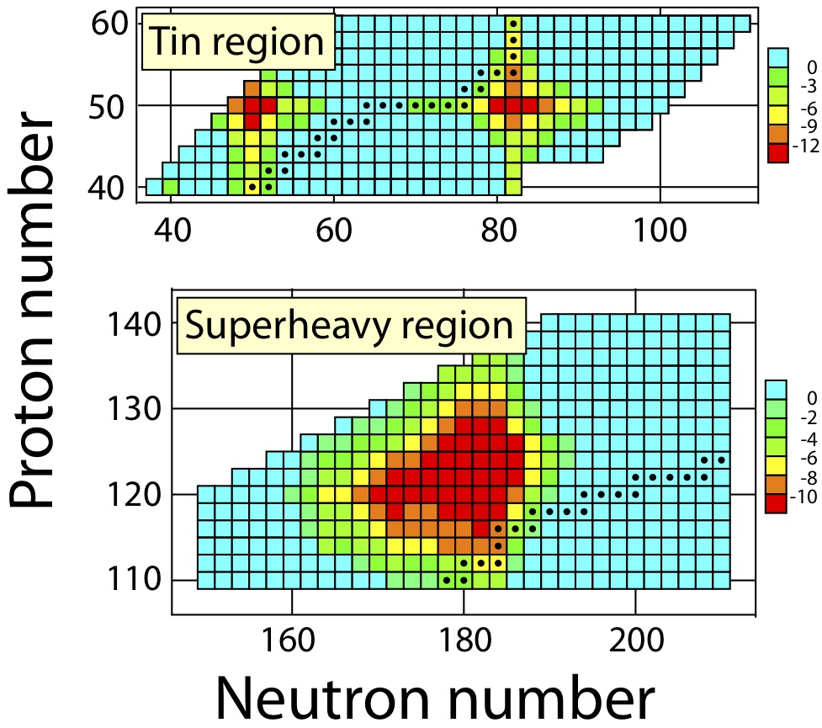
Shell structure and Coulomb frustration
Small shifts of single-particle levels can impact shell structure significantly
Shell energy
Level density
M. Bender et al.
Phys. Rev. C 60, 034304 (1999)
M. Bender et al.
Phys. Lett. B 515, 42 (2001)
Because of the presence of highly-degenerate high-j levels and the smallness of the gaps in the single-particle spectrum, significant binding originates from the bunching of low-j orbits near the Fermi energy, not from the gaps

Slide 31
Where is the end of the nuclear landscape at the extremes of mass and charge?
We do not know…
We really do not know!

Slide 32
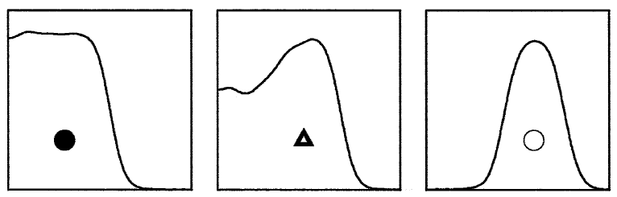

Exotic topologies of superheavy nuclei: Coulomb frustration
bubble
density
semi
bubble
normal
radial distance
Self-consistent calculations confirm the fact that the “pasta phase” might have a rather complex structure, various shapes can coexist, at the same time significant lattice distortions are likely and the neutron star crust could be on the verge of a disordered phase.
A challenge is to assess stability of such forms

Slide 33
Exotic topologies of superheavy nuclei: Coulomb frustration
S. Ćwiok et al
see also Jachimowicz, Kowal, Skalski, Phys. Rev. C 83, 054302 (2011)

Slide 34
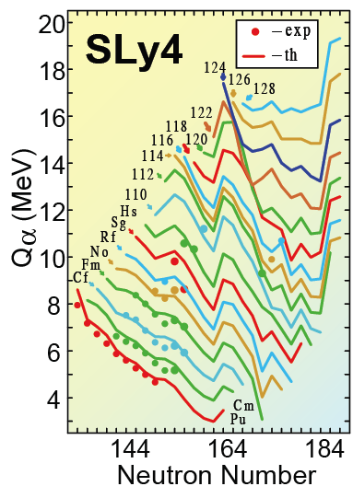
Q_{α} values and deformations fairly robust; easier to predict
V. Prassa et al., Phys. Rev. C86 (2012) 024317
S. Cwiok et al , Nature 285 (2005) 705
M. Bender & P.-H. Heenen, arXiv:1210.2780

Slide 35
Computed quadrupole ground-state shape deformations
Global behavior shows generic patterns and similar systematic trends
Erler et al., Nature 486, 509 (2012)
N=258
N=184
Notes:
Z=20: Exp. 1973-75, DFT. 1975
Z=28: Exp. 1993-94, DFT. 1994
Overall: Dobaczewski et al. Phys. Rev. Lett. 72, 981 (1994)

Slide 36
Fission: the major uncertainty
²³⁸U lives 4.5 billion years
²⁵⁰No fissions after 4.2 μs
A huge span indeed!
Major theoretical challenge
Notes:
Universe: 13.8 billion years

Slide 37
Spontaneous Fission Lifetimes: huge theoretical uncertainties!
D1S
M. Warda and J.L. Egido, Phys. Rev. C 86, 014322
see also: Spontaneous fission lifetimes from the minimization of self-consistent collective action, Jhilam Sadhukhan et al., Phys. Rev. C 88, 064314 (2013)
J. Erler et al, Phys. Rev. C 85, 025802 (2012)

Slide 38
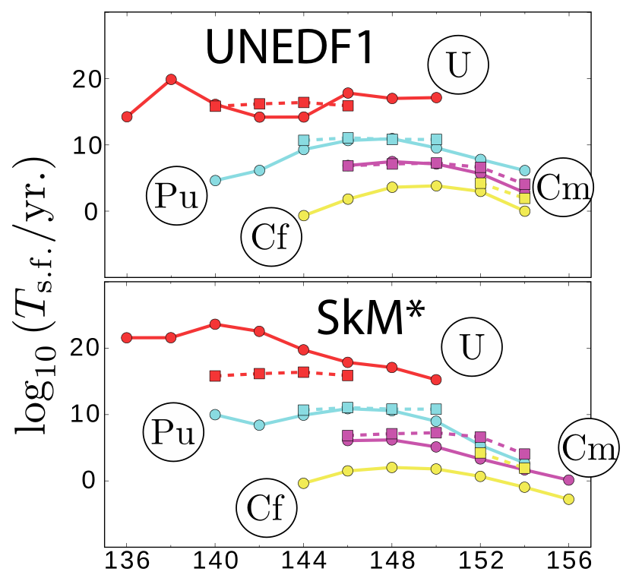
Spontaneous Fission Lifetimes
SF fission lifetimes in the actinides
Quality input
A. Staszczak, A. Baran, WN,
Phys. Rev. C 87, 024320 (2013)
J. McDonnell et al.

Slide 39
A. Staszczak, A. Baran, WN,
Phys. Rev. C 87, 024320 (2013)
Oganessian et al.
Spontaneous fission “Death Valley”

Slide 40
The major challenge:
towards N=184
The Holy Grail
How to get there experimentally?

Slide 41
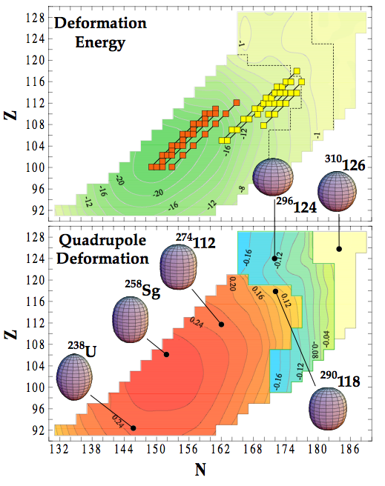
Towards long-lived Superheavy Nuclei
Nature, 433, 705 (2005)
long-lived superheavies

Slide 42

What are chemical properties of superheavy elements?
(after P. Schwerdtfeger)
Would element 137 (feynmanium) really spell the end of the periodic table?

Slide 43
The relativistic 7s contraction in Au and Rg
Consequence: Cu, Ag, Au nd¹⁰(n+1)s¹
Zn⁺,Cd⁺,Hg⁺
however: Rg, 112⁺ nd⁹(n+1)s² (²D_{5/2})
H
Rg
relativistic RgH
contraction
E. Eliav, U. Kaldor, P. Schwerdtfeger, B. Hess, Y. Ishikawa, Phys. Rev. Lett. 73, 3203 (1994).
M. Seth, P. Schwerdtfeger, M. Dolg, K.Faegri, B.A. Hess, U. Kaldor, Chem. Phys. Lett. 250, 461 (1996).

Slide 44
Relativistic shell-expansions and spin-orbit
Due to the increased relativistic shielding by the s-orbitals, the diffuse
p_{3/2} and higher angular momentum orbitals will expand relativistically
ε [a.u.]
C. Thierfelder, P. Schwerdtfeger, A. Koers, A. Borschevsky, B. Fricke, Phys. Rev. A 80, 022501-1-10 (2009).

Slide 45
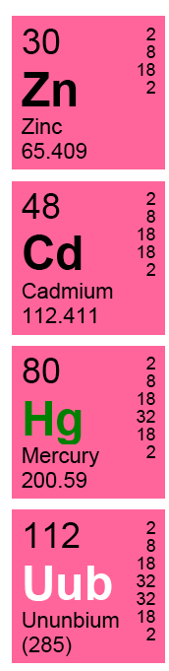
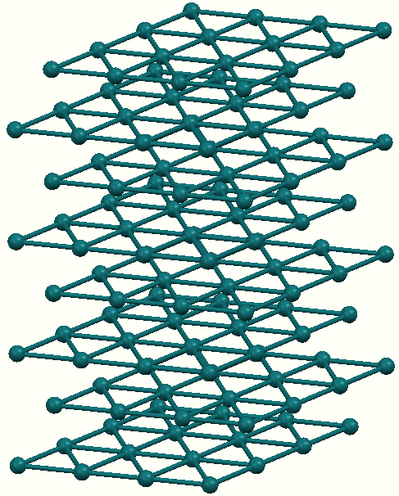
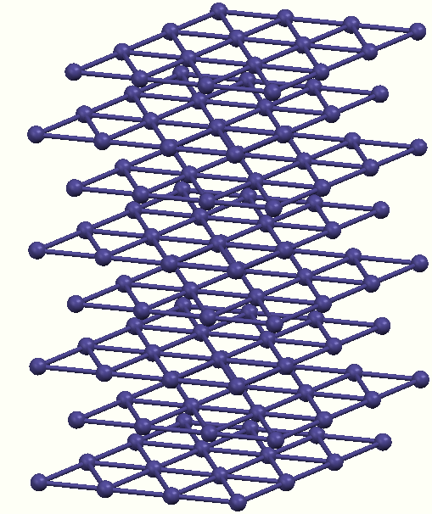
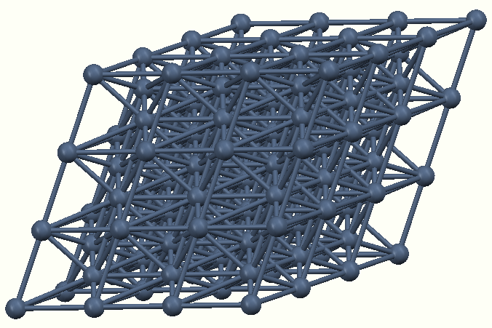
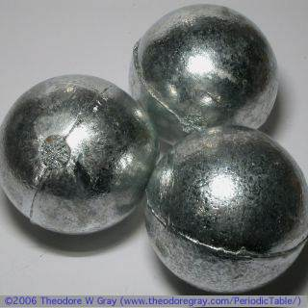
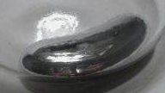
Is Copernicium a Group 12 Metal?
Zn, Cd (hcp, P63/mmc)
Hg (rhomb., R-3mr)
112 (hcp, P63/mmc)
Cn
?
N. Gaston, I. Opahle, H. W. Gäggeler, P. Schwerdtfeger, Angew. Chem. Int. Ed. 46, 1663 (2007).

Slide 46
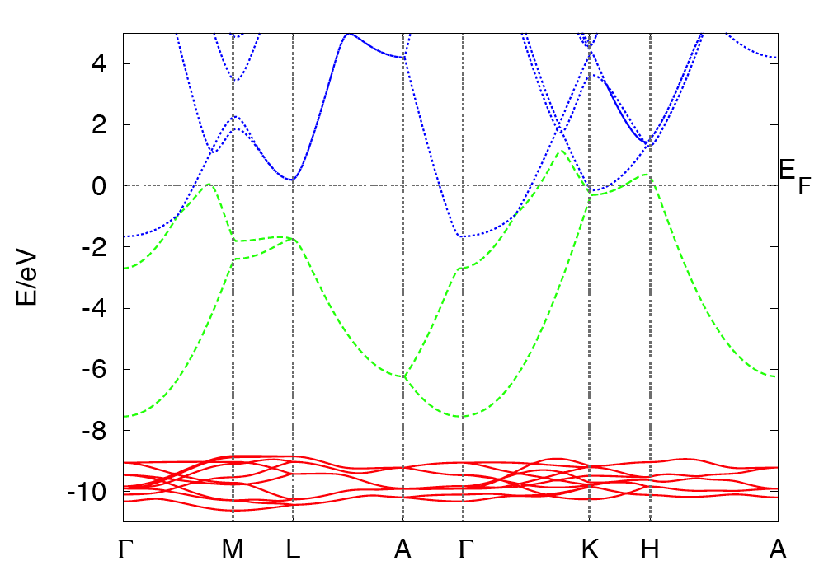
Band Structure of Copernicium
7p
NR/hcp
7s
6d
Metal at the nonrelativistic level (as is Zn, Cd and Hg)

Slide 47
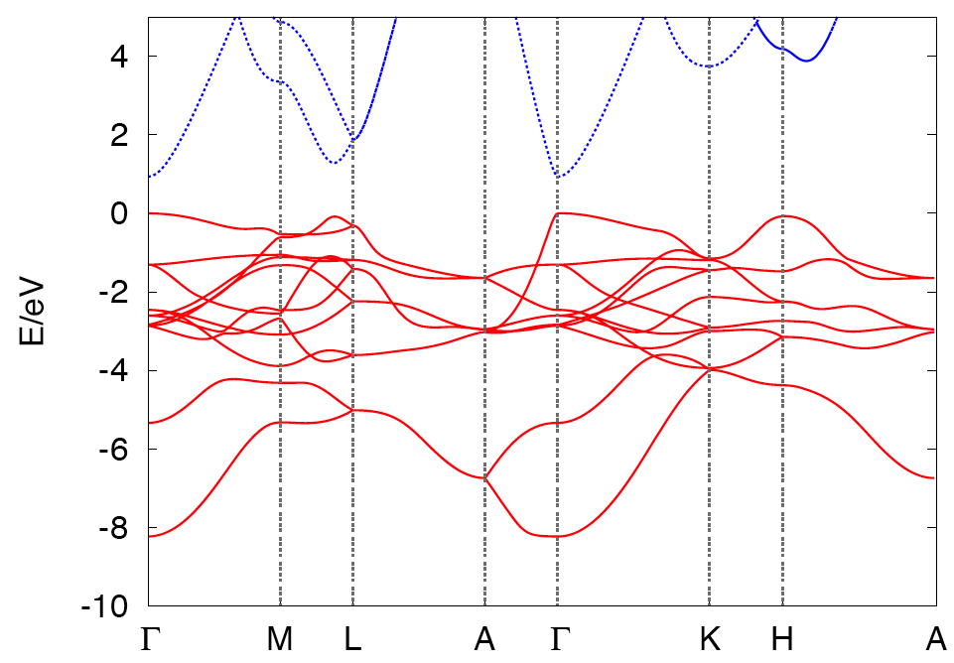
Band Structure of Copernicium
7p
SR/hcp
0.9 eV
7s,6d
Insulator at the scalar relativistic level

Slide 48
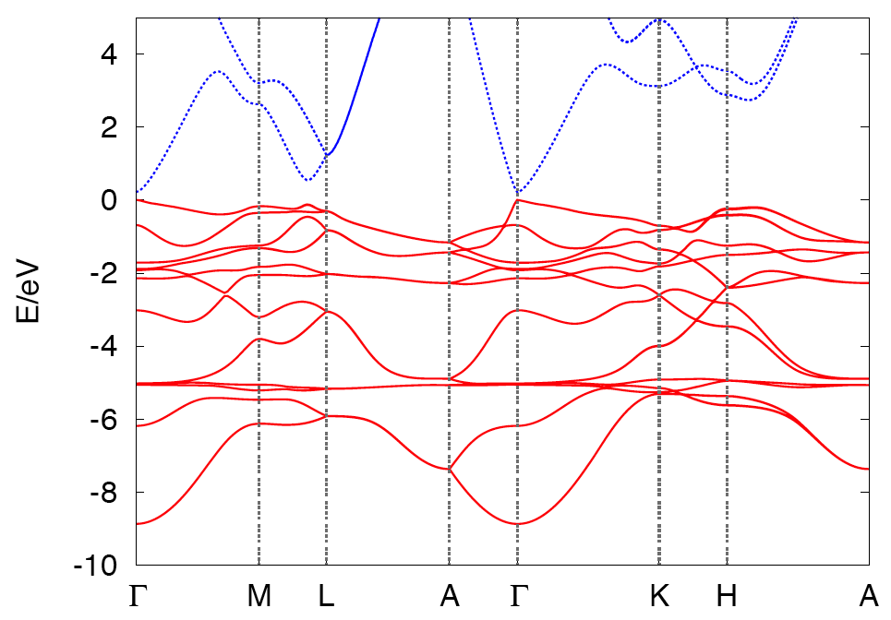
Band Structure of Copernicium
7p
FR/hcp
0.2 eV
7s,6d
Semiconductor at the fully relativistic level
(cohesive energy similar to Hg)

Slide 49
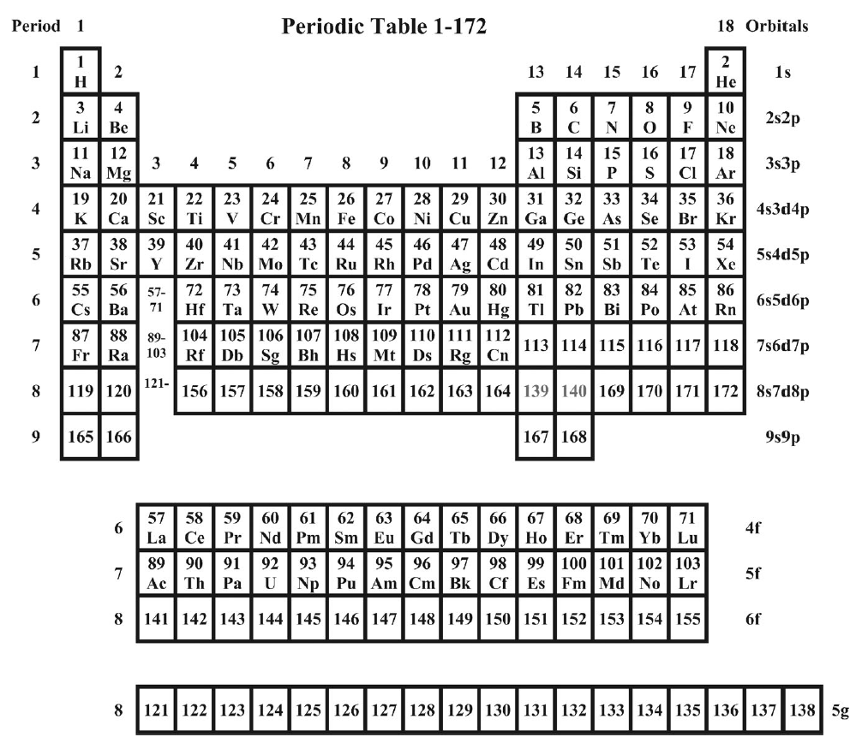
P. Pyykkö: A suggested Periodic Table up to Z ≤ 172, based on Dirac-Fock calculations on atoms and ions, Phys. Chem. Chem. Phys. 13, 161-168 (2011)
“Half of chemistry is still undiscovered. We don't know what it looks like and that's the challenge”
The limit of mass and charge is still undiscovered. We don't know what it looks like and that's the challenge.

Slide 50
Are superheavy nuclei produced in stellar explosions?

Slide 51
Fission of neutron rich nuclei impacts the formation of heavy elements at the final stages of the r-process through the recycling mechanism. The fission recycling is believed to be of particular importance during neutron star mergers where free neutrons of high density are available.
Super-heavy nuclei can be formed in the r-process. But their yields strongly depend on predicted nuclear data and astrophysical scenario.
I.V. Panov et al., A&A 513, A61 (2010).
?
Fission properties for r-process nuclei
J. Erler et al, Phys. Rev. C 85, 025802 (2012)
N. Nikolov et al., Phys. Rev. C 83, 034305 (2011)

Slide 52
What have we learned so far?
Elements up to Z=118 do exist
Their stability is governed by alpha decay and spontaneous fission – consistent with theoretical expectations
Their half-lives increase with N – consistent with theoretical expectations
Their chemical properties can be investigated

Slide 53
Conclusions
Cool multi-scale science
International collaboration
Importance of basic research

Slide 54
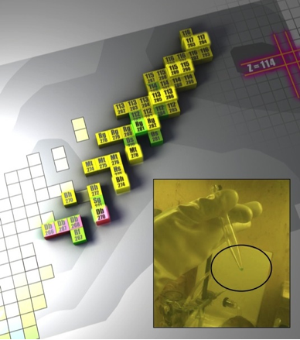

SHE – international collaboration
The superheavy element Z=117 required coordinated collaborative efforts between US and Russia laboratories and nearly 3 years to achieve.
Production of the berkelium-249 target material, with a short half-life of T_{1/2} = 330 days, required an intense neutron irradiation at the High Flux Isotope at ORNL, chemical separation from other reactor-produced products including californium-252 at ORNL
Target fabrication in Dimitrovgrad, Russia
Six months of accelerator bombardment with an intense calcium-48 beam at Dubna
Analysis of the experimental data was performed independently at Dubna and Lawrence Livermore National Laboratory.
Oganessian et al., PRL 104, 142502, 2010
Australia: ANU; China: Lanzhou; Finland: Jyväskylä;
Germany: GSI, Mainz, Munich; India: Kolkata;
Japan: Niigata, Tokai, RIKEN; Norway: Oslo;
Poland: Warsaw; Russia: St. Petersburg;
Sweden: Göteborg, Lund; Switzerland: Bern, PSI;
UK: Surrey, Liverpool; USA: Berkeley, LLNL, ORNL, Tennessee

Slide 55
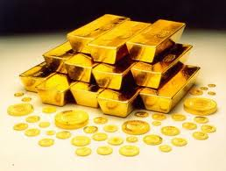
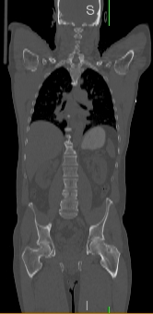
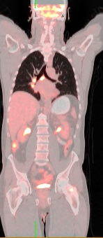
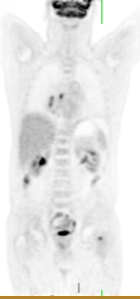

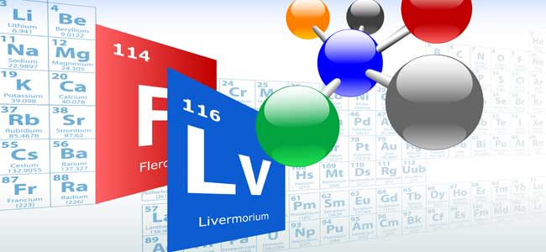
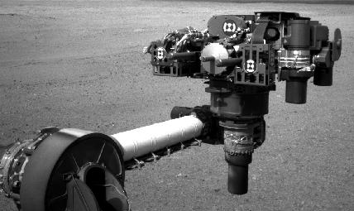
Conclusions: Importance of basic research
(based on D. Geesaman’s IUPAP slides)
WEALTH
HEALTH
WOW
STEALTH
WOW
+ Reputation
+ Glory

