Slide 1

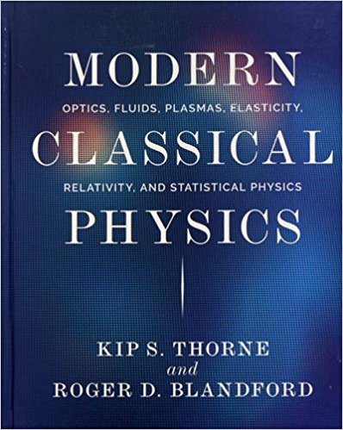
(Mostly)
Classical physics of neutron star magnetic fields
Andreas Reisenegger
Instituto de Astrofísica
Pontificia Universidad Católica de Chile
Workshop
«Astro-solids, dense matter, and gravitational waves»
Institute of Nuclear Theory, U. of Washington, Seattle
16-20 April 2018

Slide 2
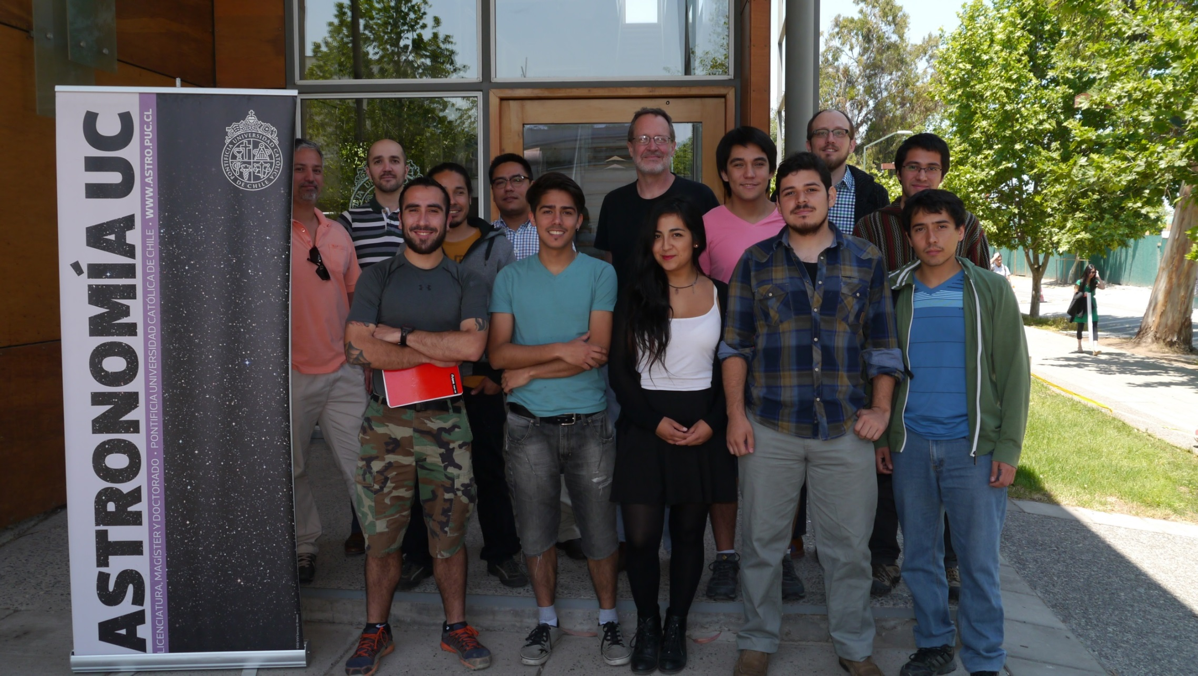
«ANSWERS» group (as of 2016)
Astrophysics of Neutron Stars With Extra/Exotic/Energetic/Extreme Related Stuff http://www2.astro.puc.cl/answers/
Funding:
FONDECYT Regular Grant 1150411 Rotational & magnetic effects in neutron stars and beyond (2015-2019)
FONDECYT postdoctoral grants, CONICYT PhD Fellowships
PFB-06 Center for Astronomy & Associated Technologies (CATA)

Slide 3
Outline
Composition gradients & stable stratification
Hydromagnetic equilibria & stability
Processes in the neutron star crust: Hall + Ohm
Core B evolution: eroding stable stratification
Application: weak B of LMXBs & MSPs
Conclusions & discussion

Slide 4
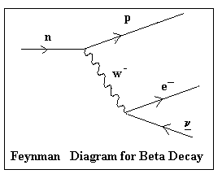
Magnetic field in neutron stars??
In vacuum (lab), neutrons decay with half-life ~ 15 min:
In dense, degenerate matter, low-energy quantum states are filled (blocked)
“Chemical” (weak interaction) equilibrium:
Around nuclear density, neutrons coexist with some protons & electrons:
Density-dependent fraction, few %
Charged & degenerate: currents flow with very little resistance → Magnetic field “frozen in” for a long time (Baym et al. 1969)

Slide 5
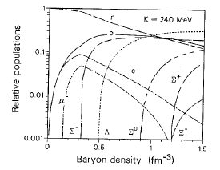
Composition gradient in NS core
Possible equilibrium particle populations in very dense matter Glendenning,
Compact Stars, p. 239

Slide 6
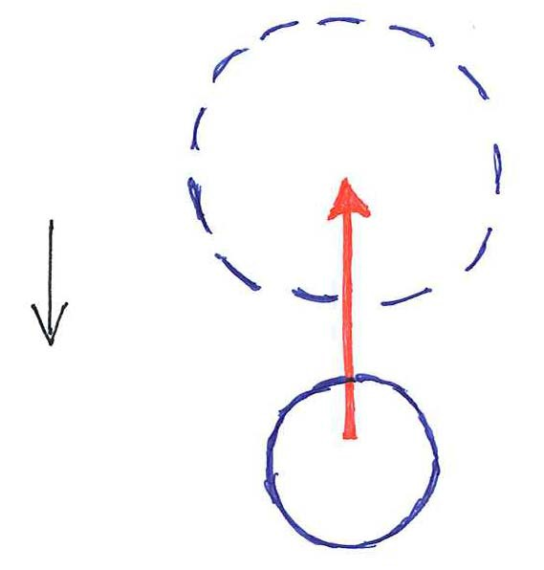
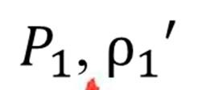
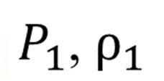
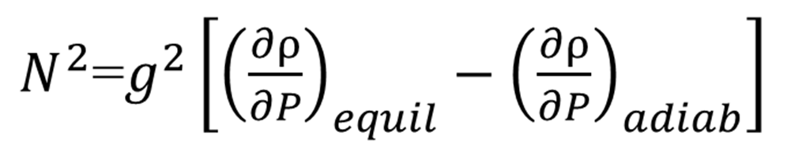
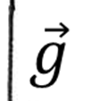
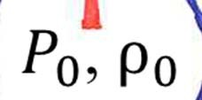
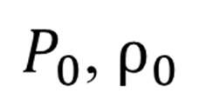
Stratification & buoyancy
Non-barotropic fluid:
blob displaced from equilibrium “remembers” where it came from,
through its composition (in NSs) or specific entropy (main sequence, WDs)
Brunt-Väisälä (buoyancy) frequency
> 0: stable oscillations (“g-modes”)
< 0: unstable → convection
= 0: neutrally stable (“barotropic”)
“Ledoux criterion”

Slide 7
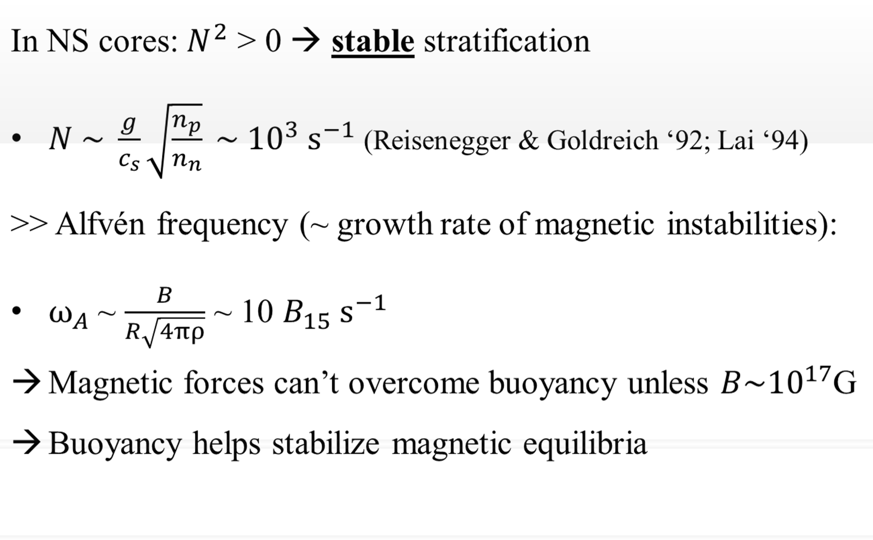
Stable stratification vs. B

Slide 8
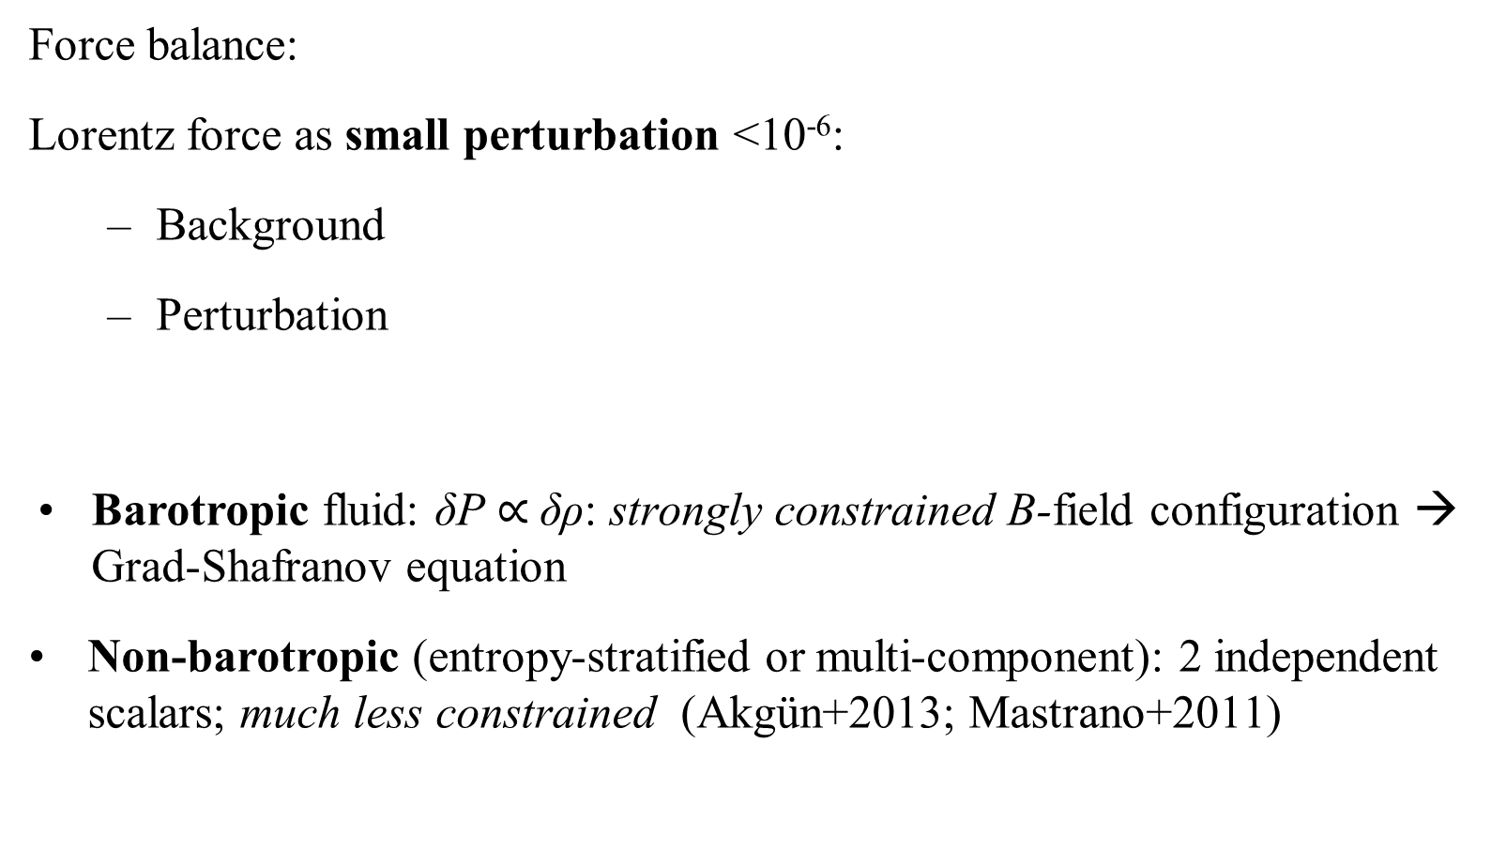
Hydromagnetic equilibria

Slide 9
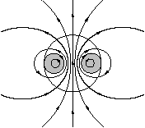
Axially symmetric equilibria
Poloidal+toroidal decomposition:
  2 scalars α (r,θ ) & β (r,θ )
  Each component independently satisfies
No fluid forces in φ - direction:
Thus,
2 types of toroidal “magnetic surfaces” of constant α & β :
  closing outside the star: β = 0: pure poloidal field
  closed inside the star: β ≠ 0: twisted toroidal field
Braithwaite 2007

Slide 10

Stability??
Purely toroidal (azimuthal) fields are unstable
Flux rings “repel” each other (Tayler 1973)
Figure from Spruit 1999

Slide 11
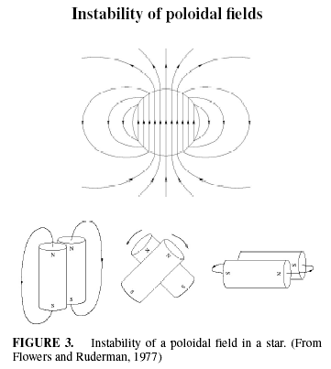
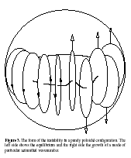
Purely poloidal (meridional) fields are also unstable
Braithwaite 2008

Slide 12
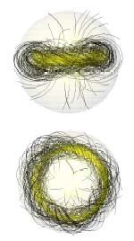
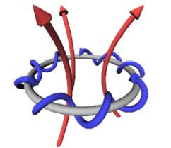
Stable MHD equilibria
MHD simulations:
(Braithwaite & Spruit 2004, 2006; Braithwaite 2009)
Self-gravitating balls of conducting fluid
Stably stratified by an entropy gradient
Disordered initial B
Generic outcome ~ axially symmetric:
Poloidal & toroidal B components stabilize each other

Slide 13
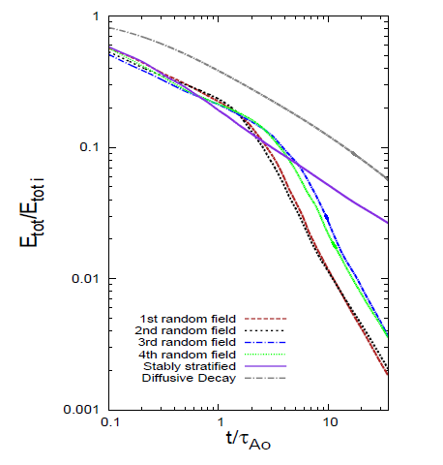
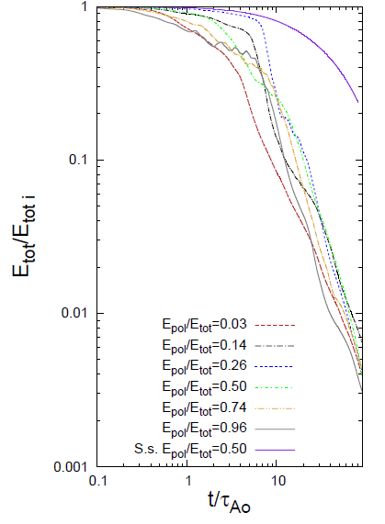

Effect of stable stratification
Mitchell, Braithwaite, Reisenegger, Spruit, Valdivia, & Langer 2015
Random initial B Ordered initial B (twisted torus)
Stable
Strat.
In stably stratified stellar models, we find configurations that decay slowly (~diffusion time → MHD-stable) & others that decay quickly (~Alfvén time → unstable).
In barotropic models, all configurations explored decay quickly.
Diffusion
only
Stable
Strat.
Barotropic
Warning: Ratio of diffusive/Alfvén time strongly reduced in the simulations!

Slide 14
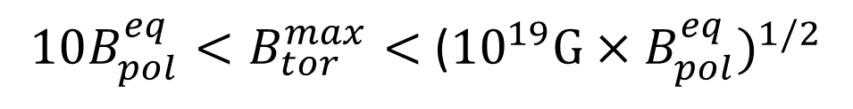
Stability condition & hidden energy
(Very rough) conditions for mutual stabilization of ^{B}pol vs. ^{B}tor :
Braithwaite 2009; Marchant+ 2011; Akgün+ 2013; Mitchell+ 2015
→ Possibly strong, hidden toroidal B
Energy reservoir for magnetars (Thompson & Duncan 2001), especially «low‐B magnetars» (Rea+ ‘10, ‘12, ‘13)
Non‐uniform surface temperature on CCOs (Shabaltas & Lai 2012)
Continuous gravitational waves (Cutler 2002; Mastrano+ 2011; many more)
Will these equilibria live forever?

Slide 15
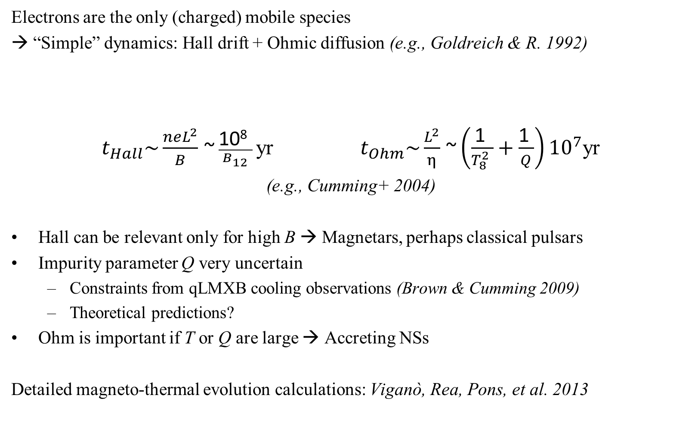
Solid NS crust: Hall + Ohm

Slide 16
NS crust: Hall drift
Hall drift non-linear → “turbulent cascade” to small scales? (Goldreich & R. 92)
Analytic solutions:
  Current sheets (Vainshtein et al. 2000; Reisenegger et al. 2007)
  Large-scale Hall equilibria (Gourgouliatos et al. 2013)
Numerical 2D (= axial symmetry):
  Stable Hall equilibria = “attractors” (Gourgouliatos & Cumming 14a,b; Marchant et al. 14; Cumming et al. in prep.); braking indices n<3 (Gourgouliatos & Cumming 14c)
  Coupled thermo-magnetic evolution: Viganò et al. 13
Numerical 3D: Attractors appear to survive (Wood & Hollerbach 15)
All this assumes that the magnetic flux goes only through the crust
Unlikely unless a core superconductor can expel the flux (time scale???)
Either way, need to study processes in the core

Slide 17


(Multi-)fluid core
B pushes on the fluid (charged particles): Can it escape??
Not trivial: Stable stratification (composition gradient) prevents (or strongly constrains) bulk motions.
Ways out:
Bulk motion with “real-time” composition adjustment through beta decays (mUrca): n ←→ p + e
  Effective at high T (& B): magnetars (Thompson & Duncan 1996)
Ambipolar diffusion (solenoidal mode): Relative motion of 2 fluids: neutrons & charged particles (frozen to B) against their mutual collisions
Effective at low T: old NSs ~ progenitors of LMXBs & MSPs?
  [Time scales: Goldreich & R. 1992; 1D sim.: Hoyos, R., & Valdivia 2008, 2010]

Slide 18
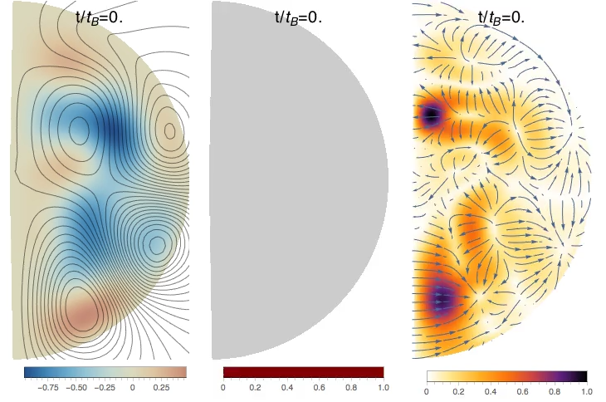
Simulation (Castillo+ 2017): axial symmetry (meridional cut)
charged particles & B moving against a fixed, uniform neutron background
Magnetic field Density/pressure Velocity field

Slide 19
Simulation results & discussion
B evolves towards twisted-torus equilibria → No full decay
BUT: Still to be included:
  Radial density gradients
  Neutron motion
  Additional particle species
  Superconductivity (type I or II??) & superfluidity
  3D effects: likely instabilities!

Slide 20
Low B in MSPs & LMXBs
Standard explanation: «Recycling» via accretion reduces not only P, but also B, through either:
1) Accretion heating → enhanced crustal resistivity (Shibazaki+ 1989): requires B not to penetrate the core
2) Diamagnetic screening by accreted material (Bisnovatyi-Kogan & Komberg ’74; Melatos++; many others): instabilities?? (Mukherjee+ 2013)
Alternative (toy model -- Cruces, R., & Tauris, in prep.):
Spontaneous decay by ambipolar diffusion of core field in cold pre-accretion phase (requires crust to «cooperate»)
Time available ~ companion’s main sequence lifetime → infer from remnant

Slide 21
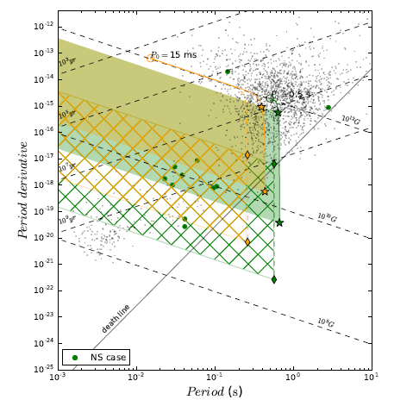
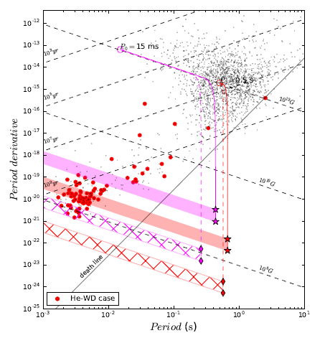
Magneto-roto-thermal evolution
Massive, short-lived companion
(now neutron star)
Low-mass, long-lived companion
(now He white dwarf)
Cruces, R., & Tauris, in preparation

Slide 22
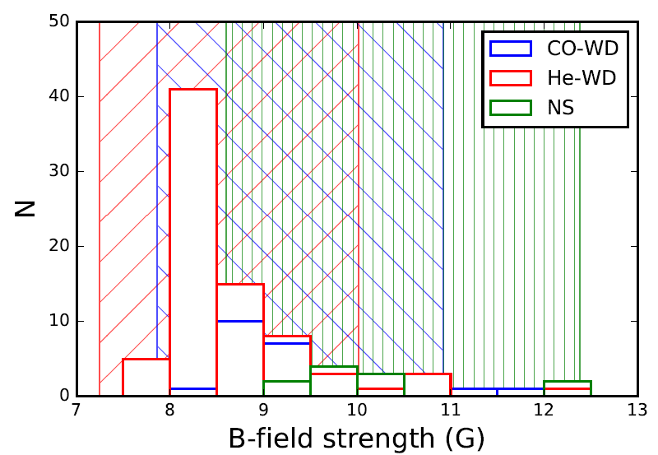
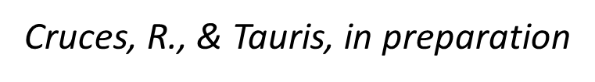
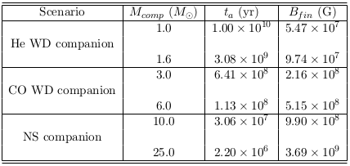
Magnetic fields of binary pulsars
Histogram: Binary pulsars not in globular clusters
Shaded bands: Rough estimates of expected fields for ambipolar diffusion for each companion type, with (companion’s main sequence lifetime) – (NS cooling time) (10⁶ yr) = (ambipolar diffusion time)
Caveats:
Several outliers: unusual binary evolution?
Predictions similar to «standard» accretion-induced decay model

Slide 23
Conclusions & discussion
B fields are «weak» (ε ~ 10⁻⁶ B₁₅²)
Their stability depends on:
  Linked poloidal & toroidal components
  Stable stratification of core matter
→ Allows for a strong, hidden toroidal component
Secular evolution through non‐ideal MHD processes:
  Ohmic resistivity in the crust
  Non-linear Hall dynamics in the crust
  Erosion of stable stratification in core → destabilization of equilibria → Explanation of weak MSP/LMXB fields?
Still no full simulations or understanding:
  3D instabilities?
  Ubiquity & effects of superfluidity or superconductivity?

