Slide 1
How we look for r-modes (and what we can learn from them)
Benjamin J. Owen

Slide 2
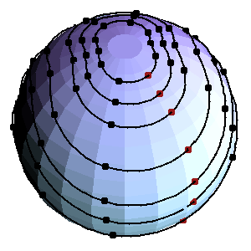
What is an r-mode?
Rotation (Coriolis force)
Like Rossby waves
Mostly δ velocity
Little δ density
Mode frequency ≈ 4/3 spin
Amplitude α ≈ <δv/v>
Prograde / retrograde
Generic CFS instability! Andersson & Kokkotas, Int. J. Mod. Phys. D 10, 381 (2002)
C. Hanna & B. Owen

Slide 3
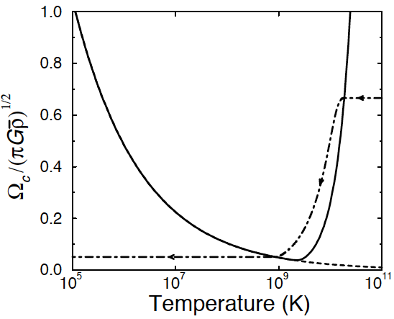
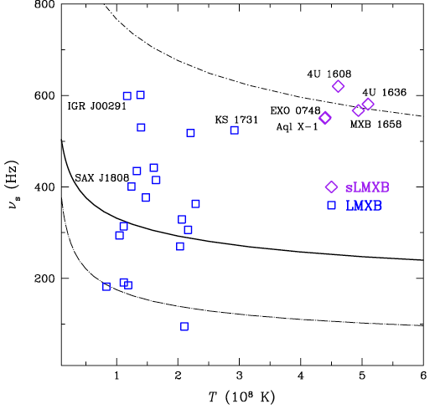
Beats viscosity at high frequencies
UNSTABLE
STABLE
(???)
Lindblom et al., PRL 80, 4843 (1998)
Ho et al., PRL 107, 101101 (2011)
STABLE
(SHEAR)
STABLE
(BULK)

Slide 4
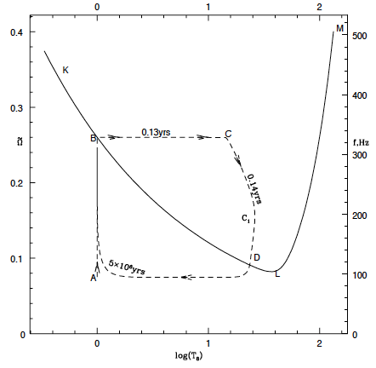
In accreting neutron stars
Levin, ApJ 517, 328 (1999)

Slide 5
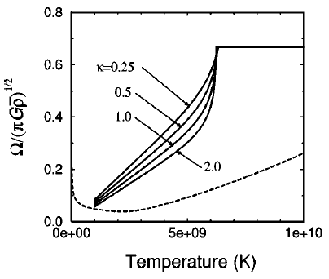
In newborn neutron stars
Saturation amplitude (likely) too high!
Owen et al., PRD 58, 084020 (1998)
DO NOT USE that signal-to-noise!

Slide 6
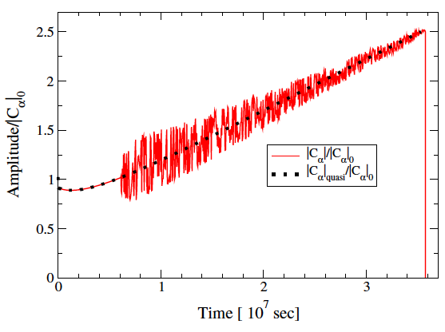
Saturation amplitude
At first we had no idea, just put order unity
Some numerics suggested that too
But mode-mode coupling probably keeps it small…
Simulations are difficult, so perturb (higher order)
R-modes have unusual selection rules, pairs of daughters
Parametric instability threshold probably limits α to 10⁻³−10⁻⁴ Bondarescu et al., PRD 79, 104003 (2009)
That is good for real achievable searches!
1 year spin-down is hopeless
10³ or 10⁴ year spin-down is (kind of) standard CW source

Slide 7
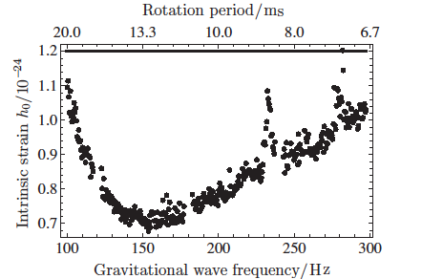
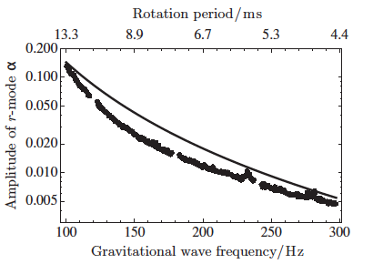
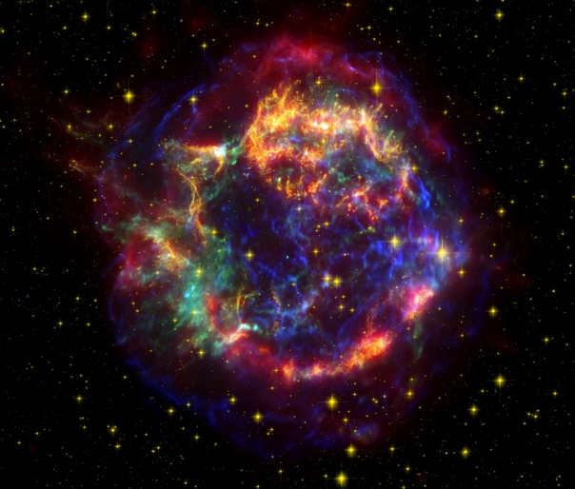
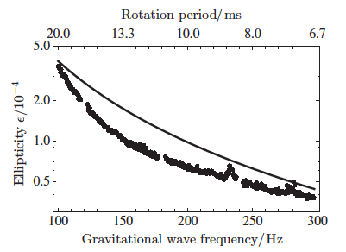
S5 search for Cas A Abadie et al., ApJ 722, 1504 (2010)
NASA/Chandra/STScI/Spitzer

Slide 8
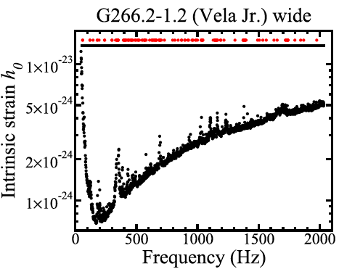
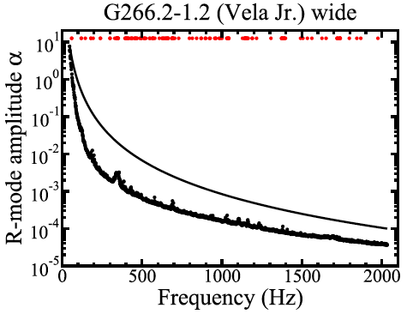
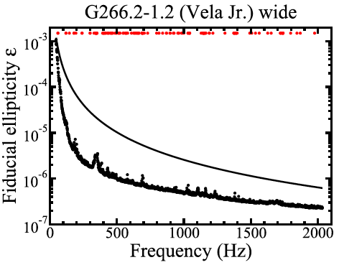
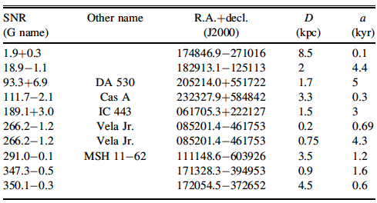
S6 nine supernova remnants Aasi et al., ApJ 813, 39 (2015)
…and more coming on O1 data
Plus Fomalhaut b…

Slide 9
Broadband searches already cover r-modes Owen, PRD 82, 104002 (2010)
Derivatives first: Wette et al., CQG 25, 235011 (2008)
From braking index 7 for constant α, > 2 for most pulsars
Polarization gains 45 degrees
Affects some searches using jet orientation
Few % in reconstruction of h₀
Amplitude can be obtained from existing h₀’s
Translate direct h₀ upper limits to α
Put spin-down limits on h₀ and α
Similar limits based on age, accretion torque

Slide 10
Known pulsars need frequency
GR correction to 4/3 probably biggest: 1.39 to 1.57 (10% level), others at 1% Idrisy et al., PRD 91, 024001 (2015)
Using to look for Crab (in progress)
Don’t expect to see it (high α needed)
Sets up for better things in future
No glitches in O1!
But wrestling with derivatives
Suggested for J0537−6910 based on braking index 7(*) by Andersson et al., arXiv:1711.05550

Slide 11
What we would learn
(Assuming there is a pulsar known before or after GW)
That it is an r-mode…
That it’s unstable
At what amplitude
Viscosity and other microphysics
Exact GW/spin frequency tells us M/R (forget EOS)

Slide 12
Things we haven’t done
Phase coherence time of saturated mode
Dealing with glitches
Amplitude wobbling – not big deal, just respond to average
Plotted α limits for Sco X-1 and all-sky searches (we thought not so interesting, but…)

