Slide 1
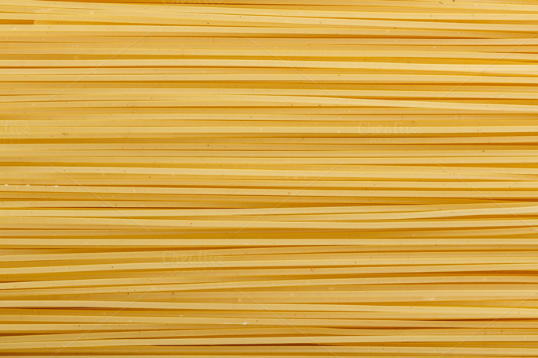

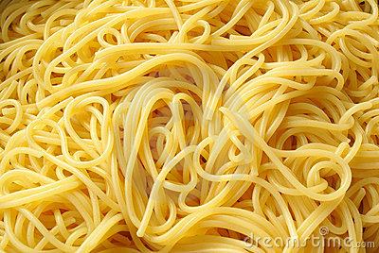
Nuclear pasta in neutron stars
William Newton, Lauren Balliet, Matt Witt, Michael Ross, Sarah Cantu, Shuxi Wang
Texas A&M University-Commerce
Jirina Rikovska Stone, Helena Pais, Alex Kaltenborn
University of Tennessee
Coming May!

Slide 2
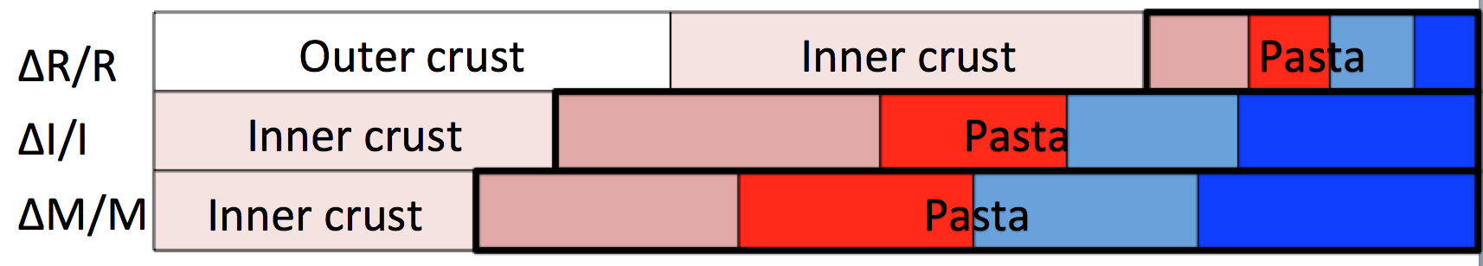
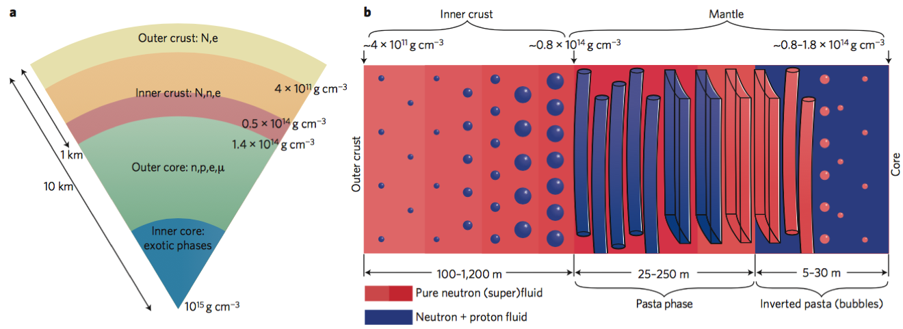
Take home message: There is a lot of pasta in neutron star crusts; If you care about r-modes, magnetic field evolution, crust modes, glitches, crust cooling, …then you care about pasta
Picture: Newton, “A Taste of Pasta?” Nature News and Views, 2013

Slide 3
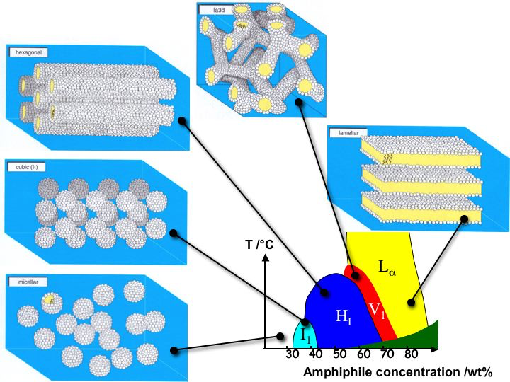
In multi-fluid condensed matter systems, competition between
surface and bulk energies drive spontaneous formation of
complex structures when volume fractions approach same order

Slide 4
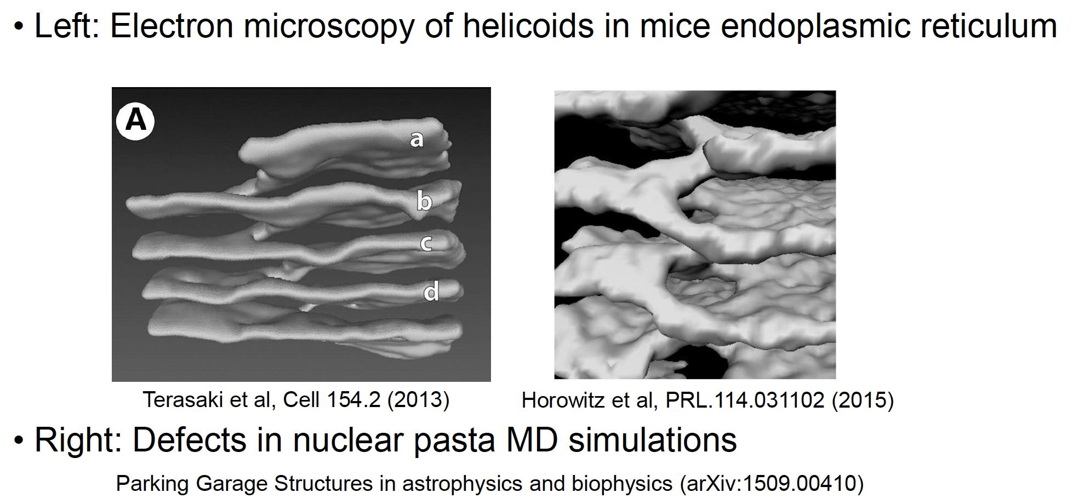
Slide courtesy of Matt Caplan

Slide 5
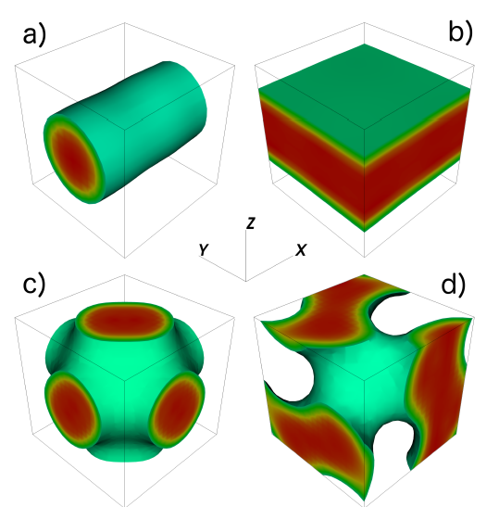
In mixes of nuclear/neutron matter, such structures are called
“nuclear pasta”
T(MeV)
10
y_{p}
0.3
0.1
0.01
1
0.1
1
ρ (10¹⁴ g cm⁻³)
Schuetrumpf+ PRC 025801, 2015; 045806, PRC 2015

Slide 6
In mixes of nuclear/neutron matter, such structures are called
“nuclear pasta”
T(MeV)
SNe
10
y_{p}
0.3
0.1
PNS
0.01
1
Neutron stars
0.1
1
ρ (10¹⁴ g cm⁻³)
Schuetrumpf+ PRC 025801, 2015; 045806, PRC 2015

Slide 7
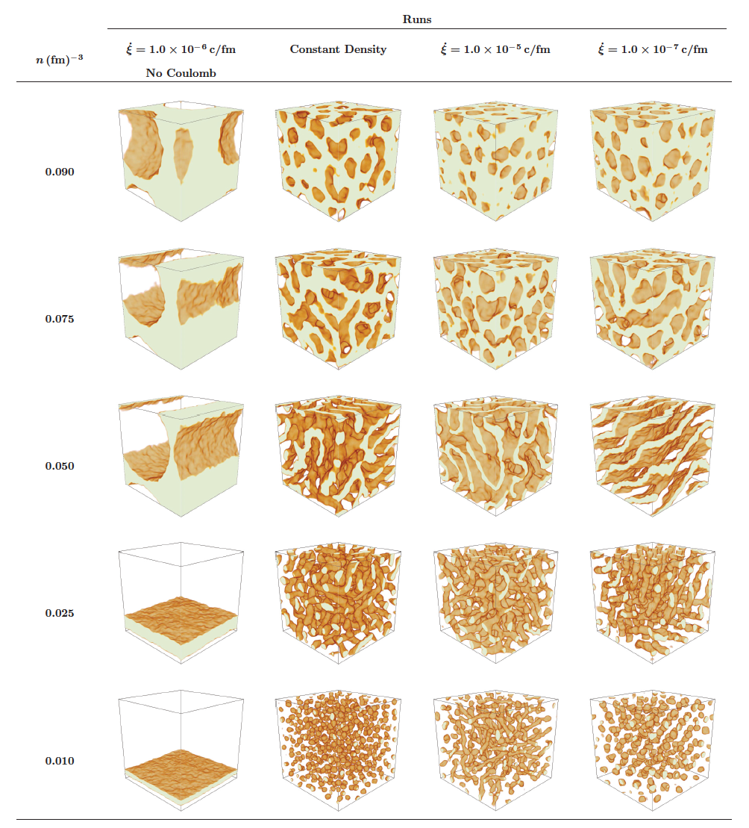
Microscopic Models of Pasta: Classical/Quantum Molecular Dynamics
Large computational
volumes –
many structures/cell
Defects – disorder, Q_{imp}
Quantum shell effects
missing
Difficulty simulating low
y_{p}/low T (neutron star
crust conditions)
e.g. Schneider, Horowitz, Hughto, Berry, PRC88 (2013)
Caplan, Schneider, Horowitz, Berry, PRL114, 031102 (2015)
Sonoda, Watanabe, Sato, Yasuoka, Ebisuzaki, PRC77 (2008)

Slide 8
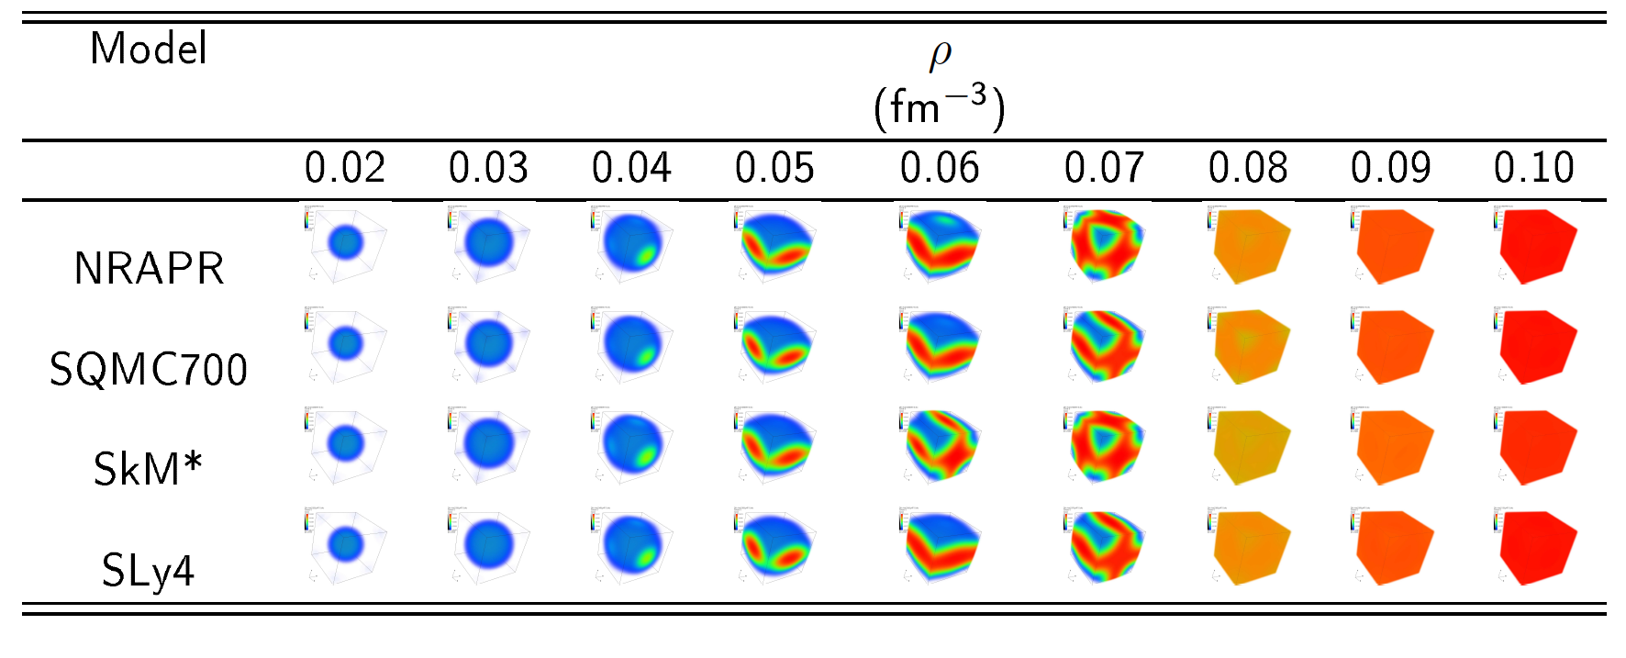
Microscopic Models of Pasta: Quantum (DFT)
Magierski & Heenen PRC 045804 2002
Gogelein+ PRC77, 2007
Newton, Stone, PRC 055801, 2009
Pais, Stone, PRL 151101, 2012
Pais, Newton, Stone PRC 065802, 2014
Schuetrumpf+ PRC 025801, 2015
Fattoyev+, PRC 055804, 2017
Computationally expensive
(few structures/cell)
Spurious shell effects
Real shell effects
Low y_{p}, T

Slide 9
Phase diagram: NRAPR; y_{p} = 0.3
gnochhi
T(MeV)
spaghetti
11
10
waffle
9
lasagna
8
bubble
7
6
5
4
3
2
1
0
0.02
0.03
0.04
0.05
0.06
0.07
0.08
0.09
0.1
0.11
n_{b} (fm⁻³)

Slide 10
NRAPR; y_{p} = 0.2
gnochhi
T(MeV)
spaghetti
11
10
waffle
9
lasagna
8
bubble
7
6
5
4
3
2
1
0
0.02
0.03
0.04
0.05
0.06
0.07
0.08
0.09
0.1
0.11
n_{b} (fm⁻³)

Slide 11
NRAPR; y_{p} = 0.1
gnochhi
T(MeV)
spaghetti
11
10
waffle
9
lasagna
8
bubble
7
6
5
4
3
2
1
0
0.02
0.03
0.04
0.05
0.06
0.07
0.08
0.09
0.1
0.11
n_{b} (fm⁻³)

Slide 12
NRAPR; y_{p} = 0.05
gnochhi
T(MeV)
spaghetti
11
10
waffle
9
lasagna
8
bubble
7
6
5
4
3
2
1
0
0.02
0.03
0.04
0.05
0.06
0.07
0.08
0.09
0.1
0.11
n_{b} (fm⁻³)

Slide 13
NRAPR; beta-equlibrium
gnochhi
T(MeV)
spaghetti
11
10
waffle
9
lasagna
8
bubble
7
6
5
4
3
2
1
0
0.02
0.03
0.04
0.05
0.06
0.07
0.08
0.09
0.1
0.11
n_{b} (fm⁻³)

Slide 14
NRAPR; beta-equlibrium
gnochhi
T(MeV)
spaghetti
11
L = 30 MeV T_{crit} = 4-5 MeV
L = 60 MeV T_{crit} = 2-3 MeV
L = 90 MeV T_{crit} = 2 MeV
waffle
10
9
lasagna
8
bubble
7
6
5
4
3
2
1
0
0.02
0.03
0.04
0.05
0.06
0.07
0.08
0.09
0.1
0.11
n_{b} (fm⁻³)

Slide 15
NRAPR; beta-equlibrium
gnochhi
T(MeV)
spaghetti
11
L = 30 MeV T_{crit} = 4-5 MeV
L = 60 MeV T_{crit} = 2-3 MeV
L = 90 MeV T_{crit} = 2 MeV
Good agreement with Roggero (2017)
Shell effects unimportant near melting temp
(MeV vs 1-10 keV)
waffle
10
9
lasagna
8
bubble
7
6
5
4
3
2
1
0
0.02
0.03
0.04
0.05
0.06
0.07
0.08
0.09
0.1
0.11
n_{b} (fm⁻³)

Slide 16
NRAPR pasta phase diagram
At a fixed proton fraction, these results are ≈independent of nuclear EDF

Slide 17
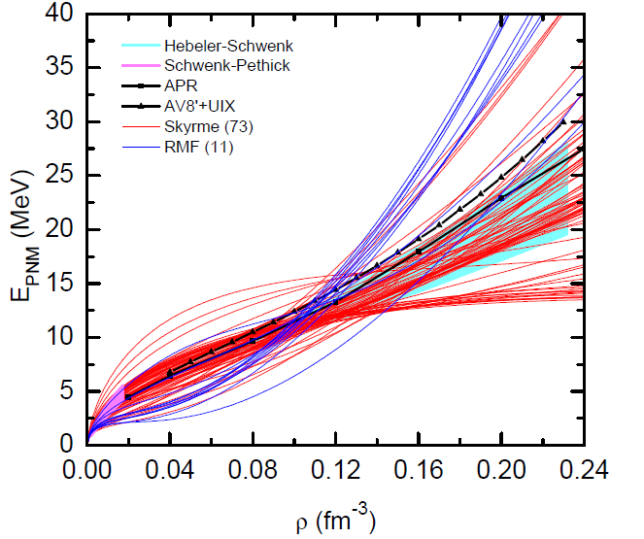
Equation of State and Symmetry Energy
Farrukh Fattoyev, 2013

Slide 18
Equation of State and Symmetry Energy
Farrukh Fattoyev, 2013

Slide 19
Equation of State and Symmetry Energy
pasta
nuclear experiment
Pasta transition
crust-core
Farrukh Fattoyev, 2013
Notes:
Slope of the symmetry energy at nuclear saturation density is the most uncertain part of the nuclear EOS at that density
The way to characterize the uncertainty in these models
3 ways
Relation of crust with nuclear matter properties

Slide 20
Equation of State and Symmetry Energy
pasta
nuclear experiment
uncertainty in n_{cc} and P_{cc}
Pasta transition
crust-core
Farrukh Fattoyev, 2013
Notes:
Slope of the symmetry energy at nuclear saturation density is the most uncertain part of the nuclear EOS at that density
The way to characterize the uncertainty in these models
3 ways
Relation of crust with nuclear matter properties

Slide 21
Equation of State and Symmetry Energy
S, L, K_{sym}
pasta
nuclear experiment
uncertainty in n_{cc} and P_{cc}
Pasta transition
crust-core
Farrukh Fattoyev, 2013
Notes:
Slope of the symmetry energy at nuclear saturation density is the most uncertain part of the nuclear EOS at that density
The way to characterize the uncertainty in these models
3 ways
Relation of crust with nuclear matter properties

Slide 22
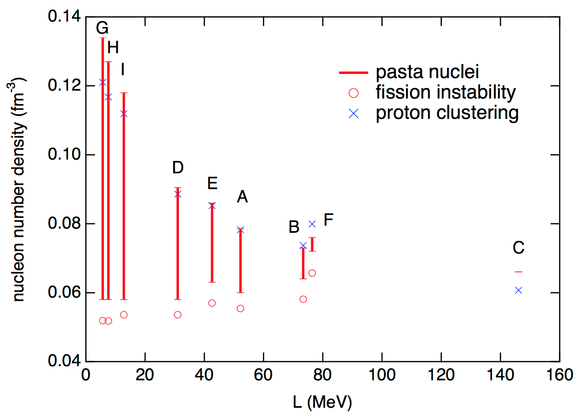
Pasta in a Compressible Liquid Drop Model
Oyamatsu, Iida PRC 75, 015801 (2007)
Strong dependence of crust-core transition density on slope of Symmetry Energy

Slide 23
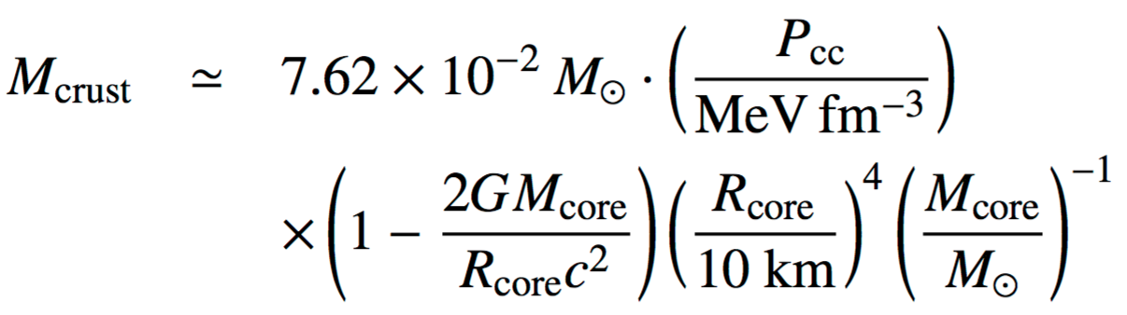
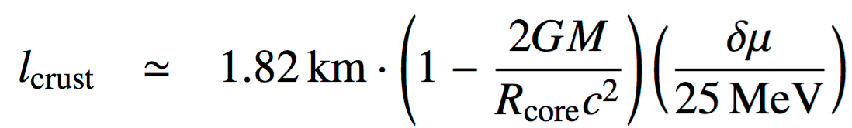
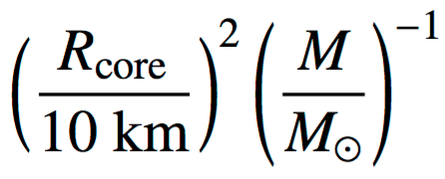
But…
Amount of pasta in crust depends on transition pressures and chemical potentials
Zdunik, Fortin and Haensel, A&M 599, (2017)
- See also Fattoyev, Lattimer, Pethick

Slide 24
Farrukh Fattoyev, 2013

Slide 25
Pasta in a Compressible Liquid Drop Model

Slide 26
Pasta in a Compressible Liquid Drop Model

Slide 27
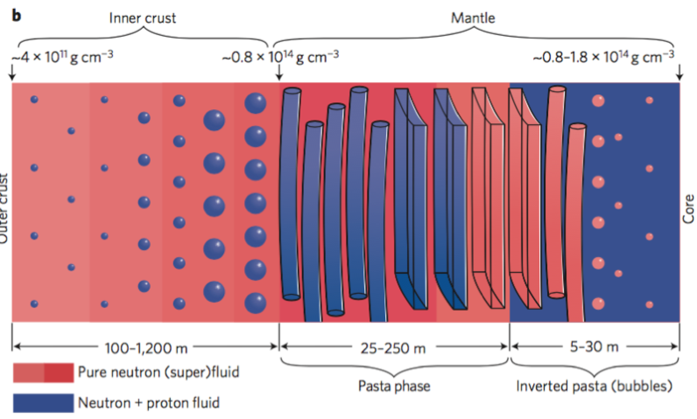
Pasta in a Compressible Liquid Drop Model
Pasta is:
40-60% of the crust by mass
12-20% of the crust by thickness
OUTER
CRUST
INNER
CRUST
INNER
CRUST
PASTA
PASTA

Slide 28
Pasta in DFT
Magierski & Heenen PRC 045804 2002
Gogelein+ PRC77, 2007
Newton, Stone, PRC 055801, 2009
Pais, Stone, PRL 151101, 2012
Pais, Newton, Stone PRC 065802, 2014
Schuetrumpf+ PRC 025801, 2015
Fattoyev+, PRC 055804, 2017
Computationally expensive
(few structures/cell)
Spurious shell effects
Real shell effects
Low y_{p}, T

Slide 29
Pasta in DFT
PNM constraints from:
Hebeler+2013
Gandolfi+2015
Lynn+2016

Slide 30
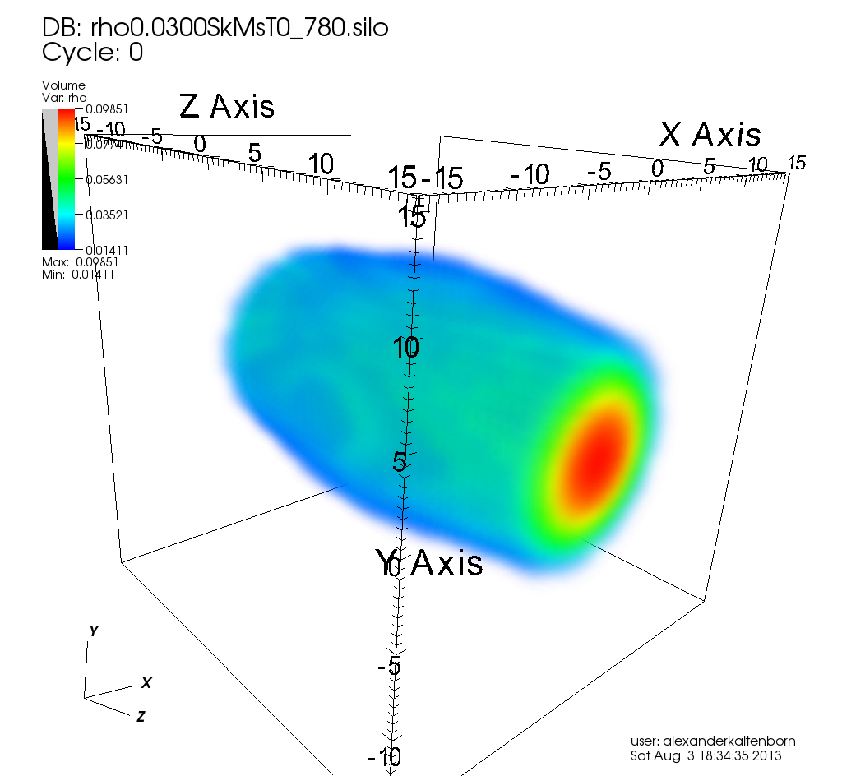
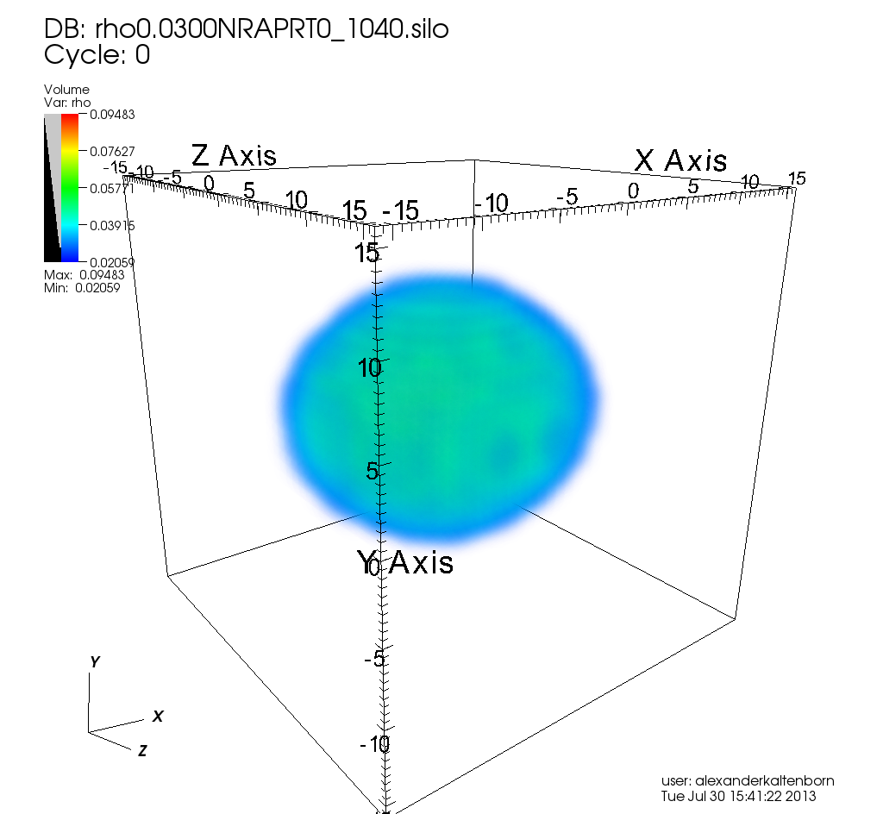
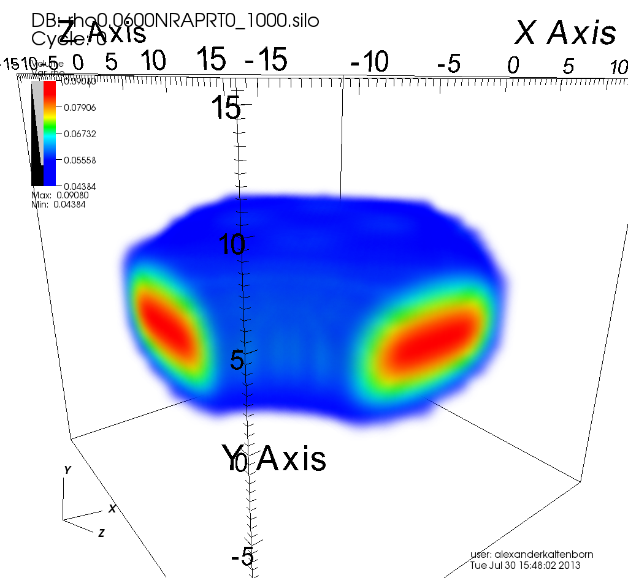
Systematically probing the energy landscape of pasta
Prolate: γ=0º
Increasingly deformed with β
Spherical: β=0
Oblate: γ=60º
Increasingly deformed with β
n_{b} = 0.058 fm⁻³
Minima separated by energy barriers
of order 10 keV/particle
Newton, Kaltenborn and Stone, in prep

Slide 31
NRAPR: n_{b}=0.04 fm⁻³; y_{p}=0.022; A=1544
Pasta first appears as a local minimum
T_{f} ≈ 4x10⁸K
e^{-Δ/kT} ≈ 35:65 (spaghetti:spherical)
L/a ≈ 20
After freezing:
mechanism to homogenize composition
(e.g. annealing)? Timescale?

Slide 32
NRAPR: n_{b}=0.04 fm⁻³; y_{p}=0.022; A=1544
Pasta first appears as a local minimum
kT_{f}
Δ
T_{f} ≈ 4x10⁸K
e^{-Δ/kT} ≈ 35:65 (spaghetti:spherical)
L/a ≈ 20
After freezing:
mechanism to homogenize composition
(e.g. annealing)? Timescale?

Slide 33
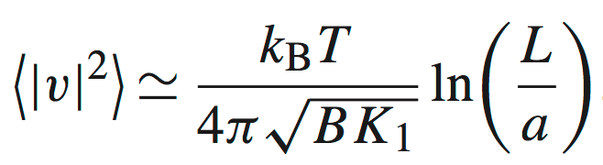
Cooking Pasta: Thermal fluctuations destroy long-range order
1/λ =
λ
Landau-Peierls instability
(Pethick, Potekhin PLB427, 1998
Watanabe+, NPhysA 676, 2000)
a

Slide 34
NRAPR: n_{b}=0.04 fm⁻³; y_{p}=0.022; A=1544
Pasta first appears as a local minimum
kT_{f}
Δ
T_{f} ≈ 4x10⁸K
e^{-Δ/kT} ≈ 35:65 (spaghetti:spherical)
λ/a ≈ 20
After freezing:
mechanism to homogenize composition
(e.g. annealing)? Timescale?

Slide 35
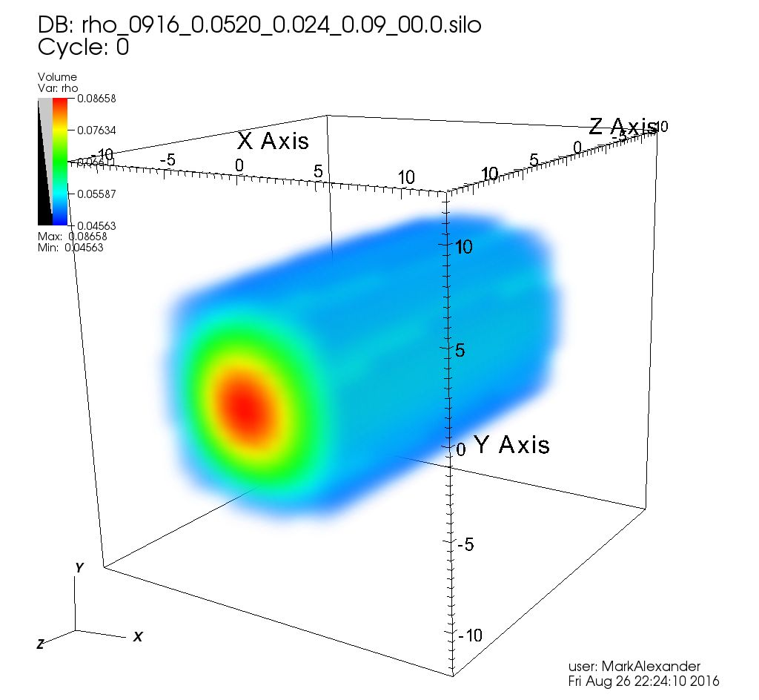
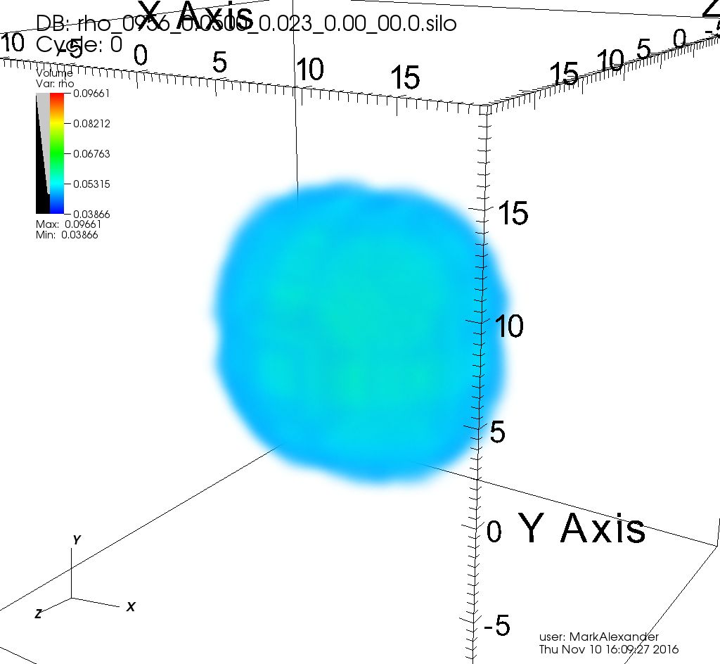
NRAPR: n_{b}=0.054 fm⁻³; y_{p}=0.024; A=1166
Pasta becomes energetically most favored
T_{f} ≈ 0.14x10⁸K
e^{-Δ/kT} ≈ 82:18 (spaghetti:spherical)
λ/a ≈ 20
After freezing:
mechanism to homogenize composition
(e.g. annealing)? Timescale?

Slide 36
NRAPR: n_{b}=0.06 fm⁻³; y_{p}=0.026; A=308
T_{f} ≈ 0.17x10⁸K
e^{-Δ/kT} ≈ 93:7 (spaghetti:waffle)
λ/a ≈ 80 (spaghetti), 2 (waffle)
After freezing:
mechanism to homogenize composition
(e.g. annealing)? Timescale?

Slide 37
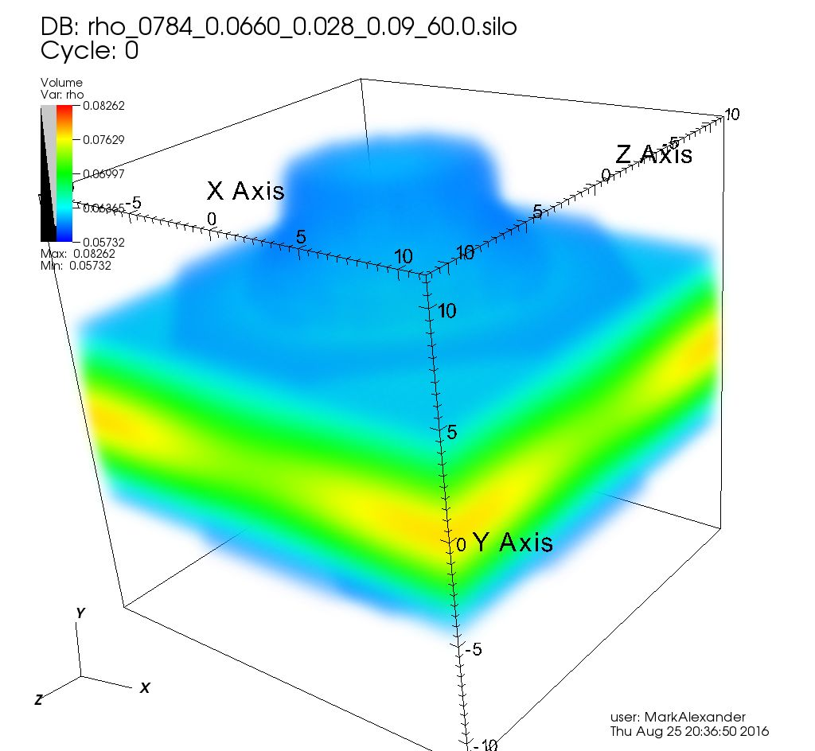
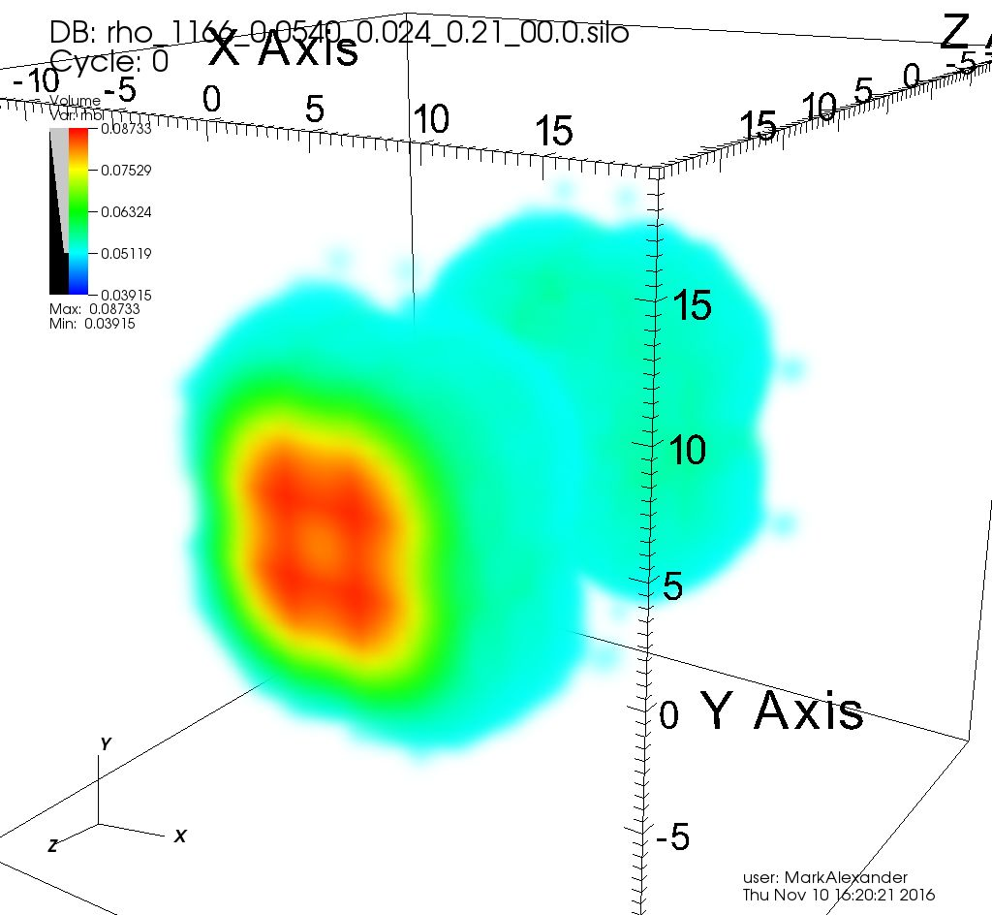
NRAPR: n_{b}=0.066 fm⁻³; y_{p}=0.026; A=784
Spherical nuclei no longer a local minimum – pasta domains
T_{f} ≈ 0.37x10⁸K
e^{-Δ/kT} ≈ 30:70 (spaghetti:lasagna)
λ/a ≈ 10 (spaghetti), 5(lasagna)
After freezing:
mechanism to homogenize composition
(e.g. annealing)? Timescale?

Slide 38
NRAPR L = 60 MeV; n_{sph-pasta} = 0.038 fm⁻³; n_{cc} = 0.082 fm⁻³
0.02 fm⁻³
0.04 fm⁻³
0.05 fm⁻³
0.054 fm⁻³
0.058 fm⁻³
0.062 fm⁻³
0.07 fm⁻³
0.08 fm⁻³

Slide 39
Gibbs Equilibrium n_{b} = 0.04 fm⁻³, y_{p} = 0.022

Slide 40
Gibbs Equilibrium n_{b} = 0.04 fm⁻³; 0.026

Slide 41
Gibbs Equilibrium: n_{b} = 0.04 fm⁻³; y_{p} = 0.018, 0.022, 0.026
G/N
G/N
G/N
n_{b}
n_{b}
n_{b}

Slide 42
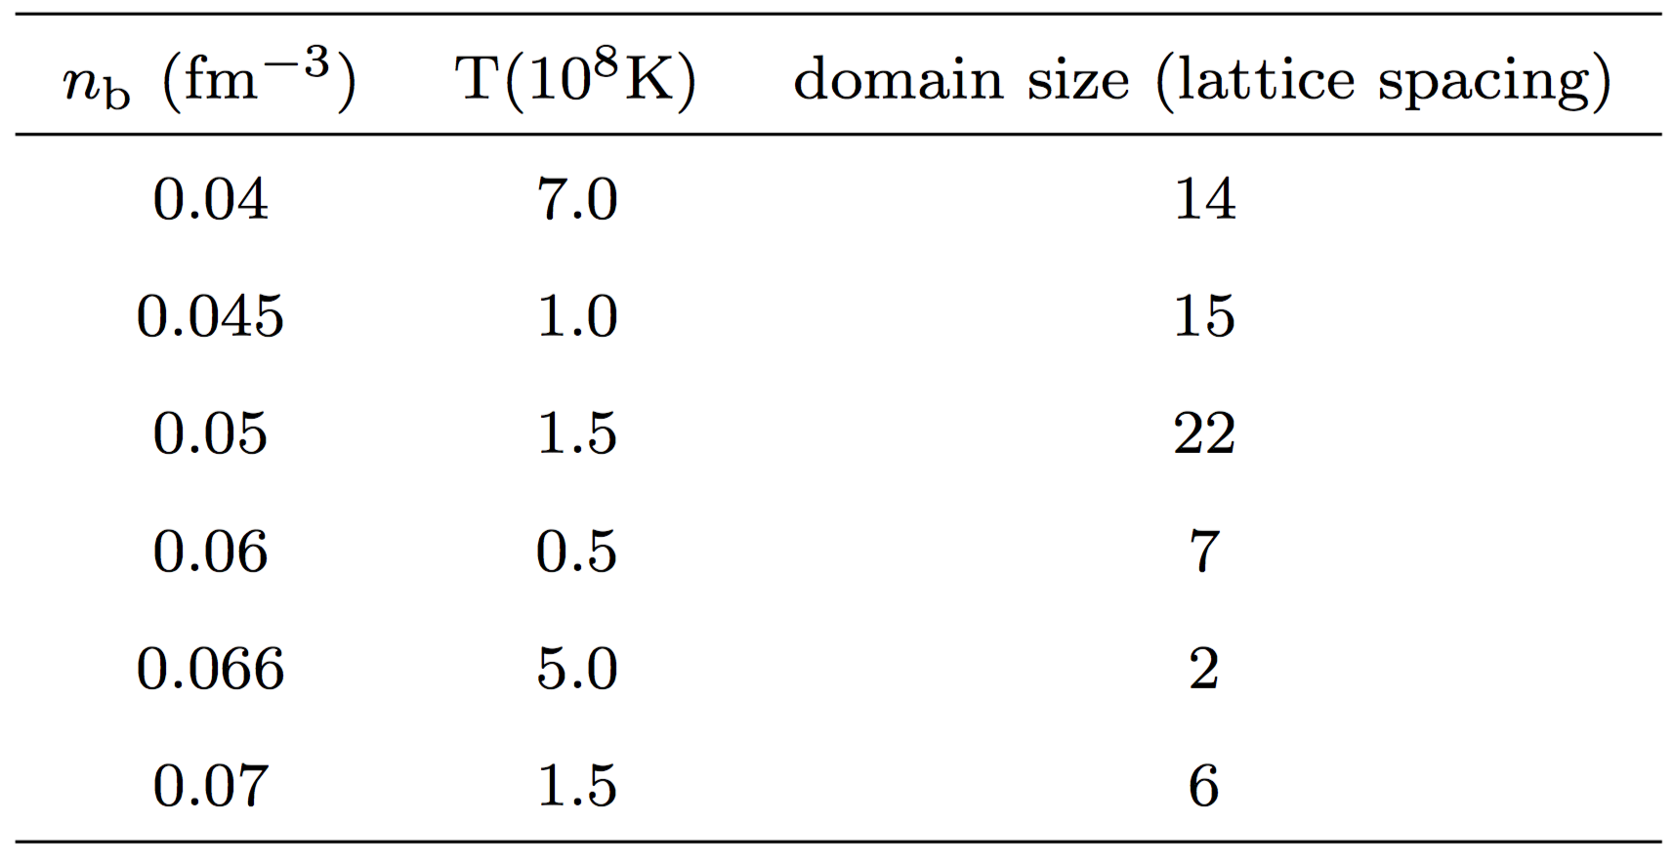
Gibbs Equilibrium: Upper limit to domain sizes
Fluctuations in proton fraction of order 10%
Fluctuations in average baryon density of order 5%

Slide 43
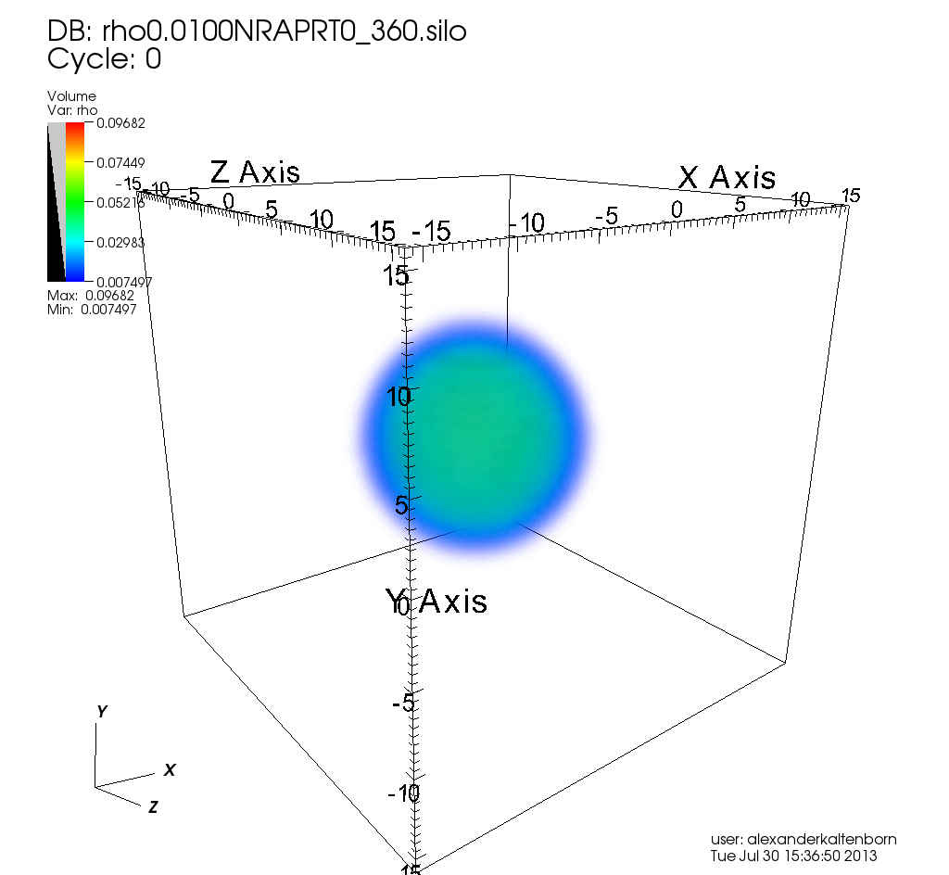
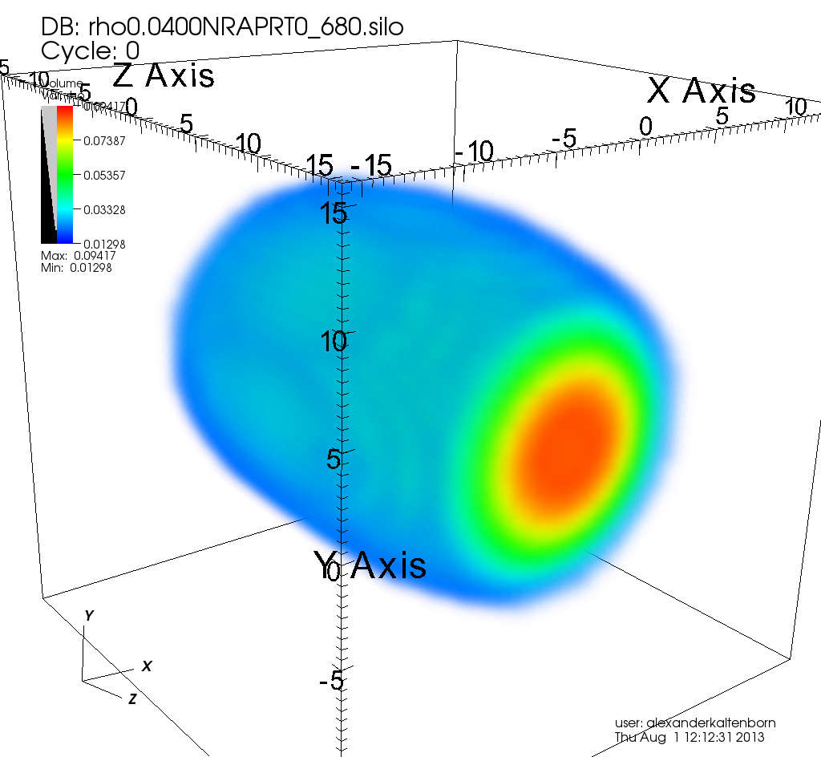
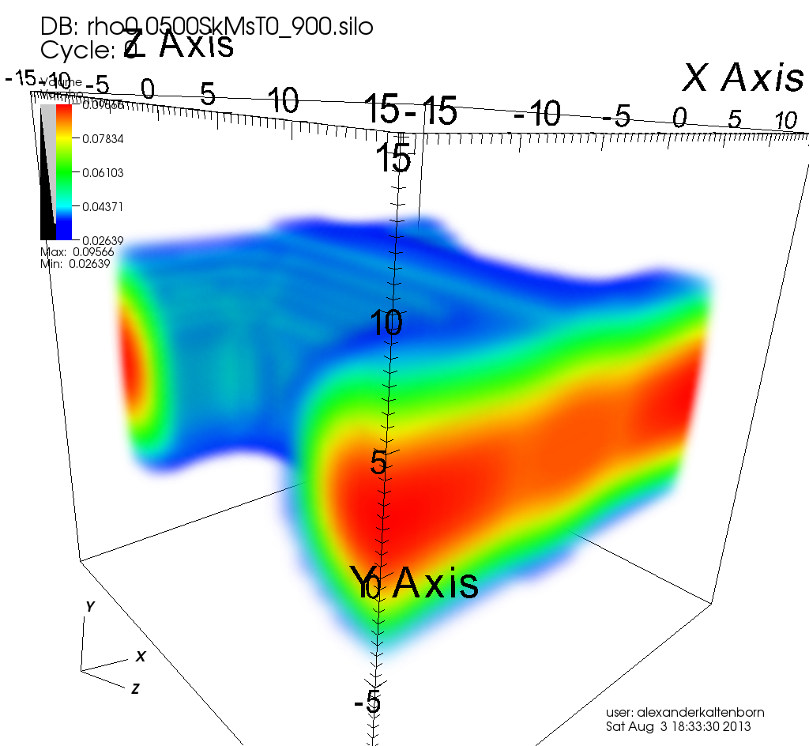
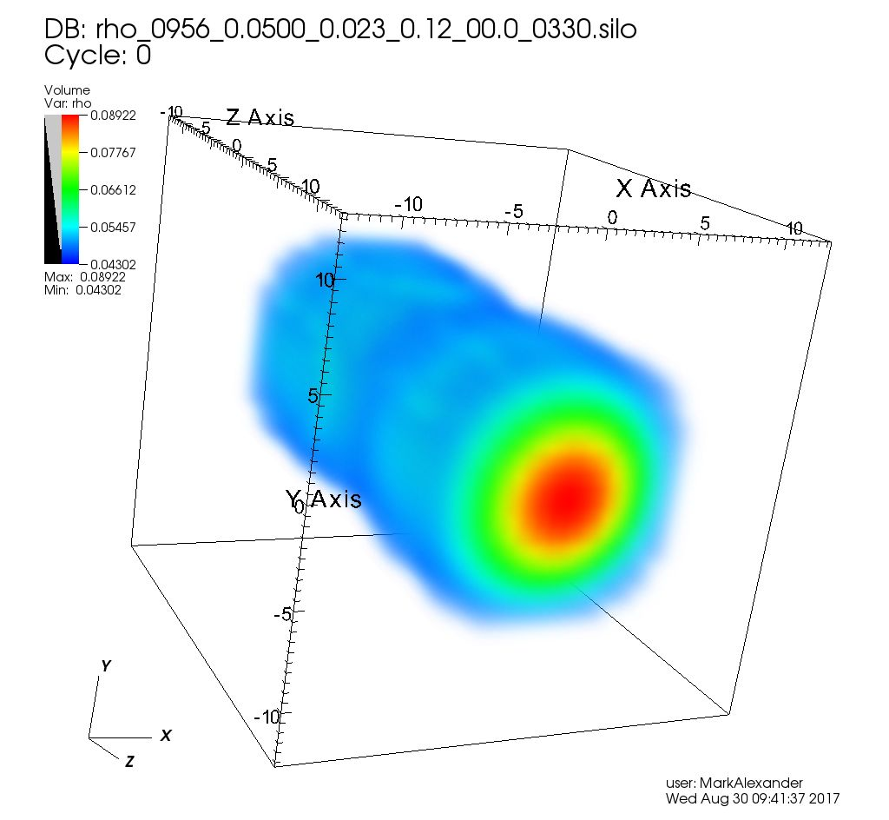
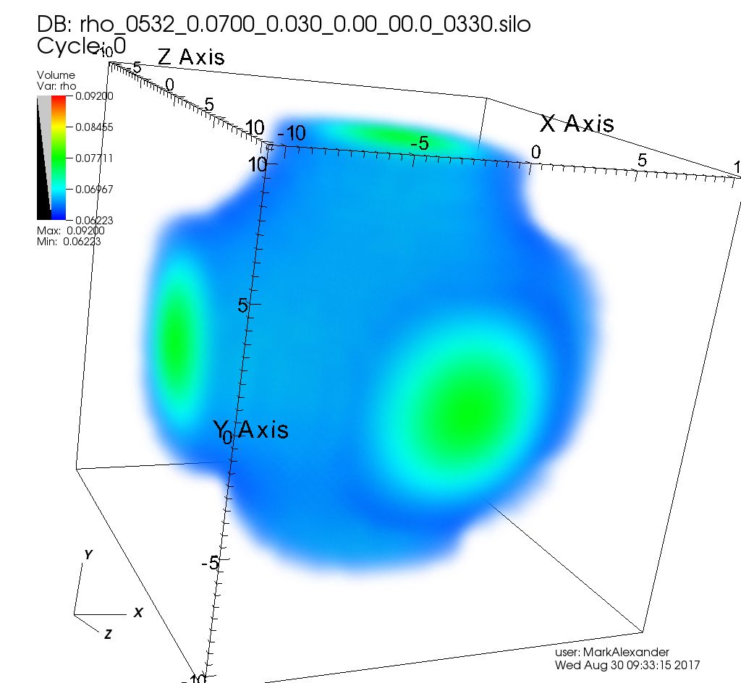
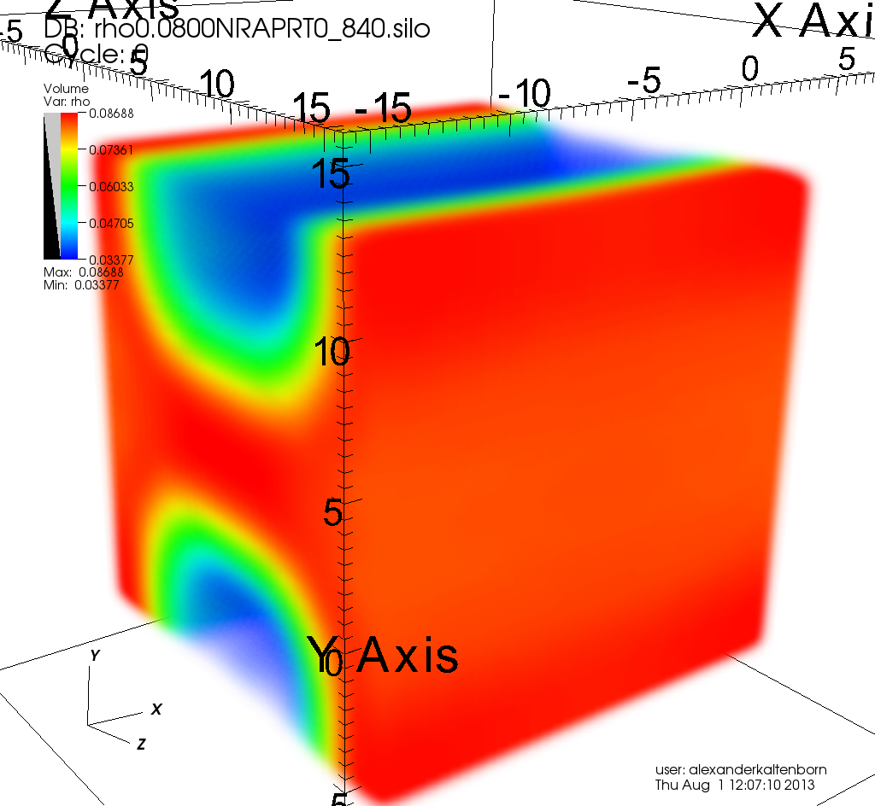
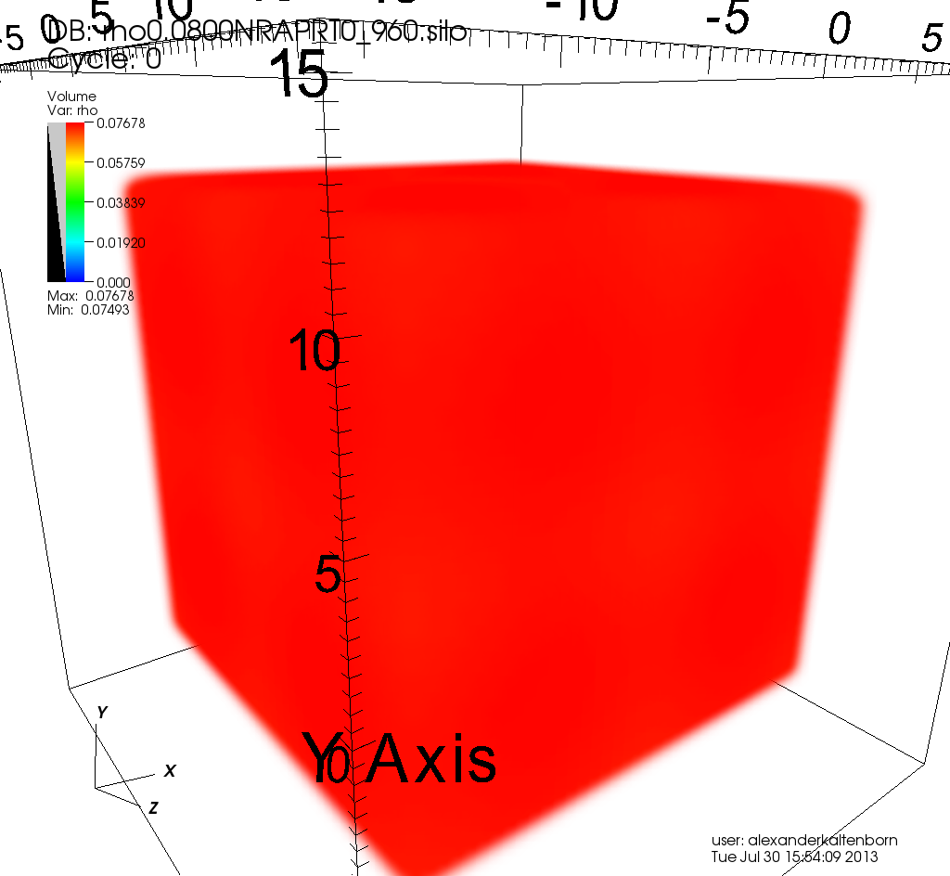
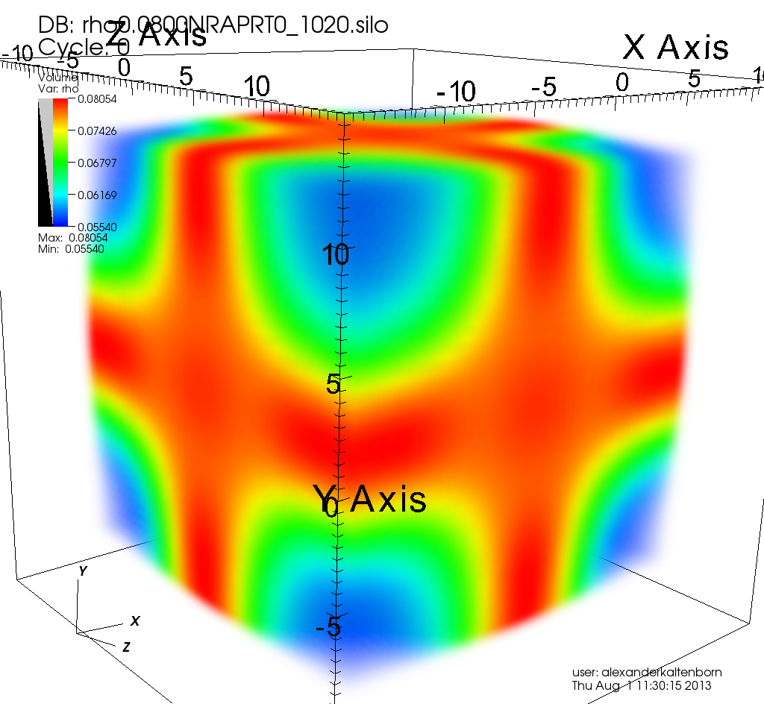
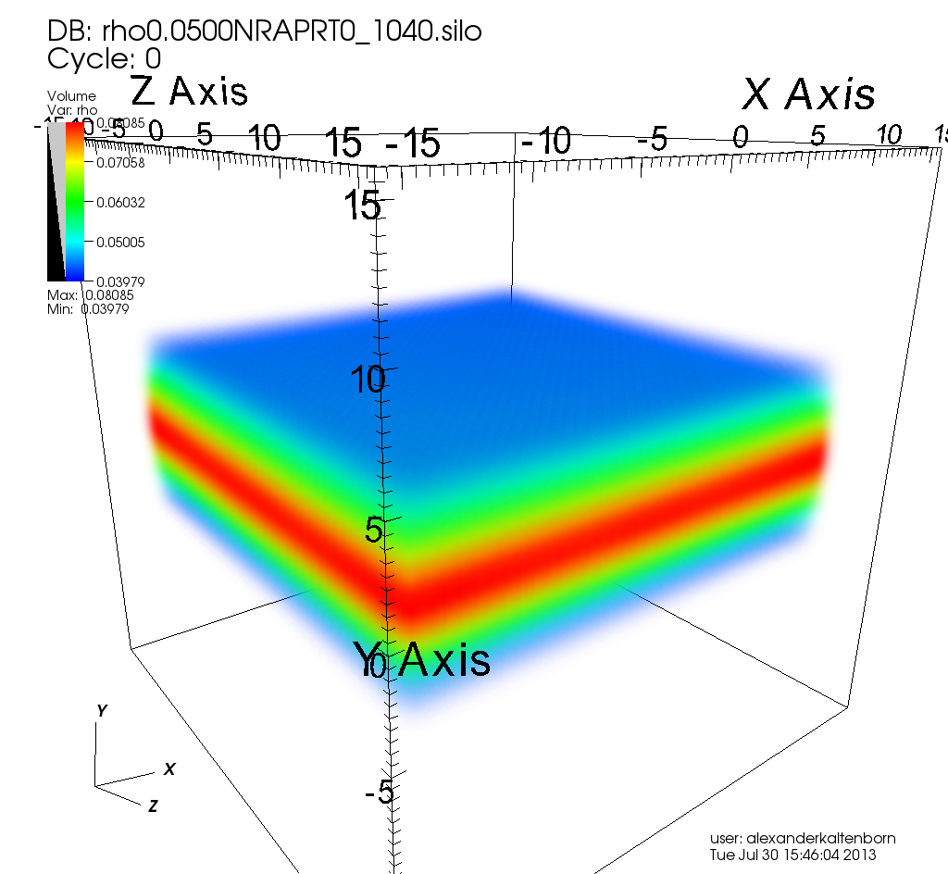
T=0 MeV; NRAPR L = 60 MeV; n_{sph-pasta} = 0.038 fm⁻³; n_{cc} = 0.082 fm⁻³
0.01 fm⁻³
0.03 fm⁻³
0.04 fm⁻³
0.05 fm⁻³
0.06 fm⁻³
0.07 fm⁻³
0.08 fm⁻³
0.09 fm⁻³
Newton+ in prep

Slide 44
Pasta in DFT
Pasta is:
50-75% of the crust by mass
15-25% of the crust by thickness
OUTER
CRUST
INNER
CRUST
INNER
CRUST
PASTA
PASTA

Slide 45
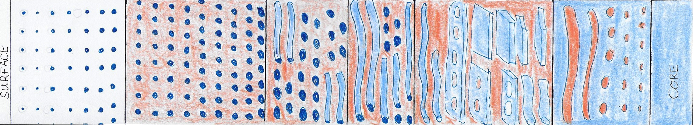
Conclusions
T_{crit} = 0.5-5x10⁸K
T_{crit} = 0.1-0.5x10⁸K
Mixed:
ground
state
spherical
Mixed:
ground
state
pasta
Pure pasta
bubbles
Pure pasta
Outer
Inner

Slide 46
Conclusions
10¹¹K
Pasta forms
10¹⁰K
Amorphous pasta
Solid crust forms
10⁹K
Superfluid transition
10⁸K
Pasta freezes into domains,
characteristic sizes 10xlattice spacing
Pasta in microscopic
domains
10⁷K

Slide 47
Conclusions
15-25% of the crust thickness and 50-75% of the crust mass is pasta
A given crust layer contains multiple pasta phases, maybe in domains of order 10 lattice spacings
Size of domains, disorder sensitive to temperature around 10⁸K
Proton fraction fluctuations of around 10%
Local density fluctuations of around 1%
Below pasta freezing temperature, does composition homogenize, and on what time/length scales?

Slide 48
Extent of pasta in neutron star crusts
L=30 MeV
NRAPR: L=60 MeV
L=90 MeV
n_{b} (fm⁻³)
Spherical ground state + pasta local minima
Pasta ground state + spherical local minima
Pasta only (may be multiple)
Pasta only + unbound protons
At freezing, domains of order 10s of lattice units (spaghetti-like pasta) or a few lattice
spacings (lasagna-like pasta)
Mixed spherical-pasta phases certainly relevant above 10⁷ K; may be relevant at lower
temperatures depending on physics of domains

