Slide 1

Nuclear PDFs and GPDs
with EIC
Salvatore Fazio
Brookhaven National Lab
INT 18-3, week 4
Seattle WA
22-26 October 2018
Notes:
S. Fazio – Brookhaven National Laboratory

Slide 2
Plan of the talk
Imaging with an EIC
DVCS
      Impact studies
DVMP
Nuclei
  nPDFs
  imaging, saturation
Summary

Slide 3
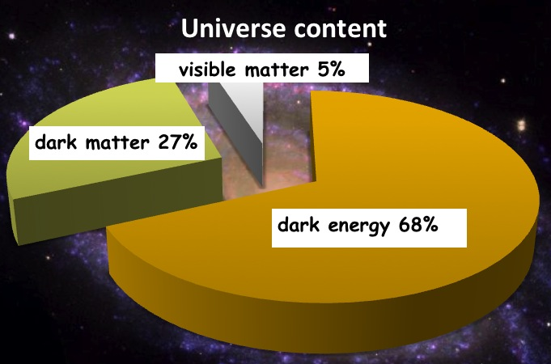

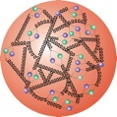
What do we know?
This is us !!!
protons, neutrons, electrons
Proton
10⁻¹⁵m
increase
beam energy
Quarks and Gluons
10⁻¹⁷m
To investigate the nucleon’s partonic structure, the previous and only e+p collider, HERA, was built
The x (of Bjorken) variable: fraction of the nucleon’s momentum carried by the interacting parton
HERA’s discovery:
Gluon density dominates at x<0.1
Proton:
Quark-Masses: ~1% M_{p}
Mass of the “visible matter” is completely dominated by gluons, QCD dynamics
Notes:
Counter-intuitively the best way is through an EM process: DIS
y = inelasticity = fraction of the incoming electron energy carried by photon in the rest frame of the nucleon
The structure function F2 is sensitive to the sum of quark and anti-quark momentum distribution in the nucleon.
The apparent scaling of the data with Q2 at large x in early DIS data from SLAC was termed “Bjorken scaling” and motivated the parton model.
In the parton model, FL = 0, while in QCD, it is directly proportional to the gluon structure function, FL(x,Q2) ~ aS xG(x,Q2), at low x.
DGLAP: fixed x -> evolution along Q2
sigma (gamma N) = sig_T + sig_L
sig_L ~ FL
sig_tot ~ F2/Q^2
\frac{d^2 \sigma^{ep \rightarrow eX}}{dx dQ^2} = \frac{4 \pi \alpha^2_{e.m.}}{xQ^4} \left[ \left(1-y+\frac{y^2}{2} \right ) F_2(x,Q^2) - \frac{y^2}{2} F_L(x,Q^2) \right]

Slide 4
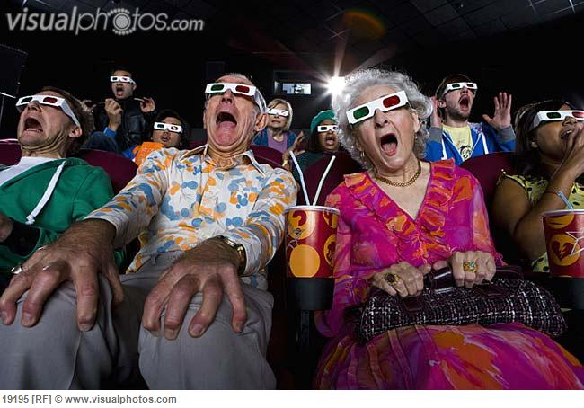
Partonic tomography of the nucleons
Wigner distribution 5D
TMDs
GPDs
3D
d²r_{T}
d²k_{T}
2D+1 picture in momentum space 2D+1 picture in coordinate space
transverse momentum dependent PDFs generalized parton distributions
  → SIDIS, Drell-Yan, weak bosons → exclusive reaction
Quarks
unpolarized polarized

Slide 5
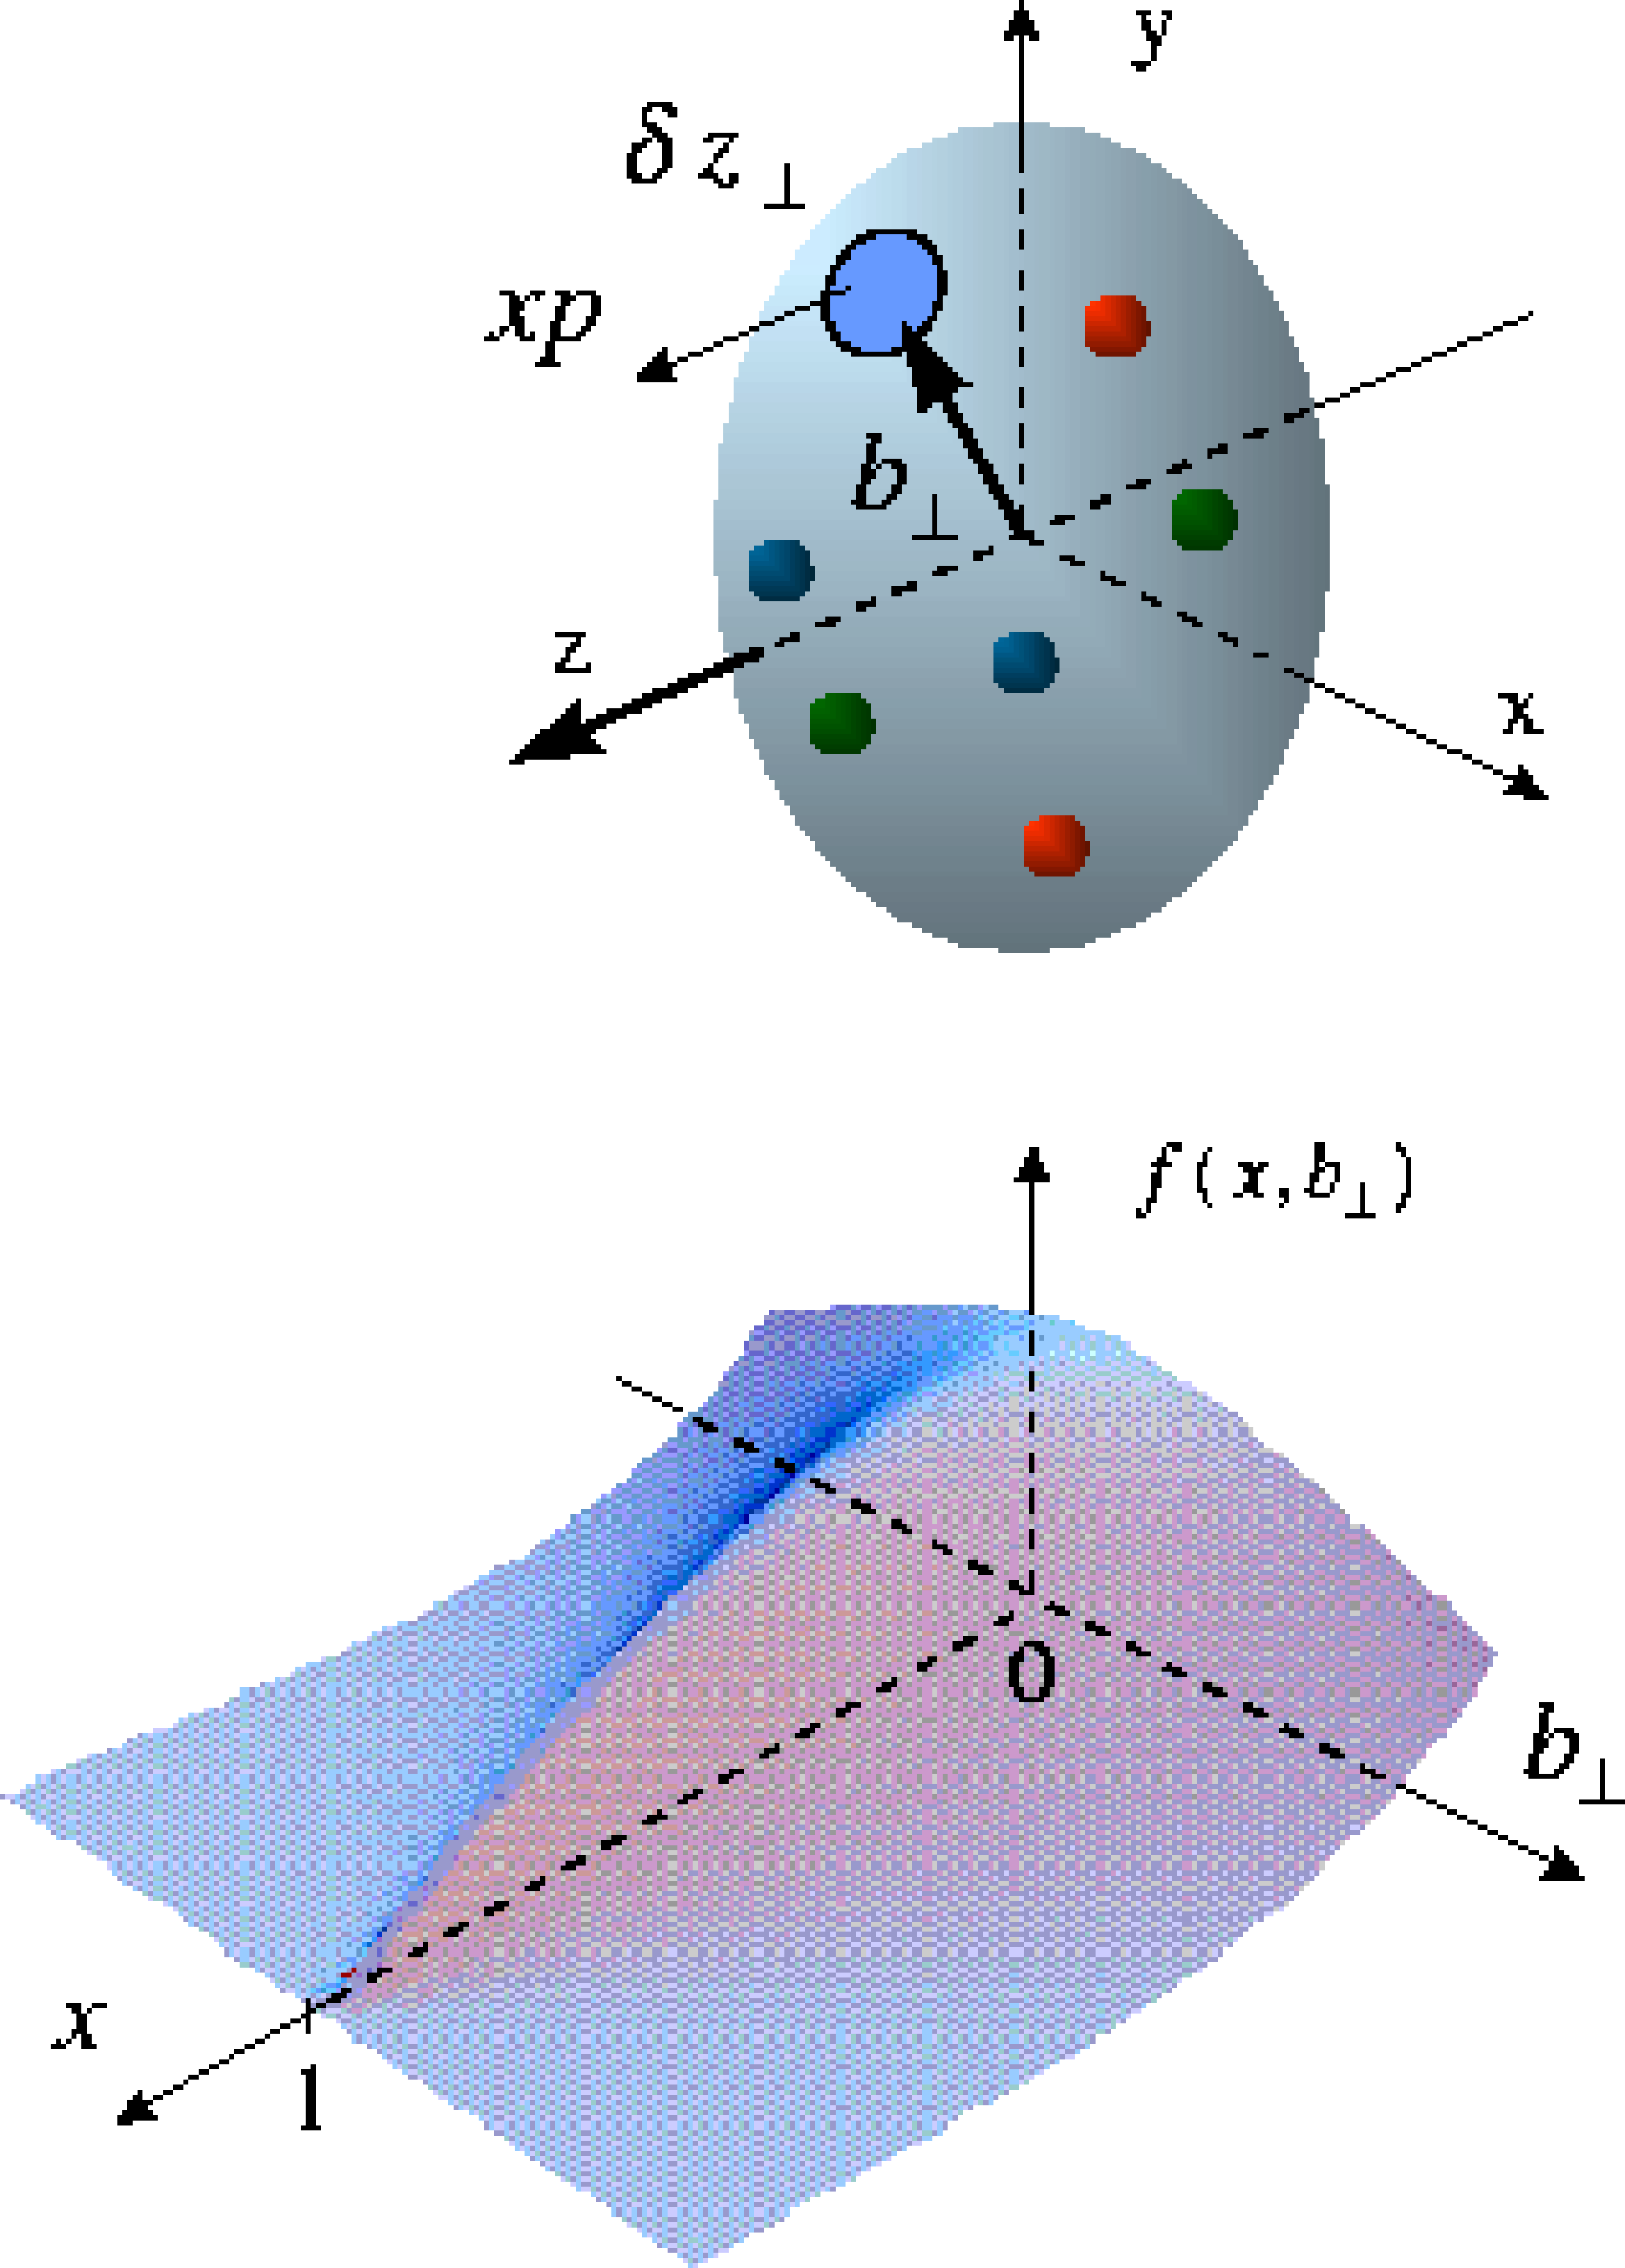
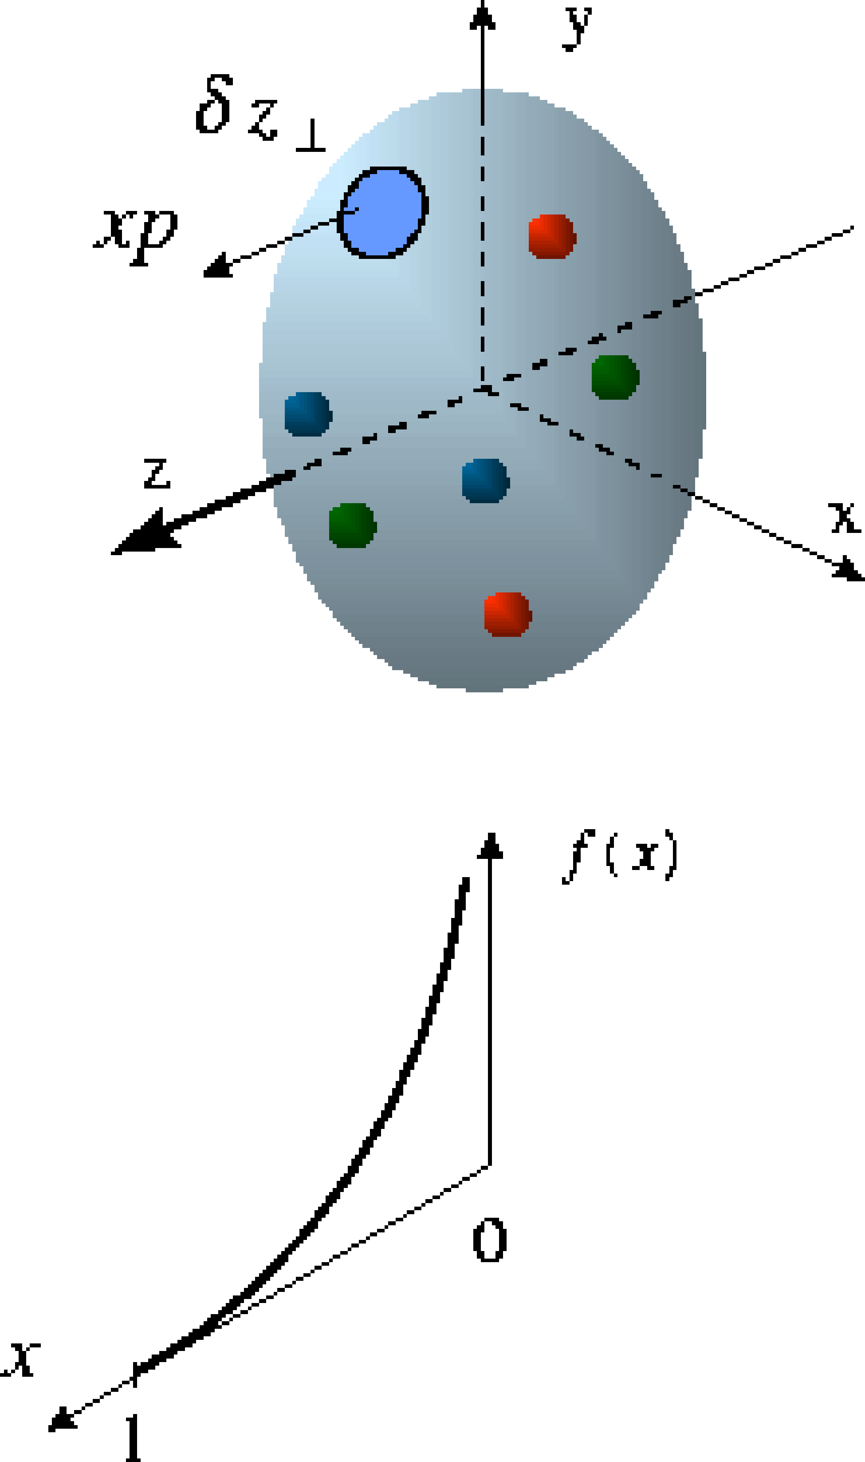
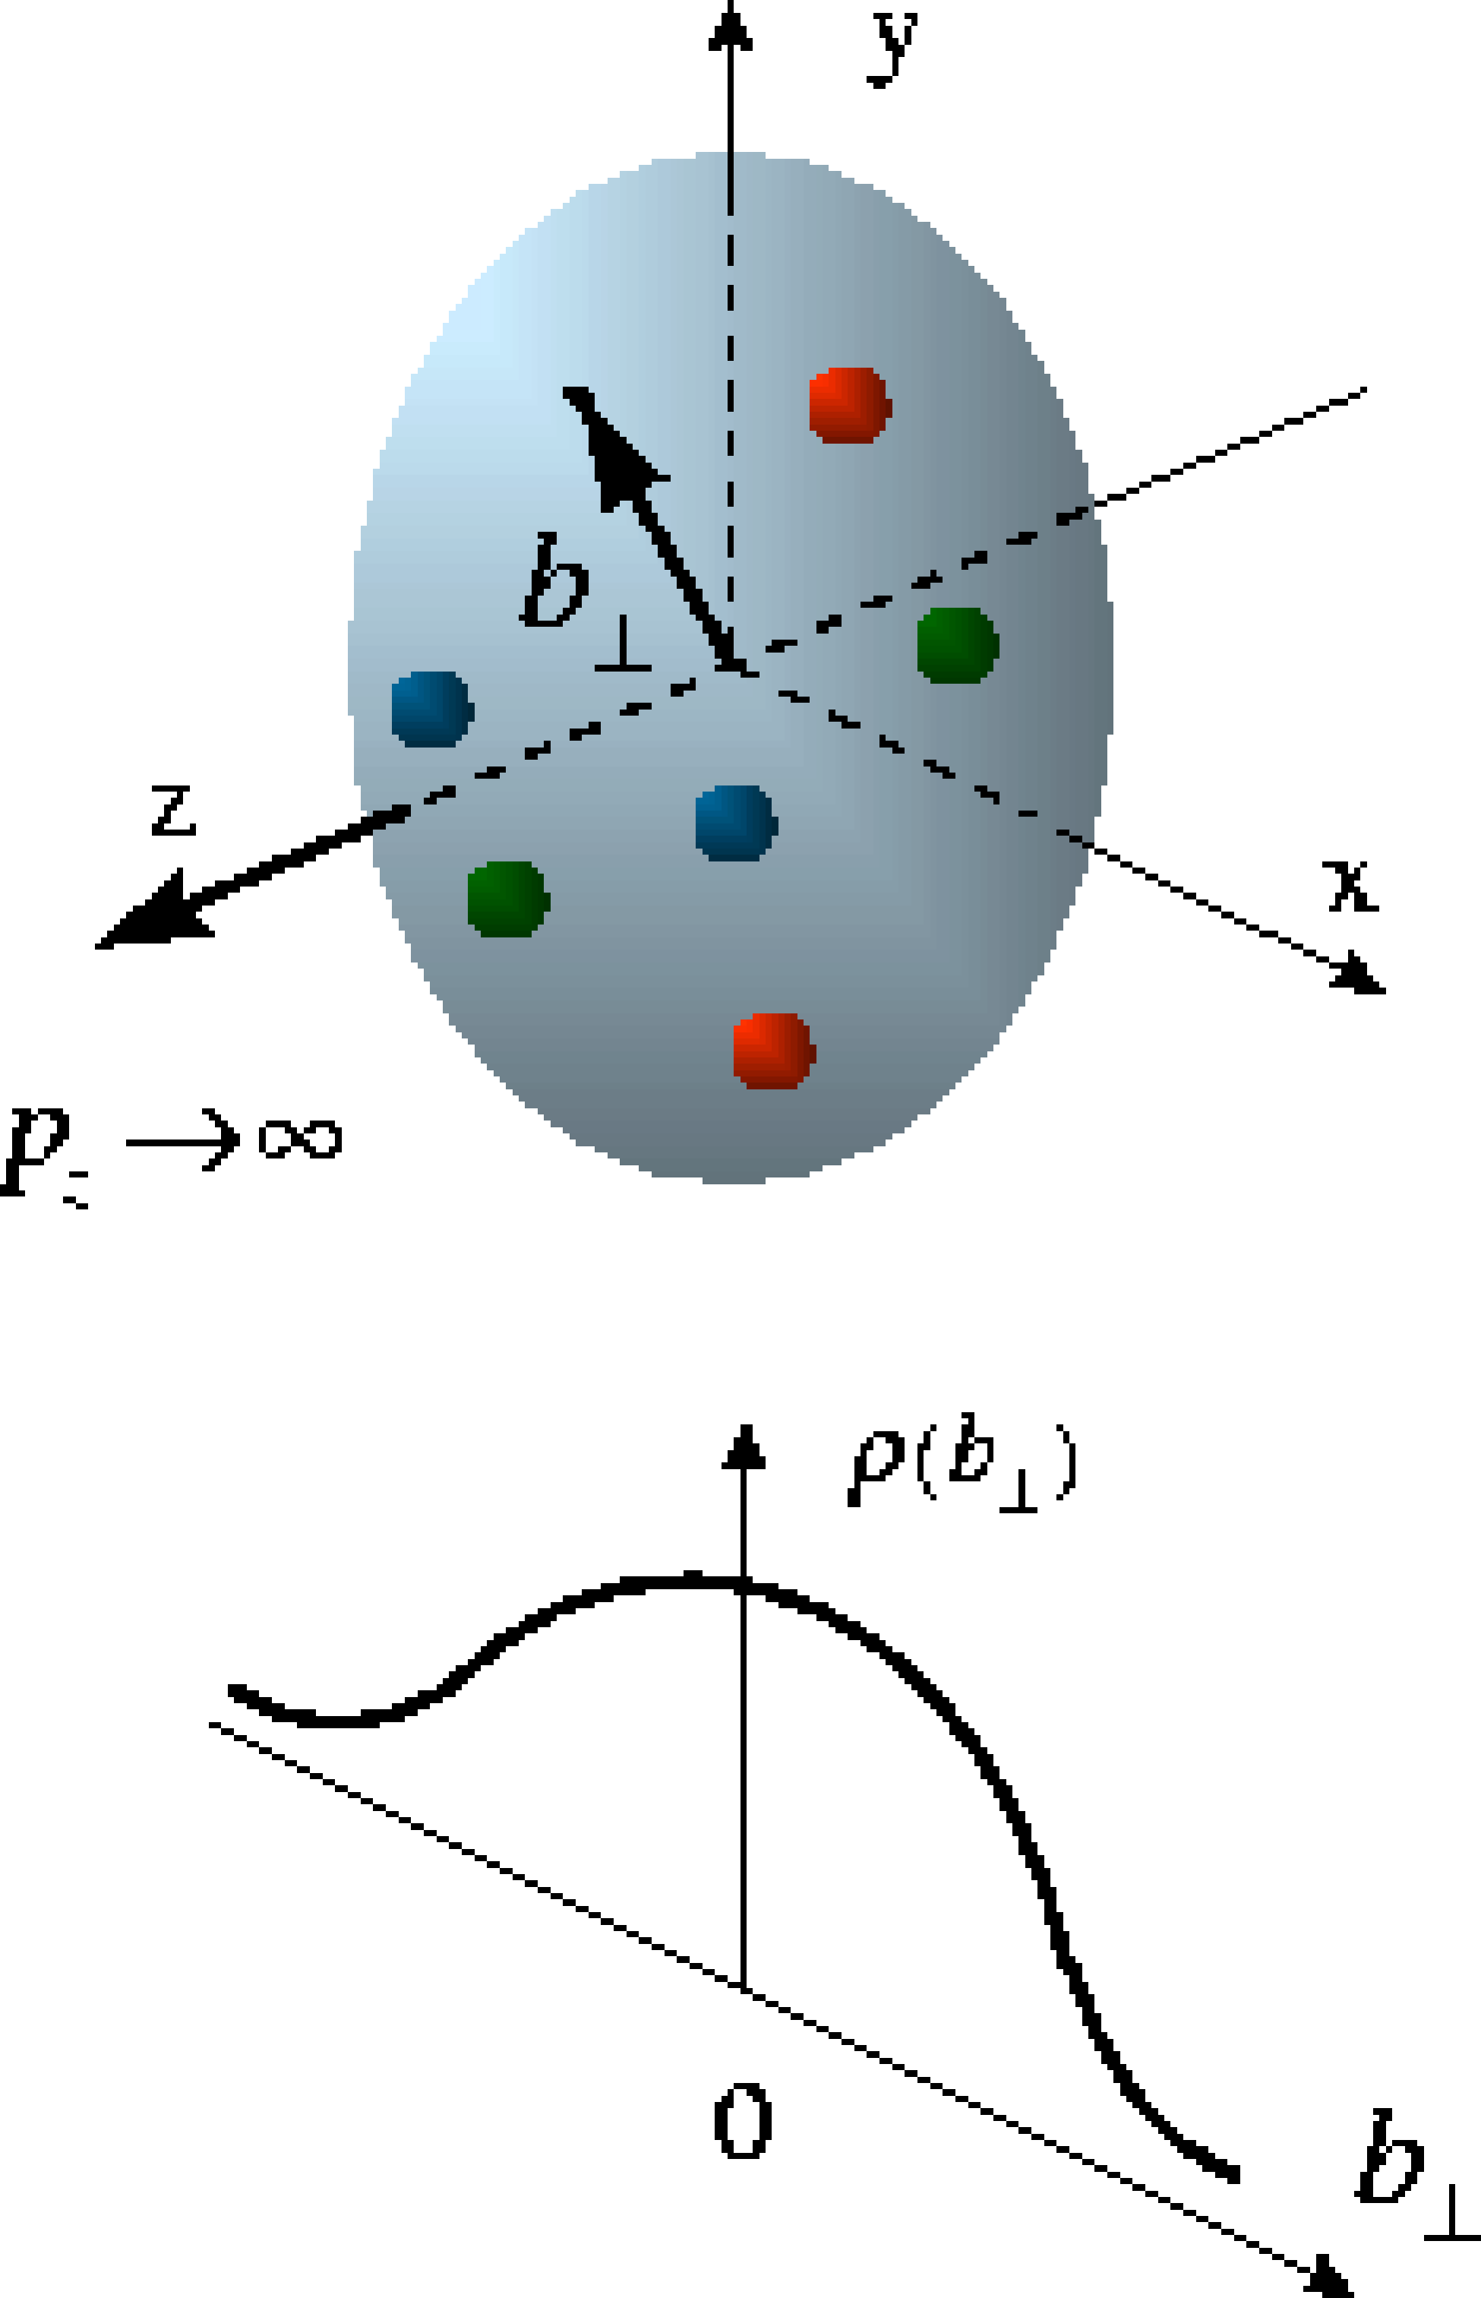
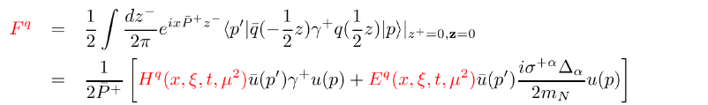
Generalized Parton Distributions
Longitudinal momentum & helicity distributions
transverse charge & current densities
parton densities
form factors
GPDs
The nucleon (spin-1/2) has four quark and gluon GPDs (H, E and their polarized versions). Like usual PDFs, GPDs are non-perturbative functions defined via the matrix elements of well-defined parton operators:

Slide 6

Exclusive Vector Meson and real photon production
DVCS (γ)
VM (ρ, ω, φ, J/ψ, Υ)
^{γ*}
^{γ}
^{γ*}
V
IP
p
p
square 4-momentum at the p vertex:
p
p
t
t
Scale:
Q²
Q² + M²
DVCS:
Very clean experimental signature
No VM wave-function uncertainty
Hard scale provided by Q²
Sensitive to both quarks and gluons [via Q² dependence of xsec (scaling violation)
VMP:
Uncertainty of wave function
J/Psi → direct access to gluons, c+bar-c pair produced via quark(gluon)-gluon fusion
Light VMs → quark-flavor separation
Alternative/complementary way to quark-flavor separation
DVCS on a real neutron target → polarized Deuterium or He³

Slide 7
Accessing the GPDs in exclusive processes
Dominated by H
slightly dependent on E
Angle btw the production and scattering planes
Angle btw the scattering plane and the transverse pol. vector
Requires a positron beam
done @ HERA
sin(Φ_{Τ}−φ_{Ν})
governed by E and H
Requires a polarized proton-target
Spin-Sum-Rule in PRF:
from g₁
responsible for orbital angular momentum
a window to the SPIN physics

Slide 8
Ingredients for a High Resolution “Femtoscope”
Large center-of-mass coverage:
Access to wide kinematic range in x and Q²
Polarized electron and hadron beams:
access to spin structure of nucleons and nuclei
Spin vehicle to access the 3D spatial and momentum structure of the nucleon
Full specification of initial and final states to probe q-g structure of NN and NNN interaction in light nuclei
Nuclear beams:
Accessing the highest gluon densities → amplification of saturation phenomena
High luminosity:
Detailed mapping the 3D spatial and momentum structure of nucleons and nuclei
Access to rare probes
All these requirement will be addressed by a future Electron-Ion Collider

Slide 9
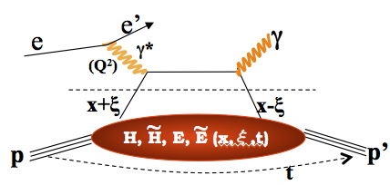
DVCS at an EIC
E.C. Aschenauer, S. F., K. Kumerički, D. Müller JHEP09(2013)093
DVCS signal
Bethe-Heitler QED bkgd.
Comprehensive EIC studies
Signal extraction “a la HERA”
xSec meas.: Specific requirements to suppress BH
keep BH/sample below 60% at high energies
Radiative Corrections evaluated
detector acceptance & smearing
t-slope: b=5.6 compatible with H1 data
|t|-binning is (3*resolution)
5% systematic uncertainties
Overlap with HERA:
Large impact on current fits at low x
Overlap with JLAB12:
Sanity check
Intermediate region:
Fine mapping of the GPDs evolution
HERA results limited by lack of statistics
EIC: the first machine to measure cross sections and asymmetries

Slide 10
DVCS at a high luminosity collider
The code MILOU by E. Perez, L Schoeffel, L. Favart [arXiv:hep-ph/0411389v1]
is Based on a GPDs convolution by: A. Freund and M. McDermott [http://durpdg.dur.ac.uk/hepdata/dvcs.html]
EIC will provide sufficient lumi to bin in multi-dimensions
wide x and Q² range needed to extract GPDs
√s = 45 GeV
√s = 140 GeV
… we can do a fine binning in Q2 and W… and even in |t|

Slide 11
BH fraction
Q²
cuts keep BH below 60% of the sample at large y > 0.5
20 x 250 GeV²
BH subtraction will be not an issue for y<0.6
BH subtraction will be relevant at lower energies and large y, in some of the x-Q² bin
BUT…
higher-lower √s kin. overlapping:
x-sec. measurements at a higher √s at low-y can cross-check the BH subtraction made at lower √s
x
y

Slide 12

Contribution from ISR
Fraction of ISR events for three Q²-bins as fct of x for two EIC beam energy combinations.
ONLY 15% of the events emit a photon with > 2% energy of the incoming electron
ISR photons with E_{γ} < 0.02 E_{e} do not result in a significant correction for the event kinematics.
q₃
DVCS
&
BH -ISR

Slide 13
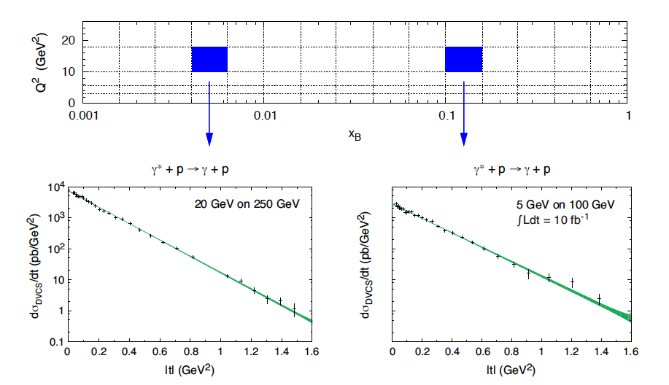
DVCS & J/ψ differential cross section
Luminosity: 10 fb⁻¹
Measurement dominated by systematics
Fourier transf. of dσ/dt → partonic profiles
DVCS

Slide 14
Transverse target-spin asymmetry
Different assumptions for E
sin(Φ_{Τ}−φ_{Ν})
governed by E and H
Spin-Sum-Rule in PRF:
from g₁
Gives access to GPD E
E.C. Aschenauer, S. F., K. Kumerički, D. Müller JHEP09(2013)093

Slide 15
DVCS-based imaging
A global fit over all mock data was done, based on: [Nuclear Physics B 794 (2008) 244–323]
Known values q(x), g(x) are assumed for H^{q}, H^{g} (at t=0 forward limits E^{q}, E^{g} are unknown)
Fourier
Fourier
Unpolarized
sea-quarks
Polarized
sea-quarks
gluons
E.C. Aschenauer, S. F., K. Kumerički, D. Müller, JHEP09(2013)093

Slide 16
Spatial Imaging – as in the EIC White Paper
E.C. Aschenauer, S. F., K. Kumerički, D. Müller, JHEP09(2013)093
Unpolarized
sea-quarks
Polarized
sea-quarks
gluons
Shift due to GPD E
Impact of EIC (based on DVCS only):
Excellent reconstruction of H^{sea}, and H^{g} (from dσ/dt)
Reconstruction of sea-quarks GPD E
Other capabilities still to be evaluated?
GPD H-Gluon is nice but can be much better by including J/ψ
Access to GPD E-gluon → orbital momentum (Ji sum rule)
Flavor Separation of GPDs (VMP and/or DVCS on deuteron)
Nuclear imaging (modification of GPDs in p+A collisions)

Slide 17
How to separate flavors?
Method 1 – VMP
rho0: 2u+d 9/4g
omega: 2u-d /4g
phi: s,g
rho+: u-d
J/psi: g
We simulated the J/Psi cross section and the Fourier transform but never included it on GPDs fits
Challenges of VMP (if compared to DVCS)
Uncertainty on wave function
measuring muons vs electron decay channel
Method 2 – DVCS on protons and neutrons
We do not a real neutron target → Use Deuterium (D)
We incoherent DVCS on D (D can break up) but coherent on n (tagged by ZDC)
One still needs J/psi to directely access the gluons and extract Eg

Slide 18
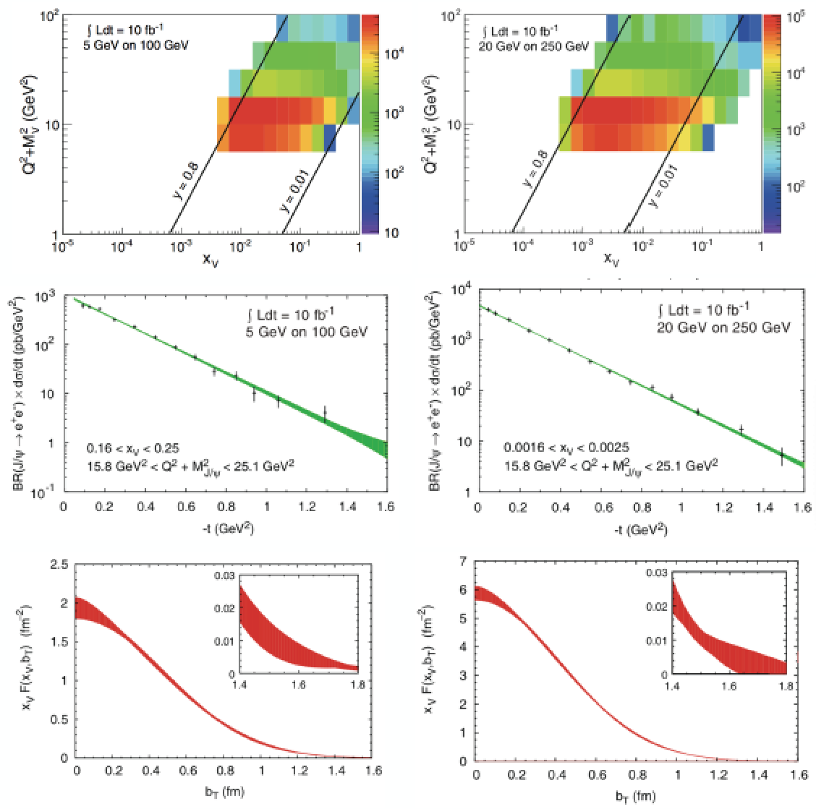
Imaging gluons with J/ψ
EIC White Paper
Luminosity: 10 fb⁻¹
Measurement dominated by systematics
Fourier transf. of dσ/dt → partonic profiles
Average gluon densities

Slide 19
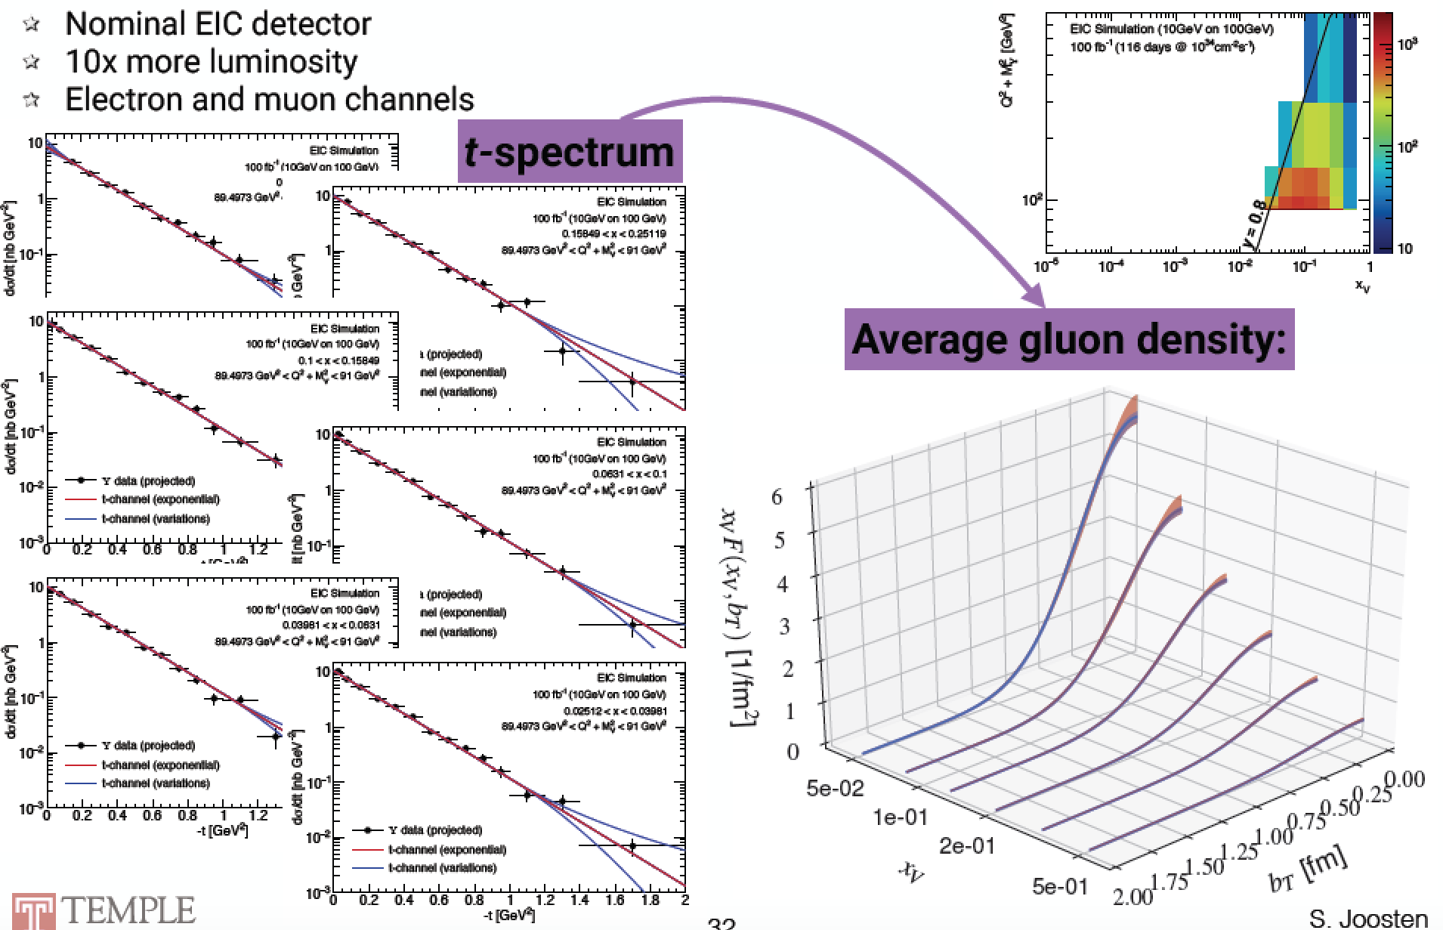
Imaging gluons with Y(1s)
S. Joosten, Z.-E. Meziani 2018 EICUG Meeting
This is just for √s = 63 GeV
√s=140 GeV gives a factor >~3 higher xSec (eSTARLight) and reach at low-x

Slide 20
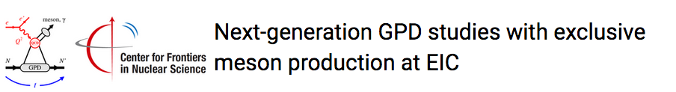
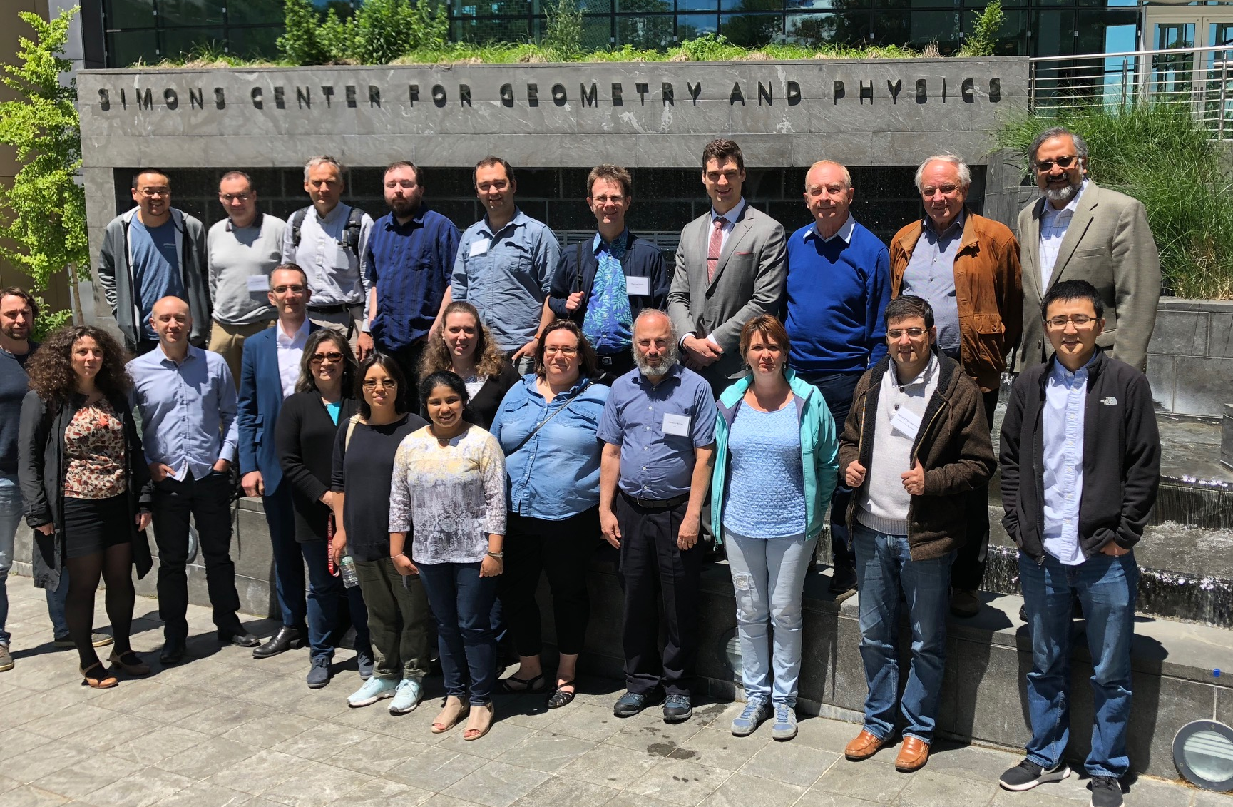
https://indico.bnl.gov/event/4346/
Outcomes of the Workshop
• QCD factorization with finite-size effects
provides realistic description of exclusive
meson production
Use in GPD & imaging studies
Need theoretical work: NLO corrections,
relation between approaches
• UPCs at LHC extend energy frontier in heavy quarkonium production
LHCb, ALICE results for γ + p → J/ψ + p (up to W ∼ 1.5 TeV)
Consistent with HERA data; no indications of nonlinear effects
• Meson production could become essential tool for GPD studies at EIC
Dedicated community, great interest
• Next-level impact studies need GPD-based physics models
Aim for GPD extraction with uncertainties
• PARTONS project (H. Moutarde et al) can play important role in integrating GPD efforts at JLab12 and EIC

Slide 21
Scattered Proton measurement
Remember:
Detector -4 to 4 in h
35 mrad from beam line
so not seen in main detector
need different detection technology
p_{T} of proton critical for physics
p_{T} = pʹ sin(𝛩)
pʹ _{L} > 97% of p_{Beam}
ZEUS Coll, JHEP 06 (2009) 074
Note:
high energy colliders (HERA, Tevatron, LHC, RHIC) use Roman Pots to detect these protons
→ RPs are high resolution movable small tracking detectors (Si strips, Si pixels…), a crucial component
𝛩 < 10 mrad
  impact on large p_{T}-acceptance
small p_{T}-acceptance limited by beam divergence and immittance
→ rule of thumb keep 10s between RP and beam
non-diffractive events
⟻
X_{L}=pʹ_{L}/p_{Beam}

Slide 22
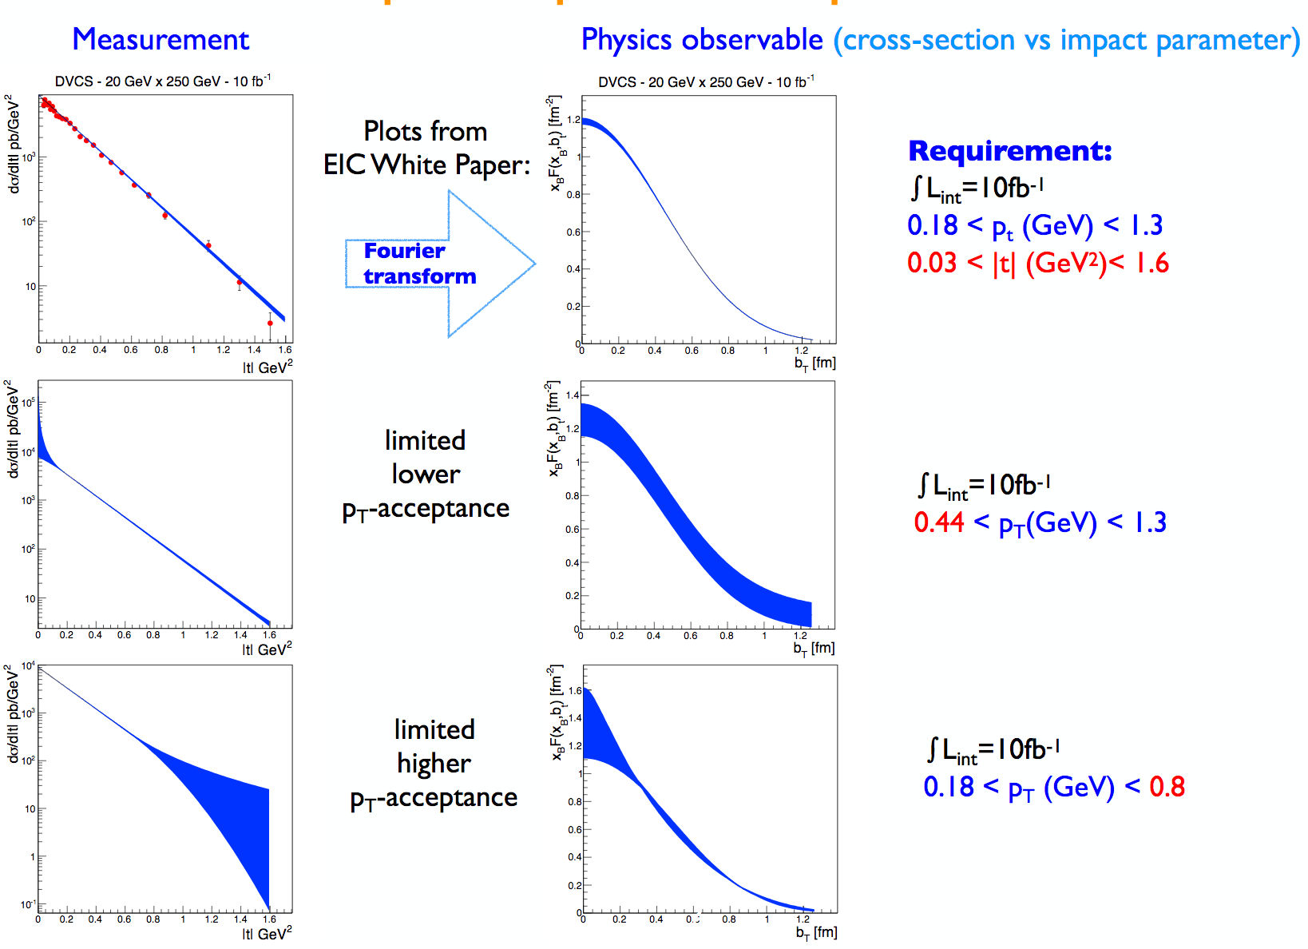
Impact of proton acceptance
We need a proton spectrometer with large acceptance!

Slide 23
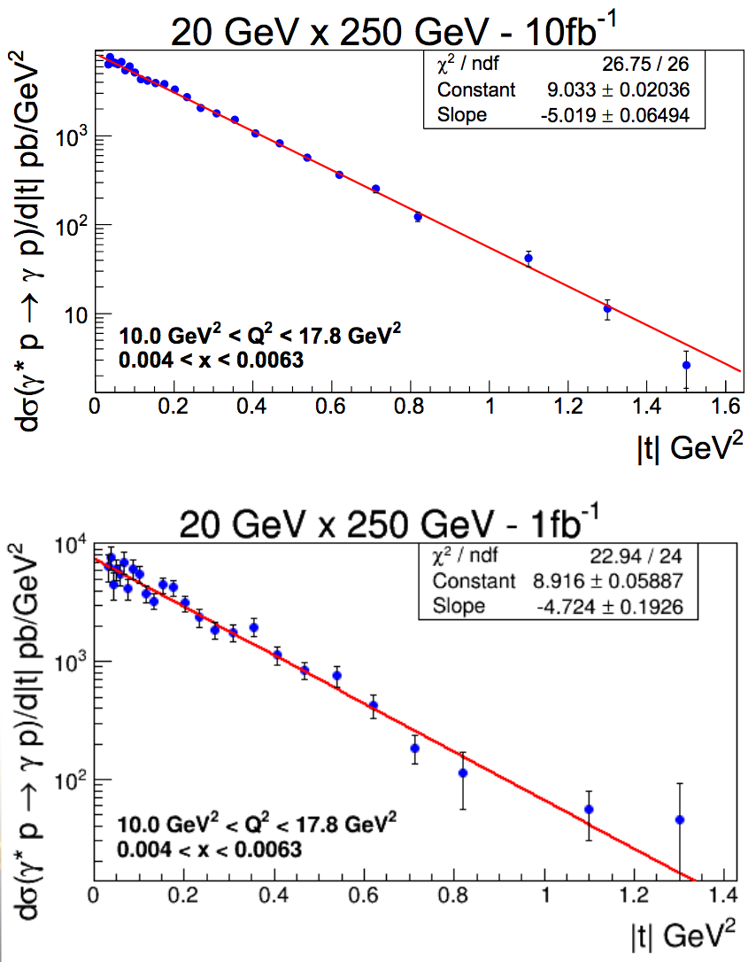
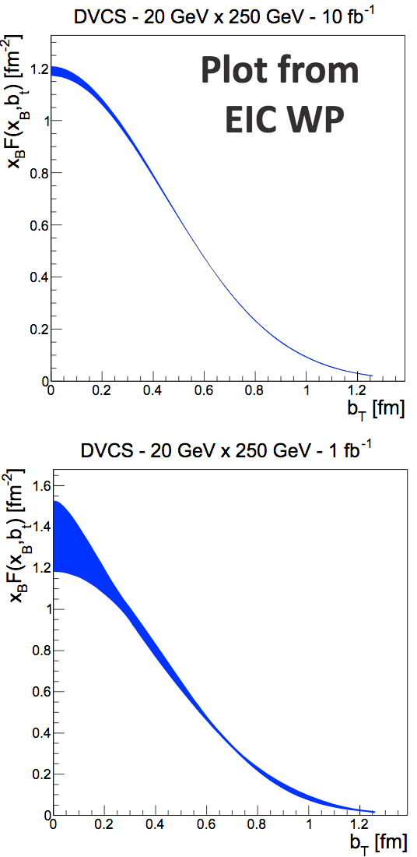
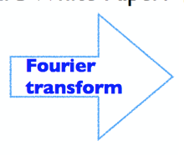
Impact of collected luminosity
See also B. Mueller’s talk
0.18 < p_{T} < 1.3 GeV
10 fb⁻¹ → 1 fb⁻¹
10 fb⁻¹
1 fb⁻¹

Slide 24
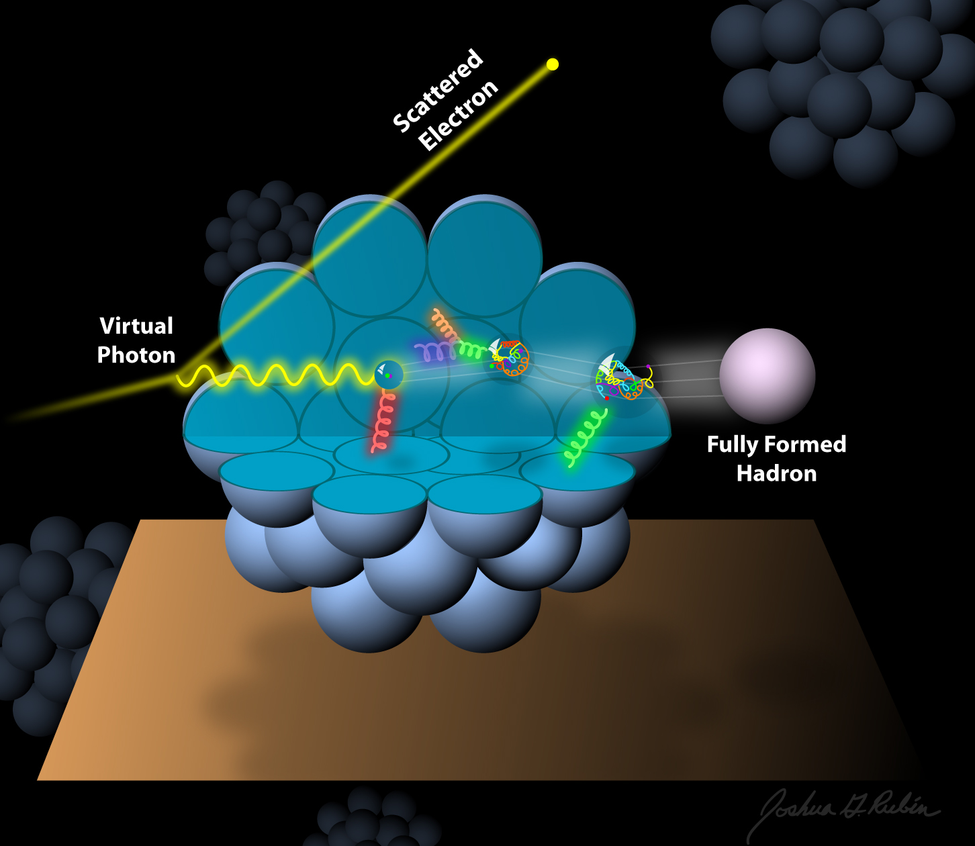

Nuclear PDFs and GPDs
an Electron-Ion Collider (EIC)
How does the nuclear environment affect the distribution of quarks and gluons and their interaction in nuclei?
Incoming
Electron Beam
Where does the saturation of the gluon density set in?

Slide 25
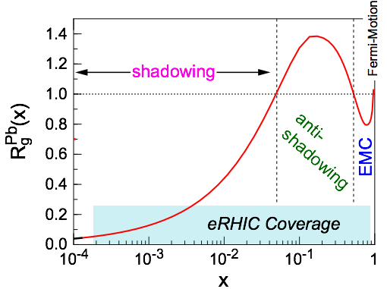
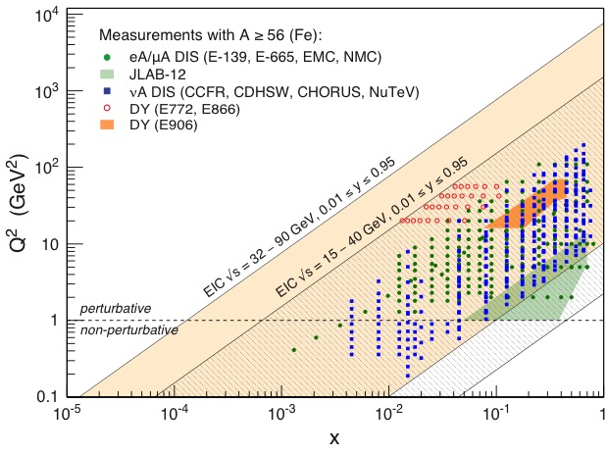
Nuclear Structure Functions
Inclusive DIS on e+A analog to e+p:
Ratio: F₂(x,Q²)_{Pb}/F₂(x,Q²)_{p}
quark+anti-quark
gluons
(or tag on F₂-charm)
Theory/models have to be able to describe the structure functions and their evolution
DGLAP:
predicts Q² but not A-dependence and x-dependence
Saturation models:
predict A-dependence and x-dependence but not Q²
→ Need: large Q² lever-arm for fixed x, A-scan
Aim at extending our knowledge on structure functions into the realm where gluon saturation effects emerge ⇒ different evolution

Slide 26
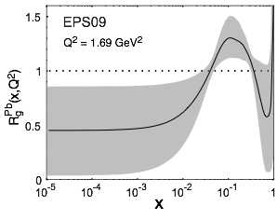
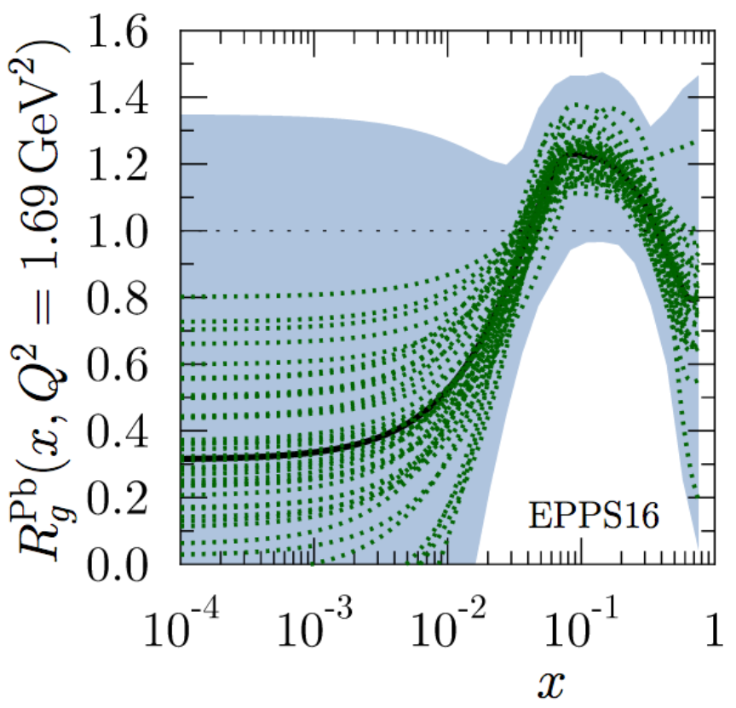
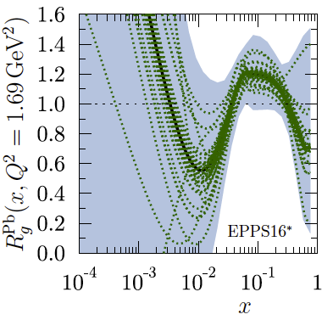
Nuclear Modifications – Present Knowledge
Measure different structure functions in e+A → constrain nPDF
Latest state-of-the-art nPDF is EPPS16
K. J. Eskola, P. Paakkinen, H. Paukkunen, C. A. Salgado [Eur.Phys.J. C77 (2017) no.3, 163]
  Replacing EPS09. Quark flavors are now separated
  includes latest LHC data
  EPPS16*→ functional form with less constraints (for gluons) in extrapolating for x < xdata
  ⇒ critical to study the impact of the high precision EIC data!
  What is the possible impact of an Electron-Ion Collider?
Ratio: g(x,Q²)_{Pb}/g(x,Q²)_{p}
EPS09
EPPS16
EPPS16*

Slide 27
Reduced Cross Section & F₂ (e+Au)
  Systematics = 3%
  Stat. and Sys. error summed in quadrature (Sys. dominate!)
  Gluon extraction via scaling violation → dσ(x,Q²)/dlnQ² (requires ~> 1 decade in Q² at a fixed x)
  Comparison of linear with non-linear evolution in x will signal saturation
  ⇒ needs low-x reach
σ
An EIC at its highest energy provides a factor 10 larger reach in Q² and low-x compared to available data
Large expected impact on current theory uncertainty, especially at low-x and low-Q²

Slide 28
Radiated photons
We use Django simulator including O(α) radiative effects
We look at photons radiated from the electron
before or after the interaction
50% events radiate a photon
Radiated photons are
Low energy (most of them < 1 GeV)
uniformly distributed in the azimuthal angle
collinear to the scattered electron (θ_{γ} > 3 rad)
Correction factor:

Slide 29
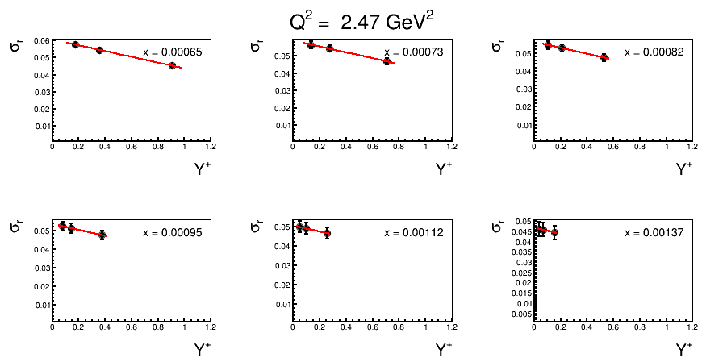
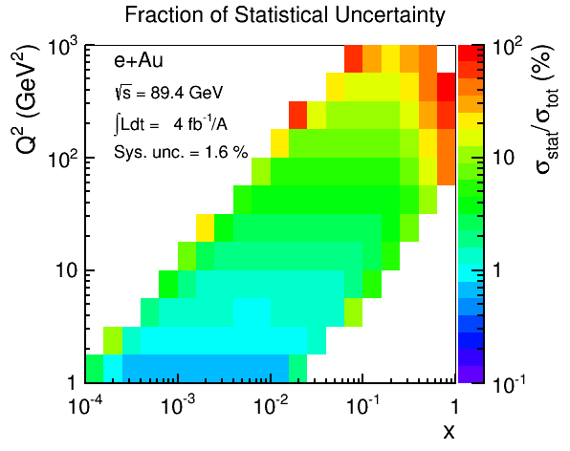
Extracting F_{L} (e+Au)
Higher energy EIC: √s = 63, 78, 89 GeV
Enough Lever Arm required
(three points, Y⁺ > 0.2)
(similarly for larger Q² and lower energies)
Simulation:
[√s = 32(63) GeV] –> L = 2 fb⁻¹/A
[√s = 39(78) GeV] –> L = 4 fb⁻¹/A
[√s = 45(89) GeV] –> L = 4 fb⁻¹/A
Total simulated event sample L = 10 fb⁻¹/A
total error = stat. + sys. summed in quadrature
assumed sys. = 3%
Errors still dominated by systematics

Slide 30
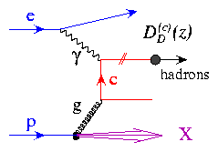
Charm production: a unique tool!
Direct access to gluons at medium to high x by tagging photon-gluon
Helps determining heavy quarks mass scheme
Novel probe!
Selection of charm-production events
We select kaons in the final state of the D meson decay, looking for:
a displaced vertex: 0.01 cm <|Vertex|< 3 cm
Momentum within the acceptance of an EIC model detector (BeAST @ eRHIC)
CENTRAL DETECTOR (-1 < η < 1)
dE/dx -> 0.2 GeV < P < 0.8 GeV
RICH -> 2 GeV < P < 5 GeV
FORWARD (1 < η < 3.5)
RICH -> 2 GeV < P < 40 GeV
REAR (-3.5 < η < -1)
RICH -> 2 GeV < P < 15 GeV

Slide 31
Charm selection: background & efficiency
Background study
We look at background from DIS events with kaons that pass the whole selection but are not coming from a charm decay.
The fraction of background over signal events is:
(selected bkg events) / (selected Charm Events)
Conclusion:
The B/S fraction is expected in the order of ~1% with a very light energy dependence
Efficiency study
We look at the efficiency of selection charm production events. The efficiency is defined as:
(selected Charm Events) / (charm Events in Acceptance)
Conclusion:
The charm selection efficiency is expected in the order of ~28% with no significant energy dependence

Slide 32
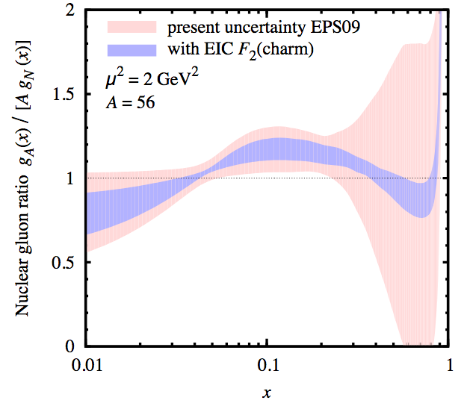
The EIC impact – gluons
low-energy scenario
high-energy scenario
EPPS16*
EPPS16*
E.C. Aschenauer, S. F., M.A.C. Lamont, H. Paukkunen, P. Zurita
Phys.Rev. D 96 114005 (2017)
  Inclusive DIS alone has a huge effect at low-x
  Charm has a dramatic effect at high-x
See also C. Weiss et al.
Santa Fe Jets and heavy flavor Workshop Jan 18

Slide 33
Proton SFs
e+Au F_{L} - EIC
Proton F_{L} - HERA
Phys.Rev. D 96 114005 (2017)
Not only for nuclei!
Comparable precision for proton Structure Functions in e+p scattering, to even higher Q² at high x
→ Beyond what HERA achieved: precise measurement of proton F_{L}

Slide 34

Proton PDFs
Therefore EIC can have large impact on proton PDFs too!
e+Deutrium data are sensitive to u/d quark flavor separation (need to account for nuclear modifications)
Electroweak data allow to constrain s quark PDFs as well as SIDIS +FF

Slide 35
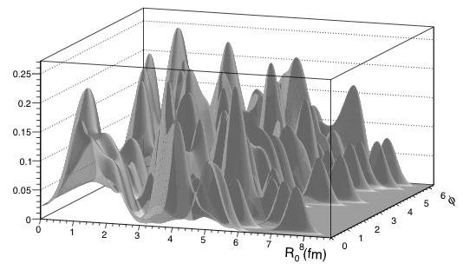
Imaging the gluons in nuclei
Diffractive physics in eA
Measure spatial gluon distribution in nuclei
Reaction:
→ Momentum transfer t = |pAu-pAu′|²
  Hot topic:
      Lumpiness of source?
      Just Wood-Saxon+nucleon g(b_{T})
      coherent part probes “shape of black disc”
      incoherent part (large t) sensitive to “lumpiness” of the source [= proton] (fluctuations, hot spots, ...)
e + Au → e′ + Au′ + J/ψ, φ, ρ
possible Source distribution with b_{T}^{g} = 2 GeV⁻²
suppress
by detecting
break-up
neutrons
J/ψ
Sensitive to saturation effects!
Physics requires forward scattered nucleus needs to stay intact
Veto breakup through neutron detection
φ
Notes:
spin-dependent gluon distribution

Slide 36
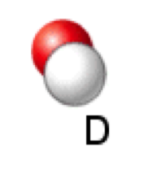
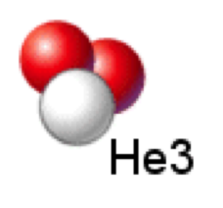
Imaging of light nuclei
Scattered light nuclei can be detected directedly.
  The t momentum transfer can be directedly measured
Full range of nuclear densities: from D → He4 (similar to heavy ions)
D is the least dense nucleus unbound
Polarized He3 beams will allow for simultaneous measurement of
both tagged neutron structure and coherent diffraction on He3
Interesting comparison since spin of He3 is dominated by the neutron

Slide 37
Detector Requirements for Exclusive Reactions in ep/eA
γ, ρ, Φ, J/Ψ, Jets
t = p_{T}²
Exclusivity criteria:
  Large rapidity coverage or tracker and Calorimeter (ballpark -4.5 <η<4.5 )
  Reconstruction of all particles in event
    wide coverage in t (=p_{T}²) → Roman pots
eA: large acceptance for neutrons from nucleus break-up
  Zero Degree Calorimeter
    veto nucleus breakup
    determine impact parameter of collision
Au

Slide 38
Summary on PDFs
e+A physics program at a future Electron-Ion Collider provides an unprecedented opportunity to study quarks and gluons in nuclei
Precise measurements of nuclear structure functions in a large phase-space
Constrain gluon nPDFs at large-x by tagging photon-gluon fusion through precise measurements of charm production
Large impact in constraining gluon nPDFs at low-x
Same or better precision expected for proton SFs too, Plus constraining large x gluons and separate u/d/s flavors
This is year 1 high impact physics!

Slide 39
Summary on GPDs
We studied and quantified the capability of an EIC to provide high precision and fine binned DVCS and VMP measurements of both cross sections and asymmetries over a large phase-space. This opens an unprecedented possibility for
Accurate 2+1D imaging of the polarized and unpolarized quarks and gluons inside the hadrons, and their correlations
Investigate the proton-spin decomposition puzzle (orbital angular momentum)
To do list
Include VMP in global fits (flavor separation, precision on gluons)
Study of GPDs in nuclei (and possible gluon saturation effects)

Slide 40
Back up

Slide 41
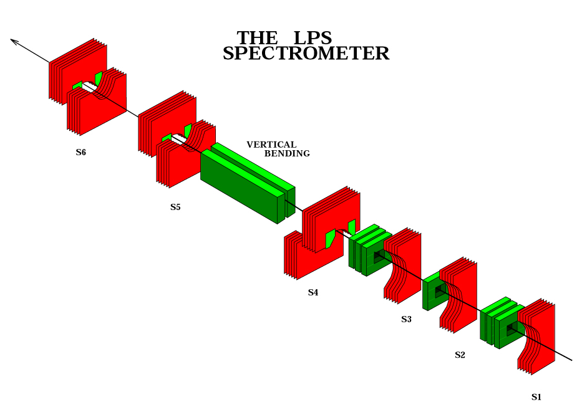
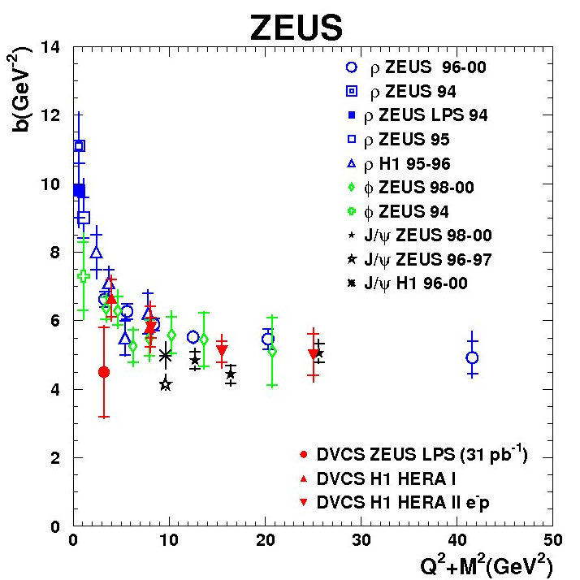
DVCS & VMPs at HERA
ZEUS released the only DVCS
measurement with Roman Pots
Spectrometer at HERA
No p-dissociation background
0.08 < |t| < 0.53 GeV²
Low geometrical acceptance → low statistics
This detector was removed after the HERA II upgrade → L = 31 pb⁻¹
dσ/dt measured for the first time by a direct measurement of the outgoing proton 4-momentum using the Leading Proton Spectrometer (roman pots)
The ZEUS result still statistically compatible with H1, but hints for a flatter trend

Slide 42
Data simulation & event selection
The code MILOU by E. Perez, L Schoeffel, L. Favart [arXiv:hep-ph/0411389v1]
is Based on a GPDs convolution by:
Freund and M. McDermott
[http://durpdg.dur.ac.uk/hepdata/dvcs.html]
√s = 45 GeV → 10 fb⁻¹
√s = 140 GeV → 10 fb⁻¹
Acceptance criteria
  for Roman pots: 0.03< |t| < 1.5 GeV²
  0.01 < y < 0.85 GeV²
  η < 5
BH rejection criteria (applied to x-sec. measurements)
  y < 0.6
  (θel-θγ) > 0
  Eel>1GeV²; Eel>1GeV²
Events smeared for expected resolution in t, Q2, x
Systematic uncertainty assumed to be ~5% (having in mind experience from HERA)
Overall systematic uncertainty from luminosity measurement not taken into account

Slide 43
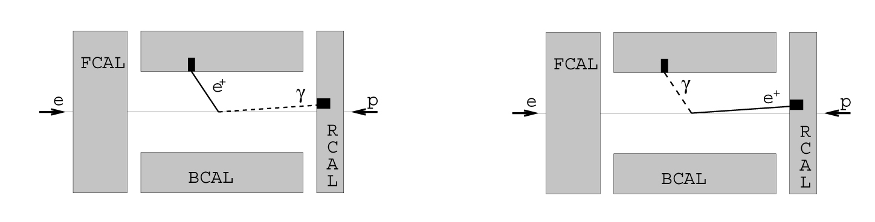
DVCS – clusters separation in rapidity
Very important: hermetic tracker
γ
Δθ
e
N.B. - Need for a emCAL with a very fine granularity, to distinguish clusters down to Δθ=1 deg
N.B. – when electron lies at a very small angle its track can be missing
This is also important for Δφ calculation in asymmetries measurement and for BH rejection in the xsec measurement
A pre-shower calorimeter needed to control background from π⁰→γγ

Slide 44
BH suppression
Eel
Eγ
BH dominated
BH and DVCS
Eel
Eγ
BH electron has very low energy (often below 1 GeV)
DVCS: most of the γ are less “rear” than e
(θel-θγ) > 0 → rejects most of the BH
Important: em Cal must discriminate clusters above noise down to 1 GeV
cuts keep BH below 60% of the sample even at large y > 0.5 – at high energies

Slide 45
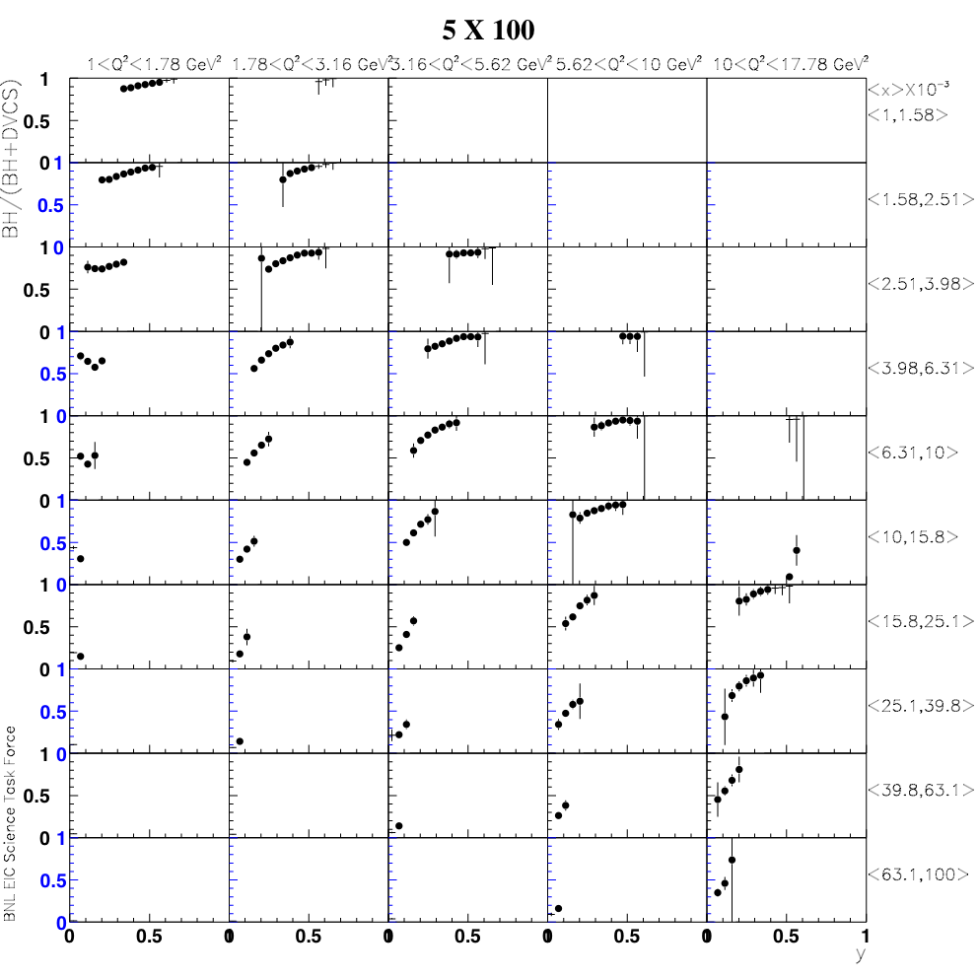
BH fraction
Q²
5 x 100 GeV²
BH subtraction will be relevant at low beam-energies, at large y, depending on the x-Q² bin
x
y

Slide 46
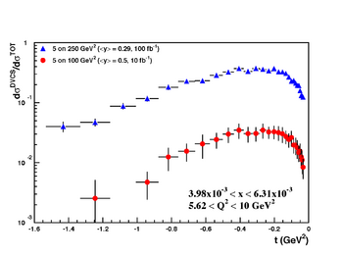
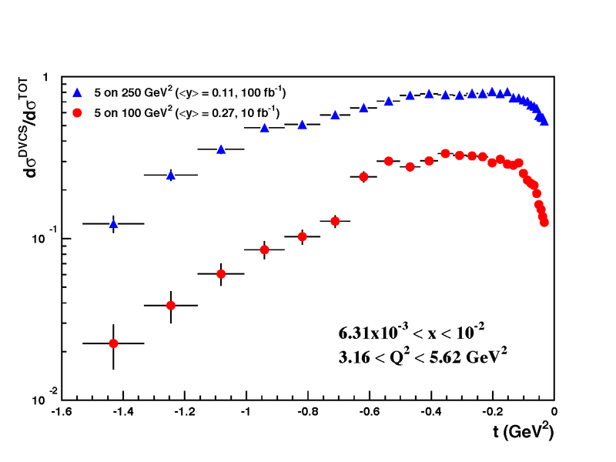
Rosenbluth separation
Rosenbluth separation of the electroproduction cross section into its parts
The statistical uncertainties include all the selection criteria to suppress the BH
exponential |t|-dependence assumed

Slide 48
Reduced Cross Section & Structure Functions
Structure functions can be extracted from the reduced cross section
Pseudo-data are generated using PYTHIA and according to EPS09 central values
In order to extract F₂ from the reduced cross section, we adopted the same method used at HERA [e.g. see HERMES paper on arXiv:1103.5704]
F_{L} extracted from the reduced cross section by fitting the slopes in Y⁺ for different √s at fixed x, Q² → requires running at (at least) three different c-o-m energies
Simulation:
e+Au sample simulated using PYTHIA
5(20) GeV electrons X 50 GeV Au [√s = 32(63) GeV] –> L = 2 fb⁻¹/A
5(20) GeV electrons X 75 GeV Au [√s = 39(78) GeV] –> L = 4 fb⁻¹/A
5(20) GeV electrons X 100 GeV Au[√s = 45(89) GeV] –>L = 4 fb⁻¹/A
Total simulated event sample (for each electron energy) L = 10 fb⁻¹/A

