Slide 1
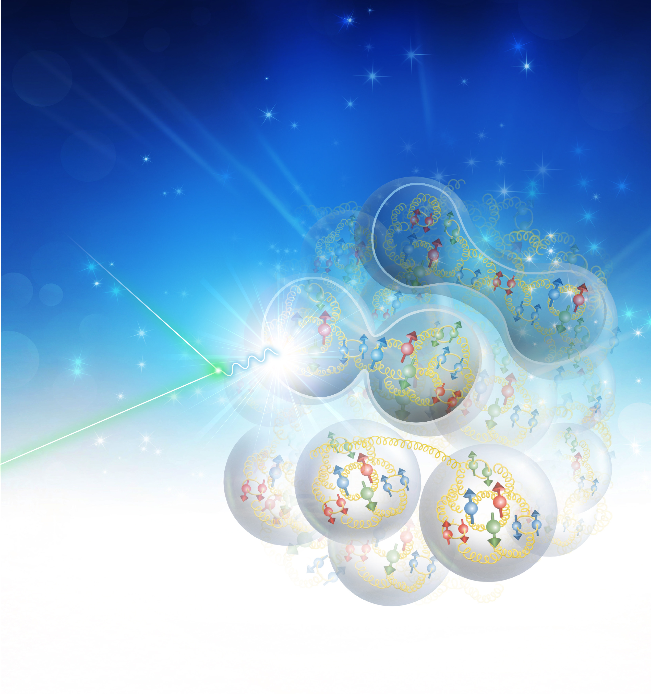
JLab 12 GeV Science and Outlook to EIC
Rolf Ent

Slide 2
Outline
Recent Highlights
Ongoing program (FY18)
Future Projects – MOLLER and SoLID
Near-Term 12 GeV Schedule (FY19 & FY20)
12 GeV Science Program (FY21 on)
  Science of specific relevance for EIC
Emerging Science for the “New EIC White Paper”
  Pion and Kaon Structure and the Emergence of Mass
  Quarks and Gluons in (Polarized) Few- and Many-Body Nuclei
Summary

Slide 3

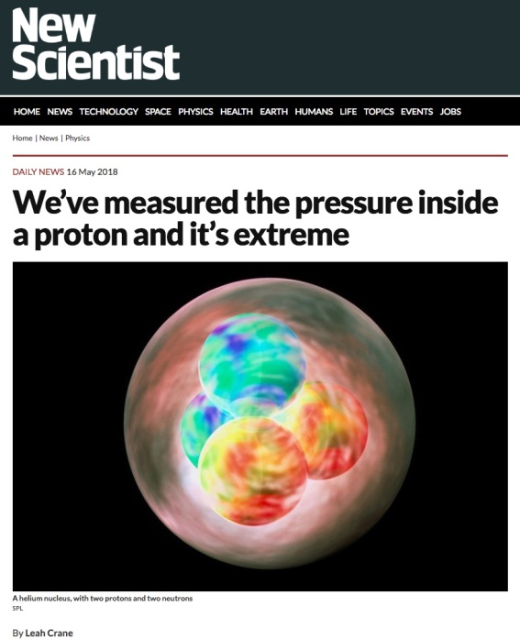
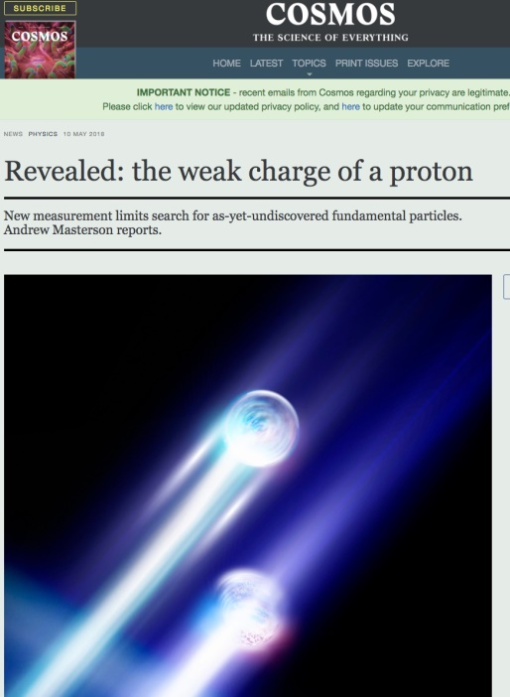
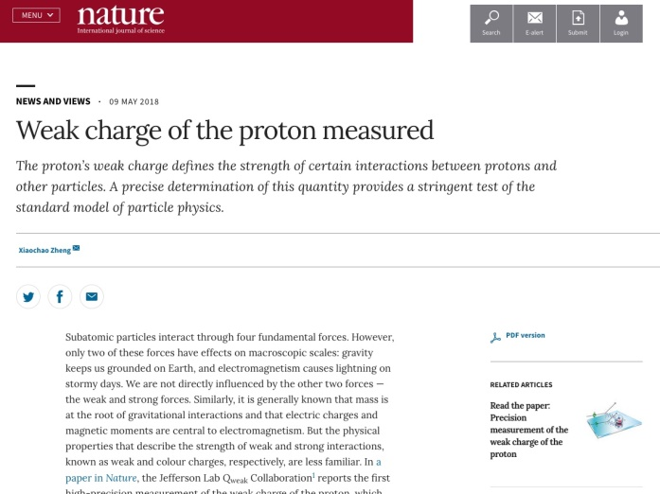
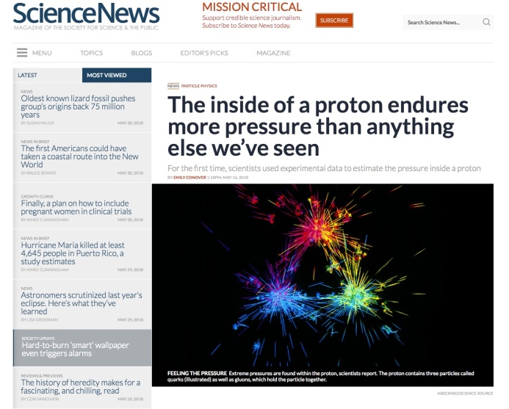
Results Recently Published in Nature
Precision measurement of the weak charge of the proton, Qweak collaboration,
Published: Nature 557, 207–211 (2018)
The pressure distribution inside the proton, Burkert, Elouadrhiri, Girod,
Published: Nature 557 (2018) no.7705, 396-399
A per-cent-level determination of the nucleon axial coupling for quantum chromodynamics, Berkowitz et. al., Published: Nature 558, 91-94 (2018)
Ultrafast Nucleons in Asymmetric Nuclei, M. Duer et. al., CLAS Collaboration,
Published: Nature 560 (2018) no.7720, 617-621
A glimpse of gluons through deeply virtual compton scattering on the proton, Dufurne et. al., Published: Nature Communications 8, 1408 (2017)

Slide 4
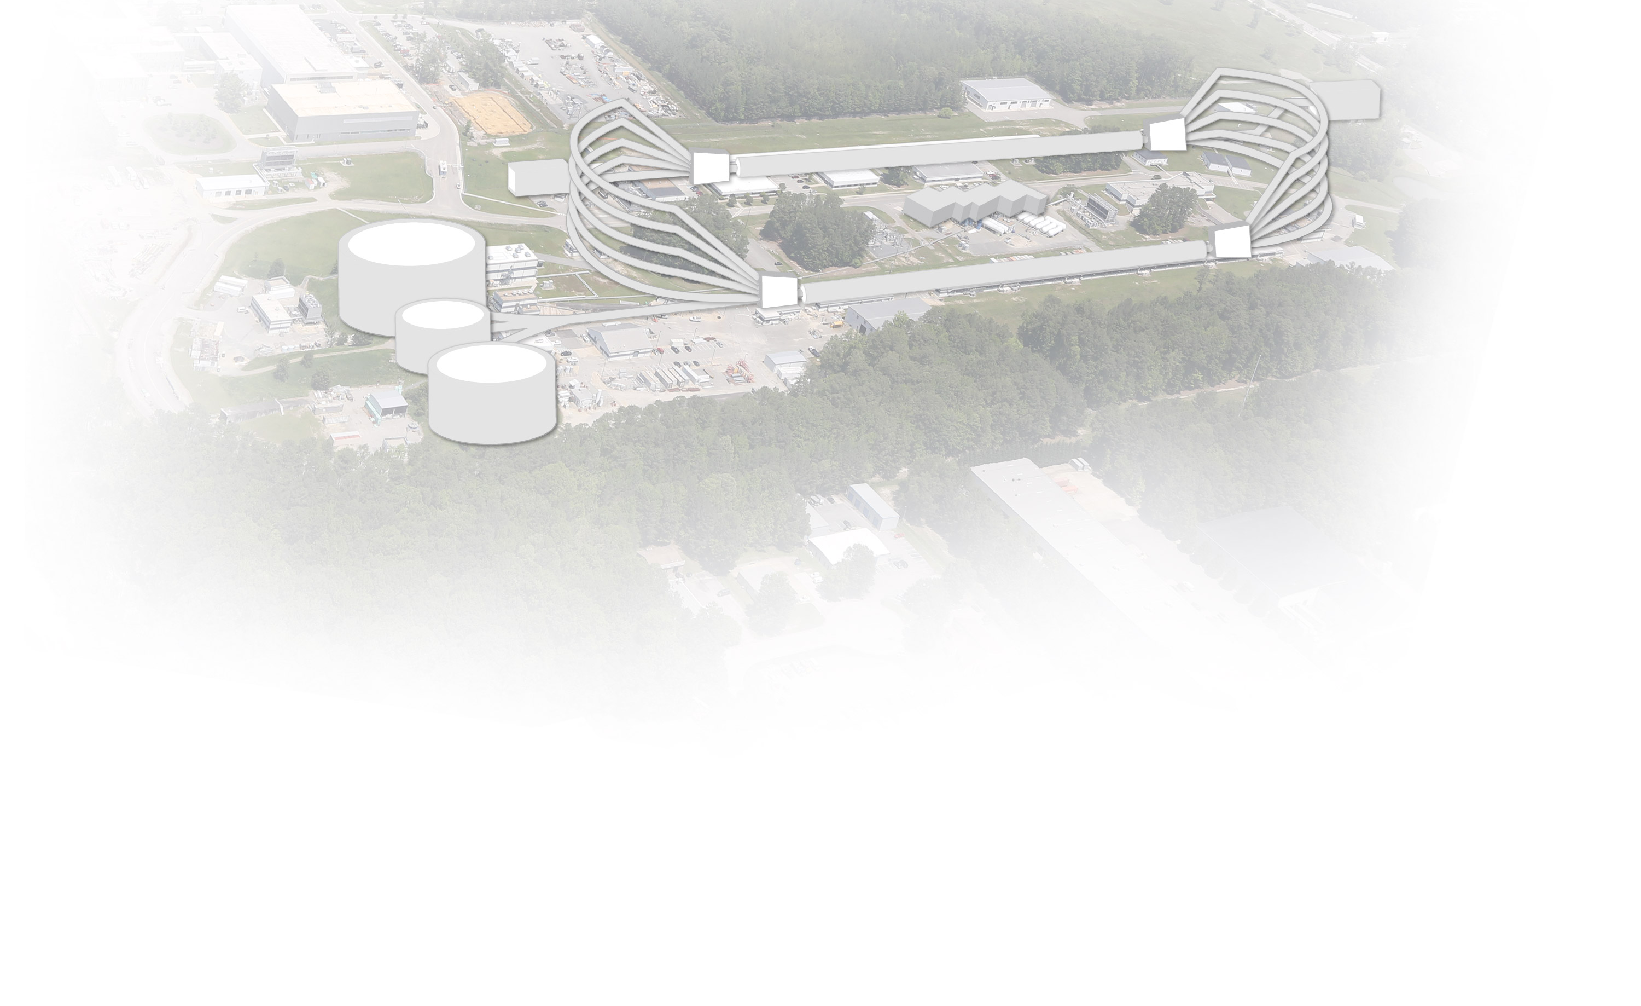
CEBAF at Jefferson Lab
INJECTOR
LINAC
RECIRCULATION ARCS
D
2
1
3
A
3
2
B
C
CEBAF Upgrade completed in September 2017
  CW electron beam
  E_{max} = 12 GeV
  I_{max} = 90 μA
  Pol_{max} = 90%
Nuclear experiments at ultra-high luminosities, up to 10³⁹ electrons-nucleons /cm²/ s
World-record polarized electron beams
Highest intensity tagged photon beam at 9 GeV
Ability to deliver a range of beam energies and currents to multiple experimental halls simultaneously
Unprecedented stability and control of beam properties under helicity reversal
CEBAF World-leading Capabilities
Commissioning:
  April 2014: hall A
  October 2014: hall D
  February/March 2017: halls C & B

Slide 5
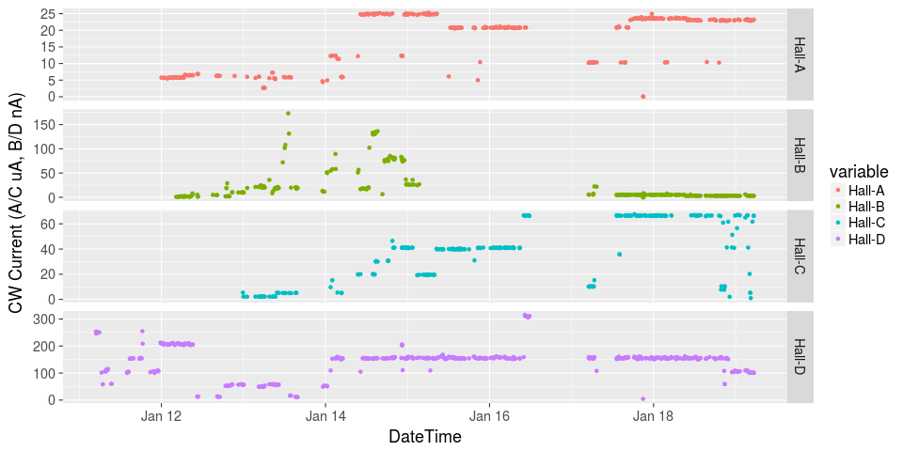
Initiated Four Hall Operation
μA
A up!
nA
B up!
Beam Current
Pass Change
C up!
μA
D up!
nA
Simultaneous 4-Hall Beam Delivery since Jan 18, 2018
Now operating total 900 kW CW beam power to 4 Halls

Slide 6



12 GeV Science Era in all 4 Halls!
Hall A: In physics operations
  4.5 Experiments completed to date
  First 12 GeV era publications will be this year
  December 15, 2017: First Beam on Tritium Target!
  Series of measurements on nuclear structure & quark properties that use that Helium-3 (2p + n) and Tritium (2n + p) are (Isotope) Mirror Nuclei
Hall B: In physics operations
  Engineering run completed, up to nearly twice design luminosity
  CLAS12 Physics data taking started February 5, 2018!
  Hall B Proton Radius and Heavy Photon Search of pre-CLAS12 measurements publications anticipated
Hall C: In physics operations
  New spectrometer engineering run completed
  Physics data taking started January 19, 2018!
  Series of “simple” measurements on Nucleon and Nuclear Structure that can lead to early publications – 2 Experiments completed to date
Hall D: In physics operations (GlueX)
  Engineering Run Complete: Basis for > dozens papers at both American Physical Society (APS) Division of Nuclear Physics 2016 & 2017 Meetings
  First 12 GeV era publication: 24 April, 2017!
  Working on several other publications
  First physics run (GlueX – search for exotic mesons) started in Spring 2017 and continuing in 2018

Slide 7
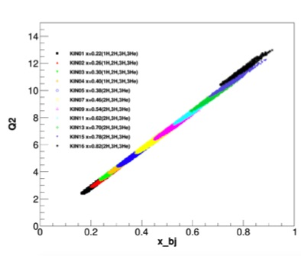
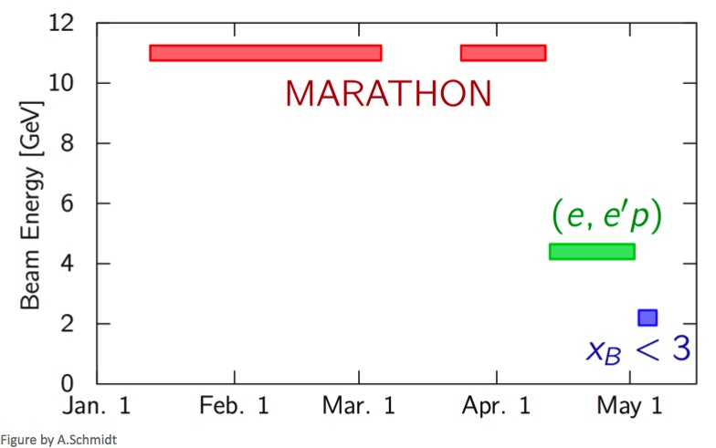
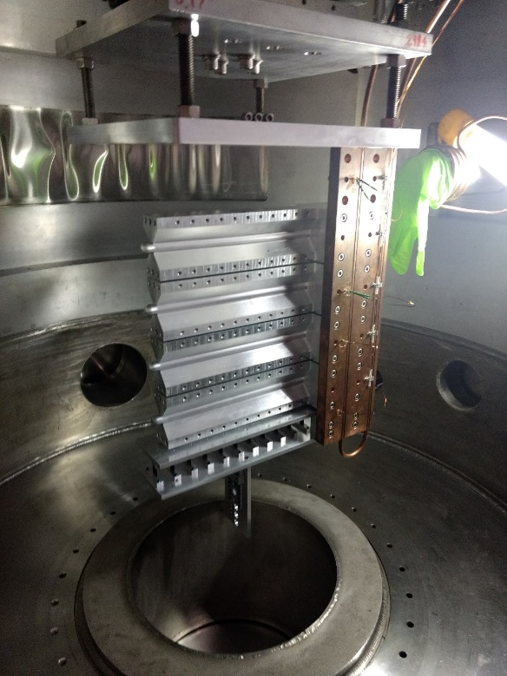
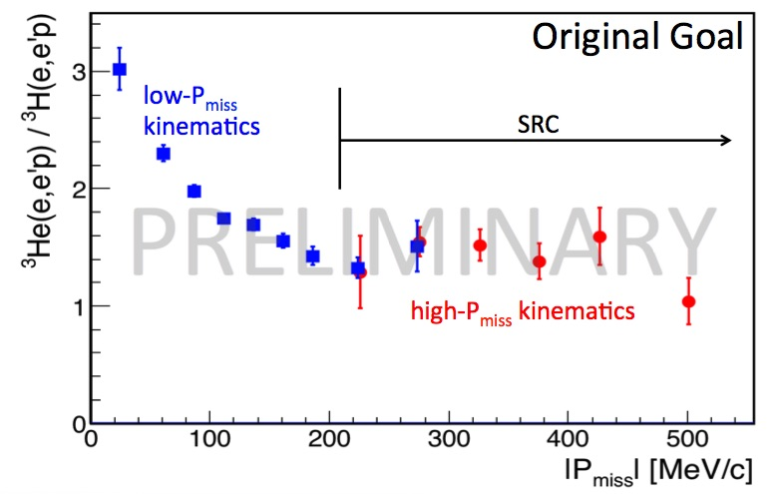
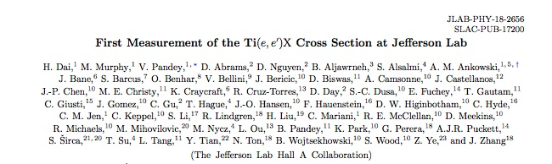
Hall A – first use of 3H Targets at Electron Lab Since 3 Decades
plot from T. Su
Preliminary results plot from R. Cruz Torres
Running tritium family of experiments in 2018 – 3 complete!
Continue to publication results of previous 12 GeV experiments
Published in Phys. Rev. C98 (2018) no.1, 014617

Slide 8
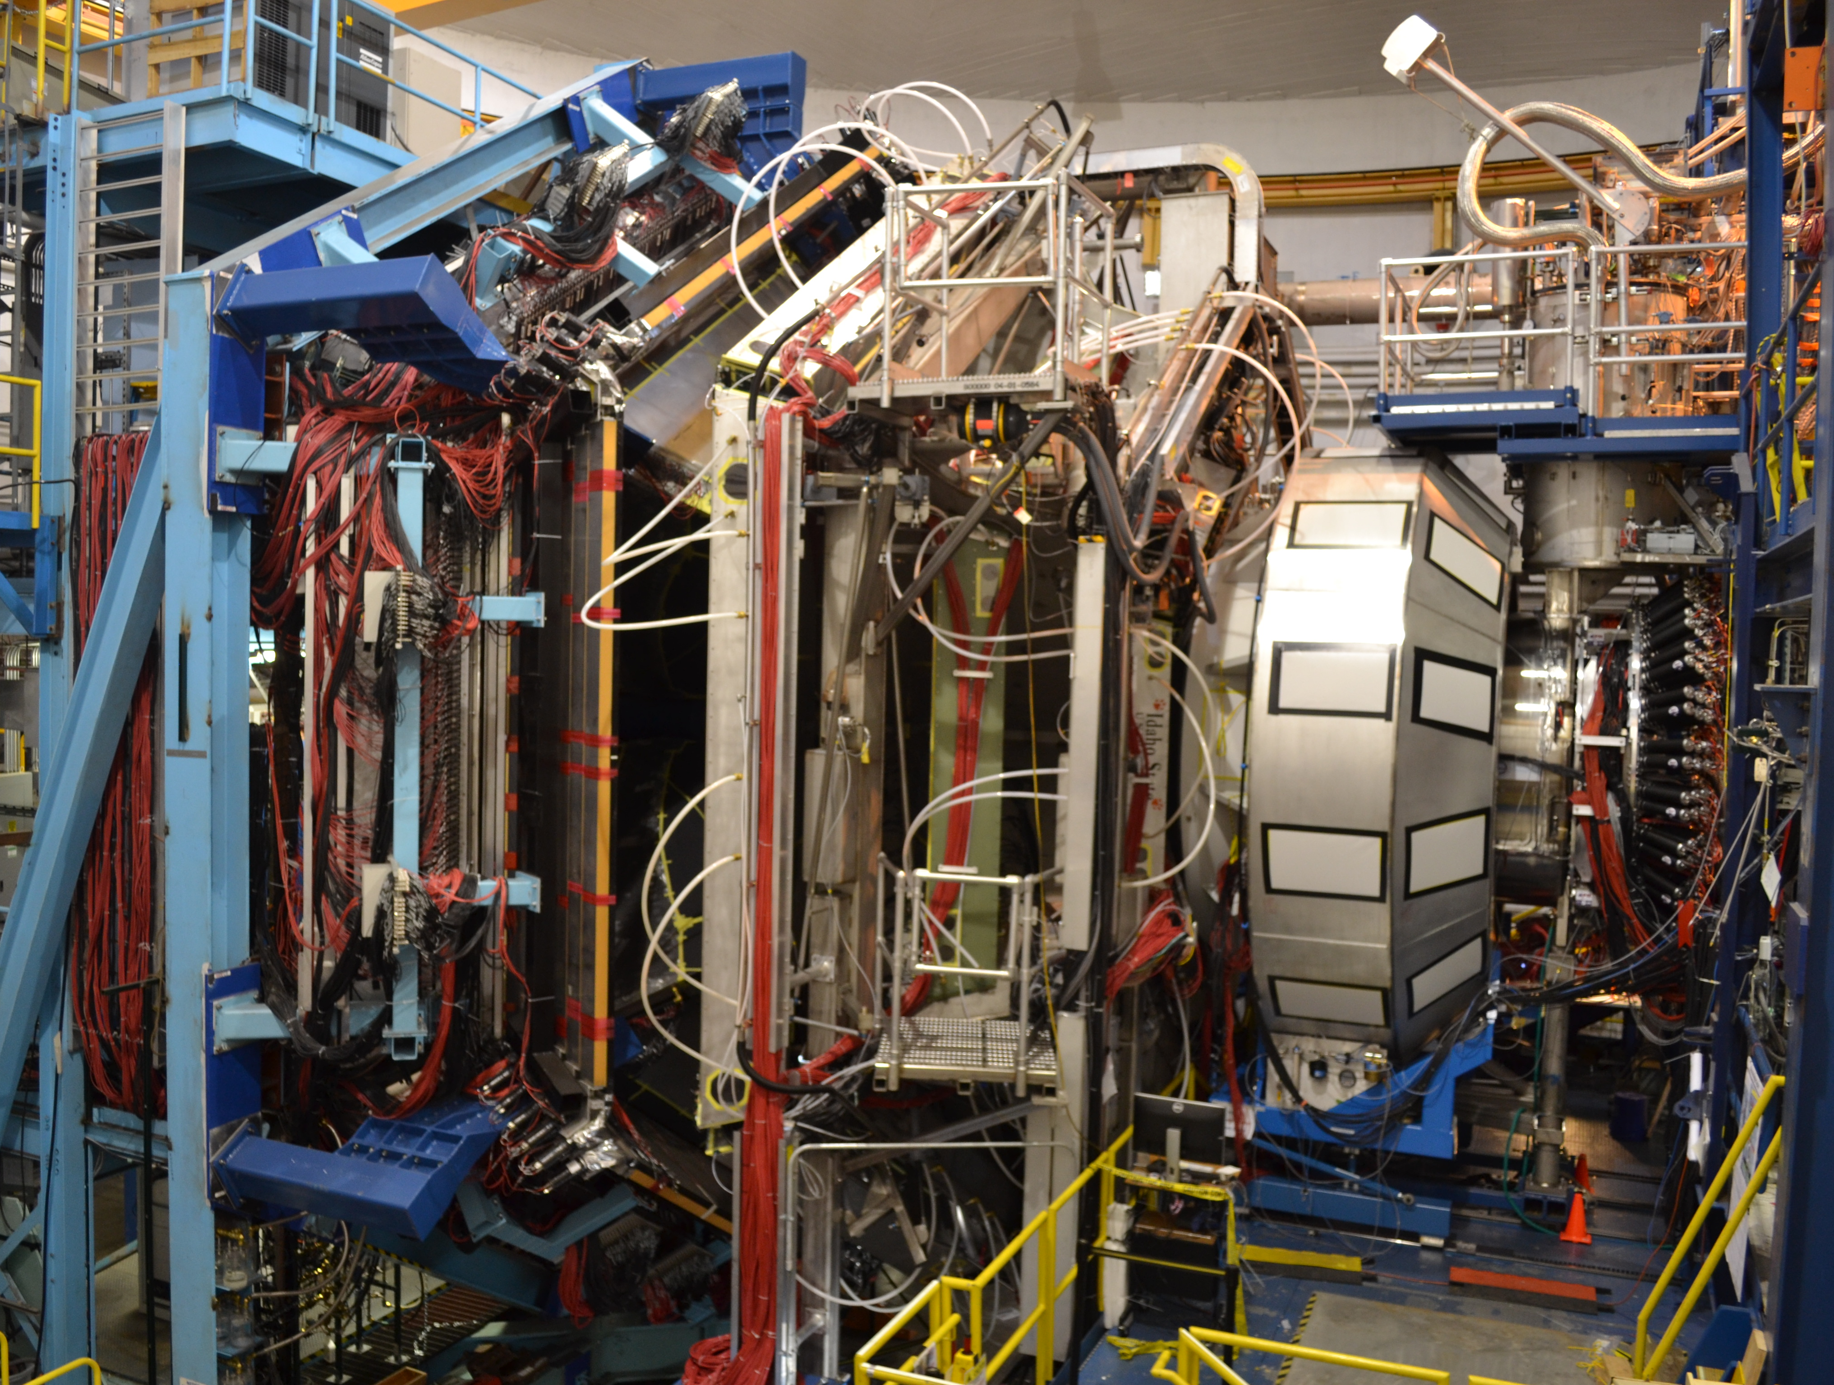
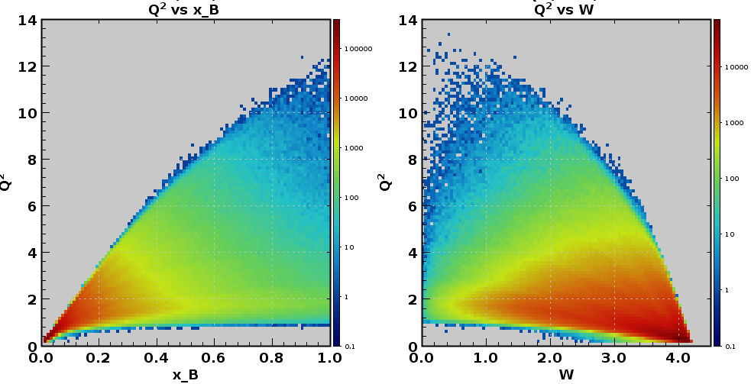
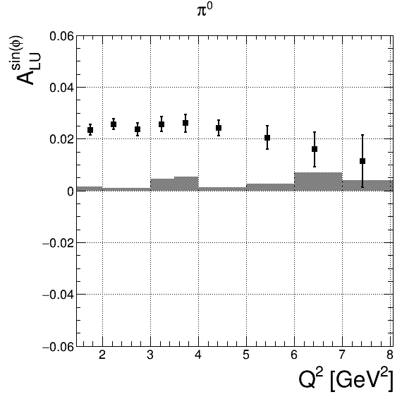
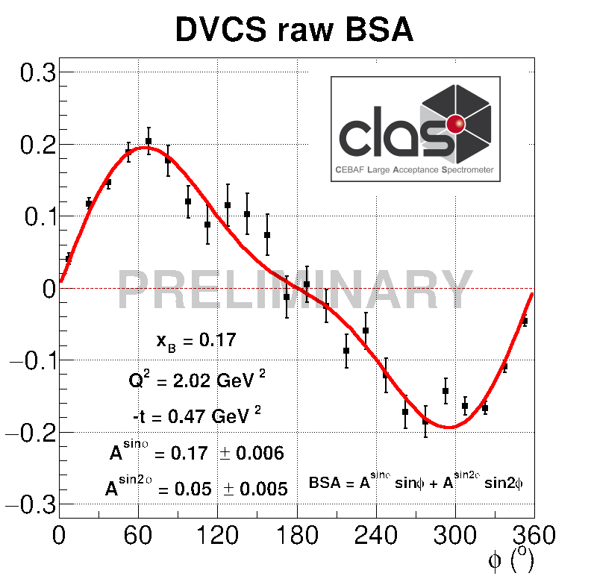
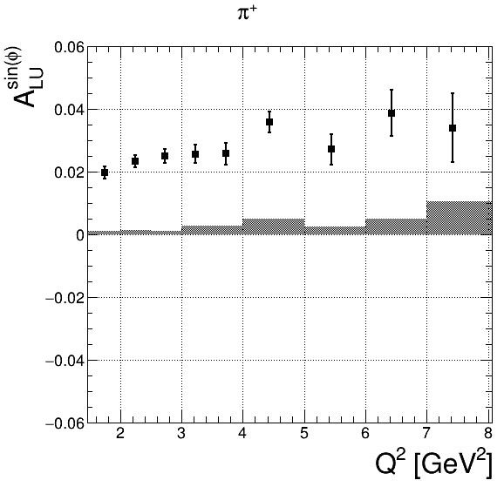
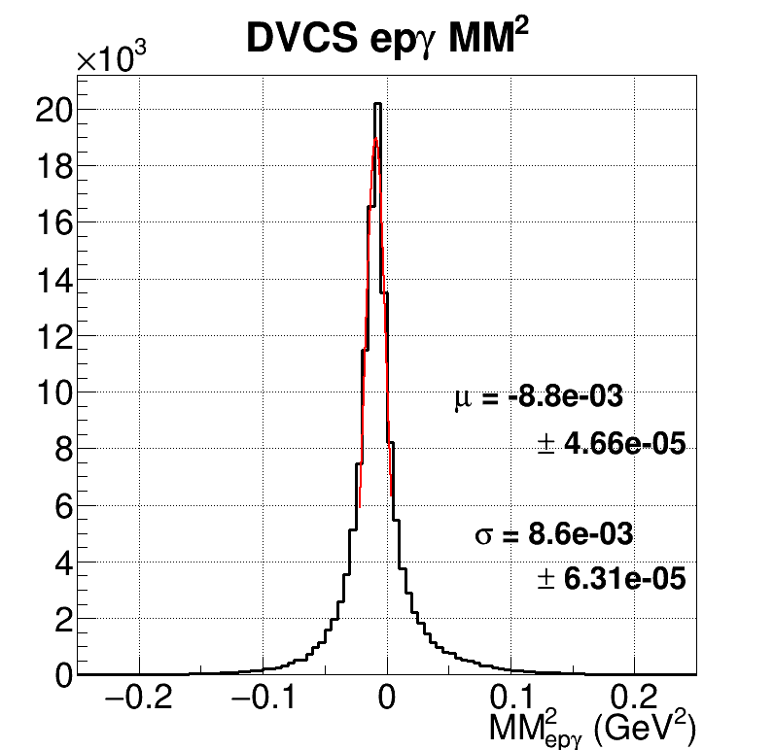
Hall B – CLAS12: toward High Impact science
Kinematic reach at 10.6 GeV
p(e,e’π)X
Beam-spin asymmetry
p(e,e’)X
Q² (GeV²)
π⁰
￼
x_{B}
π⁺

Slide 9
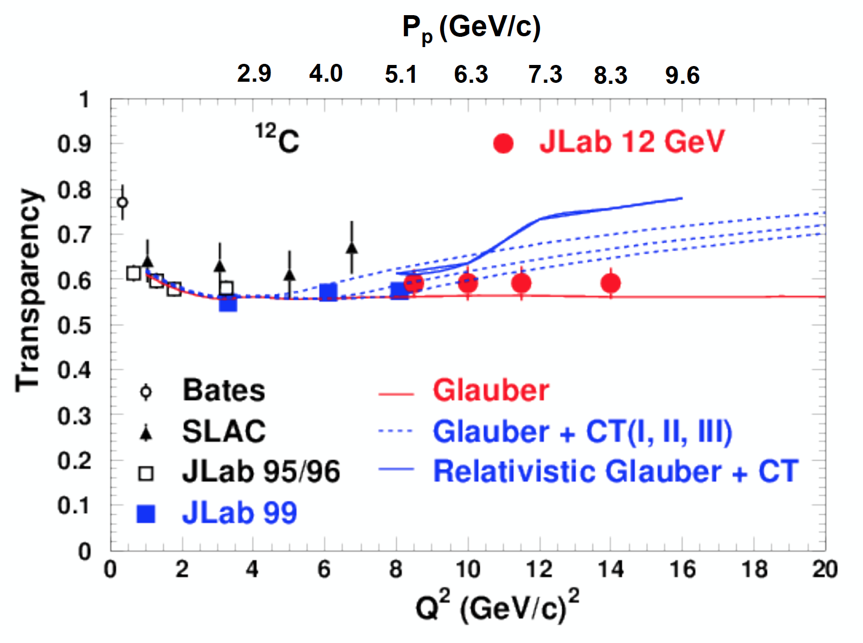
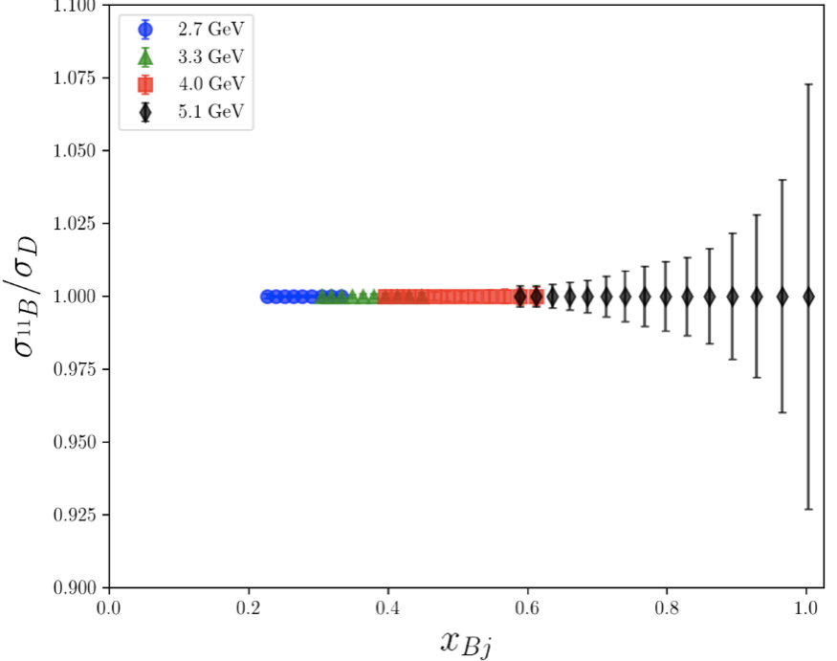
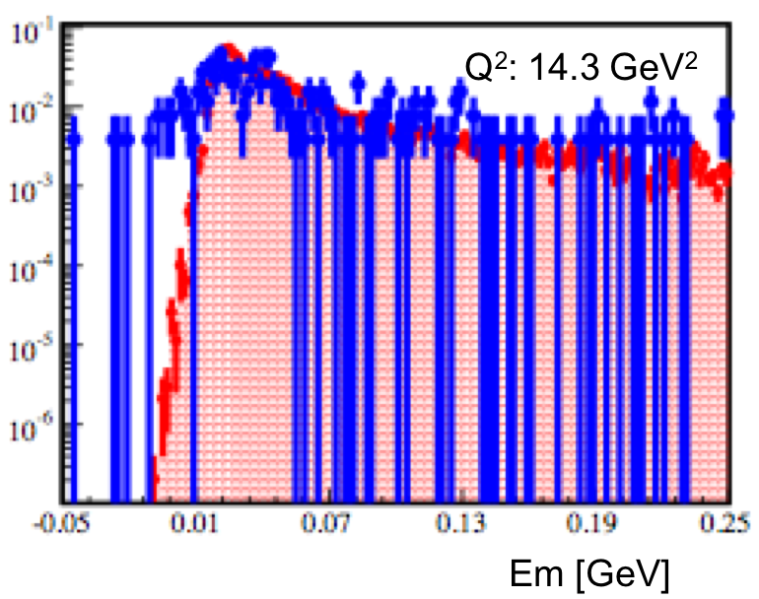
Hall C – SERIES OF TMD Studies and KAON L/T Ongoing
SHMS calibration initial physics data acquired
  F₂^{H,D} structure functions, EMC effect
  D(e,e’p) at high missing momentum
  Color Transparency (CT) – ¹²C(e,e’p)
    Data for 3 points acquired.
    Highest Q² is where BNL A(p,2p) saw rise in transparency
  TMD studies (SIDIS) and Kaon electroproduction scaling measurement underway
Analyses of CT, F2, D(e,e’p), EMC underway
Projected Color Transparency errors
overlaps BNL data
EMC: Expected ¹¹B to deuteron cross section ratio errors. Similar for ⁹Be, ¹⁰B and ¹²C.
CT: Good agreement between data and simulation even at the highest Q². Will improve as SHMS optics model is optimized.

Slide 10
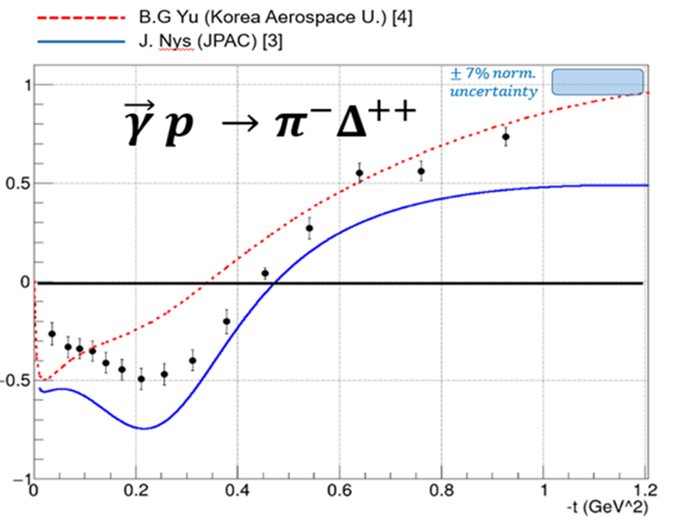
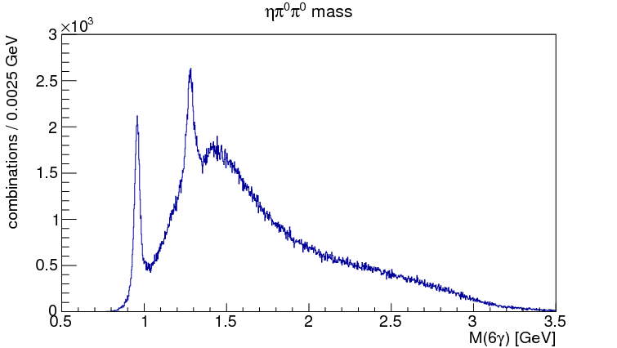
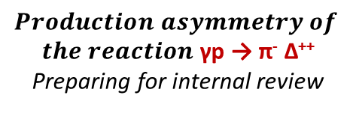

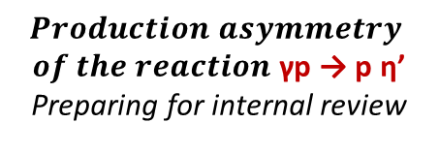
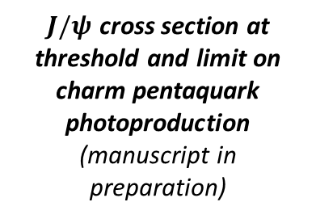

Hall D: GluEX PHASE-I NEAR-COMPLETE analysis as of Fall 2018
$J/ψ$ production at threshold
$$Production Asymmetries$$
η′
$$Production asymmetry$$
$of the reaction$ γp → p η’
Preparing for internal review
$$Production asymmetry of$$
$the reaction$ γp → π⁻ Δ⁺⁺
Preparing for internal review
$J/ψ$ cross section at threshold and limit on charm pentaquark photoproduction
(manuscript in preparation)
GlueX-I has 80% of data
GlueX-I is scheduled to collect all data by FY19/Q2
25% of data analyzed
3 papers in preparation
Getting ready for Primex-η and GlueX-II (with DIRC)
f₁(1285)/η(1295)
η′
γp → p ηπºπº → p 6γ

Slide 11
JLab Approved 12 GeV experiments
Topic | Hall A | Hall B | Hall C | Hall D | Other | Total
The Hadron spectra as probes of QCD | 0 | 2 | 1 | 3 | 0 | 6
The transverse structure of the hadrons | 6 | 3 | 3 | 1 | 0 | 13
The longitudinal structure of the hadrons | 2 | 3 | 6 | 0 | 0 | 11
The 3D structure of the hadrons | 5 | 9 | 6 | 0 | 0 | 20
Hadrons and cold nuclear matter | 8 | 5 | 7 | 0 | 1 | 21
Low-energy tests of the Standard Model and Fundamental Symmetries | 3 | 1 | 0 | 1 | 2 | 7
Total | 24 | 23 | 23 | 5 | 3 | 78
Total Experiments Completed | 4.6 | 2.7 | 2.1 | 0.8 | 0 | 10.2
Total Experiments Remaining | 19.4 | 20.3 | 20.9 | 4.2 | 3.0 | 67.8
This reports the status up to May 2018, it does not include the Fall 2018 run yet

Slide 12
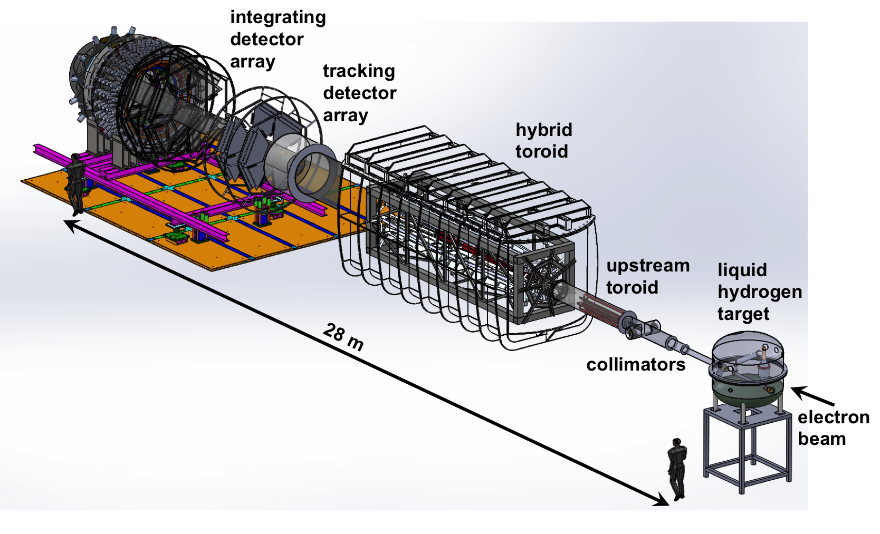
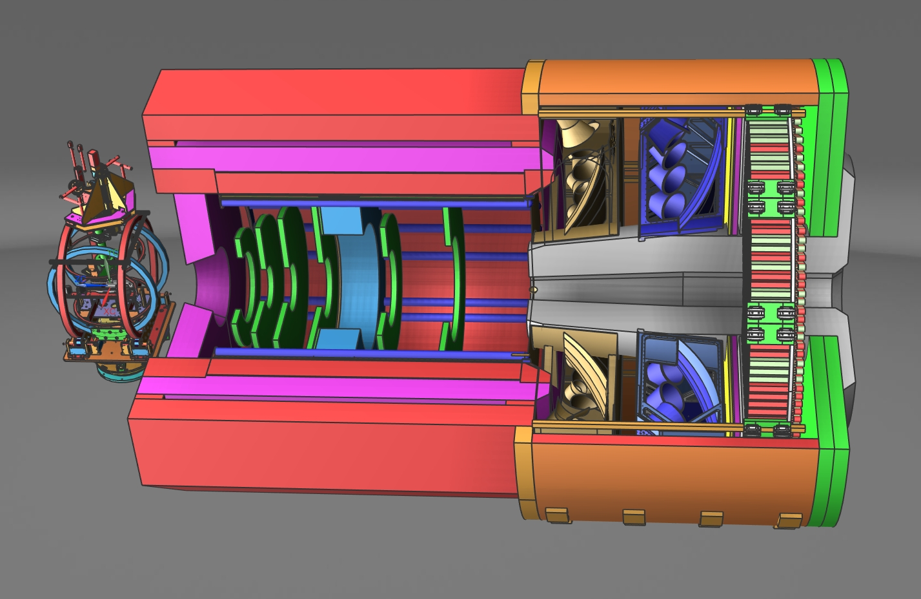
FUTURE PROJECTS
MOLLER experiment
  Precision Standard Model Test
  DOE science review (Sept. 2014) – strong endorsement
  CD-0 approved, Dec. 2016 (project paused due to budget)
  Awaiting green light to proceed
  Developing project structure in preparation for FY19 Director’s Review
SoLID Experimental Program
  Full exploitation of 12-GeV Upgrade
  Large acceptance, high luminosity
  Standard model test; nucleon imaging
  New pre-CDR completed
  Briefed ONP, Pre-R&D request
  Awaiting science review from ONP

Slide 13
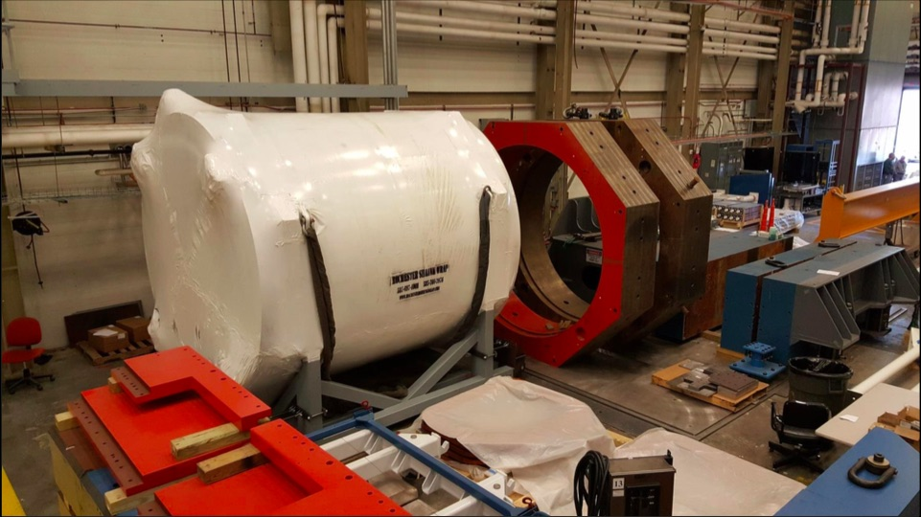
Towards SoLID and MOLLER
High power target development for MOLLER, SoLID, possibly SBS (with JLab Target group)
SoLID magnet static tests and common instrumentation (I&C, CCR) development, and as needed preparation for cold test
Tagged DIS/SoLID/EIC general high rate GEM test stand (with JLab DAQ & FE groups) to:
  learn how to utilize the “SAMPA” chip functionality to reduce data volume
  tests of continuous readout data stream & link with triggered data streams from other sources
Parity quality beam instrumentation (polarimetry, charge monitoring, DAQ,..) (with Accelerator Division)
MOLLER magnet development (with JLab Magnet group)

Slide 14
Jefferson Lab User Growth
“Other Users” include US National Labs and Industry

Slide 15
Near Term CEBAF Schedule
We have released a schedule of experiments to be run during the next 18 months that includes many “high impact” nuclear physics topics:
Completion of first phase of GlueX (search for exotic mesons)
PREX-II/CREX neutron skin radius (relevant to LIGO/VIRGO studies of neutron star mergers)
Heavy Photon Search (HEP detectors and electronics) and APEX, searches for dark photons
Search for Λnn resonance (evidence from GSI)
Search for charmed pentaquark (evidence from LHCb)
Quark dynamics: transverse polarization of quarks inside an unpolarized nucleon (3D/TMD)
Neutron Spin Structure (precision study)

Slide 16
FY19 Halls C & B – nature of charmed pentaquark
What is the exact nature of the charmed pentaquark states discovered by the LHCb collaboration at CERN?
5-quark bound state
Hadronic molecule
high impact
Hall C
Hall B
Ongoing
Projected to run February 2019

Slide 17
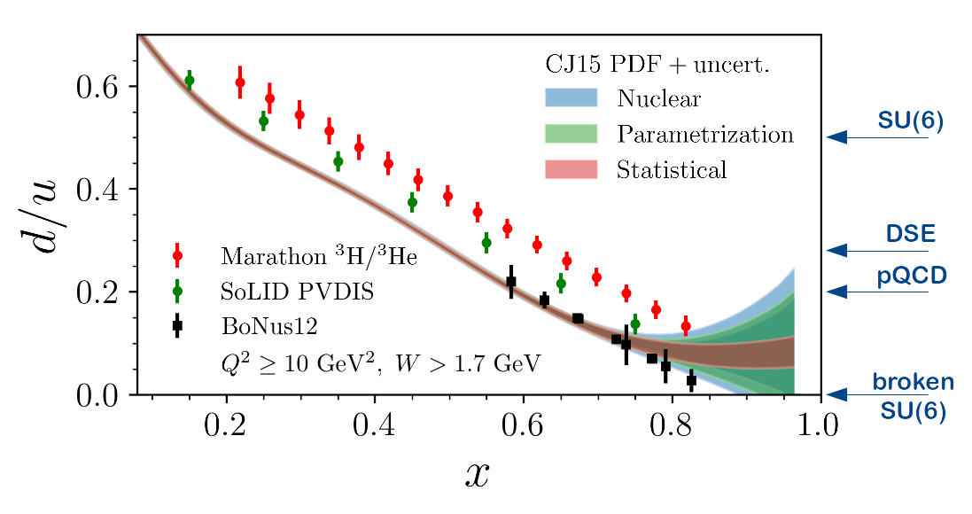
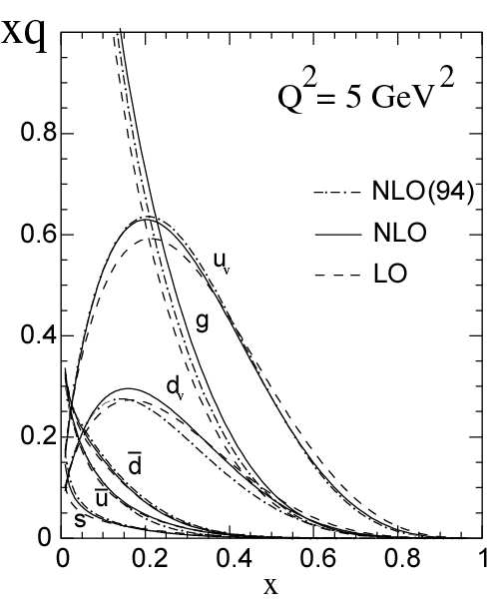
Measuring High-x Structure Functions
REQUIRES:
High beam polarization
High electron current
High target polarization
Large solid angle spectrometers
Projected JLab 12 GeV d/u Extraction
Marathon ³H/³He completed!
x →1 predictions | F₂^{n}/F₂^{p} | d/u | A₁^{n} | A₁^{p}
SU(6) | 2/3 | 1/2 | 0 | 5/9
Diquark Model/Feynman | 1/4 | 0 | 1 | 1
Quark Model/Isgur | 1/4 | 0 | 1 | 1
Perturbative QCD | 3/7 | 1/5 | 1 | 1
QCD Counting Rules | 3/7 | 1/5 | 1 | 1
12 GeV will access the regime (x > 0.3), where valence quarks dominate

Slide 18
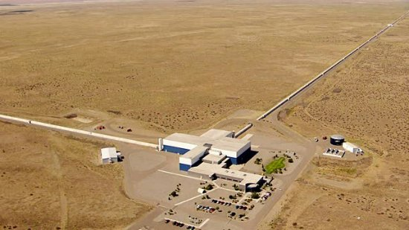
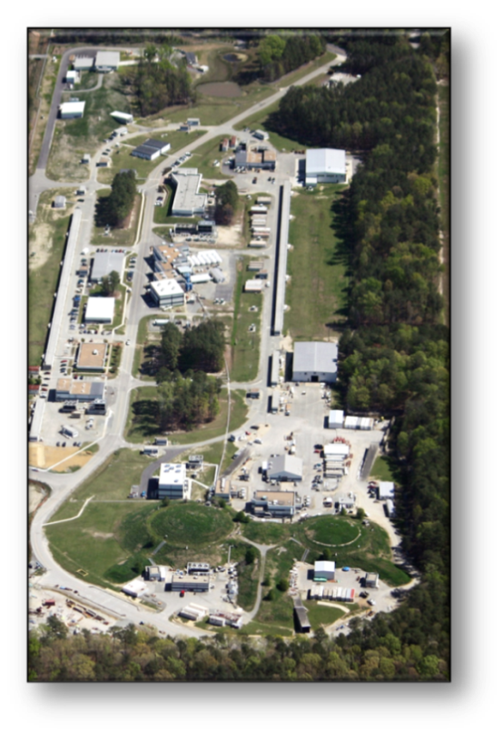
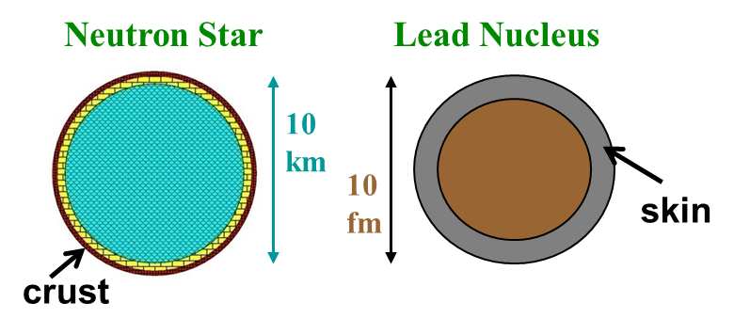
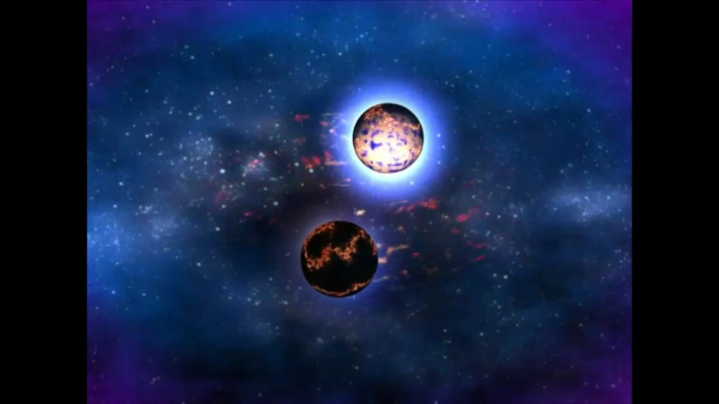
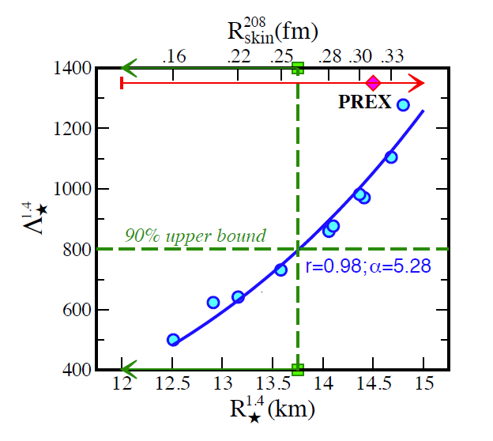
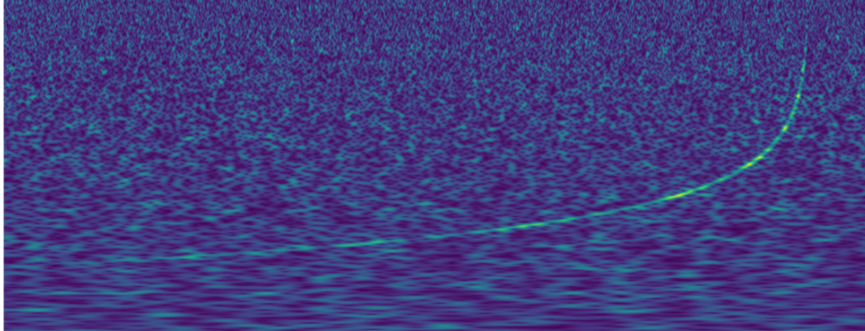
Hall A: Nuclear Physics and Neutron Stars
(LIGO)
(JLab)
Measurement of neutron skin at JLab constrains tidal polarizability of neutron stars
Courtesy of NASA/Goddard Space Flight Center
arXiv:1711.06615

Slide 19
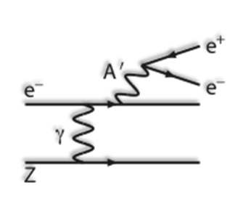
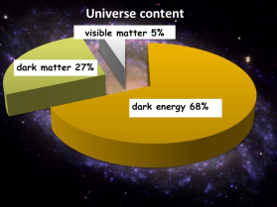
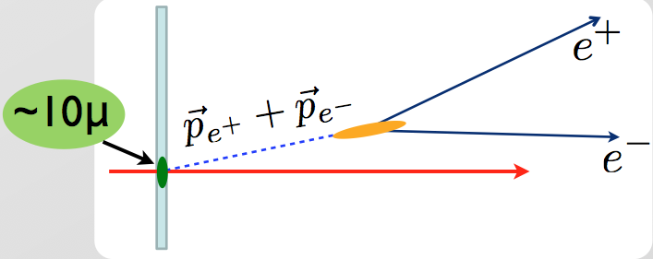
Heavy Photon Search
Search for a U(1) Heavy Gauge Boson following up on cosmological observations (PAMELA, AMS)
HPS (Hall B)
2015 Engineering Run
1.7 PAC days @ 1.05 GeV
2 GeV data taken in 2016,
under analysis
APEX (Hall A)
Search for 50-500 MeV A’ decaying promptly to e⁺e⁻ pairs
Displaced decay vertex search
2019 Program: HPS (upgraded), APEX

Slide 20
Exploring the 3D Nucleon Structure
After decades of study of the partonic structure of the nucleon we finally have the experimental and theoretical tools to systematically move beyond a 1D momentum fraction (x_{Bj}) picture of the nucleon.
    High luminosity, large acceptance experiments with polarized beams and targets.
    Theoretical description of the nucleon in terms of a 5D Wigner distribution that can be used to encode both 3D momentum and transverse spatial distributions.
Deep Exclusive Scattering (DES) cross sections give sensitivity to electron-quark scattering off quarks with longitudinal momentum fraction (Bjorken) x at a transverse location b.
Semi-Inclusive Deep Inelastic Scattering (SIDIS) cross sections depend on transverse momentum of hadron, P_{h⊥}, but this arises from both intrinsic transverse momentum (k_{T}) of a parton and transverse momentum (p_{T}) created during the [parton → hadron] fragmentation process.
Nuclear Femtography

Slide 21
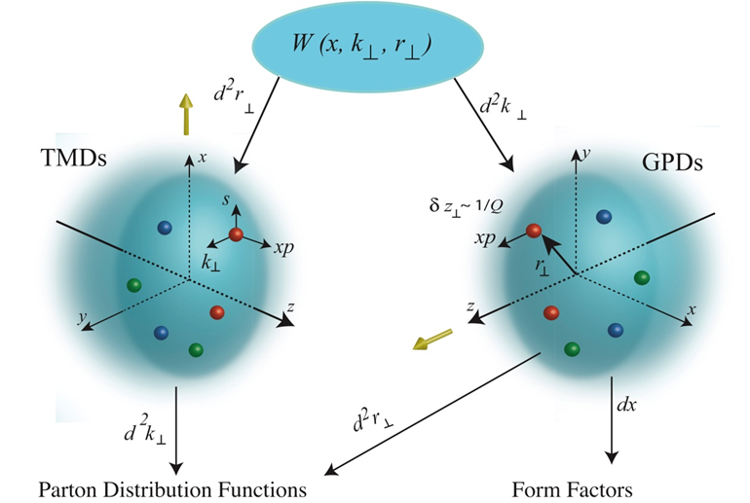
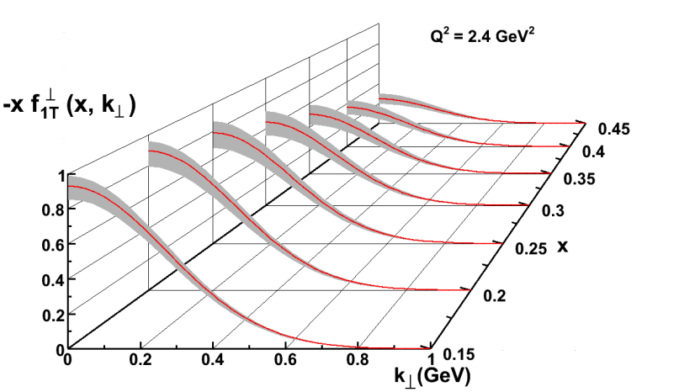
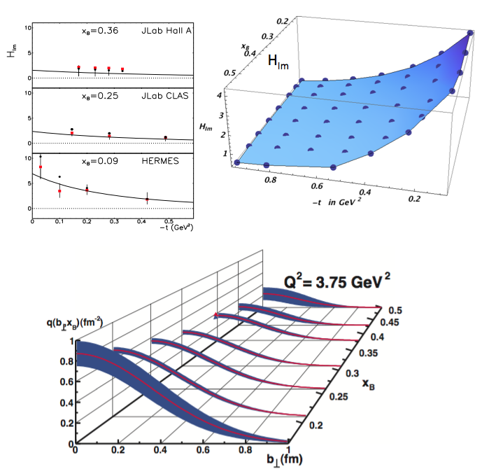
New Paradigm for Nucleon Structure
5D
TMDs
– Confined motion in a nucleon
(semi-inclusive DIS)
GPDs
– Spatial imaging
(exclusive DIS)
Requires
− High luminosity
− Polarized beams and targets
− Sophisticated detector systems
3D
Major new capability with JLab12

Slide 22
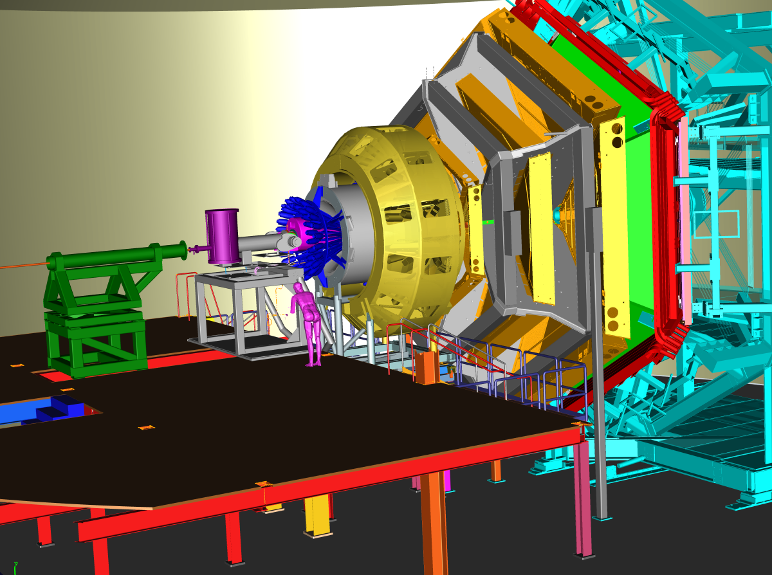
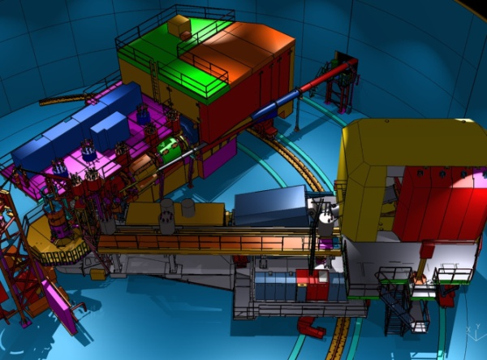
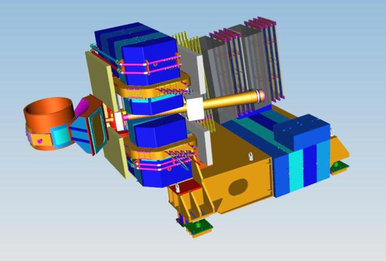
Imaging With JLab @ 12 GeV
Generalized Parton Distributions (GPDs) and Transverse Momentum Distributions (TMDs)
CEBAF Large Acceptance Spectrometer (CLAS12) in Hall B: general survey experiments, large acceptance and medium luminosity
SHMS, High Momentum Spectrometer (HMS) and Neutral-Particle Spectrometer (NPS) in Hall C: precision cross sections for L-T studies and ratios, small acceptance and high luminosity
Super Bigbite Spectrometer (SBS) in Hall A : dedicated large-x TMD study
medium acceptance and high luminosity
Future: Solenoidal Large Intensity Device (SoLID) in Hall A: large acceptance and high luminosity

Slide 23
Deeply Virtual Compton Scattering @ 11 GeV
Hall A DVCS scaling check completed
Hall B DVCS on H ongoing
CLAS12 (projected)
A_{LU}
Nature 557 (2018) no.7705, 396-399

Slide 24
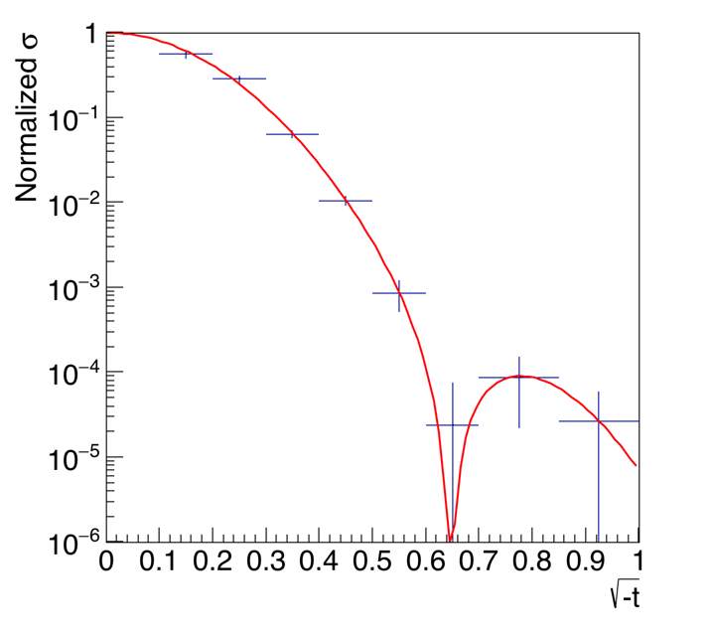
Tomography of ⁴He Nucleus @ 11 GeV
Deep-Virtual Exclusive φ Production projections
JLab DVCS Beam-Spin Asymmetry projections
Spin-0 ⁴He Nucleus makes for much simpler extraction of GPDs → Tomography in terms of q and g
(R. Dupre and S. Scopetta,
EPJA 52 (2016) 159)
x_{B}
More in talk by Dupre

Slide 25
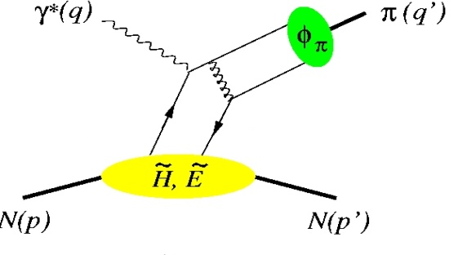
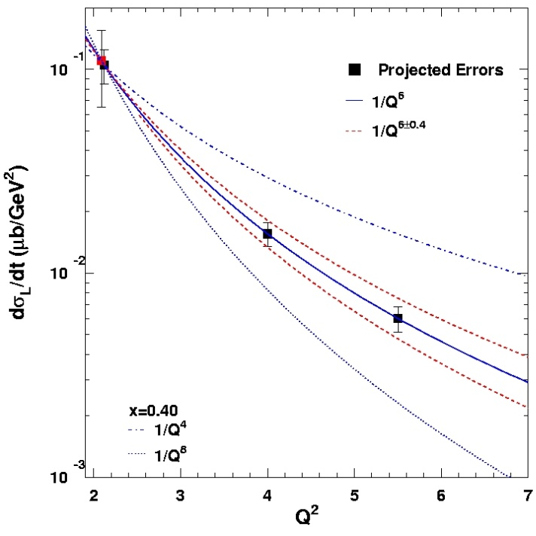
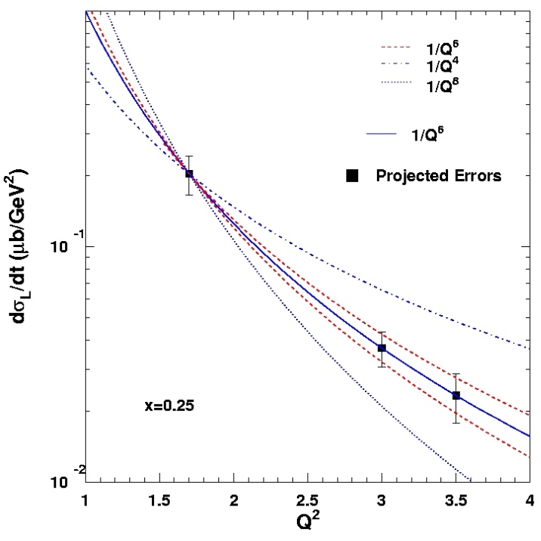
Factorization Tests in π⁺ and K⁺ Electroproduction
σ = Γ(σ_{Τ} + εσ_{L} + ε cos(2φ)σ_{TT} + [ε(ε+1)/2]^{1/2}cos(φ)σ_{LT})
π, K, etc.
p(e,e’π⁺)n
φ
π⁺: up to Q² = 10
K⁺: up to Q² = 6
Hard Scattering
Q⁻⁴
GPD
Q⁻⁶
Fit: 1/Q^{n}
Q⁻⁸
One of the most stringent tests of factorization is the Q² dependence of the π and K electro-production cross section
  σ_{L} scales to leading order as Q⁻⁶
x_{B} = 0.40
p(e,e’K⁺)Λ
Q⁻⁶
Q⁻⁴
Experimental validation of factorization essential for reliable interpretation of results from the JLab GPD program at 12 GeV for meson electro-production
Q⁻⁸
x_{B}=0.25
K and π together provide quasi model-independent study

Slide 26


Momentum Tomography with TMDs @ 11 GeV
JLab/12 GeV Goal → Precision in 3D Momentum Imaging of the Nucleon!
Sivers function for d-quarks extracted from model simulations with a transverse polarized ³He target.
δk_{x}
d-quark momentum tomography for Sivers function. The d-quark momentum density shows a distortion and shift in k_{x}. A non-zero δk_{x} value requires a non-zero orbital angular momentum.
12 GeV ~ Valence Quark Region (x > 0.1)

Slide 27

LONGITUDINAL CROSS SECTION: R = σ_{L}/σ_{T} IN SIDIS
R_{DIS} is in the naïve parton model related to the parton’s transverse momentum:
R = 4(M²x² + <k_{T}²>)/(Q² + 2<k_{T}²>).
R_{DIS} → 0 at Q² → ∞ is a consequence of scattering from free spin-½ constituents
Cornell 70’s existing (H and D, π⁺ and π⁻)
JLab 12-GeV projected (H and D, π⁺ and π⁻)
R_{DIS}
Knowledge on R_{SIDIS} is non-existing
R_{SIDIS} may (will!) vary with z, and with p_{T}
(JLab E12-06-104 will scan versus p_{T} too)
Knowledge on R_{SIDIS} needed for any TMD-related asymmetry
Even if one can relate R_{SIDIS} to a flavor- dependent average transverse momentum in a naïve parton model
(W. Melnitchouk et al, in progress), R_{SIDIS} can not easily be integrated
in a global TMD analysis as it is
sensitive to gluon and HT effects.
R_{DIS} (Q² = 2 GeV²)

Slide 28




Pion Form Factor and Structure Function
Conformal QCD
DSE
RL
Real-world PDAs are squat and fat
Implications if so: two longstanding puzzles could be solved
Magnitude of pion form factor in hard scaling regime
Power of pion parton behavior at large x
Also implications for nucleon and N* form factor interpretation (not shown here).
monopole
Hard QCD obtained with the PDA appropriate to the scale of the experiment
Hard QCD obtained with φ_{π}^{asy}(x)
Pion FF – first quantitative access to hard scattering scaling regime?
Pion SF – (1-x)¹ or (1-x)² dependence at large x?

Slide 29

Pion and kaon structure at an EIC - White Paper in Production
White paper in the works!!
(R. Ent, T. Horn, C.D. Roberts, R. Yoshida et al.)
Introduction
Mass Budgets
Comparison with HERA and Capacity of an EIC
Key EIC Measurements

Slide 30
The role of gluons in pions
Pion mass is enigma – cannibalistic gluons vs massless Goldstone bosons
f_{π} E_{π}(p²) = B(p²)
Adapted from Craig Roberts:
The most fundamental expression of Goldstone’s Theorem and DCSB in the SM
Pion exists if, and only if, mass is dynamically generated – “because of B, there is a pion”
On the other hand, in absence of the Higgs mechanism, the pion mass m_{π} = 0 – the pion mass² is entirely driven by the current quark mass (for reference, for the ρ, only 6% of its mass² is driven by this).
Rapid acquisition of mass is effect of gluon interactions
What is the impact of this for gluon parton distributions in pions vs nucleons?
One would anticipate a different mass budget for the pion and the proton

Slide 31

The role of gluons in the chiral limit
In the chiral limit, using a parton model basis: the entirety of the proton mass is produced by gluons and due to the trace anomaly
$$\left\langle P\left(p\right)\left|Θ_{0}\right|P\left(p\right)\right\rangle =−p_{μ}p_{μ}=m_{N}^{2}$$
In the chiral limit, for the pion (m_{p} = 0):
$$\left\langle π\left(q\right)\left|Θ_{0}\right|π\left(q\right)\right\rangle =−q_{μ}q_{μ}=m_{π}^{2}=0$$
Sometimes interpreted as: in the chiral limit the gluons disappear and thus contribute nothing to the pion mass.
This is unlikely as quarks and gluons still dynamically acquire mass – this is a universal feature in hadrons – so more likely a cancellation of terms leads to “0”
Nonetheless: are there gluons at large Q² in the pion or not?

Slide 32


Mass of the Visible Universe
Gluon mass-squared function
The strange quark is at the boundary - both emergent-mass and Higgs-mass generation mechanisms are important.
Emergent mass of the visible universe

Slide 33


The Incomplete Hadron: Mass Puzzle
Proton Mass Budget: see talks of C. Lorce and Z-E. Meziani
“Mass without mass!”
Bhagwat & Tandy/Roberts et al
Proton: Mass ~ 940 MeV
  preliminary LQCD results on mass budget, or view as mass acquisition by DcSB
Kaon: Mass ~ 490 MeV
  at a given scale, less gluons than in pion
Pion: Mass ~ 140 MeV
  mass enigma – gluons vs Goldstone boson
{
EIC expected contributions in:
EIC’s expected contribution in:
trace anomaly:
Quark-gluon energy:
J/Ψ, Υ, …
quark-gluon momentum fractions
Upsilon production
near the threshold
In π, K and N with
DIS and SIDIS
In π and K with Sullivan process
S. Joosten, Z-E. Meziani

Slide 34
EIC – Versatility and Luminosity is Key
Why would pion and kaon structure functions, and even measurements of pion structure beyond (pion GPDs and TMDs) be feasible at an EIC?
L_{EIC} = 10³⁴ = 1000 x L_{HERA}
Detection fraction @ EIC in general much higher than at HERA
Fraction of proton wave function related to pion Sullivan process is roughly 10⁻³ for a small –t bin (0.02).
Hence, pion data @ EIC should be comparable or better than the proton data @ HERA, or the 3D nucleon structure data @ COMPASS
If we can convince ourselves we can map pion (kaon) structure for –t < 0.6 (0.9) GeV2, we gain at least a decade as compared to HERA/COMPASS.
Ratio of the F₂ structure function related to the pion Sullivan process as compared to the proton F₂ structure function in the low-t vicinity of the pion pole, as a function of Bjorken-x (for JLab kinematics)

Slide 35

Experimental Validation (Pion Form Factor example)
Experimental studies over the last decade have given confidence in the electroproduction method yielding the physical pion form factor
Experimental studies include:
F_{π}
Take data covering a range in –t and compare with theoretical expectation
F_{π} values do not depend on -t – confidence in applicability of model to the kinematic regime of the data
-t [GeV²]
Verify that the pion pole diagram is the dominant contribution in the reaction mechanism
R_{L} (= σ_{L}(π⁻)/σ_{L}(π⁺)) approaches the pion charge ratio, consistent with pion pole dominance
-t [GeV²]
[T. Horn, C.D. Roberts, J. Phys. G43 (2016) no.7, 073001]
[G. Huber et al, PRL112 (2014)182501]

Slide 36


Global pion PDF fit with EIC pseudodata
5 GeV (e-) on 50 GeV (p)
0.1 < y < 0.8
EIC pseudodata fitted existing data using self-serve pion PDF (N. Sato, based on work in PRL 121 (2018) 152001)
Work ongoing:
Why did the curves shift?
The pion D-Y data, even if not many, already do constrain the curves surprisingly well – due to symmetries and sum rules?
Curves to improve with the EIC projections, especially for kaon as will have similar-quality data.
Precision gluon constraints of pion and kaon pdfs are possible.
T. Horn, N. Sato, R. Trotta

Slide 37
Kaon structure functions – gluon pdfs
Based on Lattice QCD calculations and DSE calculations:
Valence quarks carry some 52% of the pion’s momentum at the light front, at the scale used for Lattice QCD calculations, or ~65% at the perturbative hadronic scale
At the same scale, valence-quarks carry ⅔ of the kaon’s light-front momentum, or roughly 95% at the perturbative hadronic scale
EIC Projections
0%
10%
1st DSE analysis (Tandy et al., fully numerical DSE solutions)
gluon content of the kaon
T. Horn, C. Roberts, R. Ent
Thus, at a given scale, there is far less glue in the kaon than in the pion:
  heavier quarks radiate less readily than lighter quarks
  heavier quarks radiate softer gluons than do lighter quarks
  Landau-Pomeranchuk effect: softer gluons have longer wavelength and multiple scatterings are suppressed by interference.
  Momentum conservation communicates these effects to the kaon's u-quark.

Slide 38

EIC: Pion Form Factor Prospects
1. Models show a strong dominance of σ_{L} at small –t at large Q².
2. Assume dominance of this longitudinal cross section
3. Measure the π⁻/π⁺ ratio to verify – it will be diluted (smaller than unity) if σ_{T} is not small, or if non-pole backgrounds are large
Assumed 5 GeV(e⁻) x 100 GeV(p) with an integrated luminosity of 20 fb⁻¹/year, and similar luminosities for d beam data
R=σ_{L}/σ_{T} assumed from VR model – and assume that π pole dominance at small t confirmed in ²H π⁻/π⁺ ratios
Assumed a 10% experimental systematic uncertainty, and a 100% systematic uncertainty in the model subtraction to isolate σ_{L}
Can we measure the kaon form factor at EIC?
Not clear – needs guidance from JLab 12- GeV
Garth Huber, Tanja Horn

Slide 39




Parton Dynamics and N-N Correlations
EMC effect: quark momentum in nucleus is altered
N-N Correlations: pairing due to tensor force and strong repulsive core
EMC Slopes 0.35 ≤ x_{B} ≤ 0.7
a₂(A/d)
Luminosity, nuclei
N-N correlated pairs x_{B} ≥ 1.4
12 GeV science quest:
isospin dependence: ³H, ³He, ^{6,7}Li, ⁹Be ^{10,11}B, ^{40,48}Ca
initial spin dependence (⁷Li)
“tagged” deep-inelastic scattering off ²H
  with both slow and fast protons
⁹Be ~
ααn

Slide 40

Parton Dynamics and N-N Correlations
EMC effect: quark momentum in nucleus is altered
N-N Correlations: pairing due to tensor force and strong repulsive core
EMC Slopes 0.35 ≤ x_{B} ≤ 0.7
Luminosity, light ions
N-N correlated pairs x_{B} ≥ 1.4
EIC possibilities:
“tagged” deep-inelastic scattering off: ³H, ^{3,4}He, ^{6,7}Li, ⁹Be, ^{10,11}B, ¹²C, ^{40,48}Ca
isospin dependence – u vs d EMC Effect
with both slow and fast spectators (study structure and SRC)
spin dependence (next slide)
⁹Be ~
ααn

Slide 41

g₁(A) – “Polarized EMC Effect”
Calculations indicate larger effect for polarized structure function ratio than for unpolarized: scalar field modifies lower components of Dirac wave function
Spin-dependent parton distribution functions for nuclei nearly unknown
QMC
See talk by Cloet
With EIC definite possibilities with polarized ions like ^{1,2}H, ³He, ^{6,7}Li, ^{14,15}N, …
Spin degrees of freedom access specific nuclear orbitals and dynamical mechanisms

Slide 42




EIC Science: Nuclei and quarks/gluons (Deuterons)
Figure-8 design enables polarized (vector and tensor)
deuteron beams (>80% polarization).
Collider → allows a precision measurement of the spectator nucleon.
First precision measurement of polarized (and unpolarized) neutron is possible at EIC
Extrapolation
from bound to
free neutron
under control
Polarized
Neutron
Structure
F₂^{n} can be extracted at % level accuracy
Investigate nuclear effects at the level of partons with Tensor Polarization Observables
Polarized Deuteron Structure Function b₁
Are quarks sensitive to the shape of the nucleus?
Double helicity-flip distribution Δ(x,Q²)
→ Gluon Transversity
-
Non-nucleonic gluon component!
Lattice results ≠ 0!

Slide 43
Summary
12 GeV science program at JLab is underway
  4 Hall operation
  A broad program of 78 approved experiments with many opportunities for discovery is planned, 10 have been completed
  Schedule released through CY19, many “high-impact” experiments
  Initial science results being reported
Future Equipment projects
  MOLLER: CD0 – hope for FY20 start
  SoLID: Prepare for DOE science review
12 GeV Outlook to EIC is transparent
  L/T separation program at JLab a must for EIC (π, K, 3D structure)
  12 GeV spearheads nuclear femtography program
  JLEIC construction and operation can be concurrent with 12 GeV
Future EIC project taking shape, much activity
  “New” EIC Science – structure of pions and kaons; origin of mass
  “New” EIC Science – use of (polarized) light- to medium-heavy ions & tagging

Slide 45

Near Term CEBAF Schedule
Note: 7 “High Impact” Experiments!

Slide 46



FY18 Plan vs Delivered
Oct
Nov
Dec
Jan
Feb
Mar
Apr
May
Jun
Jul
Aug
Sep
Original FY18 Schedule
Original schedule had a 6 month maintenance period
Mid-year adjustment
Improved FY18 funding:
weeks of operations increased, maintenance period decreased
Delivered
CHL 4160 V transformer failure, 3 week interruption to the Spring run. Second transformer failed in August interrupting the “hot check out” period.
Frozen N2 blockage in North linac cryomodule (1L21) prevented clean transport of beam. Beam restoration halted, 2 week delay to thermal cycle module.
Hurricane Florence forecast to impact Hampton roads, evacuation order impacts restoration

