Slide 1
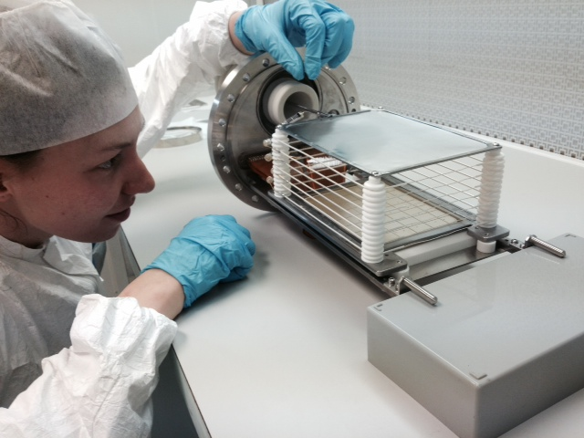
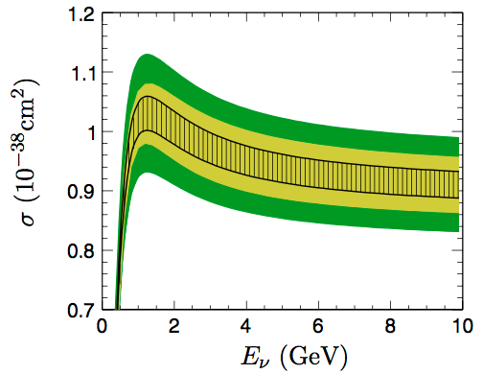
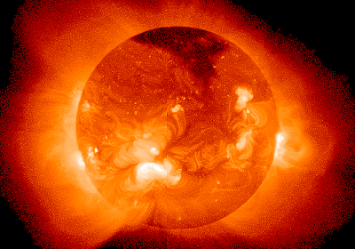
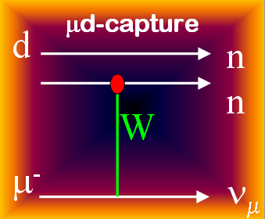
Muon capture, TPCs and nucleon axial structure
Peter Kammel
University of Washington and CENPA
INT Workshop INT-18-2a, From nucleons to nuclei: enabling discovery for neutrinos, dark matter
29 June, 2018

Slide 2
Outline
Introduction
UW/CENPA program
MuCap: μ⁻ + p → ν_{μ} + n
MuSun: μ⁻ + d → ν_{μ} + n + n
Axial form factor and muon capture
new analysis
potential future experiment
High pressure hydrogen TPCs
technology
Summary

Slide 3
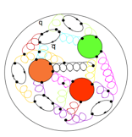
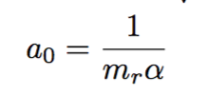
Muon Capture Phenomenology
μ
γ
ν
muon decay
muon capture
μ
n
μ
ν
ν
e
W
close to free muon decay
1.6 permille BR ratio

Slide 4
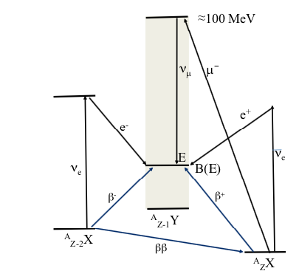
Muon Capture Physics
charged-current weak interaction probe of nucleon and lightest nuclei
access to unique observables, where scarce information is available
tremendous experimental progress with new technique
from 10% to sub-percent: μ³He (0.3%), μp (1%), μd(1.5% MuSun goal)
recent advances on nucleon, few-body theory
radiative corrections for basic μ+p capture process
χPT: low-energy EFT of fundamental theory QCD
high-energy dynamics integrated out, low energy constants (LECs)
retains QCD symmetries → tests with precision experiments
model independent relations → predictions based on experimental input
Lattice QCD
heavier nuclei
capture rate ~Z⁴, decay = capture @ Z=13
nuclear structure information
0νββ

Slide 5
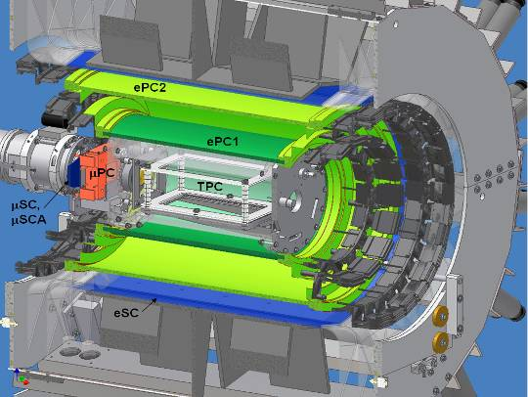
UW/CENPA Program
MuCap
Basic QCD Symmetries
Nucleon axial radius
MuSun
Weak few nucleon reactions
Neutrino astrophysics

Slide 6
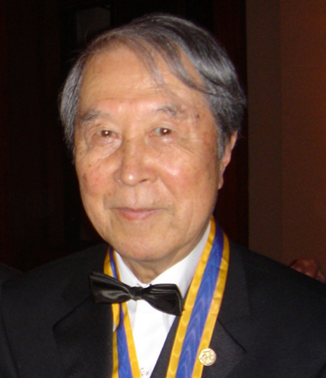
Muon capture on the proton
μ⁻ + p → ν_{μ}+ n rate Λ_{S} at q²= -0.88 m_{μ}²
Muon capture
Form factors
Pseudoscalar FF g_{P}
modern χPT prediction 2% level
50 yr efforts to measure precisely
Lorentz, T invariance
before MuCap All form factors precisely known from SM symmetries and data
apart from g_{P}^{exp} = 8.3 ± 50%
assuming g_{A}(q²) dipole
Foundations for mass generation chiral perturbation theory of QCD

Slide 7
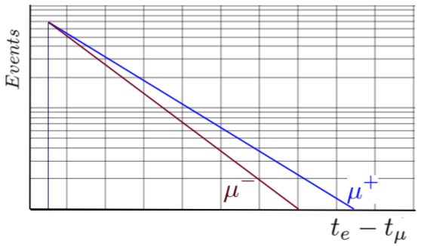
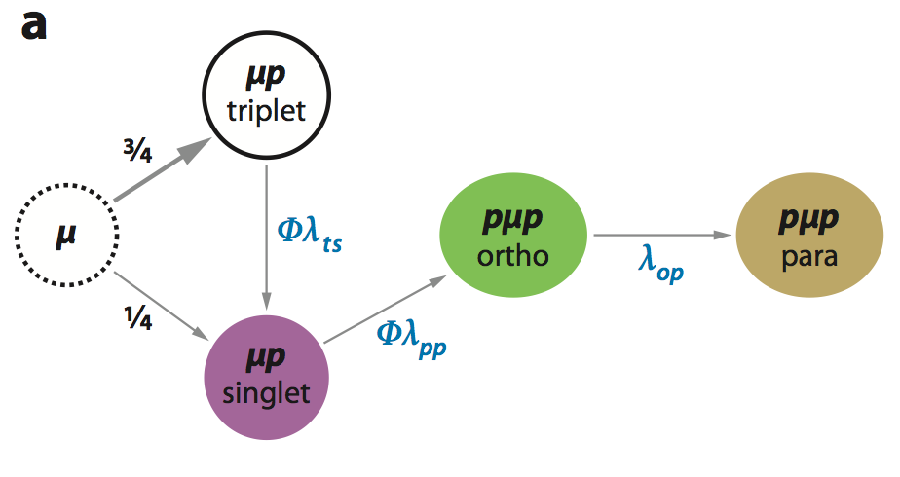
MuCap strategy
capture rare, only 0.16% of μ→eνν
Lifetime method
Λ_{S} = 1/τ_{μ−} - 1/τ_{μ+}
measure to lifetime to 10ppm !!
Precision technique
Clear Interpretation
Clean stops in H₂
Impurities < 10 ppb
Protium D/H < 10 ppb
Muon-On-Request
All requirements simultaneously

Slide 8
MuCap Active Target Technique
e
t
μ
Notes:
Different techniques, plot with more and more results

Slide 9
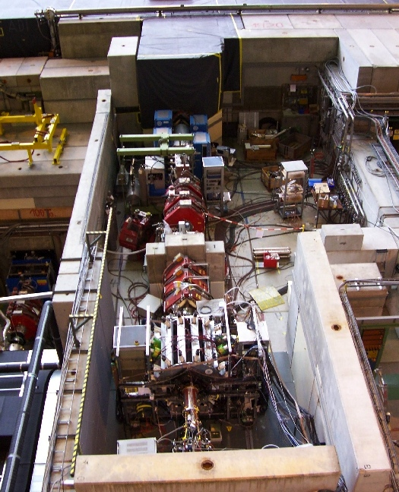
MuCap at PSI
34 MeV/c, 70 kHz beam
Muon-on-request with fast kicker
πE3 beamline
Kicker
Separator
Quadrupoles
Slit
TPC
MuCap detector

Slide 10
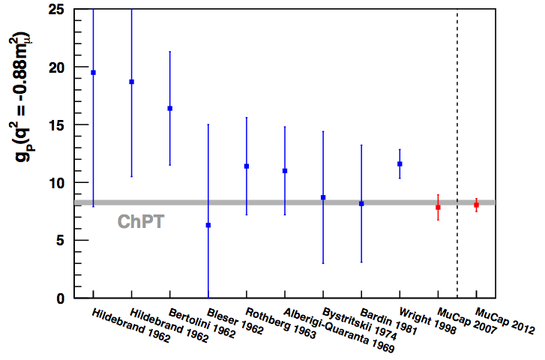
MuCap “Final” Result
assuming F_{A} dipole
χPT parameter free prediction: g_{P} = 8.26 ± 0.23
including uncertainty
MuCap final result: g_{P} = 8.06 ± 0.55
verifies basic prediction of low energy QCD
Phys. Rev. Lett. 110, 012504 (2013) APS Editor's spotlight
Eur. Phys. J. A 50, 163 (2014)
Phys. Rev. C91, 055502 (2015)
Rev. Sci. Instrum. 86, 125102 (2015)

Slide 11
UW/Cenpa Program
MuCap
Basic QCD Symmetries
Nucleon axial radius
MuSun
Weak few nucleon reactions
Neutrino astrophysics

Slide 12
Muon Capture on the Deuteron: MuSun
Δ
Goal: Determine
Axial current coupling to 2N system: “g_{A} of 2N system”
Low Energy Constant in EFT
Relevance
calibrate fundamental astrophysics reactions
important for EFT formulation of nuclear physics
matrix elements for 0ν2β decay
MEC
π
EFT
L_{1A} , d_{R}
chiral 2-body currents
Family of weak 2N reactions
pp fusion (Sun)
νd scattering (SNO)
d_{R}
d_{R}
d_{R}
d_{R}
C_{D}

Slide 13
Determine Unknown Coupling Constant in μd Capture ?
Many calculations:
- impulse-approximation
- EFT variants
MuSun Goal: 1.5%
Theoretical calculations fix LEC with tritium $β$-decay

Slide 14
MuSun Strategy
Cryo TPC as active target
cathode (-80 kV)
Clear Interpretation
Precision technique
Clean stops in D₂
Impurities < 1ppb
H/D < 100 ppm
field wires
novel device:
high purity,
high-pressure,
cyrogenic
deuterium TPC
6% LH₂ density
31 K, 5.1 bar
90x120x72 mm³
anode 48 pads
continuous circulation & cleaning
ultra-pure D₂
cyro preamplifier 250e rms @ 0.5μs shaping

Slide 15
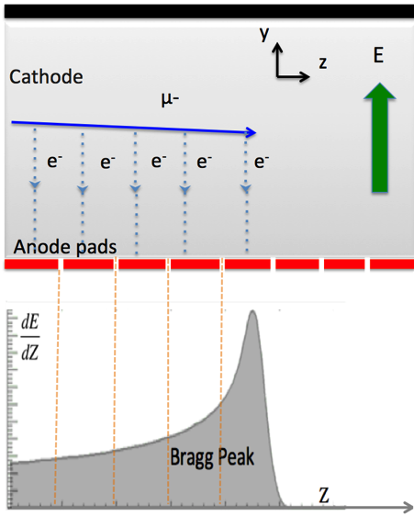
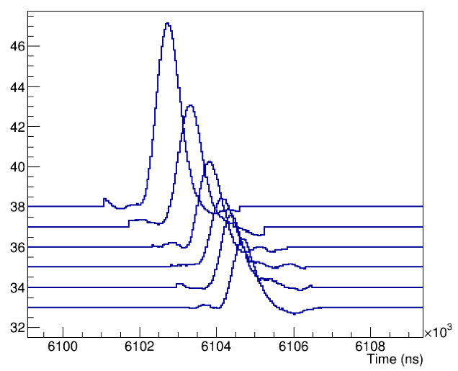
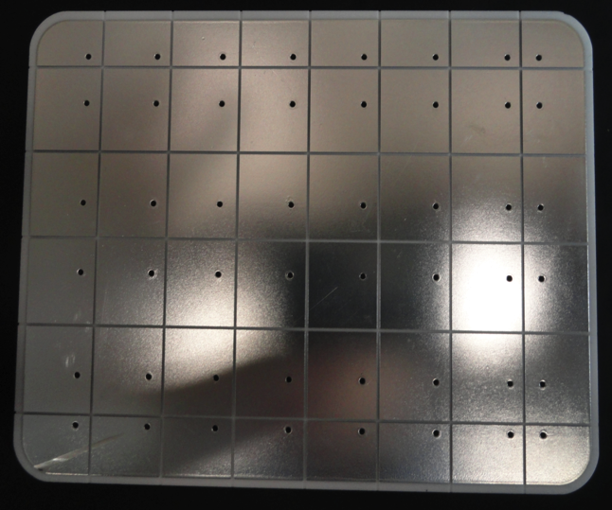
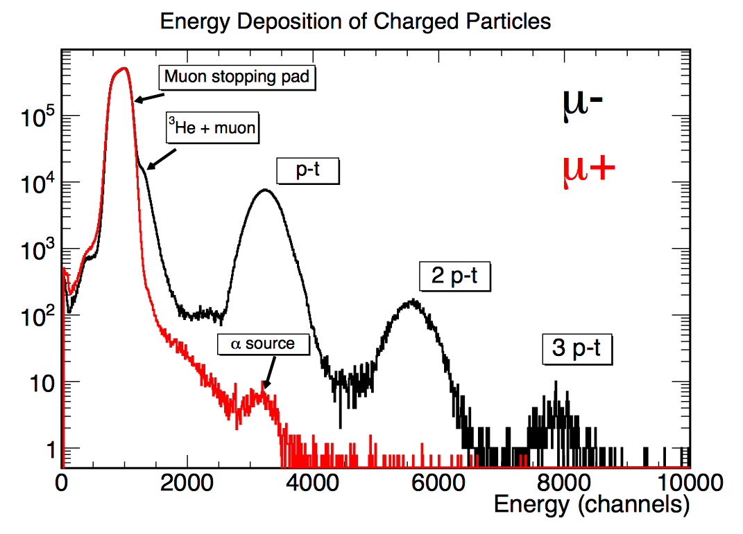
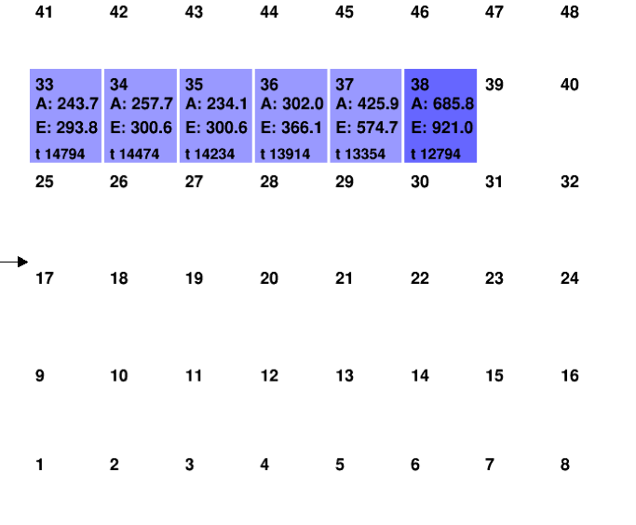
Events in TPC
μ
μ
95.5 mm
125.5 mm

Slide 16
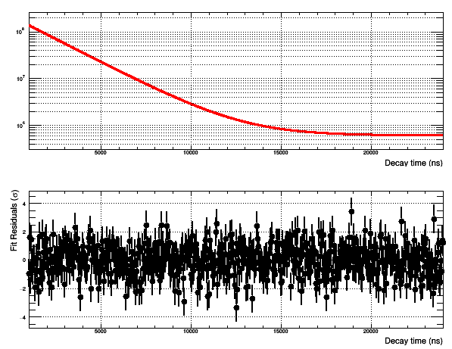
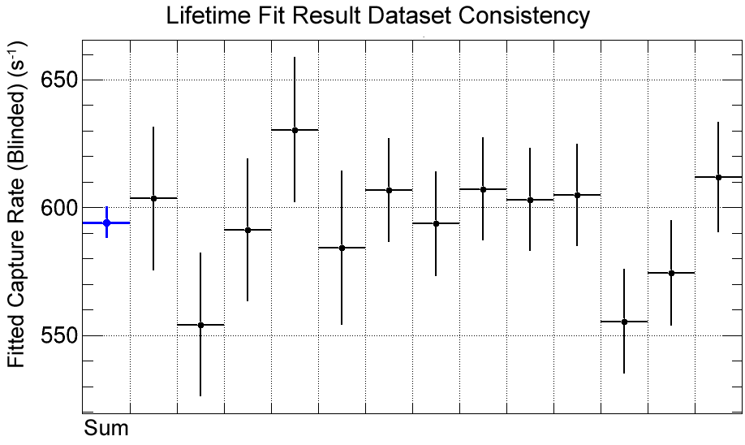
MuSun Status
R2015 decay spectrum
Statistics:
Data taking complete
1.4 x 10¹⁰ events
goal: δΛ_{d}= 4 s⁻¹
Systematics:
goal: δΛ_{d}= 4 s⁻¹
Working hard on all topics
First unblinding planned this fall
R2014 data set consistency
R2015 data set consistency

Slide 17
Outline
Introduction
UW/CENPA Program
MuCap: μ⁻ + p → ν_{μ}+ n
MuSun: μ⁻ + d → ν_{μ}+ n + n
Axial form factor and muon capture
new analysis
potential future experiment
High pressure hydrogen TPCs
technology
thoughts on ν + d → μ⁻ + p + p
Summary

Slide 18
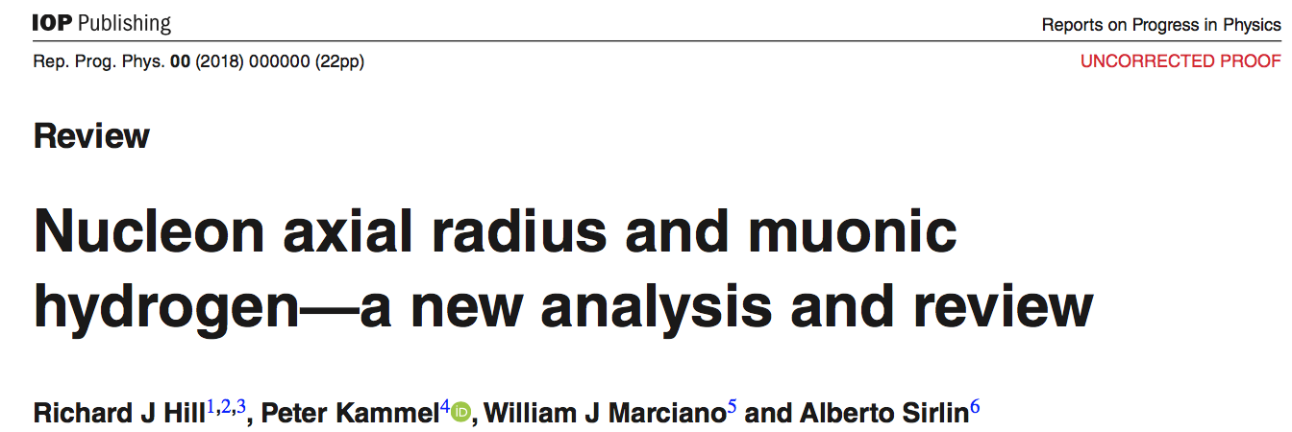
New perspective on nucleon axial form factor
2% for MuCap
Nucleon axial radius r_{A} has surprisingly large uncertainty
basic nucleon property
doubles uncertainty in QE νn￫pμ cross section prediction (important for DUNE, T2HK)
Problem and opportunity for muon capture
Can g_{P} still be reliably extracted from MuCap?
Can one use MuCap to extract the axial radius?
A.Meyer
Phys.Rev. D93 113015, (2016)

Slide 19
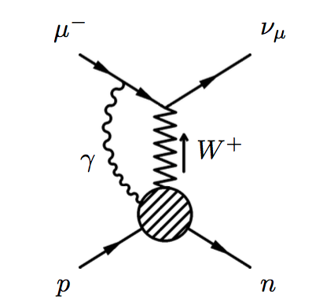
Axial Radius and Muon Capture Review
Theory improvements
Theory uncertainties in $Λ_{S}$ reduced to 0.2% level. (ignoring $r_{A}^{2}$ input uncertainty)
Λ_{singlet} = 715.4 (6.9) s⁻¹
rel. uncertainties (%):
g_{P} determination from muon capture
$∆r_{A}^{2}$ dominates uncertainty in g_{A}(q₀²) and g_{P}(q₀²) from theory.
MuCap still provides QCD test at 8% level:

Slide 20
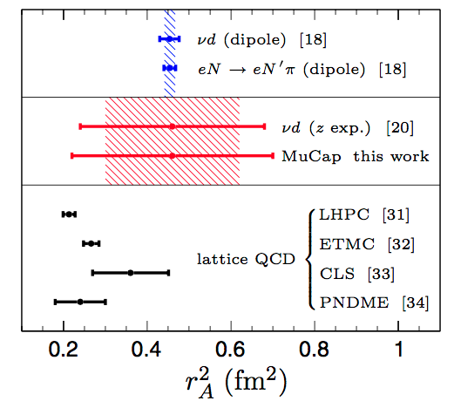
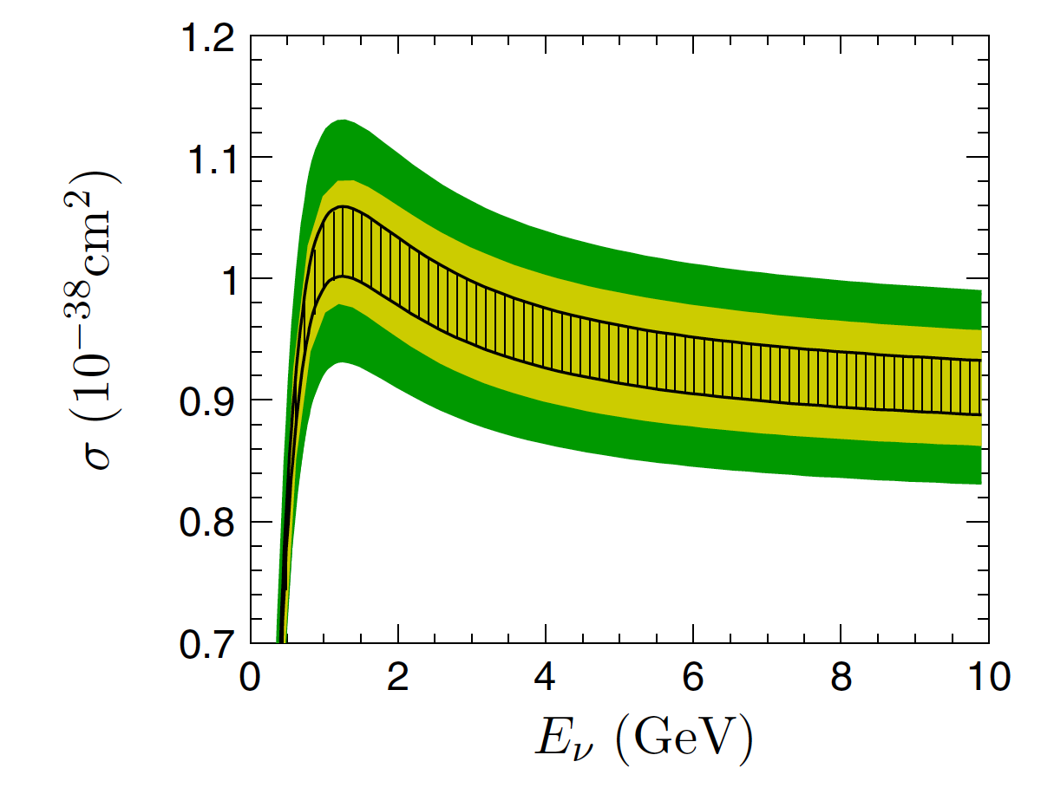
Axial Radius from MuCap
Use
g_{A}(q²,r_{A}²)
g_{P}(q²,r_{A}²) from EFT (with g_{πNN}= 13.12(10))
0.3% future precision MuCap measurement could reduce
$∆r_{A}^{2}$ from 0.22 to 0.09 fm²
uncertainty in QE σ(νn) by nearly 2
current σ band
$$\text{s} indep of r_{A}^{2}$$
σ from $r_{A}^{2}$=0.09 fm²

Slide 21
Ideas toward 3-fold improved MuCap++
Goal
MuCap: Λ_{singlet}= 715.6 (5.4)_{stat} (5.1)_{sys}
MuCap++ Λ_{singlet}= (1.7)_{stat} (1.7)_{sys}
Conservative approach: incremental improvements
Statistics:
10x increase
Systematics
τ_{μ} to 3.7 ppm
MuLan 1 ppm
TPC gain and stability
 | uncertainty (1/s)
effect | MuCap | MuCap++
Boundary and interference effects | 3.3 | ~1.0
Gas impurities | 1 | ~0.1
Electron tracker effects | 1.8 | ~1
ppμ molecular effects | 1.8 | ~0.5

Slide 22
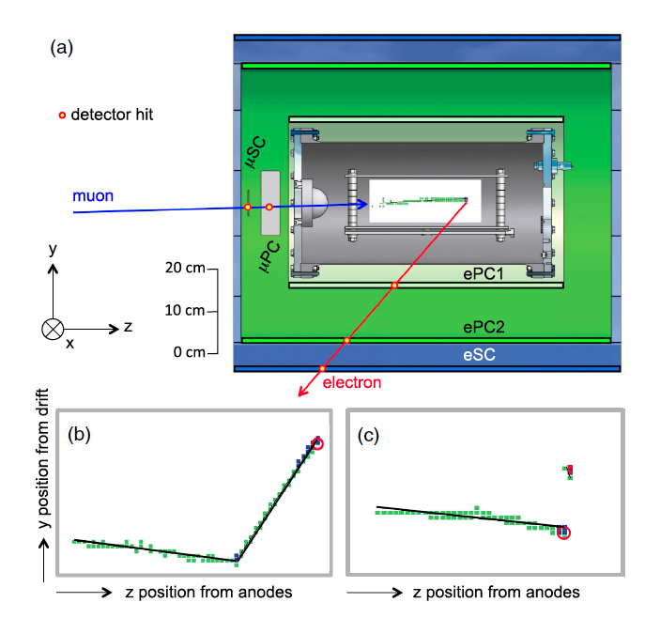
Muon stop defined by TPC
TPC side view
Compromise required
between
accurate tracking
constant tracking efficiency after muon stop @ 10⁻⁵
10⁻²/μ
~10⁻⁶/μ
b) Large angle μ-p scatter c) Delayed capture on impurity μO→Nν

Slide 23
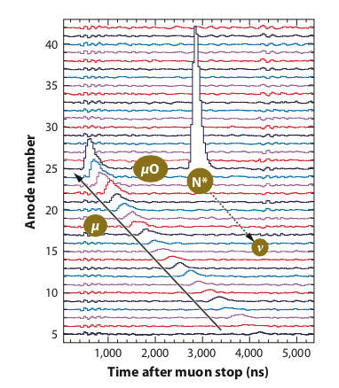
Main ideas
intermediate
focus
pressure window 0.3 mm Be
Beam
reduce beam momentum
minimal material
continuous vacuum
thin windows
faster kick
TPC
larger size, higher drift field
stability, gain improvement: GEM, Micromega
pad chamber electronics, digitizer
Electron detectors
modern SiPM based fast scintillator
with high segmentation
Purity
gold plating
improved GC, in-situ monitoring
@ ppb level
vacuum
H₂ 10 bar
0.2 mm μSC
additional safety
volume such that small pressure increase with Be window rupture
additional upstream fast shutter valve

Slide 24
Outline
Introduction
UW/CENPA Program
MuCap: μ⁻ + p → ν_{μ}+ n
MuSun: μ⁻ + d → ν_{μ}+ n + n
Axial form factor and muon capture
new analysis
potential future experiment
High pressure hydrogen TPCs
technology
Summary

Slide 25
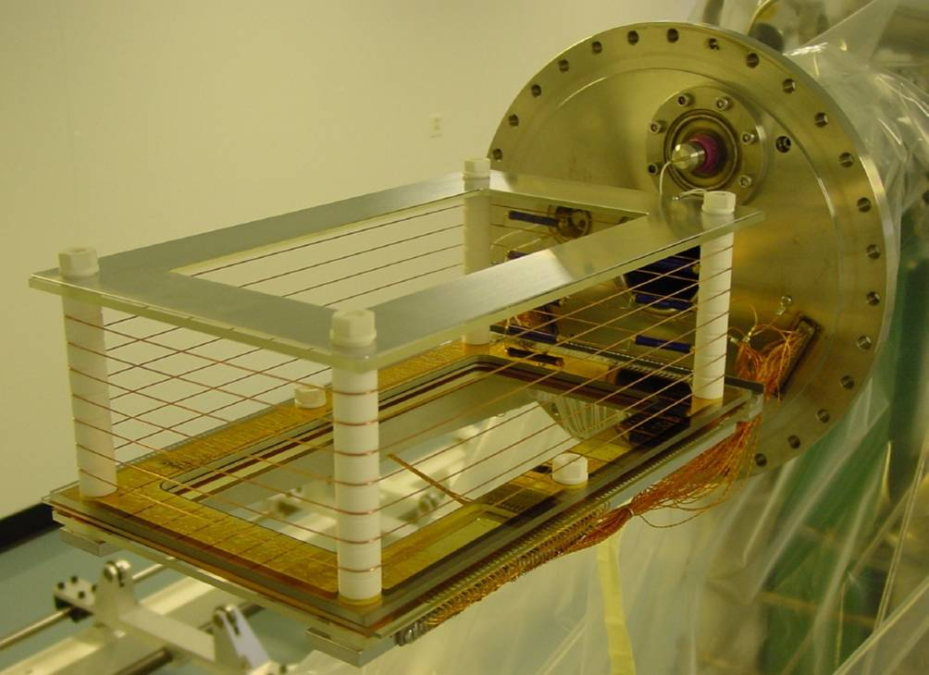
MuCap/MuSun H₂ / D₂ TPC
15 x 12 x 28 cm³
φ = 0.0116 LH₂, T=300 K, 10 bar
MuCap
MWPC, G=125-320, 25μm anode wires
4 mm anode, cathode pitch
30 kV HV
10% energy resolution
MuSun
G=1, Frisch grid
16x16 mm² pads
80 kV HV
excellent resolution 17 keV with cryo-preamps
Both chambers
1-10 ppb purity (difficult operation with gain)
continuous circulations system
2.4x10⁻⁴ P stabilized @ 10 bar
scale up at least 2000 required for ν program 🙄
φ = 0.065 LH₂, T=31 K, 5.1 bar
9.6 x 7.1 x 12.5 cm³
partially LD₂ filled during tests

Slide 26
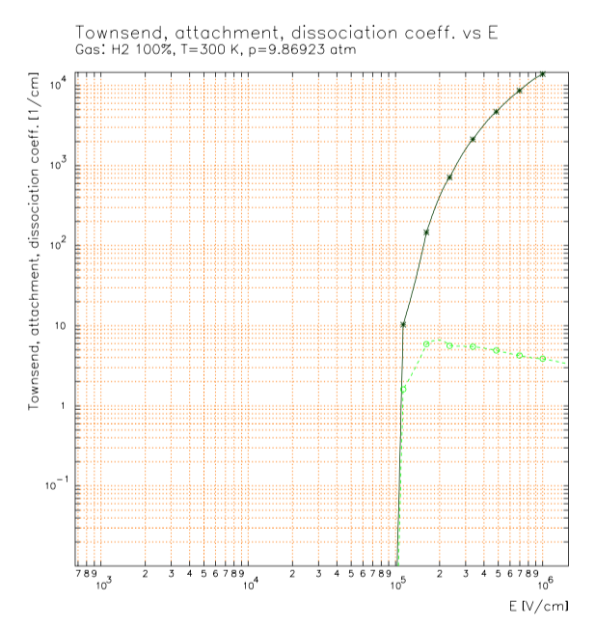
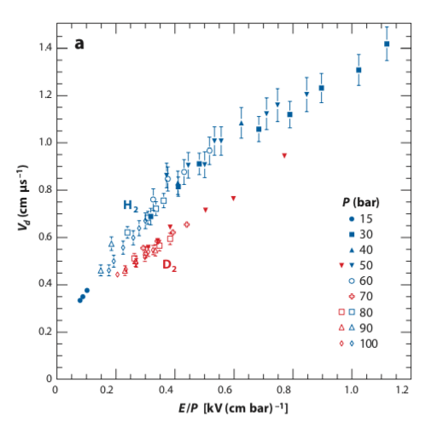
Hydrogen TPC Properties
Townsend coefficient
small
need >10⁵ V/cm @ 10 bar for gas amplification
typically 2-3x higher than standard chamber gases
0.5 MV/cm on anode wire
Drift velocity
rather slow gas
MuCap 2 kV/cm @ 10 bar
MuSun 10 kV/cm @ “60 bar”
Energy per ion-e pair: W=37 eV
dE/dx per cm small in H₂ need sufficient pixel size for MIPS detection @ G=1

Slide 27
Hydrogen TPC Properties
Recombination
significant for dE/dx > dE/dx_{MIPS}
dependence on angle to drift field
Impurities: O₂ terrible, H₂O might stabilize MWPC operation
MuSun G=1 high density TPC achieved very stable operation, thus LH₂ TPC preferable, if electron attachment, drift velocity, etc. ok
$$ddμ→{}_{}^{3}{He \left(820 keV\right)+n\left(2.5 MeV\right)+μ}$$

Slide 28
Summary
MuCap: μ⁻ + p → ν_{μ}+ n
in spite of $r_{A}^{2}$problem: stringent test of chiral symmetry
competitive and complementary $r_{A}^{2}$determination
sufficient motivation/support for 3x improved experiment?
MuSun: μ⁻ + d → ν_{μ}+ n+ n
data taking with full statistics completed
challenging analysis converging
νH, νD TPC
significant experience with high density hydrogen TPCs in our collaboration
Alan’s LH₂ TPC idea interesting, I need more time to consider this option
connection to MuCap++ project motivation

Slide 29
Backup

Slide 30
e⁻ Attachment on O₂
• Thermal Electron Attachment to O₂ in H₂ and D₂
Shimamori and Hatano, Chem. Phys. Let.
Vol.38 (1976) 242-247
• Bloch-Bradbury-Herzenberg mechanism (two-stage three-body process)
• attachment time constant:
p.n.d.
p = 10 bar, T = 300 K, f_{O2} = 10 ppm :
impurity level
calculated: τ = 3.4 μs
↔ “MuCap observation” (pulse height → threshold, exp. attenuation)
E = 0.5 kV / cm
E = 2.0 kV / cm
τ ≈ 0.4 - 0.8 μs
τ ≈ 1.6 - 2.0 μs

Slide 31
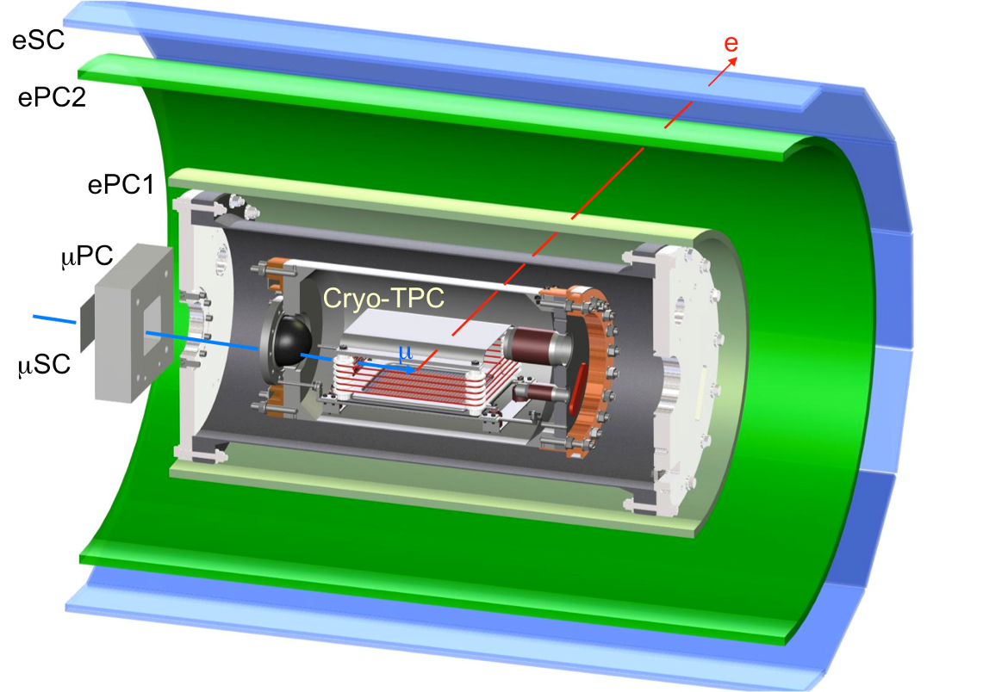
Experimental Setup at PSI, Switzerland
Measure the time of the decay electron t_{e} relative to the muon entrance t_{μ} and fit to extract the lifetime.
Detector and cyro / gas cleaning system

Slide 32
Thanks
MuSun Collaboration
Petersburg Nuclear Physics Institute (PNPI), Gatchina, Russia Paul Scherrer Institute (PSI), Villigen, Switzerland
University of Washington, Seattle, USA University of Kentucky, Lexington, USA Boston University, USA
Regis University, Denver, USA
University of South Carolina, USA
Funding agencies
The UW work was supported by the U.S. Department of Energy Office of Science,
Office of Nuclear Physics under Award Number DE-FG02-97ER41020.
Collaboration funding includes support by the US National Science Foundation and the Russian Science Foundation (Project No. 14-12-01056).
This work used the Extreme Science and Engineering Discovery Environment (XSEDE), which is supported by National Science Foundation grant number ACI-1548562.

Slide 33
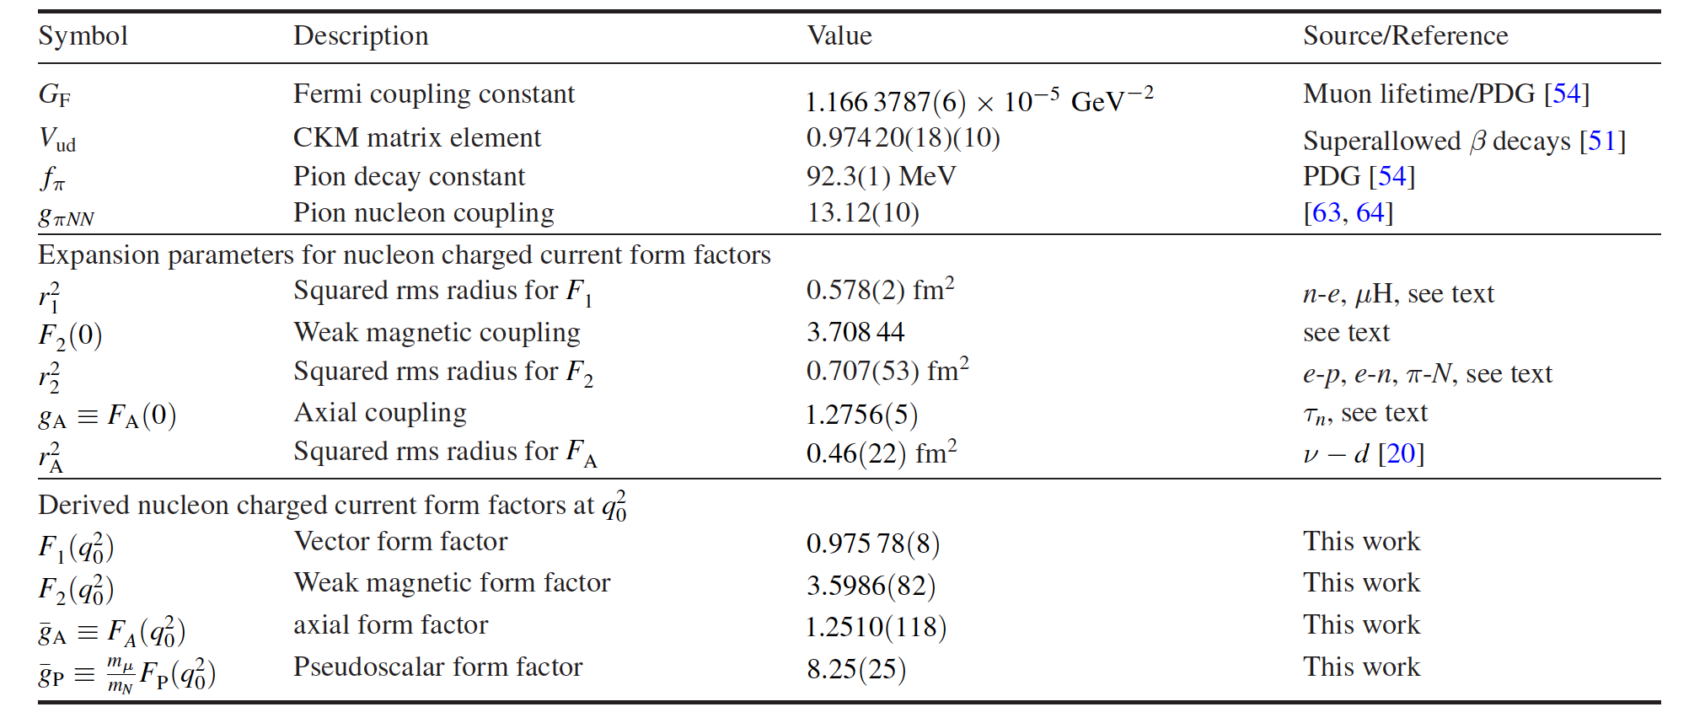
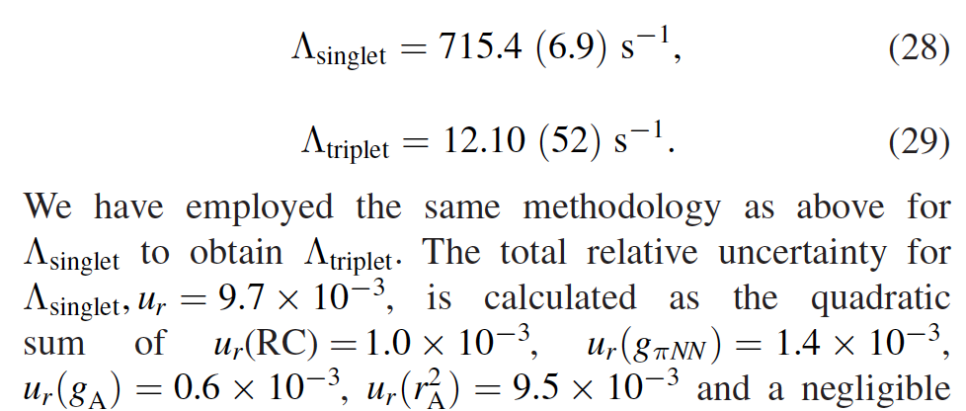
Axial Radius Details I

Slide 34
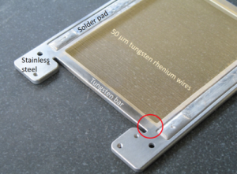
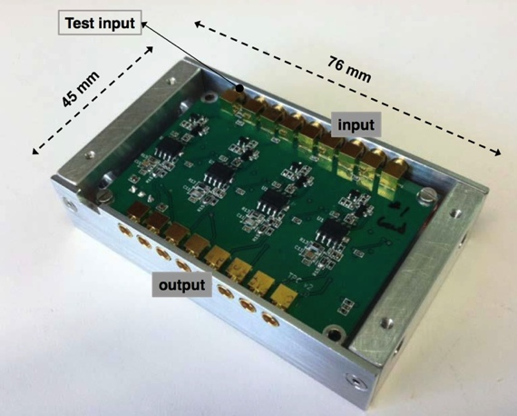
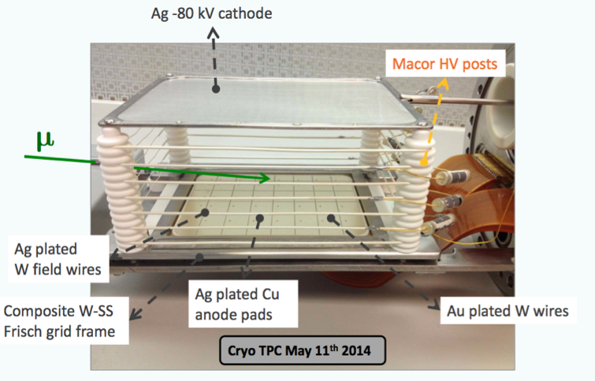
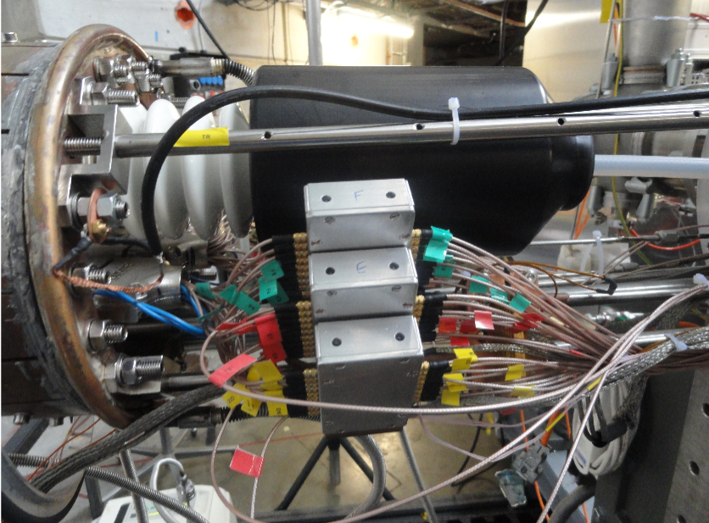
Hardware
new
Cryo TPC
tight constraints, new design flawless during production runs
Cryo preamps
140K, 250e rms @ 0.5μs shaping essential for purity monitor
Frisch grid 3.5 kV

