Slide 1
An introduction to nuSTORM; opportunity for nuclear and oscillation physics?

Slide 2
Background
The potential of bright stored muon beams
An introduction to nuSTORM

Slide 3
Basis of potential
Muon mass:
  200 m_{e} ~ m_{μ} ~ 0.1 m_{p}
Muon decay:
  ν_{e}, ν_{μ}
  Precisely known energy spectrum
Energy frontier:
  No brem-/beam-strahlung
    Rate ∝ m⁻⁴
    [5 × 10⁻¹⁰ cf e]
  Enhanced coupling to Higgs
    Production rate ∝ m²
    [5 × 10⁴ cf e⁺e⁻]
  Efficient acceleration
    Favourable rigidity
Physics of flavour:
  Precision neutrino physics
  Sensitive cLFV searches

Slide 4
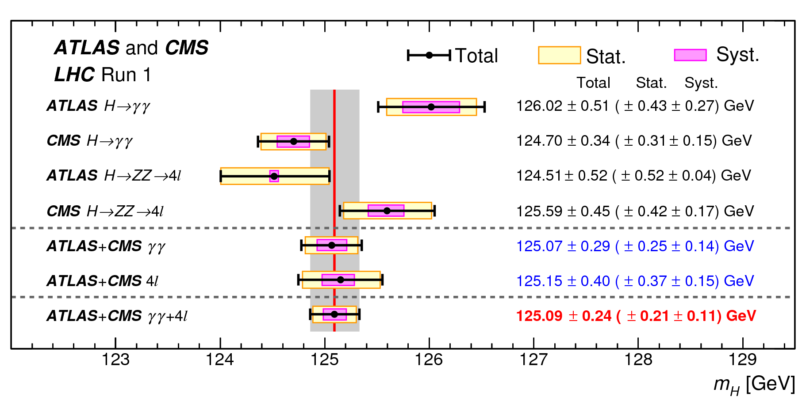
The Standard Model and beyond
S. GASCON-SHOTKIN, La Thuile 2016
Future study of the Higgs:
  Line width; establish single resonance (?) in s-channel with μ⁺μ⁻
  Couplings; requires > 1 TeV for complete, precise study

Slide 5
Line shape
Standard Model Higgs:
  M = 125 GeV;
  Γ=4.5 MeV
    Exquisite resolution
      R < 0.003%
“Two-state” Higgs:
  Deviation from SM line shape
  Resolve states
    Exquisite resolution!
M.Greco,T.Han,Z.Liu
B.Autin, A.Blondel, J.Ellis;
CERN 99-02, 1999

Slide 6
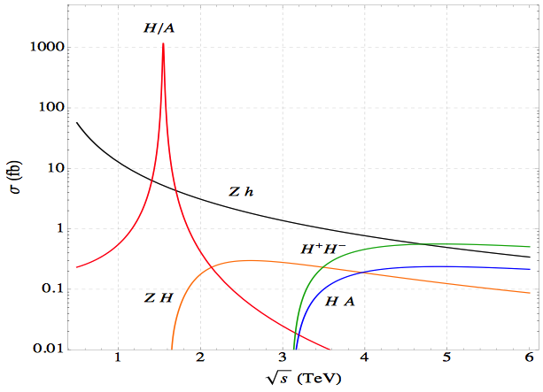
Couplings/branching ratios
Standard Model Higgs
  Accurate threshold measurement
  Exploiting accurate knowledge of (narrow) energy spectrum
Beyond SM Higgs
  Exploit narrow energy spectrum to search for :
    Narrow resonances
    Unexpected thresholds
M.Greco,T.Han,Z.Liu
m_{bb} > 100 GeV
arXiv:1306.2609

Slide 8
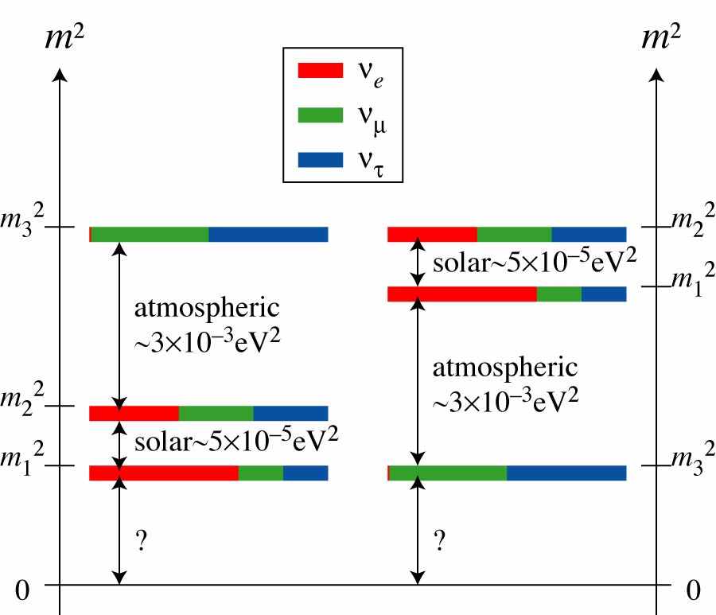
http://kamland.lbl.gov/FiguresPlots/; http://www-numi.fnal.gov/PublicInfo/forscientists.html

Slide 9
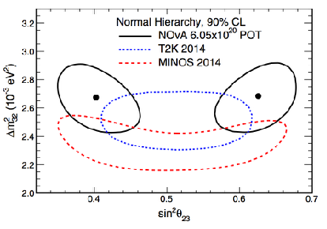
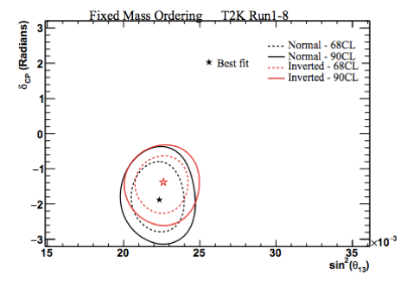
What do we know?
Marrone: proc. Neutrino 2016
Summer 2017:
  NOvA:
    θ₂₃ ≠ 45º at 2.6σ
  T2K:
    CP conservsation excluded at ⪆ 2σ

Slide 10
What we need to know:
Do neutrino oscillations violate the CP symmetry?
Ordering of neutrino mass eigenstates and neutrino mass scale
Empirical relationships between ν-mixing parameters ...
or between ν- and q-mixing parameters
Dirac or Majorana?
Anomalies (aka hints for sterile neutrinos):
statistical fluctuations, systematic effects or indications of new physics?
Impact: particle physics, astroparticle physics, cosmology, ...

Slide 11
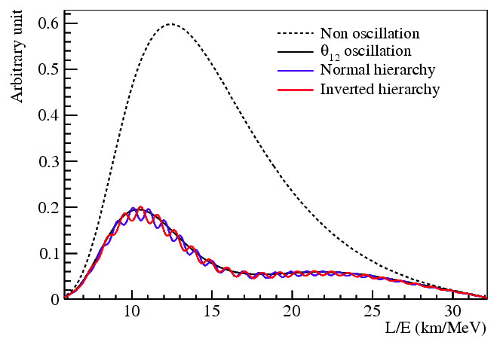
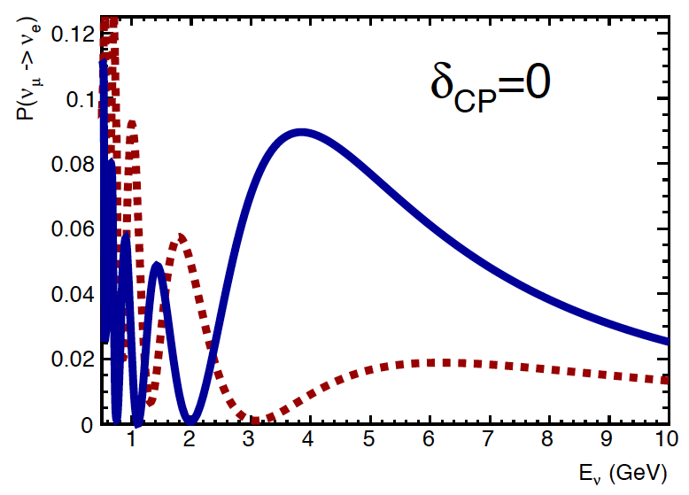
Mass hierarchy: two options
Exploit L/E spectrum:
JUNO:
  Reactor-neutrino exp^{t}
  20 kton liquid-scintillator
    3%/√E energy resolution
  Under contruction
Exploit matter effect:
  Electron-neutrino may undergo charge-exchange with atomic electron
  Modifies oscillation probability
  Large source-detector distance

Slide 12
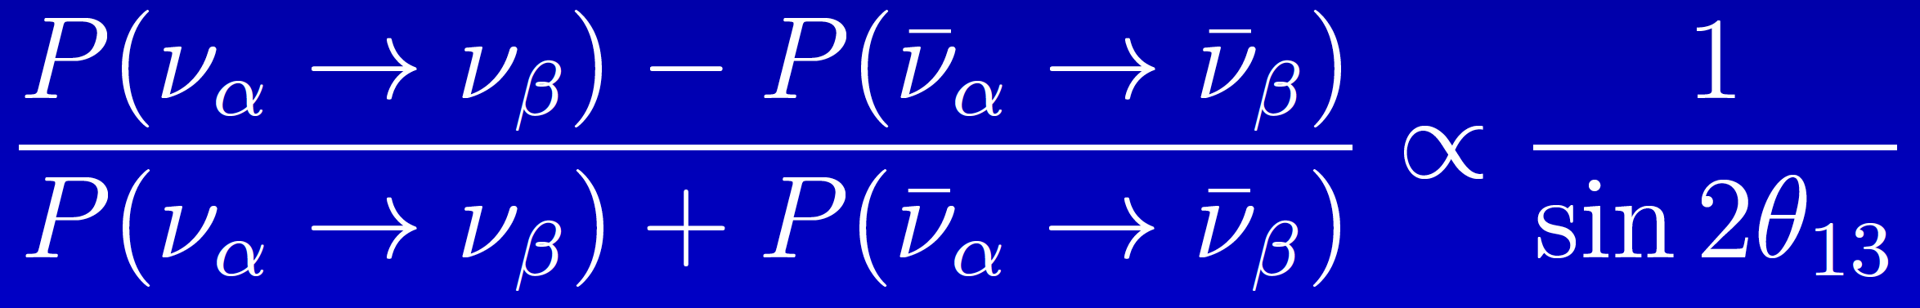
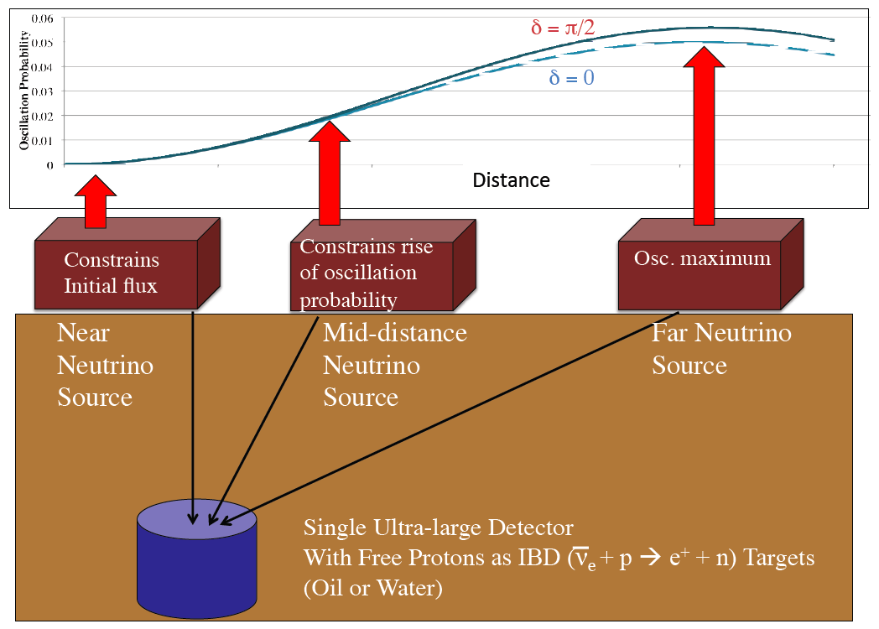
CP-invariance violation: two options
Exploit L/E spectrum:
  DAEδALUS
Measure asymmetry:
Shaevitz

Slide 13
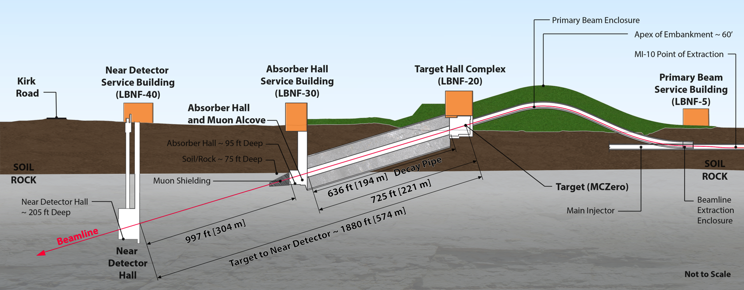
Next generation experiments
DUNE
  New beam from FNAL
    Horn-focused, wide-band beam
    Peak in E_{ν} ~ 3 GeV; matched to 1300 km baseline
  Modular, 40 kton LAr
Hyper-K(K)
  Upgrade to J-PARC beam
    Off-axis, narrow band
  Two 260 kton H₂O Cherenkov
    Considering second tank in Korea (>1000 km)
“Bubble-chamber
quality” measurement

Slide 14
Sensitivity to CPiV
DUNE and Hyper-K alone:
  5σ sensitivity over >50% of all values of δ_{CP} after 10 yrs
Combined—sensitivity enhanced

Slide 15
The potential of muon beams, pros and cons
Muon beams have the potential to:
  Revolutionise the study of the neutrino
  Provide a route to multi-TeV lepton-antilepton annihilation
Unique potential arises because:
  Heavy: 200 m_{e} < m_{μ} < 0.1 m_{p}
    Enormous (5 × 10⁻¹⁰ cf e) reduction in beam-/bremsstrahlung
    Enhanced (5 × 10⁴ cf e⁺e⁻) s-channel coupling to Higgs
  Decay: lifetime at rest 2.2 μs
    ν_{e}, ν_{μ} – 50/50
    Precisely known energy spectrum
Challenges:
  Tertiary beam
  Decay: lifetime at rest 2.2 μs

Slide 16
Neutrino Factory: sensitivity & precision
Unique:
  Large, high-energy
  ν_{e} (ν_{e}) flux
    Muon-beam cooling
  Favourable rigidity:
    Optimise E for given L

Slide 17
So, What is nuSTORM?
An introduction to nuSTORM

Slide 18
Neutrinos from stored muons
Scientific objectives:
  %-level (ν_{e}N)cross sections
    Double differential
  Sterile neutrino search
    Beyond Fermilab SBN
Precise neutrino flux:
  Normalisation: < 1%
  Energy (and flavour) precise
π ➔ μ injection pass:
  “Flash” of muon neutrinos

Slide 19
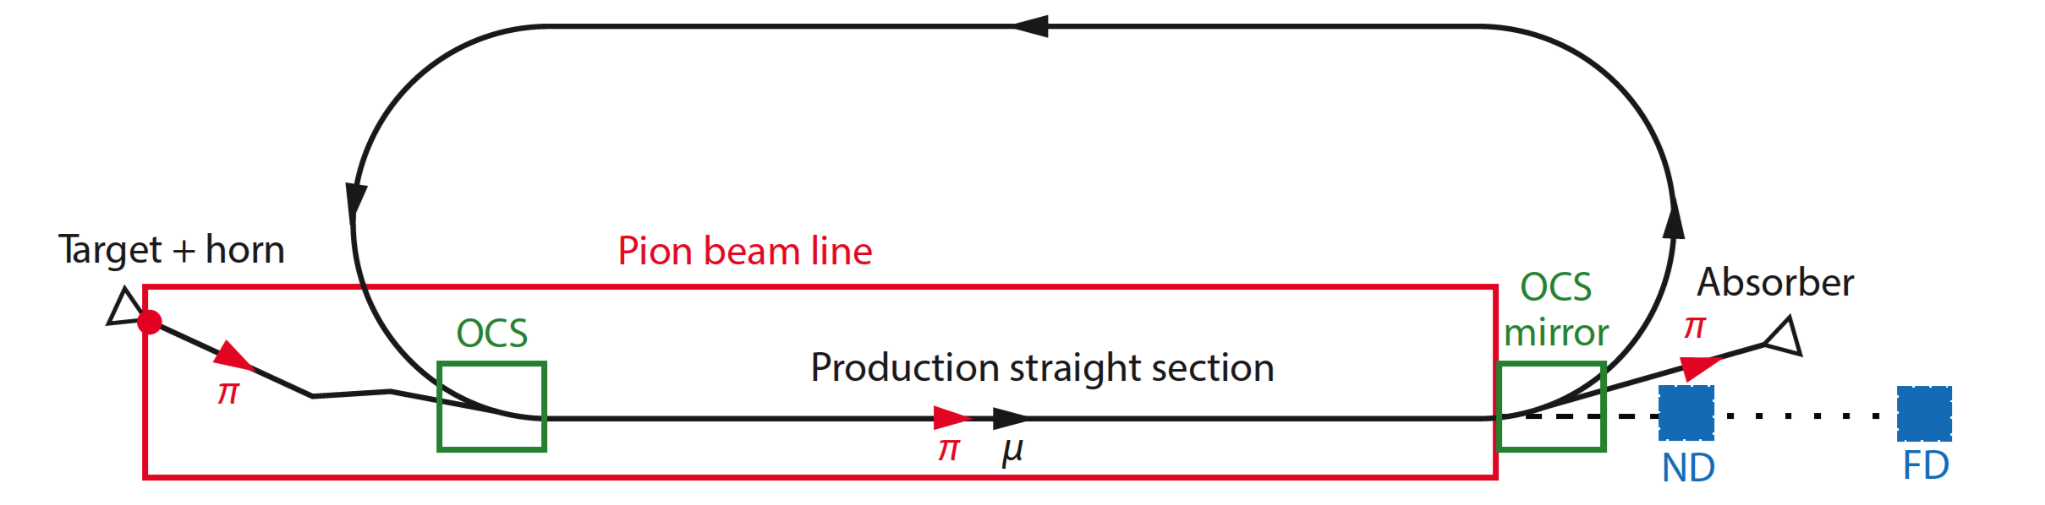
nuSTORM oveview
Fast extraction at >~ 100 GeV
Conventional pion production and capture (horn)
  Quadrupole pion-transport channel to decay ring

Slide 20
Neutrino flux
10.1146/annurev-nucl-102014-021930
ν_{μ} flash:
  Pion: 6.3 × 10¹⁶ m⁻² at 50m
  Kaon: 3.8 × 10¹⁴ m⁻² at 50m
    Well separated from pion neutrinos
ν_{e} and ν_{μ} from muon decay:
  ~10 times as many ν_{e} as, e.g. J-PARC beam
  Flavour composition, energy spectrum
    Use for energy calibration

Slide 21
Why study neutrino interactions?
An introduction to nuSTORM

Slide 22
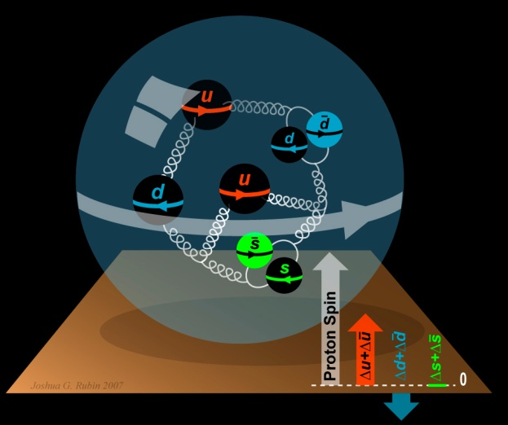
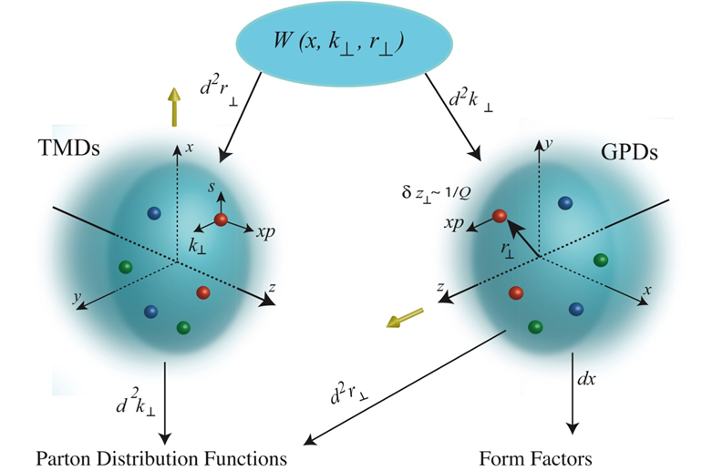
To understand the nucleon and the nucleus
Neutrino unique probe: weak and chiral:
  Sensitive to flavour/isospin and 100% polarised
How could neutrino scattering help?
  Nucleon (e.g.):
    Spin puzzle
  Nucleus (e.g.):
    Multi-nucleon correlations
    Precise determination of:
      Model parameters or, better,
      Theoretical (ab initio) description
Can the neutrino’s unique properties compete with the rate in, e.g. electron scattering?
  To be studied!
Benefit of nuSTORM:
  Precise flux and energy distribution
My question
to you!

Slide 23
Search for CPiV in lbl oscillations
Seek to measure asymmetry:
  P(ν_{μ}➤ν_{e}) – P(ν_{μ}➤ν_{e})
Event rates, convolution of:
  Flux, cross sections, detector mass, efficiency, E-scale
    Measurements at %-level required
  Theoretical description:
    Initial state momentum, nuclear excitations, final-state effects

Slide 24
Systematic uncertainty and/or bias
Phys.Rev. D89 (2014) no.7, 073015; Coloma et al
Uncertainty
(cross section
and ratio)
Event mis-classification
Phys.Rev. D92 (2015) no.9, 091301; Ankowski et al
Energy scale mis-calibration
Missing energy (neutrons)

Slide 25
Search for CPiV in lbl oscillations
Seek to measure asymmetry:
  P(ν_{μ}➤ν_{e}) – P(ν_{μ}➤ν_{e})
Event rates convolution of:
  Flux, cross sections, detector mass, efficiency, E-scale
    Measurements at %-level required
Lack of knowledge of cross-sections leads to:
  Systematic uncertainties; and
  Biases; pernicious if ν and ν differ

Slide 26
Specification: energy range
Guidance from:
  Models:
    Region of overlap
    0.5—8 GeV
  DUNE/Hyper-K far detector spectra:
    0.3—6 GeV
Cross sections depend on:
  Q² and W:
    Assume (or specify) a detector capable of:
      Measuring exclusive final states
      Reconstructing Q² and W
    → E_{μ} < 6 GeV
So, stored muon energy range:
DUNE
Hyper-K
1 < E_{μ} < 6 GeV

Slide 27
The benefit of nuSTORM
An introduction to nuSTORM

Slide 28
ν_{e}N cross section measurements
Morfin

Slide 29
Systematic uncertainties
Morfin

Slide 30
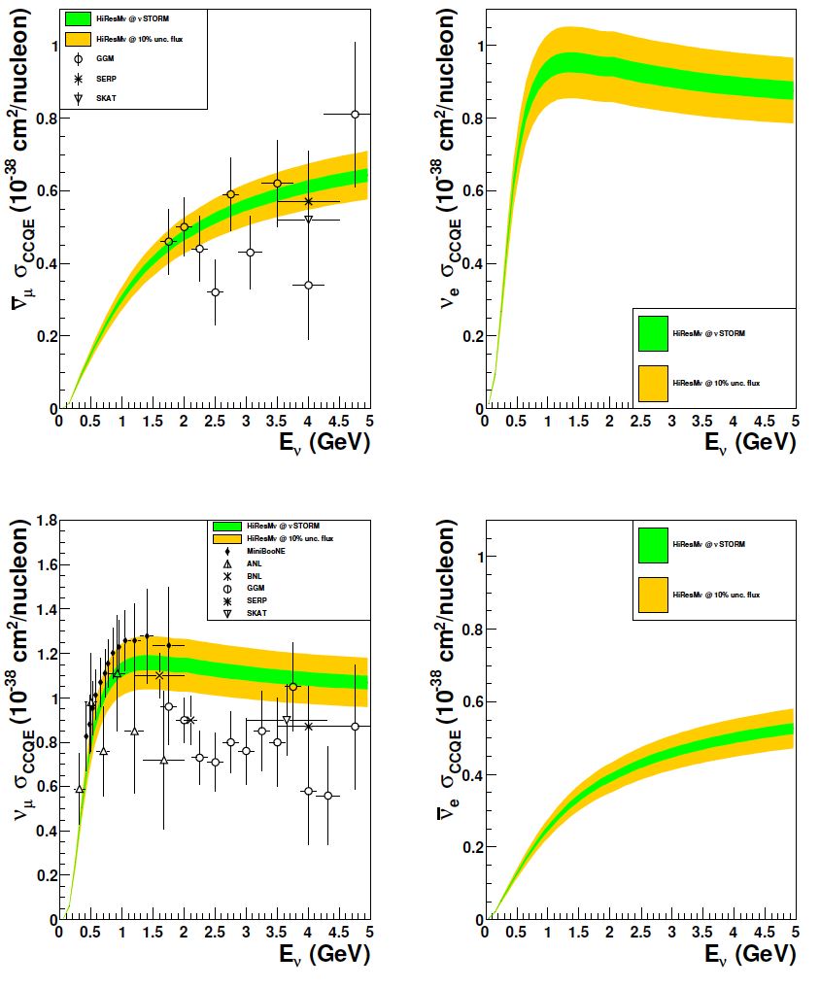
CCQE measurement at nuSTORM
CCQE at nuSTORM:
  Six-fold improvement in systematic uncertainty compared with “state of the art”
  Electron-neutrino cross section measurement unique
Require to demonstrate:
  ~<1% precision on flux
Individual ν_{e} measurements from T2K and MINERvA
[10.1103/PhysRevLett.113.241803, 10.1103/PhysRevLett.116.081802 ]
10.1103/PhysRevD.89.071301; arXiv:1305.1419

Slide 31
nuSTORM
& the CERN Physics Beyond Colliders Study group
An introduction to nuSTORM

Slide 32
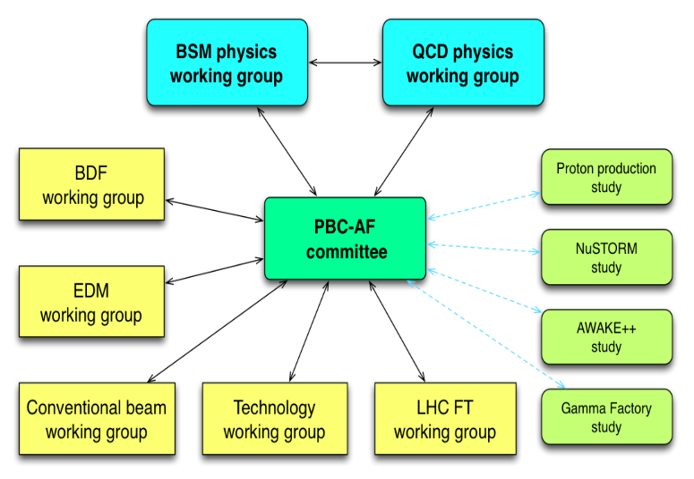
Physics Beyond Colliders study group
http://pbc.web.cern.ch

Slide 33
Elements of study
Physics case:
  Neutrino-scattering for:
    Oscillation
    Nuclear
Specification:
  Energy range:
    Long- and short-baseline neutrino
    Nuclear and particle physics
  Acceptance:
    Rate
    Neutrino-energy calibration
Accelerator:
  Full simulation that demonstrates <~1% flux precision
  Energy range (i.e. sweep down from max)
Implementation:
  Feasibility at CERN (see next slide)
Detector:
  Others are “on this”, so:
    Adopt performance of typical, or assumed, detector

Slide 34
Implementation @ CERN Exploratory study
An initial proposal for siting at CERN, including:
  Muon energy range
  SPS requirements
  Fast extraction, beam-line
  Target and target complex
  Horn
  Siting
  Civil engineering
  Radio-protection implications

Slide 35
Towards a parameter table
Preliminary!
Prepared for discussion

Slide 36
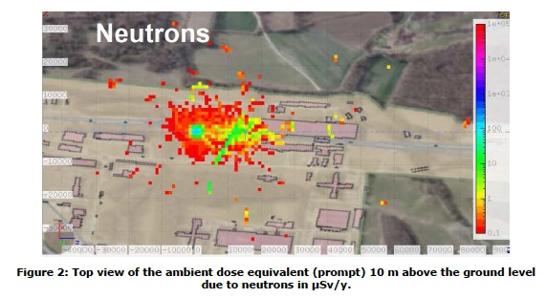
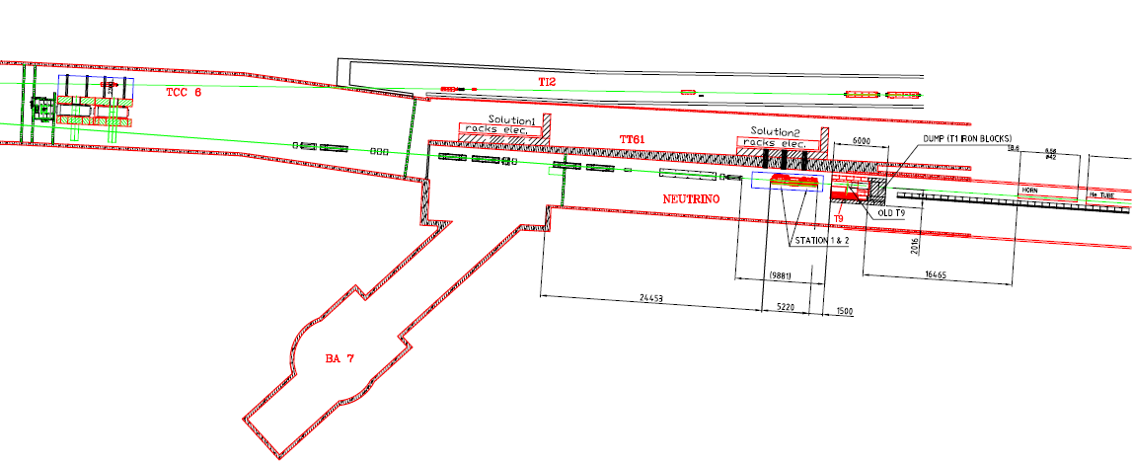
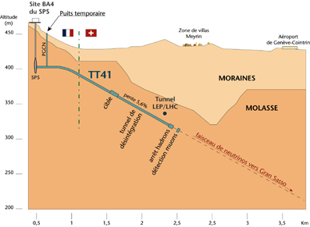
Siting at CERN, options:
North Area:
  Kick @ LSS1; extract @ LSS2
  Transport to North Area:
    Issues:
      Congestion, radio-protection,
      slow (rather than fast) extraction
LSS6/West Area:
  “TCC6”:
    Served West Area Neutrino Facility
    Now occupied by HiRadMat
CERN to Gran Sasso beam line:
  Beamline directed “down hill” in molasse to serve Gran Sasso
  Would put nuSTORM ring deeper than necessary
  Existing target area hot
Preferred option “semi-greenfield” …

Slide 37
I. Efthymiopoulos

Slide 38
Extraction from SPS; transfer line to target
W. Bartmann, B. Goddard, C. Hessler

Slide 39
Pion-production target and capture
M. Calviani

Slide 40
Radio-protection issues
H. Vincke
Initial guidance …

Slide 41
Conclusions
nuSTORM

Slide 42
Conclusions [1]
First steps in the nuSTORM@CERN study:
  Muon energy range identified;
  Preferred site identified;
  Initial review of siting issues carried out:
    Extraction, beam-to-target, target, radio-protection
      No “show-shoppers” identified
  Sections of chapter for PBC report identified

Slide 43
Concusions [2]
The physics of nuSTORM:
  Joint nuclear-/particle-physics study initiated:
    Modest resources secured from IPPP
    Interest from Neutrino Platform Week at CERN:
      Patrick Huber (VT) theory/phenomenology contact
    Mailing list for communication set up:
      nuSTORM-Gen@CERN.CH
        Self sign up!
  Output of physics study:
    Document potential of scattering programme:
      Sister publication to the PRD on the sterile-neutrino-search programme

Slide 44
Question for discussion
What is the value of exclusive neutrino scattering measurements with %-level precision for nuclear physics?

