Slide 1


Sea Partons from Eucliean Hadronic Tensor
Path-integral Formulation of Hadronic Tensor in DIS
Parton Degrees of Freedom
Short Distance Taylor expansion (OPE)
Evolution of Connected Sea Partons
Numerical Challenges and Preliminary Results
INT Workshop on Flavor Structure of Nucleon Sea, Oct. 2 - 13, 2017

Slide 2
Experimental Data
New Muon Collaboration (NMC – PRL 66, 2712 (1991)) μ+ p(n) → μX
Quark parton model + Isospin symmetry
NMC :
ratio from Drell-Yan Production (PRL 69, 1726 (1992))
NuTeV experiment (PRL 88, 091802 (2002))

Slide 3
Possible Explanation
Perturbative QCD:
Higher order effects on is small.
Sullivan Process:
Need a non-perturbative formulation to reveal
in QCD and a scheme to calculate
it quantitatively Euclidean path-integral formalism
and lattice gauge calculation.

Slide 4
Hadronic Tensor in Euclidean Path-Integral Formalism
Deep inelastic scattering
In Minkowski space
Euclidean path-integral
KFL and S.J. Dong, PRL 72, 1790 (1994)
KFL, PRD 62, 074501 (2000)

Slide 5
W_{μν} in Euclidean Space
Inverse Laplace transform

Slide 6
Cat’s ears diagrams are suppressed by O(1/Q²).

Slide 7
  Gottfried Sum Rule Violation
  NMC:
  two flavor traces ( ) one flavor trace ( )
  K.F. Liu and S.J. Dong, PRL 72, 1790 (1994)

Slide 8
Large momentum frame
Parton degrees of freedom: valence, connected sea and disconnected sea
u d s

Slide 9
Properties of this separation
No renormalization
Gauge invariant
Topologically distinct as far as the quark lines are concerned
W₁(x, Q²⁾ and W₂(x, Q²) are frame independent.
Small x behavior of CS and DS are different.
Short distance expansion (Taylor expansion) OPE

Slide 10
Euclidean path-integral
  Consider
  Short-distance expansion ( )
  Inverse Laplace transform

Slide 11
Dispersion relation
Expansion about the unphysical region ( )
even + odd n terms

Slide 12
q → - q

Slide 13
Operator Product Expansion → Taylor Expansion
Inverse Laplace transform:
  Dispersion relation
  Expand in the unphysical region

Slide 14
Moments of PDF

Slide 15
Comments
The results are the same as derived from the conventional operator product expansion.
Contrary to conventional OPE, the path-integral formalism admits separation of CI and DI.
The OPE turns out to be Taylor expansion of functions in the path-integral formalism.
For with definite n, there is only one CI and one DI in the three-point function. Thus, one cannot separate quark contribution from that of antiquark in matrix elements for even moments.

Slide 16
K.F. Liu, PRD 62, 074501 (2000)
3) Fitting of experimental data
But
A better fit
where
4) Unlike DS, CS evolves the same way as the valence.

Slide 17
How to Separate Connected Sea from Disconnected Sea?
Hint: Their small x behaviors are different.
HERMES – Kaon production in DIS, PL B666, 446 (2008)

Slide 18
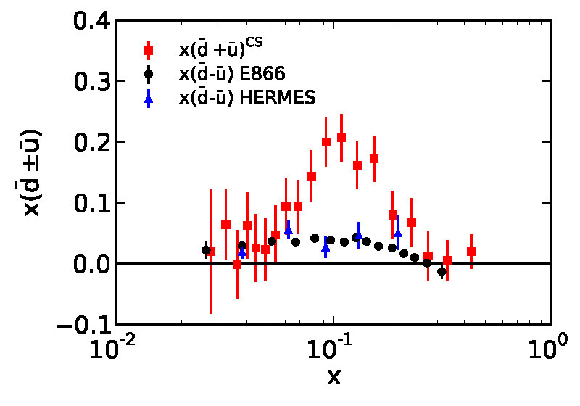

Connected Sea Partons
K.F. Liu, W.C. Chang, H.Y. Cheng, J.C. Peng, PRL 109, 252002 (2012)
CT10
expt
lattice

Slide 20
<x>_{s=} 0.050(16), <x>_{u/d} (DI=0.060(17)
<x>_{s} /<x>_{u/d}(DI) = 0.83(7)
Lattice input to global fitting of PDF
<x>_{s}
<x>_{u/d} (DI)
Lattice calculation with Overlap fermion on 3 lattices including on at m_{π} ~ 140 MeV (Mingyang Sun, )

Slide 21
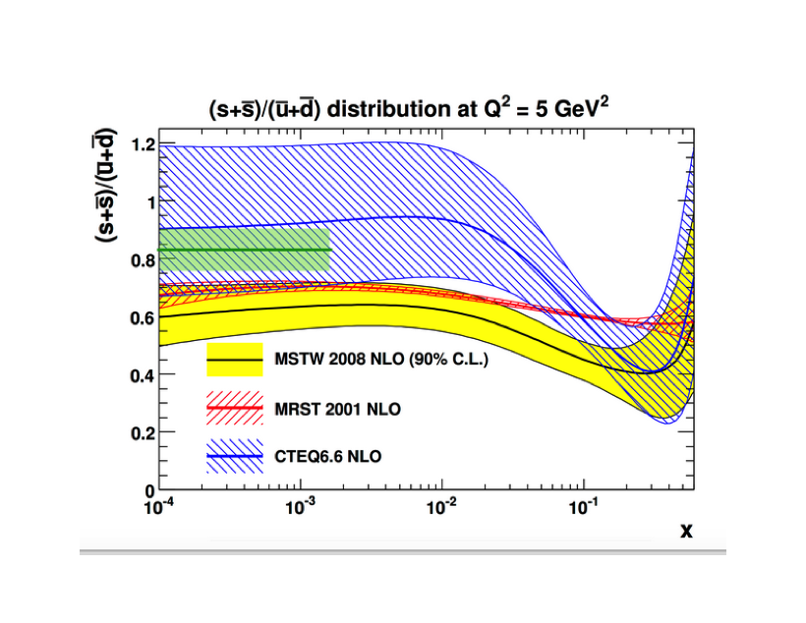
<x>_{s} /<x>_{u/d}(DI) 0.83(7)
Lattice input to global fitting of PDF

Slide 22
Operator Mixing
Connected insertion
Disconnected insertion

Slide 23
Evolution Equations
S. Moch et al., hep/0403192,0404111
Cafarella et al., 0803.0462
NNLO
Valence u can evolve into valence d ?
Note:

Slide 24
Evolution equations separating CS from the DS partons:
11 equations for the general case
K.F. Liu, PRD 96, 033001 (2017) 1703.046690

Slide 25
Conclusions (so far)
The connected sea partons (CSP) found in path-integral formulation are extracted by combining PDF, experimental data and ratio of lattice matrix elements.
It would be better to have separate evolution equations for the CSP and DSP. The separation will remain at different .
This way one can facilitate the comparison with lattice calculation of moments in the CI and DI to the corresponding moments from PDF.
Lattice calculation of hadronic tensor is numerically tougher, but theoretical interpretation is relatively easy. No renormalization is needed and the structure function is frame independent.

Slide 26
Hadronic Tensor on the Lattice
--- Numerical Challenge of Inverse Laplace Transform
Improved Maximum Entropy method
Backus-Gilbert method
Fitting with a prescribed functional form for the spectral distribution.
OPE w/o OPE

Slide 27
Improved Maximum Entropy Method
Inverse problem
Bayes’ theorem
Maximum entropy method: find from
Improved MEM (Burnier and Rothkpf, PRL 111, 182003 (2013))

Slide 28
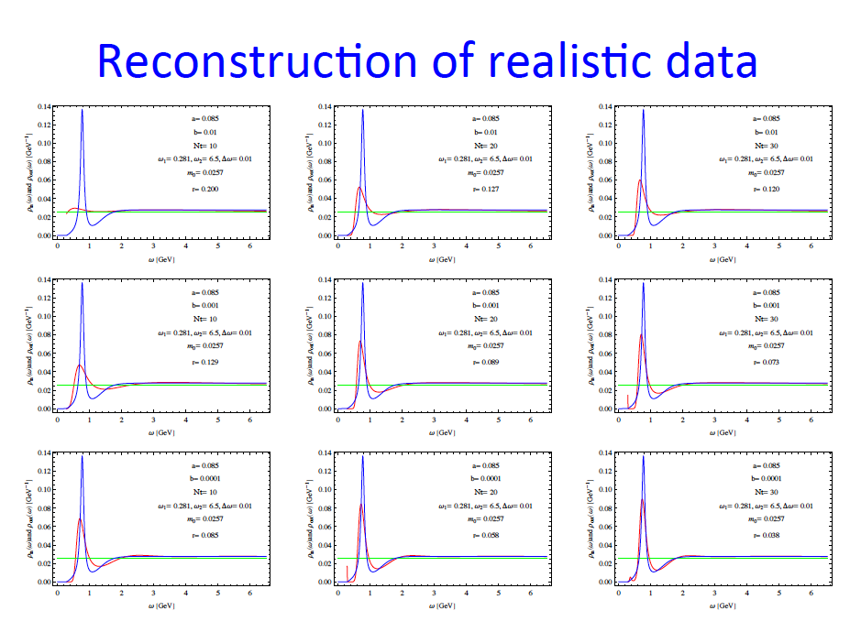
spectral function
spectral function
Frank X. Lee

Slide 29
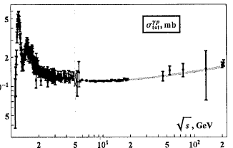
Photo-proton Inclusive X-section

Slide 30
Backus-Gilbert reconstruction test
Toy model with 3 states as marked. The reconstruct results
under the peaks are ~ 19, 45, 63.

Slide 31
More realistic spectral density
The area under the peak gives A₀ ~ 208. The height of the plateau is consistent with input and is more stable than the peaks. 25 time points in the input correlator.

Slide 32
12³ x 128 lattice (CLQCD), a ~ 0.15 fm, m_{π} ~ 600 MeV
500 configurations

Slide 33
In this case, E_{n} starts at m_{N} and there is a larger window between m_{N} and

Slide 34
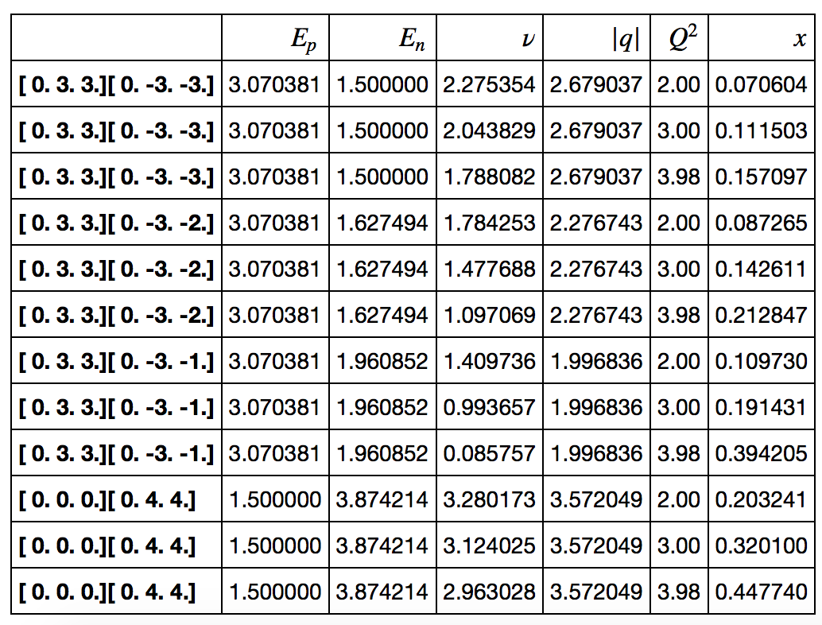
Needs a lattice smaller spacing so that
Will use the Jlab anisotropic lattice with a = 0.12 fm and m_{π}=390 MeV.

Slide 35
OPE w/o OPE
A. J. Chambers et al. (QCDSF), PRL 118, 24001 (2017)
Term coined in U. Aglietti, et al., PLB 432, 411 (1998), but the approach is different.
  In Minkowski space, the Compton amplitude is
  and

Slide 36
Moments of PDF

Slide 37
OPE w/o OPE
After OPE and relating the matrix elements to the moments of the structure function, it is shown (R. Devenish and A. Cooper-Sarkar) that
Note, this is carried out in Minkowski space.

Slide 38
A. J. Chambers et al. (QCDSF), PRL 118, 24001 (2017)
On the Euclidean lattice
This diverges when

Slide 39
It is fine to carry out OPE for T_{μν} with small ω, but it needs to be analytic on the entire complex ν plane (except cuts on real axis) in order to use the dispersion relation to relate to W_{μν}.
Chambers et al., used the lattice T₃₃ where ν=0 and E_{n} >E_{p} for a fixed q so that T₃₃ does not diverge, however, on the complex p plane, T₃₃ diverges when

Slide 40
Summary of Lattice Approaches
It is questionable if the time-integrated current-current correlator on the lattice can be treated as the Compton amplitude.
Mapping the time-dependent correlator on the lattice to its spectral density to obtain the structure function is being tested numerically.

