Slide 1

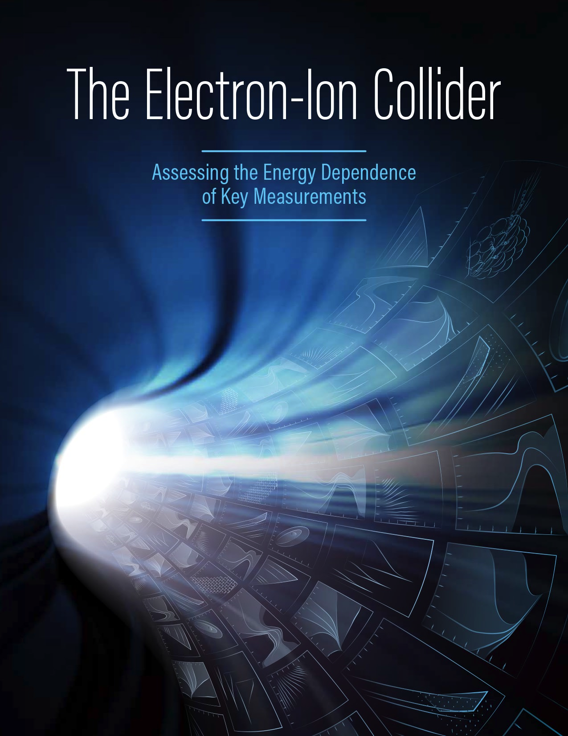
Probes of the Nucleon Sea
at the EIC
E.C. Aschenauer
arXiv: 1212.1701
arXiv: 1708.01527
and publications at https://wiki.bnl.gov/eic/index.php/Presentations#Publications

Slide 2
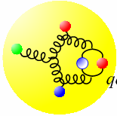
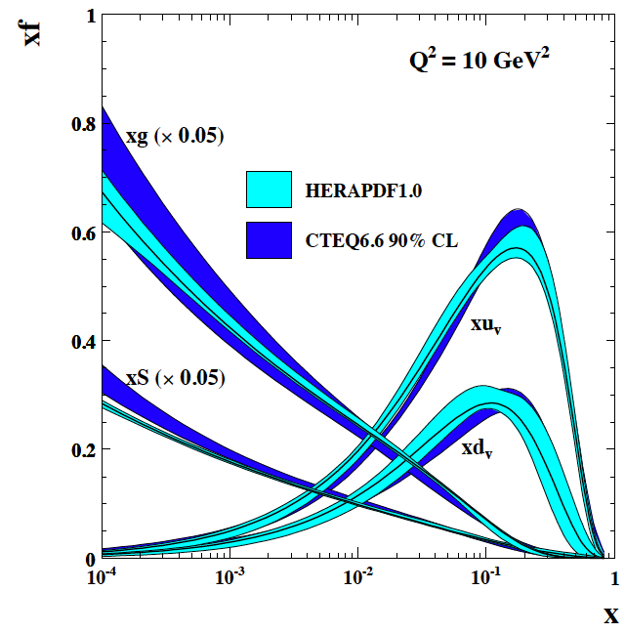
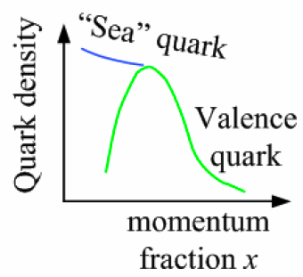
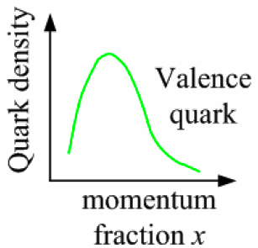
Why Polarization, large kinematic coverage , and Luminosity are critical
non-linear
dynamic Regime
QCD radiation
dominated Regime
Many-body
Regime
Few-body/
valence quark
Regime
x
10⁻⁵
10⁻⁴
10⁻³
10⁻²
10⁻¹
1
?
large kinematic coverage:
access to x and Q² over a wide range → from large to small x
polarized electron and hadron beams:
access to spin structure of nucleons and nuclei
Spin vehicle to access the spatial and momentum structure of the nucleon in 3d
Full specification of initial and final states to probe q-g structure of NN and NNN
interaction in light nuclei
nuclear beams:
accessing the highest gluon densities
high luminosity:
mapping the spatial and momentum structure of nucleons and nuclei in 3d
access to rare probes

Slide 3

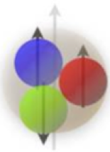
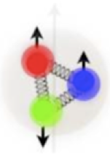
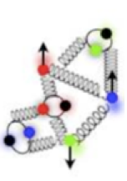
Why is large kinematic coverage critical: Q²
critical to
map the transition from non-perturbative to perturbative regime
Non-perturbative
Regime
Perturbative
Regime
Transition
Region
EIC
RHIC
LHC
HERMES, COMPASS, JLAB 6 and 12
HERA high-x
Q²
10⁻¹
1
10
10²
10³
10⁴
[GeV²]
Color Confinement
Asymptotic freedom
Q² (GeV²)
Probing
momentum
200 MeV (1 fm)
2 GeV (1/10) fm)
Q²: ~ center-of-mass energy measure for the resolution power in the reaction to unravel the full structure of the nucleon
Notes:
one slide before this explaining Q2
x momentum fraction

Slide 4
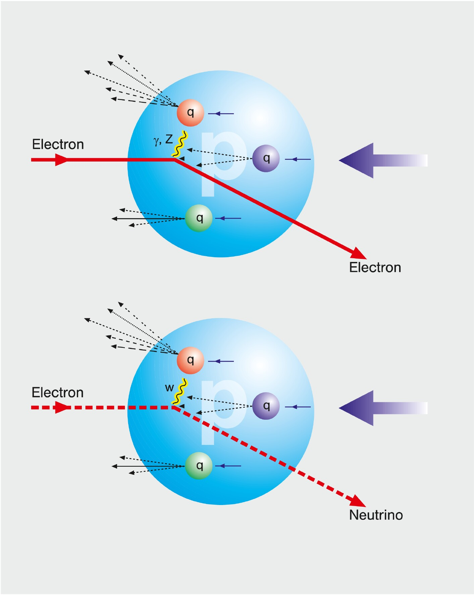
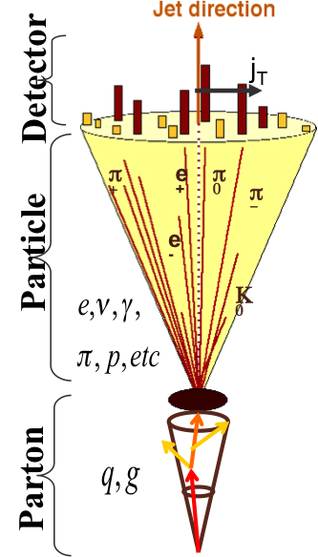
HOW TO ACCESS SEA QUARKS IN DIS
SIDIS:
Detect identified hadrons in coincidence to
scattered lepton
needs fragmentation functions to correlate
hadron type with parton
→ Detector: PID over a wide range of η
Charge Current:
W-exchange: direct access to the quark flavor
no FF – complementary to SIDIS
→ Detector: large rapidity coverage and large √s
Jets:
tag sea-quarks through the sub-processes and
jet substructure
→ Detector: large rapidity coverage and PID

Slide 5
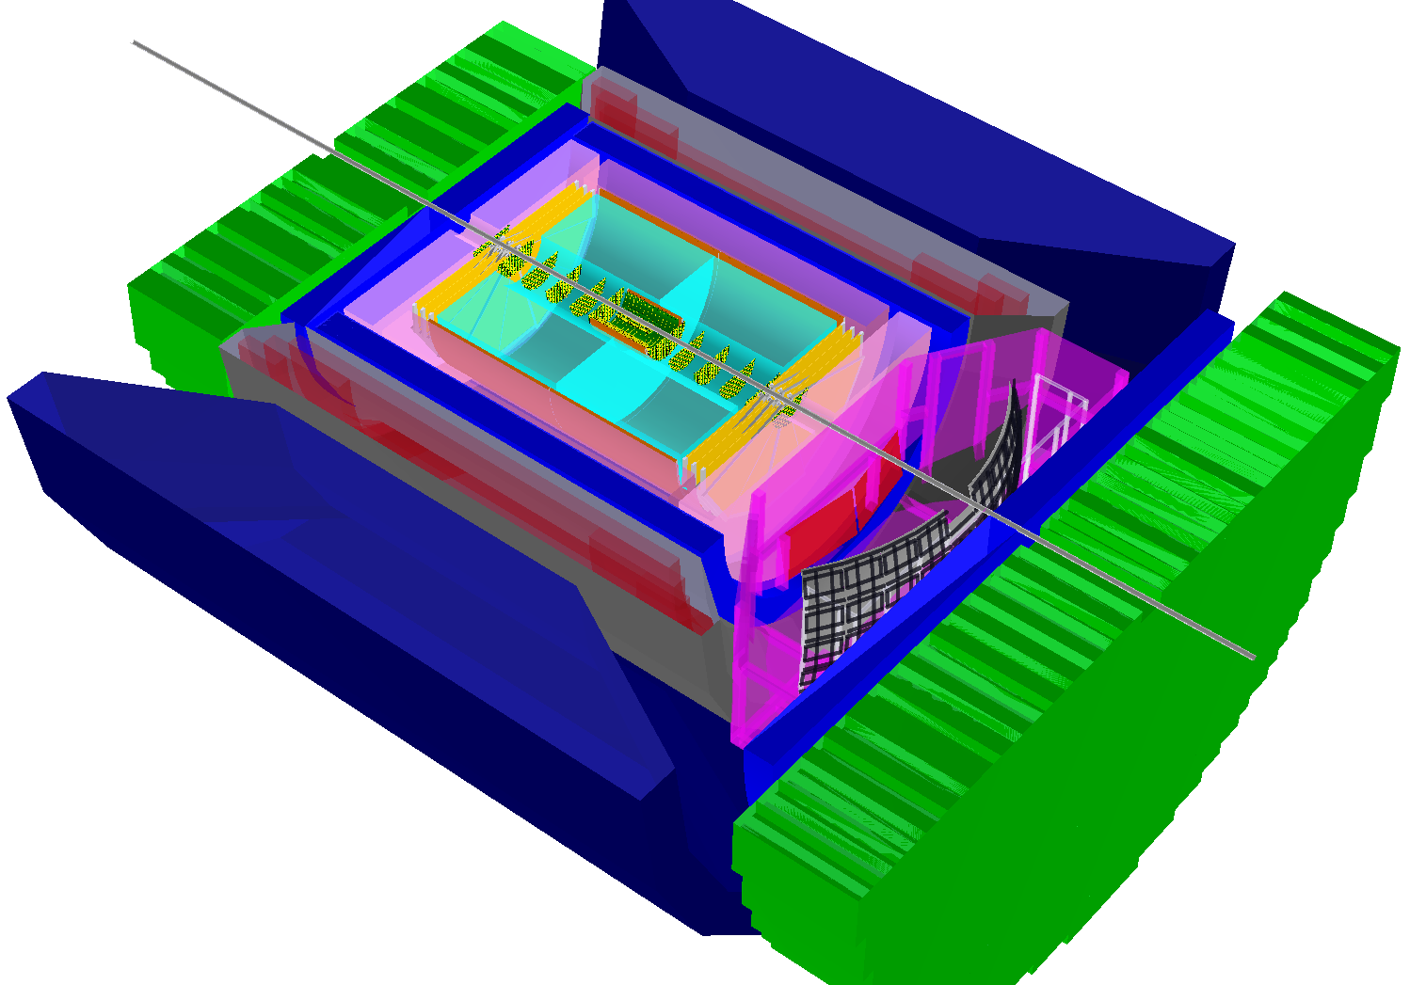
BeAST detector layout
-3.5<η<3.5: Tracking & e/m Calorimetry (hermetic coverage)
hadronic calorimeters
e/m calorimeters
RICH detectors
9.0m
Overall detector requirements:
large acceptance: -4.5 ≲ η ≲ 4.5
high precision low mass tracking
equal coverage of tracking and EM-calorimetry
high performance PID to separate π, K, p on track level
high control on systematic effects
active EIC Detector R&D
  https://wiki.bnl.gov/conferences/index.php/EIC_R%25D
Hadron PID:
-1<η<1: proximity focusing
RICH + TPC: dE/dx
1<|η|<3: Dual-radiator RICH
Lepton-ID:
-3 <η< 3: e/p
1<|η|<3: in addition Hcal response
& γ suppression via tracking
|η|>3: ECal+Hcal response &
γ suppression via tracking
-4<η<4: Tracking (TPC+GEM+MAPS) MAPS: CMOS Monolithic Active Pixel Sensors
hadrons
electrons
silicon trackers
TPC
GEM trackers
3T solenoid coils

Slide 6
Deep Inelastic Scattering

Slide 7
EIC’s kinematic reach in x and Q²
ep:
EIC extends kinematic coverage
for data with polarised beams and
nuclei by 2 decades in x at a fixed Q²
and by 2 decades in Q² at a fixed x
eA:
eRHIC
JLEIC
ep: √s_{max}= 140
ep: √s_{max}= 63
eAu: √s_{max}= 90
eAu: √s_{max}= 40
nuclei from deuterium to Uranium

Slide 8
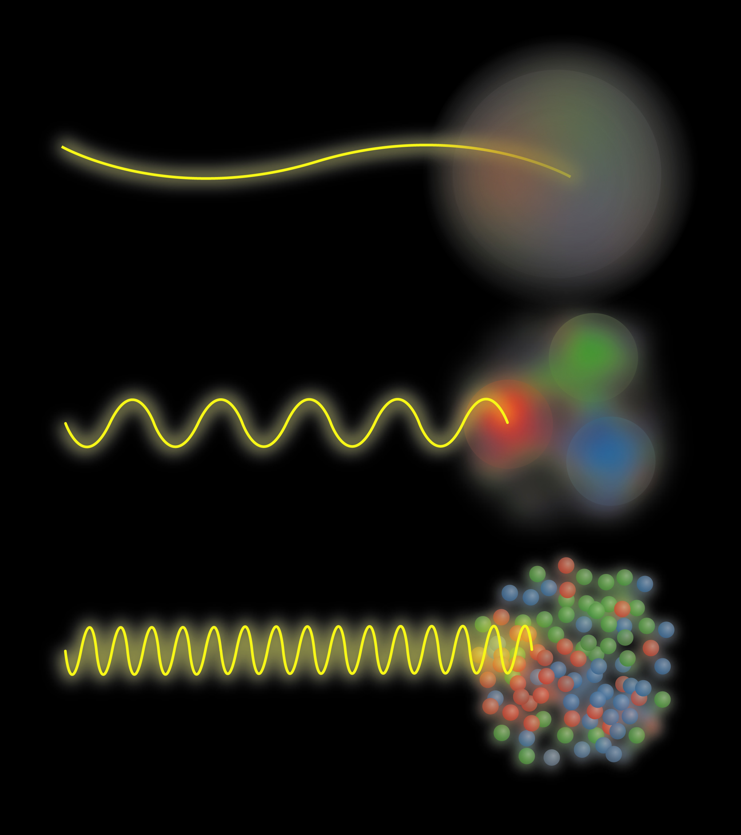
Electron Proton Scattering

Slide 9
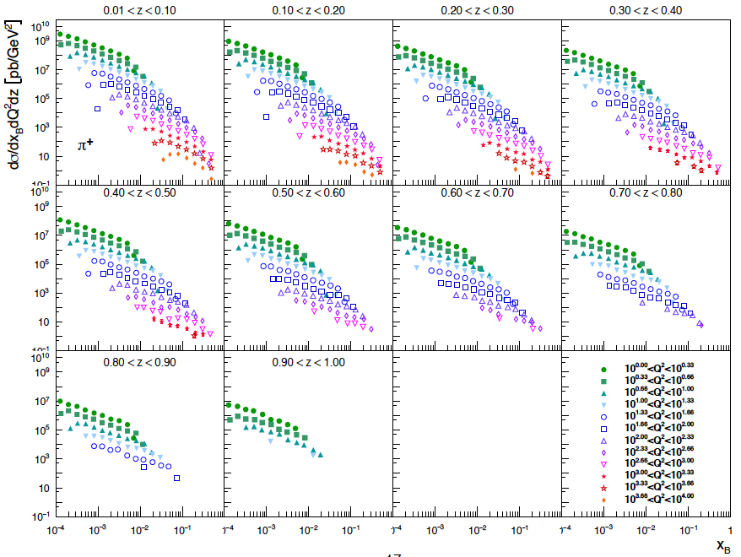
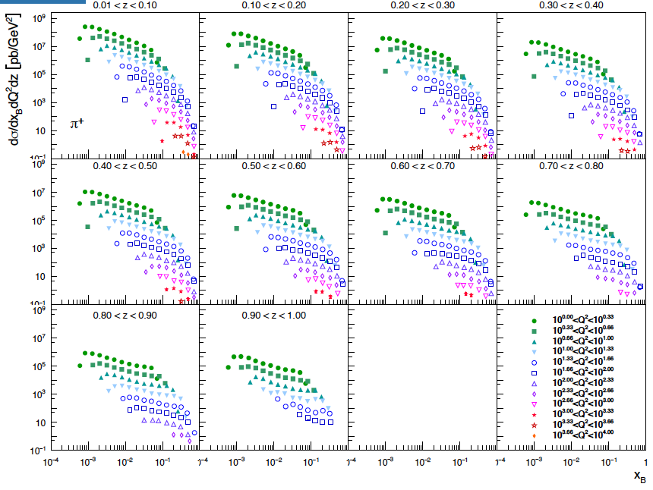
UnpolariZed SIDIS
Same precision and kinematic coverage for π±, K±, p±
should provide great input to simultaneously constrain
PDFs and FFs
5 GeV x 100 GeV
20 GeV x 250 GeV

Slide 10
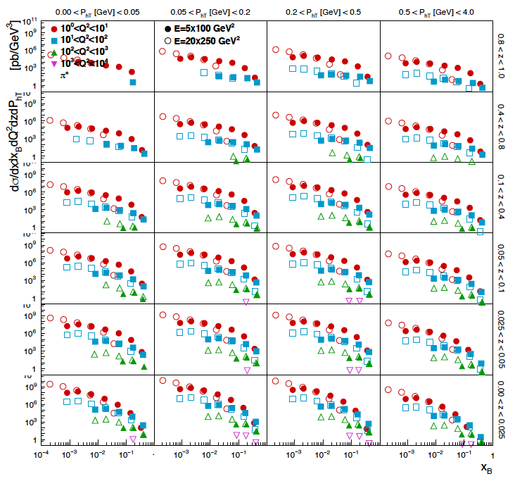
UnpolariZed SIDIS
Both:
5 GeV x 100 GeV
20 GeV x 250 GeV
Same precision and kinematic coverage for π±, K±, p±
should provide great input to simultaneously constrain
TMD PDFs and FFs

Slide 11
What forms the Spin of the Proton
SPIN is one of the fundamental properties of matter
all elementary particles, but the Higgs carry spin
Studying Spin revealed many surprises in physics
proton anomalous magnetic moment → substructure
Spin cannot be explained by a static picture of the proton
It is more than the number ½ ! It is the interplay between
the intrinsic properties and interactions of quarks and gluons
total
quark spin
gluon
spin
angular
momentum
What do we know:
⟼
⟼
data
data
1/2 -
Gluon
-
Quarks
=
orbital angular
momentum
40%
30%

Slide 12
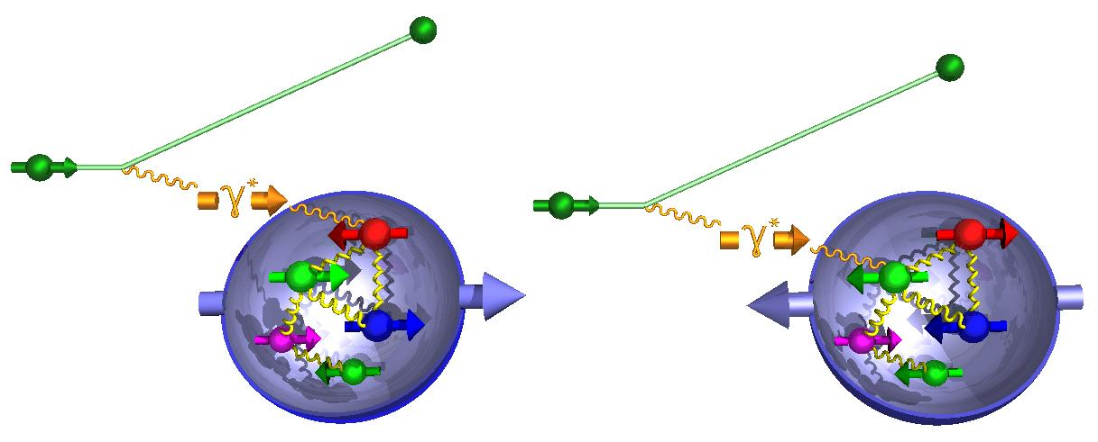
How to decompose the Spin of the Proton
To determine the contribution of quarks and gluons
to the spin of the proton, one needs to measure
the cross section difference g₁ as function of x and Q²
The current knowledge about g₁
as function of x at Q²=10 GeV²
g₁ ~
-
quark contribution:
The integral of g₁ over x from 0 to 1
gluon contribution:
dg1(x,Q²)/dlnQ² → Δg(x,Q²)

Slide 13
What forms the Spin of the Proton
The polarized SF g₁(x,Q²) as
measured by EIC for low to high √s
The polarized SF g₁(x,Q²) as
measured by EIC for low √s
Only with the center-of-mass energies
available at the final stage of an EIC
the different contributions
to the spin of the proton can be disentangled
arXiv:1509.06489
PRD 92, 094030

Slide 14
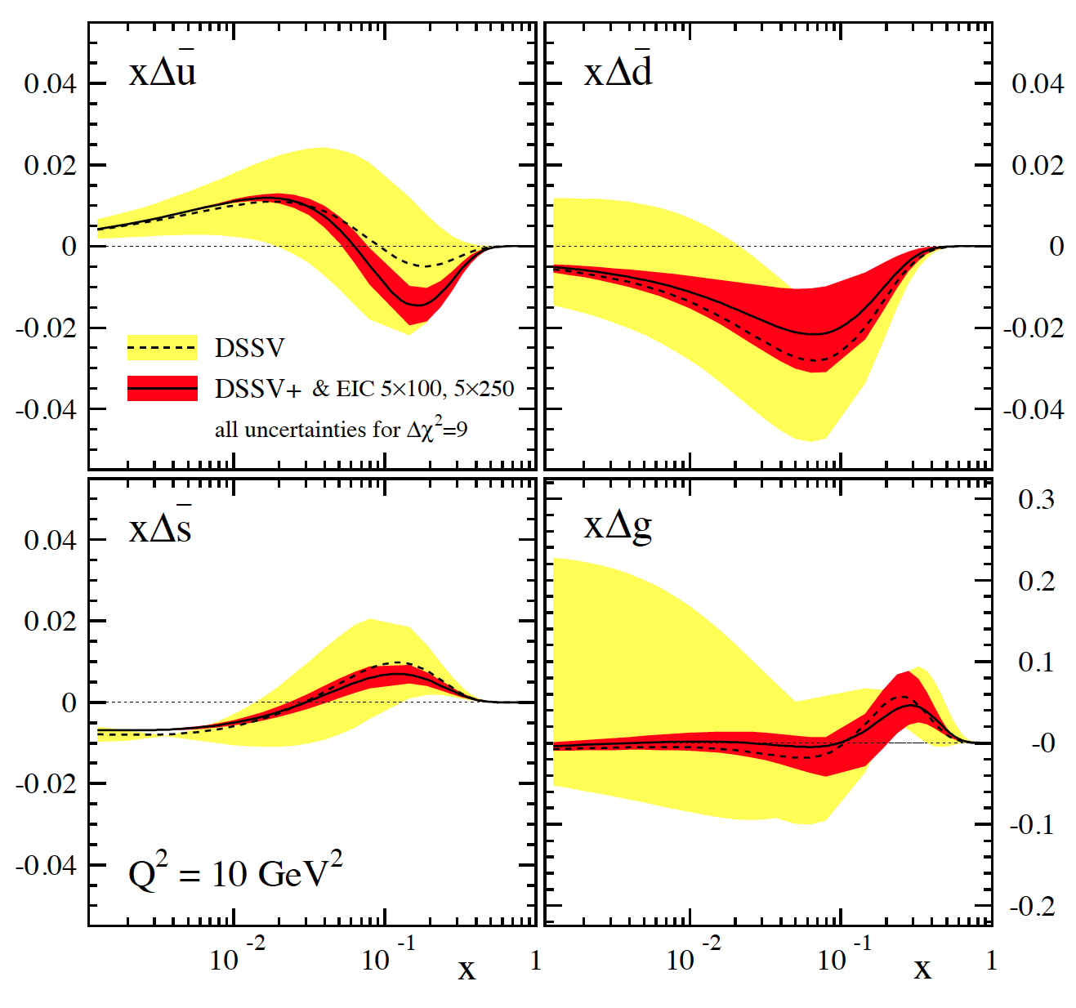
SIDIS at EIC
Can cover the same kinematics as for g₁^{π,K}
→ will constrain Δq
yet, small x behavior completely
unconstrained
→ determines x-integral,
which enters proton spin sum
includes only “stage-1 data”
can be pushed to x=10⁻⁴ with
20 x 250 GeV data
dramatic reduction
of uncertainties:
“issues”:
(SI)DIS @ EIC limited by
systematic uncertainties
need to control rel. lumi,
polarimetry, detector performance,
… very well

Slide 15
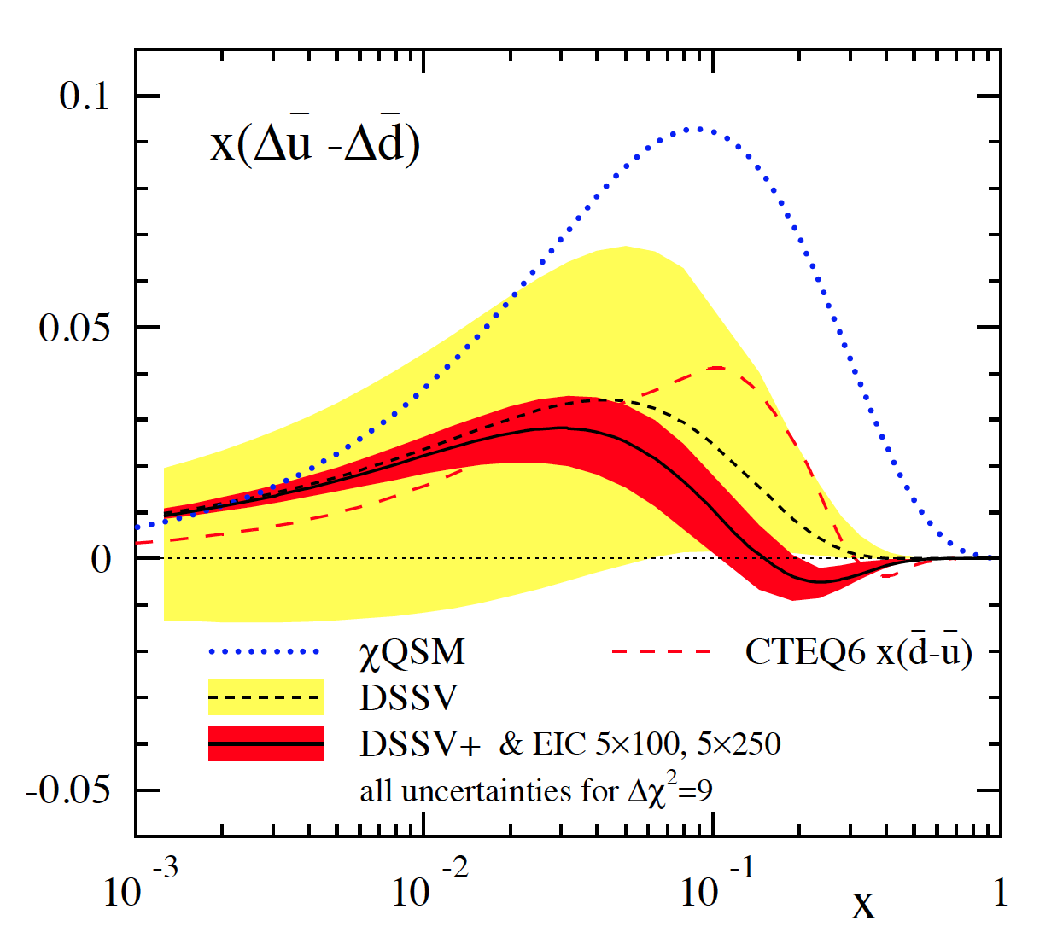
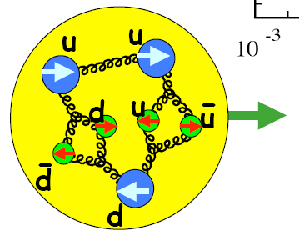
probing a possible asymmetry in the polarized sea
current SIDIS data not sensitive to (known to be sizable for unpol. PDFs)
many models predict sizable asymmetry [large N_{C} , chiral quark soliton, meson cloud, Pauli blocking]
Thomas, Signal, Cao; Holtmann, Speth, Fassler;
Diakonov, Polyakov, Weiss; Schafer, Fries; Kumano;
Wakamatsu; Gluck, Reya; Bourrely, Soffer, …
can be easily studied at an EIC
main effect expected to be at not too small x
→ can test x dependence
can try to look into a possible
with K^{+/-} SIDIS data

Slide 16
Observables: Charge Current in ep and eA
W-exchange: direct access to the quark
flavor
Ws are maximally parity violating
→ Ws couple only to one parton helicity
Complementary to SIDIS:
high Q²-scale: > 100 GeV²
extremely clean theoretically
No Fragmentation function
stringent test on theory approach
for SIDIS
UNIVERSALITY of PDFs
EIC:
first time charge current physics in polarized ep and eA collisions
Physics opportunities:
polarized ep/en:
test models based on helicity retention Δd/d → 1
(Phys.Rev.Lett. 99 (2007) 082001)
test models assuming charge symmetry violation
unpolarized eA:
Test Models for the EMC-effect
  charge symmetry violation
  Isovector EMC effect
(Cloet, Bentz, Thomas et. al., PRL 102 252301 )

Slide 17
Observables: Charge Current in ep and eA
EIC has a large kinematic coverage for charge current events ( )
The larger cross section at higher √s does eliminate the need for luminosities
> 10³⁴ cm⁻²s⁻¹
→ allows for lower risk machine design

Slide 18
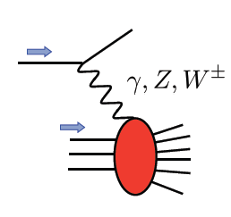
Polarized EW PHYSICS
ν
e
W^{+/-}
Complementary to SIDIS:
very high Q2-scale
extremely clean theoretically
No Fragmentation function
best way to measure at very high x
QCD
fit
More Details: arXiv:1309.5327

Slide 19
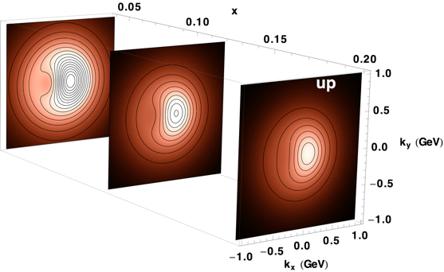
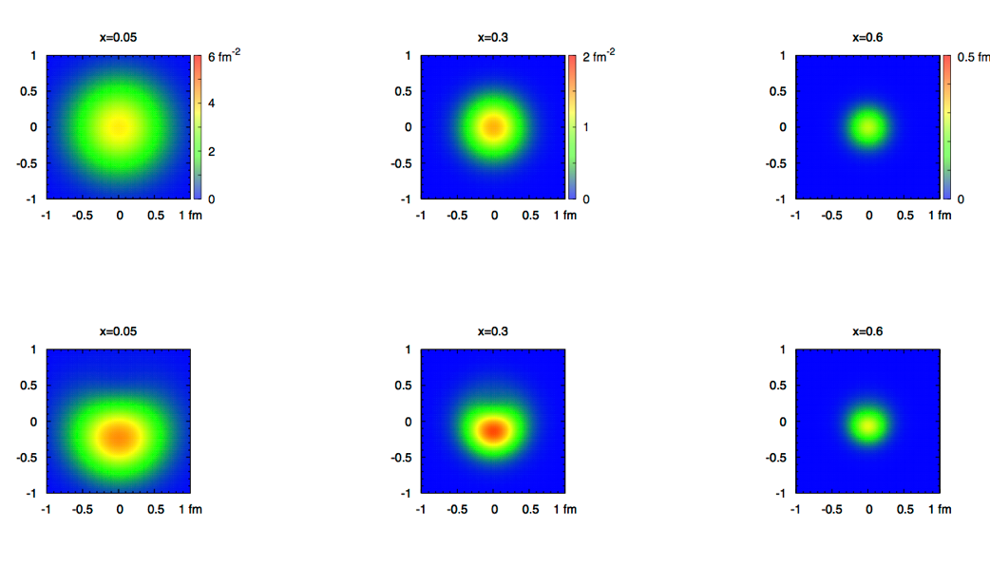
2+1 dimensional Imaging of Quarks & Gluons
Wigner function
W(x,b_{T},k_{T})
QCD genetic map
Momentum
space
Coordinate
space
∫d²b_{T}
∫ d²k_{T}
f(x,k_{T})
f(x,b_{T})
Quarks
Quarks
down quark
x
Spin-dependent 3D momentum space
images from semi-inclusive scattering
Spin-dependent 2+1D coordinate space images from exclusive scattering

Slide 20
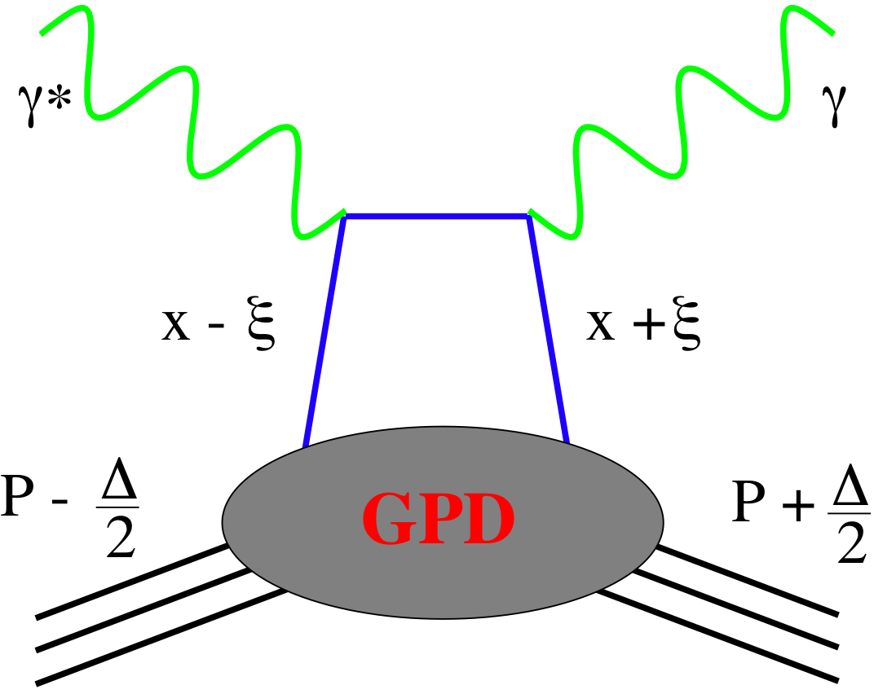
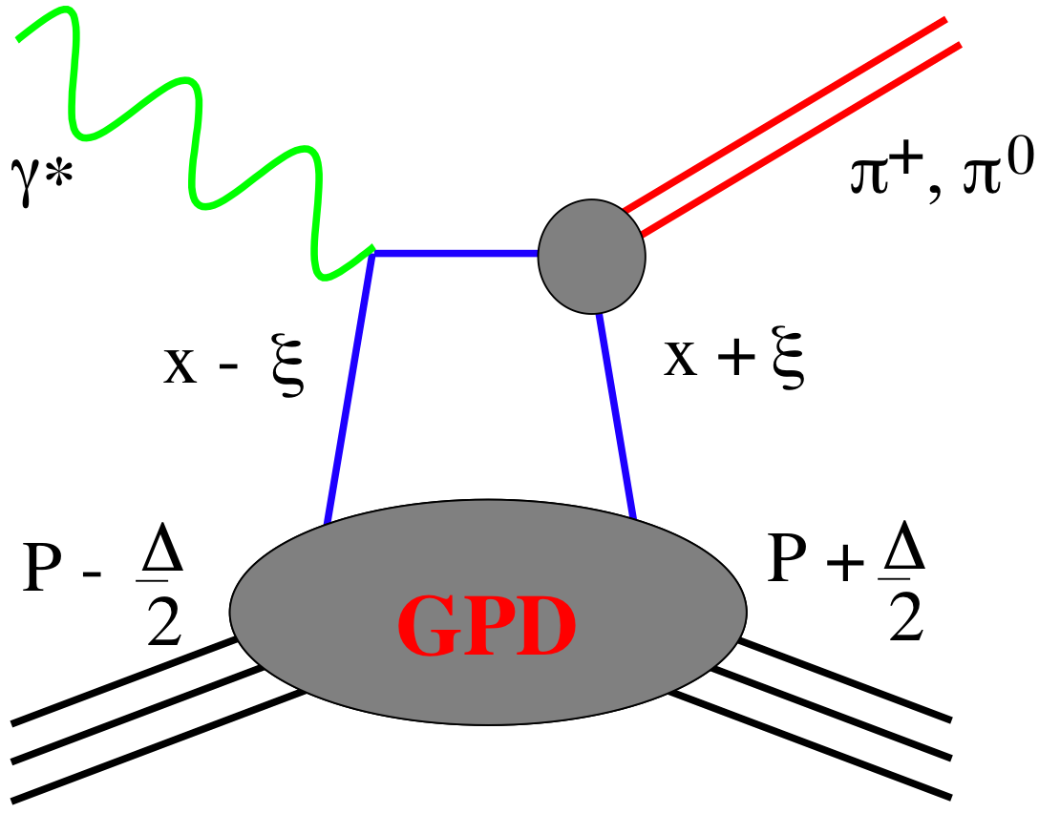
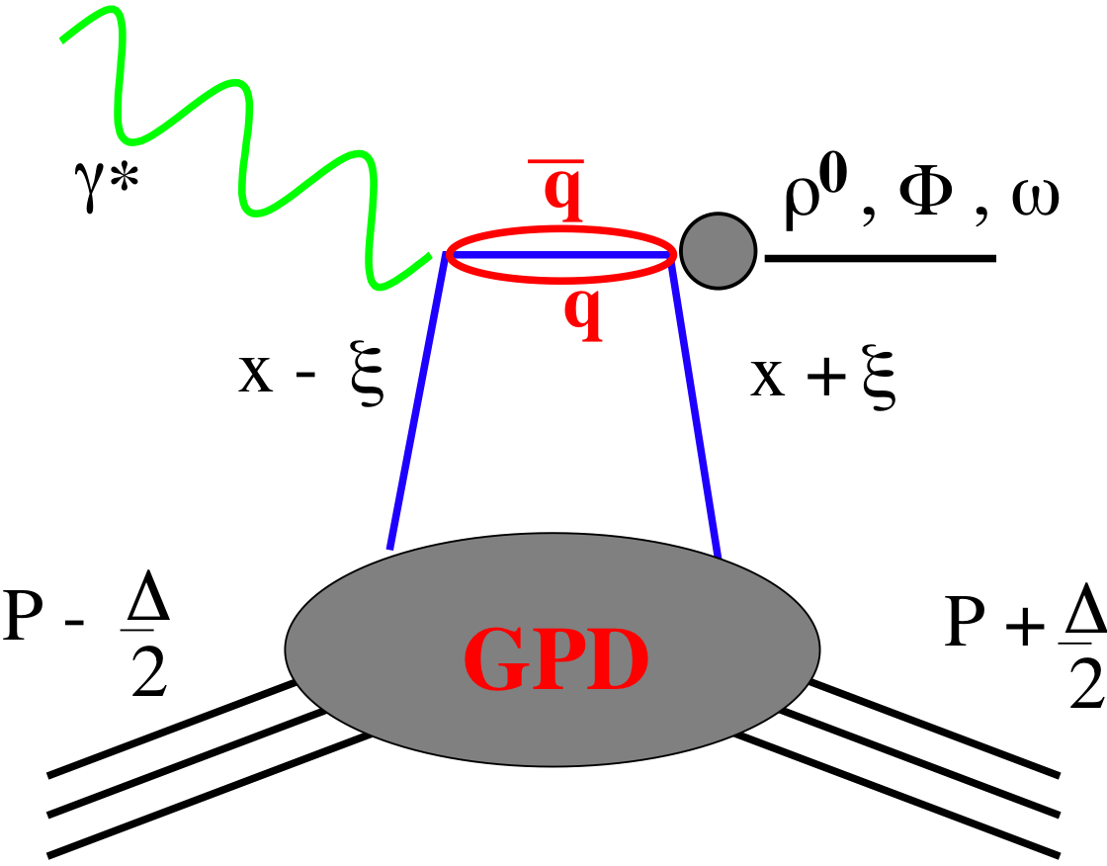
SMALL GPD Primer
How are GPDs characterized?
unpolarized polarized
conserve nucleon helicity
flip nucleon helicity
not accessible in DIS
quantum numbers of final state select different GPD
DVCS
pseudo-scaler mesons
vector mesons
π⁰ | 2Δu+Δd
η | 2Δu−Δd
ρ⁰ | 2u+d, 9g/4
ω | 2u−d, 3g/4
φ | s, g
ρ⁺ | u−d
J/ψ | g
Q²= 2E_{e}E_{e}’(1-cosθ_{e’})
x_{B} = Q²/2Mν ν=E_{e}-E_{e’}
x+ξ, x-ξ long. mom. fract.
t = (p-p’)²
ξ ≅ x_{B}/(2-x_{B})

Slide 21

Deeply Virtual Compton Scattering at EIC
e’
γ
e
Golden Channel: Deeply Virtual Compton scattering
Observable: cross section as function of x, Q² and t
A_{UT}, A_{LU}, A_{UL}, A_{C} as fct. of x, Q² and t
γ_{L}*
(Q²)
x+ξ
x-ξ
~
~
→ spatial distribution of quarks through Fourier transform of
dσ/dt(x,Q²)
Gluon Distribution: through scaling violation of
dσ/dt(x,Q²) needs large lever in Q² at fixed x
H, H, E, E (x,ξ,t)
p’
p
t
D. Mueller, K. KumerickiS. Fazio, and ECA arXiv:1304.0077
pion cloud
effects seen
at high b_{T}
Fourier
Transform

Slide 22
GPD H^{g}: J/ψ
To improve imaging on gluons
add J/ψ observables
cross section
A_{UT}
…..
Fourier
Transform
This statistics can be achieved for other VMs
→ flavor separation

Slide 23
Observables: Jets
Jets have in the last years turned out as the golden tool to study quarks and gluons both in (un)polarized ep, pp, pA and AA
At an EIC inclusive jets and di-jets can be used for the first time
in eA and polarized ep collisions
Jet Physics in eA:
EIC opens unique possibilities to study jet/hadron production in cold dense QCD matter
  Jet/Hadron production and attenuation in semi‐inclusive DIS will shed light on the process of hadronization and the nature of color neutralization and confinement
Event shape observables can be used for precise extraction of the strong coupling constant
Jet and hadron production at the EIC will pinpoint the transport properties of nuclei
Jet substructure observables will provide a detailed picture of in-medium parton shower (longitudinal and transverse structure) evolution in the background of strong color fields
Jet Physics in ep:
Diffractive Di-jets possibly the first opportunity to access Wigner functions in QCD more directly
precise measurement of high x unpolarized gluon distributions functions
  impact on high Mass BSM searches at the LHC
alternative measurement of polarized gluon distribution function
precision measurement of polarized and unpolarized hadronic photon structure

Slide 24
Observables: Jets
EIC can access jet observables for a wide range of di-jet masses and inclusive jet-pt
large

Slide 25
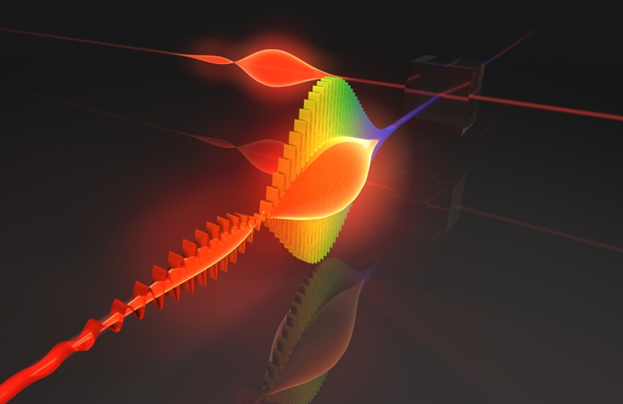
Example for Jet Physics at an EIC:
Unpolarized and polarized photon structure
Details: arXiv:1705.08831

Slide 26
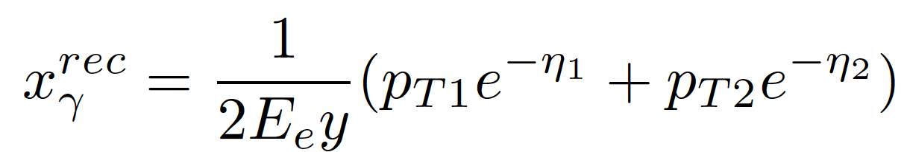
Photon Parton Structure
In high energy ep collision, two types of processes lead to the production of di-jets:
direct: point-like photon
resolved: hadronic photon
Di-jets@EIC ideal probe to constrain (un)polarised Photon-PDFs
  Direct/resolved contributions can be separated reconstructing xγ

Slide 27
Photon Parton Structure
unpolarized cross section:
polarized cross section:
Input: proton-CTEQ-5 & γ: SAS
Input: proton-DSSV &
γ: PLB 337 373 (1994)

Slide 28
Photon Parton Structure
Jets from photon and proton side
are well separated in η for quarks
processes
Jets from photon and proton side
are well separated in η for quarks
processes

Slide 29
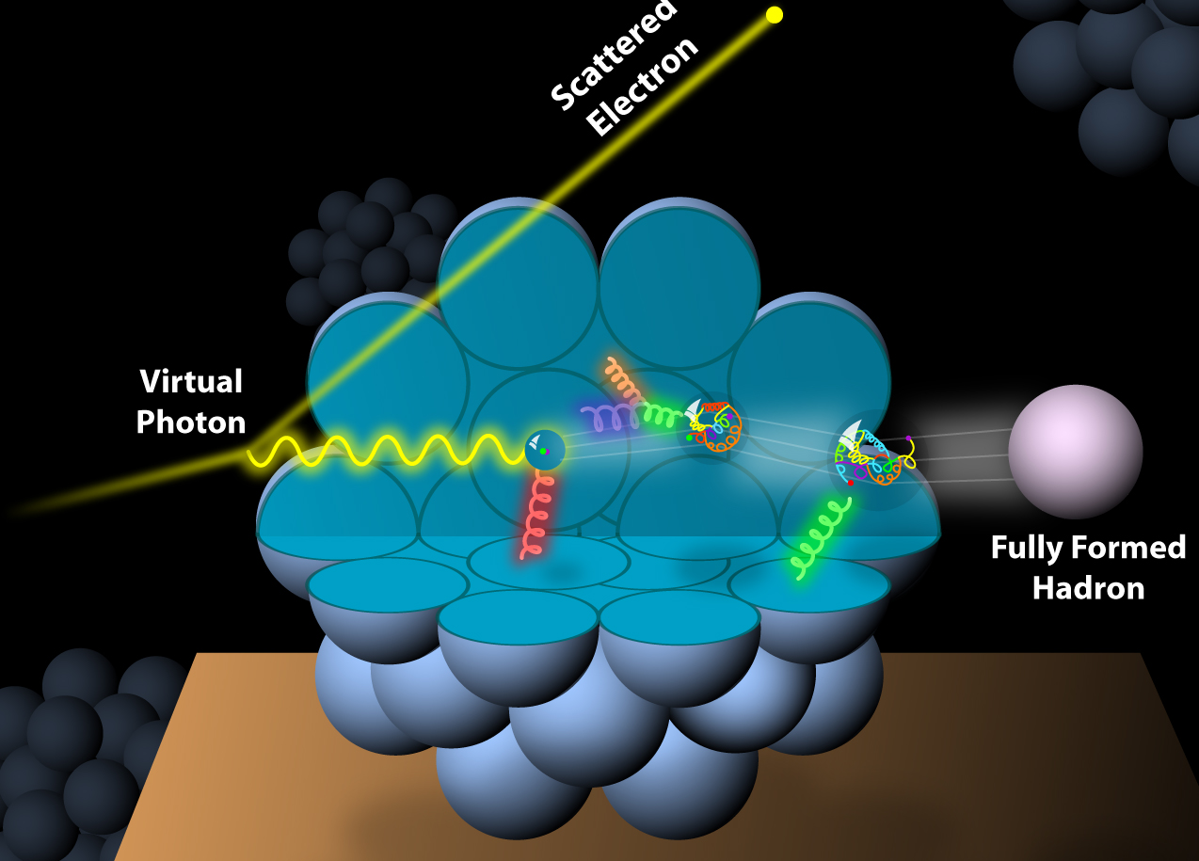
What about Nuclei?
Incoming
Electron Beam

Slide 30
npdfs before and after EIC
Ratio g(x,Q²)_{pb} /g(x,Q²)_{p}
DGLAP:
predicts Q² but not A-dependence and x-dependence
Saturation models:
predict A-dependence and x-dependence but not Q²
→ Need: large Q² lever-arm for fixed x, A-scan
LHC
RHIC
Measure different structure function in eA → constrain nPDF:
quark+anti-quark
momentum distributions
gluon momentum distribution
or tag on charm → F₂^{C}

Slide 31
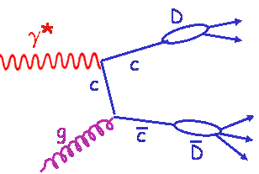
Inclusive Cross-Sections in eA
For Details: arXiv:1708.05654
Direct Access to gluons at
medium to high x by tagging
photon-gluon fusion through
charm events
Gluon distribution ~ dσ(x,Q²)/dlnQ²

Slide 32
EIC: Impact on the Knowledge of 1D Nuclear PDFs
√s < 45 GeV
√s < 90 GeV
Ratio of PDF of Pb over Proton
Without EIC, large
uncertainties
→ With EIC significantly
reduced uncertainties
Complementary to RHIC
and LHC pA data.
Provides information on
initial state for heavy ion
collisions.
Does the nucleus behave
like a proton at low-x?
→ relevant to very
high-energy cosmic
ray studies
→ critical input to AA
submitted to PRD
arXiv:1708.05654

Slide 33

Studying Final State Effects
h
e’
γ*
q
e
What happens if we add a nuclear medium
Observables:
Broadening:
Attenuation:
Δp_{t}² linked directly with saturation scale
ratio of hadron production in A to d
modifications of nPDF cancel out
Notes:
Example here is DIS in vacuum
Propagating quark is colored, thus emits gluons. “Free.” “Lifetime of deconfined quark.” Universal for light quarks?
Dipole is a color singlet object, thus no gluon emission. “Prehadron.” Formation time depends on hadron formed.
Heuristic arguments and models: Formation time is longer, ~ 1 order of magnitude for pions.
One of the goals of the studies I will be describing is to directly measure these two time parameters. Another is to understand the detailed mechanisms of how the hadron gets formed. The method of determining these quantities consists of studying this process embedded in a nuclear medium of well-known properties such as size and density.
Make point here - whole process is hadronization? or make that point later?

Slide 34
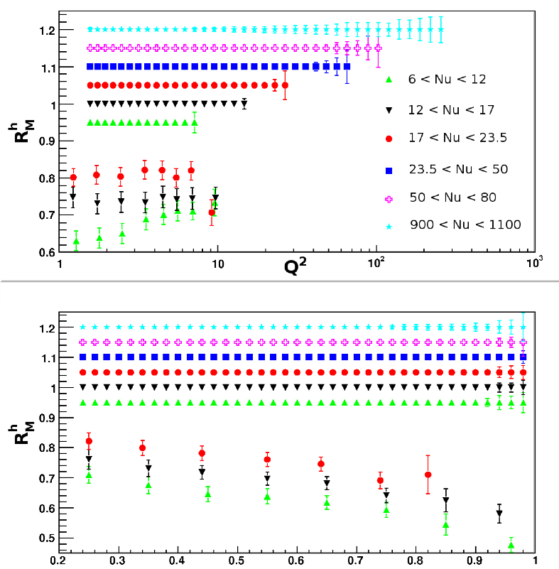
What do we know and what can EIC do
light hadrons
Hermes:
E_{e} = 27 GeV → √s = 7.2 GeV
E_{h} = 2-15 GeV
Unprecedented precision to distinguish between different models
large ν range
hadronization in- and outside
of nucleus
first time for charm
Simulations. A. Accardi & R. Dupre
z
EIC:

Slide 35
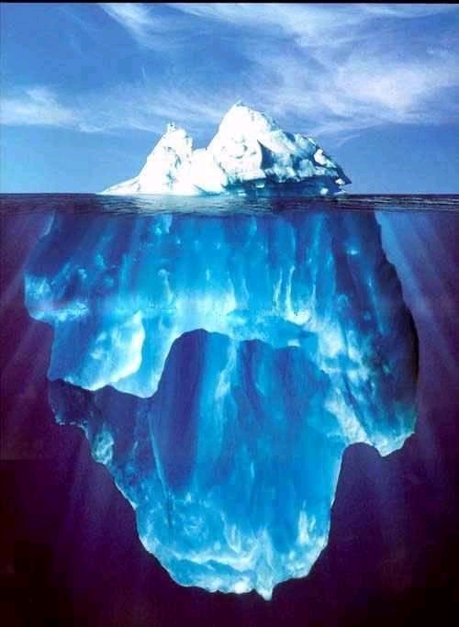

Take Away Message
Current
knowledge about
nucleon structure
sea-quarks and the glue
EIC is the ideal
machine to study
the nucleon sea
with several
complementary
probes
with EIC

Slide 36


Slide 37
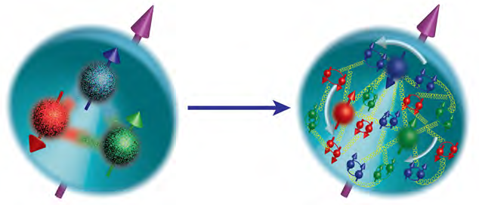
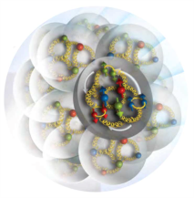
Hot Question in Cold QCD
How are the sea quarks and gluons, and their spins, distributed in space and momentum inside the nucleon?
How do the nucleon properties emerge from them and their interactions?
How do color-charged quarks and gluons, and colorless jets, interact with a nuclear medium?
How do the confined hadronic states emerge from these quarks and gluons?
How do the quark-gluon interactions create nuclear binding?
How does a dense nuclear environment affect the quarks and gluons, their correlations, and their interactions?
What happens to the gluon density in nuclei? Does it saturate at high energy, giving rise to a gluonic matter with universal properties in all nuclei, even the proton?
gluon
emission
gluon recombination
?
=
Notes:
Moved this slide before DIS facility animation to tie it more to the physics intro

Slide 38
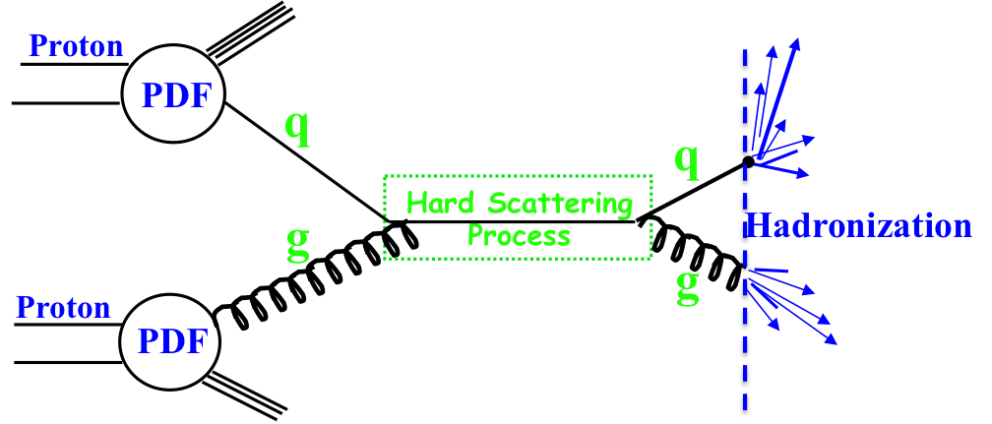
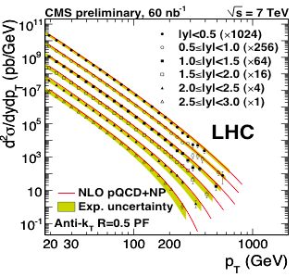
EIC’s Physics Impact, Complementarity and Uniqueness
Complementarity
QCD has two concepts which lay its foundation
factorization and universality
To tests these concepts and separate interaction dependent phenomena from
intrinsic nuclear properties
different complementary probes are critical
Probes: high precision data from ep, pp, e+e-
Factorization
Universality
Example: Measure PDFs at HERA at √s=0.3 TeV:
Predict pp and measurements at √s=0.2, 1.96 & 7 TeV
(un)polarized cross section ~
PDF ⊗ hard-scattering ⊗ Hadronization
hard-scattering : calculable in QCD
PDFs and Hadronization: need to be determined experimentaly
Notes:
start from intrinsic part can separate inteaction by universality
real time phenomena

Slide 39
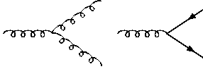
How to access Gluons in DIS
Gluons manifest themselves through
the behavior of the cross section as function of x and Q²
quark+anti-quark
momentum distributions
gluon momentum
distribution
without gluons the cross section depends only on x, no dependence on Q² → F₂(x)
Bjorken scaling
BUT:
Observe strong rise of cross section
with both x and Q²
Because of gluon initiated processes
Cross Section
Scaling violation
Gluon Distribution:
dσ(x,Q²)/dlnQ²
Resolution (Q² / GeV²)

Slide 40
Deep Inelastic Scattering
DIS:
As a probe, electron beams
provide unmatched precision of
the electromagnetic interaction
Direct, model independent
determination of parton
kinematics of physics
processes
s: center-of-mass energy squared
Q²: resolution power
x: the fraction of the nucleon’s momentum
carried by the struck quark (0<x<1)
y: inelasticity

Slide 41
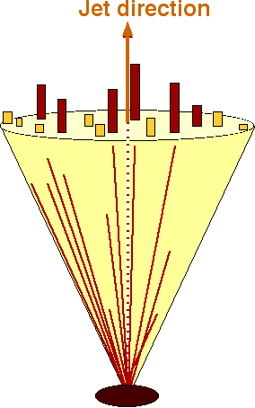
How to access Gluons in DIS
Several different complementary channels to access gluons
Indirect: the scaling violation of the cross section as function of x and Q²
dF2(x,Q²)/dlnQ² → G(x,Q²)
Direct: the measurement of F_{L}
Direct: tagging the photon gluon fusion process
  Di-jets
  charm production, i.e. F₂^{CC}
quark+anti-quark
momentum distributions
gluon momentum
distribution
All these process need a wide coverage in x and Q²

Slide 42
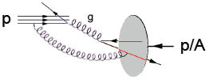
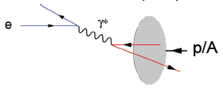
EIC’s Physics Impact, Complementarity and Uniqueness
Hadron-Hadron:
Electron-Hadron:
probe has structure as complex as the “target”
no clean access to parton kinematics
p_{t} → x; p_{t}² → Q² → x-Q² strongly correlated
UPC: M²→ Q² can only be varied by VM
limited access to spatial structure of nucleons and nuclei
Point-like probe → resolution
High precision & access to partonic kinematics through scattered lepton → x, Q²
Interaction governed by colorless Photon
→ preserve the properties of partons in the
nuclear wave function
    initial and final state effects can be cleanly disentangled
Notes:
details in backup
picture much more schematic / carton

Slide 43
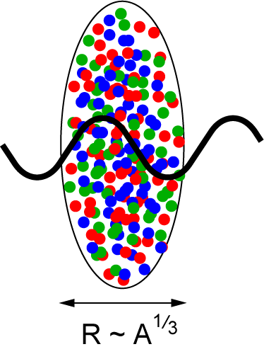
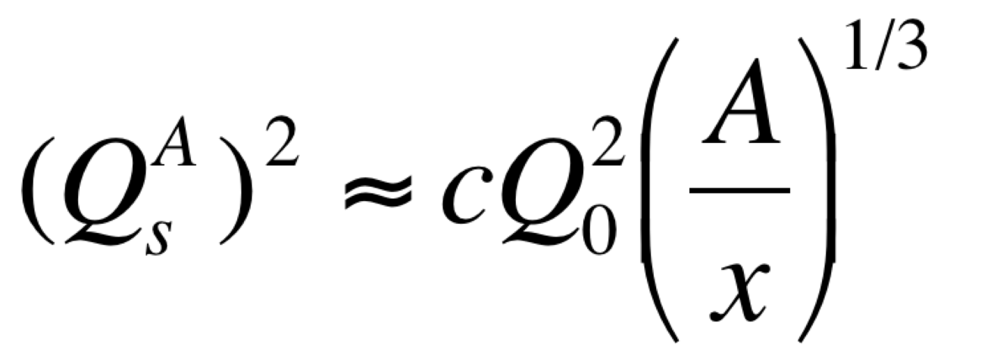
Studying non-linear effects
Scattering of electrons off nuclei:
Probes interact over distances L ~ (2m_{N} x)⁻¹
For L > 2 R_{A} ~ A^{1/3} probe cannot distinguish between nucleons in front or back of nucleon
Probe interacts coherently with all nucleons
Nuclear “Oomph” Factor
Pocket Formula:
Enhancement of Q_{S} with A ⇒ non-linear QCD regime reached at significantly lower energy in A than in proton

Slide 44
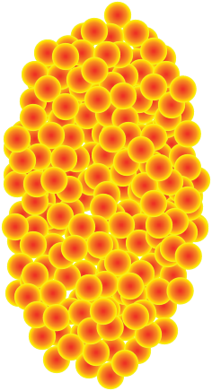
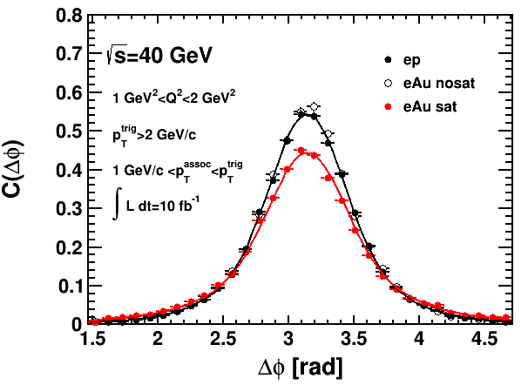
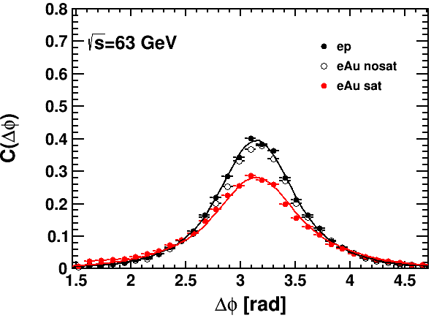
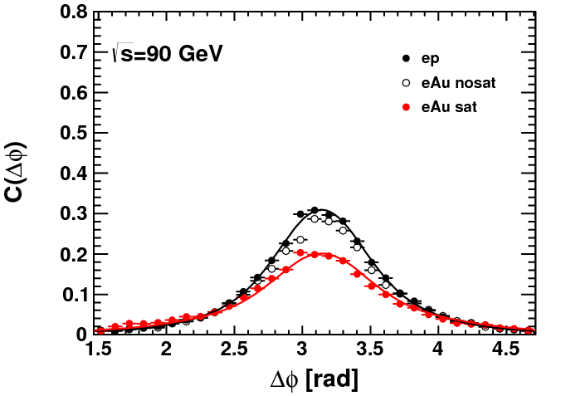
Key Observables for Saturation
Di-Hadron Correlations:
side-view:
jet-1
beam-view:
p
A
π
High gluon density (eA):
2 → many process
⇒ expect broadening of away-side
jet-2
Low gluon density (ep):
pQCD predicts 2→2 process
⇒ back-to-back di-jet
Only EIC allows to study the evolution of Q_{s} with x
x
Ratio

Slide 45
How to access Gluons in DIS
Several different complementary channels to access gluons
 |  | Photon Gluon Fusion
Scaling Violation | F_{L} | Di-jets
all x-Q² x_{g} = x_{Bj} | only accessible if y is large x_{g} = x_{Bj} | wide coverage in x_{Bj}-Q² x_{g} =x_{Bj}(1+M²/Q²⁾ > x_{Bj}
only limited by detector acceptance | need several beam energies | need a wide acceptance detector
 |  | Photon Gluon Fusion
Scaling Violation | F_{L} | Di-jets | Charm
all x-Q² x_{g} = x_{Bj} | only accessible if y is large x_{g} = x_{Bj} | wide coverage in x_{Bj}-Q² x_{g} =x_{Bj}(1+M²/Q²) > x_{Bj} | same coverage in x_{Bj}-Q² as incl. F₂ x_{g} ≳x_{Bj}
only limited by detector acceptance | need several beam energies | need a wide acceptance detector | needs excellent μ-vertex detector and particle ID
Scaling Violation
all x-Q² x_{g} = x_{Bj}
only limited by detector acceptance
Scaling Violation | F_{L}
all x-Q² x_{g} = x_{Bj} | only accessible if y is large x_{g} = x_{Bj}
only limited by detector acceptance | need several beam energies

Slide 46
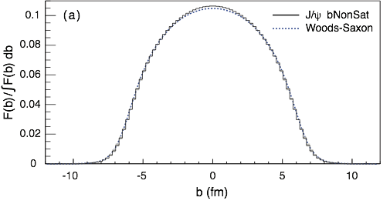
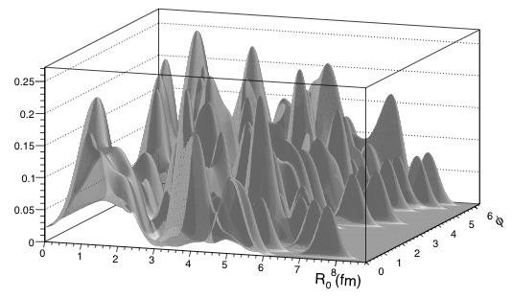
EIC: Spatial Gluon Distribution from dσ/dt
1950-60: Measurement of charge (proton) distribution in nuclei
Ongoing: Measurement of neutron distribution in nuclei
EIC ⇒ Gluon distribution in nuclei
Diffractive vector meson production:
e + Au → e′ + Au′ + J/ψ
Method:
Fourier Transform
Diffractive vector meson production:
e + Au → e′ + Au′ + J/ψ
Momentum transfer t = |pAu-pAu′|² conjugate to bT
only process in eA to directly measure t
PRC 87 (2013) 024913
possible Source distribution with b_{T}^{g} = 2 GeV⁻²
  Hot topic:
      Lumpiness of source?
      Just Wood-Saxon+nucleon g(b_{T})
      coherent part probes “shape of black disc”
      incoherent part (large t) sensitive to
      “lumpiness” of the source (proton in nucleus)
Notes:
spatial gluon distribution only done in eA / ep focus on lumpiness and source

