Slide 1
The RHIC Cold QCD Program:
Physics with transversely polarized Protons
Relevant papers / documents:
PHENIX & STAR: arXiv:1602.03922
PHENIX:
A_{N} Charm: arXiv:1703.09333
p_{t}: arXiv:1609.04769
A_{N}: arXiv:1406.3541 & arXiv:1312.1995
STAR:
TMDs@500 GeV: arXiv:1708.07080
IFF@200 GeV: arXiv:1504.00415 500 GeV coming soon
A_{N} W+/-: arXiv:1511.06003
A_{N}: arXiv:1309.1800 and arXiv:1205.6826
E.C. Aschenauer

Slide 2
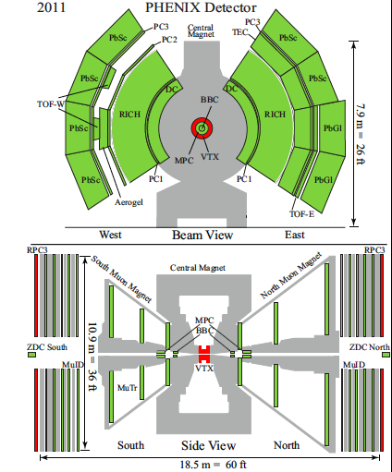
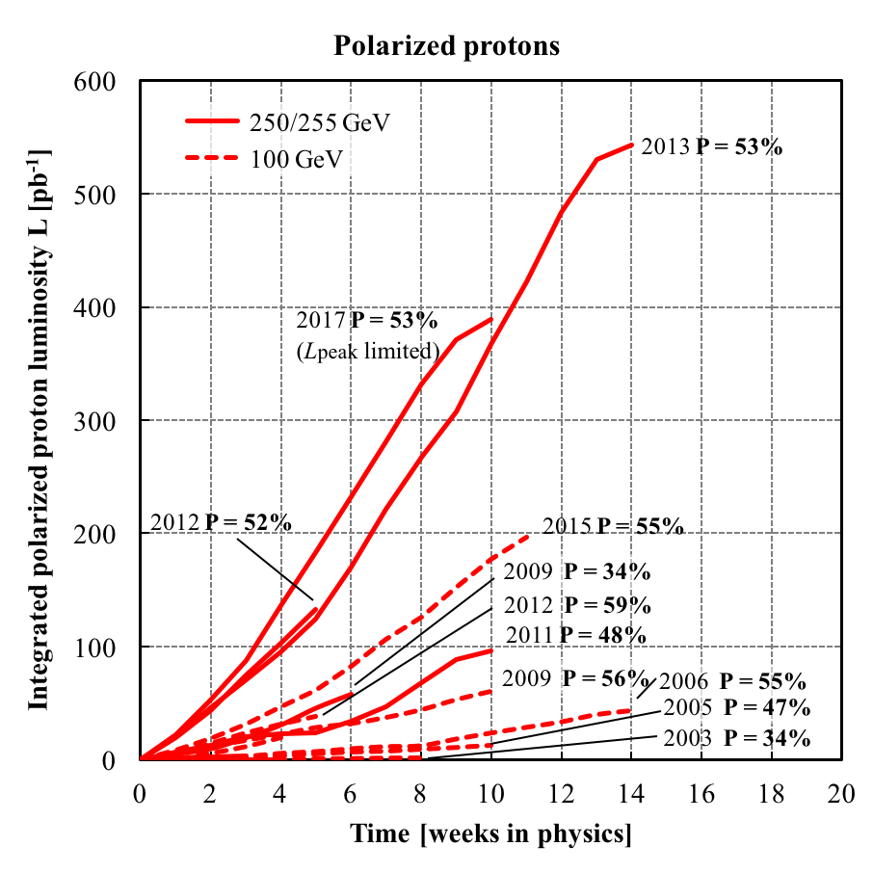
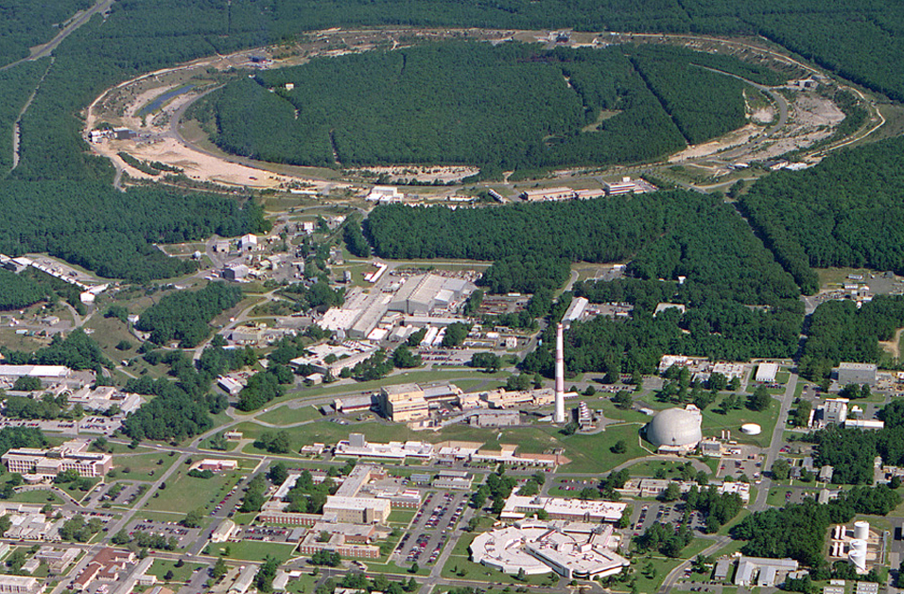
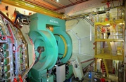
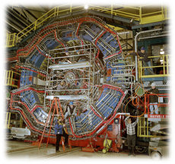
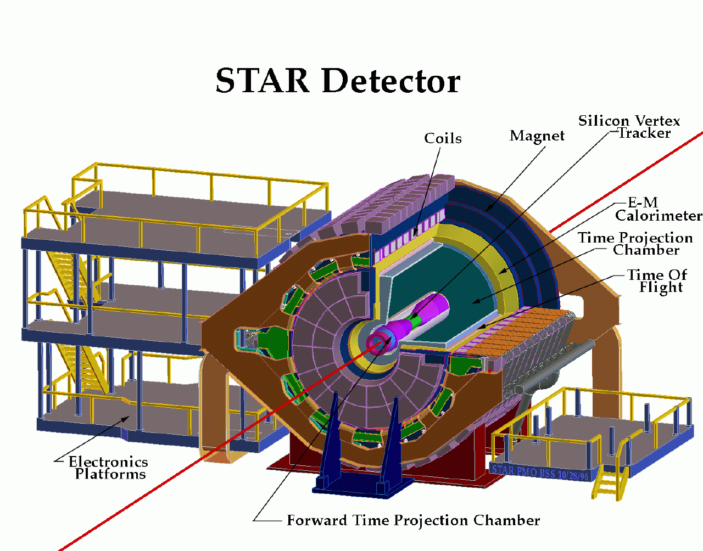

RHIC@BNL Today
eLens
Jet/C-Polarimeters
CeC
RHIC
PHENIX
small mid-rapitity
-0.35 < η < 0.35
forward μ-arms
RF
Beams: √s=<500 GeV pp; 50-60% polarization
Lumi: ~60 pb⁻¹/week
STAR
large rapidity
-1 < η < 4
multipurpose
LINAC
EBIS
Booster
NSRL
STAR
AGS
What do we collide ?
p
Polarized protons
24-255 GeV
Tandems
Light ions (d,Si,Cu)
Heavy ions (Au,U)
5-100 GeV/u

Slide 3
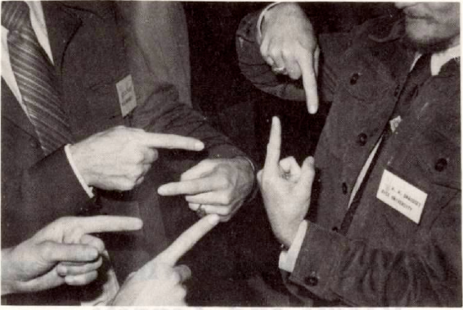
What can transverse polarized pp/pA tell us
Objectives:
Establish transverse momentum dependent PDFs survive at low x and/or high Q²
→ critical input to make a TMD program at EIC successful
→ high precision data to test factorization and universality of TMDs
pp ← → DIS@EIC

Slide 4
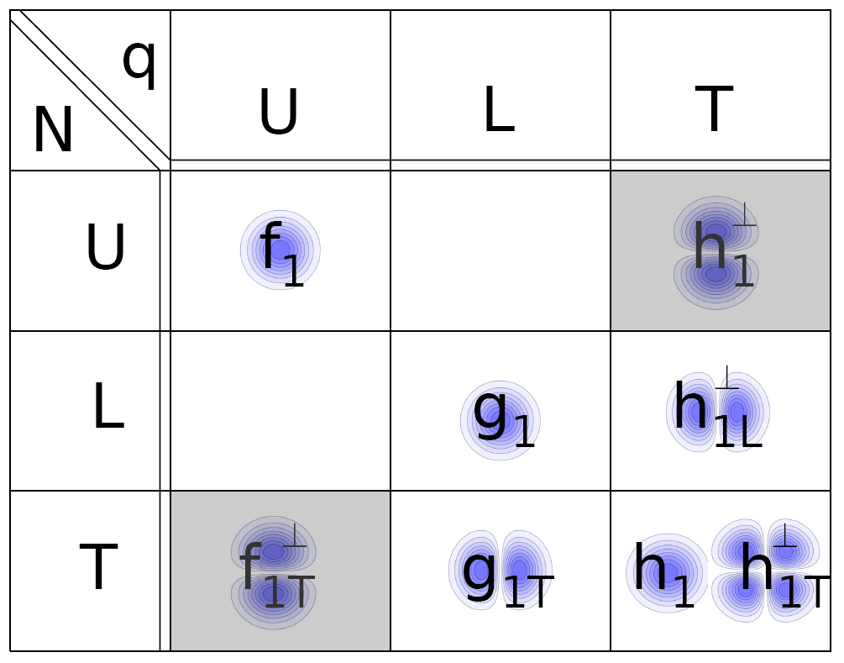
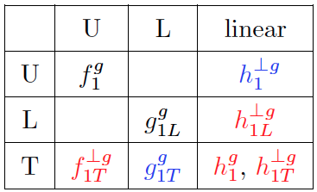
transverse momentum dependent PDFs & FFs
What is the dynamic structure of the proton and nuclei ?
2D+1 picture in momentum space
Visualize color interactions in QCD
collective phenomena and correlations in fragmentation
Features:
Need to still establish test universality for TMDs ep ←→ pp
very different evolution then collinear PDFs
pertubative & non-pertubative contributions to evolution kernel
manifest themselves in azimuthal modulations of the cross section
slew of different TMDs can be defined, similar for FF
Leading Twist q-TMDs
Leading Twist g-TMDs
g
un-integrated gluon density g(x,Q²,k_{T}) important for physics
at small x
→ CGC
→ applications at LHC,
i.e. Higgs production
N

Slide 5
TMDs at RHIC
Till today TMDs came only from fixed target data → high x @ low Q²
need to establish concept at high Q² and wide range in x
polarised pp at RHIC
RHIC unique kinematics: from low to high x at high Q²
Notes:
separate forward region in plot

Slide 6
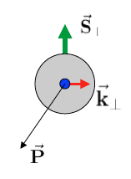
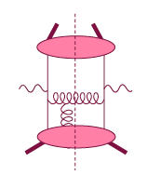
Initial State: TMDs vs. Twist-3
TMD
Twist-3
Requires:
Q>>Q_{T}>=Λ_{QCD}
Q>>p_{T}
Requires:
Q,Q_{T}>>Λ_{QCD}
p_{T}~Q
Efremov, Teryaev;
Qiu, Sterman
or
Twist-3 FF
Sivers fct.
Q_{T}/P_{T}
Λ_{QCD}
<<
Q_{T}/P_{T}
<<
Q
Require 2 scales
Q² and p_{t}
2 scale observables in pp/pA
DY, W/Z-production
Provides access
to full transverse
momentum dynamics k_{T}
Intermediate Q_{T}
Q>>Q_{T}/p_{T}>>Λ_{QCD}
Need only 1 scale
Q² or p_{t}
But
should be of reasonable size
framework for pp observables
A_{N}(π⁰/γ/jet)
Provides access
to average transverse
momentum <k_{T}>
related through

Slide 7
The objectives for TMDs
Constrain TMDs over a wide x and Q² range (valence, sea-quarks & gluons)
  different √s → different p_{t} at the same x_{t} → evolution
  Test non-universality of TMDs ← → SIDIS
observables as transversity can be accessed also in collinear observables
  test of TMD factorization & universality
observables purely sensitive to the TWIST-3 formalism
  different √s → evolution
Initial State
Final State
A_{N} for W^{+/-}, Z⁰, DY
  → Sivers
A_{N} for jets
  g-Sivers in Twist-3
direct photons
    → q-Sivers in Twist-3
A_{UT} π^{+/-}π⁰ azimuthal distribution in jets
  → Transversity x Collins
A_{UT} in dihadron production
  → Transversity x Interference FF
A_{N} for π+/- and π⁰
→ Novel Twist-3 FF Mechanisms
related through
related through

Slide 8
Measure nFF
Observable: Hadron distribution inside jet
jet
h
Study a hadron distribution inside a fully reconstructed jet
j_{t}; hadron transverse momentum with respect to the jet direction
The 1st observable is like collinear fragmentation function,
while the 2nd observable is more like a TMD fragmentation function
Nuclear dependence at RHIC 200 GeV using nuclear FFs
  Seems to follow the feature of p+Pb at LHC
  Will see how energy loss picture works out
W. Vogelsang et al. arXiv:1506.01415
Kang, Ringer, Vitev, Xing,
in preparation

Slide 9
Jets to access Transversity x Collins
Kinematics for hadrons in a jet:

Slide 10
Jets to access Transversity x Collins
STAR arXiv:1708.07080
200 vs. 500 GeV Comparison:
first observation of a TMD at low x
and high Q²
Evolution: 200 GeV ←→ 500 GeV
factor 3 in Q
Test of factorization & Universality
→ compare with transversity from IFF
→ compare with SIDIS and e+e-
Triggered a lot of theory work
proof of factorization:
Kang et al. arXiv:1705.08443
asymmetry calculation:
Kang et al. arXiv:1707.00913
First Sign TMDs survive at low x and high Q²

Slide 11
Collins like Asymmetry
Maximized contribution
for √s = 500 GeV
D’Alesio et al.
Model predictions shown for “maximized” effect,
saturated to positivity bound
Until now, Collins-like asymmetries completely unconstrained
→ Sensitive to linearly polarized gluons

Slide 12
Collins like Asymmetry
Shaded bands represent
maximal predictions from
U. D’Alesio, F.Murgia, and
C. Pisano, arXiv:1707.00914
utilizing Kretzer and DSS FF

Slide 13
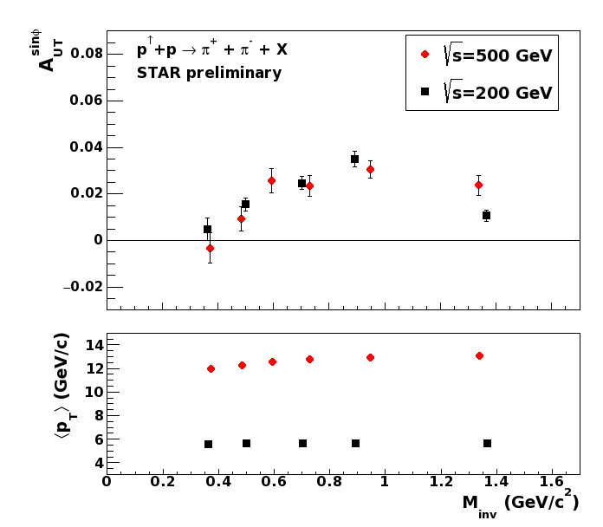
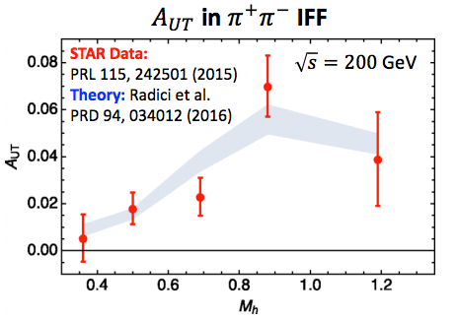
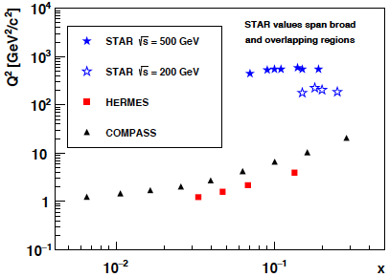
Interference Fragmentation Function (IFF)
p↑+p → π⁺π⁻+X → transversity x IFF
survives in collinear framework
Significant di-hadron asymmetries both at √s=200GeV and √s=500GeV
Increasing with p_{T}
Access to transversity with a collinear observable

Slide 14
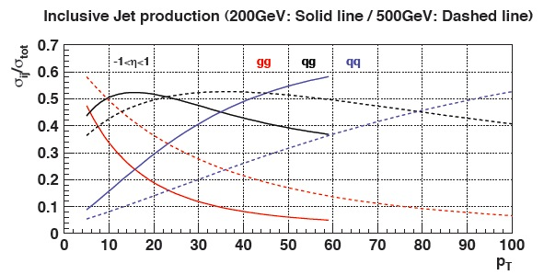
“Twist-3 Sivers” Through Jets
Asymmetries shown as function of particle-jet p_{T}
Corresponding parton-jet p_{T} lower by 0.6-1.4 GeV
Horizontal errors include uncertainties from statistics, calorimeter gains, efficiencies, track momentum, and tracking efficiency
No sign of sizable azimuthal asymmetry in jet production at √s = 500 GeV
Consistent with expectation from inclusive jets, di-jets, and neutral pions at √s = 200 GeV
p_{T} [GeV/c]
Notes:
----- Meeting Notes (9/26/13 11:10) -----
specify p_T range on left-hand plot
specify eta range

Slide 15
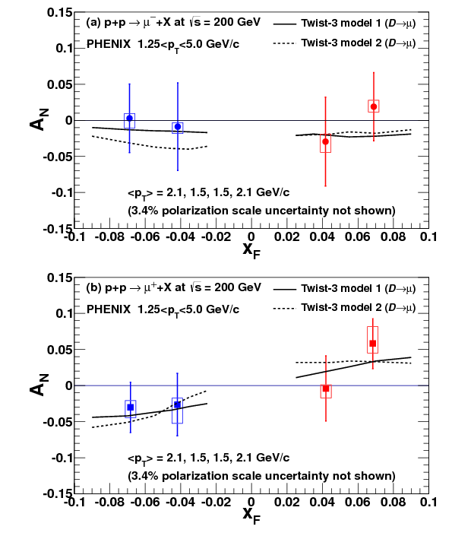
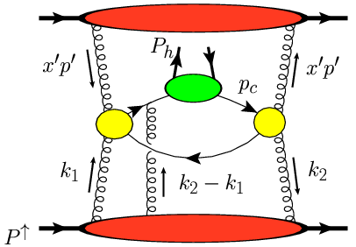
Sensitivity to Gluon “TMDs”
Phys.Rev. D95 (2017) 112001
Heavy flavor asymmetries most sensitive to Twist-3 counterpart of Gluon Sivers and tri-gluon correlator,
no final state effects expected due to heavy quark mass
Both contributions poorly known
Model calculations from: Koike et.al. Phys.Rev. D84 (2011) 014026

Slide 16
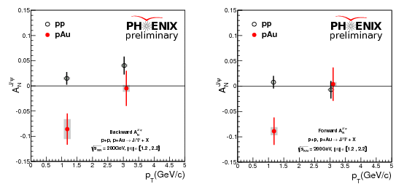
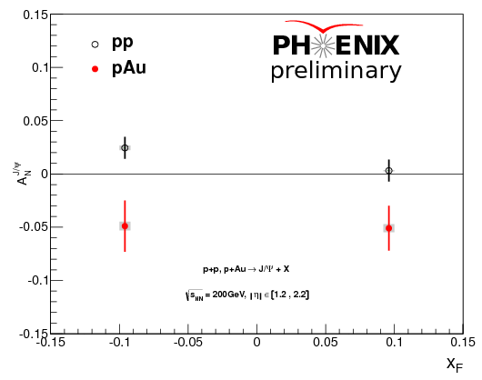
Sensitivity to Gluon “TMDs”
Surprising nonzero J/Psi A_{N}s seen in pAu collisions while pp Asymmetries are mostly consistent with zero
Nonzero effect only visible at the lowest available P_{t}
Diffractive effects as cause not very likely due to coincidence with hard collision trigger
pAl data is being analyzed

Slide 17
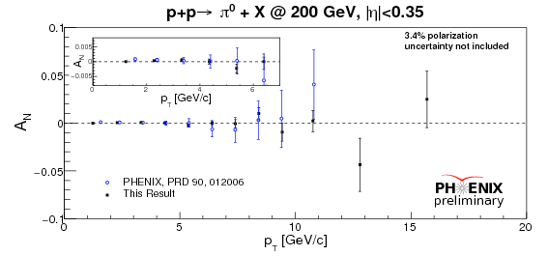
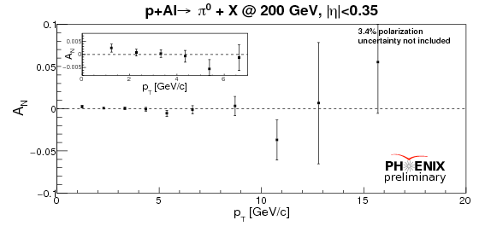
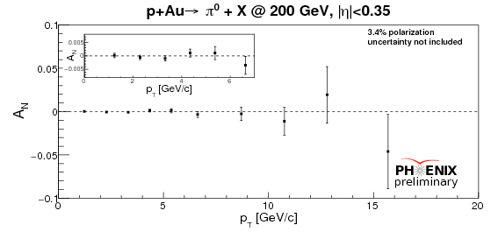
Sensitivity to Gluon “TMDs”
pp
pp:
Improved results from 2015!
Consistent with 0
to 3~10⁻⁴ precision level at low p_{T}
constrain of gluon Sivers effect
Anselmino et al, PRD 74 (2006), 094011
D’Alesio et al, JHEP 1509 (2015), 119
pA:
high precision test of nuclear effects
pAl
pAu

Slide 18
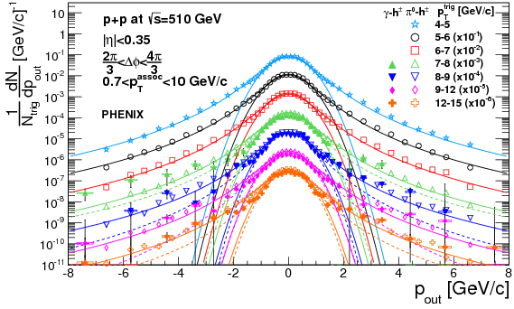
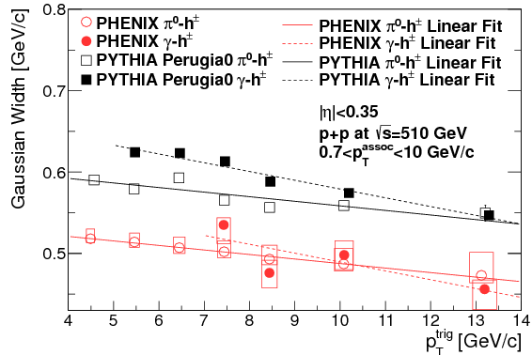
Angular Correlations
Phys.Rev. D95 (2017) 072002
Di-hadron and h-γ correlations
Look at angular correlation between nearly back-to-back particles
Widths of Gaussian components seem to be decreasing with trigger particle momentum while increase is expected
Pythia qualitatively describes this effect
NLO contributions move k_{T} into exponential p_{T} tails
  extra kicks less back to back
not exactly clear what is expected by a NLO TMD calculation

Slide 19

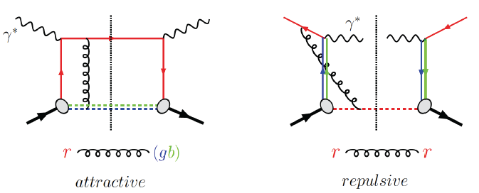
Visualize Color interactions in QCD
Sivers function
correlation of nucleon’s transverse spin
with the kT of an unpolarized quark
measures spin-orbit correlations
link to parton orbital motion (through models)
reveals non-trivial aspects of QCD color gauge invariance
poster child
TMD:
modulation
Measure non-universality of sivers-function
DIS:
γq-scattering
attractive FSI
pp:
qqbar-anhilation
repulsive ISI
QCD:
Critical test of factorization in QCD
no sign change
→ need to rethink QCD factorization
Sivers_{DIS} = - (Sivers_{DY} or Sivers_{W} or Sivers_{Z0})
A_{N}(direct photon) measures the sign change in the Twist-3 formalism
All three observables can be approached
at 500 GeV at STAR

Slide 20
STAR: A_{N}^{W}
Analysis Strategy to fully reconstruct Ws:
Follow the analysis steps of the A_{L}
→ W candidate selection via high p_{t} lepton
Data set 2011 transverse 500 GeV data set (25 pb⁻¹)
In transverse plane:
Recoil reconstructed using tracks and towers:
Part of the recoil not within STAR acceptance
→ correction through MC (Pythia)
W Rapidity reconstruction:
W longitudinal momentum (along z) can be calculated from the invariant mass:
Neutrino longitudinal momentum component from quadratic equation
GOOD data/MC agreement after P_{T} correction

Slide 21
First Results: A_{N}^{W}
Results based on 2011 25 pb⁻¹ transversely polarized 500 GeV data
→ published in PRL 116 (2016) 132301
y and p_{t} for fully reconstructed Ws → recoil combined with MC
→ method used at Fermi-Lab and LHC
Asymmetry favors Sivers fct. sign change
and small TMD evolution for asymmetries

Slide 22


Slide 23
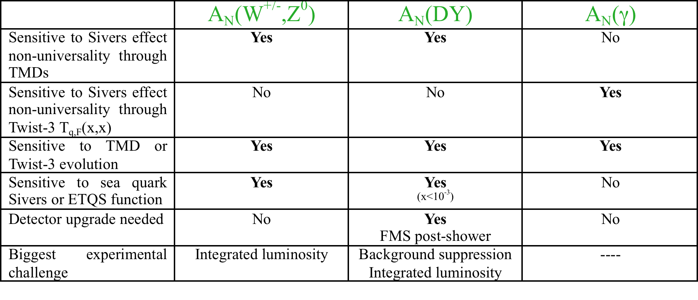
Sivers TMD@STAR

Slide 24
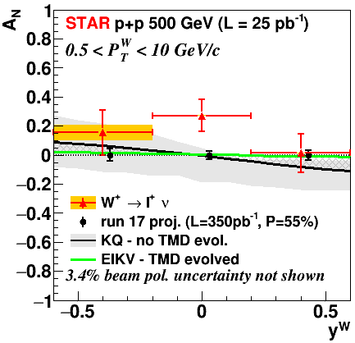
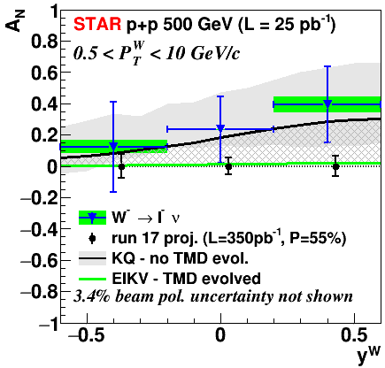
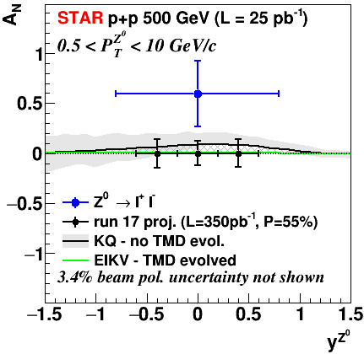
RUN-17: A goldmine for TMDs@STAR
Collected:
350 pb⁻¹ → 14 times Run-11 for -1 < η < 1.8 → A_{N} W^{+/-} & Z⁰, Collins, ……
Will provide data to constrain
→ TMD evolution,
sea-quark Sivers fct
  through rapidity distribution → neg. η
test of Sivers fct. non-universality
Z⁰ very clean channel no corrections
Notes:
analysis plans

Slide 25
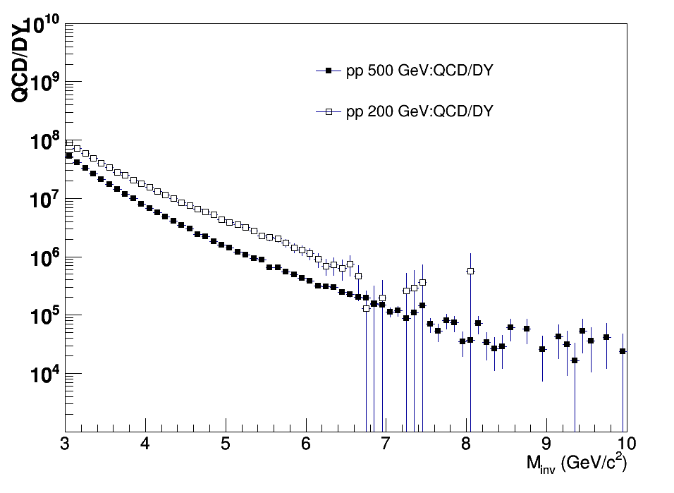
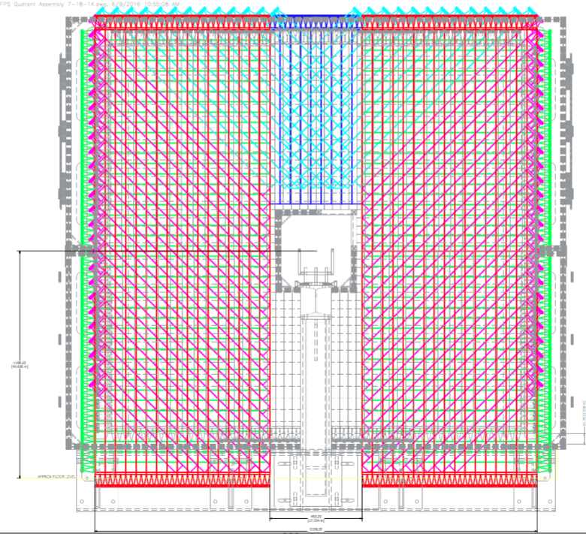
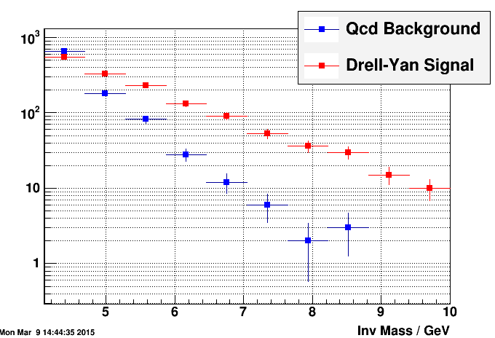
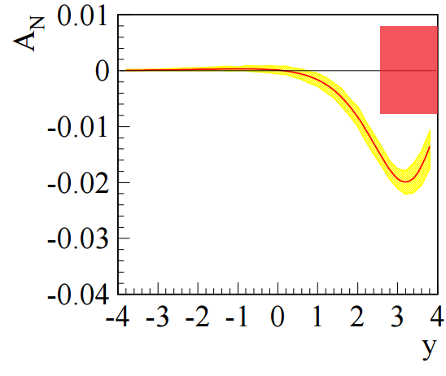
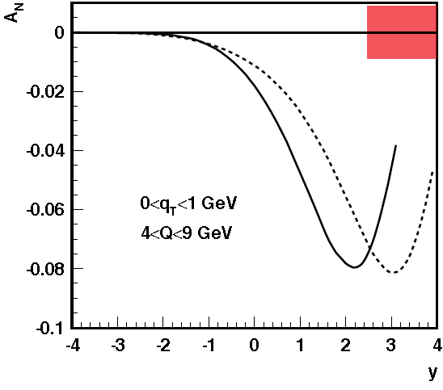
DY@STAR For 500 GeV
Kinematics:
DY e+e- in 2.5 < η < 4.0 4.0 GeV < M_{e+e-} < 9.0 GeV
Add a postshower to the preshower & the FMS
will be able to measure A_{N} DY
2.5 < η < 4.0
Design follows successful
Preshower design
→ 3 layers of u, x, y with
SiPM readout
Combined with W & Z⁰ an other test of TMD evolution
Complementary to COMPASS
After analysis 2.5 < η < 4.0
:
With TMD Evolution
No TMD Evolution
Run-17 ∫L_{del}=400 pb⁻¹
A_{N} for DY to +/- 0.008

Slide 26
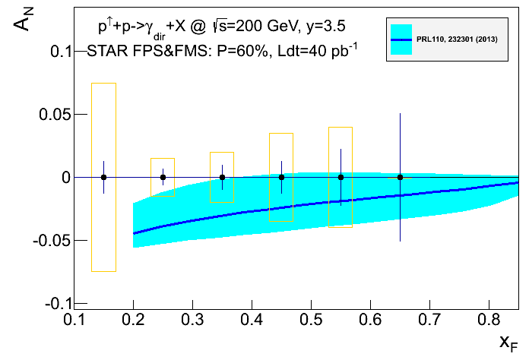
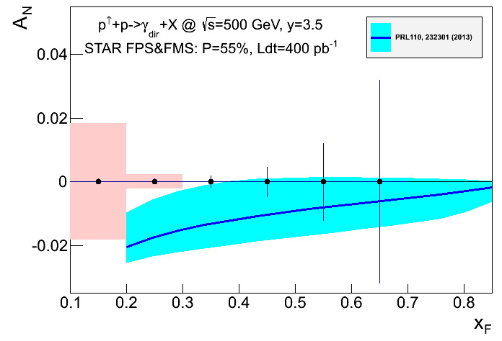
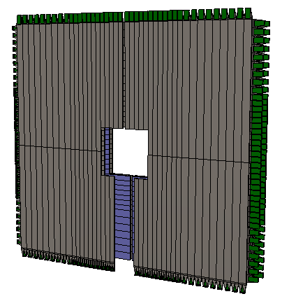
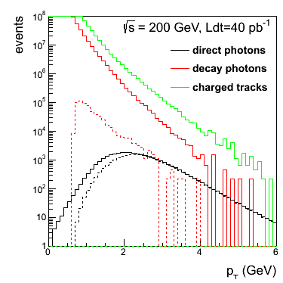
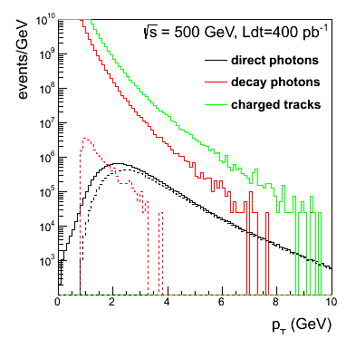
Complementary Channel
STAR FMS-PreShower:
3 layer preshower in front of the FMS,
distinguish photons, electrons/positrons
and charged hadrons → installed for RUN-15
2015
2017
2023:
reduction of uncertainties by ~3
critical to pin down Twist-3 evolution
A_{N} for direct photon production:
sensitive to sign change, but in TWIST-3 formalism
not sensitive to TMD evolution
no sensitivity to sea-quarks; mainly u_{v} and d_{v} at high x
collinear objects but more complicated evolutions than DGLAP
indirect constraint on Sivers fct.
Not a replacement for A_{N}(W^{+/-}, Z⁰, DY) measurement
but an important complementary piece in the puzzle

Slide 27
Mid-rapidIty observables
At 500 GeV in 2017:
Transversity x Collins
Sivers function through TWIST-3:
linearly polarised gluons
could be an explanation for
the ridge seen in pp and pA
To have high precision data at
different √s
→ constrain TMD evolution
→ fixed x and Q² → p_{T} different

Slide 28
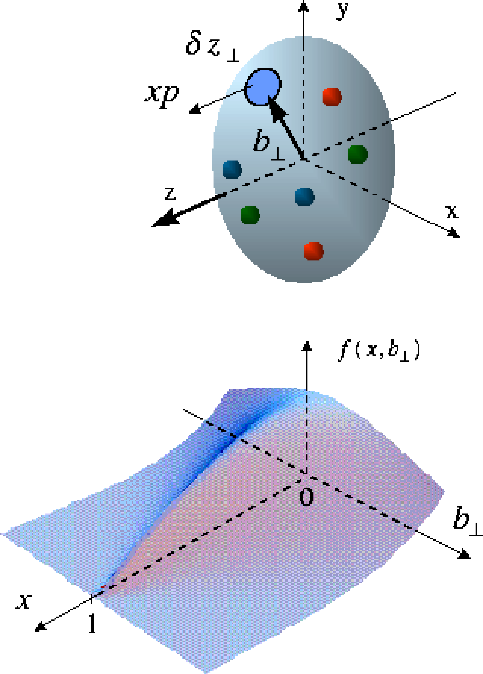
The Missing Piece: orbital angular momentum
GPDs: PDFs that
correlated parton momentum
and their distributions in
transverse space
exclusive reactions the vehicle to access L_{q} & L_{g}
golden channel: J/Ψ
new theoretical concept: Generalized Parton Distributions
Spin-Sum-Rule in PRF:
responsible for orbital angular momentum
J/Ψ production in p↑Au UPC
→ world wide only access to GPD E for gluons

Slide 29
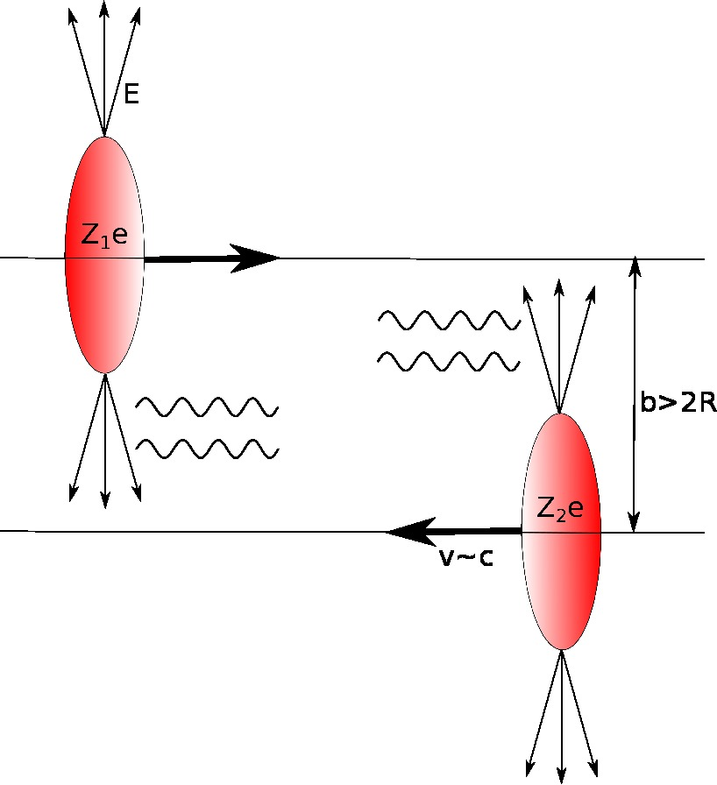
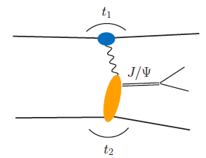
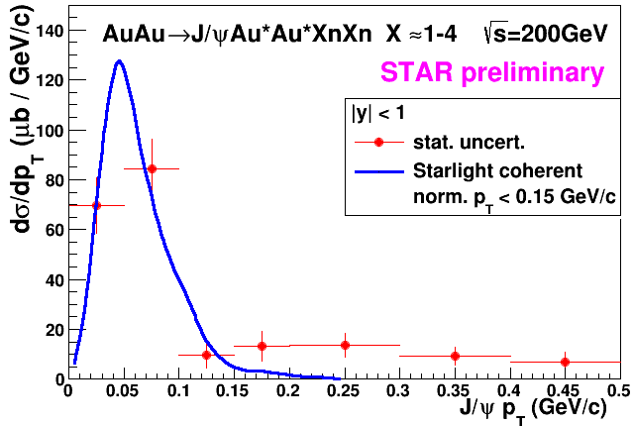
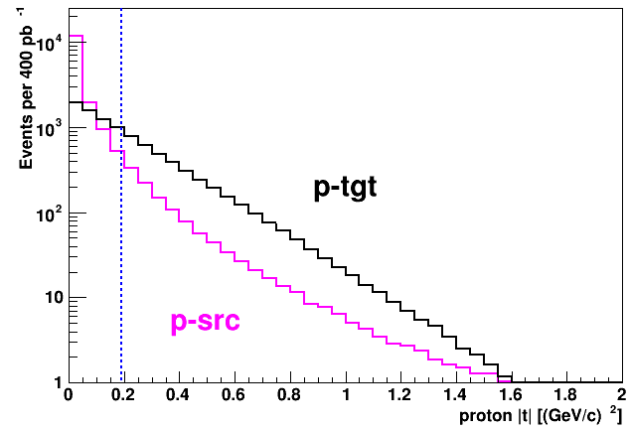
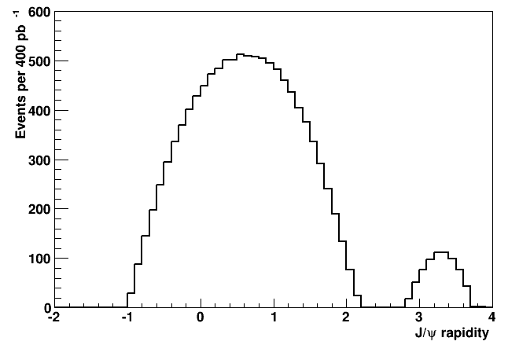
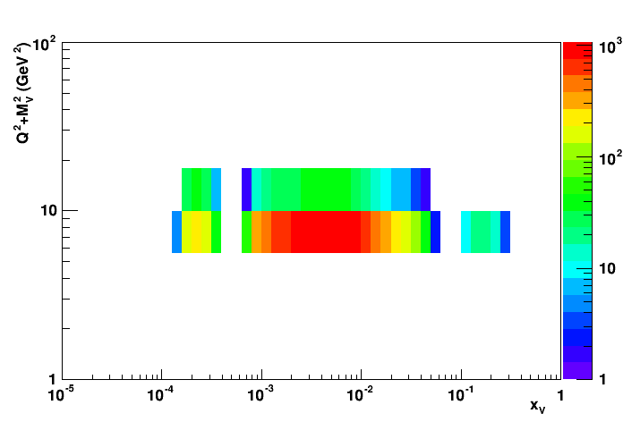
Run-15&17: J/ψ in pp/pA UPC
p/Au
p/Au’
Z²
p↑
p’↑
RP acceptance for scattered proton:
t-dist for protons (tgt & γ-src):
J/Ψ-rapidity
Required:
2017 p↑+p 400 nb-1
1k J/Ψs
δA_{UT:} +/-0.2 in 3 t-bins
Run-15: ~300 J/Ψ

Slide 30

A_{N} at forward
rapidities

Slide 31
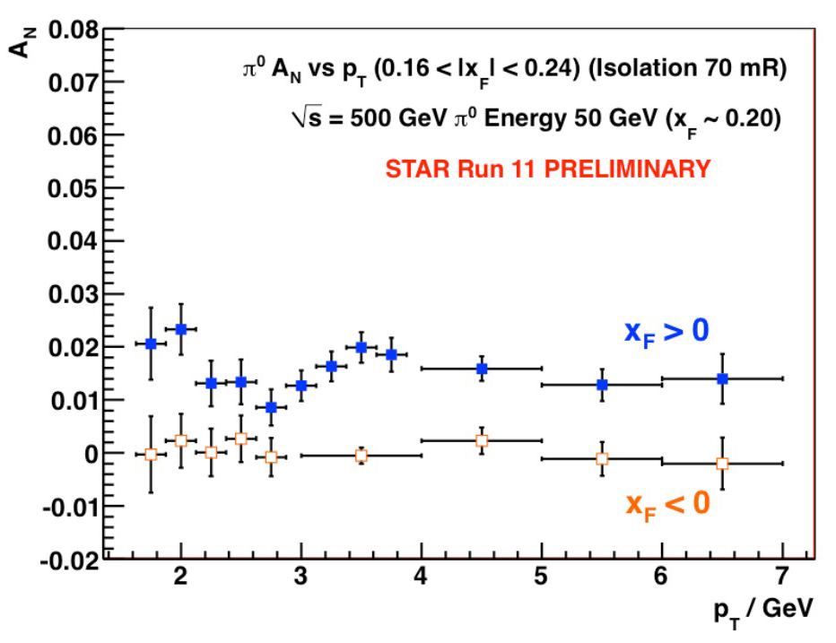
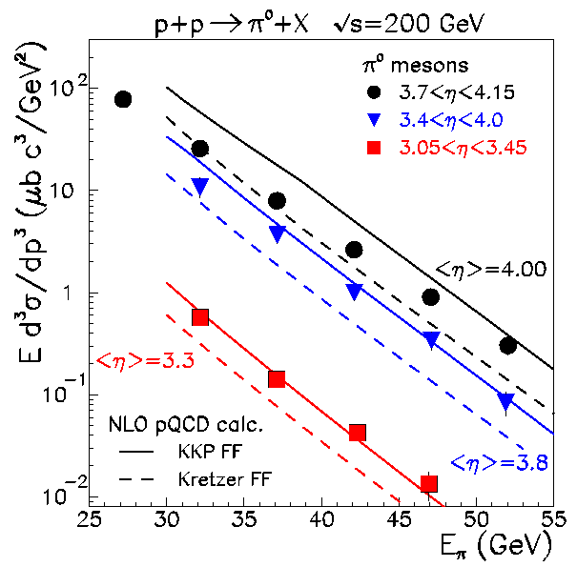

World Data for Inclusive A_{N}
left
right
Single-spin transverse asym.
1
N↑/L↑ − N↓/L↓
A_{N} ≡
P₁
N↑/L↑ + N↓/L↓
where ↑ (↓) are defined with
respect to reaction plane
Stat. Unc. ~ 1/(P₁ √N )
Underlying subprocess responsible for the
large asymmetries till today not clear
Most popular explanation a TMD
PRL 97, 152302
strong rise with
A_{N} pretty much independent of √s
A_{N}(π⁰) ≠ (A_{N}(π⁺) + A_{N}(π⁻))/2
p_{t} dependence flat for p_{t} > 3.5 GeV
cross section can be described by collinear calculation

Slide 32
Collins asymmetries for π⁰ relative to jet axis
Calculated A_{N} for jet-isolated π⁰, background subtracted A_{N} for inclusive π⁰ and π⁰ in EM-jet
Isolation defined by anti-k_{T} jet algorithm with
R = 0.7
Longitudinal momentum fraction z of π⁰ is calculated w.r.t the EM-jet as Z_{EM}
Asymmetries of less exclusively produced π⁰ (Z_{EM} < 0.9) is smaller than isolated π⁰
Total of Sivers and Collins asymmetries of EMjet and π⁰ relative to jet axis are found to be insufficient to account for the observed inclusive π⁰ single spin asymmetries.

Slide 33
Surprises at forward rapidities
1-photon events, which include a large π⁰ contribution in this analysis, are similar to 2-photon events
Three-photon jet-like events have a clear non-zero asymmetry, but substantially smaller than that for isolated π⁰’s
A_{N} decreases as the event complexity increases (i.e.,the "jettiness”
A_{N} for #photons >5 is similar to that for #photons = 5
Jettier events
Several other Asymmetries for jettier events are also very small
Data suggest that probed process changes with jettiness of the event

Slide 34
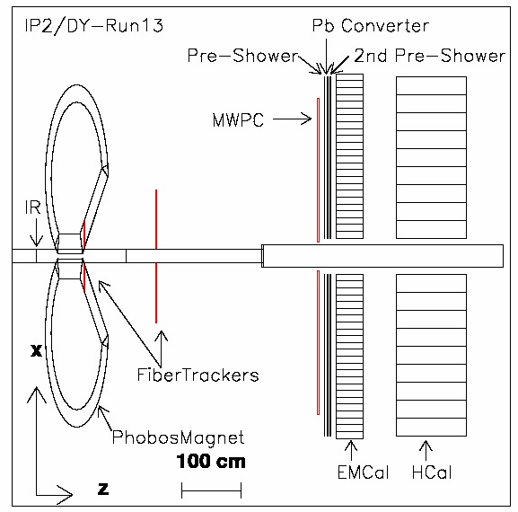
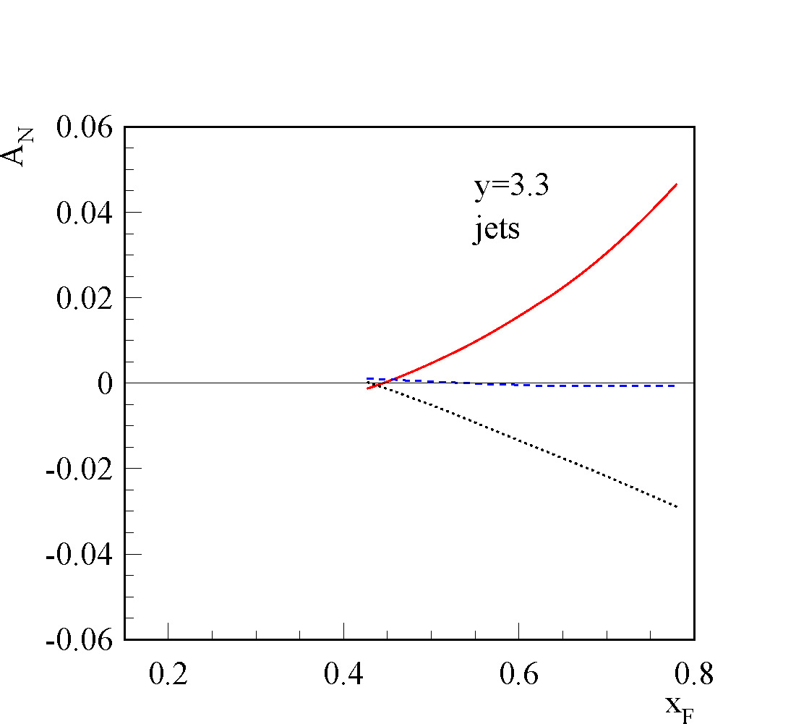

A_{N}DY: “jets” at η>3
2013 Final configuration
2011 Configuration
Theory: arXiv:1103.1591 A_{N}(jet)
arXiv:1302.3218
Remember:
√s=200 GeV
from p↑+p→π
“new” Sivers function SIDIS fit
“old” Sivers function SIDIS fit
arXiv: 1304.1454
Caveat: no correction
for underlying event and
detector effects
small asymmetry: cancelation of u and d Sivers TMDs
Determine A_{N}(jet) at same rapidity of big A_{N}(π⁰) η>3
RUN-11: A_{N}DY collected ~ 6.5/pb

Slide 35
What did we learn on Inclusive A_{N}
Note: Need to use Twist-3 formalism as one scale process
A_{N} decreases as the event complexity
increases(i.e., the "jettiness”)
π⁰-Jets –
2γ-EM-Jets with
m_{γγ} <0.3 and Z_{γγ} <0.8
2γ-EM-Jets
(η +continuum) –
with m_{γγ} > 0.3
EM-Jets –
with no. photons >2
A_{N} of forward jets are small
→ sensitive to “Twist-3 Sivers”
cancelation of u and d “Twist-3 Sivers fcts”
Collins asymmetries of π⁰ in EM-jet
are insufficient to account for the
observed inclusive π⁰ A_{N}
→ consistent with findings for Twist-3 Collins
BUT: new Twist-3 FF can explain the
data (arXiv:1404.1033)
→ unfortunately till
today only kinematics
this Twist-3-FF
is sizeable
→ amplitude fitted
to data
Alternative explanation: A_{N} for p⁰ is dominated by single hard diffraction p↑+p → π⁰+ p’+X
The STAR RP phase-II* will be the key detector component to investigate
this interpretation

Slide 36

RHIC Cold QCD physics after BES-II at Mid- & Forward Rapidities:
The RHIC Cold QCD Plan for 2017 to 2023: A Portal to the EIC arXiv:1602.03922
STAR:
Midrapidity: https://drupal.star.bnl.gov/STAR/system/files/STAR_Midrapidity_Beyond_BESII.pdf
Forward-rapidity Proposal: https://drupal.star.bnl.gov/STAR/system/files/ForwardUpgrade.v20.pdf
sPHENIX:
Midrapidity: https://www.sphenix.bnl.gov/web/sph-cqcd-2017-002
Forward-rapidity LoI: https://www.sphenix.bnl.gov/web/node/450
Strong endorsement by RHIC PAC:
As the physics program that is foreseen for forward physics is substantial, full utilization of future polarized proton beam time must be made to realize the proposed forward physics program.
RHIC management is encouraged to find a way to enhance and include a forward physics program at RHIC.

Slide 37


pp/pA Physics in 2020+
Objective:
unique program addressing several fundamental questions in QCD
→ essential to
complete the mission of the RHIC physics program
fully realize the scientific promise of the EIC
based on two pillars
midrapidity program based on existing STAR detector and base
sPHENIX midrapidity detector
NO upgrades needed
forward rapidity program based on upgrades at STAR and sPHENIX
Upgrades consist of Hcal + ECal + tracking
STAR: 2.5 < η < 4 sPHENIX: 1 < η < 4

Slide 38


Forward rapidity pp Physics
Goals for TMDs:
Increase statistics for A_{N} DY
→ TMD evolution world best constraint ← → A_{N}(W^{+/-} Z⁰)
→ Sivers sign change
Unravel the mystery what is the underlying process of A_{N}
→ measure A_{N} for π^{+/-}
→ clear prediction of importance of special Collins like FF
flavor tagging of the Twist-3 equivalent of the Sivers fct.
→ Observable h^{+/-} with z > 0.5 in jet
Kanazawa et al. PRD 89, 111501 (2014)
A_{N} for jets with tagged h⁺, h⁻
stringent test for opposite sign
but equal magnitude of
u and d quark Sivers fct.

Slide 39

Forward rapidity pp Physics
Transversity x Collins FF through hadron in jet
h^{+/-}
jet
500 GeV: access high x (0.05 – 0.5) at high Q² (10 – 100 GeV²)
very strong constrain for tensor charge

Slide 40

What about Nuclei?
Incoming
Electron Beam
3 conundrums of the initial state:
What are the nPDFs at low-x?
How saturated is the initial state of the nucleus? → needs k_{T} unintegrated nPDFs → TMD
What is the spatial transverse distributions of nucleons and gluons?
  How much does the spatial distribution fluctuate? Lumpiness, hot-spots etc.

Slide 41




Key Observable for Saturation in pA
small x
Bremsstrahlung
~ s_{s}ln(1/x)
pQCD 2→2 process = back-to-back di-jet
Forward jet
p
p
Away side jet
Phys. Rev. Lett. 107, 172301 (2011)
With high gluon density
2→1 (or 2→many) process = Mono-jet
Recombination
~ σ_{s}ρ
p/d
dilute
parton
system
Au
dense gluon field
CGC predicts suppression of back-to-back correlation
dA: alternative explanation through double interactions

Slide 42


Saturation with the forward upgrade
Expand the number of observables:
rigorous test of theory predictions
get a handle on the different gluon distributions
provide variety of high precision data to test universality of CGC ←→ EIC
study of evolution/universality of Q_{s}² with A and x for different probes
arXiv:1101.0715
CGC prediction for
R_{pA} direct photon:
jet-hadron / jet photon correlations
→ 1M events with forward upgrade
in 2023 pAu and pAl

Slide 43



Surprises at forward rapidities
Very unique RHIC possibility p↑A
Gluon saturation signature in transverse
single spin asymmetries A_{N}
Suppression is enhanced in nuclei
Suppression of A_{N} in p↑A provides
sensitivity to Q_{s}.
arXiv:1106.1375 & arXiv:1201.5890
seen suppression is minimal
CGC approach only applicable
if main underlying process of A_{N} is of 2→2 nature
several new theory calculations
strong suppression of odderon STSA in nuclei.
Q_{s}^{p}=1.0 GeV
r=1fm
Q_{s}^{p}=0.8 GeV
p+p
r=1.4fm
p+Al
r=2fm
p+Au

Slide 44
nuclear modification of TMDs
Collins FF in pAu
First study of a nuclear modification of a spin observable ever

Slide 45

Summary
RHIC pp/pA unique program addresses several fundamental questions in QCD
RHIC provides/will provide many different data sets to constrain TMDs
  STAR provided the first data to show TMDs survive at low x and high Q²
  First 3 σ sign of non-universality of Sivers fct.
  no signs of a significant gluon Sivers function
  RHIC pA data can provide important data to study nuclear TMDs
Many more results to come
RHIC pp/pA
EIC
universality
factorization
evolution
inform EIC physics program
experimental requirements
Notes:
add extra slide on concerns
add workshops on pp/pA trigger of theory work
add remark AA for forward

Slide 46


Slide 47

W+/W- ratio From STAR
Collected Lumi = 102 pb⁻¹
Systematic uncertainties
(blue shades) from background
subtraction:
QCD background varied the
normalization bin to: [15;17] and
[15;21]
  Z⁰ -> ee background vary the normalization to STAR lumi +/- 13%
σ(W⁺) / σ(W⁻)
σ(W⁺) / σ(W⁻)
Total systematic uncertainty accounts for
Syst. from background subtraction
Syst. from W reconstruction

Slide 48

run-13 data fully analyzed
Impact study by NNPDF
STAR W data high constrain on
polarized ubar and dbar
Run-13 reduced uncertainties by 40%
working on paper

Slide 49


2+1 dimensional Imaging of Quarks & Gluons
Wigner function
W(x,b_{T},k_{T})
QCD genetic map
∫d²b_{T}
∫ d²k_{T}
Momentum
space
Coordinate
space
f(x,k_{T})
TMDs
f(x,b_{T})
GPDs
(Spin-dependent) 2+1D transverse momentum images
(Spin-dependent) 2+1D spatial images from exclusive scattering
down quark
x
Recent theoretical work indicates direct access to Gluon Wigner function
through diffractive di-jets in UPC (arXiv:1706.01765)

Slide 50


EIC’s Physics Impact, Complementarity and Uniqueness
Complementarity
QCD has two concepts which lay its foundation
factorization and universality
To tests these concepts and separate interaction dependent phenomena from
intrinsic nuclear properties
different complementary probes are critical
Probes: high precision data from ep, pp, e+e-
Factorization
Universality
Example: Measure PDFs at HERA at √s=0.3 TeV:
Predict pp and measurements at √s=0.2, 1.96 & 7 TeV
(un)polarized cross section ~
PDF ⊗ hard-scattering ⊗ Hadronization
hard-scattering : calculable in QCD
PDFs and Hadronization: need to be determined experimentaly
Notes:
start from intrinsic part can separate inteaction by universality
real time phenomena

Slide 51

Measure nFF
Observable:
arXiv:1506.01415

